Slide 1
Communications
Northeast Region Construction Training
March 16, 2017

Slide 2
Public information in the digital age
NE Region Construction Website: http://projects.511wi.gov/
Annual advisory
Weekly advisory
Project websites
Can update quickly
NE Region Twitter https://twitter.com/WisDOTnortheast
Ability to talk directly with public
Late breaking construction information
Pictures or video of your project

Slide 3
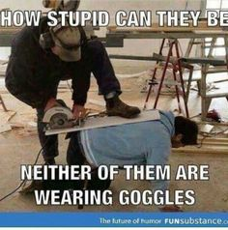
Public information in the digital age
Camera phones, the media and citizens watching you work.

Slide 4
Your Friendly NE Region Communications Staff
Mark Kantola
920-492-4153
Mark.kantola@dot.wi.gov
Melissa Kok
920-492-5743
Melissa2.kok@dot.wi.gov

