Slide 1
2017 Northeast Region Construction Conference
USDOT - Federal Highway Administration
FHWA Overview and Practical Tips
Peter M. Garcia, PE, AVS
Field Operations Engineer
City Center West ▪ 525 Junction Road Ste. 8000 ▪ Madison, WI 53717
E-mail: pete.garcia@dot.gov▪ Phone: 608-829-7513
Northeast Wisconsin Technical College Lecture Hall
March 16, 2017

Slide 2
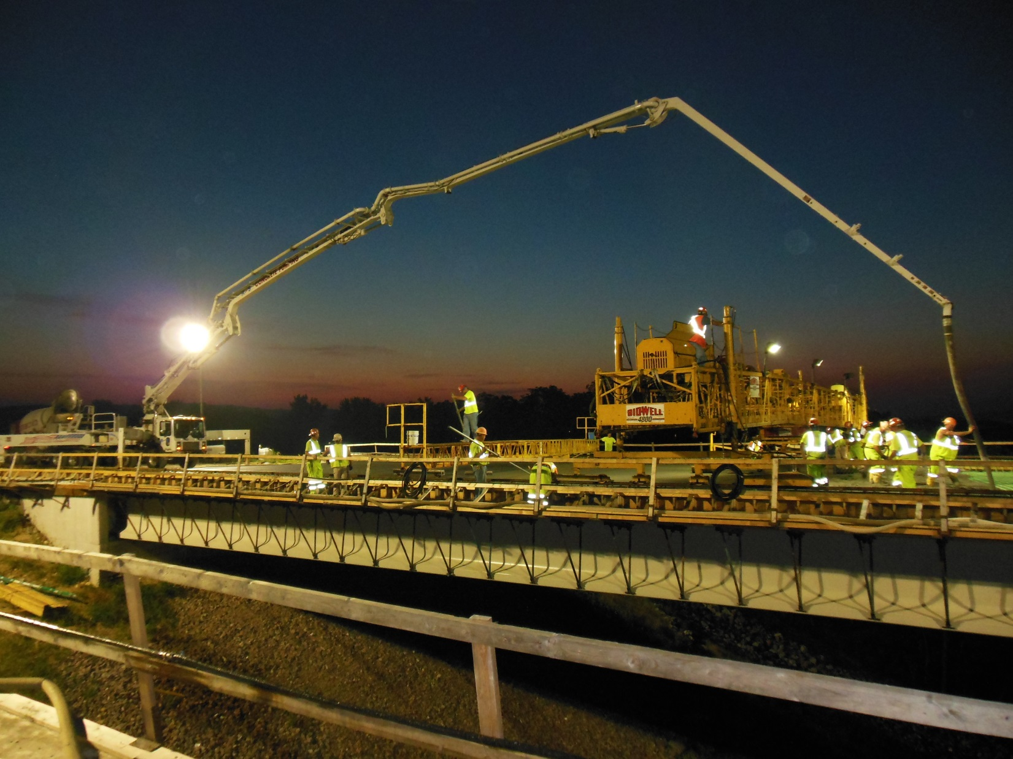
Agenda
Introduction
Stewardship & Oversight
CY 2016 Construction Summary
Practical Tips administering Construction
Notes:
Agenda Items– Looking at some of CY16 construction inspection areas as well as looking
Into CY 17

Slide 3
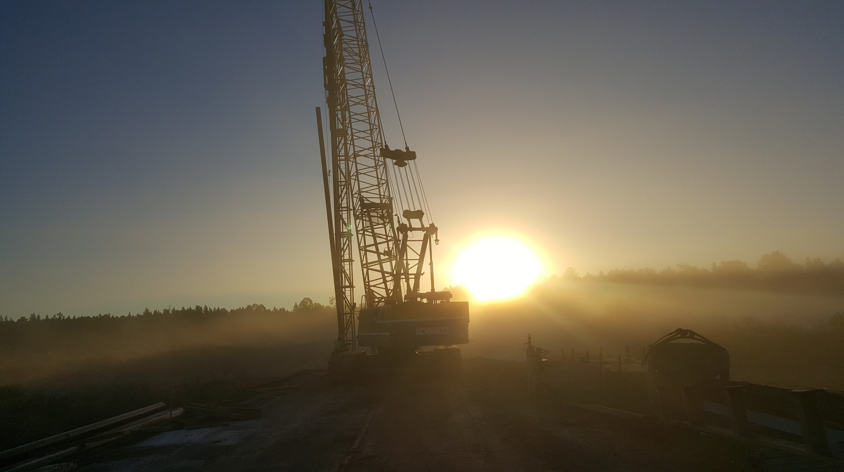
Expectations
Stewardship and Oversight Initiatives
Reviews.
Program Assessments.
Workgroups & Committees.
Compliance Assessment Program (CAP).
Oversight Project Inspections.
Other, i.e. ER.
Notes:
Fulfilling Expectations Through Stewardship and Oversight
Initiatives
Construction Change Order Review on Major Projects in CY 16
Materials Review on Major Projects CY 16
Annual Compliance Assessment Program (CAP)

Slide 4
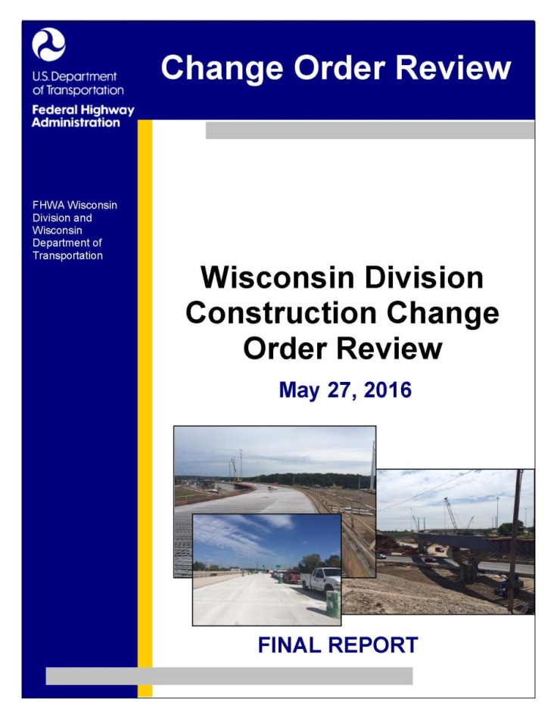
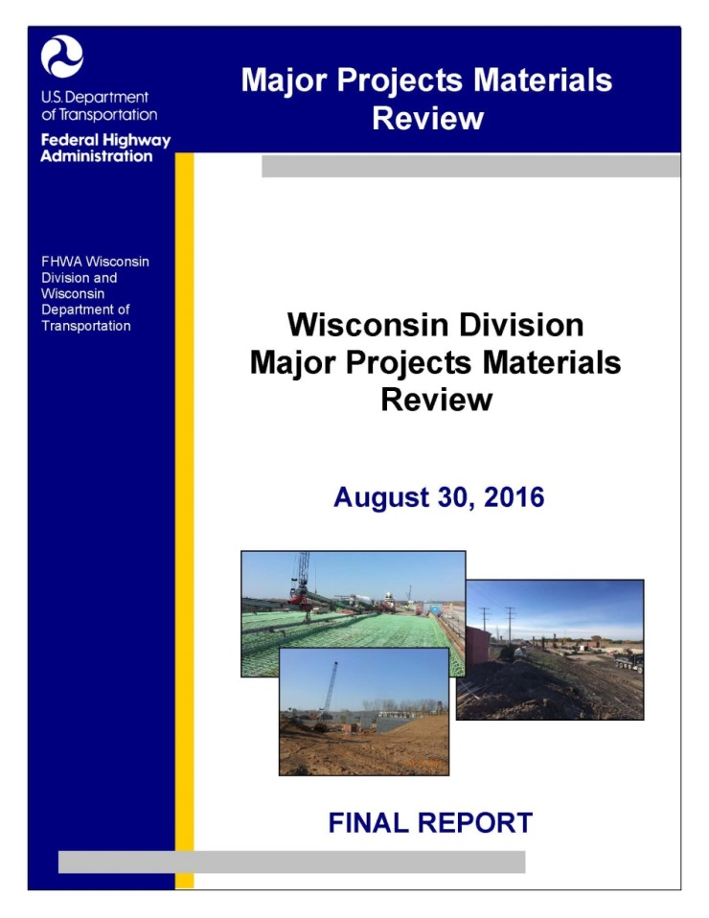
Projects Reviews
Notes:
Worked with Project Teams
Excellent Support from Project Teams
Identified Best Practices as well as Areas for Improvement
Implementation – Working Together with WisDOT to Implement Recommendations
Materials Review on Major Projects
Annual Compliance Assessment Program (CAP)

Slide 5
Compliance Assessment Program
CAP
Provide reasonable assurance.
Both the national and local level.
Federal-Aid highway construction projects are in compliance with key federal requirements.
The CAP is one element of project oversight.
Supplement and strengthen the agency’s movement toward being more data-driven and risk-based.
Notes:
CAP Compliance Assessment Program.
National – Born of FHWA Risk Based Approach.
The purpose of the CAP is to provide reasonable assurance at both the national and local level, that Federal-Aid highway construction projects are in compliance with key federal requirements. The CAP is one element of project oversight and it will supplement and strengthen the agency’s movement toward being more data-driven and risk-based.
FHWA Program Staff and FOE’s Worked with WisDOT Project Teams and Responsible Charge Staff to compile the data.

Slide 6
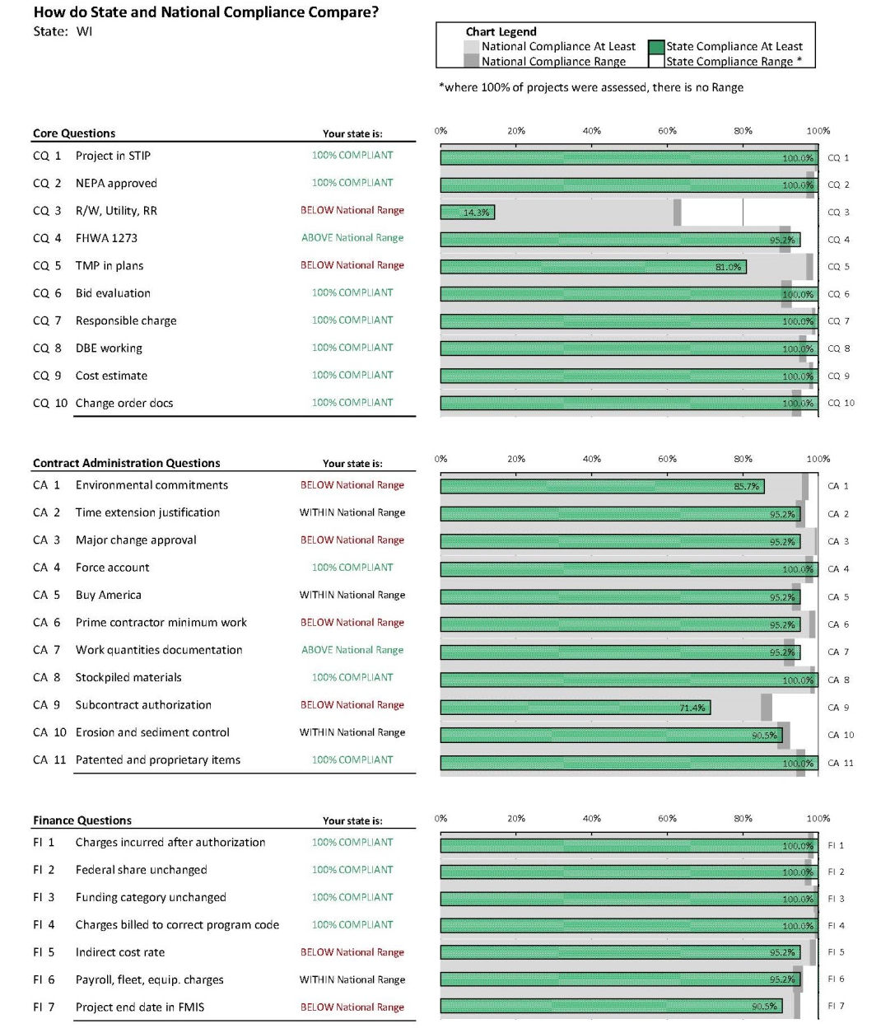
PY16 CAP Summary
FHWA Program and Project staff Worked with WisDOT Project Teams and Responsible Charge Staff to compile the data.
Notes:
CY 15 Primary Areas of Focus
Core Project Delivery Questions
70% @ 100% Compliance
10% Above National Average
20% Below National Average
Contract Administration Questions
27% @ 100% Compliance
36% Above National Average
36% Below National Average
Finance Questions
57% @ 100% Compliance
15% Above National Average
28% Below National Average
CY 16 CAP currently underway – some of you were involved in this process. Thanks for working
With us to get the required information.

Slide 7
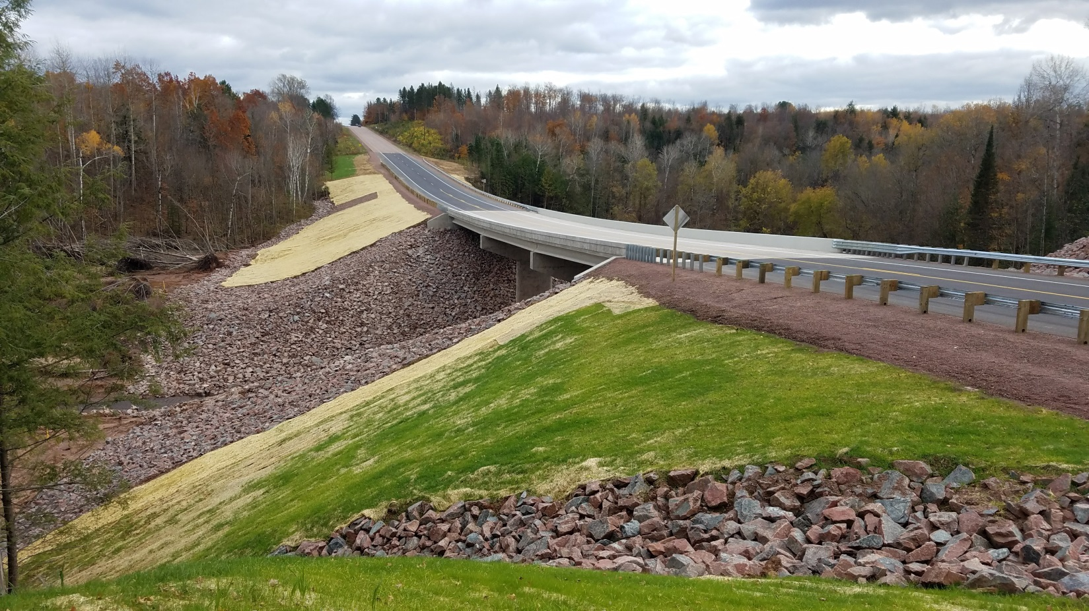
Construction Summary
CY 16 Construction Summary Report
Demonstrates the level of Division Stewardship and Oversight pertaining to monitoring and assessing the health of our construction program.
In Final Development
Division Inspections
67 in 2013/2014
22 in 2015
36 in 2016
Notes:
Construction summary report – currently in process
Number of Inspections – Upward trend – Staffing
Would have been More in 2016 if not for ER Support!
Not entirely sure how the CY17 is going to evolve.
Stewardship and Oversight Agreement Language is in process. There are going to be some changes.

Slide 8
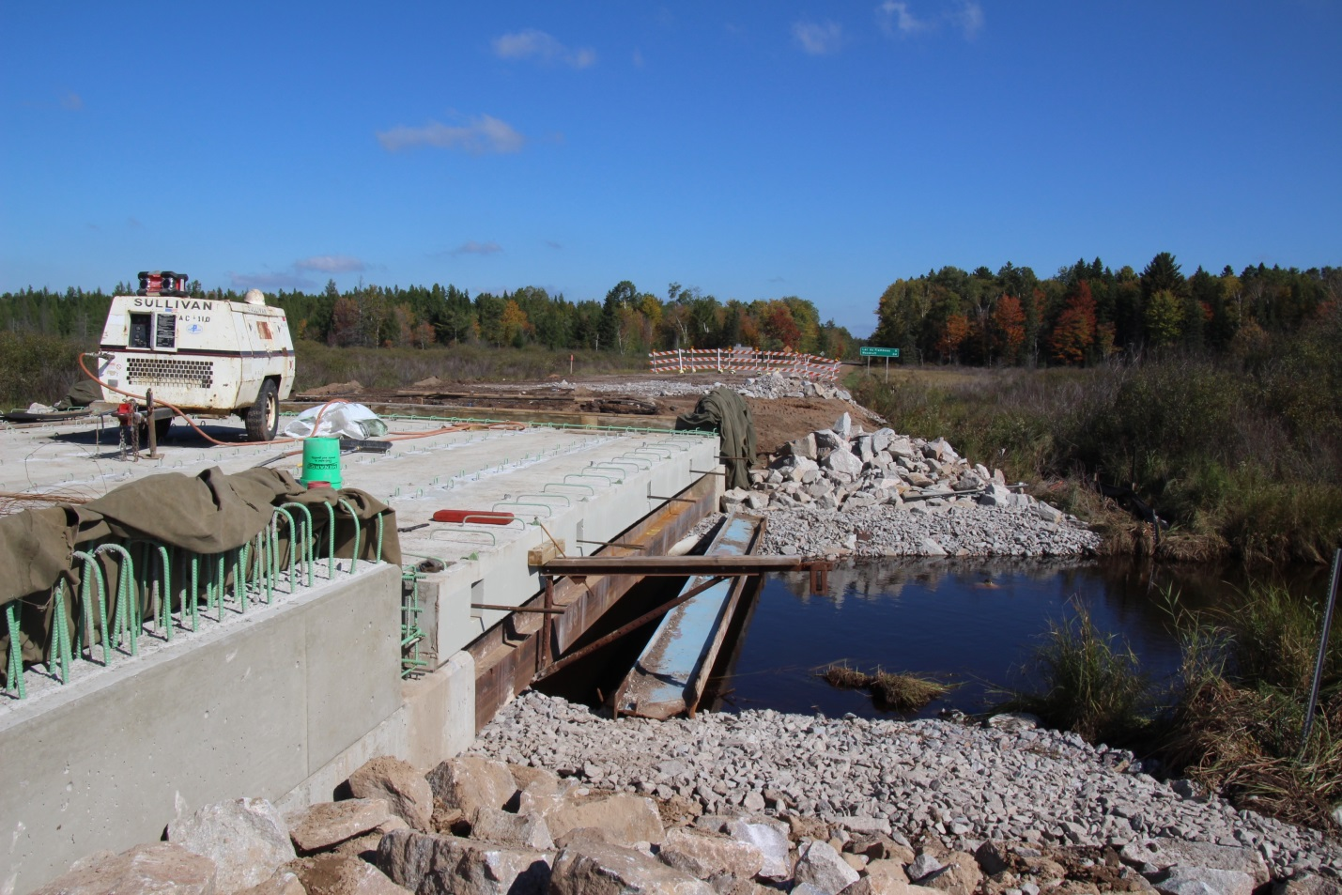
Construction Summary
Inspection Focus Areas for CY 16
Staffing
Non Conforming Materials
Buy America
CRI
Work zone Traffic Control
Job Site Postings and Access
Notes:
Typical Focus areas for project inspections.
Expect these to remain , however for the most
Part there were no issues noted during all the Construction Inspections Performed in 2016
We will continue to track these elements into CY2017 but will also include Construction
Program Emphasis areas as well.

Slide 9
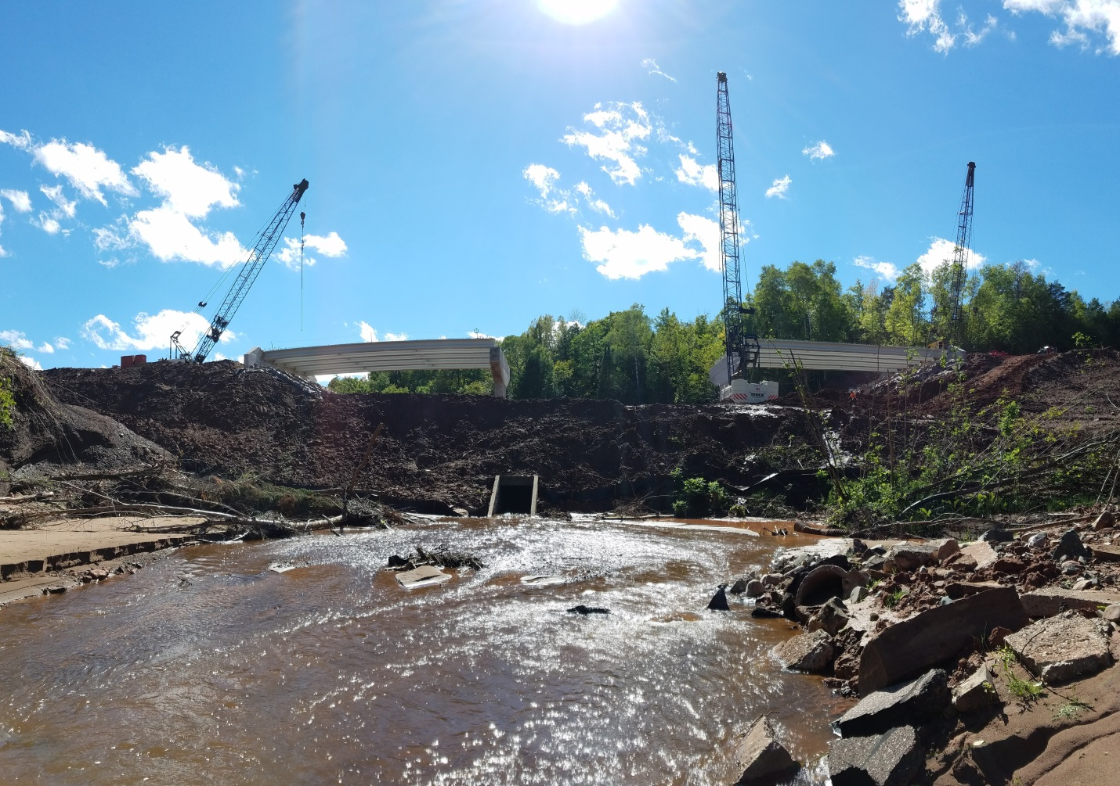
Construction Program Level
Construction Program
Emphasis Areas for CY 17
Pavement and Materials
Pavement Performance
Non Conforming Materials
Non Performance of QMP
Progress Payments
CRI’s - Program Advancing
Notes:
Rolling into 2017 these are some of the Construction Program Emphasis Areas
That may evolve into focus areas for construction inspections as well as the previous Focus Areas indicated in CY16
Quality Assurance (QA) – All those planned and systematic actions necessary to provide confidence that a product or facility will perform satisfactorily in service

Slide 10
Construction Project Level
Practical Tips in General
Exercise good/reasonable judgement.
Be observant, think, communicate, document.
Safety considerations in all aspects.
Documentation Quality Product/Project.
Ensure proper Costs.

Slide 11
Construction Project Level
Practical Tips, more Specific
Work Zone Traffic Control.
Bike & Pedestrian Accommodations.
CCOs & Justification – Cost: independent determination.
Buy America Provision.
Job Site Postings, updates & placement.

Slide 12
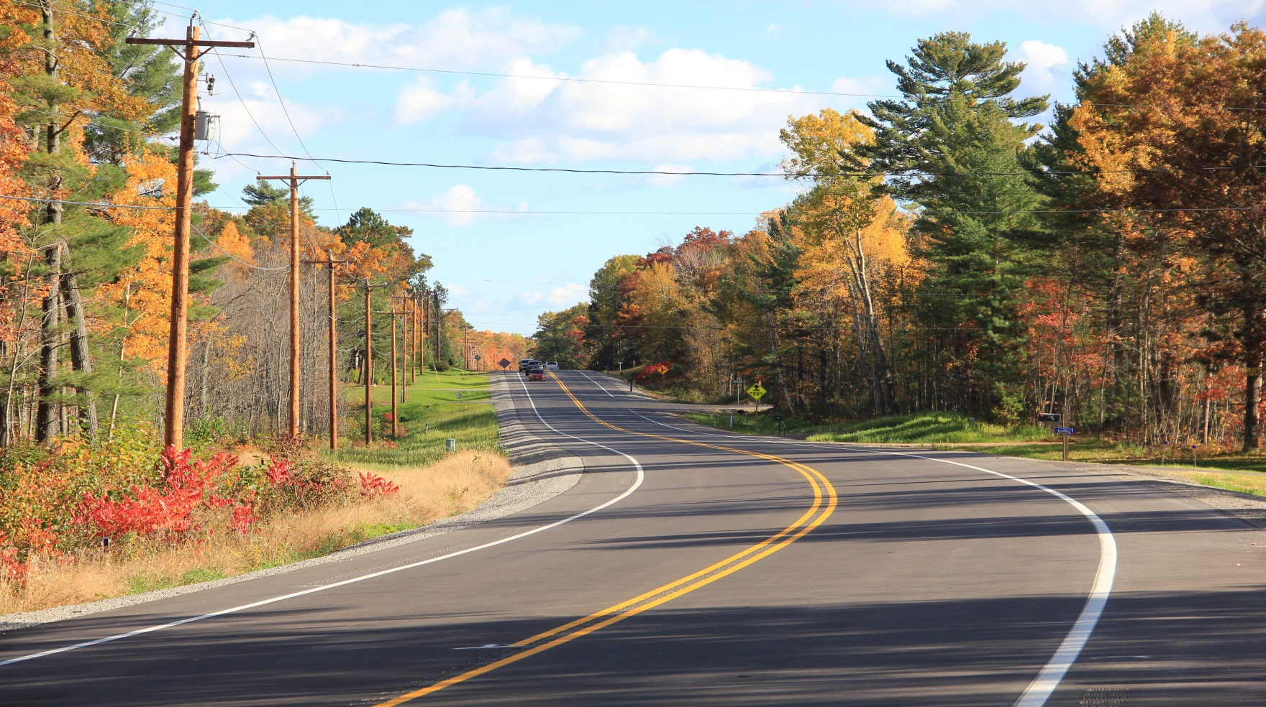
Questions?
Pete Garcia
Field Operations Engineer
City Center West ▪ 525 Junction Road Ste. 8000 ▪ Madison, WI 53717
E-mail: pete.garcia@dot.gov ▪ Phone: 608-829-7513

