Slide 1
2017 Northeast Region Construction Training
Northeast Wisconsin Technical College
March 16, 2017

Slide 2
NER 2016 Construction Awards

Slide 3
Award Criteria
Project Schedule / Budget
Contractor’s Performance
General Appearance
Pavement / Structure Smoothness
Quality Control
Complexity
Innovation

Slide 4
Asphalt Paving
County: Outagamie
Project I.D: 6520-03-60
Location: Shiocton – NCL/STH 54 – NCL
Project Length: 9.8 miles
Prime Contractor: Northeast Asphalt, Inc.
Project Leader: Ken Baierl
DOT Project Manager: Tim Verhagen
DOT Project Supervisor: Chuck Karow

Slide 5
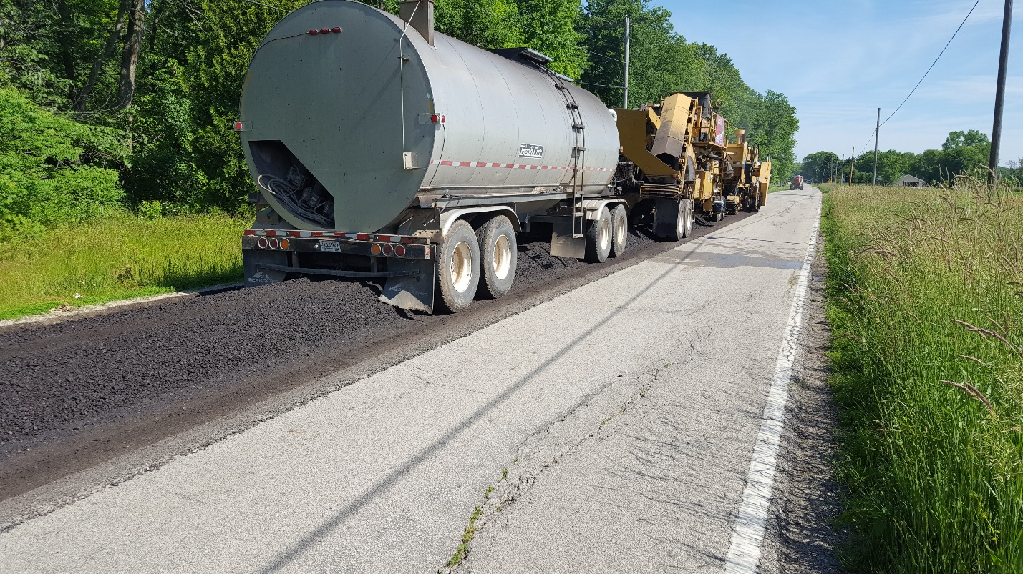
Asphalt Paving

Slide 6
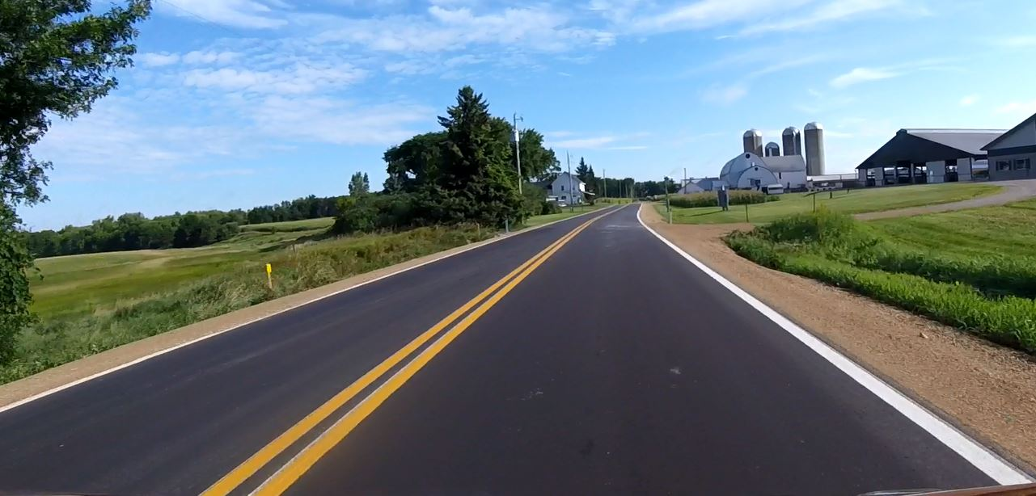
Asphalt Paving

Slide 7
Concrete Paving
Statewide Award Recipient
County: Door
Project I.D. : 4610-06-71
Location: STH 42 – Village of Sister Bay, County Walk Drive – Scandia Road
Project Length: 0.77 miles
Prime Contractor: Vinton Construction Company
Project Leader: Pat Bailey, REI Engineering, Inc.
DOT Project Manager: Jeremy Ashauer
DOT Project Supervisor: Jim Thompson

Slide 8
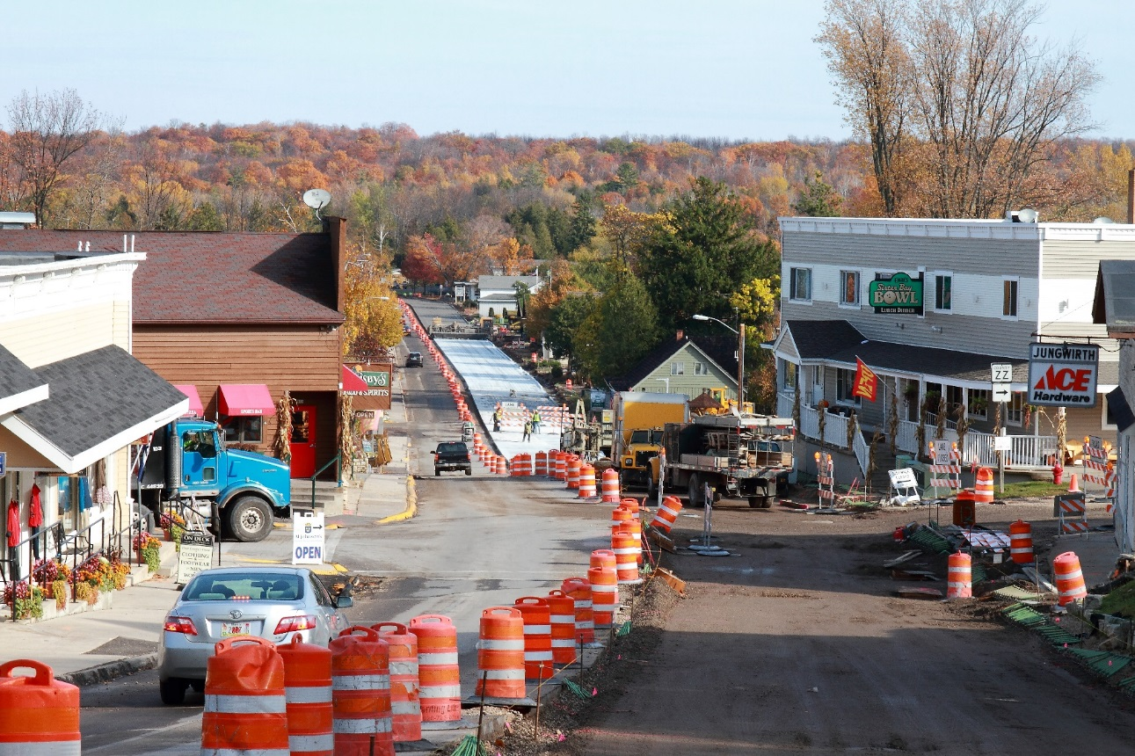
Concrete Paving

Slide 9
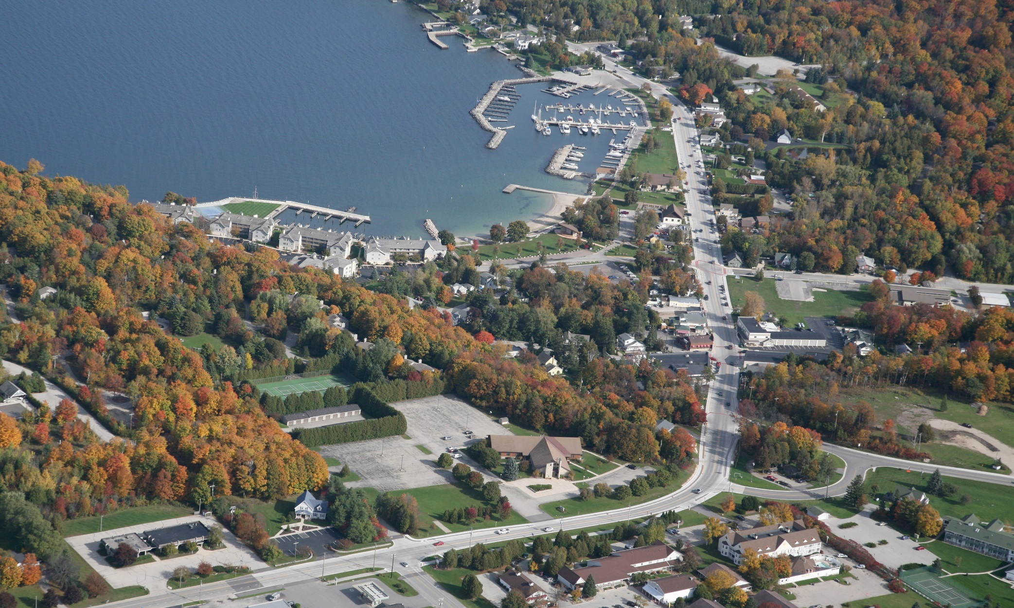
Concrete Paving

Slide 10
Concrete Paving – Local Program
County: Outagamie
Project I.D. : 4989-00-19
Location: Kimberly Avenue
Project Length: 0.81 miles
Prime Contractor: Peters Concrete
Project Leader: Scott Hintz, Gremmer & Assoc.
Project Manager: Craig Treadway, JT Engineering
DOT Project Supervisor: Brian Edwards

Slide 11
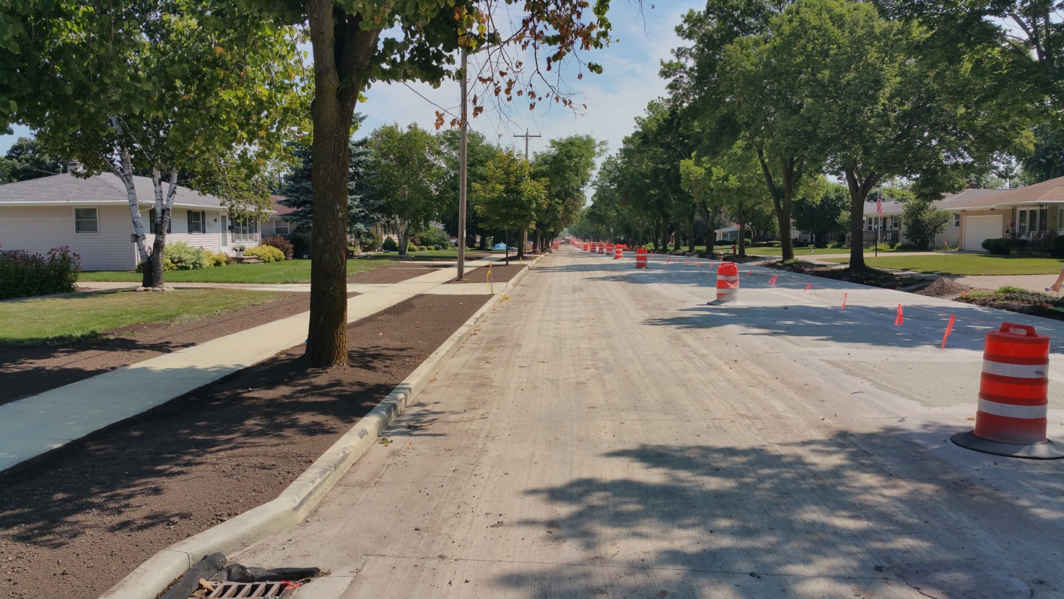
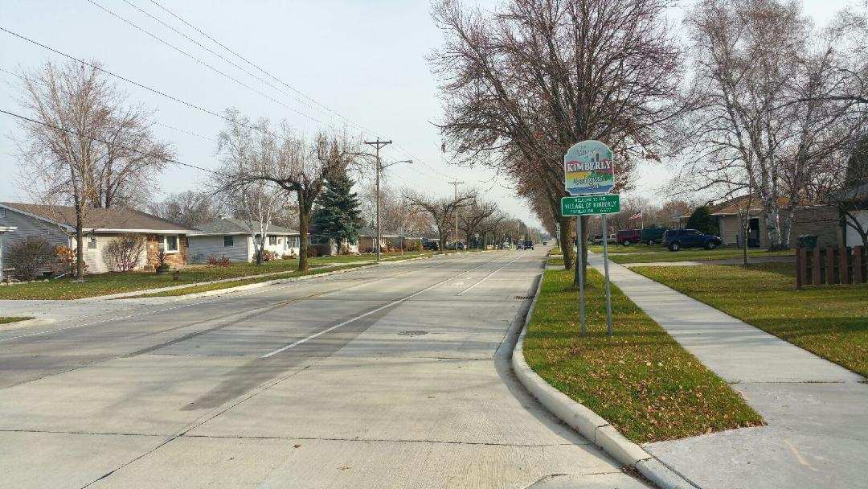
Concrete Paving – Local Program

Slide 12
Grading
County: Fond du Lac
Project I.D.: 1420-23-71
Location: USH 151, CTH T Overpass/CTH V Interchange
Project Length: 1.0 mile (CTH V); 0.75 mile (CTH T)
Prime Contractor: Mashuda Contractors Inc.
Project Leader: Brooks Fechhelm
DOT Project Manager: Bryan Learst
DOT Project Supervisor: Robert Wagner

Slide 13
Grading

Slide 14
Grading
Before - 2011
After – 2013

Slide 15
Small Structure
County: Sheboygan
Project I.D. : 4640-06-71
Location: 14th Street, City of Sheboygan, Sheboygan River Bridge STH 28
Project Length: 0.074 miles
Prime Contractor: Zenith Tech, Inc.
Project Leader: Kevin Jump, Donohue & Assoc.
DOT Project Manager: Paul Brauer
DOT Project Supervisor: Robert Wagner

Slide 16
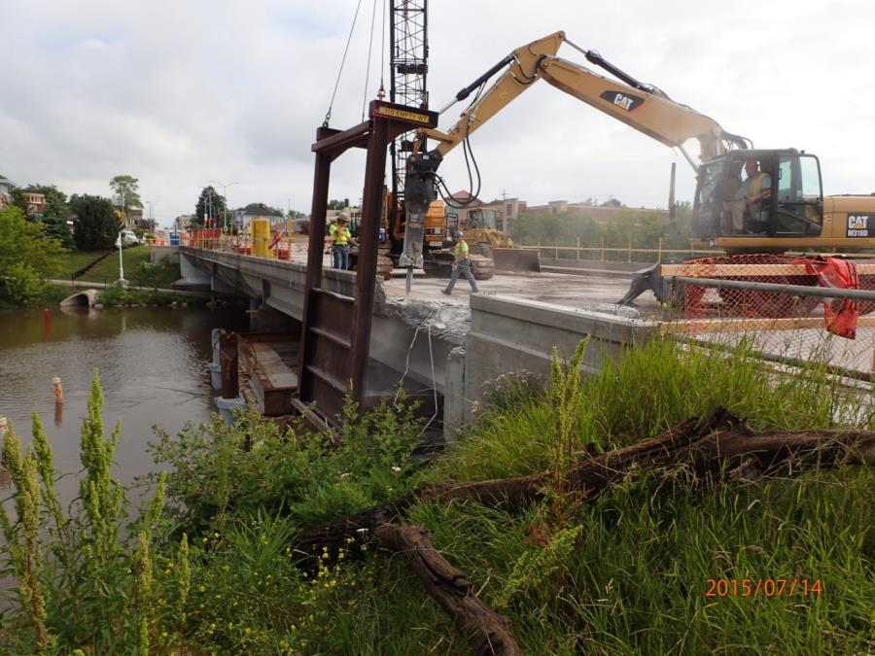
Small Structure

Slide 17
Large Structure
County: Winnebago
Project I.D.: 1517-07-76
Location: USH 10 – USH 10/STH 441, Little Lake Butte Des Morts
Project Length: 0.655 miles
Prime Contractor: Lunda Construction Co.
Project Leader: Heath Hagner, DAAR Engineering
DOT Project Manager: Kurt Peters
DOT Project Supervisor: Tammy Rabe

Slide 18
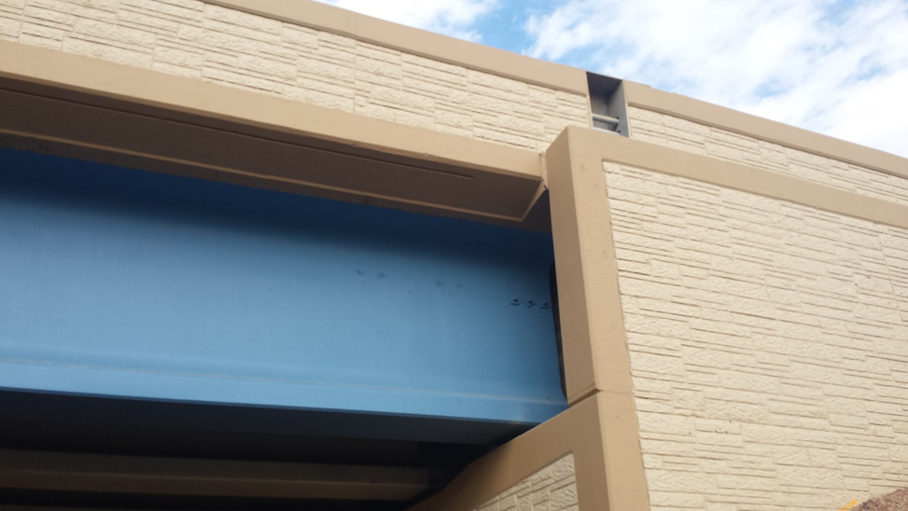
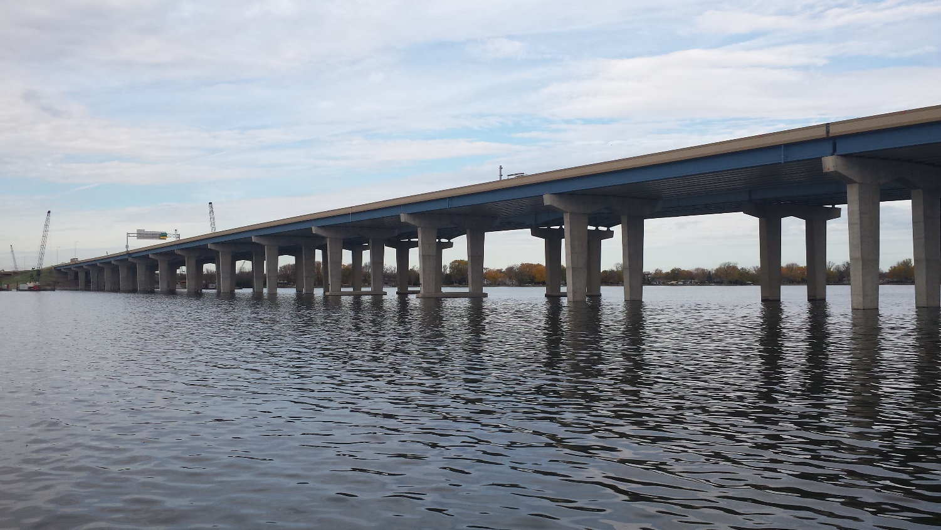
Large Structure

Slide 19
Large Structure

Slide 20
Mega/Major
County: Brown
Project I.D.: 1133-07-77/1133-09-71,74,76
Location: I-41, De Pere – Suamico, Glory Road to Ninth Street
Project Length: 4.79 miles
Prime Contractor: Lunda Construction Co.
Project Leader: Tom Schmidt, Kapur & Assoc.
DOT Project Manager: Kurt Peters/Eric Gwidt
DOT Project Supervisor: Mike King

Slide 21
Mega/Major

Slide 22
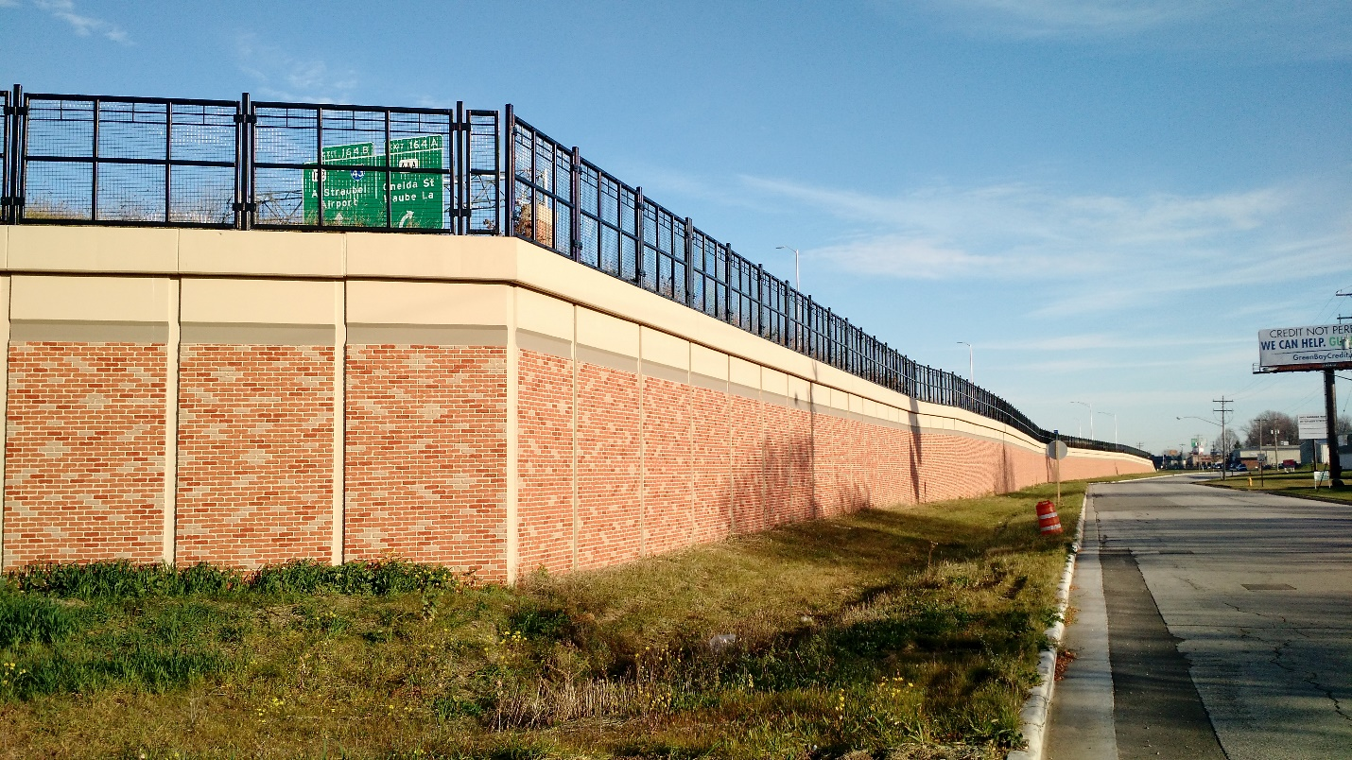
Mega/Major

Slide 23
Unique Category – Local Program
County: Sheboygan
Project I.D. : 4996-01-58
Location: Taylor Drive, City of Sheboygan
Project Length: 2.64 miles
Prime Contractor: Lunda Construction Co.
Project Leader: Cory Corson, QUEST
Project Manager: Jeff Zlatohlavek, JT Engineering
DOT Project Supervisor: Dave Schmidt

Slide 24
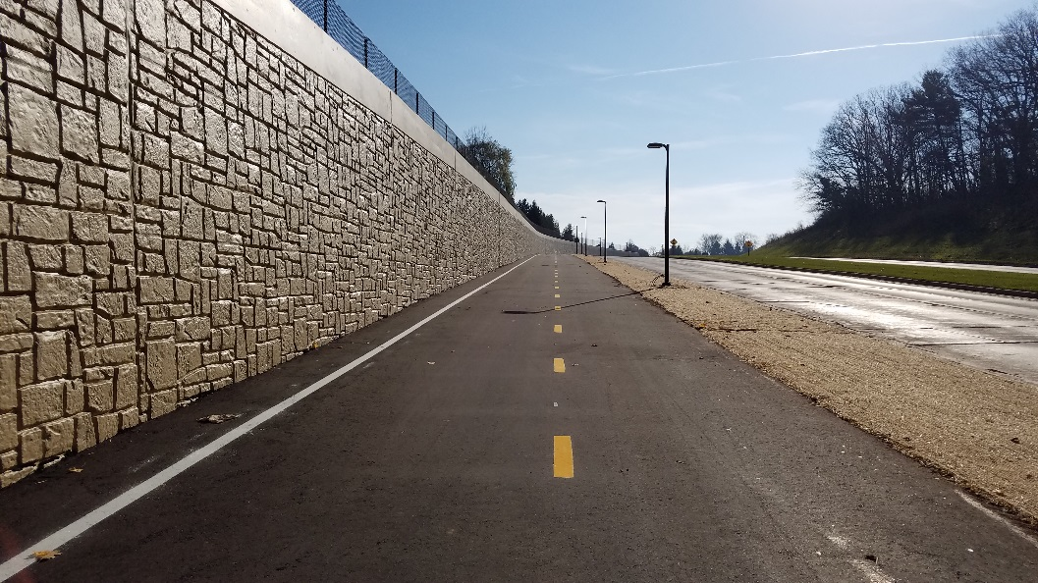
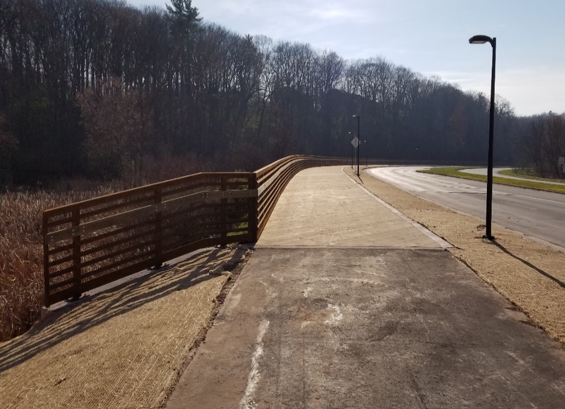
Unique Category – Local Program

Slide 25
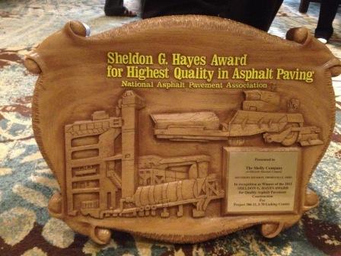
National Recognition
National Asphalt Pavement Association (NAPA) 2016 Sheldon G. Hayes Award
STH 26, Fond du Lac County
Notes:
The National Asphalt Pavement Association (NAPA) announced the winner of the 2016 Sheldon G. Hayes Award for excellence in construction of an asphalt pavement. The award, bestowed annually since 1971, recognizes the country’s highest quality highway pavements.
The winning project was the 2015 paving of the 16 mile stretch of STH 26 north and south of Rosendale in Fond du Lac County.
Northeast Asphalt, WisDOT and Gremmer & Associates were involved in the success of this high recycle asphalt mix pilot. Materials staff participated in coordination, testing and quality assurance of this large asphalt paving effort. The ride quality is extraordinary and is recognized as tops in the nation!

Slide 26
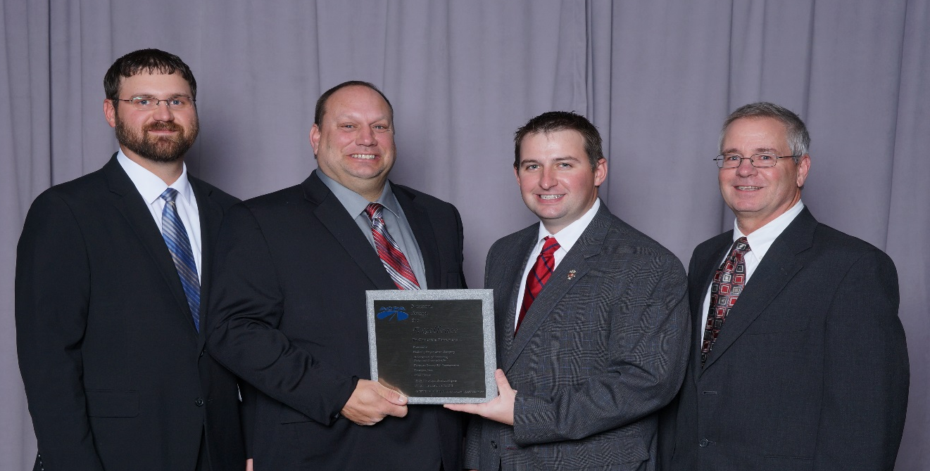
National Recognition
American Concrete Pavement Association (ACPA) 2016 Excellence in Concrete Pavement Awards
Appleton Road, WIS 441/47 Interchange – Silver Level for Municipal Streets & Intersections >30,000 SY
Notes:
American Concrete Pavement Association: 2016 Excellence in Concrete Pavement Award Winners (27 projects recognized nationwide including 1 from WisDOT NE Region; 70 projects submitted; each state/chapter only allowed to submit 1 per category)
Appleton Road, WIS 441/47 Interchange was recognized as the Gold Level Winner in the category of Municipal Streets & Intersections (>30,000 SY).

Slide 28
Region Construction Emphasis
Culture and Leadership
Safety
CRI’s
Efficiency List
Cost to Complete
Performance Measures

Slide 29
Region Construction Emphasis
Safety
Would you watch out for my safety?

Slide 30
Region Construction Emphasis
Safety
Five Reasons Why We Should Watch Out for EACH Other’s Safety

Slide 31
Region Construction Emphasis
1. Improve Your Own Safety Awareness

Slide 32
Region Construction Emphasis
2. People Get Distracted
Many things going on with the project… traffic, cell phones, equipment, etc.

Slide 33
Region Construction Emphasis
3. Our Perceptions Can Fail Us
Inattentionial blindness, also known as perceptual blindness, event in which an individual fails to recognize an unexpected stimulus that is in plain sight
Plain and simple, no one is perfect
Accidents happen
Items will be right in front of us and we will be oblivious to them

Slide 34
Region Construction Emphasis
4. Live Life without Regrets
Avoid feeling any regret by not saying or doing something to prevent an accident
It is a benefit to ourselves to eliminate the risk of feeling regret that could last forever

Slide 35
Region Construction Emphasis
“ I Chose to Look the Other Way”
I could have saved a life that day
But I chose to look the other way.
It wasn’t that I didn’t care,
I had the time, and I was there.
But I didn’t want to seem a fool,
or argue over some safety rule.
I knew he’d done the job before,
If I spoke up, he might get sore.
The chances didn’t seem that bad,
I’d done the same thing – He knew I had.
So I shook my head and walked on by,
He knew the risks as well as I.
He took the chance, I closed an eye,
And with that act, I let him Die.
I could have saved a life that day
But I chose to look the other way.

Slide 36
Region Construction Emphasis
“ I Chose to Look the Other Way”
Now Every time I see his Wife,
I’ll know, I should have saved his life.
That guilt is something I must bear,
But it isn’t something you should share.
If you see a risk that others take,
That puts their health or life at stake,
the question asked or think you say,
could help them live another day.
If you see a risk and walk away,
Then you hope you never have to say
“I could have saved a life today,
But I chose to look the other way”
Don Merrell
J.R. Simplot Company

Slide 37
Region Construction Emphasis
5. IT’S Just the Right Thing to Do
Think of all the negative consequences that could happen (medical expenses, job disruption, media coverage, insurance, etc.)

Slide 38
Region Construction Emphasis
Safety
Three Reasons that get in the way of Safety

Slide 39
Region Construction Emphasis
Safety
1. YOU Don’t Think IT COULD EVER HAPPEN!
No history of it happening
You haven’t ever seen it happen before

Slide 40
Region Construction Emphasis
Safety
2. It’s NOT COMFORTABLE
Avoidance
Sometimes certain individuals are harder to deal with or maybe it’s your friend

Slide 41
Region Construction Emphasis
Safety
3. We Don’t Know How to Communicate
Flat out telling someone what they are doing wrong isn’t always easily accepted
Saying, “Hey would you like me to watch out for your Safety?” begs for a yes answer due to curiosity.
Your approach and communication can have a positive, ‘pay it forward’ type of effect. It’s all in how you choose to address Safety.

Slide 42
Region Construction Emphasis
Safety
Think of Someone Who is Counting on You?

Slide 43
Region Construction Emphasis
Safety
Be a safety coach
Teach procedures and principles
Observe and provide feedback (positive too)
Use observation to identify hazards and barriers to safe behavior
Discuss at weekly meetings; Daily tailgate talks

Slide 44
Region Construction Emphasis
Cost Reduction Incentive (CRI)
Document all CRIs
Notify and forward all concept submittals and proposal submittals to CQA (Krissy) and BPD Oversight Engineer (Alfaro)
Include appropriate decision-makers in review
Respond timely

Slide 45
Region Construction Emphasis
Efficiencies

Slide 46
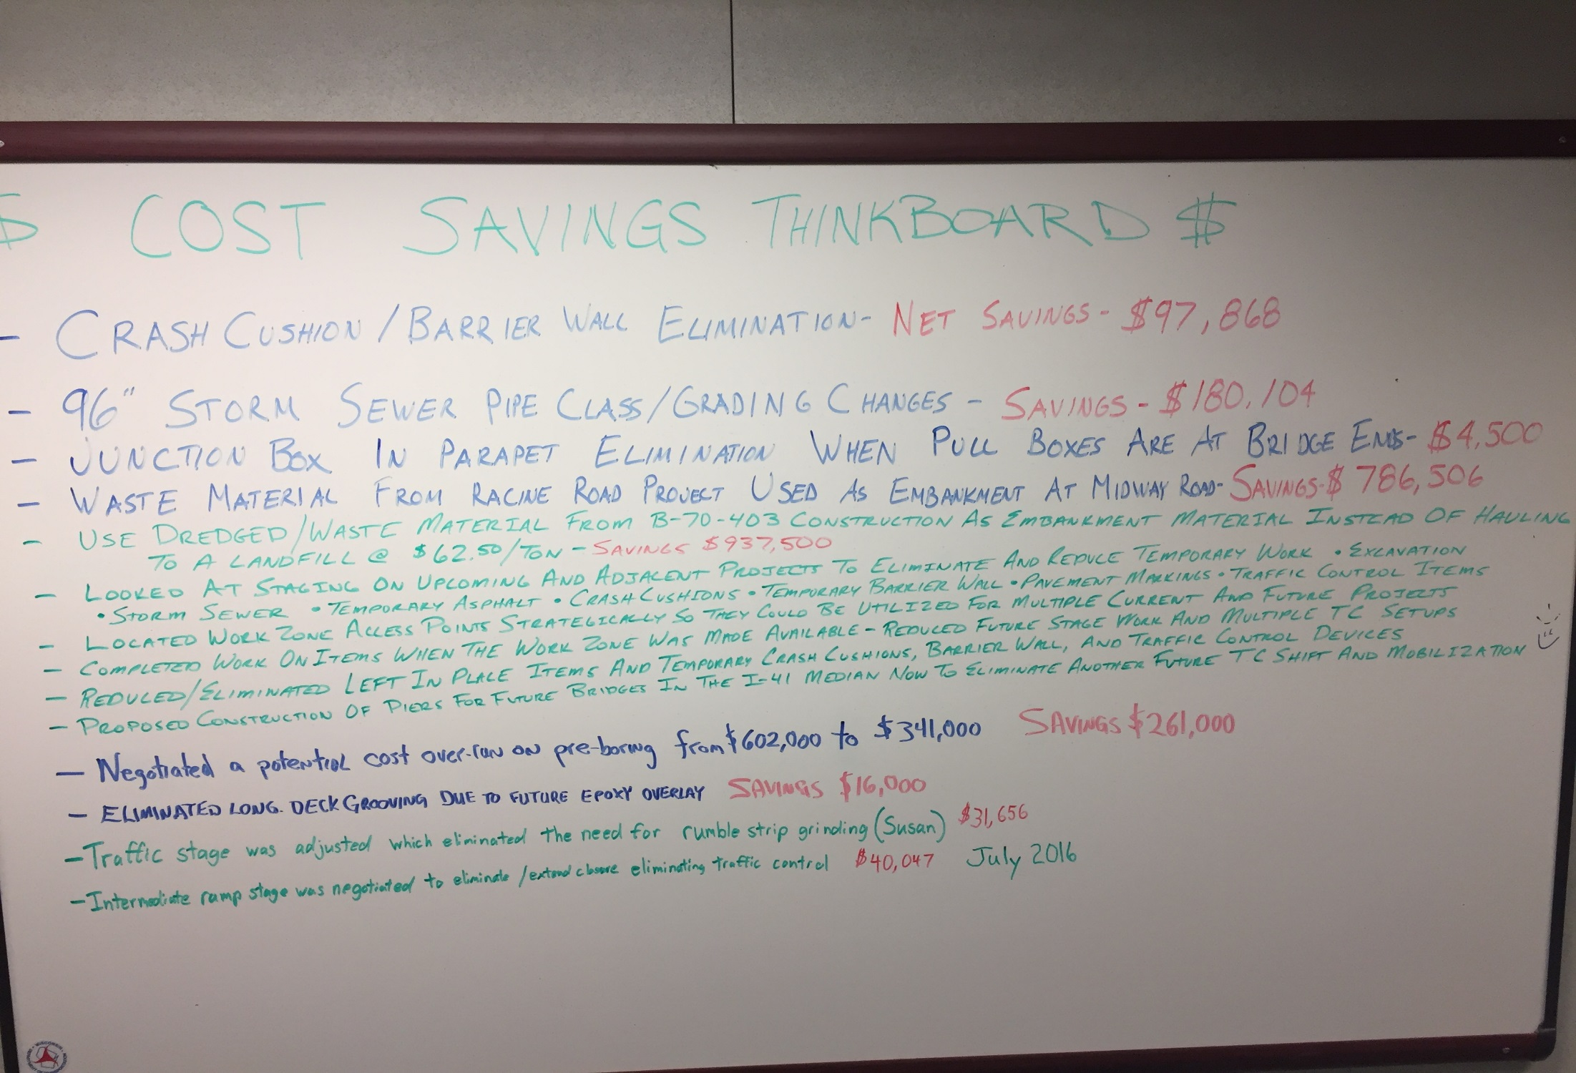
Region Construction Emphasis - Efficiencies

Slide 48
Region Construction Emphasis
Cost to Complete
a.k.a Over/Under Spreadsheet
Started on ARRA/Mega Projects in 2009

Slide 49
Region Construction Emphasis
Cost to Complete
To control unprogrammed cost increases they must be identified early on so action can be taken to minimize those costs.
A centralized document to help PDS management understand and forecast the region’s final construction costs
Savings created by the teams innovative ideas will be reported out to others creating opportunities for recognition of the team’s ideas.
Creates an atmosphere that encourages the project team to proactively identify future issues before they are incurred, resulting in reduced costs.
This process allows for more easily identified trends in quantity variations across the region

Slide 50
Region Construction Emphasis
Cost to Complete
Process:
Each contract line item will be transferred from Field Manager into an Excel spreadsheet. The project team will then note projected quantity variations and extra work on the spreadsheet. The spreadsheet will be sent to the region construction program controls unit on a monthly basis. A summary of all projects cost to complete will be reported out to PDS project managers and management on a monthly basis.

Slide 51
Region Construction Emphasis
Cost to Complete
In 2017, approximately a dozen projects will be required to complete. Projects chose on dollar value, duration, and likelihood of quantity changes.
In 2018, expand on all NE Region projects except on short duration or simple projects.

Slide 52
Region Construction Emphasis
Performance Measures
Time
Decisions, ContMods, Finals, Completion/Opening
Budget
Project Costs, Delivery Costs
Quality
Records, Materials, Final Product

