Slide 1
Performance Measures
NER Construction Training
March 16, 2016

Slide 2
Construction Related Measures
On-time
On-budget
Construction Quality Index
Finals Closeout
Construction Delivery Cost Index

Slide 3
On-Time Performance
94.8 96.2 98.2 94.8 98.1 95.5
Target = 100%

Slide 4
On-Budget Performance
103.5 103.7 101.7 100.6 100.7 99.6
Current Target ≤103%

Slide 7
Finals Closeout

Slide 8
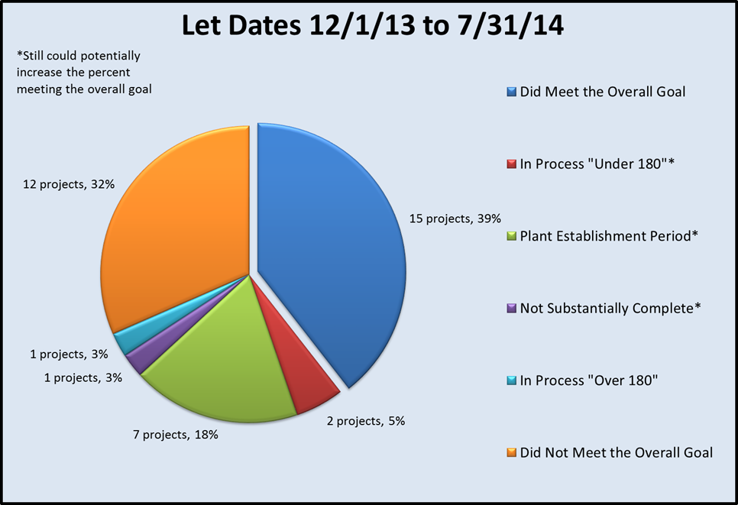
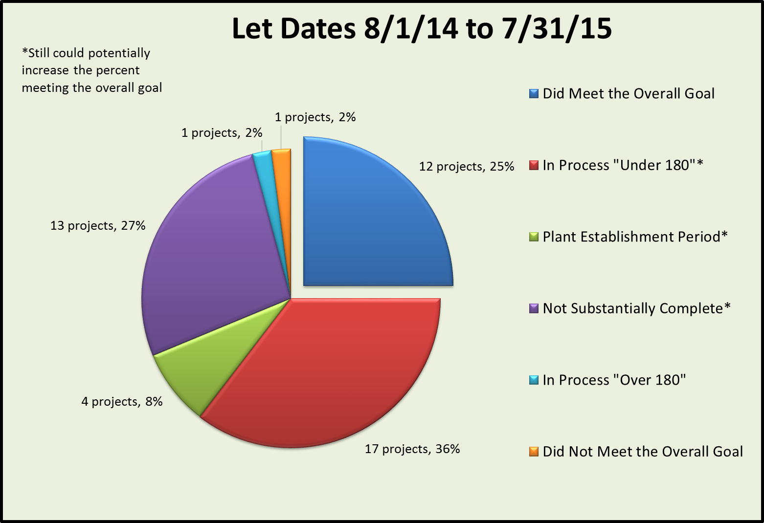
Finals Closeout

Slide 9
Finals Closeout
Tasks most often exceeding the allotted # of days:
Punch List
Contract Records Issues Resolved
Material Certification

Slide 10
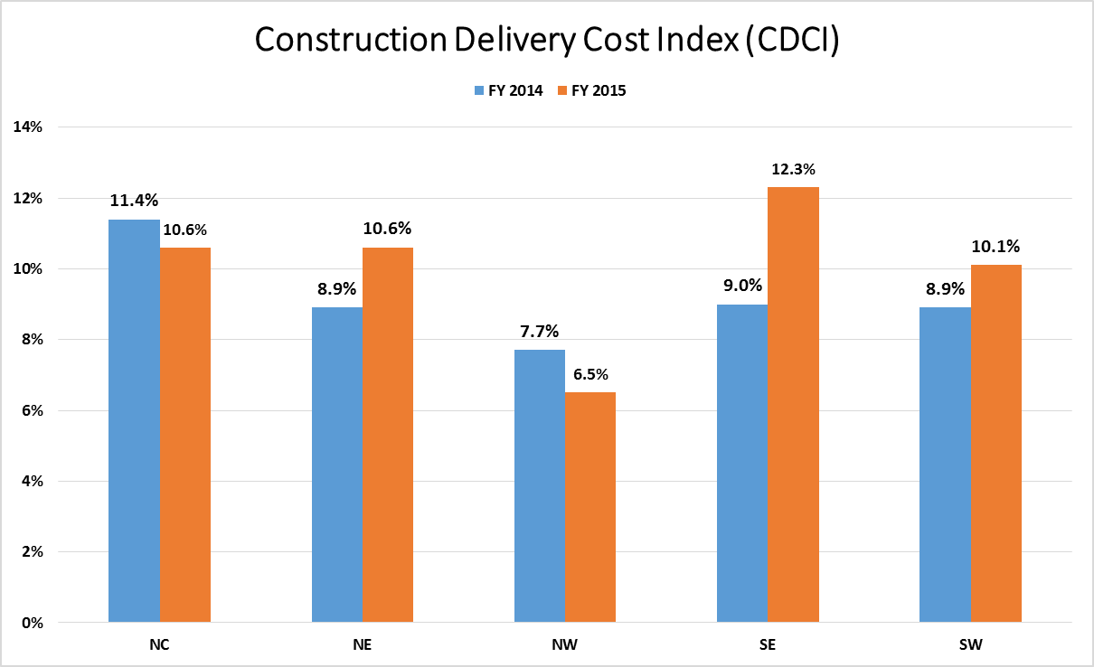
Target < 10%

Slide 11
Construction Delivery Cost Index (CDCI)

Slide 12
Construction Delivery Cost Index (CDCI)
Notes:
http://wisconsindot.gov/Pages/doing-bus/eng-consultants/cnslt-rsrces/default.aspx

Slide 13
Construction Delivery Cost Index (CDCI)

