Slide 1
Contract Administration
NER Construction Training
March 16, 2016

Slide 2
2016 Field Software Updates
Scheduling appointments:
Prior to July 31, 2016, Project Leaders contact BITS Level 2 ACM Support staff to schedule an appointment for the software installs.
Starting on August 1, 2016, Project Leaders contact the WisDOT IT Service Desk at (800) 362-3050 or (608) 264-9434 to schedule an appointment for software installs.
Contact the WisDOT IT Service Desk for all software issues.
Installations
BITS Level 2 ACM staff can install software and resolve issues using remote access tools (Example – Bomgar).
If a company has 5 or more computers requiring updates they can be brought to a DTSD office or an on-site visit can be arranged.
Local administrative rights required for ALL software installs.
Notes:
Who to contact to schedule appointments: Prior to July 31, 2016 - PL’s please call or email local IT staff for software installation. Starting on August 1, 2016, call the IT Service Desk to schedule appointments.
Installs can be done remotely OR onsite. Why - BITS project to account for time to complete installs.

Slide 3
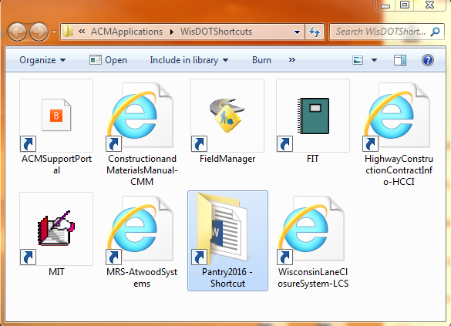
Notes:
Currently Steve puts the Contract ID Field Files folder in this location as well. Beginning August 1st we will likely email or put the folder on a disc (similar to LP) and make it available where the plans & proposals are in the drawer.

Slide 4
2016 Pantry Region Updates
NEW
Project Binders
Instructions and empty 3-ring binders available at region office with project plans/proposals
Required postings and other binder sheets in
Pantry2016\RegionSpecific\NorthEastRegion\NER\ProjectBinder
41 and 441 contact Lindsay Deswarte for binders
LP project binders assembled by MC
REVISED
Concrete Substructure Prepour Meeting
Preconstruction Agenda

Slide 5
2016 Pantry Statewide Updates
NEW
Asphalt Sample Tag DT1352
Pantry2016\StatewideForms\DTForms
Mailbox Removal
Pantry2016\StatewideForms
REVISED
Traffic Control Inspection Checklist (added Temp Crash Cushions)
Pantry2016\StatewideForms
Concrete Mixture Design WS5014
Pantry2016\StatewideForms\WSForms
Notes:
Several other forms had minor formatting issues fixed and contact information or spec references updated.
Ancillary Concrete Daily Test Report WS5013 was updated last year and is required to be used this year.

Slide 6
Notes:
New statewide data entry guide for FM, FieldBook, FIT and MIT. Our region guide is more specific and should be referenced first. Hopefully we will be able to better combine or reference between the two in the future.
Stored in Pantry2016\StatewideManualsAndGuides with shortcut in WisDOT Shortcuts folder.

Slide 7
FieldManager v5.1a - Backups
Upon exiting your FieldManager database for the 5th time, a Warning window will appear prompting you to backup.
The backup window was shortened due to the number of crashed FieldManager databases reported to the AASHTOWare Project Administrators in 2014 and 2015.
The initial backup is stored at C:\ProgramData\FieldManager\database\Backup
An additional backup can be saved on an external USB or hard drive too.
Notes:
It is very important to do backups! After logging out of FieldManager 5 times, the system will prompt the user to back up the FieldManager database. The first backup saves it to the local PC and then the user is prompted to save to another location if desired (e.g. USB or external hard drive).
This is different direction than we’ve given in the past.

Slide 8
FieldManager v5.1a - Estimates
All Estimates must contain the following comments:
Fiscal year the work being paid on the estimate was performed (MUST be the first line)
“FY16” = July 1, 2015 – June 30, 2016 “FY17” = July 1, 2016 – June 30, 2017
Your name, company, phone number
PM name
41 and 441 also include Deputy PM name
LP – first line of comments must be the date range that work was performed for this estimate instead of FY
There is a 60 character limit on the voucher report for estimate comments. Comments that exceed 60 characters will be truncated on the voucher report.
Notes:
Estimate comments are required for the Bureau of Financial Services and aid in the processing of payment to the contractor. It helps them determine which fiscal year funds to use to pay the voucher.
Timely processing of contmods is desired so it may be paid with the correct fiscal year funds.

Slide 9
Field Information Tracking (FIT)
Required data entry:
DQI information for each project
Explanation of Variation report - Item variation entered in FieldManager
Acceptance information
Punch List Completed Date
Contracts with Plant Establishment Periods – Initial Completion of Planting Date AND Plant Estb Period (Years)
Late Seeding prompt if applicable
Late Paving prompt if applicable NOTE: Late Paving to be replaced with Cold Weather Paving in FIT 2016 service pack.
If a claim is submitted, Submission of Claim Date is required.
Structure(s) information
Staff / Field Office information
Warranty information, if applicable
Notes:
Punch List Completed Date is when both work and documentation are complete.
Initial Completion of Planting should only be entered for contacts with a Plant Establishment Period.
Late Paving will be revised to Cold Weather Paving with the FIT 2016 Service Pack.

Slide 10
Document critical dates in Daily Diary comments
CONDITIONAL NOTICE TO PROCEED issued today allowing for work only on traffic control and staking. ECIP still needs approval…
NOTICE TO PROCEED issued today…
WORK STARTED TODAY with MegaRentals installing message boards…
CONTROLLING OPERATIONS AND TIME CHARGES STARTED TODAY…
TIME CHARGES FOR STAGE 1 STARTED TODAY…
TIME CHARGES STARTED TODAY. Controlling operations have not begun however it has been 10 days since the NTP was issued…

Slide 11
Document critical dates in Daily Diary comments
ROAD CLOSED/OPENED TO TRAFFIC…
WORK/TIME SUSPENDED/RESUMED…
TIME CHARGES STOPPED and PROJECT SUBSTANTIALLY COMPLETE today…
PUNCHLIST WORK COMPLETE but still waiting on documentation…
PUNCHLIST COMPLETE and ALL CONTRACT WORK COMPLETE today…
CONDITIONAL FINAL ACCEPTANCE issued today…
Remaining contract work includes items associated with the Plant Establishment Period which ends 10/15/XX...

Slide 12
Various Reminders
Site Events tab only for suspend/resume (pg 22)
Weekly Report of Time Charges from Construction Start date (pg 26)
Print Diary from FM (pg 34, 82)
Only one IHTD for multiple project IDs (pg 36)
Roadway & Bridge Maintenance forms (pg 74-76)
Notes:
Weekly Report of Time Charges for Working Day Contracts should begin from the Construction Start Date. Remarks may be necessary about work starting on non controlling items.
For contracts with multiple project IDs, only one IHD is allowed. If separate documentation is kept during construction be sure to number the sheets appropriately so they can be combined into one IHD prior to turning in your project records.
Reminder to fill out and send in maintenance forms, schedule inspections prior to opening, and enter structures in FIT.

Slide 13
Types of Reviews/Audits
Project Review
Process Review
Compliance Assessment Program (CAP) Review
Improper Payment Information Act (IPIA) Review
Legislative Audit Bureau (LAB) Review

Slide 14
LAB Review
Process, Project or Item Specific
Materials
Adequate QMP Plans and certs
Appropriate number of QC and QV tests taken

Slide 15
IPIA Review

Slide 16
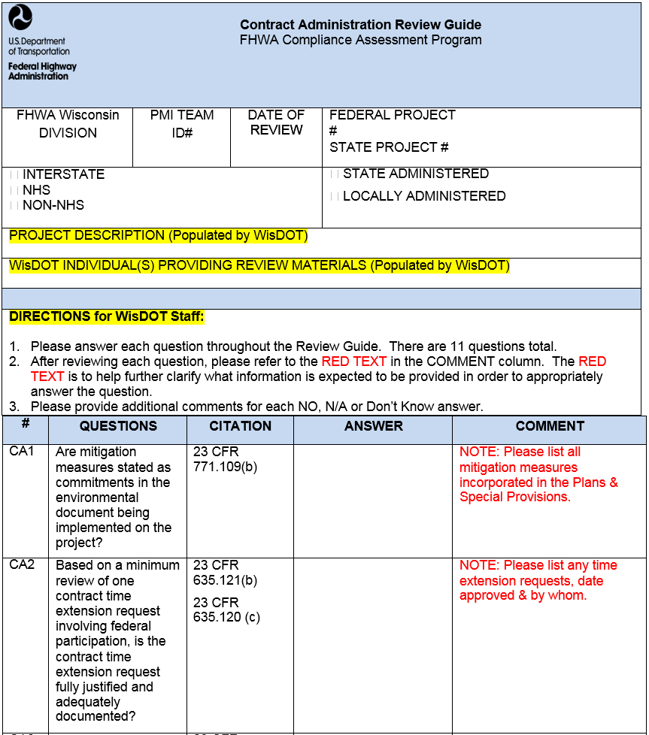
CAP Review
Notes:
Are mitigation measures stated as commitments in the environmental document being implemented on the project?
2) Based on a minimum review of one contract time extension request involving federal participation, is the contract time extension request fully justified and adequately documented?

Slide 17
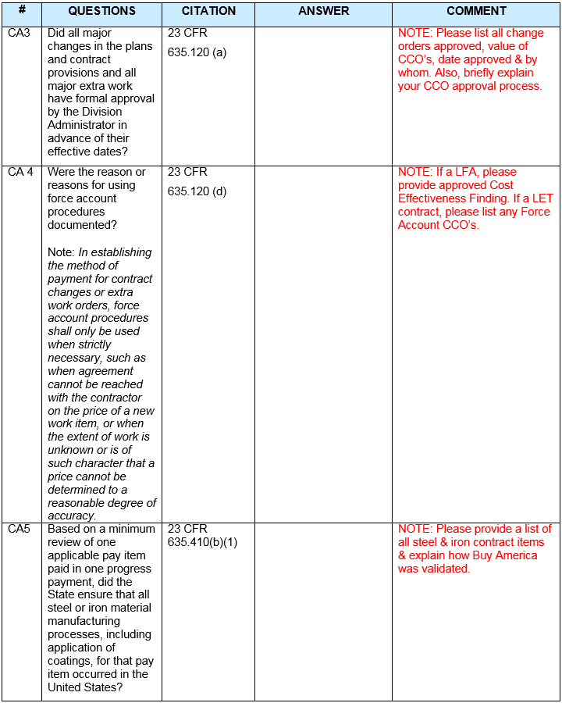
CAP Review
Notes:
3) Did all major changes in the plans and contract provisions and all major extra work have formal approval by the Division Administrator in advance of their effective dates?
4) Were the reason or reasons for using force account procedures documented? Note: In establishing the method of payment for contract changes or extra work orders, force account procedures shall only be used when strictly necessary, such as when agreement cannot be reached with the contractor on the price of a new work item, or when the extent of work is unknown or is of such character that a price cannot be determined to a reasonable degree of accuracy.
5) Based on a minimum review of one applicable pay item paid in one progress payment, did the State ensure that all steel or iron material manufacturing processes, including application of coatings, for that pay item occurred in the United States?

Slide 18
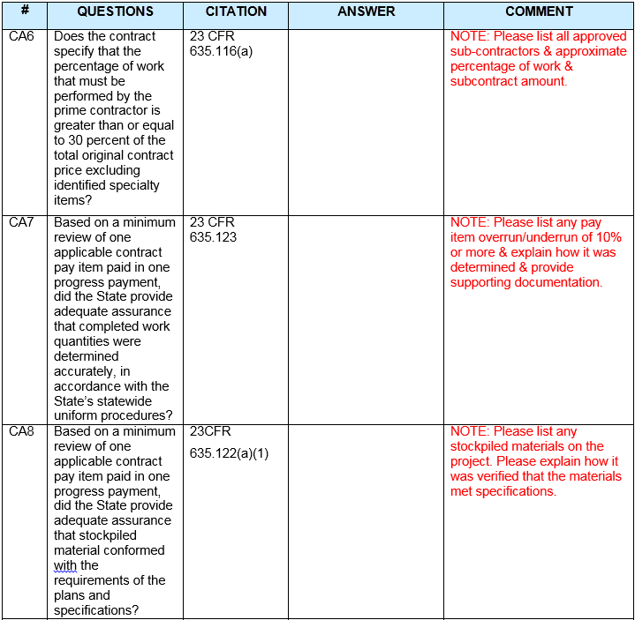
CAP Review
Notes:
6) Does the contract specify that the percentage of work that must be performed by the prime contractor is greater than or equal to 30 percent of the total original contract price excluding identified specialty items?
7) Based on a minimum review of one applicable contract pay item paid in one progress payment, did the State provide adequate assurance that completed work quantities were determined accurately, in accordance with the State’s statewide uniform procedures?
8) Based on a minimum review of one applicable contract pay item paid in one progress payment, did the State provide adequate assurance that stockpiled material conformed with the requirements of the plans and specifications?

Slide 19
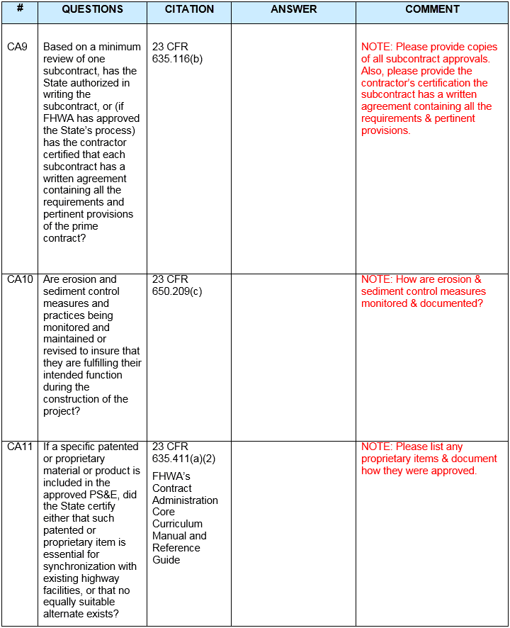
CAP Review
Notes:
9) Based on a minimum review of one subcontract, has the State authorized in writing the subcontract, or (if FHWA has approved the State’s process) has the contractor certified that each subcontract has a written agreement containing all the requirements and pertinent provisions of the prime contract?
10) Are erosion and sediment control measures and practices being monitored and maintained or revised to insure that they are fulfilling their intended function during the construction of the project?
12) If a specific patented or proprietary material or product is included in the approved PS&E, did the State certify either that such patented or proprietary item is essential for synchronization with existing highway facilities, or that no equally suitable alternate exists?

Slide 20
Process Review

Slide 21
Project Review

Slide 22
Project Review

Slide 23
Project Review

Slide 24
ContMod Justification
One issue per CMJ/AJR
Prior Approval
Independent Estimates
Stand alone document – reference Spec, CMM or contractual reason for the change
Reason codes

Slide 25
ContMod Justification
If it involves any local funding, include a statement of local government acceptance of price
Document Negotiation
Don’t show contractor mark-up
Time & Materials vs. Force Account

Slide 26
Supplemental Agreements

Slide 27
Supplemental Agreements
No statement necessary regarding contract time
Do not include quantity
Do not wait until end of project
Comment under Items-Documentation-Notes:
“Supplemental agreement via ContMod# to pay plan/revised quantity. Variation from original plan quantity due to…”
Notes:
Agree to early.
ContMod (not CCO) required for all Supplemental Contract Agreements.
No statement necessary regarding contract time.
Do not include quantity in ContMod.
If there is a supplemental contract agreement for an item, state this in the notes area. If the quantity varies from the plan quantity explain the variation regardless of the percent of variation.
BPD questioning the overuse of supplemental agreements. Makes sense for certain items given the method of construction operations but not to be used as the easy way out.

Slide 28
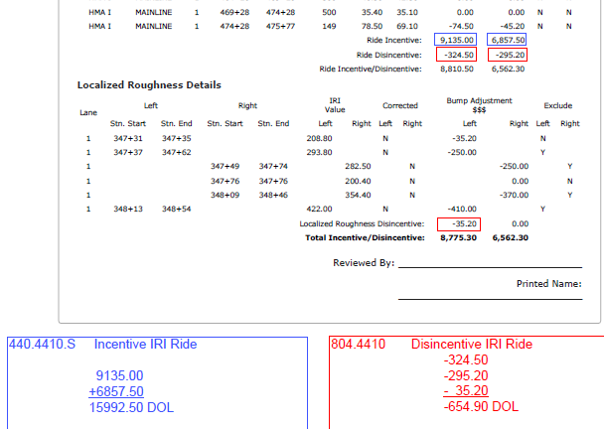
Incentive/Disincentive Payment
Pay incentive under contract bid item and disincentive under administrative item
Notes:
Unfortunately Atwood reports are not set up this way. Needed for analysis of the incentive/disincentive specs.

Slide 29
Cold Weather Paving
See handout for complete flow chart

Slide 30
Cold Weather Paving
Applies to 460 items when air temp ˂ 40°F
CWP Plan submitted at precon
Written acceptance of CWP Plan
Validate the day prior to paving
CWP Plan followed all day for payment
Contractor responsible for CWP damage/defects (unless excusable compensable delay and department directs)

Slide 31
Cold Weather Paving
Applies to 460 and 465 items when air temp ˂ 36°F for upper and ˂ 32°F for lower layer
Contractor request to pave outside temps (not dates)
Written engineer approval – may require additional cold weather measures, revise CWP Plan as necessary
Validate the day prior to paving
CWP Plan followed all day for payment (460 items only)
Contractor responsible for CWP damage/defects (unless excusable compensable delay and department directs)
Notes:
Paving below temps should be rare occasion, proactively look at schedule to try to avoid.
Will not accept blanket requests to pave at lower temps. Do not need to approve paving outstide of dates.
Engineer approval should be specific (dates, locations, layers, minimum temps, additional cold weather measures, etc.)

Slide 32
Detailed Project Schedules
Notes:
Review contractor schedule using questions in the CMM prior to acceptance. Request updated schedules as necessary.
Trouble on recent projects where items of work were not shown (temp sheeting/shoring), sequence of work was not correct (linear vs. concurrent), production rates were arbitrarily high/low, etc.

Slide 33
Production Rates
Notes:
Reminder to collect production rates and submit data via web-based tool.

