Slide 1
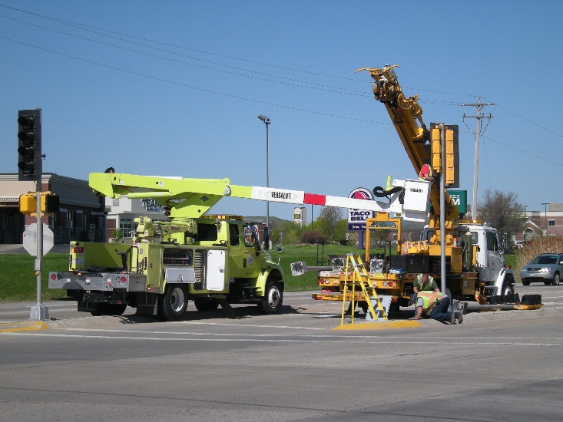
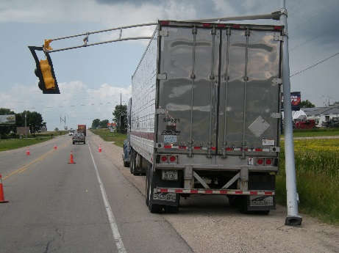
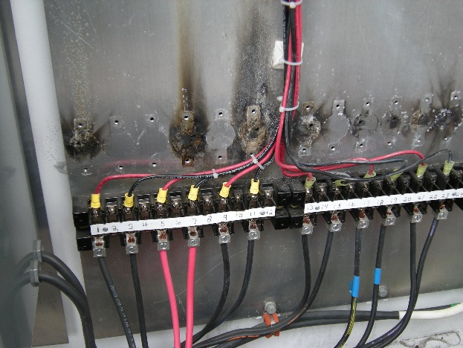
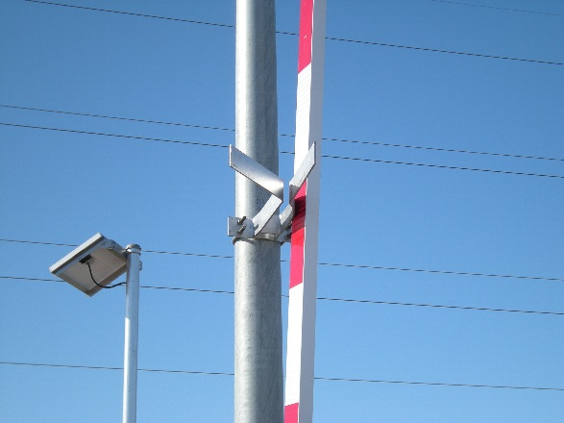
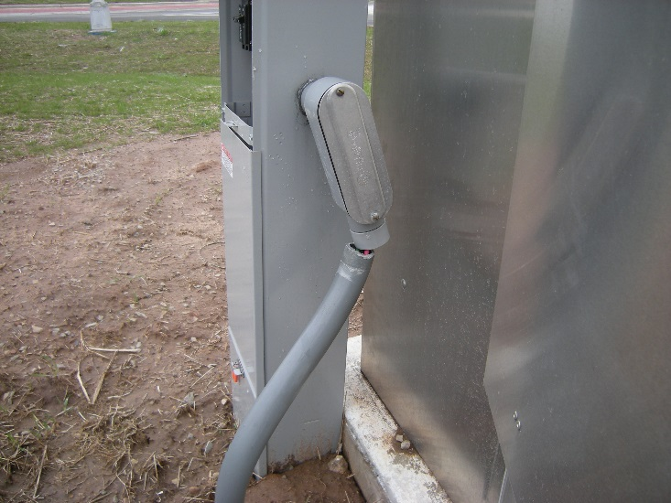
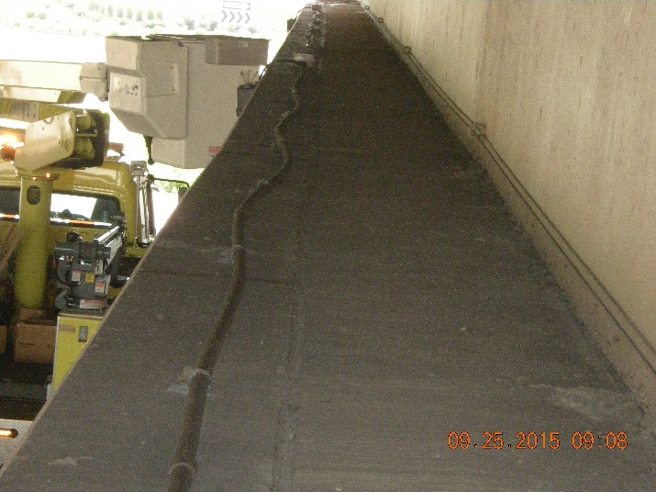
Electrical
Traffic Section, Electrical Unit
March 16, 2016 ▪▪▪ NWTC

Slide 2
Electrical
Pull Boxes
New Pull Boxes
Non-Conductive
No Ground
Traffic Signal and Lighting Wire
How do we Estimate
Round-up
How do you field measure
Additional wire in PB’s, poles, etc.

Slide 3
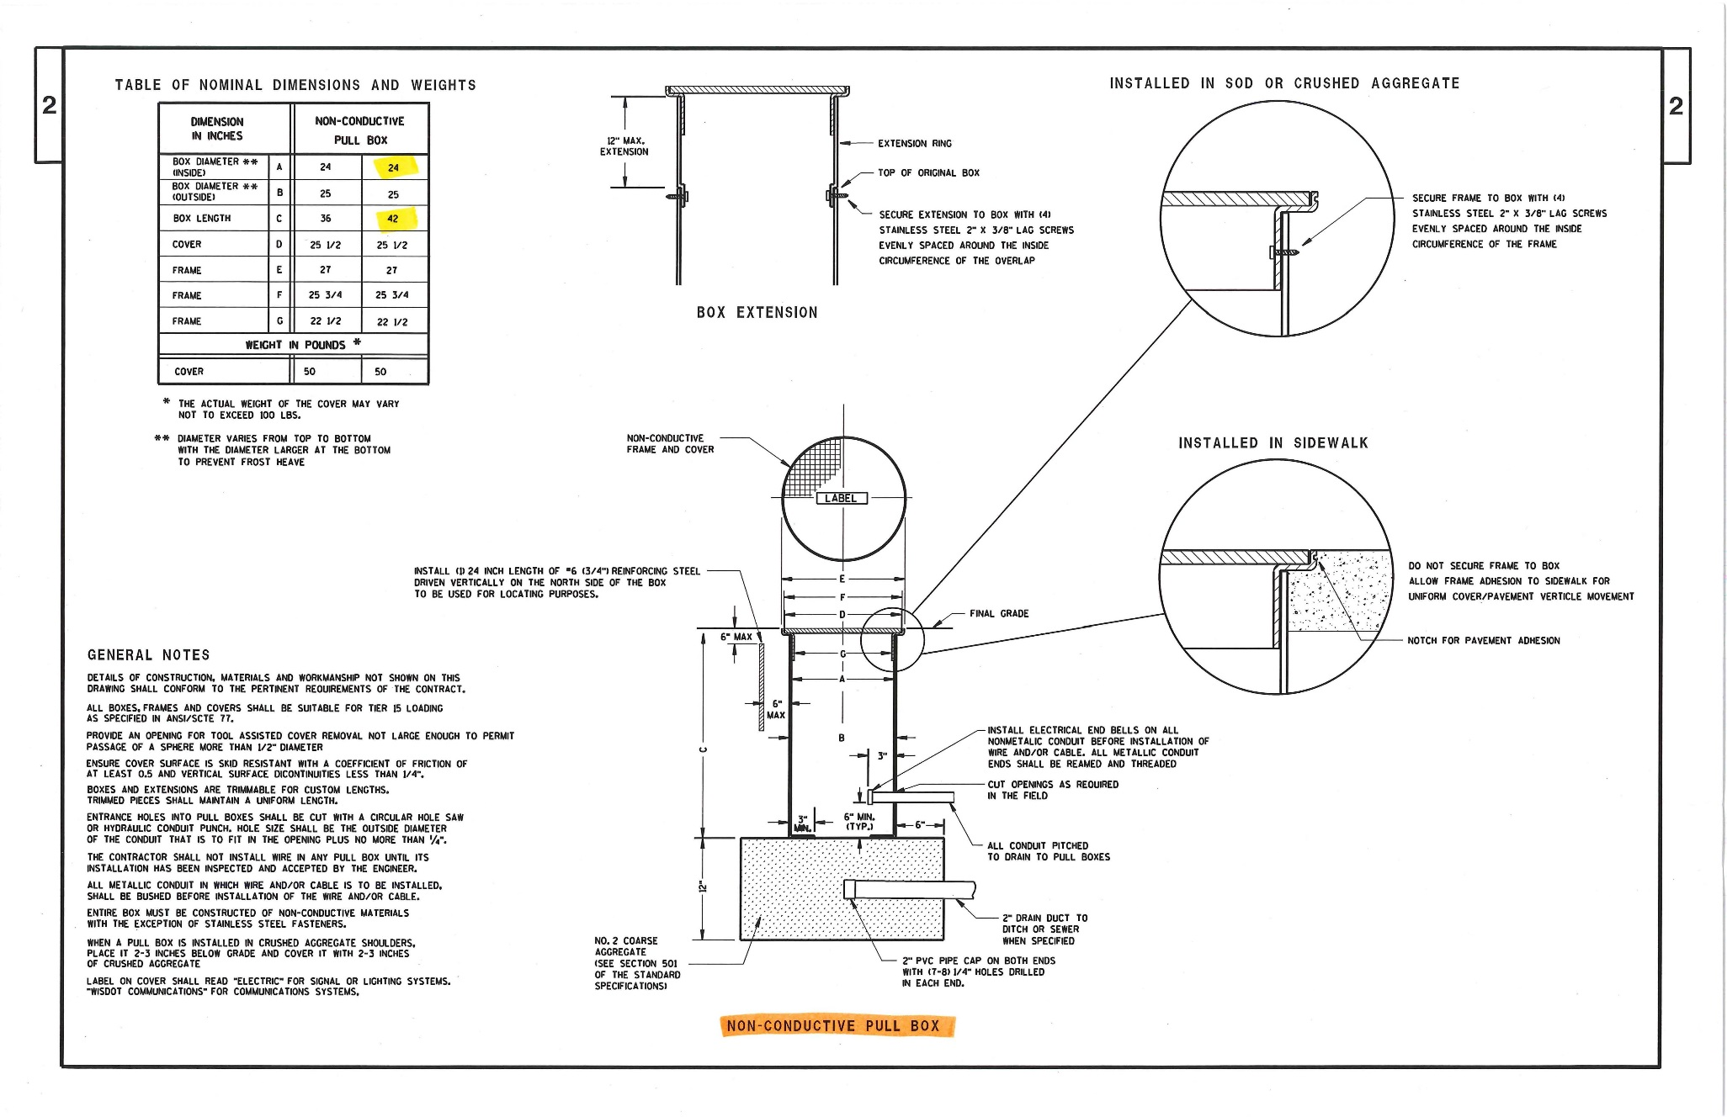

Slide 4
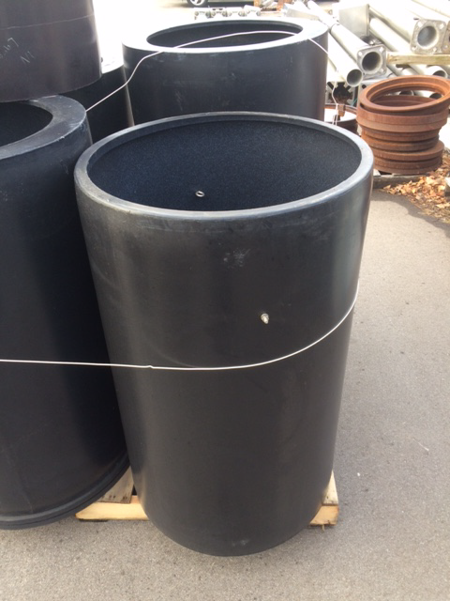

Slide 5
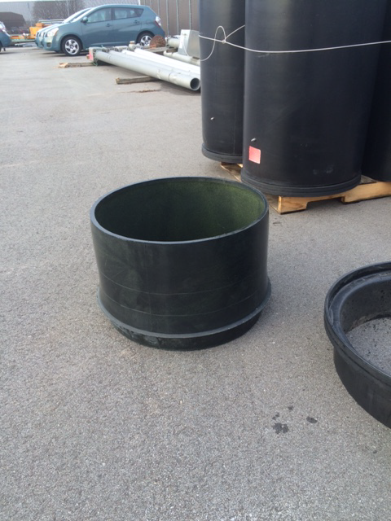

Slide 6
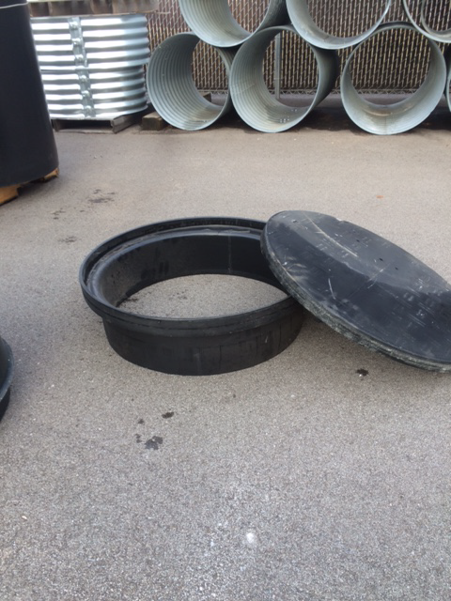

Slide 7
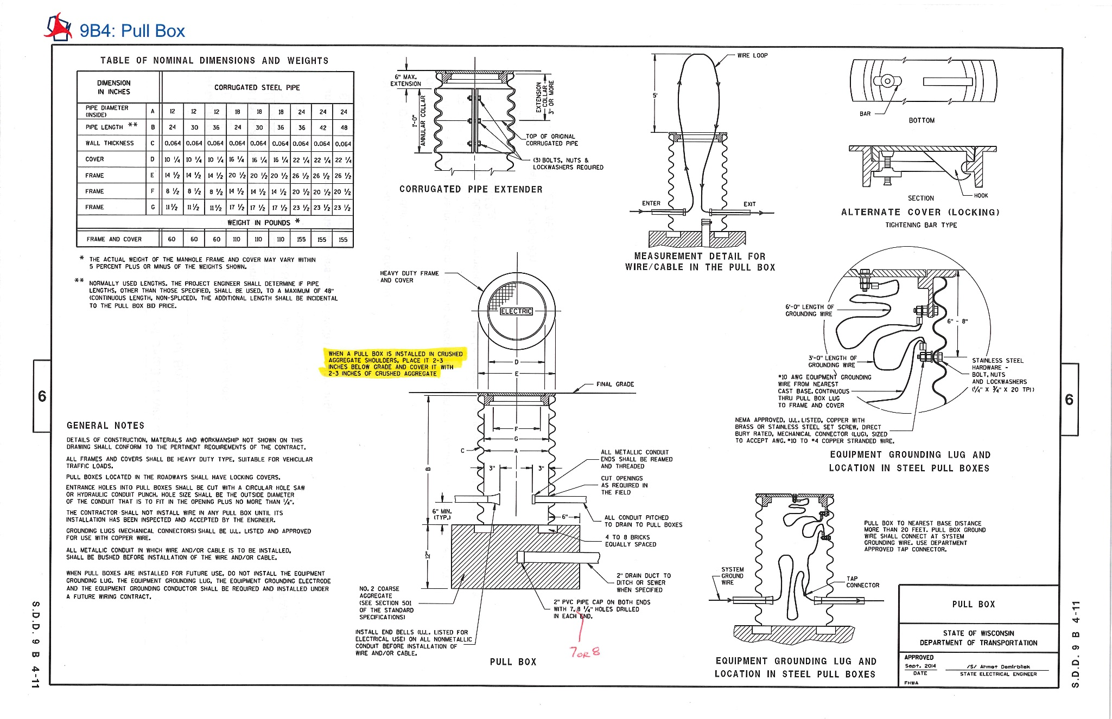

Slide 9
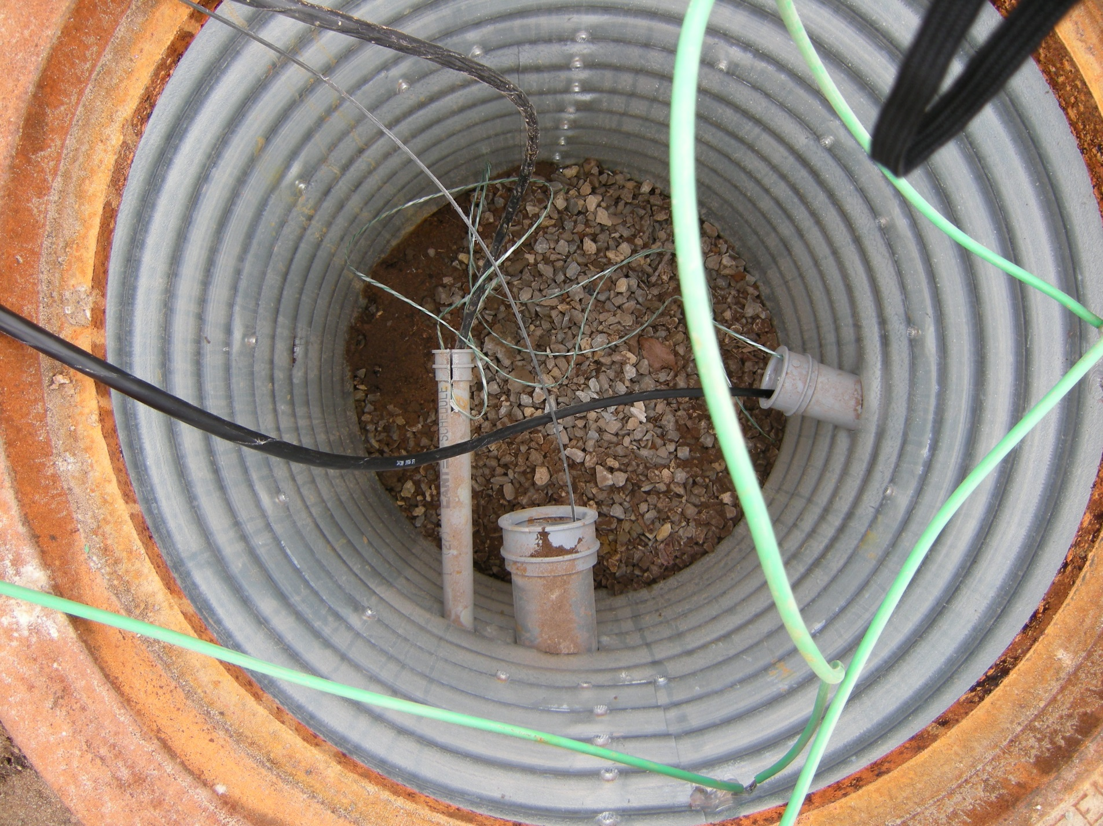

Slide 10
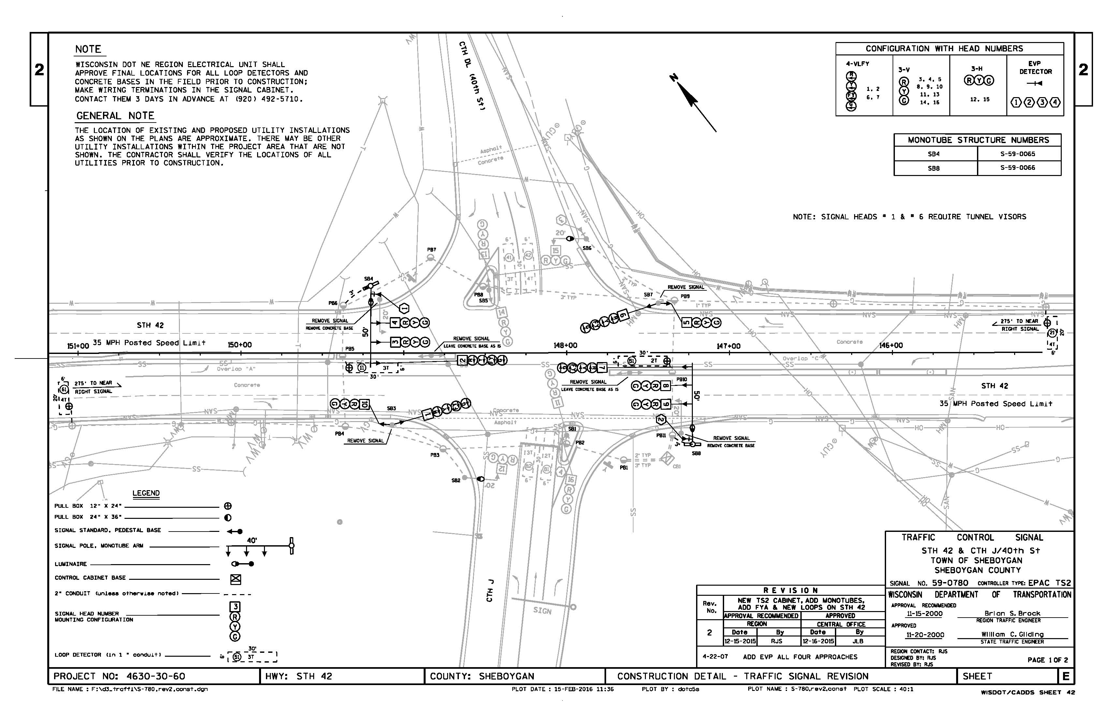

Slide 11
TRAFFIC SIGNAL CABLE
STH 42 & CTH J/40th St (S59-0780) | 655.0230 | 655.0240 | 655.0260 |  | 655.0230 | 655.0240 | 658.0215 | 658.0220
 |  |  |  |  | Base to Head | Base to Head | Backplates | Backplates
 | 5-14 | 7-14 | 12-14 | HEAD | 5-14 | 7-14 | Signal Face | Signal Face
 | AWG | AWG | AWG | NO. | AWG | AWG | 3 Section | 4 Section
 |  |  |  |  |  |  | 12-Inch | 12-Inch
From CB1 to | LF | LF | LF |  | LF | LF | EACH | EACH
SB1 |  |  | 120 | 11
 |  |  |  | 16
SB2 | 220 |  |  | 12
SB3 |  |  | 240 | 1 |  | 20 |  | 1
 |  |  |  | 10 | 20 |  | 1
SB4 |  |  | 390 | 2 |  | 80 |  | 1
 |  |  |  | 3 | 70 |  | 1
 |  |  |  | 4 | 60 |  | 1
SB5 |  |  | 290 | 13
 |  |  |  | 14
SB6 | 220 |  |  | 15
SB7 |  |  | 160 | 5 | 20 |  | 1
 |  |  |  | 6 |  | 20 |  | 1
SB8 |  |  | 50 | 7 |  | 80 |  | 1
 |  |  |  | 8 | 70 |  | 1
 |  |  |  | 9 | 60 |  | 1
Sub Total | 440 | 0 | 1,250 |  | 300 | 200 | 6 | 4
TOTALS | 740 | 200 | 1,250 |  |  |  | 6 | 4

Slide 12
TRAFFIC SIGNAL CABLE
STH 42 & CTH J/40th St (S59-0780) | 655.0230 | 655.0240 | 655.0260 |  | 655.0230 | 655.0240 | 658.0215 | 658.0220
 |  |  |  |  | Base to Head | Base to Head | Backplates | Backplates
 | 5-14 | 7-14 | 12-14 | HEAD | 5-14 | 7-14 | Signal Face | Signal Face
 | AWG | AWG | AWG | NO. | AWG | AWG | 3 Section | 4 Section
 |  |  |  |  |  |  | 12-Inch | 12-Inch
From CB1 to | LF | LF | LF |  | LF | LF | EACH | EACH
SB1 |  |  | 120 | 11
 |  |  |  | 16
SB2 | 220 |  |  | 12
SB3 |  |  | 240 | 1 |  | 20 |  | 1
 |  |  |  | 10 | 20 |  | 1
SB4 |  |  | 390 | 2 |  | 80 |  | 1
 |  |  |  | 3 | 70 |  | 1
 |  |  |  | 4 | 60 |  | 1
SB5 |  |  | 290 | 13
 |  |  |  | 14
SB6 | 220 |  |  | 15
SB7 |  |  | 160 | 5 | 20 |  | 1
 |  |  |  | 6 |  | 20 |  | 1
SB8 |  |  | 50 | 7 |  | 80 |  | 1
 |  |  |  | 8 | 70 |  | 1
 |  |  |  | 9 | 60 |  | 1
Sub Total | 440 | 0 | 1,250 |  | 300 | 200 | 6 | 4
TOTALS | 740 | 200 | 1,250 |  |  |  | 6 | 4

Slide 13
75’

Slide 16
+5’
+15’
+10’
+15’

Slide 17
+5’
+15’
+10’
+15’
75’+2(15’)+10’+5’= 120’

Slide 18
Circumference = 2$πr$
2x3x1’=6’
2 coils = 12’
2’ needed to get to side of PB
2’ needed to cross PB
Total = 16’
24” (2’)

Slide 19
Circumference = 2$πr$
2x3x1’=6’
2 coils = 12’
2’ needed to get to side of PB
2’ needed to cross PB
Total = 16’
24” (2’)

Slide 20
