Slide 1
Work Zone Traffic Control Presentation
2016 NE Construction Training
March 16th
Notes:
Before
Be well prepared with content. Know facts and figures and your audience.
Everyone should be able to read the slides but if NOT, read it to them. Otherwise don’t include it.
Do a final check on microphone and other equipment well before the start time.
Practice the presentation aloud several times. Feel comfortable.
Drink fluids and do something to relax you.
During presentation
Smile and be confident.
Introduce yourself and the organization.
Speak with energy, clearly, and in a reasonable volume so everyone can hear you.
Do not read each line on the slide show – use your own wording and add in examples or additional information which will aid in comprehension.
Talk “friendly” and with the attitude that you are here to provide information and assistance. Have a “win/win” attitude.
If you make an error, politely clarify or correct it. Move on quickly and don’t dwell on it.
If you can’t answer a question, politely indicate you don’t have the information available. Indicate that you will follow-up individually with the requestor.
After presentation
Be available for follow up.
Be prepared for additional comments, questions or clarifications.
Maintain composure.
If you make a promise, be sure to follow up quickly or reassign if appropriate.

Slide 2
Work Zone Topics
Signing Issues
Equipment Reminders
Construction Practices and Procedures
Lane Closure System Entries
Changes for 2017 Construction
Notes:
Overview should be specific such as listing the goals of the presentation and items to be covered. For example: “Explain Hwy 51 project alternatives.”
Use a verb followed by a brief phase or sentence.
Overview should include time for Q&A or indicate if you intend to take questions during the presentation or prefer that they wait until the end of the presentation.

Slide 3
Signing Issues
Traffic Control Covering Signs
Notes:
Overview should be specific such as listing the goals of the presentation and items to be covered. For example: “Explain Hwy 51 project alternatives.”
Use a verb followed by a brief phase or sentence.
Overview should include time for Q&A or indicate if you intend to take questions during the presentation or prefer that they wait until the end of the presentation.

Slide 4
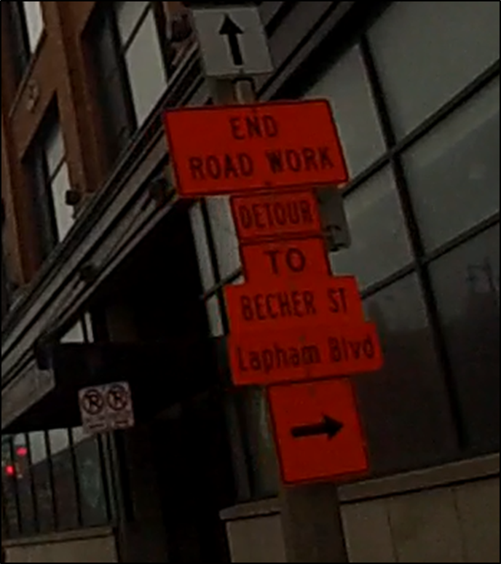
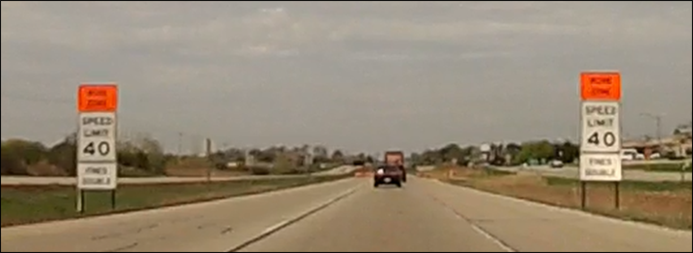
Signing Issues
Mounting Height and Clutter
Notes:
Overview should be specific such as listing the goals of the presentation and items to be covered. For example: “Explain Hwy 51 project alternatives.”
Use a verb followed by a brief phase or sentence.
Overview should include time for Q&A or indicate if you intend to take questions during the presentation or prefer that they wait until the end of the presentation.

Slide 5
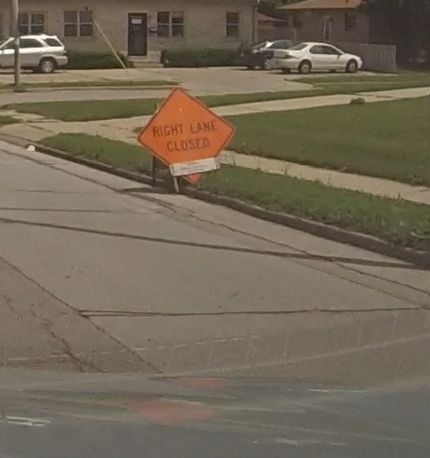
Signing Issues
Installation Issues
Notes:
Overview should be specific such as listing the goals of the presentation and items to be covered. For example: “Explain Hwy 51 project alternatives.”
Use a verb followed by a brief phase or sentence.
Overview should include time for Q&A or indicate if you intend to take questions during the presentation or prefer that they wait until the end of the presentation.

Slide 6
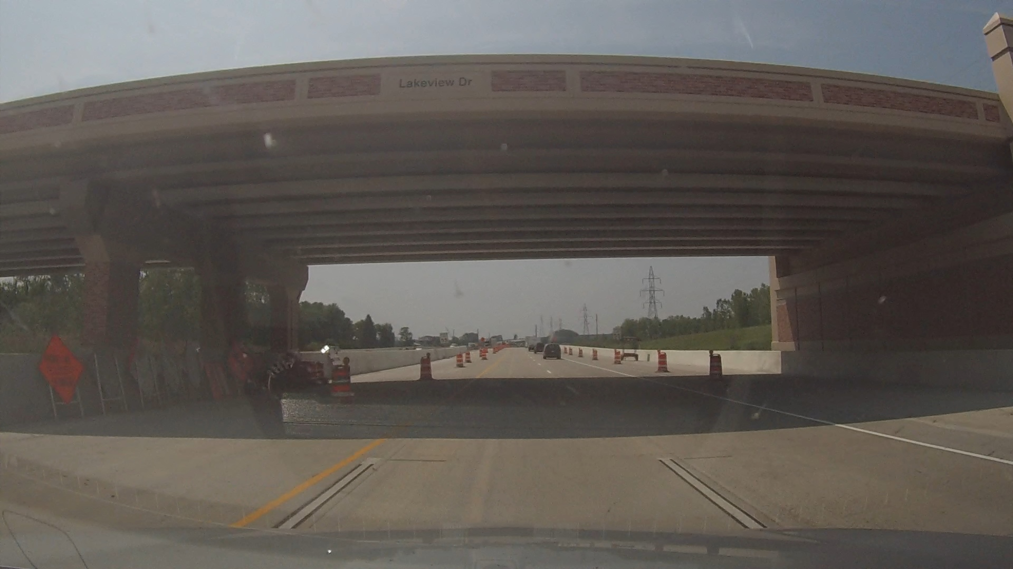
Signing Issues
Other Various Issues –Sign Storage
Notes:
Overview should be specific such as listing the goals of the presentation and items to be covered. For example: “Explain Hwy 51 project alternatives.”
Use a verb followed by a brief phase or sentence.
Overview should include time for Q&A or indicate if you intend to take questions during the presentation or prefer that they wait until the end of the presentation.

Slide 7
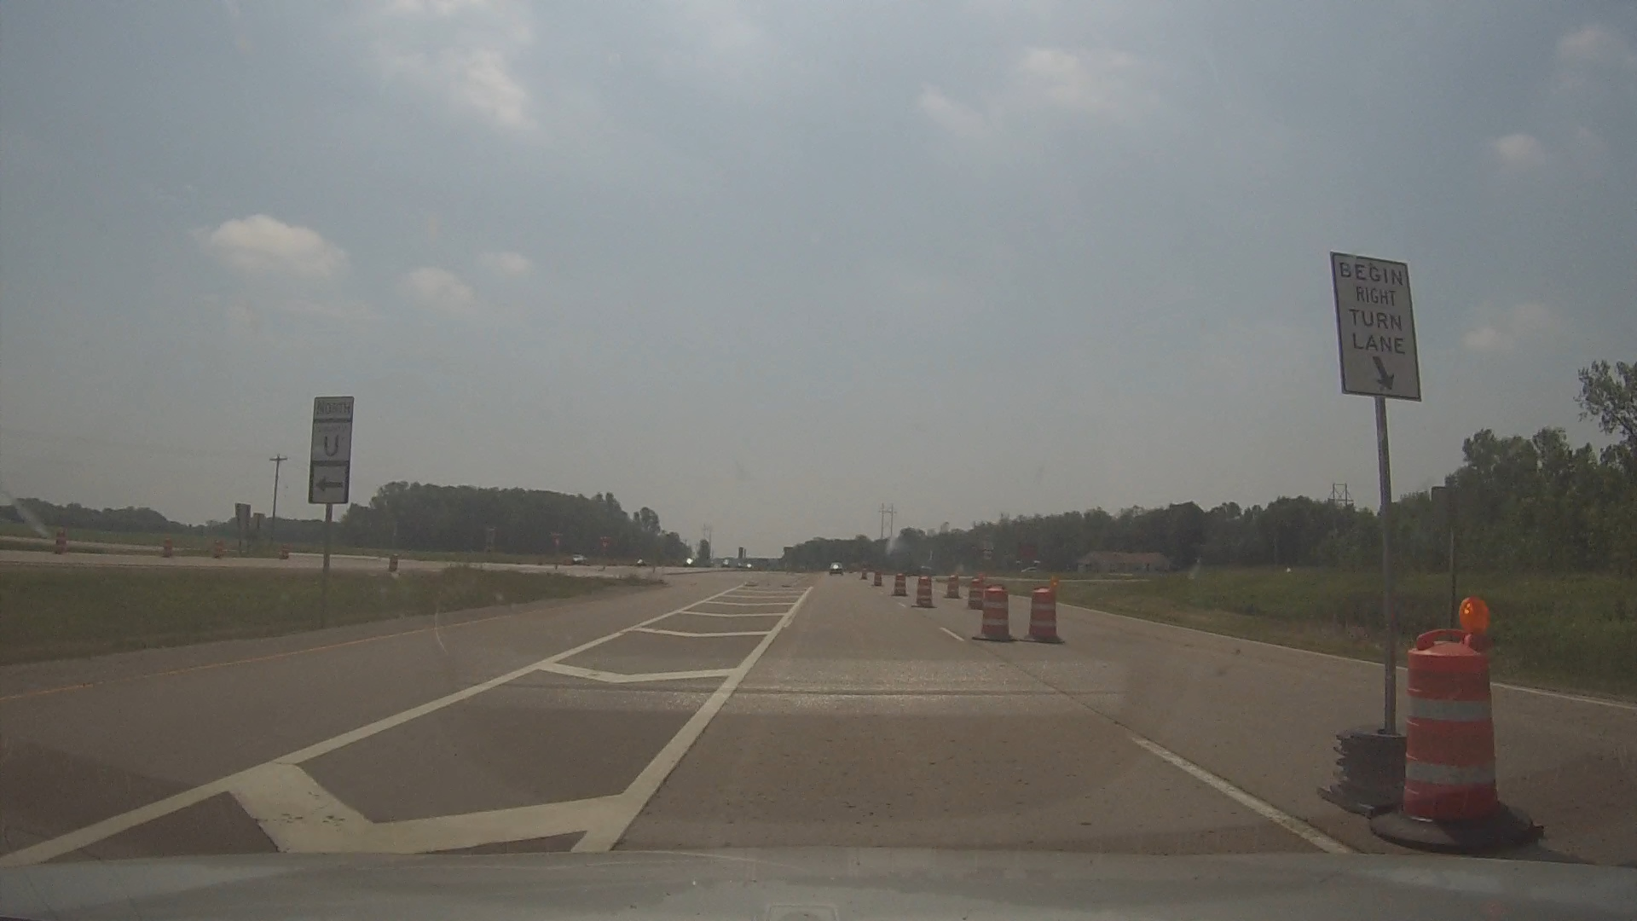
Signing Issues
Other Various Issues-Sign Stand Weights
Notes:
Overview should be specific such as listing the goals of the presentation and items to be covered. For example: “Explain Hwy 51 project alternatives.”
Use a verb followed by a brief phase or sentence.
Overview should include time for Q&A or indicate if you intend to take questions during the presentation or prefer that they wait until the end of the presentation.

Slide 8
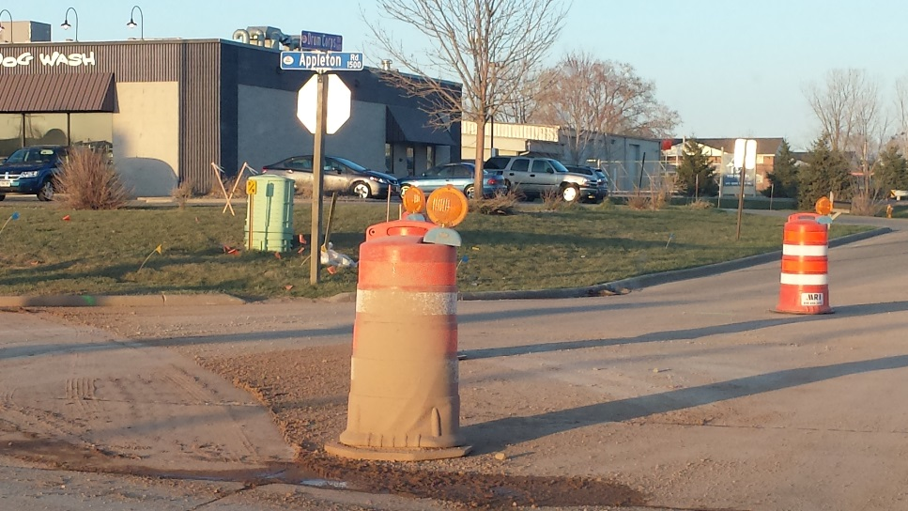
Equipment Reminders
Difference between Acceptable-Marginal-Unacceptable
Marginal
Unacceptable
Acceptable
Notes:
Overview should be specific such as listing the goals of the presentation and items to be covered. For example: “Explain Hwy 51 project alternatives.”
Use a verb followed by a brief phase or sentence.
Overview should include time for Q&A or indicate if you intend to take questions during the presentation or prefer that they wait until the end of the presentation.

Slide 9
Equipment Reminders
Use of Fluorescent Orange Sheeting
Must be used on all state highways starting in 2016 (both NHS and non-NHS routes)
Used on all Traffic Control devices
Barricades
Signs
Tubular Markers
Drums
High-intensity prismatic orange shall not be accepted and must be swapped out immediately
Notes:
Overview should be specific such as listing the goals of the presentation and items to be covered. For example: “Explain Hwy 51 project alternatives.”
Use a verb followed by a brief phase or sentence.
Overview should include time for Q&A or indicate if you intend to take questions during the presentation or prefer that they wait until the end of the presentation.

Slide 10
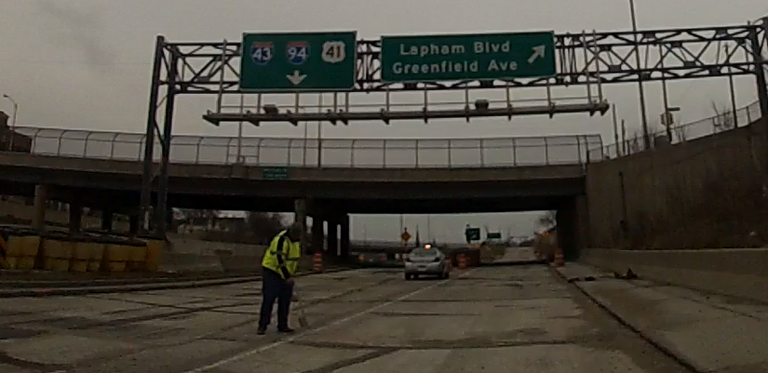
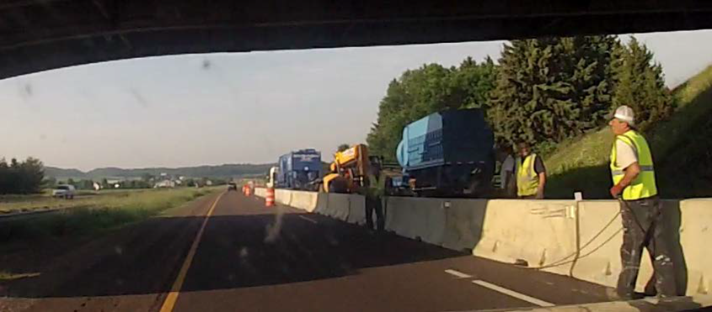
Construction Practices & Procedures
SAFETY First
Workers Within Live Lanes of Traffic
Notes:
Overview should be specific such as listing the goals of the presentation and items to be covered. For example: “Explain Hwy 51 project alternatives.”
Use a verb followed by a brief phase or sentence.
Overview should include time for Q&A or indicate if you intend to take questions during the presentation or prefer that they wait until the end of the presentation.

Slide 11
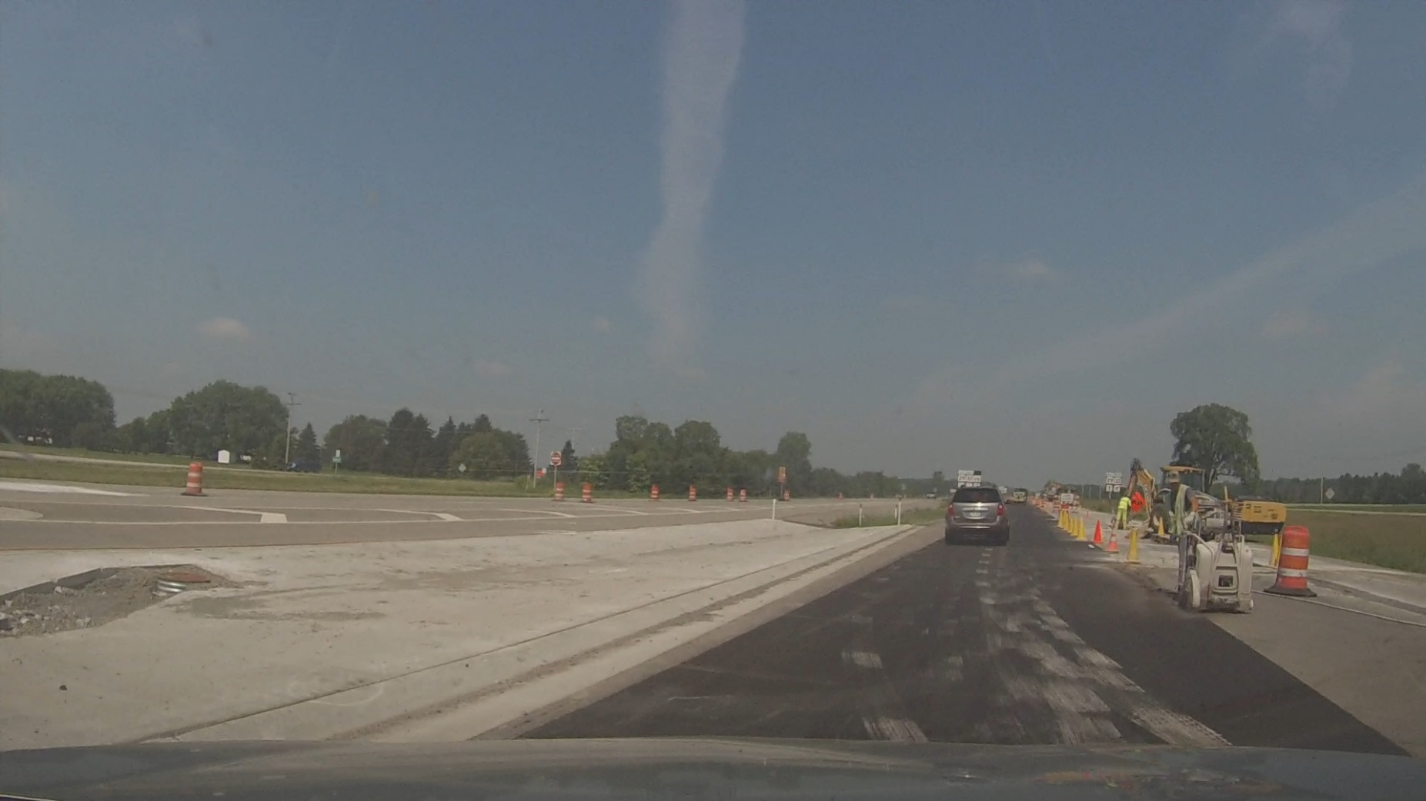
Construction Practices & Procedures
SAFETY First
Workers/Equipment Within Live Lanes of Traffic
Notes:
Overview should be specific such as listing the goals of the presentation and items to be covered. For example: “Explain Hwy 51 project alternatives.”
Use a verb followed by a brief phase or sentence.
Overview should include time for Q&A or indicate if you intend to take questions during the presentation or prefer that they wait until the end of the presentation.

Slide 12
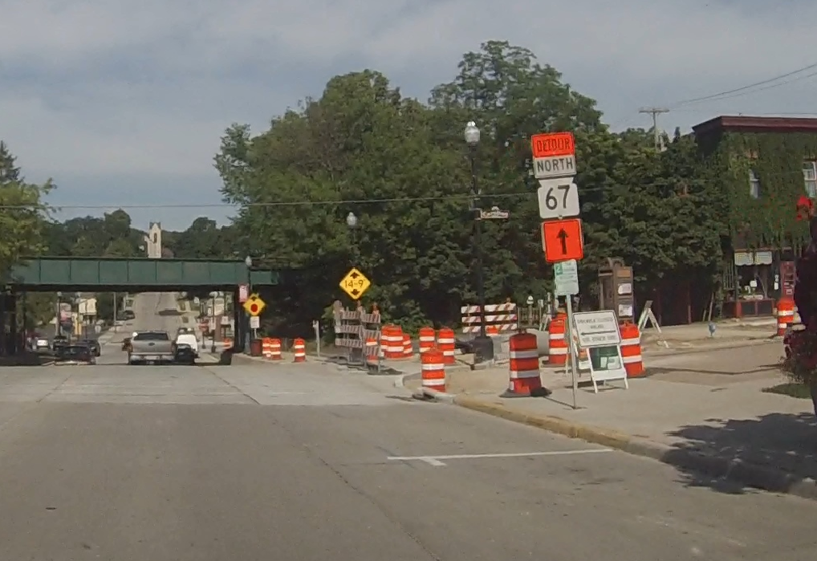
Construction Practices & Procedures
Pedestrian Accommodation Problems
Notes:
Overview should be specific such as listing the goals of the presentation and items to be covered. For example: “Explain Hwy 51 project alternatives.”
Use a verb followed by a brief phase or sentence.
Overview should include time for Q&A or indicate if you intend to take questions during the presentation or prefer that they wait until the end of the presentation.

Slide 13
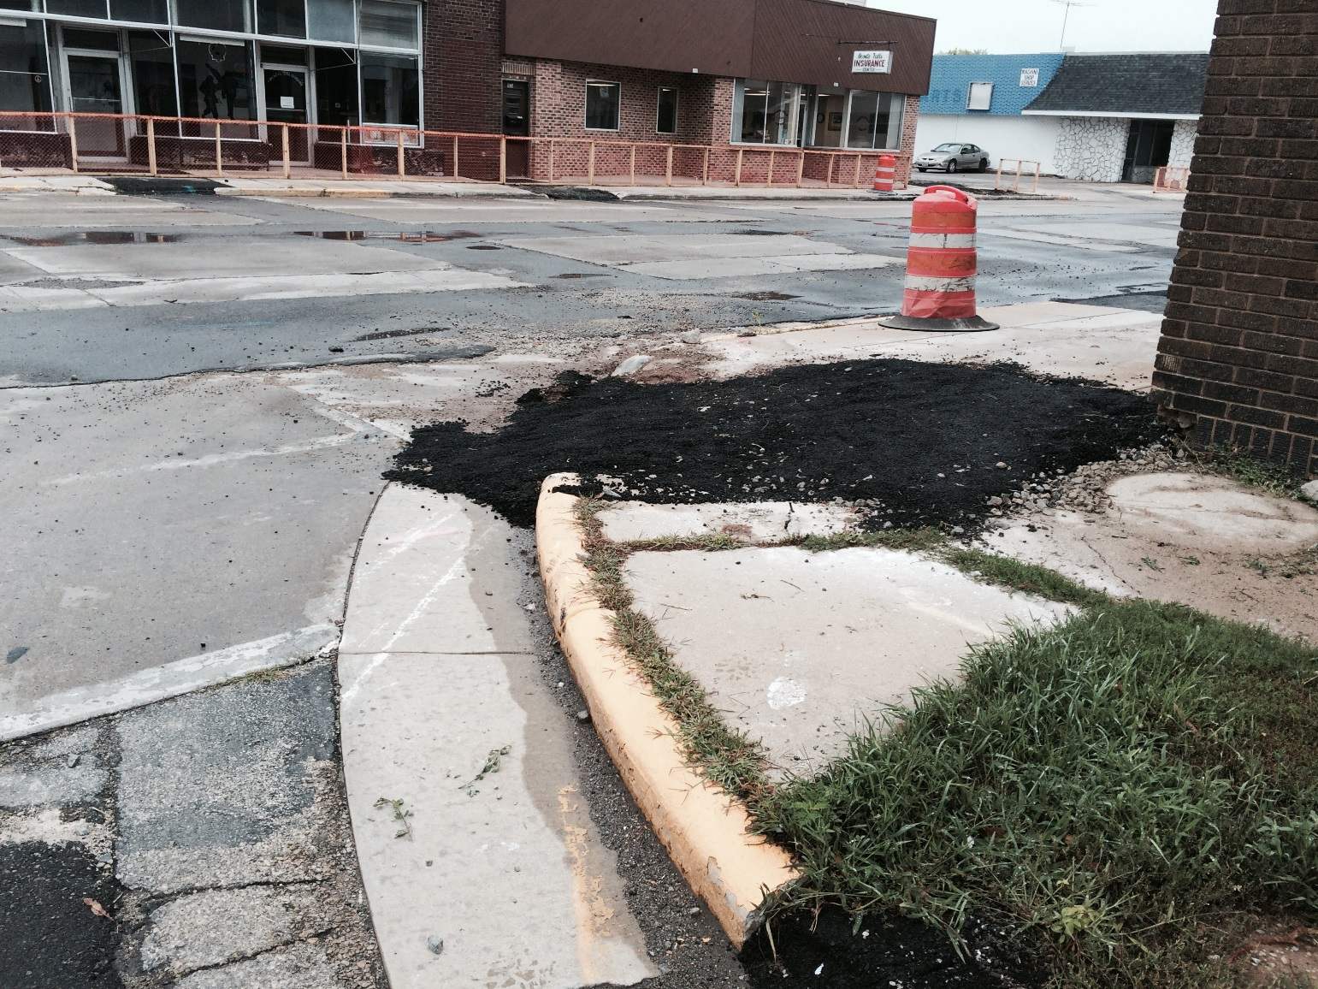
Construction Practices & Procedures
Pedestrian Accommodation Problems
Notes:
Overview should be specific such as listing the goals of the presentation and items to be covered. For example: “Explain Hwy 51 project alternatives.”
Use a verb followed by a brief phase or sentence.
Overview should include time for Q&A or indicate if you intend to take questions during the presentation or prefer that they wait until the end of the presentation.

Slide 14
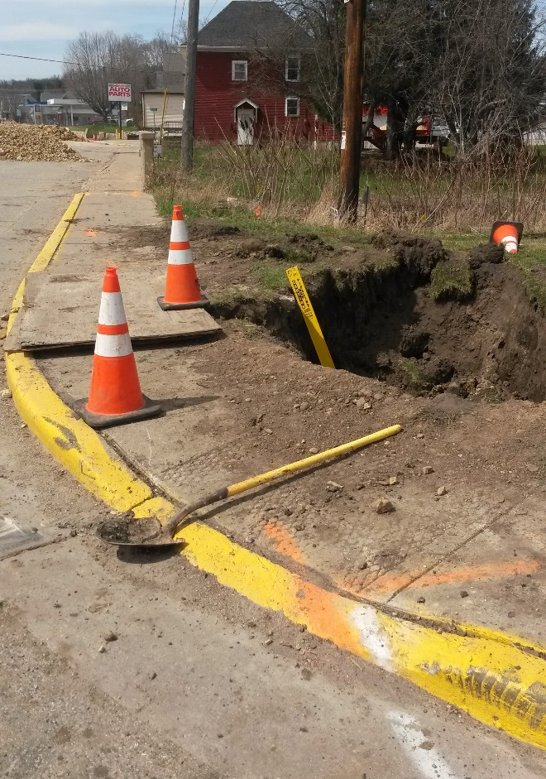
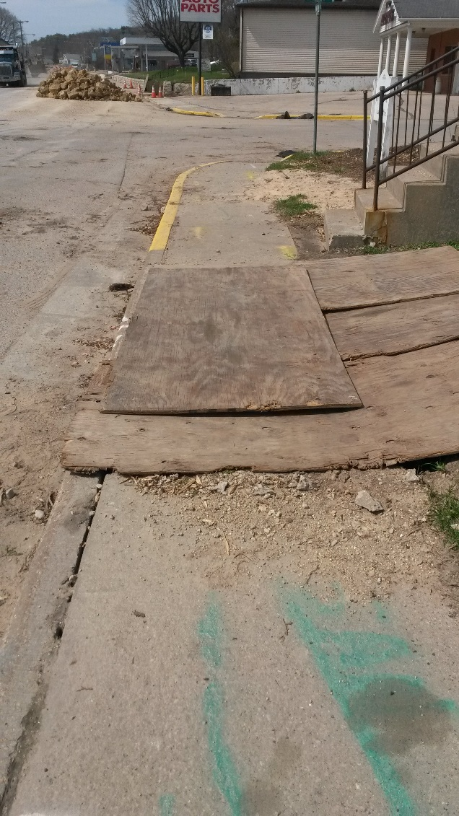
Construction Practices & Procedures
Pedestrian Accommodation Problems
Notes:
Overview should be specific such as listing the goals of the presentation and items to be covered. For example: “Explain Hwy 51 project alternatives.”
Use a verb followed by a brief phase or sentence.
Overview should include time for Q&A or indicate if you intend to take questions during the presentation or prefer that they wait until the end of the presentation.

Slide 15
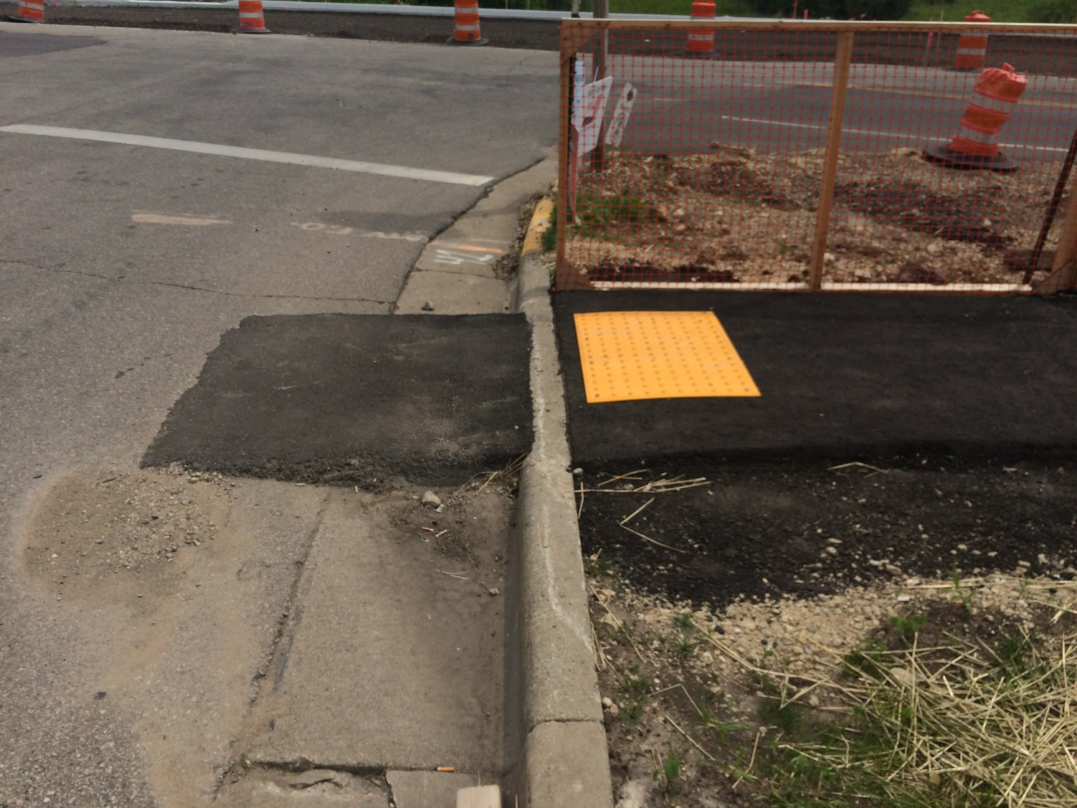
Construction Practices & Procedures
Good Pedestrian Accommodations Practices
Notes:
Overview should be specific such as listing the goals of the presentation and items to be covered. For example: “Explain Hwy 51 project alternatives.”
Use a verb followed by a brief phase or sentence.
Overview should include time for Q&A or indicate if you intend to take questions during the presentation or prefer that they wait until the end of the presentation.

Slide 16
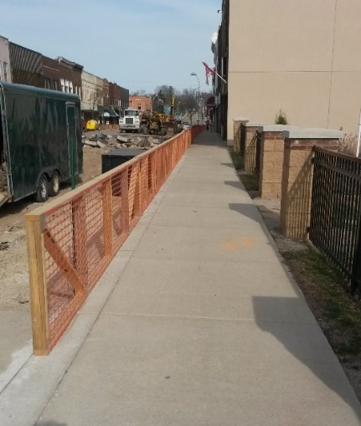
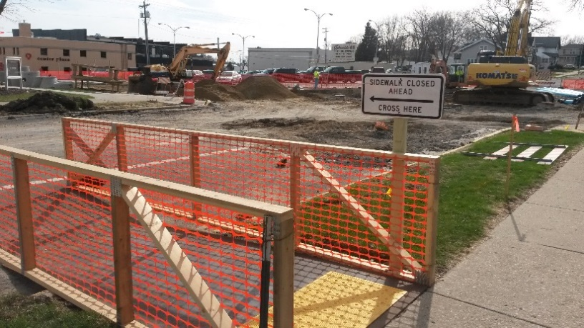
Construction Practices & Procedures
Good Pedestrian Accommodations Practices
Notes:
Overview should be specific such as listing the goals of the presentation and items to be covered. For example: “Explain Hwy 51 project alternatives.”
Use a verb followed by a brief phase or sentence.
Overview should include time for Q&A or indicate if you intend to take questions during the presentation or prefer that they wait until the end of the presentation.

Slide 17
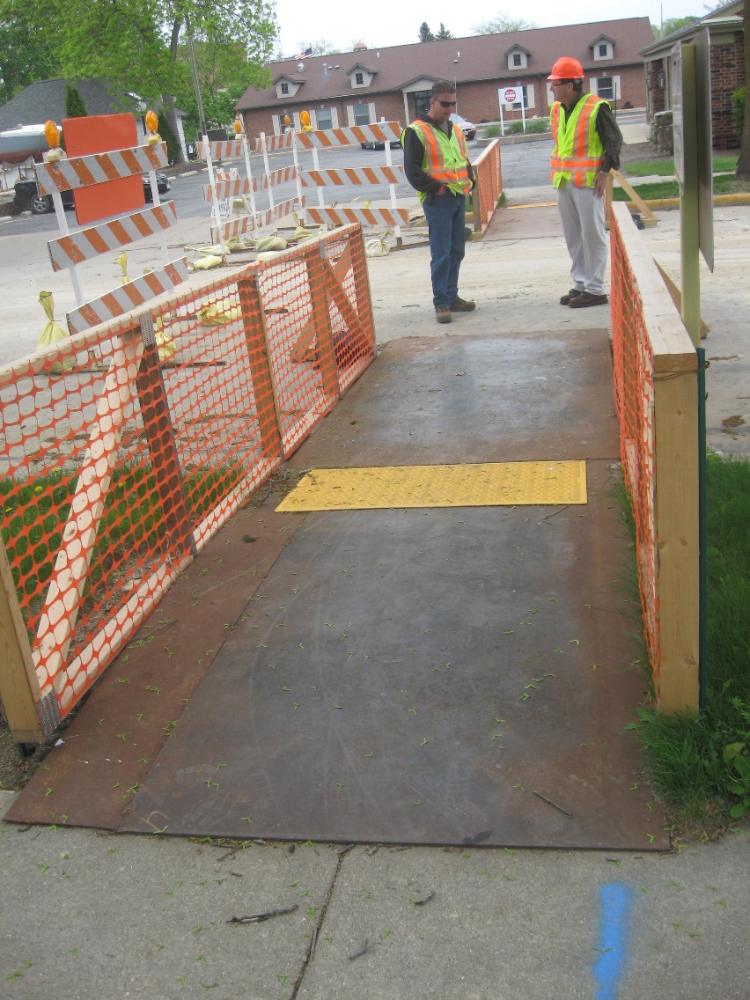
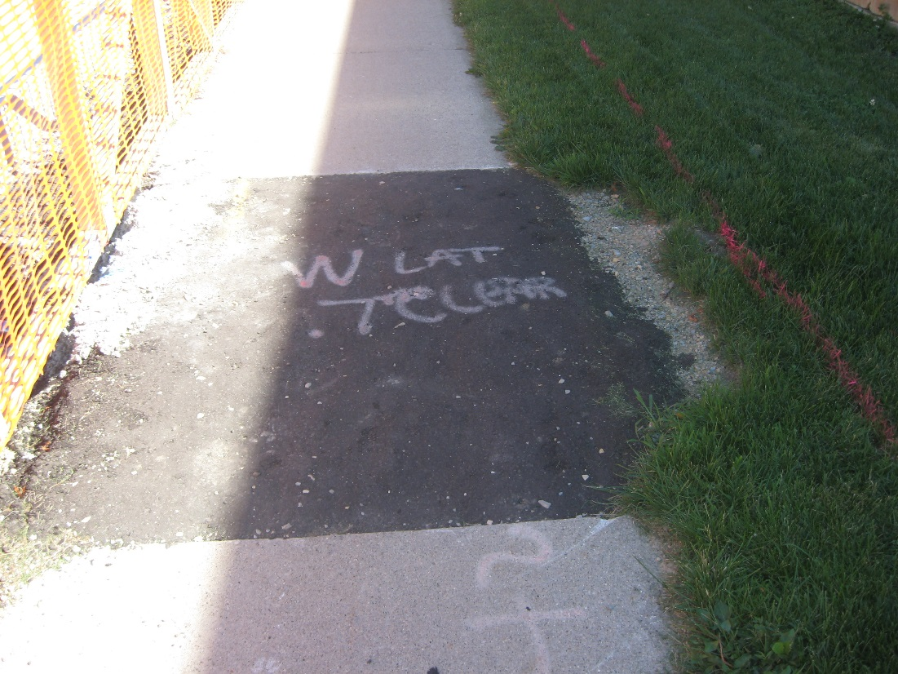
Construction Practices & Procedures
Good Pedestrian Accommodations Practices
Notes:
Overview should be specific such as listing the goals of the presentation and items to be covered. For example: “Explain Hwy 51 project alternatives.”
Use a verb followed by a brief phase or sentence.
Overview should include time for Q&A or indicate if you intend to take questions during the presentation or prefer that they wait until the end of the presentation.

Slide 18
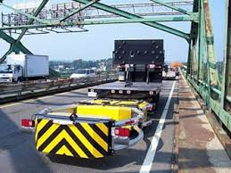
Construction Practices & Procedures
Truck Mounted Attenuator usage
Shouldn’t be used to protect hazards for an extended period of time (overnight period)
Has to be placed in 2nd gear and not parking gear/brake
Should be last resort, if temp crash cushion can’t be achieved for an overnight
Notes:
Overview should be specific such as listing the goals of the presentation and items to be covered. For example: “Explain Hwy 51 project alternatives.”
Use a verb followed by a brief phase or sentence.
Overview should include time for Q&A or indicate if you intend to take questions during the presentation or prefer that they wait until the end of the presentation.

Slide 19
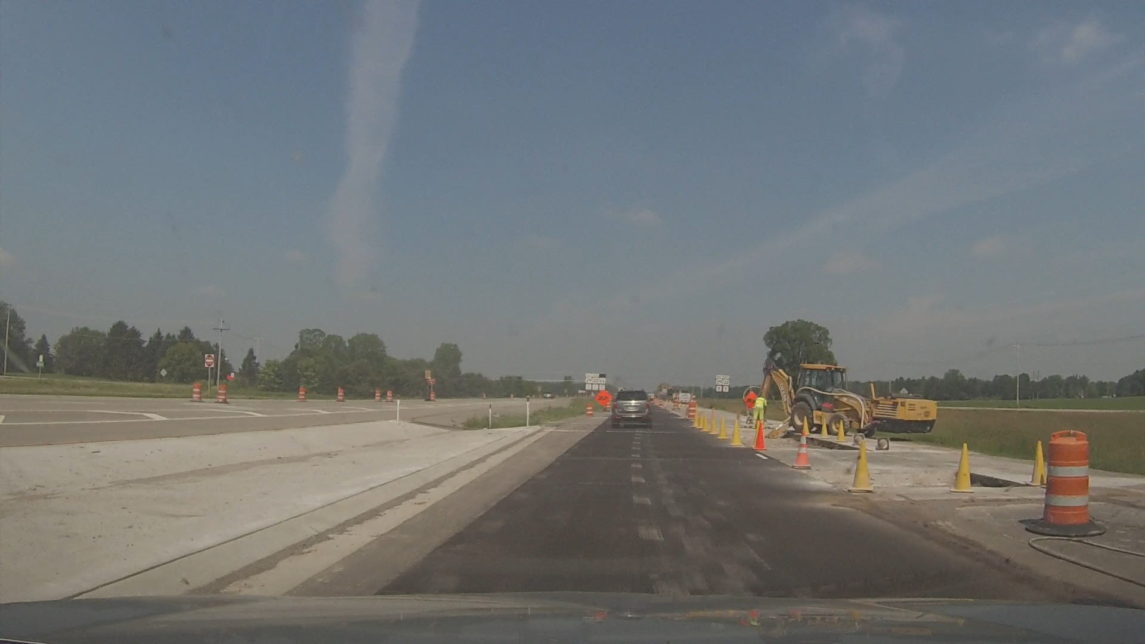
Construction Practices & Procedures
Use of Yellow Cones NOT allowed
Notes:
Overview should be specific such as listing the goals of the presentation and items to be covered. For example: “Explain Hwy 51 project alternatives.”
Use a verb followed by a brief phase or sentence.
Overview should include time for Q&A or indicate if you intend to take questions during the presentation or prefer that they wait until the end of the presentation.

Slide 20
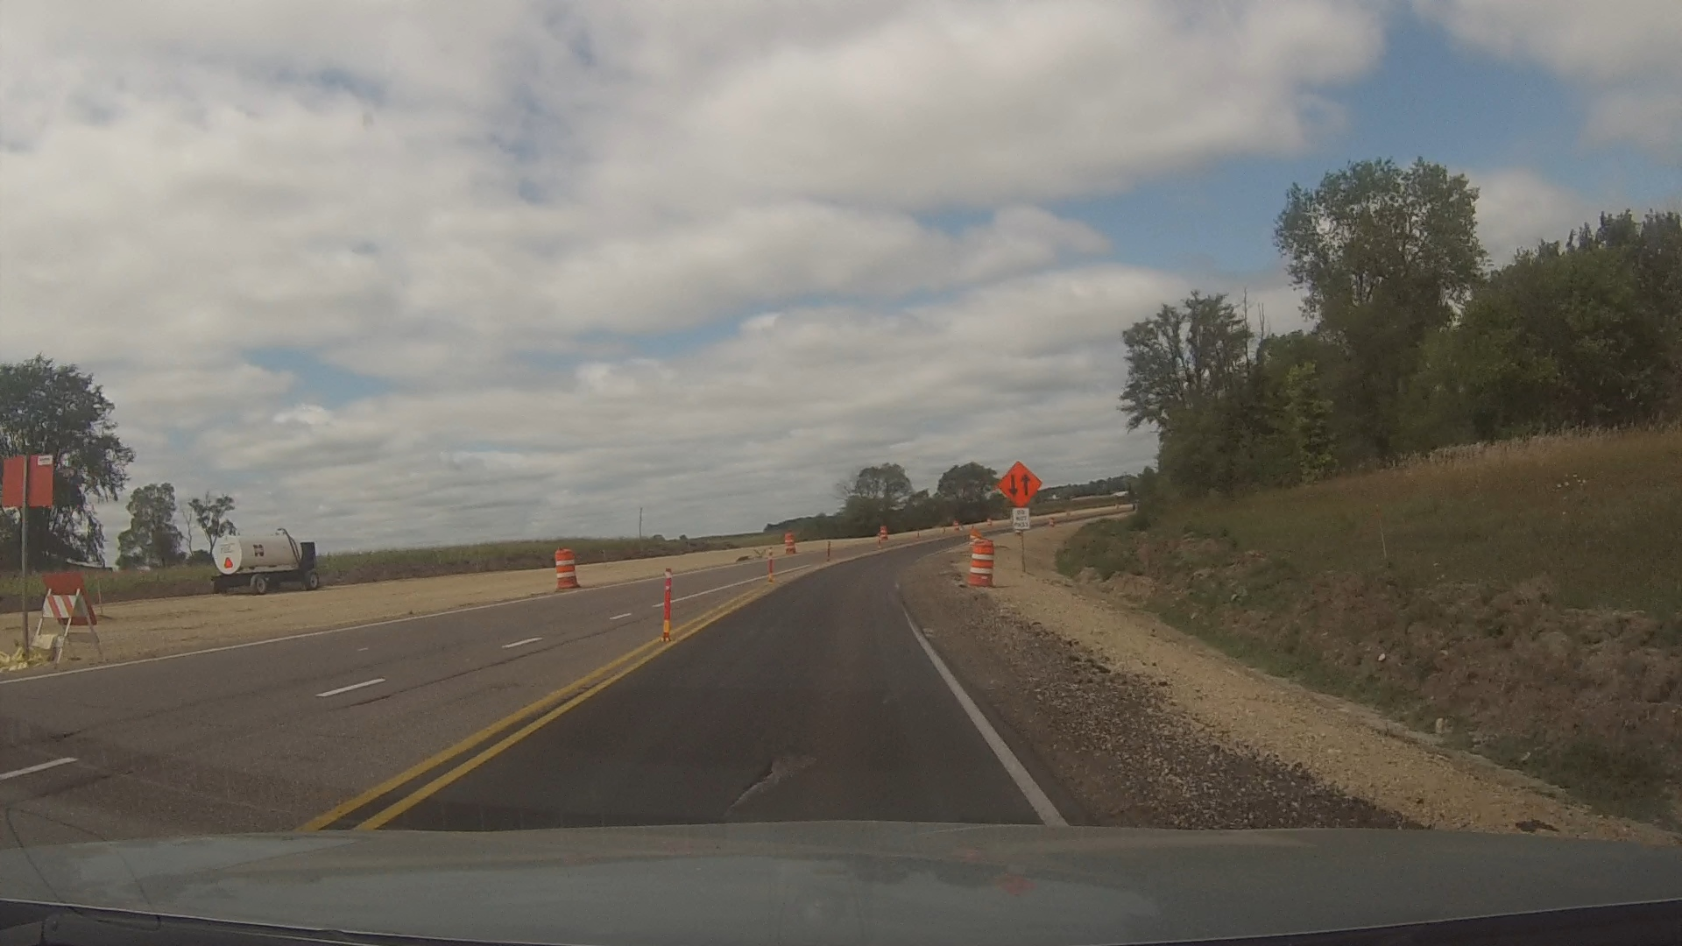
Construction Practices & Procedures
Make sure to pull back the shoulder after paving
Notes:
Overview should be specific such as listing the goals of the presentation and items to be covered. For example: “Explain Hwy 51 project alternatives.”
Use a verb followed by a brief phase or sentence.
Overview should include time for Q&A or indicate if you intend to take questions during the presentation or prefer that they wait until the end of the presentation.

Slide 21
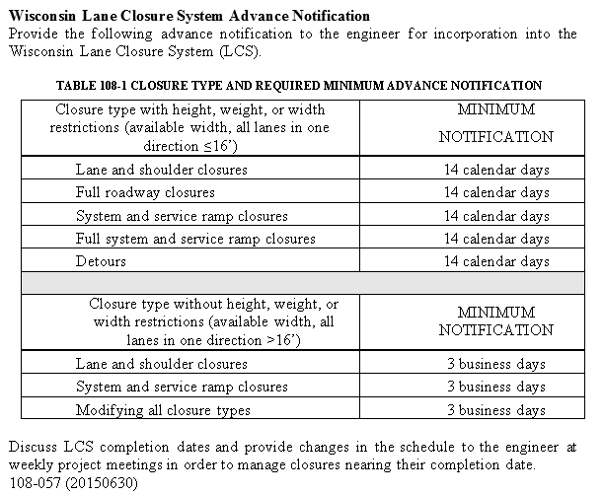
Lane Closure System Entries
Make sure to follow advanced notifications for entries
Notes:
Overview should be specific such as listing the goals of the presentation and items to be covered. For example: “Explain Hwy 51 project alternatives.”
Use a verb followed by a brief phase or sentence.
Overview should include time for Q&A or indicate if you intend to take questions during the presentation or prefer that they wait until the end of the presentation.

Slide 22
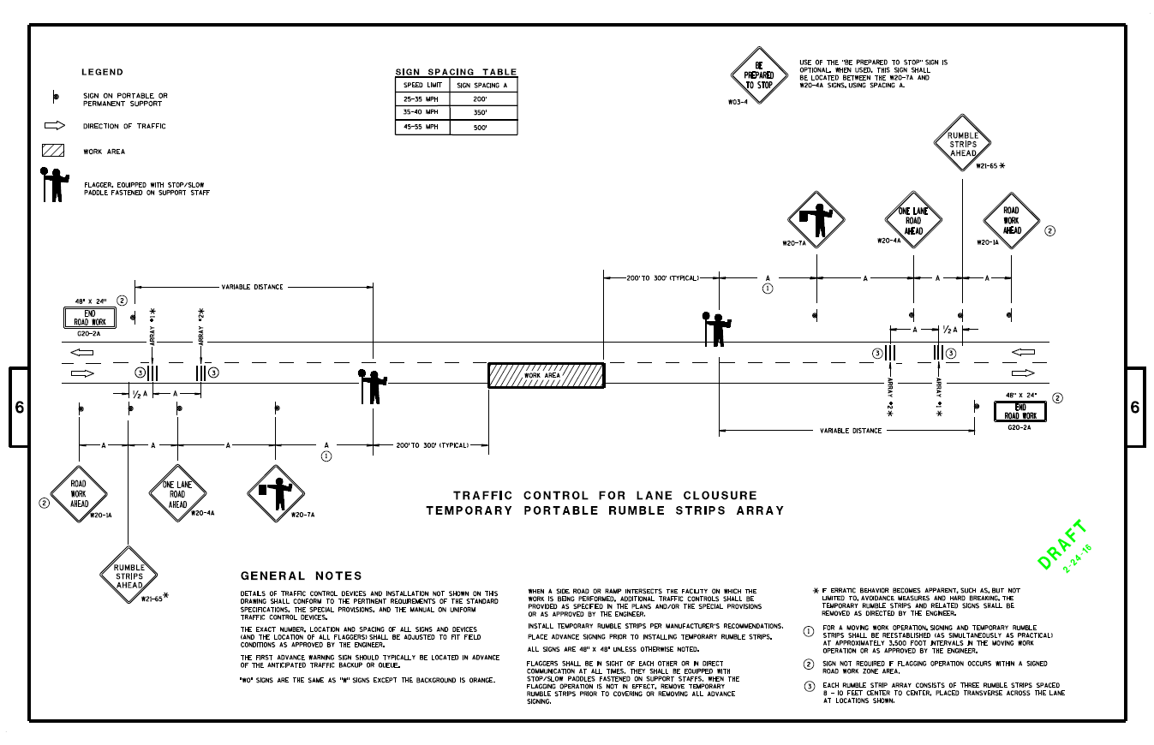
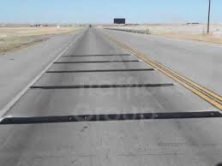
Changes for 2017 Construction
Fluorescent Orange Sheeting for all TC devices
Expanding usage of Temporary Portable Rumble Strips (NOW for both stationary and moving work operations)
Notes:
Overview should be specific such as listing the goals of the presentation and items to be covered. For example: “Explain Hwy 51 project alternatives.”
Use a verb followed by a brief phase or sentence.
Overview should include time for Q&A or indicate if you intend to take questions during the presentation or prefer that they wait until the end of the presentation.

Slide 23
Changes for 2017 Construction
FHWA acceptance letter and Federal-Aid Reimbursement Letter (for MASH criteria)
Needed only for barricades and roll-up/portable stands
NOT needed for drums, cones, delineators – Vendor self-certifies for being crashworthy
Letters are essentially the same
Most current version of letter is FHWA acceptance letter
IF they only have Reimbursement letter, that is acceptable
Must have at least one letter for submission ultimately
Notes:
Overview should be specific such as listing the goals of the presentation and items to be covered. For example: “Explain Hwy 51 project alternatives.”
Use a verb followed by a brief phase or sentence.
Overview should include time for Q&A or indicate if you intend to take questions during the presentation or prefer that they wait until the end of the presentation.

Slide 24
Need Assistance?
Joshua Falk
Traffic Control/Work Zone Engineer
920-492-7165
joshua.falk@dot.wi.gov
Notes:
List contact and resources to help get answers.
Refer to WisDOT project web site for detailed and ongoing information.
Include name and phone number/email for lead staff.
Take Q&A if time allows.
End the presentation on a positive note. Thank the audience for their time and attention.

Slide 25
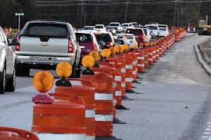
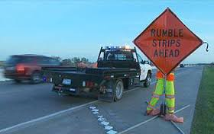
Questions?
Notes:
List contact and resources to help get answers.
Refer to WisDOT project web site for detailed and ongoing information.
Include name and phone number/email for lead staff.
Take Q&A if time allows.
End the presentation on a positive note. Thank the audience for their time and attention.

