Slide 1
WisDOT NE Region 2016 Construction Training
Ruth Coisman, P.E. – Bureau of Structures
March 16, 2016

Slide 2
Structures Agenda
Contacting BOS – When & Why
Specifications and Manual Updates
Structures Construction Issues
Ancillary (Wind Loaded) Structures
Fabrication & Materials Issues

Slide 3
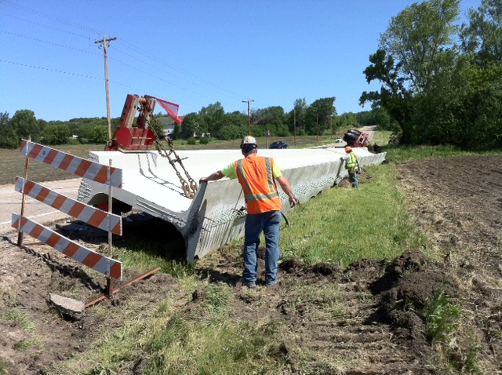
Contacting BOS – When & Why
Anything “structural”
excessive construction loads
structural capacity
pile locations, etc.
If in doubt, call us!
See Structures Contacts Handout
Bureau of Structures Contacts-General.doc
Notes:
If there is one thing that I would like for you to take away from my presentation here today, I hope that you know that BOS is able, available, and willing to answer any questions that you may have during the construction of your projects.
Any item that you may think involves structural aspects that you are not 100% comfortable answering, please don’t hesitate to contact us.
I have attached a contact list to this presentation for a reference on who to contact and for what situations.
One other reminder– is to push for contractor staff to work through the Region or Consultant construction staff for inquiries. Historically, the contractors have come directly through BOS and we have asked that they go back through project staff.

Slide 4
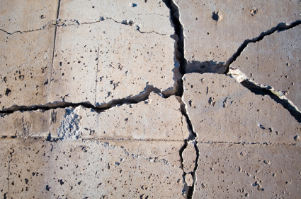
Std Spec Updates - Structures
502.2.11 Crack and Surface Sealers
Clarifies materials for crack, deck, and parapet sealing (from the approved products list)
502.3.9.2 Mixing
Lowers allowable concrete temperature to 50 degrees during placement (used to be 55)
Notes:
Section 502 Concrete Bridges
502.2.11 Crack and Surface Sealers
(1) Furnish crack and surface sealers from the department's approved products list as follows:
- Crack sealer: Low Viscosity Crack Sealers for Bridge Decks list.
- Protective surface treatment: Concrete Protective Surface Treatment list.
Pigmented surface sealer: Cure and Seal Compound for Non-trafficked Surfaces for Structural Masonry list.
502.3.9.2 Mixing
(2) During concrete placement, ensure the mixed concrete temperature is not less than 50 F or more than 80 F, unless otherwise directed.

Slide 5
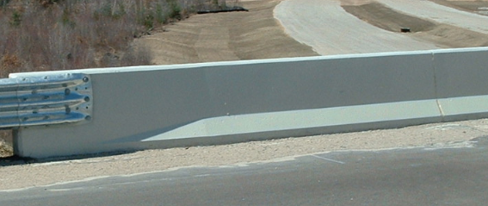
Std Spec Updates - Structures
502.3.13.3 Pigmented Surface Sealer
Clarifies construction requirements for sealing parapets
502.5.1 General
New Pigmented Surface Sealer bid item for use on the inside face and top of parapets
Notes:
Section 502 Concrete Bridges
502.3.13.3 Pigmented Surface Sealer
(1) Apply pigmented surface sealer conforming to 502.2.11 to the inside and top faces of parapets, including parapets on abutment wings. Use gray sealer unless the contract specifies a different color. Do not seal surfaces where the contract requires staining or other treatment.
(2) Clean and dry surfaces before sealing. Immediately before sealing, direct an air blast over the surface to remove all dust and any loose particles. Ensure that application equipment is clean inside before filling and that the equipment is functioning properly.
(3) Seal after providing the required surface finish under 502.3.7. Conform to sealer manufacturer recommended application procedures and coverage rate. If application in a single coat causes running, use two lighter coats allowed to dry between coats.
(4) Complete sealing before opening to traffic and before suspending work for the winter.
502.5 Payment
502.5.1 General
502.3210 Pigmented Surface Sealer SY

Slide 6
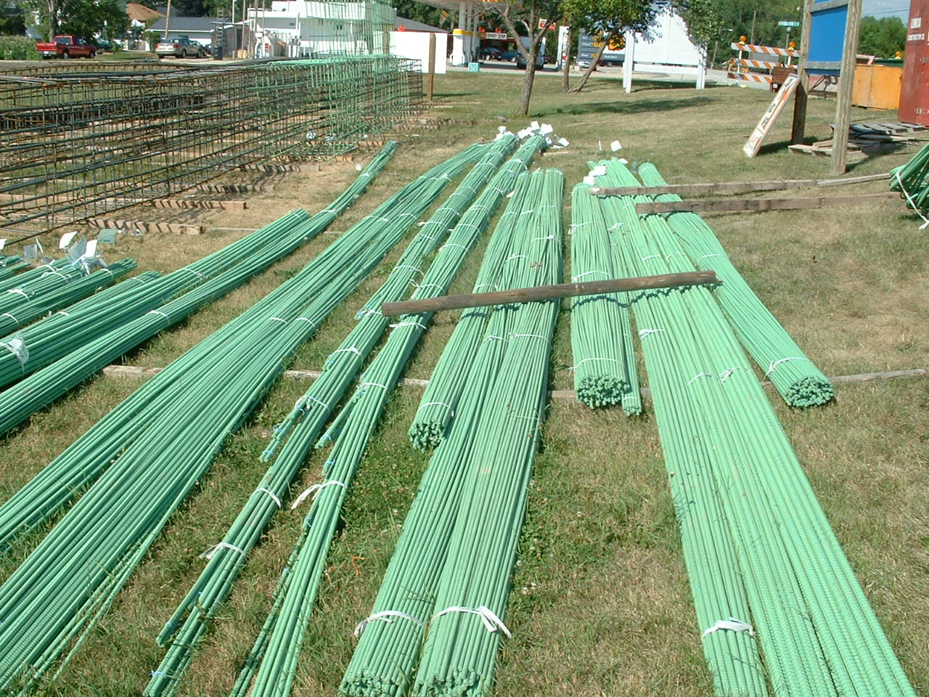
Std Spec Updates - Structures
505.5 Payment (Steel Reinforcement)
Eliminates separate bid items for bridges, culverts, and retaining walls
3 new bid items:
Bar Steel Reinforcement Structures
Bar Steel Reinforcement HS Structures
Bar Steel Reinforcement HS Coated Structures
Notes:
Section 505 Steel Reinforcement
505.5 Payment
505.0100 Bar Steel Reinforcement Structures LB
505.0400 Bar Steel Reinforcement HS Structures LB
505.0600 Bar Steel Reinforcement HS Coated Structures LB

Slide 7
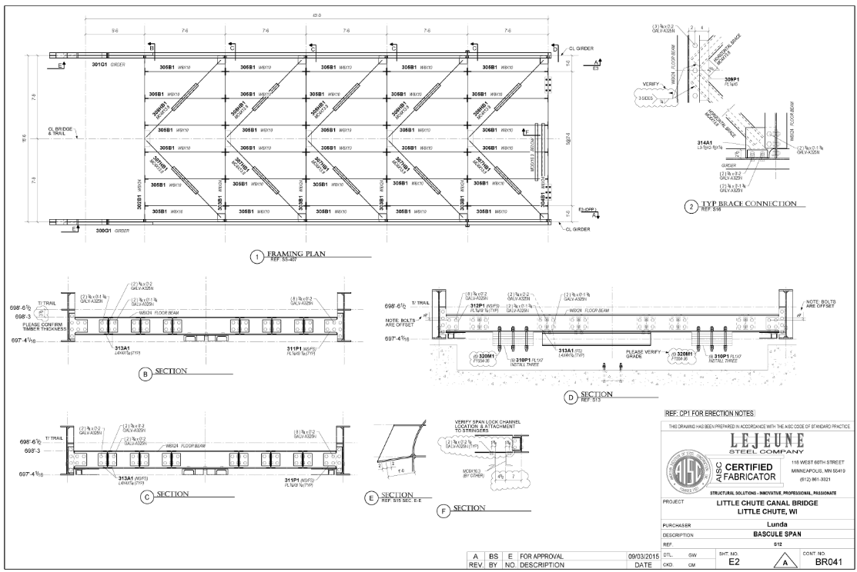
Std Spec Updates - Structures
506.3.2 Shop Drawings
Requires electronic shop drawing submittal, and form DT2333 for primary steel drawings (previously implemented in ASP 6)
Notes:
Section 506 Steel Bridges
506.3.2 Shop Drawings
(1) Ensure that shop drawings conform to the contract plans and provide additional details, dimensions, computations, and other information necessary for completely fabricating and erecting the work. Include project and structure numbers on each shop drawing sheet.
(2) Check shop drawings and submit electronically to the department before beginning fabrication. For primary fabrication items, also certify that shop drawings conform to quality control standards by submitting department form DT2333. Department review does not relieve the contractor from responsibility for errors or omissions on shop drawings.
(3) Shop drawings are part of the contract. The department must approve differences between shop drawings and contract plans. The contractor bears the costs of department-approved substitutions. Do not deviate from or revise drawings without notifying the department and resubmitting revised drawings.
(4) Ensure that the fabricator delivers 3 sets of shop drawings for railroad structures to the railroad company upon contract completion.

Slide 8
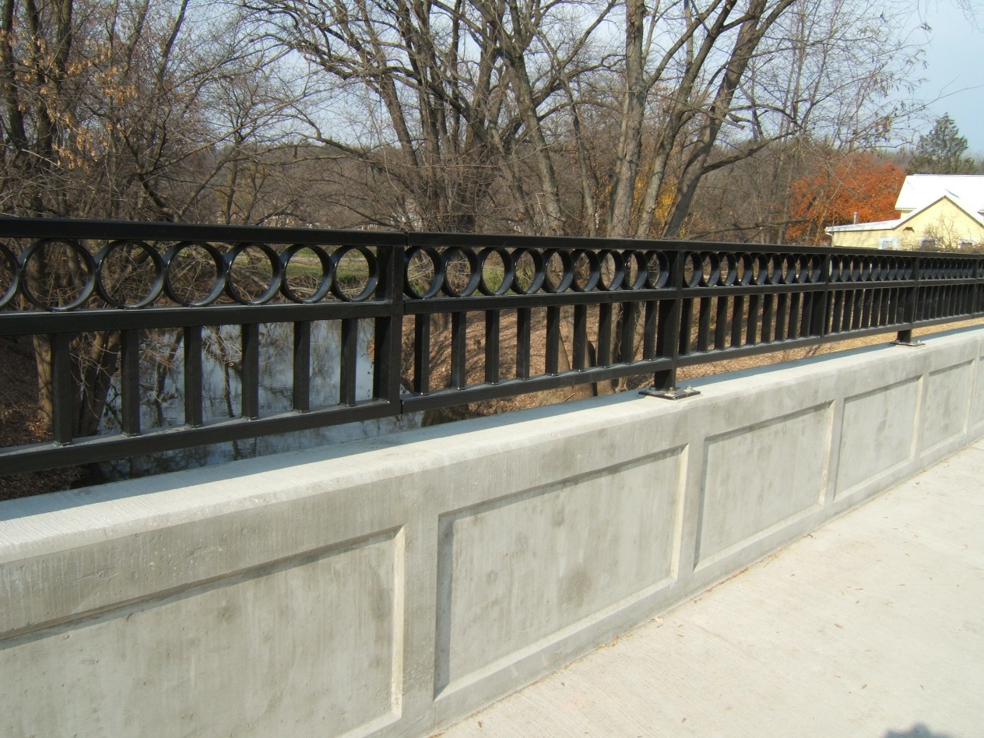
Std Spec Updates - Structures
513.4 Measurement & 513.5 Payment (Railing)
All railing bid items now measured by linear foot
Notes:
Section 513 Railing
513.4 Measurement
The department will measure the Railing Pipe, Railing Tubular, Railing Steel, and Railing Steel Pedestrian bid items by the linear foot acceptably completed.
513.5 Payment
513.2001 Railing Pipe (structure) LF
513.4000 - 4099 Railing Tubular (type) (structure) LF
513.7000 - 7099 Railing Steel (type) (structure) LF
513.8000 - 8099 Railing Steel Pedestrian (type) (structure) LF

Slide 9
ASP 6 Updates - Structures
550.5.2 Piling
Adjust pay under the Piling Quantity Variation administrative item if total driven length of each size is less than 85 percent of, or more than 115 percent of the contract quantity
Percent of Contract
Length Driven Pay Adjustment
< 85 (85% contract length - driven length) x 20% unit price
> 115 (driven length - 115% contract length) x 5% unit price
Notes:
Section 550 Driven Piles
550.5 Payment
550.5.2 Piling
Add the following as paragraph three effective with the December 2015 letting:
(3) The department will not entertain a change order request for a differing site condition under 104.2.2.2 or for a quantity change under 104.2.2.4.3 for the Piling bid items. Instead the department will adjust pay under the Piling Quantity Variation administrative item if the total driven length of each size is less than 85 percent of, or more than 115 percent of the contract quantity as follows:
Percent of Contract Length Driven Pay Adjustment
< 85 ( 85% contract length - driven length ) x 20% unit price
> 115 (driven length - 115% contract length) x 5% unit price

Slide 10
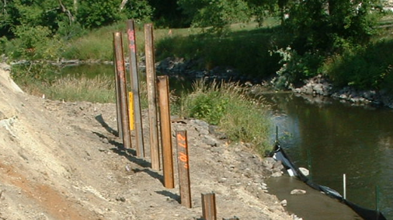
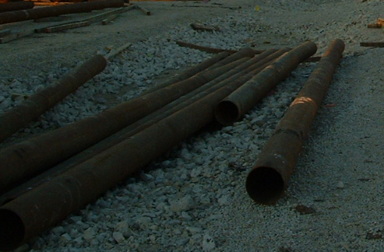
ASP 6 Updates - Structures
Piling
Consider change in pile type if piling drives considerably longer than plan length
Work with designer and Geotech engineer
Notes:
Keep in mind that it may not be as simple as “swapping out” one pile type for another. Number of piles, footing dimensions, etc. may need to be revised.

Slide 11
ASP 6 Updates - Structures
641.2.9 Overhead Sign Supports
Details for contractor to provide commercially fabricated overhead sign supports conforming to AASHTO design and fabrication standards
Design criteria
Notes:
641.2.9 Overhead Sign Supports
Correct errata adding back accidentally deleted paragraphs one through three.
(1) Provide commercially fabricated overhead sign supports conforming to AASHTO design and fabrication standards for structural supports for highway signs, luminaires, and traffic signals. Use a design life of 50 years with a wind importance factor of 1.00. Design to withstand a 3 second gust wind speed of 90 mph. Do not use the methods of appendix C of those AASHTO standards.
(2) Design structures, listed as applicable structure types in the AASHTO standards, to the fatigue category criteria as follows:
1. Structures carrying variable message signs:
- Category I criteria for structures over all roadway types.
2. Structures carrying type II or III signs:
- Category I criteria for structures used over highways and free flow ramps.
- Category II criteria for structures with arms greater than 30 feet used over local roads and city streets.
- Category III criteria for structures with arms 30 feet or less used over local roads and city streets.
(3) Use the posted speed limit of the roadway beneath the structure for truck-induced gusts.
(4) Submit shop drawings identified by structure number, design computations, and material specifications, to the engineer before erecting sign supports. Provide tightening procedures for mast arm or luminaire arm to pole shaft connections on the shop drawings. Have a professional engineer registered in the state of Wisconsin sign, seal, and date the shop drawings and certify that the design conforms to AASHTO standards and the contract.
(5) Provide steel pole shafts and mast arms zinc coated according to ASTM A123. Provide tapered pole and arm shafts with a minimum taper of 0.14 inch per foot for single-member vertical and single-member horizontal structure components. Provide bolts and other hardware conforming to 641.2.2.

Slide 12
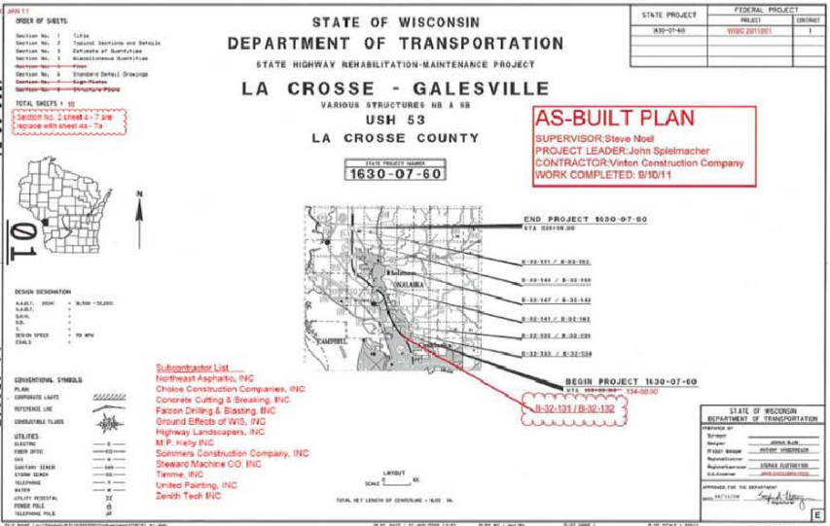
CMM Updates - Structures
CMM 1-65.14 As-Built Plans
Reminders
Work on as-built plan as job is progressing
Upon completion, Project Leader submits electronic as-built
Follow region process when submitting electronic as-built
New
Separate structure sheets by project ID and structure ID
Save into separate PDF:1234-56-78AsBuiltStructureX-YY-ZZZ
Where 1234-56-78 is project ID and X-YY-ZZZ is structure ID

Slide 13
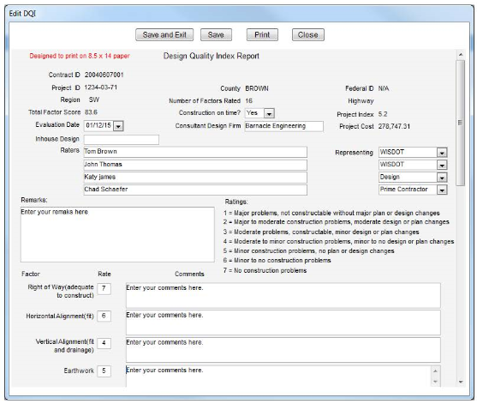
CMM Updates - Structures
CMM 1-70.3.1 Design Quality Index (DQI)
Describes constructability of design plans
Filled out by project leader, prime contractor and designer (if possible) at or near completion of project
Evaluates 16 elements of design plans
1 element is structures with 5 items:
Plans accurate and complete
Soils information and foundation details
Utility information accurate and complete
Special provisions clear and concise
Ease of assembly and construction

Slide 14
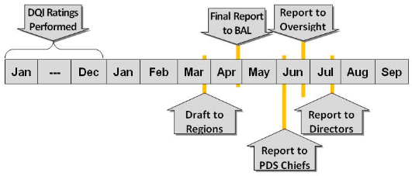
CMM Updates - Structures
CMM 1-70.3.1 Design Quality Index (DQI)
Rating: 1 to 7
1= Major problems, not constructable without major plan or design changes
7= No construction problems
For structure items
Rate 1 to 7 only if a structure is in the project (Section 8 of plans)
If no structure, leave blank; do not enter “0”

Slide 15
CMM Updates - Structures
CMM 4-10.4 (Concrete Pavement) & 4-50.4 (Asphalt Pavement): Measurement of Clearances before Opening Roadway to Traffic
When pavement construction occurs beneath an existing bridge, measure horizontal and minimum vertical clearance.
Send measurements to Structures Development Section (BOS), and regional bridge maintenance engineer

Slide 16
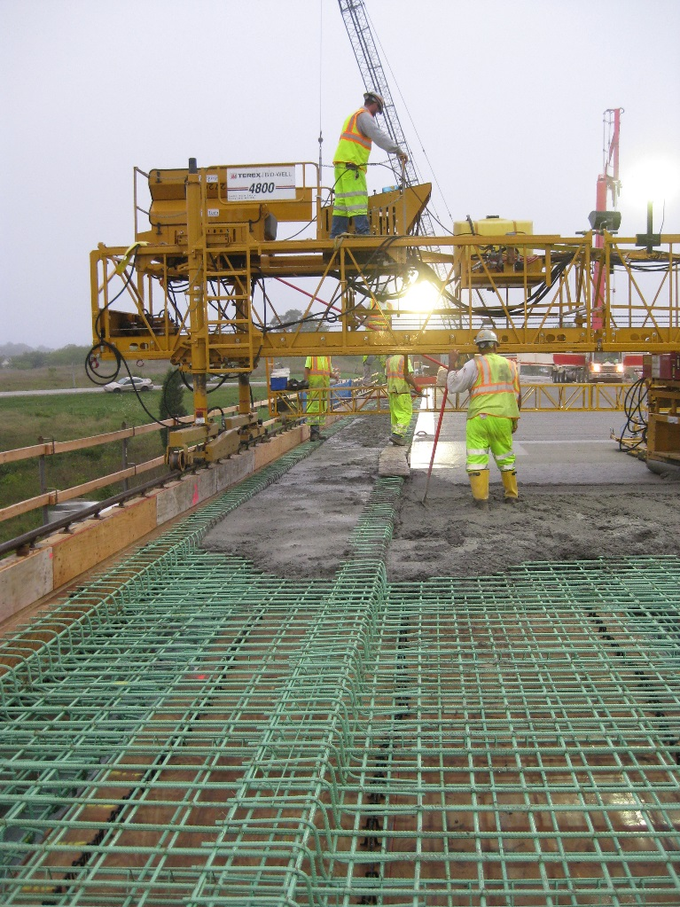
FHWA/WisDOT Joint Process Review:
Bridge Deck Construction
Purpose:
Evaluate bridge deck construction practices
Conformance to standard spec.
Identify best practices
Identify opportunities for improvement
Team Members
FHWA: Joe Balice & Dave Kopacz
DOT: 11 Members (including Region staff, BOS, BTS & BPD)
Notes:
This past construction season FHWA and WisDOT teamed up to complete a process review of bridge deck construction.
The goal of the review was to determine if bridge projects throughout the state are uniformly following the standard specifications. We also looked for best practices and opportunities for improvement.
The process review team consisted of 13 members total, including several people from the Regions and central office.

Slide 17
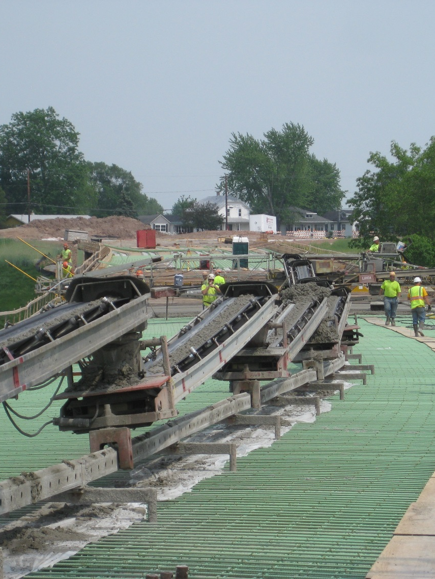
FHWA/WisDOT Joint Process Review:
Bridge Deck Construction
Scope:
Full depth concrete bridge decks & class E concrete overlays
Observed 15+ bridge projects
Target construction operations:
Formwork/rebar installation
Dry-run
Pre-pour meeting
Deck/overlay pour
QC/QV testing
Site review form completed for each project
Notes:
We limited the process review to full depth concrete bridge decks and class E concrete overlays.
We hoped to observe at least 15 projects (with at least 3 in each Region).
Sorry to NW Region which was excluded from the review due to distance.
At each site review each team member filled out a form which was based on the standard specifications. The form covered many bridge construction activities, including rebar installation, the dry-run, concrete testing, and the pour.

Slide 18
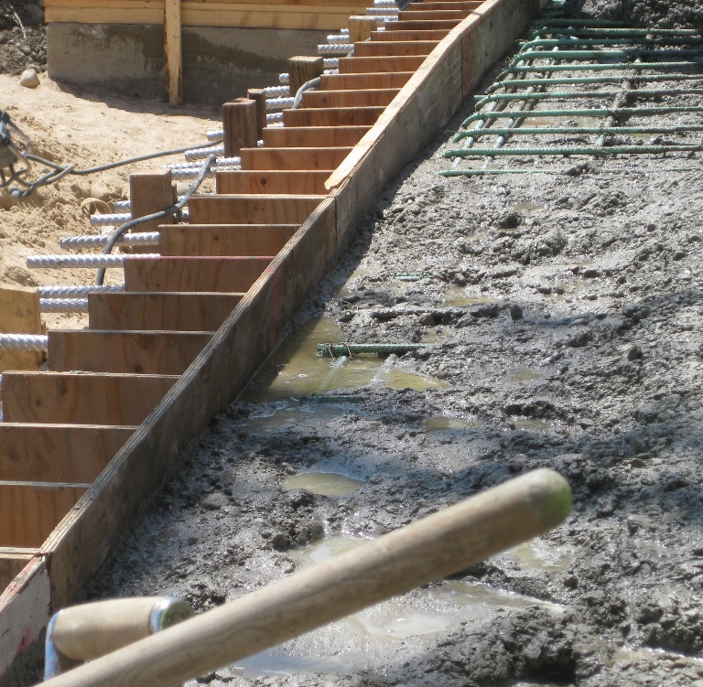
FHWA/WisDOT Joint Process Review:
Bridge Deck Construction
A Few Observations:
Lack of timely curing application
Inconsistent concrete delivery
Better define/understand QA/QC roles & responsibilities
Best Practices
Burlap soaked in tubs before application
Good bar steel spacing & percentage of ties
Report will be finished late this Spring
Notes:
Back in December the review team met to compile all of our observations. The group complied over 40 observations. A few of the top observations were consistent lack of timely curing application and inconsistent concrete delivery.
The photos show a situation where the last concrete truck was delayed by close to an hour. The end of the deck was covered with dry burlap and then the burlap was overly wetted down which resulted in puddles of water in the concrete.
This extra water results in a concrete deck that is lower in strength and less resistant to freeze thaw cycles and damage from salt. This reduction in resistance leads to more potential for the corrosion of the reinforcement.
Best practices observed were consistent bar steel spacing & tie percentages as well as the use of large tubs to pre-wet the burlap.
The report will be finished late this spring and will likely result in changes to the CMM and standard specifications.

Slide 19
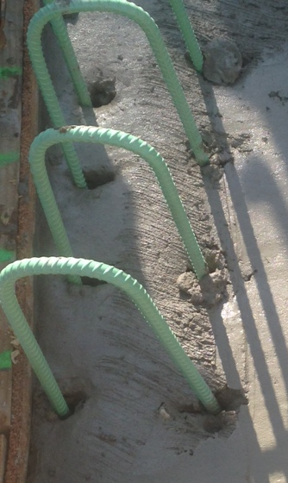
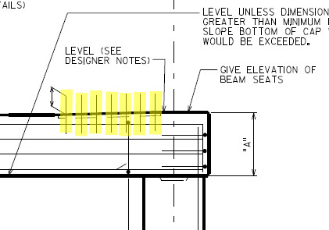
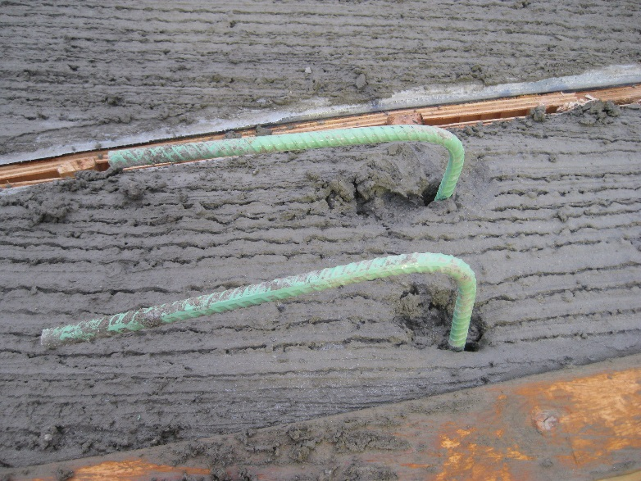
Stab Bars
Only allowed when clearly stated on the plan
Example: Dowel bar between beam seats at fixed piers & abutments
Otherwise, not allowed!
At cold joint, so creates pocket where water & salt can collect
Freeze thaw cycle & corrosion causes damage/spalling
Notes:
Stab bars are not allowed unless clearly stated in the plan.
The photos show clear examples of where stab bars should not have been used.

Slide 20
Hot Weather Concreting
Ice should be paid for – field engineers should not delay pours if ice is required by spec
STSP bid item on more structures plans
No bid item on plans ice treated as administrative item in field
Std Spec 501.3.8.2

Slide 21
Girder Damage During Removals
Unclear removal language in the Std Spec and CMM
References:
Std Spec 203.3.2.1(1) CMM 8-10.6.3
Std Spec 203.3.2.2 Std Spec 107.14
“Damage will occur no matter what I do when removing a bridge deck” THIS COMMENT MAY COME FROM CONTRACTORS BUT IS NOT THE WAY WISDOT VIEWS THIS ISSUE
Notes:
Current language in specs does not limit equipment sizes for removals, but it does state that “engineer-approved” equipment should be used – field engineers should inquire about equipment they aren’t comfortable with.

Slide 22
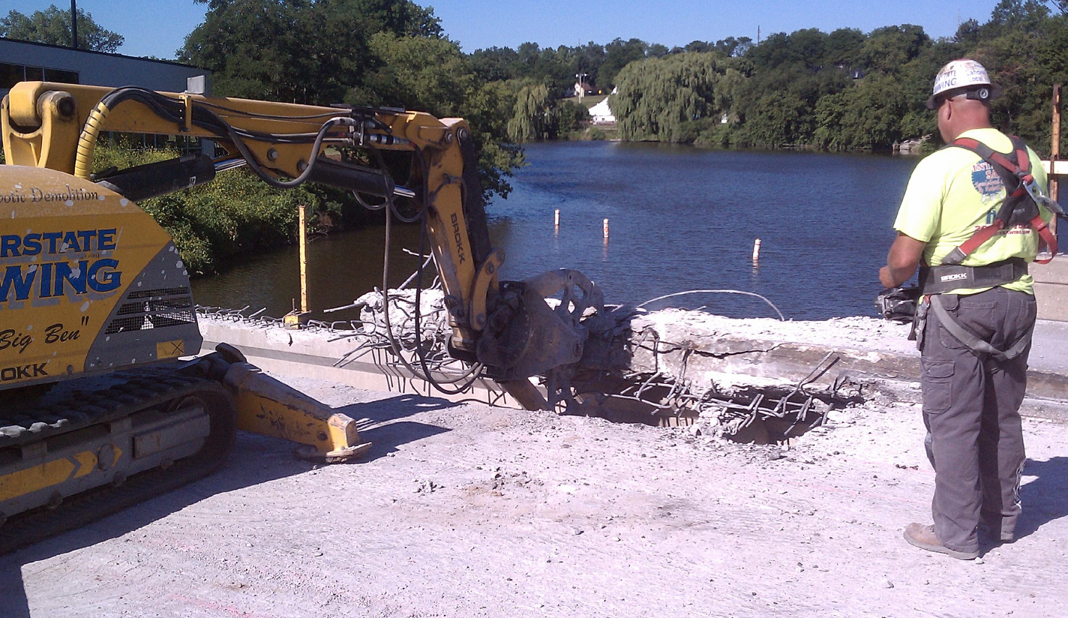
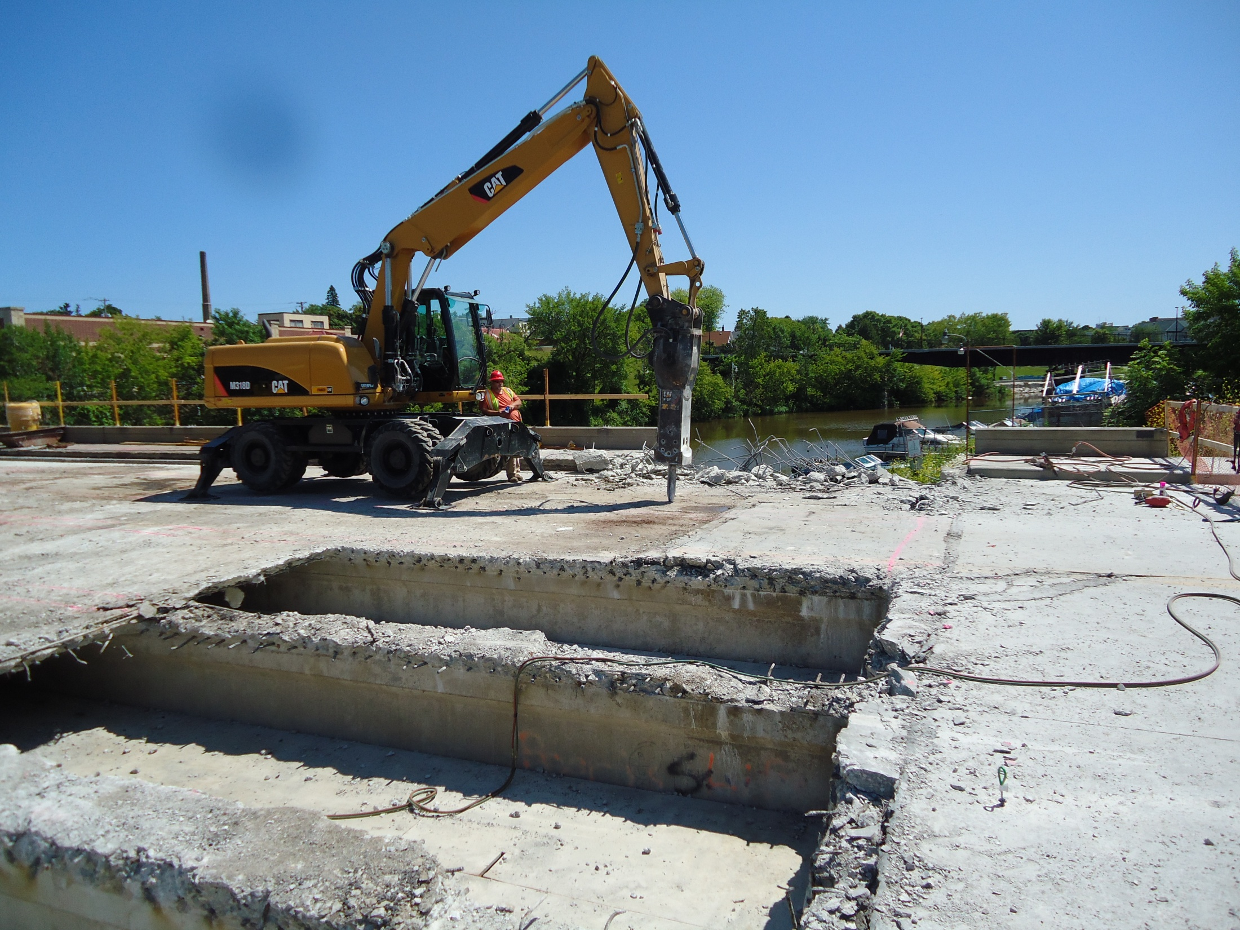
Girder Damage During Removals
Notes:
Highlight different methods for removal allowed by spec and currently used

Slide 23
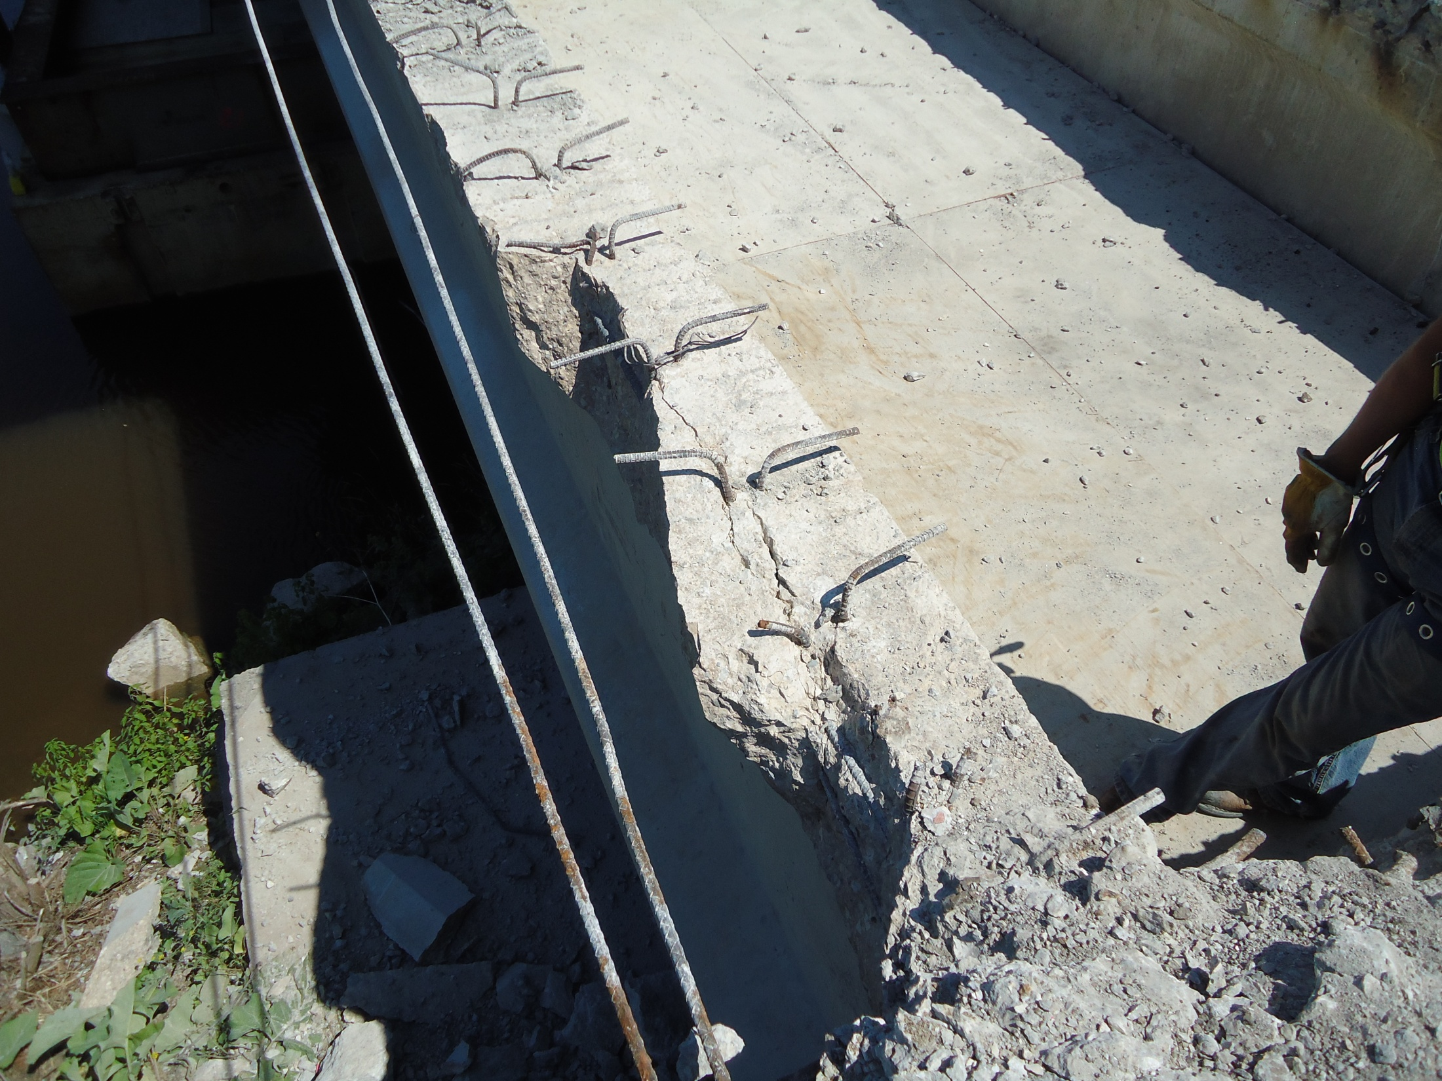
Girder Damage During Removals
Notes:
One example of damage - Highlight damage that should not be viewed as acceptable (half of top flange missing and cracks along centerline of girder between shear connectors.

Slide 24
Girder Damage During Removals
Who to contact when girder damage occurs:
Region Project Manager
Region Bridge Maintenance Engineer(s)
Region/ Consultant Field Engineer/ Project Manager
Structure Design Contact (as listed on the bridge plans)
Damage Occurs
Resolution Determined
Notes:
Stress that Structural Engineer of Record or BOS should be notified when damage occurs in order to determine course of action moving forward (i.e., repair allowed or girder replacement required).

Slide 25
Deck Prep Equipment Enforcement
Std Spec 509.3.4(2) Paragraphs 4 & 5
Hammer weight restrictions to prevent/reduce likelihood of damage
Contractors want enforcement of equipment limits
Unfair to
competing bidders
if larger
equipment is
allowed
Notes:
If we don’t enforce the requirements in the specs, which tend to slow down the removal process and be more labor intensive, what good is it to a contractor to bid the work that way – they will bid it as though they can use heavier equipment which may cause damage but is quicker (helps them win the bid compared to competitors)

Slide 26
Damage Due to Construction Ops
Steel girder bridge painting project in SE Region
Cables attached to end diaphragms to support safe-span falsework
Notes:
Be cognizant of loads applied to members used for construction operations, no matter how seemingly insignificant they may be

Slide 27
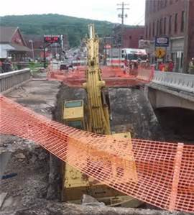
Construction Loads on Bridges
Std Spec 108.7.3 Loads on Structures
Contractor’s responsibility
If directed by Engineer, contractor to analyze and submit to BOS for review
Wisconsin P.E. required
BOS will assist if unsure
Notes:
From time to time the contractor may want to put heavy loads (ie., crane) on a bridge. If concerned and unsure about load on bridge BOS can assist to determine if submittal of analysis is necessary by contractor.

Slide 28
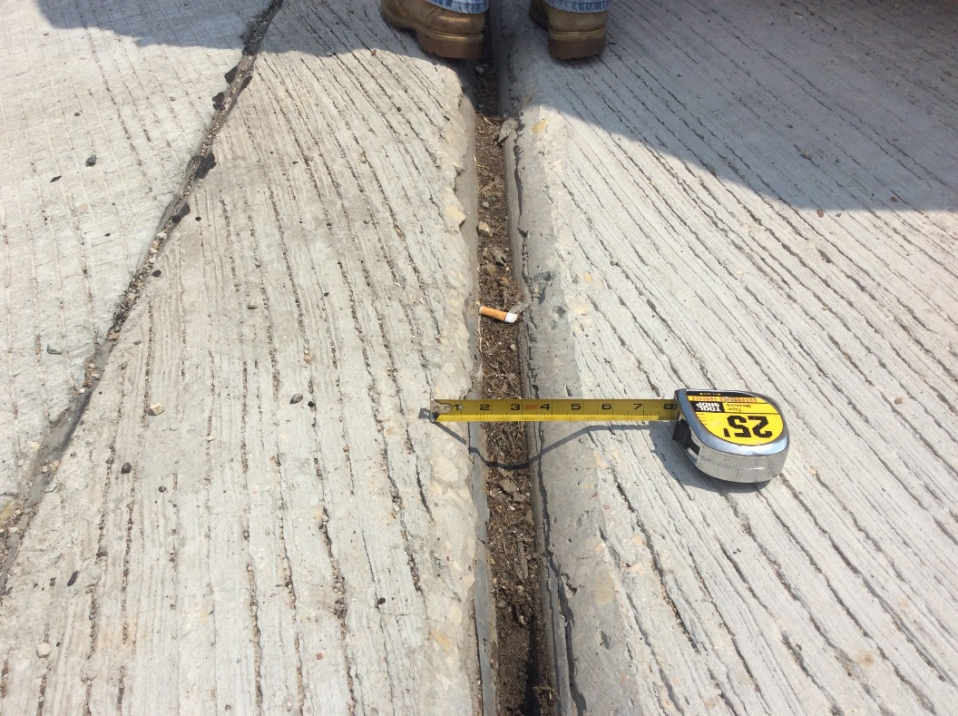
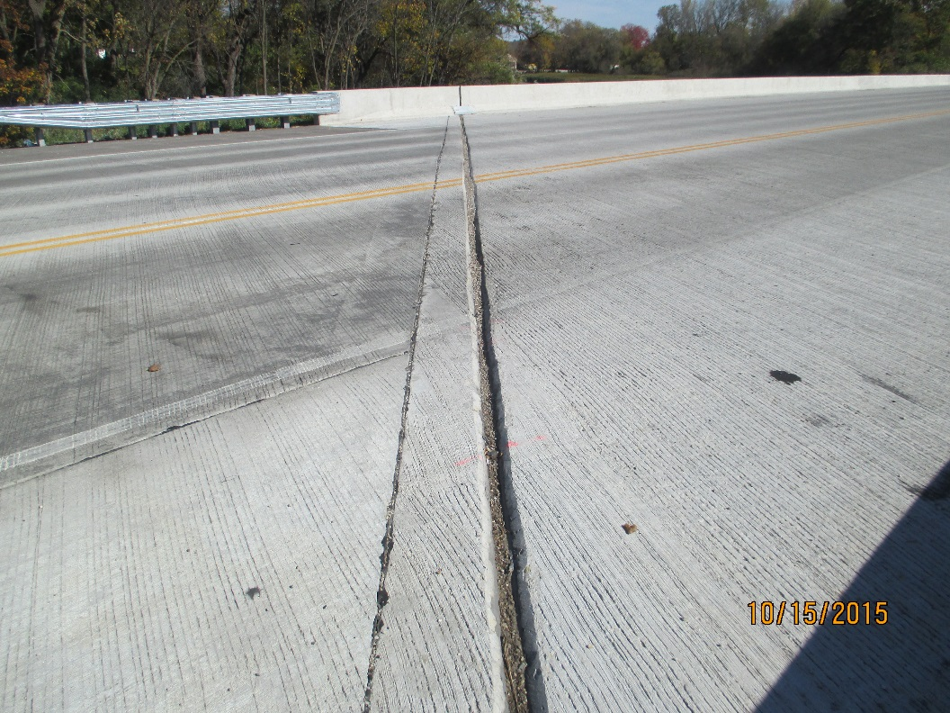
Joint Replacement Issues
Check that joint is set correctly prior to deck pour
Too high is no good, but too low is also no good
Plan note says to ‘set flush with concrete’
Notes:
The large gap caused by setting the joint too low.
Plows can catch this joint much more easily.
Dangerous for cyclists using the bridge.
Collects more debris.
Concrete above steel extrusion is more likely to spall off since it’s unreinforced.

Slide 29
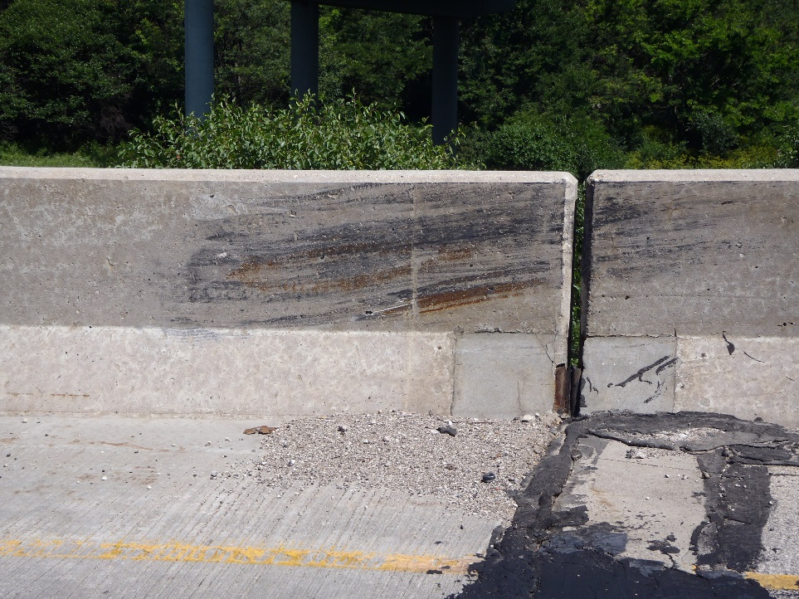
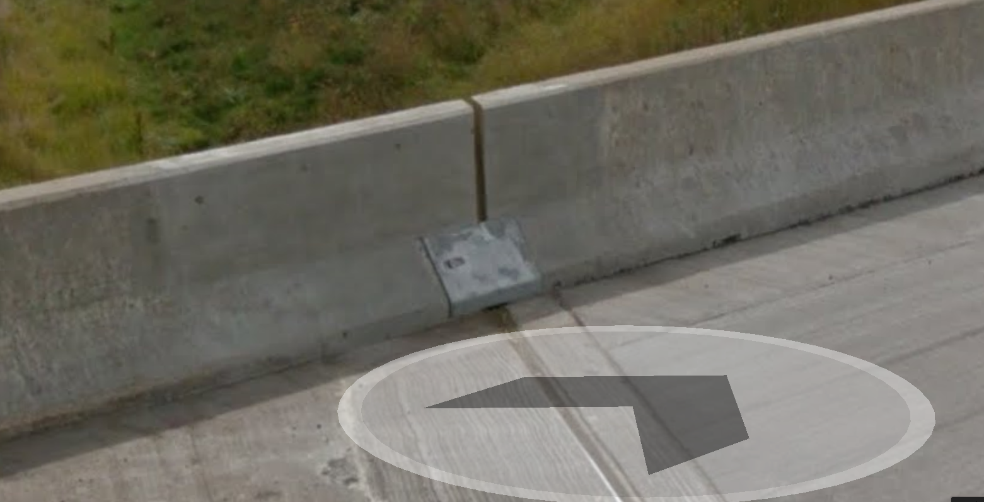
Joint Replacement Issues
Remove and replace parapet as detailed in the plan
Typically 4 feet of parapet removal is detailed
Allows for better anchorage of the extrusion

Slide 30
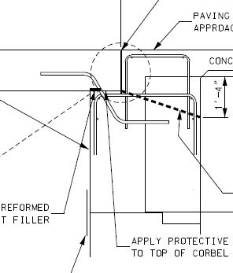
Structural Approach Slabs
Usage: All bridges with AADT > 3500
Not required on: Buried structures, Culverts, and Rehabilitation Projects
Contact BOS for detail/pour modifications
Notes:
Usage (Chapter 12.11 WBM; FDM 14-10-15)
Past: All IH and USH Bridges (July 2010)
Present: AADT > 3500 (July 2015)
Not required in some cases: buried structures, culverts, and rehabilitation projects (cost/benefit not justified for rehabs)
Contact BOS for detail/pour modifications in the field, etc.
Contractors have been requesting to pour the structural approach slabs concurrent with the bridge deck. This is an option, but the contractor and Region team should contact BOS for approval when this is the desired course of action.
The intent behind this is that it saves time in the field, both from the pour time – one versus three – and the cure times involved.
The detail shown here has been successfully . A recessed stainless steel plate has been used to create the paving notch joint and a tooled joint at the surface.

Slide 31
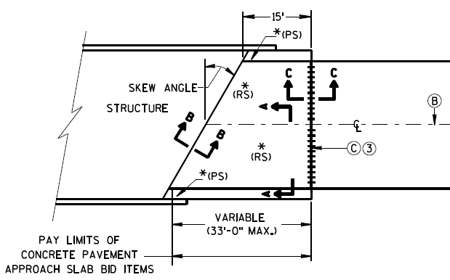
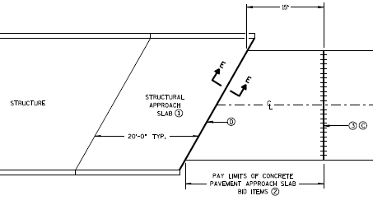
Structural Approach Slabs
Structural Approaches: See Bridge Manual Chapter 12 Standard Drawings
Concrete Pavement Approaches: See FDM 14-10-15 and SDD 13B2
Notes:
Usage (Chapter 12.11 WBM; FDM 14-10-15)
Different approach details
Structural Approaches: See WBM Chapter 12 Standard Drawings
Concrete Pavement Approaches: See SDD 13B2

Slide 32
Structure Backfill Quantities
Backfill payment disagreements (some cases 2 times plan quantities)
BOS Recommends: Discuss backfill pay limits with contractor prior to structure excavation
Future Design Guidance Considerations:
Show pay limits on plans
Add notes for payment
Better communicate quantities (Between Roadway and Structures)
Notes:
Issue: Field Disagreements on backfill payments
Interim Solution: Discuss backfill pay limits prior to structure excavation
BOS is considering the following WBM improvements:
Show limits of excavation and backfill on the plans
Add Notes:
Limits of backfill are for quantity purposes only. Limits of excavation are for informational purposes only. Actual limits of excavation shall be determined by the contractor and at the contractor's expense.
Improve design coordination between structure and roadway items. Add WBM Guidance :
“Coordinate limits of excavation with roadway designers. Pay limits for structure excavation shall be shown on the plans….Coordinate backfill limits and quantities with roadway designers. Pay limits for backfill shall be shown on the plans. See Chapter 12 for an example showing abutment backfill pay limits and quantity computations. “

Slide 33
Prestressed Girder Length Measurement
As part of the QV inspector’s role in the plant, the girder is measured just after it is released from the bed to ensure the girder meets the specification requirements.
The length of a prestressed girder does not need to be verified in the field unless there is an issue setting the girders.
Notes:
At each prestressed plant fabricating prestressed girders for WisDOT, we have Quality Verification (QV) inspectors who are present for all strand tensioning and concrete pours, and their responsibilities include verifying materials, checking stressing calculations, and verifying the dimensional tolerances in the specification are met.

Slide 34
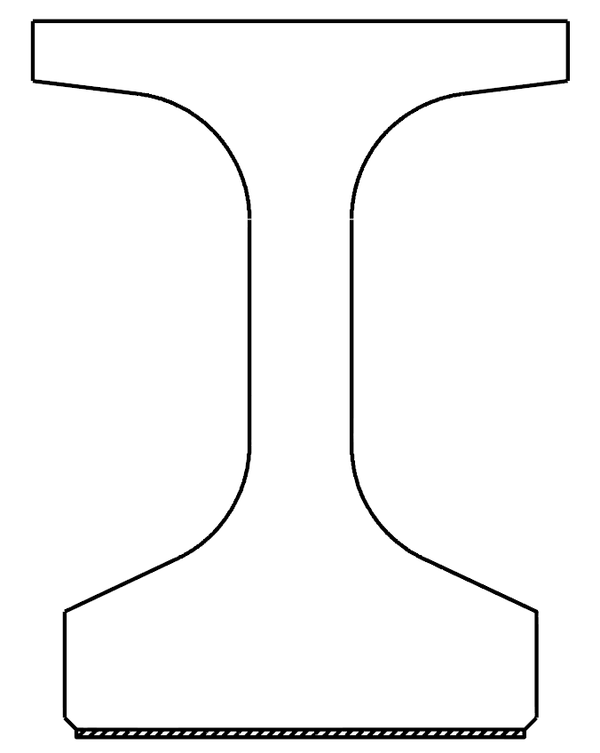
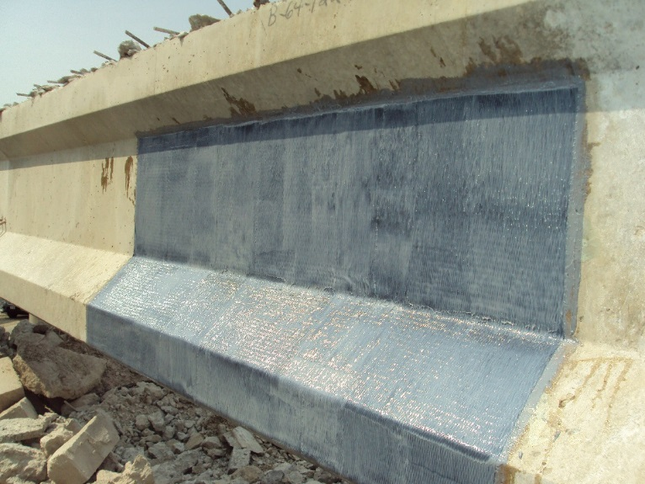
Fiber Reinforced Polymer (FRP)
Fiber sheet & epoxy resin
Past Use – since 1993
Corrosion protection
Spall and crack control
New Use– since 2012
Restore strength
Add additional capacity
Pier caps and girders
Flexure and shear
Flexure
Shear
Notes:
Fiber reinforced polymer are sheets of fiber, either carbon or glass, that are glued to concrete members with an epoxy resin. In the past, since 1993, FRP has been used for corrosion protection or for controlling spalling and cracking, mainly on columns as is shown on the top picture.
Since 2012, however, we have begun to use FRP as a means to strengthen reinforced concrete members that do not meet current design standards for strength. Some places that you can expect, going forward, to see FRP used for strengthening is on pier caps and prestressed girders. By changing the direction of the primary FRP fibers, we can strengthen the reinforced concrete members for either shear or flexure.

Slide 35
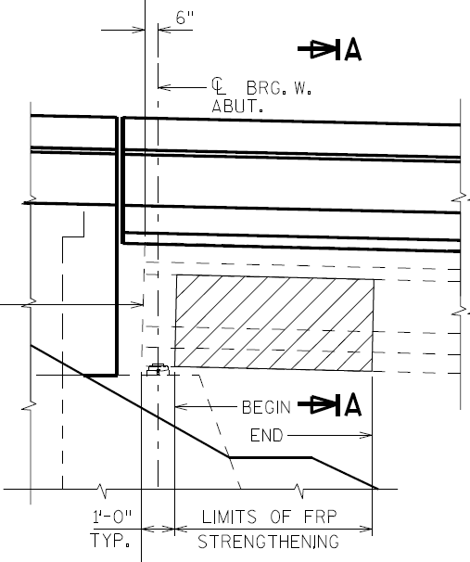
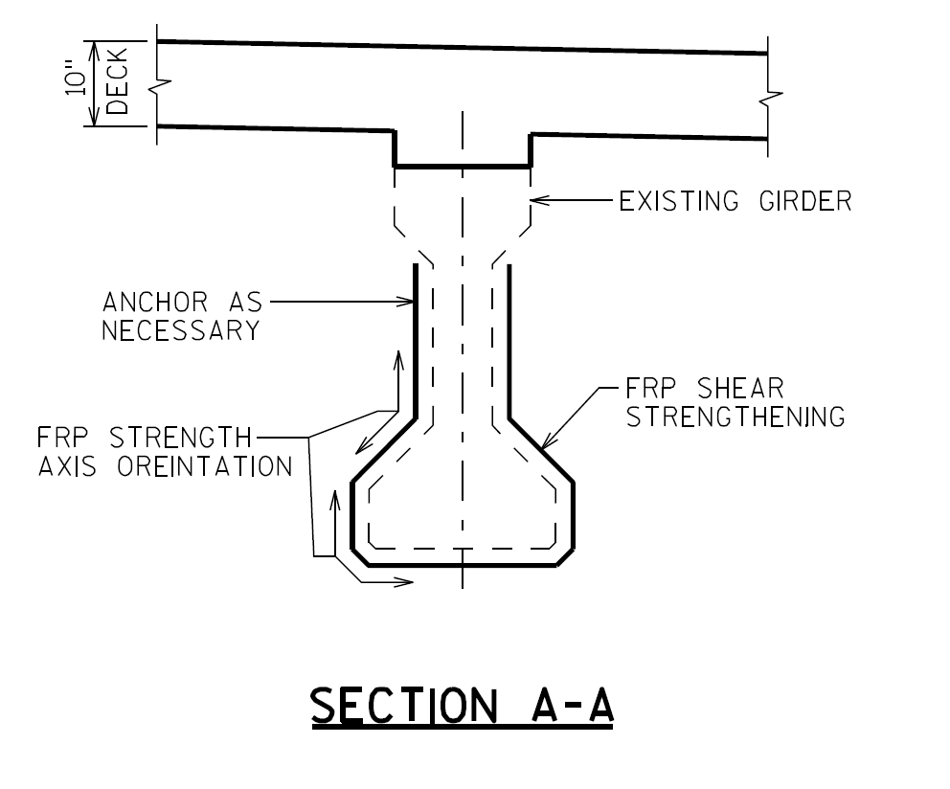
Fiber Reinforced Polymer (FRP)
Bridge plans provide
Required strength
Location
Contractor provides
Final design with stamped calculations
Design drawings
Notes:
For strengthening applications, the structure plans will provide the required strength and location of application for the FRP. The structure plans will also need to show the FRP strength axis orientation. It will be up to the contractor to provide the final design and drawings of the FRP system used. The design calculations must be stamped by a professional engineer. It is very important that the contractor installs the FRP with the fibers oriented in the correct orientation. If not, the FRP will provide no additional strength.

Slide 36
Fiber Reinforced Polymer (FRP)
Special provision
Currently being updated based on recent experiences
Separate specifications for structural and non-structural applications
Changes to come
Design requirements
Submittals
Acceptance testing
Notes:
Based upon recent experiences with having FRP installed on prestressed girders for shear strengthening, we are making updates to the current FRP specification to make the entire process more clear for both the contractor and the construction engineers. Going forward, there will be separate specifications for non-structural and structural applications.
Currently, the design codes used for design of the FRP systems are very confusing. In the near future, through the bridge manual and the construction specifications, we will be adding clarity to what the design requirements are for designing the FRP systems. Also, in the recent past, it was not very clear as to what the contractor needed to submit to the construction engineer for the FRP design and drawings. This will all be clarified in the upcoming specifications. As stated previously, the contractor will be responsible for supplying the stamped calculations and design drawings. Finally, the specification is being updated to reflect hiccups that were encountered during the acceptance testing (the number of samples that need to be tested, what properties need to be tested on each sample, etc.)

Slide 37
Ancillary (Wind Loaded) Structures
Wind Loaded Structures part of the Ancillary Structures
Sign Bridges, overhead sign Supports, monotubes (S)
High mast light poles (HML)
Light poles, and camera poles (none)
Proper installation and safety are concerns
Too many
Longer span over highways
Carrying heavier loads
Build by contractors with little or no structural background
Notes:
Wind Loaded Structures have been classified under ancillary structures. These included sign bridges, overhead sign supports, traffic monotues, high mast lighting, light poles and camera poles. These structures normally have a structure number assigned. A letter “S” is identify with sign bridges, overhead sign supports and traffic monotubes, whereas “HML” is assign for high mast light poles. Light poles and camera poles do not have structure number, and they are not being inspected by BOS.
Since we have too many of these structures on our roadways (Highway Structure Information System indicated about 300 in the system 3 years ago, now over 3,000), they carrying heavier loads and span longer on highways, and build by landscape and electrical contractors with little or no structural background, proper installation and safety are concerns.

Slide 38
Ancillary (Wind Loaded) Structures
CMM 5-70
Attachment 1 – Construction inspection checklist
Checklist highlighted items
Verify materials meet specifications
Forward shop drawings and design documents to BOS and others as listed
Communicate with contractors on means and method prior to performing work on excavation, placement of concrete footing and erection of structure.
Notes:
Section 5-70 of the CMM provides instruction and reference information necessary for to construct wind loaded structures. Attachment 1 (your handout) contain a check list of items that must be performed from excavation for the footing through installation and inspection of the completed structure.
Go over the checklist highlighted items.

Slide 39
Ancillary (Wind Loaded) Structures
Checklist highlighted items (continue)
Perform QA in various phase of construction
Concrete footing pour
H.S. bolt pre-installation test
Structure erection and installation
Forward Forms DT2321 and DT2322 to the following individuals, and schedule initial inspection.
sign structures – Tom Heydel (262) 548-6763
All other structures –Jason Zemke (262) 548-8734
Notes:
Continue with the checklist highlighted items.
Preference is to have the inspection done in between 2 days after the work is completed and prior to traffic open. Do not make full payment until initial inspection is completed and work is accepted.

Slide 40
Welding 101
Welders must be qualified prior to welding in the position, process, and type of joint (Correct Certification)
A written weld procedure for each type of weld is required
Become familiar with the typical weld symbols and nomenclature
Storage and care of welding electrodes
Notes:
Just a quick reminder when welding of structural elements is occurring on your project.
Field engineers should be aware of the typical nomenclature on plans and also should take care to obtain written weld procedures and qualifications of those doing the work.
Note that a certification from Department of Public Safety & Professional Services is not sufficient nor applicable to welding of transportation structures.

Slide 41
Steel Bridge Fabrication Process Changes
WisDOT has switched from QC to QA
We now review a portion of all primary steel shop drawings submitted, similar to consultant designed structure plans.
We require form DT2333 be filled out for all steel primary member shop drawings, stating the shop drawings have been reviewed and conform to the 16 checklist items of AASHTO/NSBA G1.1 Section 4. This form includes a PE stamp of the reviewer as well as a signature of the prime contractor indicating the review has occurred.

Slide 42
Steel Bridge Fabrication Process Changes
WisDOT has switched from QC to QA (cont’d)
We required a Storage and Shipping Plan to accompany the shop drawings. The intent of this requirement is to ensure the fabricator has considered these items up front.
Once the contractor or fabricator has submitted the completed DT form (including contractor signature and PE stamp), the shop drawing, and a Storage and Shipping plan, fabrication can commence. There is no need to wait for a WisDOT review. If BOS chooses to review a shop drawing, all parties will be notified, typically within 24 hours.

Slide 43
Steel Bridge Fabrication Process Changes
Electronic Submittals
WisDOT has created a Fabrication Library in SharePoint for all steel highway bridge submittals. This site allows the prime contractor, fabricator, QA Inspector, Project Manager, and Bureau of Structures to share files in a single location.
If you need access to the Fabrication Library for your steel bridge project, please go to the link below to request access-
http://wisconsindot.gov/Pages/doing-bus/eng-consultants/cnslt-rsrces/strct/fab-sharepoint.aspx
Notes:
If you have any questions regarding these changes, please contact Kristin Revello, Supervisor of the Structural Metals and Fabrication QA Inspection Unit.

Slide 44
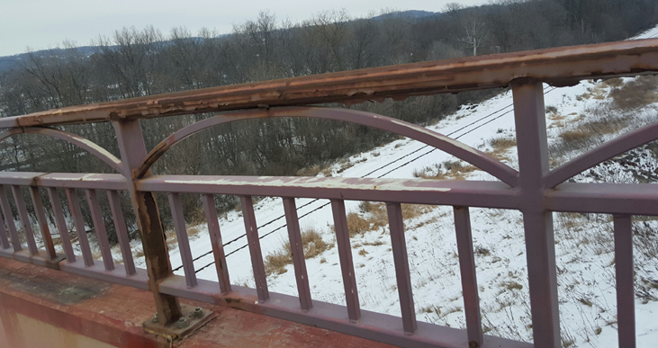
Decorative Railing Finish
Due to maintenance issues with the railings with 3 coat paint systems, we have moved to galvanizing and painting decorative railings.
Notes:
This is a picture of a bridge railing in Baraboo that was painted and not galvanized. There was significant corrosion and staining down the face of the stained parapets.

Slide 45
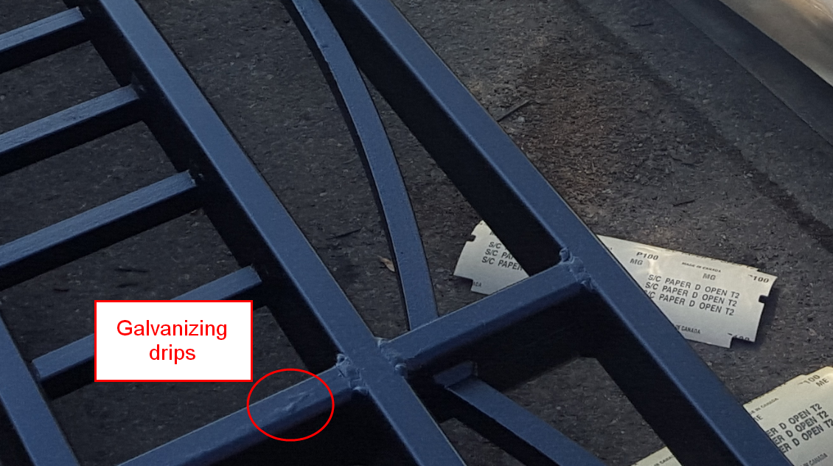
Decorative Railing Finish
When galvanized and painted, railings gain superior corrosion protection, but aesthetically may not look as polished as their 3 coat system counterparts.

Slide 46
Decorative Railing Finish
Due to the galvanizing process, you may see some slight ripples or drips on the railing surface.
These rails need to be free of sharp edges and burrs, and if you are delivered railing with these defects, ask to have these locations repaired.
If you have questions or concerns regarding the appearance of railings on your project, please send pictures to Mike Wood of the Structural Metals and Fabrication QA Inspection Unit, and he will assist you as needed.

Slide 47
Conclusion
Call us with Questions
BOS looks forward to another successful construction season – THANK YOU!
Notes:
NE Region
“We always do it that way” is not a substitution for what is shown on the plans – if the contractor is looking to do something different than the plans show, need to contact EOR/BOS

