Slide 1
2016 Northeast Region Construction Training
Northeast Wisconsin Technical College
March 16, 2016

Slide 2

NER 2015 Construction Awards

Slide 3
Award Criteria
Project Schedule / Budget
Contractor’s Performance
General Appearance
Pavement / Structure Smoothness
Quality Control
Complexity
Innovation

Slide 4
Asphalt Paving
County: Fond du Lac
Project I.D: 1110-10-71, 114-09-71, 114-10-71
Location: STH 26, Waupun – North County Line, Cattaraugus Drive – CTH FF
Project Length: 16.1 miles
Prime Contractor: Northeast Asphalt, Inc.
Project Leader: Jeff Spaeth, Gremmer & Associates
DOT Project Manager: Kyle Treml
DOT Project Supervisor: Rob Wagner
Notes:
Bumper year for AC projects also considered the northern projects on 141.
This project utilized a test section of high recycle mix and a huge amount of asphalt that went down on-time
Complement the team on addressing a large amount of unexpected EBS

Slide 5
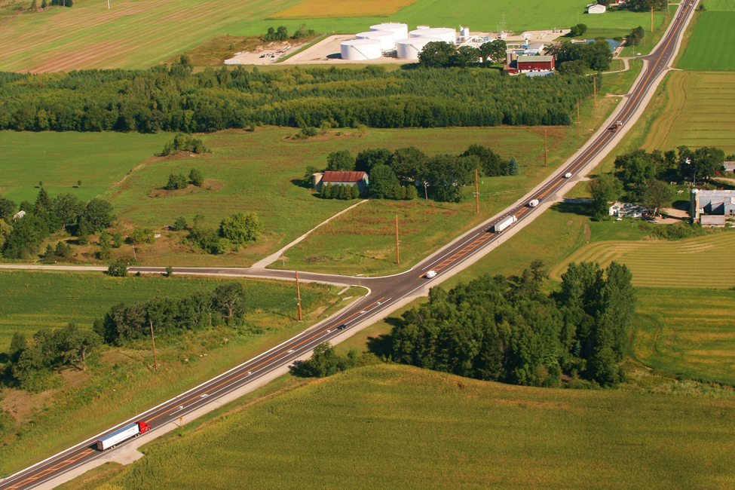
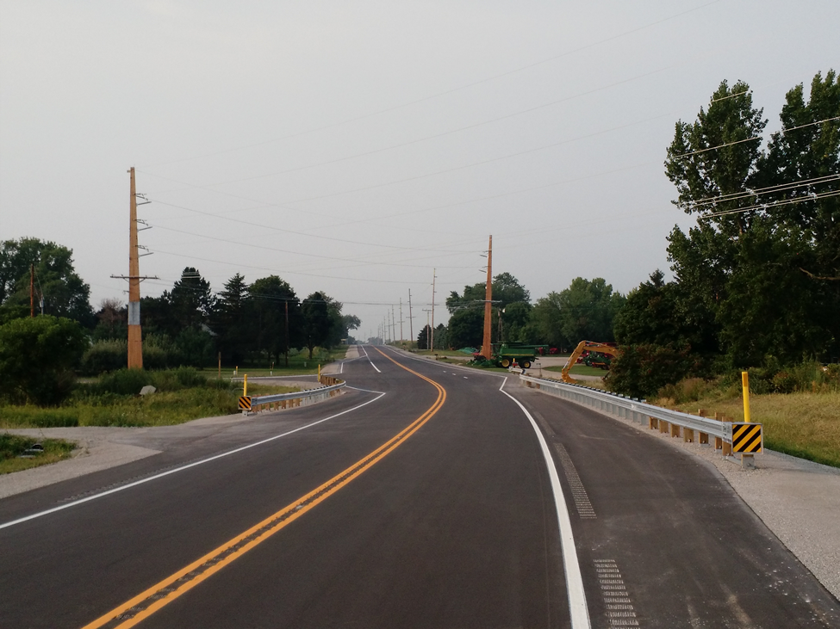
Asphalt Paving
Notes:
Pictured safety correction of curve that had been noted for several accidents including an ambulance that flipped.

Slide 6
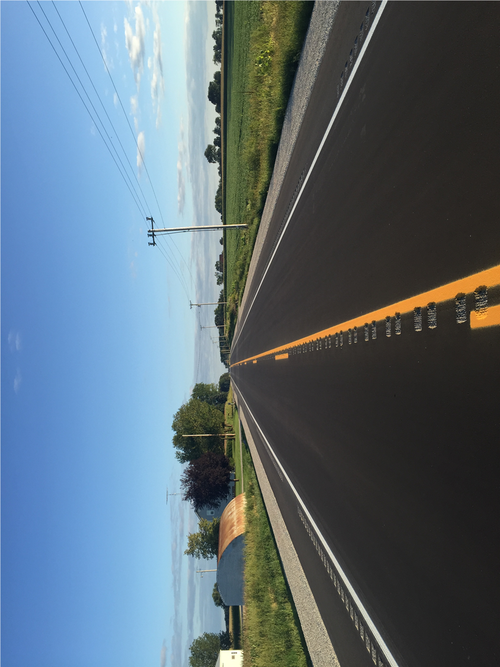
Asphalt Paving

Slide 7
Concrete Paving
County: Winnebago
Project I.D. : 1517-75-78
Location: Appleton Road (STH 47), County CB – USH 10; STH 441
Project Length: 0.58 miles
Prime Contractor: Vinton Construction Company
Project Leader: Matt Berg, Omnni Associates
DOT Project Manager: Kurt Peters
DOT Project Supervisor: Tammy Rabe

Slide 8
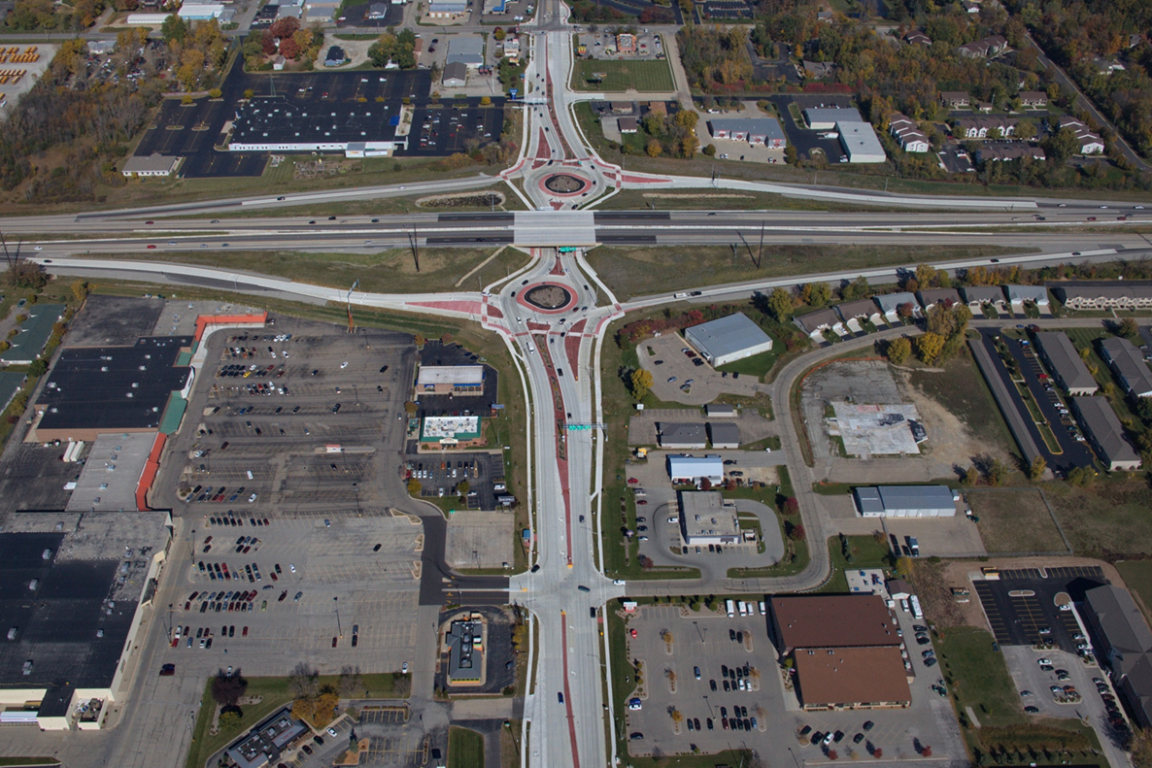
Concrete Paving

Slide 9
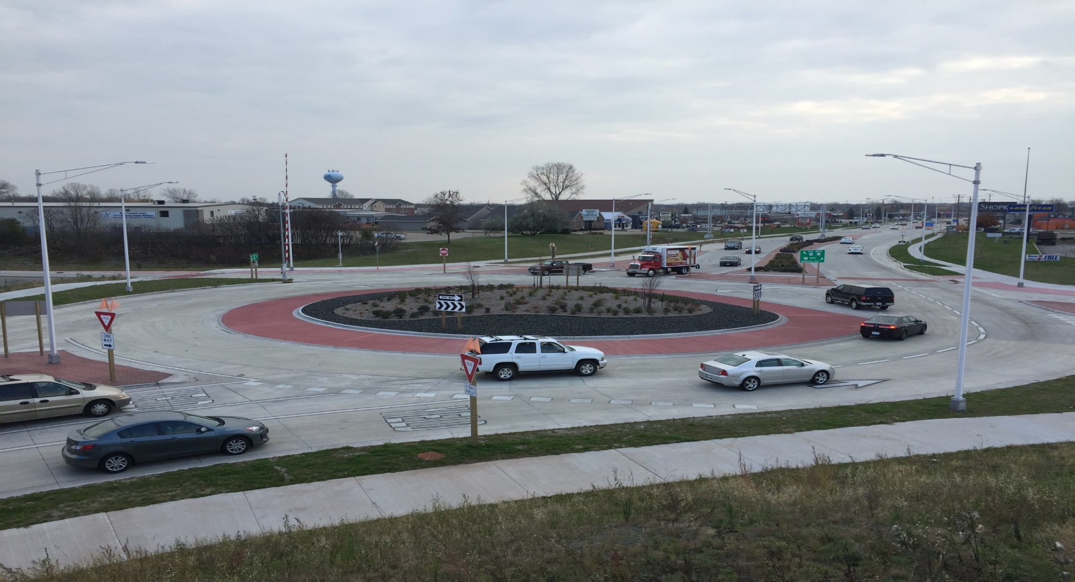
Concrete Paving

Slide 10
Grading
County: Marinette
Project I.D.: 1490-27-71
Location: STH 64 Interchange, Coleman – Crivitz, USH 141
Project Length: 0.46 miles
Prime Contractor: James Peterson & Sons
Project Leader: Todd Mulvey, Coleman Engineering
DOT Project Manager: Paul Zoellner
DOT Project Supervisor: Dan Segerstrom

Slide 11
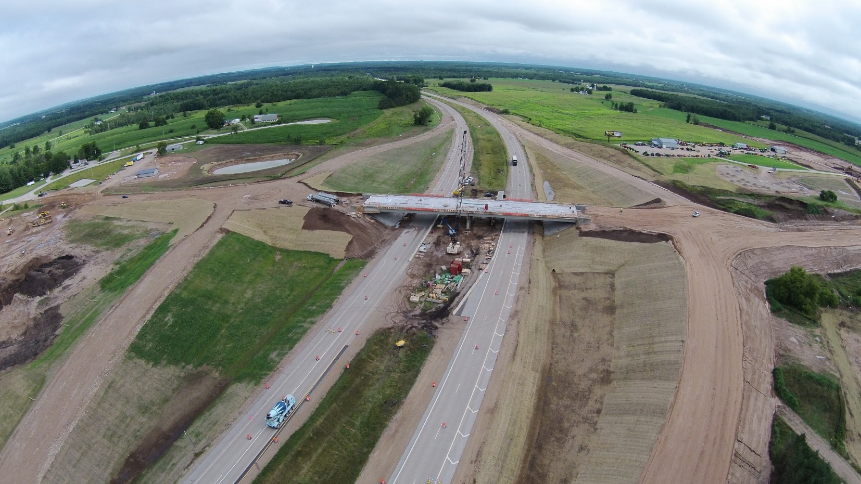
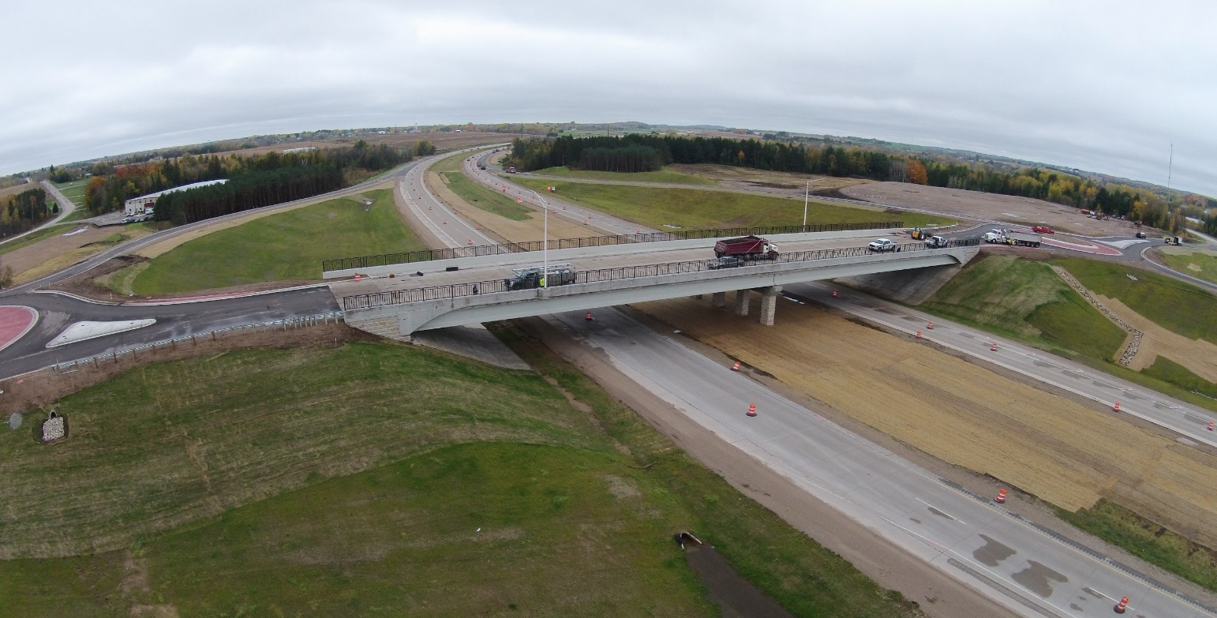
Grading
Before - 2011
After – 2013
Notes:
This project finished up late in CY 14 per plan.
The project team addressed some design issues with one the first Civil 3D grading project.

Slide 12
Small Structures
County: Door
Project I.D. : 4430-13-71
Location: Algoma – South Junction 42/57; Village of Forestville; Unnamed Creek; STH 42
Project Length: 0.048 miles
Prime Contractor: Pheifer Brothers Construction Co.
Project Leader: Matt Bertucci, WisDOT
DOT Project Manager: Jeremy Ashauer
DOT Project Supervisor: Jim Thompson

Slide 13
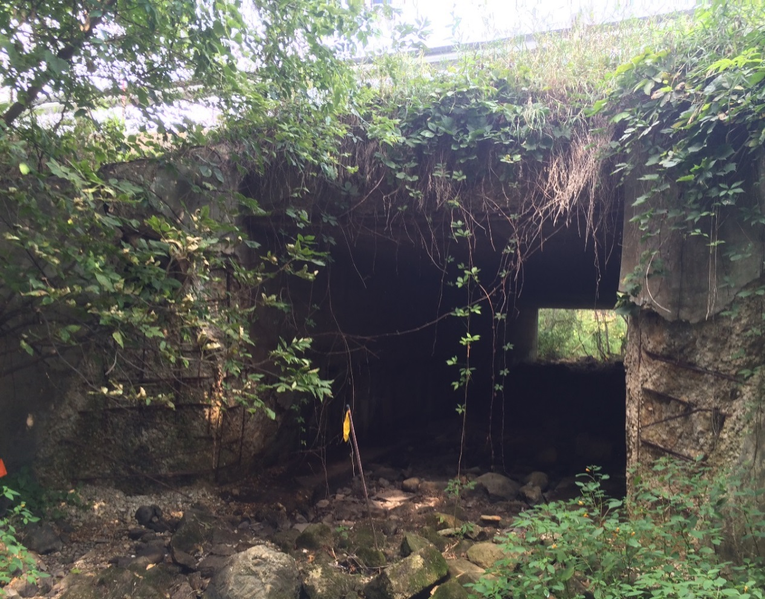
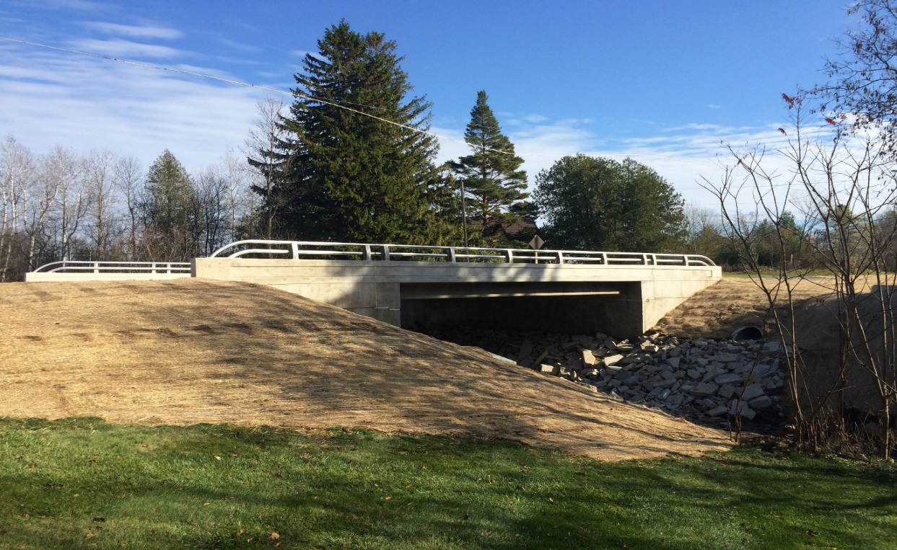
Small
Structure
Notes:
This project was a huge improvement to the previous obsolete structure.

Slide 14
Large Structure
County: Brown
Project I.D.: 4075-28-71
Location: Fox River Bridge B-5-381; Village of Wrightstown; STH 96
Project Length: 0.54 miles
Prime Contractor: Lunda Construction Co.
Project Leader: Steve Seymour, Omnni Associaties
DOT Project Manager: Andy Fulcer
DOT Project Supervisor: Dan Segerstrom

Slide 15
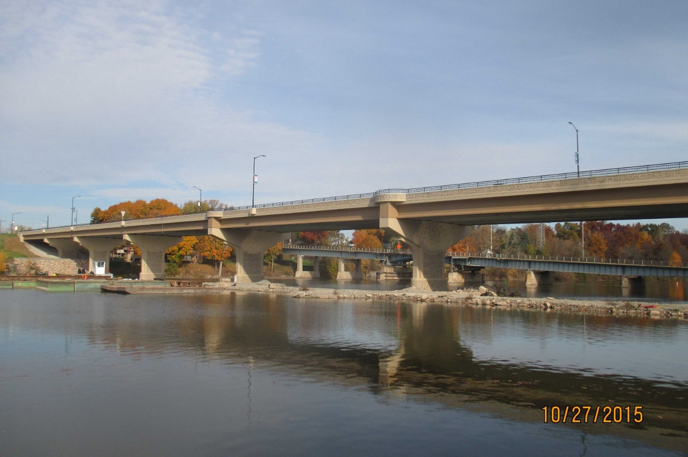
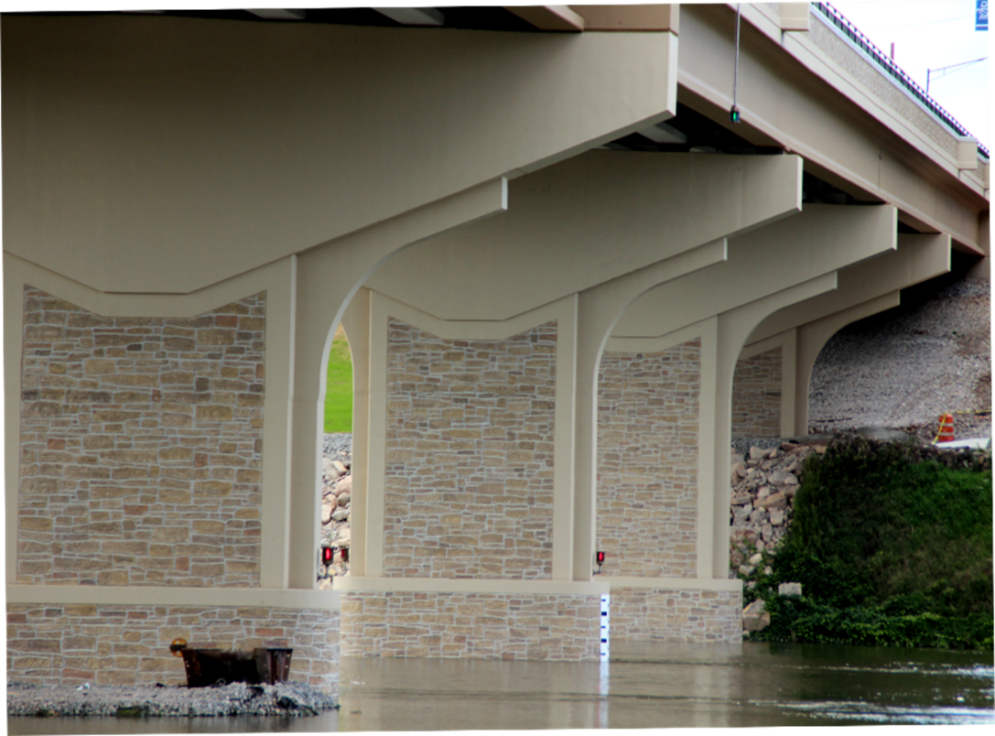
Large Structure

Slide 16

Large Structure

Slide 17
Mega/Major – Large Structure
County: Brown
Project I.D.: 1133-03-71/73, 9202-07-71 (USH 41/STH 29 Interchange “Core Contract”)
Location: Morris Ave - Memorial Dr./STH 29
Prime Contractor: Lunda Construction Co.
Project Leader: Ryan Schanhofer, KL Engineering & John Leonhard, Kapur
DOT Project Manager: Eric Gwidt
DOT Project Supervisor: Mike King

Slide 18
Mega/Major

Slide 19
Mega/Major

Slide 20
Mega/Major

Slide 21
National Recognition
National Asphalt Pavement Association (NAPA) 2015 Quality in Construction Awards
  STH 26, Fond du Lac County and USH 141, Marinette County – Sustainable construction practices utilizing high-recycle mixes
American Concrete Pavement Association (ACPA) 2015 Excellence in Concrete Pavement Awards
  Monroe Avenue, City of Green Bay – Gold Level for Municipal Streets & Intersections >30,000 SY
Roads & Bridges: Top 10 Roads 2015
  No. 7 USH 41 & STH 29 Interchange
Notes:
National Asphalt Pavement Association: 2015 Quality in Construction Award Winners (205 projects recognized nationwide including 2 from WisDOT NE Region; not sure how many were submitted)
STH 26 in Fond du Lac County and USH 141 in Marinette County were both recognized for their use of sustainable construction practices in utilizing high-recycle mixes.
American Concrete Pavement Association: 2015 Excellence in Concrete Pavement Award Winners (32 projects recognized nationwide including 1 from WisDOT NE Region; 70 projects submitted; each state/chapter only allowed to submit 1 per category)
STH 29/54/57 Monroe Avenue in the City of Green Bay was recognized as the Gold Level Winner in the category of Municipal Streets & Intersections (>30,000 SY).
Roads & Bridges: Top 10 Roads 2015 (10 projects recognized nationwide including 1 from WisDOT NE Region; not sure how many were submitted)
No. 7 USH 41 & STH 29 Interchange

Slide 22
Region Construction Emphasis
Culture and Leadership
    Safety
    Erosion Control
    Materials
    Change Orders
    CRIs
    Performance Measures

Slide 23
Region Construction Emphasis
Safety
  Lead by example, PPE
  Discuss safety at weekly meetings
  You are responsible for your safety

Slide 24
Region Construction Emphasis
Erosion Control
  Sensitive Areas and ECIP
  Borrow Sites/Waste Sites
  Make contractor complete work near sensitive areas
  Provide leadership to contractor with erosion control

Slide 25
Region Construction Emphasis
Materials
  Document, document, document
  Use your resources available
    region materials section, project managers and bureaus
  Work with contractor to be proactive on issues

Slide 26
Region Construction Emphasis
Change Orders
  Prior Approval
  Independent Estimates
  Documentation

Slide 27
Region Construction Emphasis
Cost Reduction Incentive (CRI)
  Document all CRIs
  Notify and forward all concept submittals and proposal submittals to CQA (Krissy) and BPD Oversight Engineer (Buschkopf)
  Include appropriate decision-makers in review
  Respond timely

Slide 28
Region Construction Emphasis
Performance Measures
  Time
    Decisions, ContMods, Finals, Completion/Opening
  Budget
    Project Costs, Delivery Costs
  Quality
    Records, Materials, Final Product

