Slide 2
Question 1
Which of the following is NOT necessary for field acceptance of traffic control devices?
Conformance with NCHRP Report 350 test level 3 or MASH crashworthiness criteria
On the Approved Products List
Conformance with WMUTCD
Acceptable condition according to ATSSA

Slide 3
Answer 1
Conformance with NCHRP Report 350 test level 3 or MASH crashworthiness criteria
Since traffic control devices are on the APL, field staff do not need to collect a certification of crashworthiness.

Slide 4
Question 2
True or False?
Damage to steel or concrete girders during deck removal should be evaluated in a damage survey and allowable repairs or restoration will be determined by the Region Bridge Maintenance Section.

Slide 5
Answer 2
False.
The Region Bridge Maintenance Section is available to assist with the damage survey and may offer recommendation, but the determination of repair, restoration or girder replacement should be discussed with BOS design.

Slide 6
Question 3
Notice of Termination (NOT) from coverage under the Wisconsin Pollutant Discharge Elimination System (WPDES) General Permit requires the following:
Substantial Completion of Project or Substantial Growth (70% permanent vegetation)
Substantial Completion of Project and Substantial Growth (70% permanent vegetation)
Substantial Completion of Project and Substantial Growth (80% permanent vegetation)
All Contract Work Complete and Substantial Growth (70% permanent vegetation)

Slide 7
Answer 3
B. Substantial Completion of Project and Substantial Growth (70% permanent vegetation)

Slide 8
Question 4
Wing tip erosion and drainage: Three truths and a lie. Which is the lie?
Bituminous sealant around wing tips is a good option to keep structures in place.
Typically finished grade ends 6’’ above wing tips.
Grading around wing tips should allow proper drainage.
The end of the structural approach slab is not the end of the wing.

Slide 9
Answer 4
Bituminous sealant around wing tips is a good option to keep structures in place.
While sealant around the wing tips may seem like a good fix to keep things in place, it commonly worsens issues. Do not allow bituminous sealant around wing tips!

Slide 10
Question 5
What should be monitored by the construction staff to ensure the project TMP mitigation strategies are effective?

Slide 11
Answer 5
Queue and delay matched TMP analysis
Lane closure hours are acceptable (proper times)
Complaints from traveling public
Incidents within the work zone
PM’s need to follow the FDM for post evaluation documents and mark the project complete in the TMP system.

Slide 12
Question 6
If you have electrical items on a project what should you do??
Notify Randy Asman when contractor is on site
Read and understand spec book and SDD’s
Invite region electricians to create punch list
Determine if you need a pre-electrical meeting
Ask questions
All of the above

Slide 13
Answer 6
F. All of the above
Don’t pay 100% for items not reviewed by region or on punch list.

Slide 14
Question 7
What are the three Utility Coordination Goals??

Slide 15
Answer 7
Safety
Prevent Damage to Utility Facilities
Prevent Delay to Construction Projects

Slide 16
Question 8
Name the Best Spring Break Destinations as ranked by U.S. News in 2018.

Slide 17
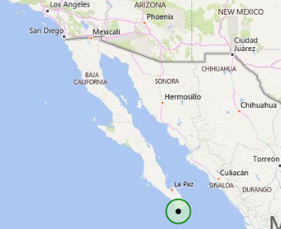
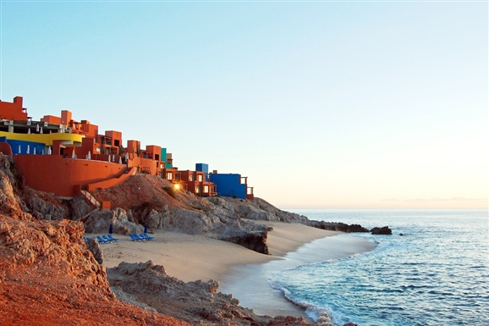
#5 Cabo San Lucas

Slide 18
#4 Bahamas

Slide 19
#3 South Padre Island
Notes:
Off of Texas

Slide 20
#2 Miami Beach

Slide 21
#1 Cancun

