Slide 2
Question 1
Which of the following should NOT be on the DT1310?
A: Missed QV Test
B: Buy America Exemption
C: Waiving Testing per Specification
D: Non-Conforming Material Credit

Slide 3
Answer 1
C: Waiving Testing per Specification
This should be documented on your 155 Report, not the DT1310.

Slide 4
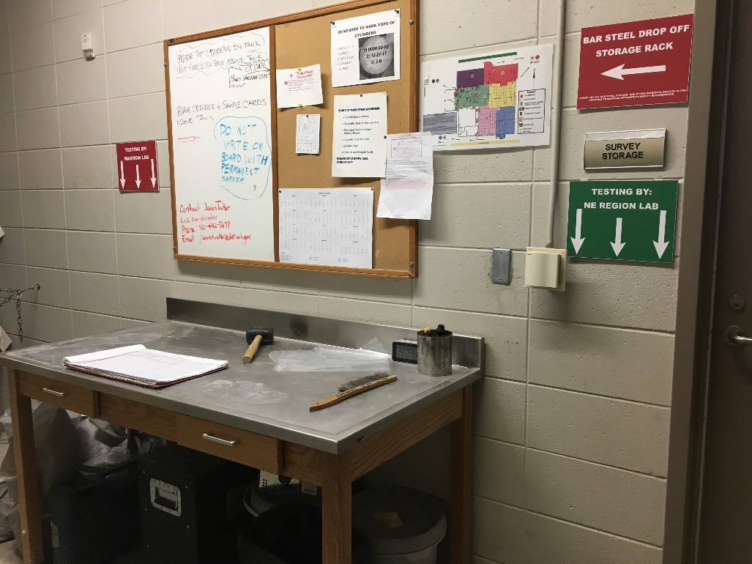
Question 2
If a sample needs to be tested by the Region Lab, which sign should it be placed under?

Slide 5
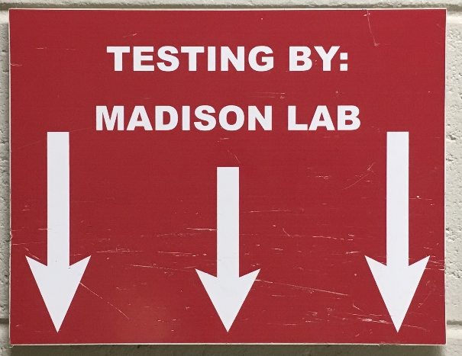
Answer 2
If the sample is placed under the RED sign – it will be sent to Madison.

Slide 6
Question 3
List at least three approval methods for materials conforming to the contract.

Slide 7
Answer 3
Approved Product Lists (APL)
Approval by Product Certification
Approval by Certified Report of Tests
Approval by RANDOM Field Sampling & Testing
CMM 8-45.2

Slide 8
Question 4
Which bid items below would be most appropriate for using a ‘Direct Entry’ posting:
Mobilization, LS
Silt Fence, LF
Traffic Control, Each
Landmark Reference Monuments, Each
Maintenance and Repair of Haul Roads, Each

Slide 9
Answer 4
All except Silt Fence because this item will require the inspector to measure the LF.
All the other items would only require a STA or Project Wide comment.

Slide 10
Question 5
Which information is NOT part of your Daily Diary entries?
Required every day
Include critical dates in ALL CAPS
State why no work is occurring or delays
Documents equipment and labor
Documents important conversations
Fill out Site Time tab data

Slide 11
Answer 5
D. Documents equipment and labor
This information is included in the IDR’s.

Slide 12
Question 6
Which of the following documentation should be included in the Contract Modification Justification?
Prior Approval Date
Engineer’s Estimate
Concurrence from Municipality
Contractual Reference of Need for CCO
All of the above

Slide 13
Answer 6
E. All of the above

Slide 14
Question 7
When the punch list complete date is entered into FIT what should also happen?
Shut off time
Enter All Contract Work Complete date
Request Conditional Final Acceptance letter from contract specialist
Generate the final estimate

Slide 15
Answer 7
Trick question!
B. Enter All Contract Work Complete date*
C. Request Conditional Final Acceptance letter from contract specialist
* Unless there is a plant establishment period. Then only ‘C’. All Contract Work Complete date is filled in upon completion of plant establishment period.

Slide 16
Question 8
What drink is this? 1 oz. dark rum, ½ oz. coconut rum, ½ oz. banana liqueur, ½ oz. grenadine, 1 oz. pineapple juice, 1 oz. OJ, ½ oz. lemon lime soda.
“Fun” on the Beach
Alabama Slammer
Mai Tai
Bahama Mama

Slide 17
Answer 8
D. Bahama Mama

