Slide 1

Contract Administration
Lisa Lumley – NER Contract Specialist
NER Construction Training
March 22, 2018

Slide 2
Start of your projects
REMINDER
Project Binders
  Pick up your plans, proposals, and labels at the NE Region office
  441 contact Mickey Jenks for plans and proposals
  Project leader prints off Binder materials (including instructions) located in Pantry
  Empty 3-ring binders available at NE Region office
Notes:
Plans, proposals and labels can be picked up anytime from our regional office. You can also wait until the pre-construction conference to pick up your items, too. Like last year, print off the binder materials from Pantry.
We have 3-ring binders and you’re welcome to take as many as you need!

Slide 3
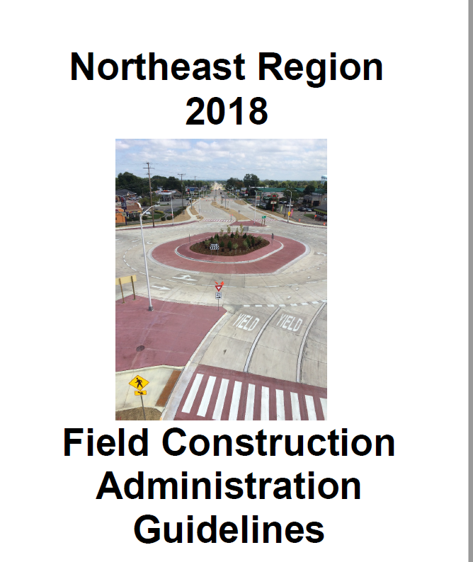

2018 NER Field Construction Administration and Field Software User’s Guide available in Pantry
Notes:
Only one regional guide. Local program does not have a separate Local Program guide.

Slide 4
Local Program
Contract administration managed in-house
Most processes are same as state projects
Differences include:
  Weekly Construction Update form (in Pantry)
  Enter Sponsor contact info into FIT at start of project
  Utility coordination and conflict
  Municipality concurrence within CMJ
Notes:
Local program projects are now-being administered in-house, rather than by JT Engineering as the MC. For the most part, the goal is to streamline local program projects and administer them the same as state projects. There are a few key differences to mention.

Slide 5
Local Program
Weekly Construction Update
Form located in Pantry
Send no later than noon on Thursday to:
  Sponsor
  Project Manager
  WisDOT Supervisor on project
  WisDOT LP Supervisor (Jim Thompson)
  NER Communication Specialists (Mark Kantola and Melissa Kok)

Slide 6
Local Program
Weekly Construction Update
Weekly update example found in 2018 NER Field Construction Guidelines, appendix pg. xiv
Update includes:
  Project ID and name
  Schedule
  Project Cost
  Location/Terminals
  Description of overall work
  This week and next week’s work
  Traffic impacts
  Any other information for the public

Slide 7
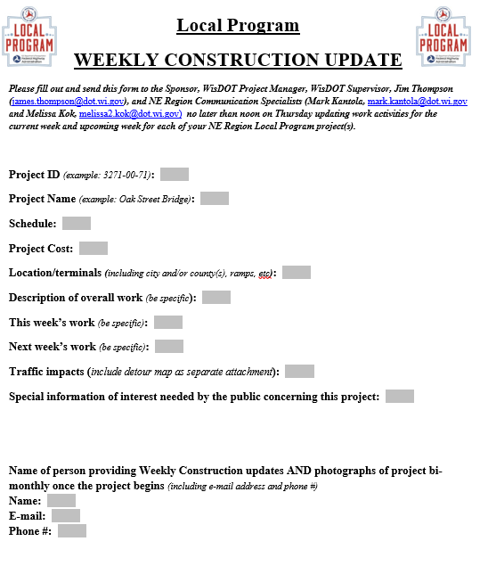

Slide 8
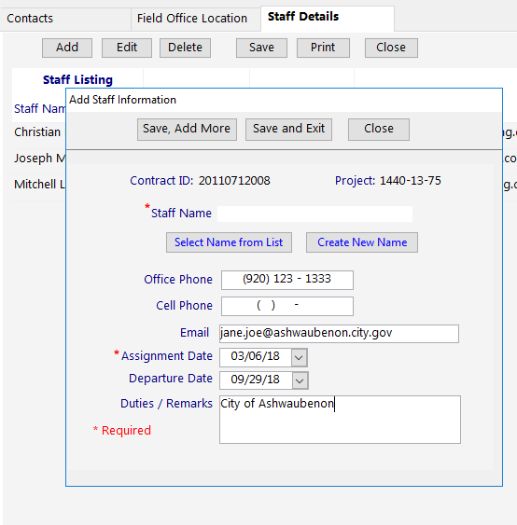
Local Program
Enter Sponsor Contact Info in FIT
Enter City or Township in the duties / remarks box
Field Construction Guide, pg. 16

Slide 9
Notice to Proceed Process
Notice to Proceed (NTP), pg. 23
  Issued by contract specialist (CS)
  Only ONE NTP per contract
  Time charges start 10 days after NTP or when controlling work begins (whichever is first).
  May include restrictions (ECIP not approved, RR insurance not received, etc.)
Notes:
Want to clear up ongoing confusion of NTP/conditional NTP. We only issue ONE notice to proceed.
There may still be some unique situations such as early clearing for NELB that uses language other than the 10 days, and we handle those on a case-by-case basis.

Slide 10
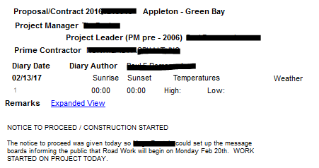
Document NTP and
Construction Start Date in Diary
Example
Notes:
Remember to document NTP issued date and construction start date in Diaries.
Include the type of work that began. Also mention any restrictions.

Slide 11

Restrictions Removed Notice
  PM emails the Prime, project engineer, CQA, and CS that all over work can begin.
  CS saves email to N drive.
  Project engineer records in diary that ECIP approved, etc. and all contract work can begin.
Notes:
The most typical restriction on a notice to proceed is due to the ECIP not being approved yet. Once the ECIP is approved, it’s the duty of the project manager to email the Prime, CQA, and Contract Specialist inform them that all work can begin.
The contract specialist saves the email to file.
The project engineer records date that ECIP was approved and all other contract work can begin. Creates diary entry to reflect this.

Slide 12
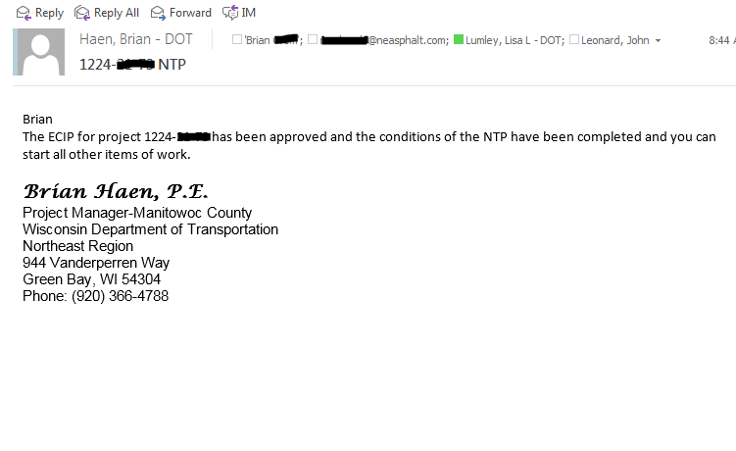
Example
Notes:
Example email from PM. Like previously mentioned, this flags the project engineer that they should follow up with diary entry that ECIP was approved on X date and all other contract work can begin.

Slide 13

Documenting Time – Important Reminders
Difference between “construction start date” and “time charges start date.”
  Construction Start Date: Date contractor begins any onsite work, including staking, traffic control, etc.
  Time Charges Start Date: 10 days after NTP or when controlling work starts, whichever first.
Notes:
That leads us into out next topic, that we remind people about quite often because we see it again and again in the finals documentation… Confusion about construction start date and time charges start date.
Project engineers must enter dates in diary entries for both construction start date and time charges start date.

Slide 14
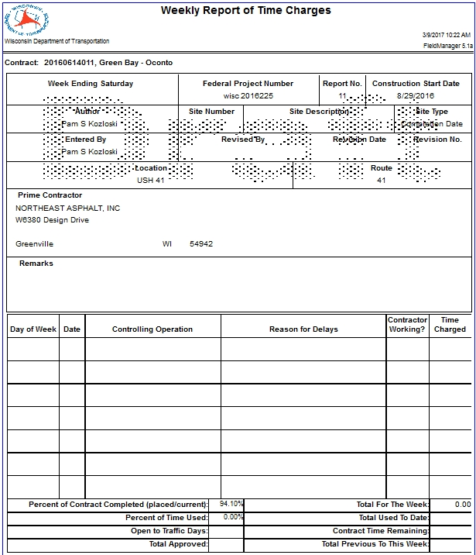
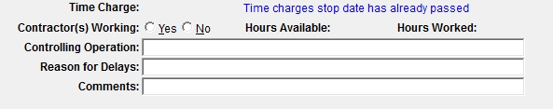
September 3, 2016
1
0
Traffic Control Signs PCMS
Construction started 8/29/16 with the installation of message boards. Time charges will start 10 days from the Notice to Proceed or when controlling work starts, whichever is first.
Sunday
8/28
Monday
8/29
Traffic Control Signs PCMS
Yes
0
Tuesday
8/30
No
0
Wednesday
Construction Staking
Yes
0
8/31
Thursday
9/1
Locating No Passing Zones
Yes
0
Friday
9/2
No
0
Saturday
9/3
No
0
Notes:
Here is an example of an entry for documenting contractor onsite installing traffic control signs and staking. Note the ZERO days time charged.
Weekly Report of Time Charges for Working Day Contracts should begin from the Construction Start Date. Remarks may be necessary about work starting on non controlling items.

Slide 15
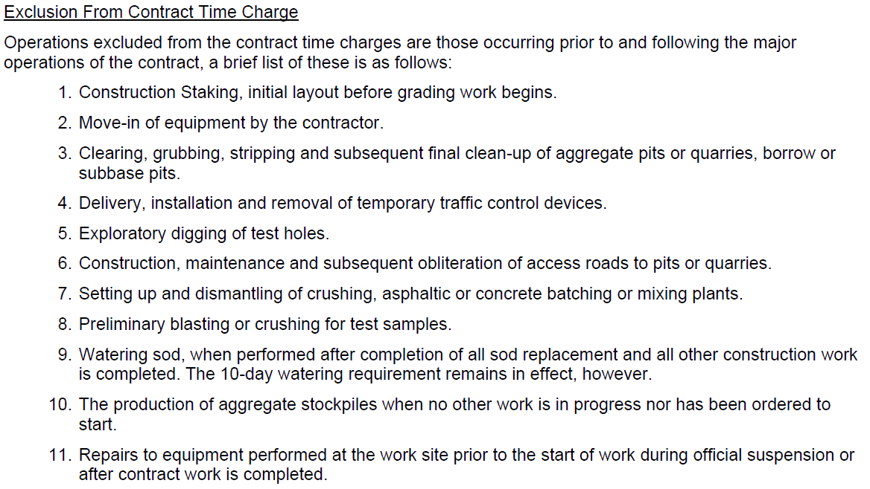
(FDM 19-10-30)
Notes:
List of exclusions from contract time charges from FDM 19-10-30
This is non-controlling work that may be performed after the NTP with restrictions is used and before the time charges begin.

Slide 16
September 10, 2016
2
1
8
0
Removing Asphaltic Surface
Contractor’s Choice
Time charges started 9/5/16 since it was 10 days from the Notice to Proceed, however no time was charged due to the holiday work restriction.
Sunday
9/4
Monday
9/5
Removing Asphaltic Surface
Holiday Restriction
No
0
Tuesday
9/6
Removing Asphaltic Surface
Contractor’s Choice
No
1
Wednesday
9/7
Removing Asphaltic Surface
Adverse Weather – Heavy Rain
Yes
0.5
Thursday
9/8
HMA Pavement
Yes
1
Friday
9/9
HMA Pavement
Noon Traffic Restriction
Yes
0.5
Saturday
9/10
HMA Pavement
No
0
Notes:
This example shows that time charges started on 9/5 because 10 days past after NTP was issued. No time charged due to holiday restriction documented in the “reason for delay” box (also should be in diary entry). Documented in the “Remarks Box” and in diary.
Text in the “Comments” field does not show up on the Weekly Report of Time Charges, so comments should be made in the Reason for Delay field.

Slide 17

Conditional Final Acceptance Letters
Requested by project engineer when punch list is complete
Alleviates responsibility of contractor on project
Can include exceptions, if necessary
Notes:
Now let’s talk about the end of the project. I touched on this last year, but I wanted to mention this again because we’ve been seeing a fair number of projects that do not have conditional final acceptance letters.
Punch List Complete Date: Date when required contract documentation, minor corrective work, and cleanup work are all complete
Examples of outstanding issues: remove silt fence, plant establishment, etc.
In some instances, the Project Engineer may find extra work after the punch list is given to the Prime or has been completed.
Discuss with PM and Krissy/Lisa to determine if more time should be added to the contract to complete remaining work.

Slide 18
Extending punch list date
PM and project engineer consult with CQA. Upon mutual agreeance with contractor, PM:
  Forwards substantially complete notification to contractor, project engineer, CQA, and CS including punch list and agreed upon punch list date (pg. 25).
  CS will save email for project records.
Notes:
Should try to complete punch list work within 5 days after time charges stop and complete punch list documentation 15 days after time charges stop. If punch list date must be extended….

Slide 19
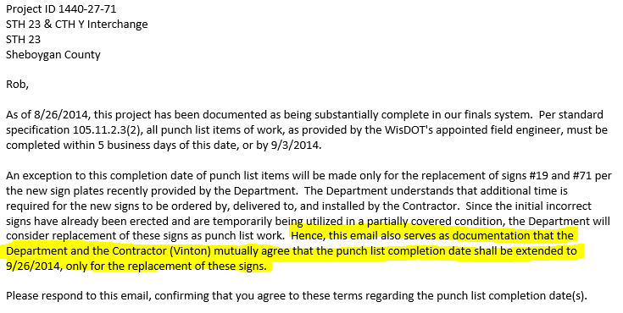
Extending punch list date
Notes:
This is an example email from the project manager to the contractor explaining an exception to the punch list date.
Email for extending the entire punchlist date can be written similar to this format. Remember to cc the contractor specialist, CQA, and project supervisor.

Slide 20
Project Recap Meetings
Only for projects designed in-house
Meeting at the end of a project to discuss lessons learned
Focus on as-builts, contract mods, overruns/underruns, provide two-way communication between construction and design

Slide 21
Project Recap Meetings
Who goes?
Required Attendees: | Optional/ONLY IF CONCERNS need to be addressed
Design Quality Assurance Engineer | Pavement Engineer
Design Lead/PDS Design Team | Soils Engineer
Design Project Manager | Materials Engineer
Construction Quality Assurance Engineer | Work Zone Engineer
Construction Lead/Construction Inspection Team | Utility Engineer
Construction Project Manager | Storm Water Engineer
 | Survey Coordinator
 | Real Estate Supervisor
 | Real Estate Lead
 | Roadway Maintenance Engineer
 | Railroad Specialist
 | EEO Officer
 | PDS Supervisor
 | Construction Specialist Engineer
 | Signals/Lighting Engineer
 | Design Supervisor
 | Construction Supervisor

Slide 22

Contract Mod Activity

Slide 23
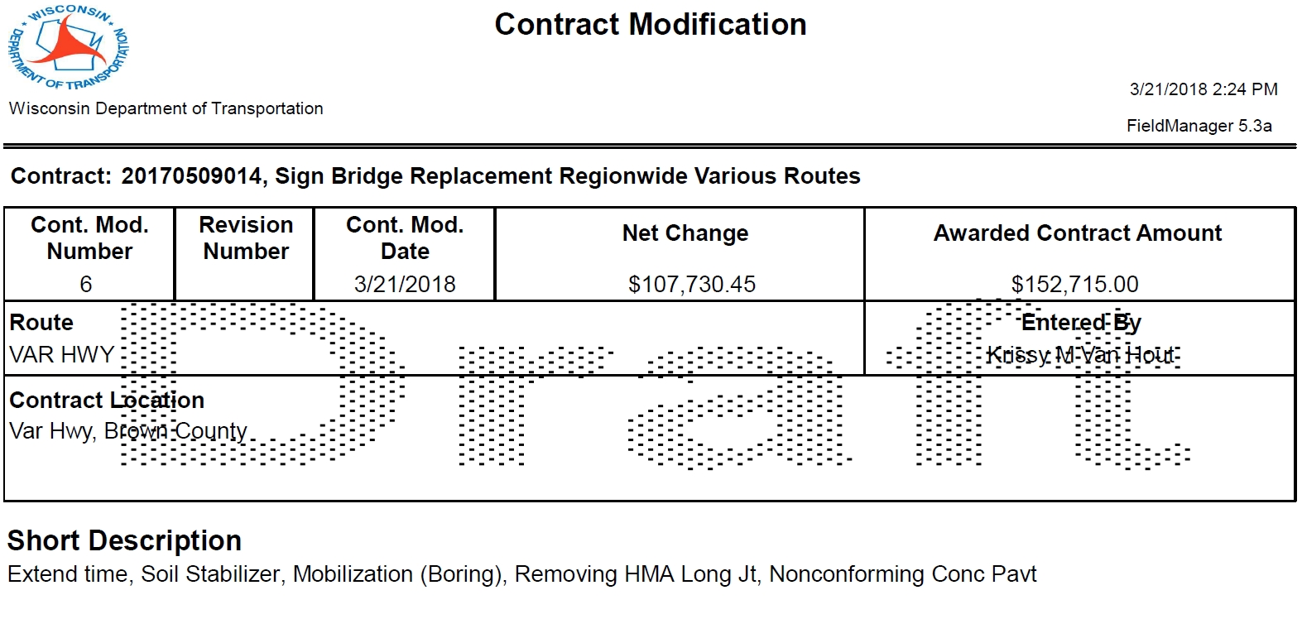

Slide 24
Description
An additional 5 working days will be added to the contract by this contract modification. However, the department will not include the cost of the additional work from this contract modification in calculating additional time as provided in standard spec 108.4.2.4 (2) since this contract modification addresses the necessary time extension required to complete this work. ____________________________________________________________________Revised sheet 115 is attached and made part of the plans for this contract.
____________________________________________________________________ Increase the contract quantity of the following item:
Conduit Rigid Nonmetallic Schedule 40 2-Inch, Item 652.0225
____________________________________________________________________

Slide 25
____________________________________________________________________
Add the following standard items to the contract:
Concrete Pavement 10-Inch – Price Reduction – Nonconforming Material – Air Content, Item 415.0100
Soil Stabilizer Type B, Item 628.6510
Mobilization (Bodart Boring), Item 619.1000
Amend subsection 619.5 as follows:
(3) Payment for Mobilization (Bodart Boring) is full compensation for supplying and providing all materials, facilities, services, and performing all work necessary to complete this item.
____________________________________________________________________

Slide 26
_____________________________________________________________________Add the following special item to the contract:
Removing HMA Longitudinal Joint Milling, Item SPV.0090.08
A Description
This special provision describes milling the longitudinal notched wedge joint prior to placing the adjacent HMA pavement.
B (Vacant)
C Construction
Remove the notched wedge longitudinal joint constructed according to standard spec 450.3.2.8 prior to paving the adjacent lane. Provide a uniform milled surface that is reasonably plane, free of excessively large scarification marks, and has the grade and transverse slope the plans show or the engineer directs. Do not damage the remaining pavement.
Use a self-propelled milling machine with depth, grade, and slope controls. Shroud the drum to prevent discharging loosened material onto adjacent work areas or live traffic lanes. Provide an engineer-approved dust control system.

Slide 27
Maintain one lane of the roadway for traffic at all times during working hours. Do not windrow or store material on the roadway. Clear the roadway of all materials and equipment during non-working hours.
D Measurement
The department will measure Removing HMA Longitudinal Joint Milling in length by the linear foot acceptably completed.
E Payment
The department will pay for measured items at the agreed unit price for the following item:
Item Number Description Unit
SPV.0090.08 Removing HMA Longitudinal Joint Milling LF
Payment is full compensation for removing HMA pavement; and for hauling and disposal of materials.

Slide 28
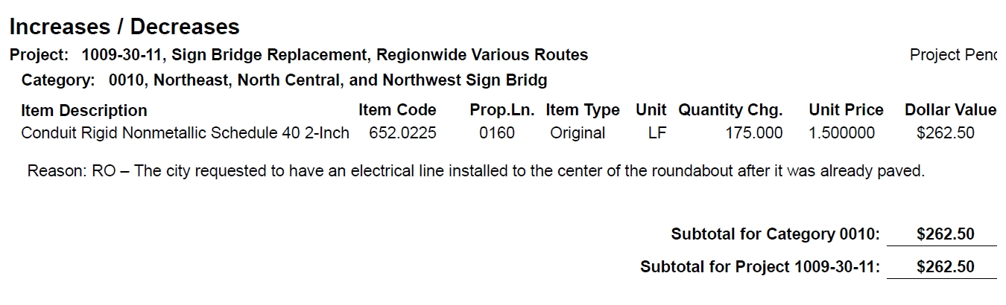

Slide 29
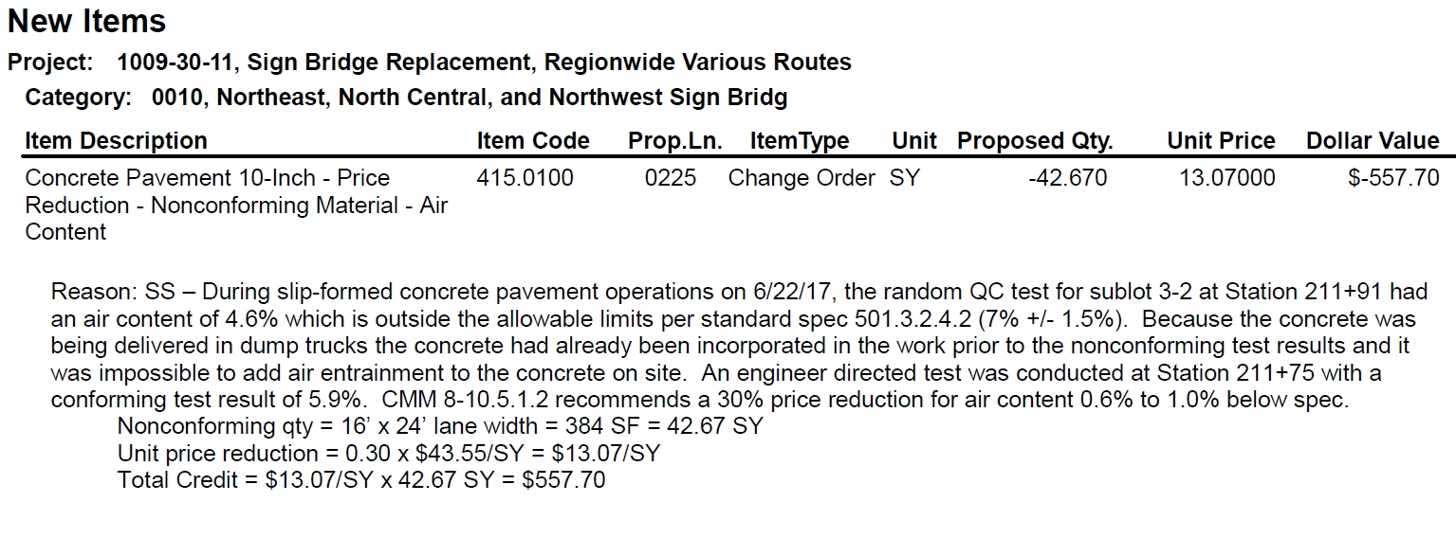

Slide 30
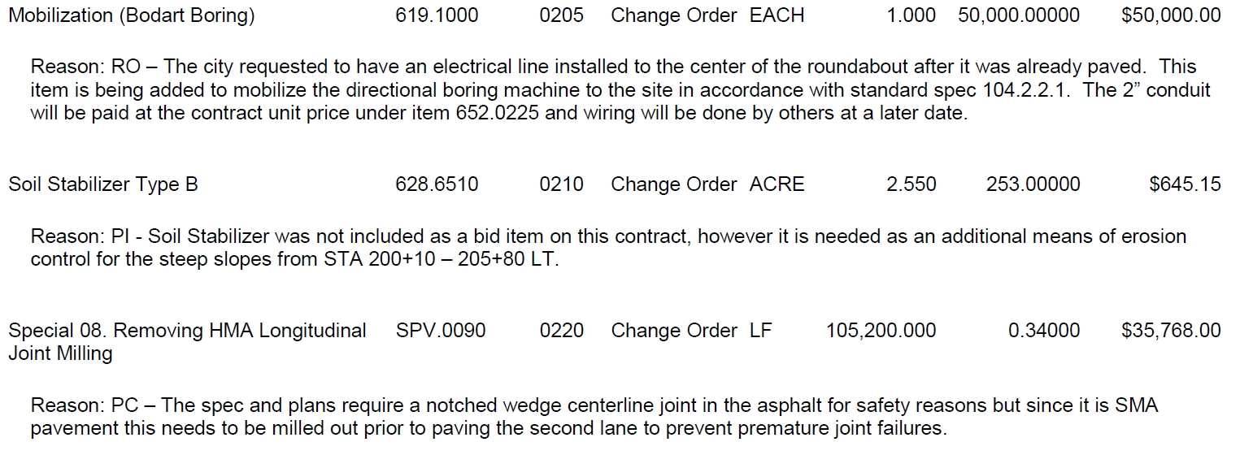

Slide 31
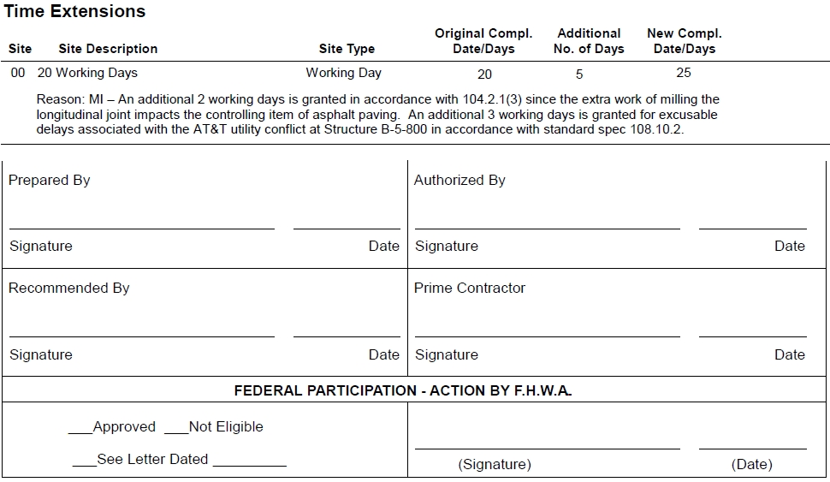

Slide 32
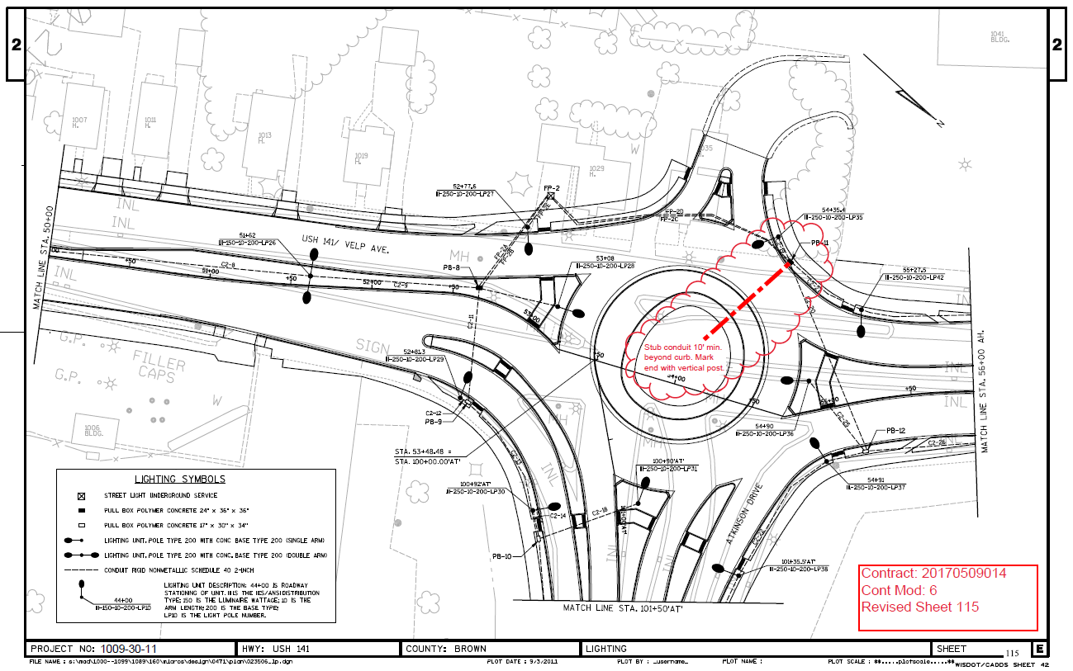

Slide 33

Questions?

