Slide 1
Work Zone Traffic Control Presentation
2018 NE Construction Training
March 22, 2018

Slide 2
Work Zone Topics
Standard Spec 643 Rewrite/ASP 6
Flagging Issues
Drop-offs
WisTMP
Temporary Pedestrian Accommodations
SDD Changes for 2018
Lane Closure System Entries

Slide 3
Standard Spec 643 Rewrite/ASP 6
Changes
Added new devices to APL list
Added 42” cones (Grabber Cone/Slimline Channelizer)
TC Device Placement/Removal

Slide 4
Standard Spec 643 Rewrite/ASP 6
Changes
Removed TC Detour and Detour Signs
Added new Traffic Control each bid item (643.5000)

Slide 5
Standard Spec 643 Rewrite/ASP 6
ASP 6 (effective with December 2017)

Slide 6
Flagging Issues
Follow Flagger’s Handbook
Do’s
Wear proper PPE
Be visible and attentive
Plan escape route for errant vehicles
Slow/Stop paddle in good and visible condition
Don’ts
Turning back to traffic
Leave flagging advance signage up
Sit down
Stand next to your vehicle
2019 Flagging Certification through ATSSA or NSC?

Slide 7
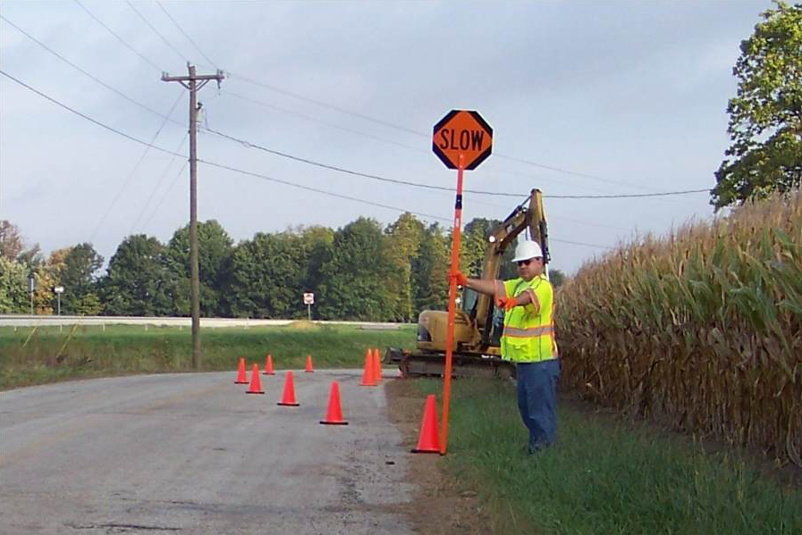
Flagging Issues
Proper Flagging Techniques

Slide 8
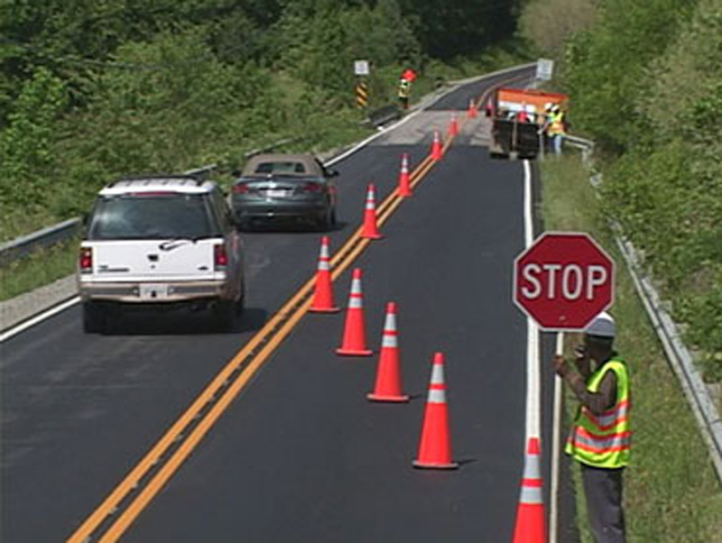
Flagging Issues
Proper Flagging Techniques

Slide 9
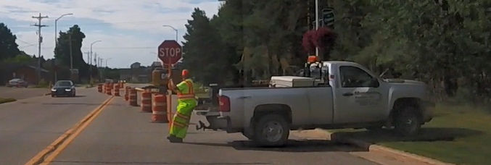
Flagging Issues
Improper Flagging Techniques

Slide 10
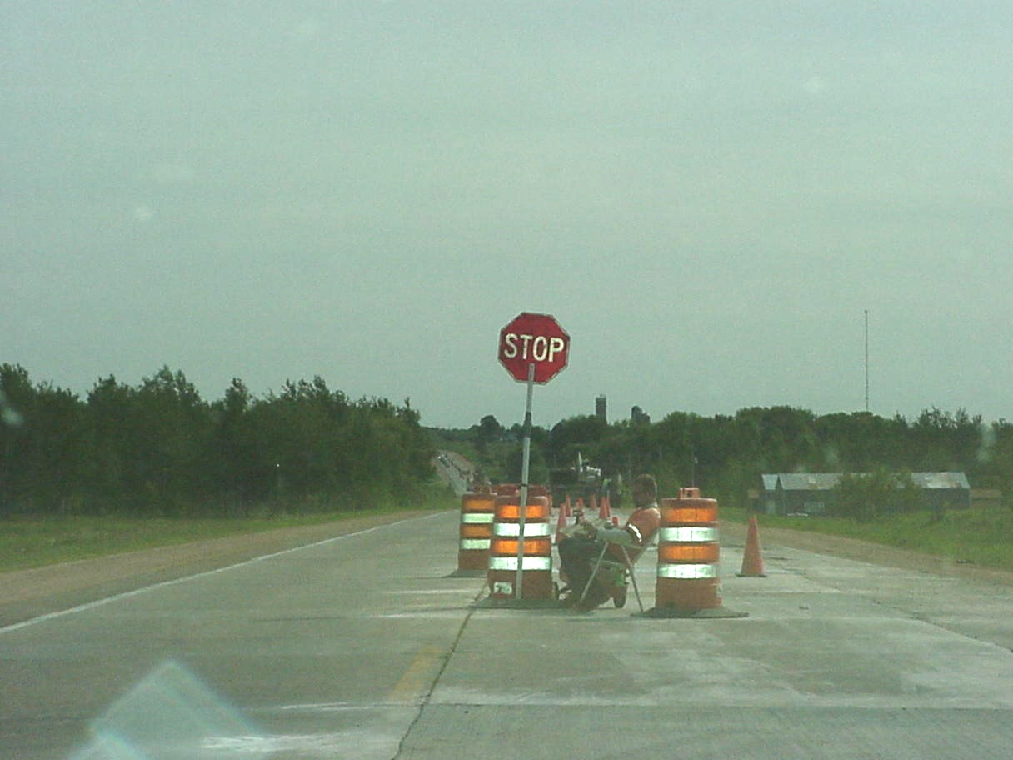
Flagging Issues
Improper Flagging Techniques

Slide 11
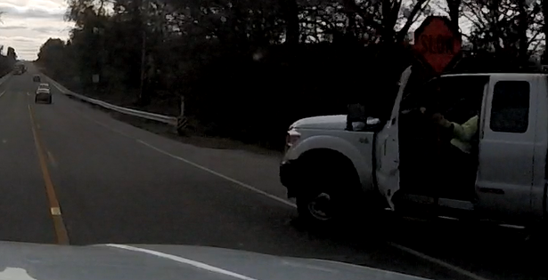
Flagging Issues
Improper Flagging Techniques

Slide 12
Drop-offs

Slide 13
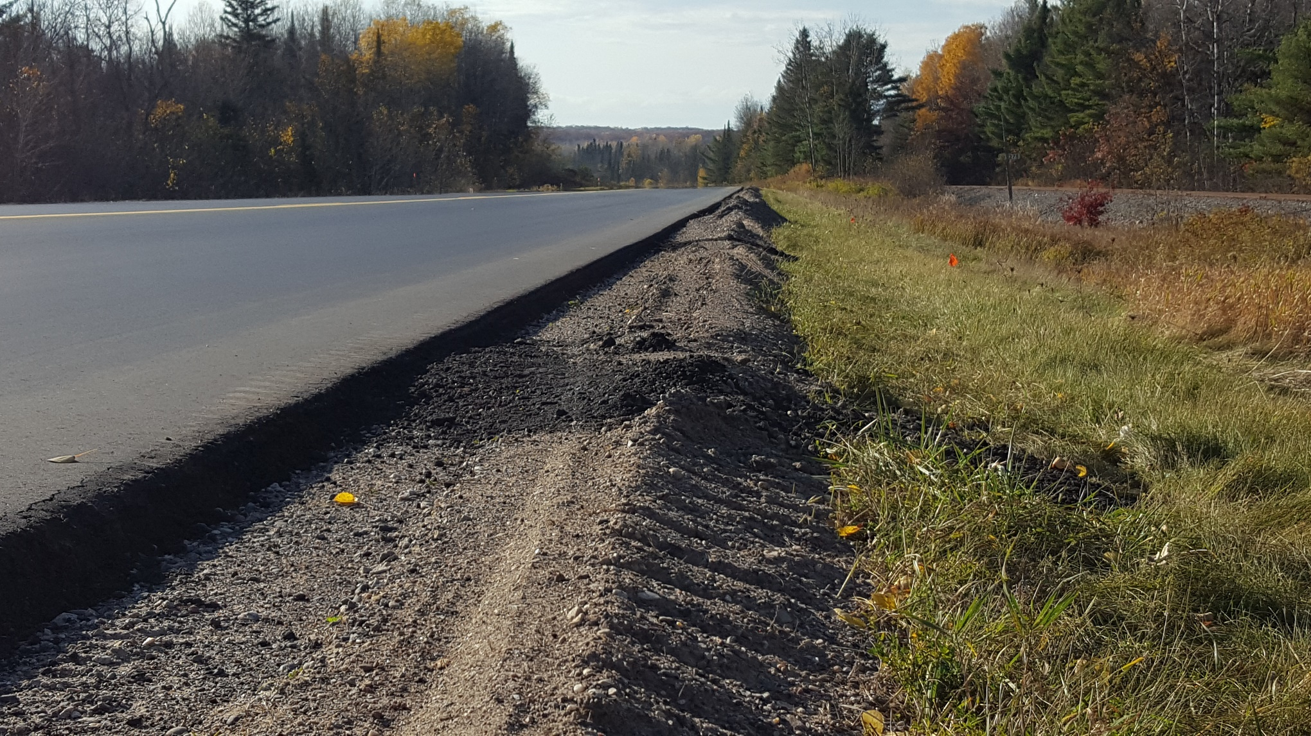
Drop-offs
Issues at the edge of paved/gravel shoulder interface

Slide 14
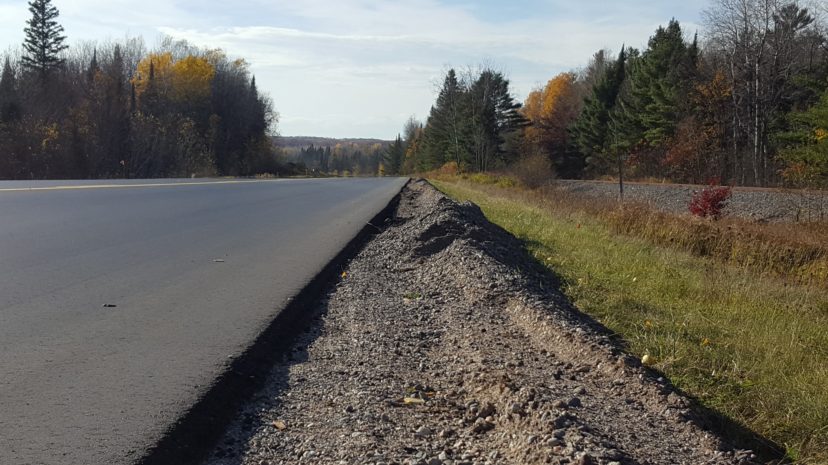
Drop-offs
Issues at the edge of paved/gravel shoulder interface

Slide 15
WisTMP
Attaching Project Amendments to the WisTMP
FDM 11-50-5.7.5 - Monitor TMP
FDM 11-50-5.7.6 Post Construction Project Evaluation
Did queue exceed what was approximated in the analysis of the TMP?
Did the mitigation strategies work?
What changes were made during construction that impacted the TMP? (allowable lane closure hours, work hours, etc)
Total number if incidents/crashes that occurred?
Any complaints from public?
Project Close out at the end of the project
Notes:
Attach amendments (after 90% approval) to the WisTMP so we have better documentation
Construction Staff needs to be monitoring the TMP to make sure mitigation strategies are effective, the queue and delay is what was predicted in the TMP analysis, lane closure hours are acceptable (could they be extended or do they need to be shortened), documented complaints from the traveling public, incidents occurring in the work zone.
Attach Post Evaluation summary document to WisTMP that includes information provided in 11-50.5.7.6 (there is a bulleted list of information that should be documented)
Reminder to PM’s to change project from 90% to marked as completed for Project Close Out in the TMP System

Slide 16
Temporary Pedestrian Accommodations

Slide 17
Temporary Pedestrian Accommodations

Slide 18
Temporary Pedestrian Accommodations

Slide 19
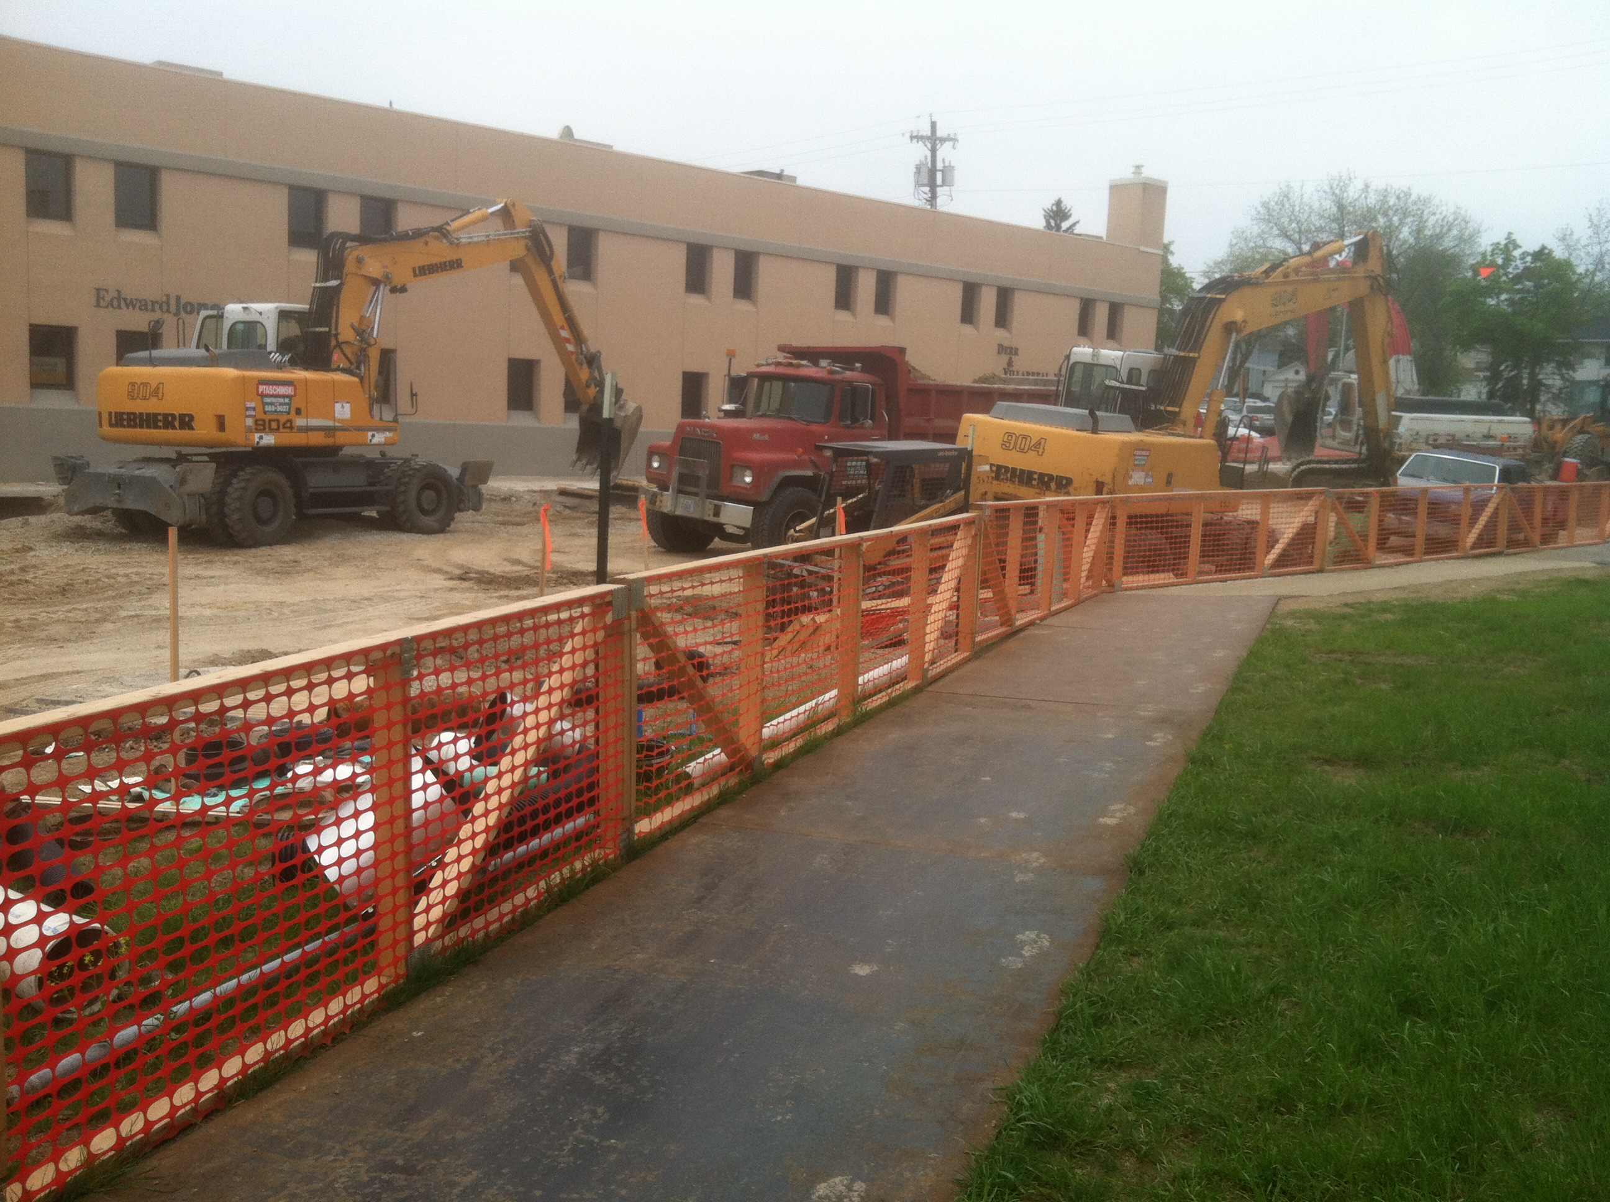
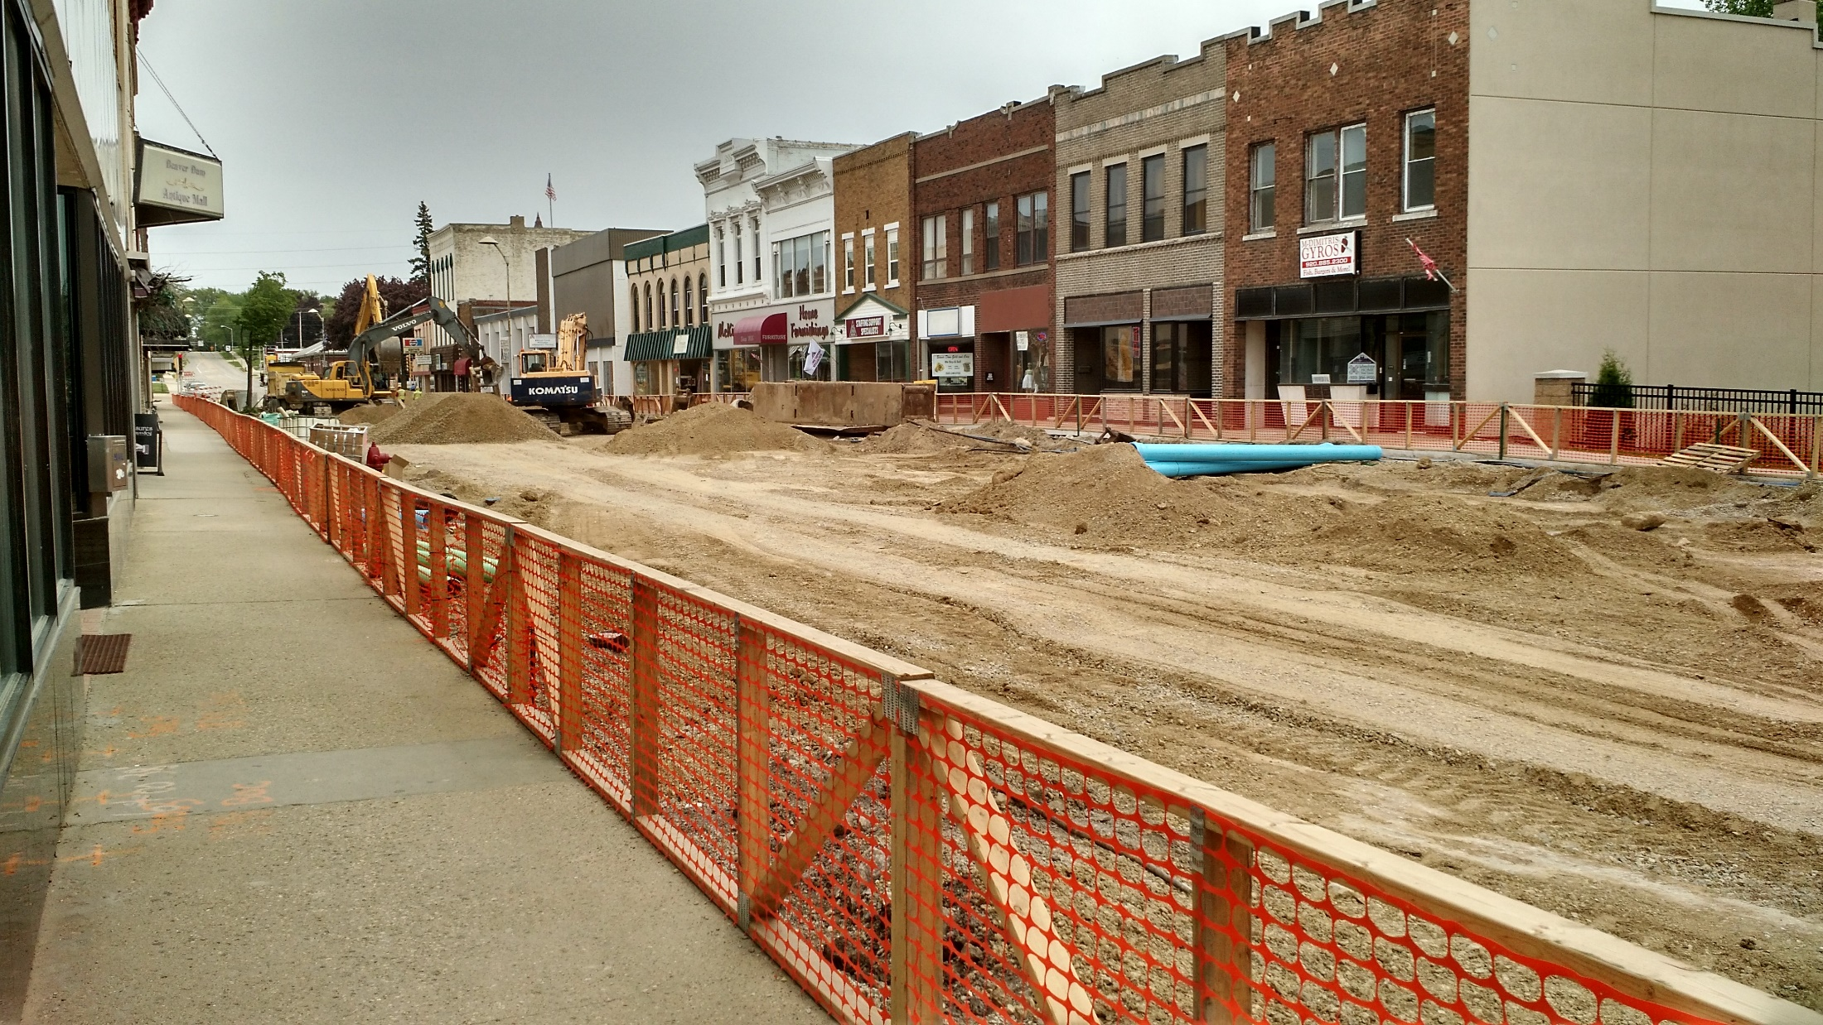
Temporary Pedestrian Accommodations

Slide 20
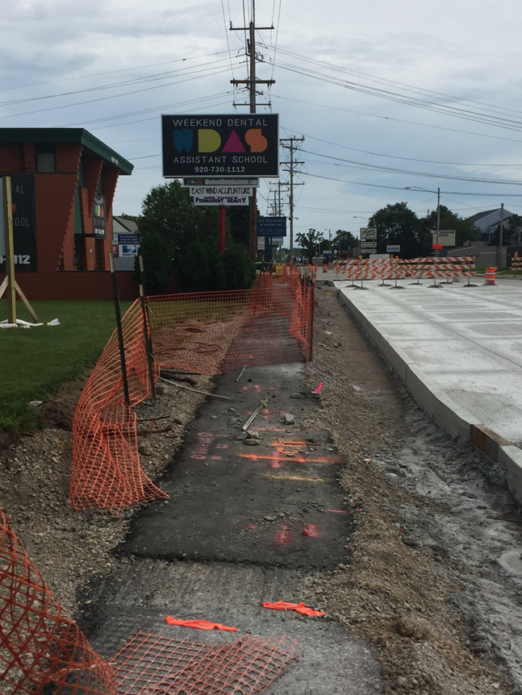
Temporary Pedestrian Accommodations

Slide 21
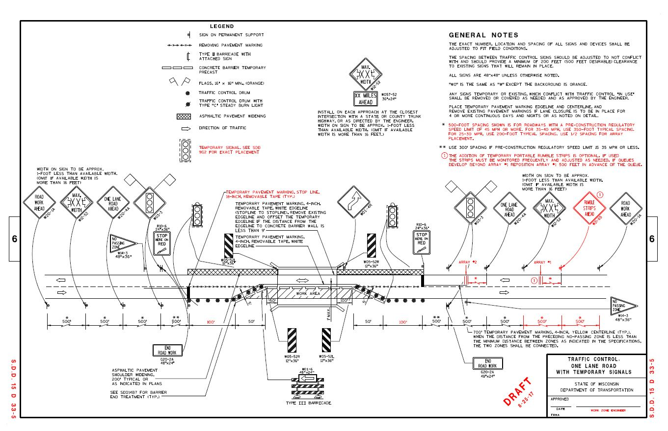
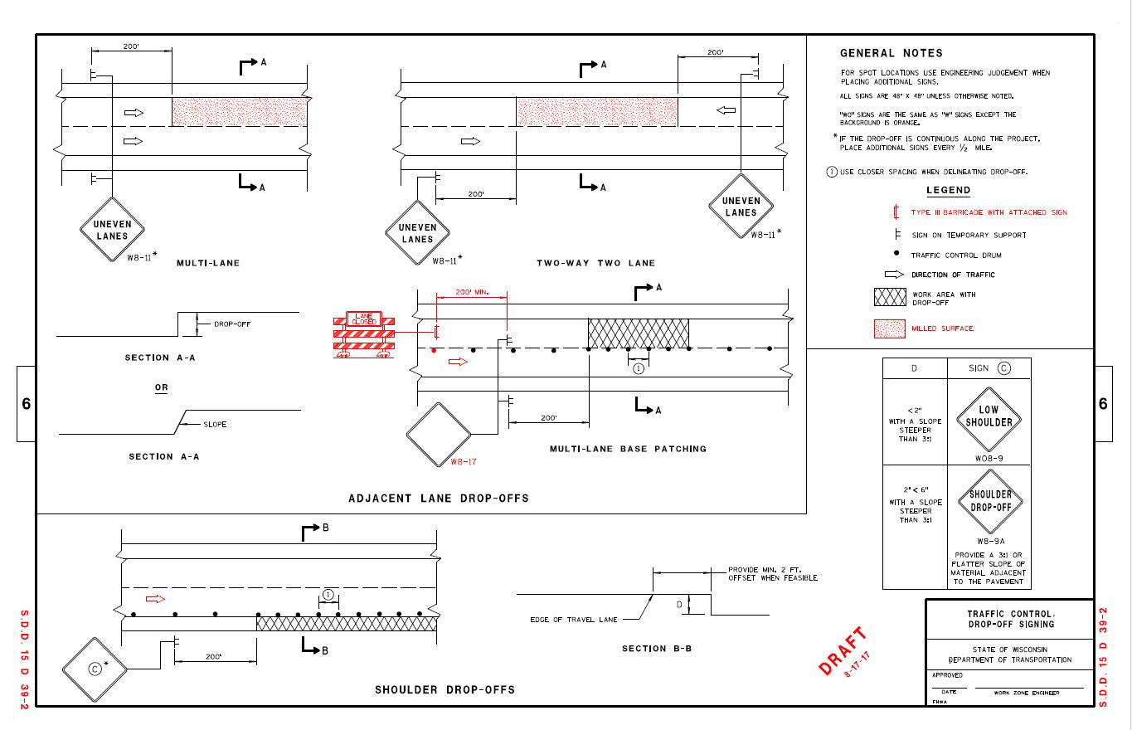
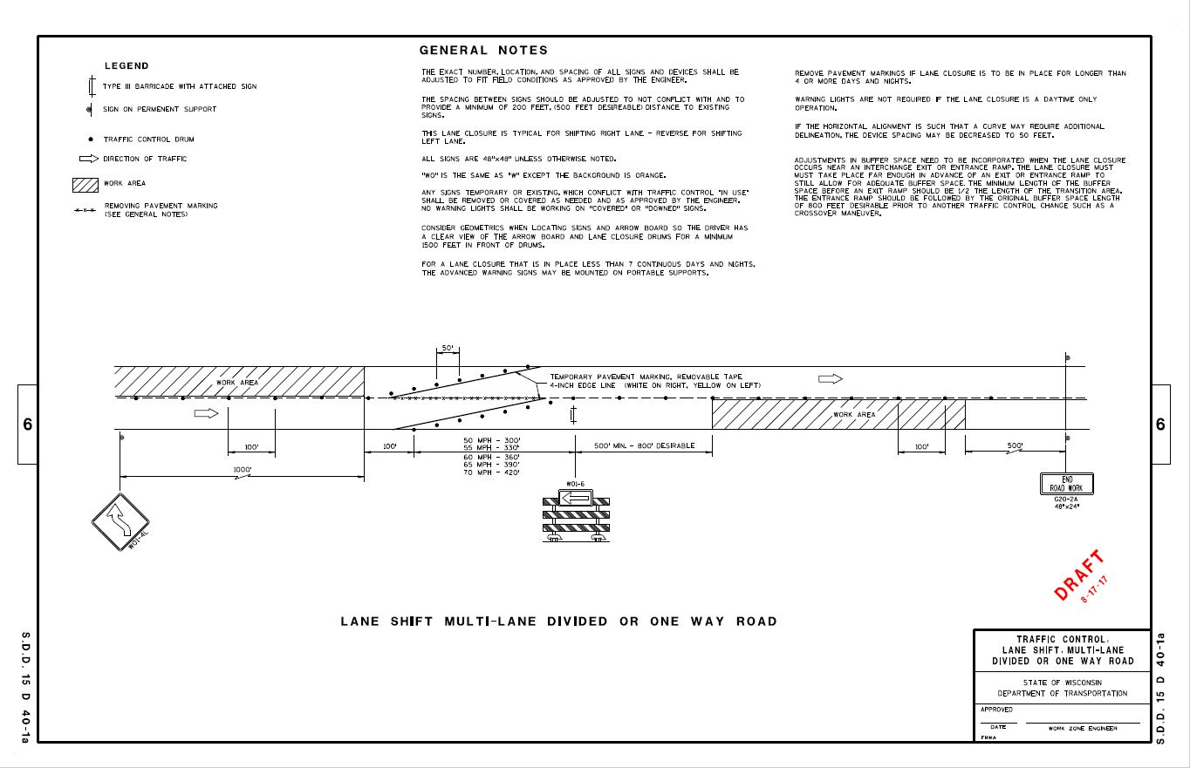
SDD Updates
SDD 15D33 – One Lane Road w/ Temp Signals (Revised)
SDD 15D39 - Drop-offs (Revised)
SDD 15D40-1A – Lane Shift for Multi-lane, Divided Roadway(New)
Notes:
-Drop-off’s SDD covers when and where “Uneven Lanes” signage needs to applied, as well as “Low Shoulder” and “Shoulder Drop-off” signs for any work on the shoulders

Slide 22
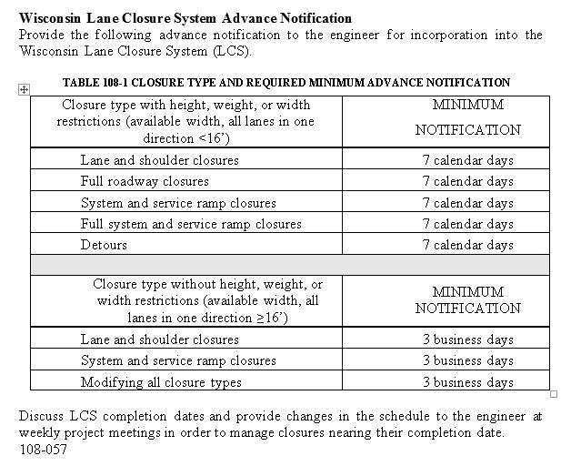
Lane Closure System Entries
STSP 108-057

Slide 23
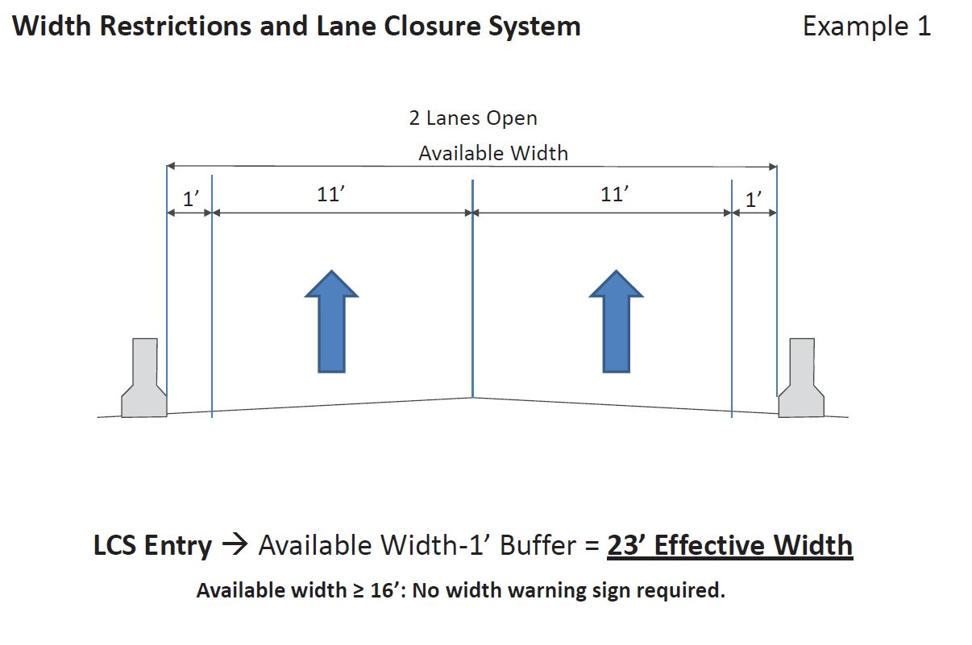
Lane Closure System Entries
Available Width Definition

Slide 24
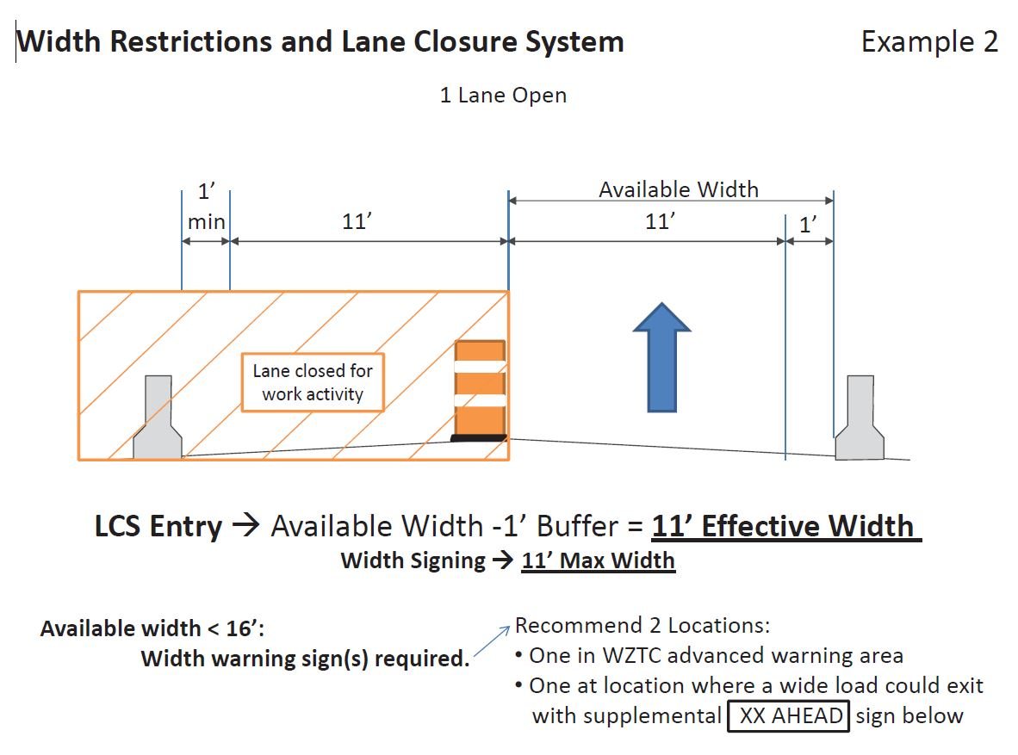
Lane Closure System Entries
Available Width Definition

Slide 25
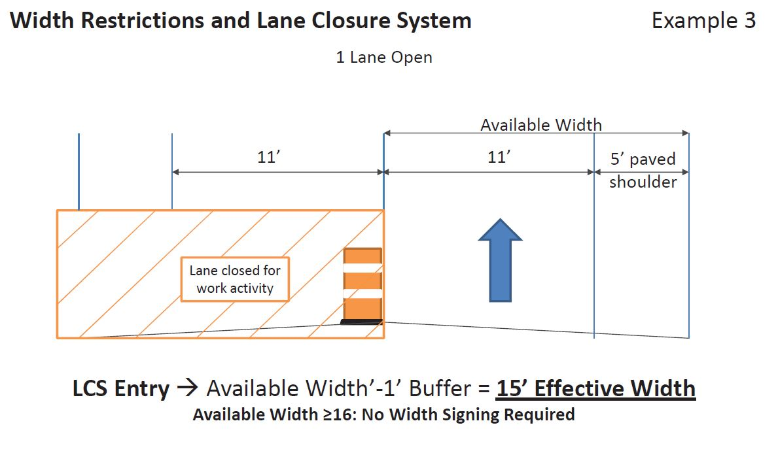
Lane Closure System Entries
Available Width Definition

Slide 26
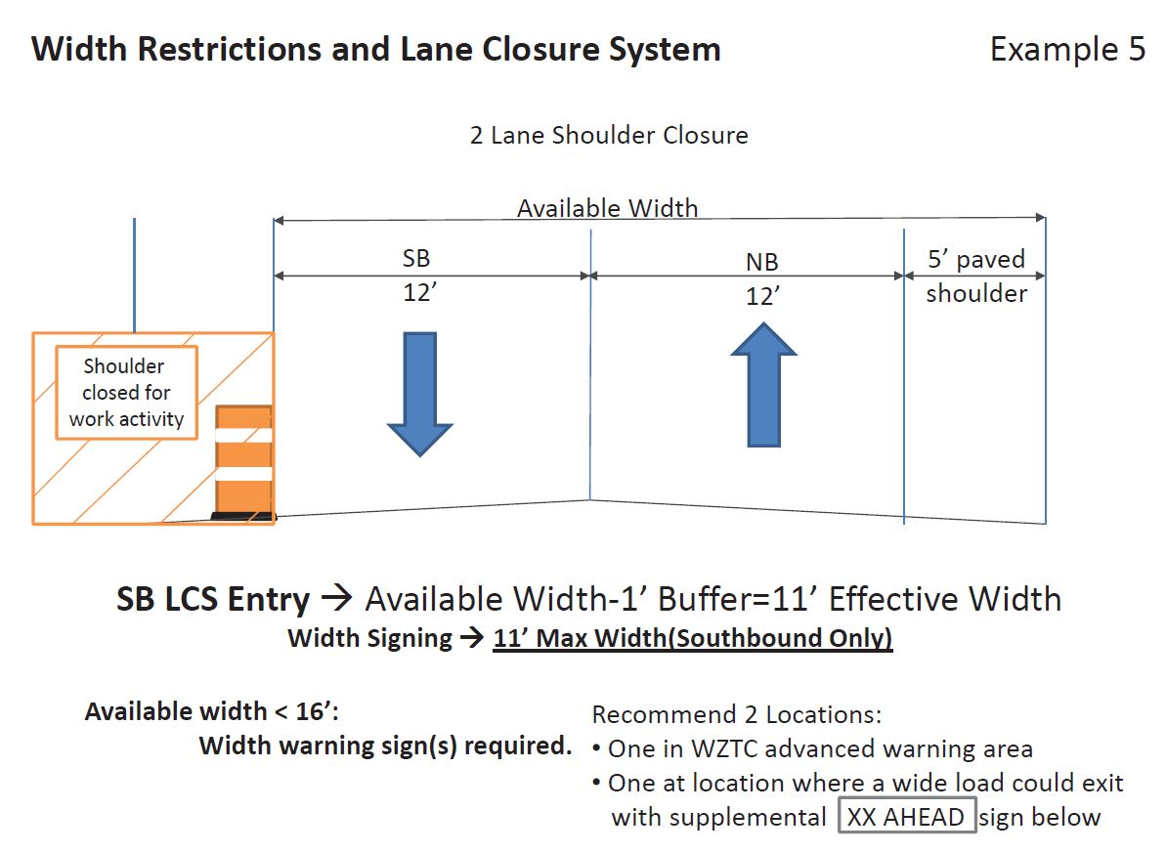
Lane Closure System Entries
Available Width Definition

Slide 27
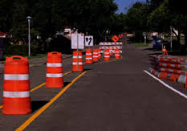
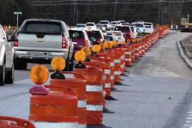
Questions?
Contact Information
Joshua Falk
Work Zone/TC Engineer
joshua.falk@dot.wi.gov
920-366-8033

