Slide 1

Performance Measures
NER Construction Training
March 22, 2018

Slide 2
Construction Related Measures
On-time
On-budget
Construction Quality Index
Finals Closeout
Construction Delivery Cost Index
Notes:
The first two measures on the list are part of the official MAPSS Performance Improvement Program, however all of them are really a means of accountability or a continuous effort to use public dollars in the most efficient and cost effective way.

Slide 3
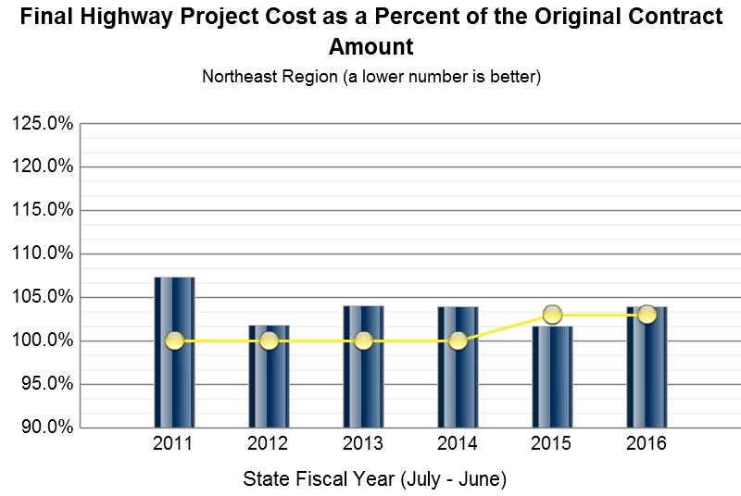
On-Budget Performance
Current Goal ≤ 103%
107.3 101.8 104.0 103.9 101.7 103.9
Notes:
Finishing highway projects on budget helps keep us accountable for the use of limited public funds and allows us to schedule future projects more effectively. This measure compares the actual construction costs (excluding engineering and project oversight) with the original contract amount and computes it as a percentage. This takes into account item overruns, underruns and contract modifications in the state and majors programs. The goal is to not exceed the original contract amount by more than 3%. The main factors that influence this measure are the quality and completeness of project designs, changes in field conditions, weather and contract oversight.
As you may recall this was identified in the LAB Audit. There was a desire to see more accurate reporting based on actual final costs. An analysis team has been working on this measure.

Slide 4
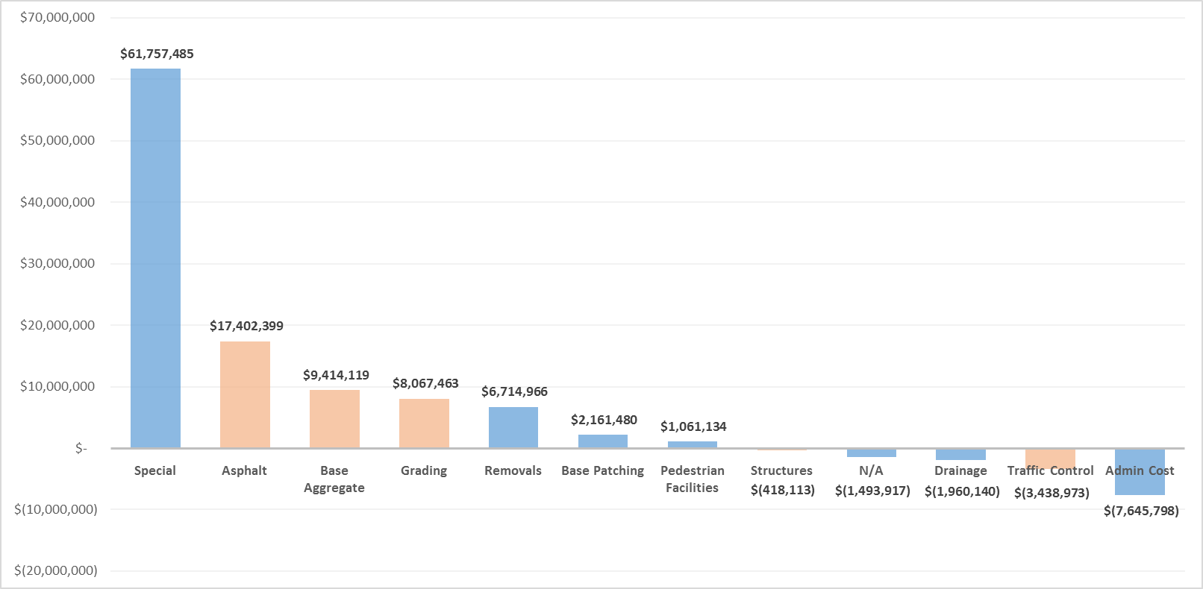
On-Budget Performance
NET VARIATION FROM EXPECTED TOTAL COST
FY2014-FY2016
Notes:
FY 2014, 2015, 2016
939 Projects
~$3 Billion with ~$72 Million additional project costs incurred during construction
Project staff can aid with the on-budget analysis by doing the following:
Try to use standard items for CCO work.
Increase/decrease existing bid items related to CCO work.
Construction reminders to reduce overruns:
Asphalt yield checks
Minimize exposed subgrade, limit heavy loads and provide drainage
Not all aggregate tickets submitted should be paid.

Slide 5
Construction Quality Index (CQI)
Form no longer needs to be completed
Still must perform project walk-thru
Foster a culture of high quality
Notes:
While budget is important, our top priority is delivering a quality product.
However….
The decision has recently been made to discontinue this performance measure. So recently in fact, that our region construction manual still contains the instructions for CQI.
We will still complete a project walk-thru near the end of the project in an effort to resolve issues while the contractor is still onsite but we won’t fill out the draft CQI form or perform the 6 month follow up.
We still need to hold our contractors to a high quality standard. That means emphasizing it prior to work operations and addressing concerns during operations. Remove/replace or credits are more reactive, less desirable measures. Our lower ratings tend to be areas of drainage, bridge approaches, expansion joints, and shoulder finishing so those are areas that more attention can be focused on.

Slide 6
Finals Closeout
Goal ≥ 45%
Notes:
Closing out project finals on time allows contractors to get their final payments in a timely manner; allows the department to liquidate unneeded funding and re-direct it to other projects; frees up staff to do other duties; and allows us to properly close out projects with FHWA. The target goal for a fiscal year is to have 55% of projects achieve the final estimate approved for payment within 180 days from substantially complete. This graph shows where we stack up on projects from fiscal year 2017. Again the number one region congrats!

Slide 7
Finals Closeout
Notes:
The finals tracking report further breaks down the projects so we can see the status on a monthly basis. For example dark blue is projects that have met the closeout goal, orange is projects that did not meet the goal and the other colors show projects that are still in process. These percentages will continue to shift with an expected increase in the percent meeting the goal as more projects complete the finals process. It’s important to follow thru on projects with plant establishment periods (shown in green) as soon as the period ends October 15th. Every project is important with each one counting over 2%.
This chart represents the 2017 construction season. We are already at 30% with a lot of our projects still in the process. We are doing much better than the previous years thanks to everyone’s hard efforts.

Slide 8
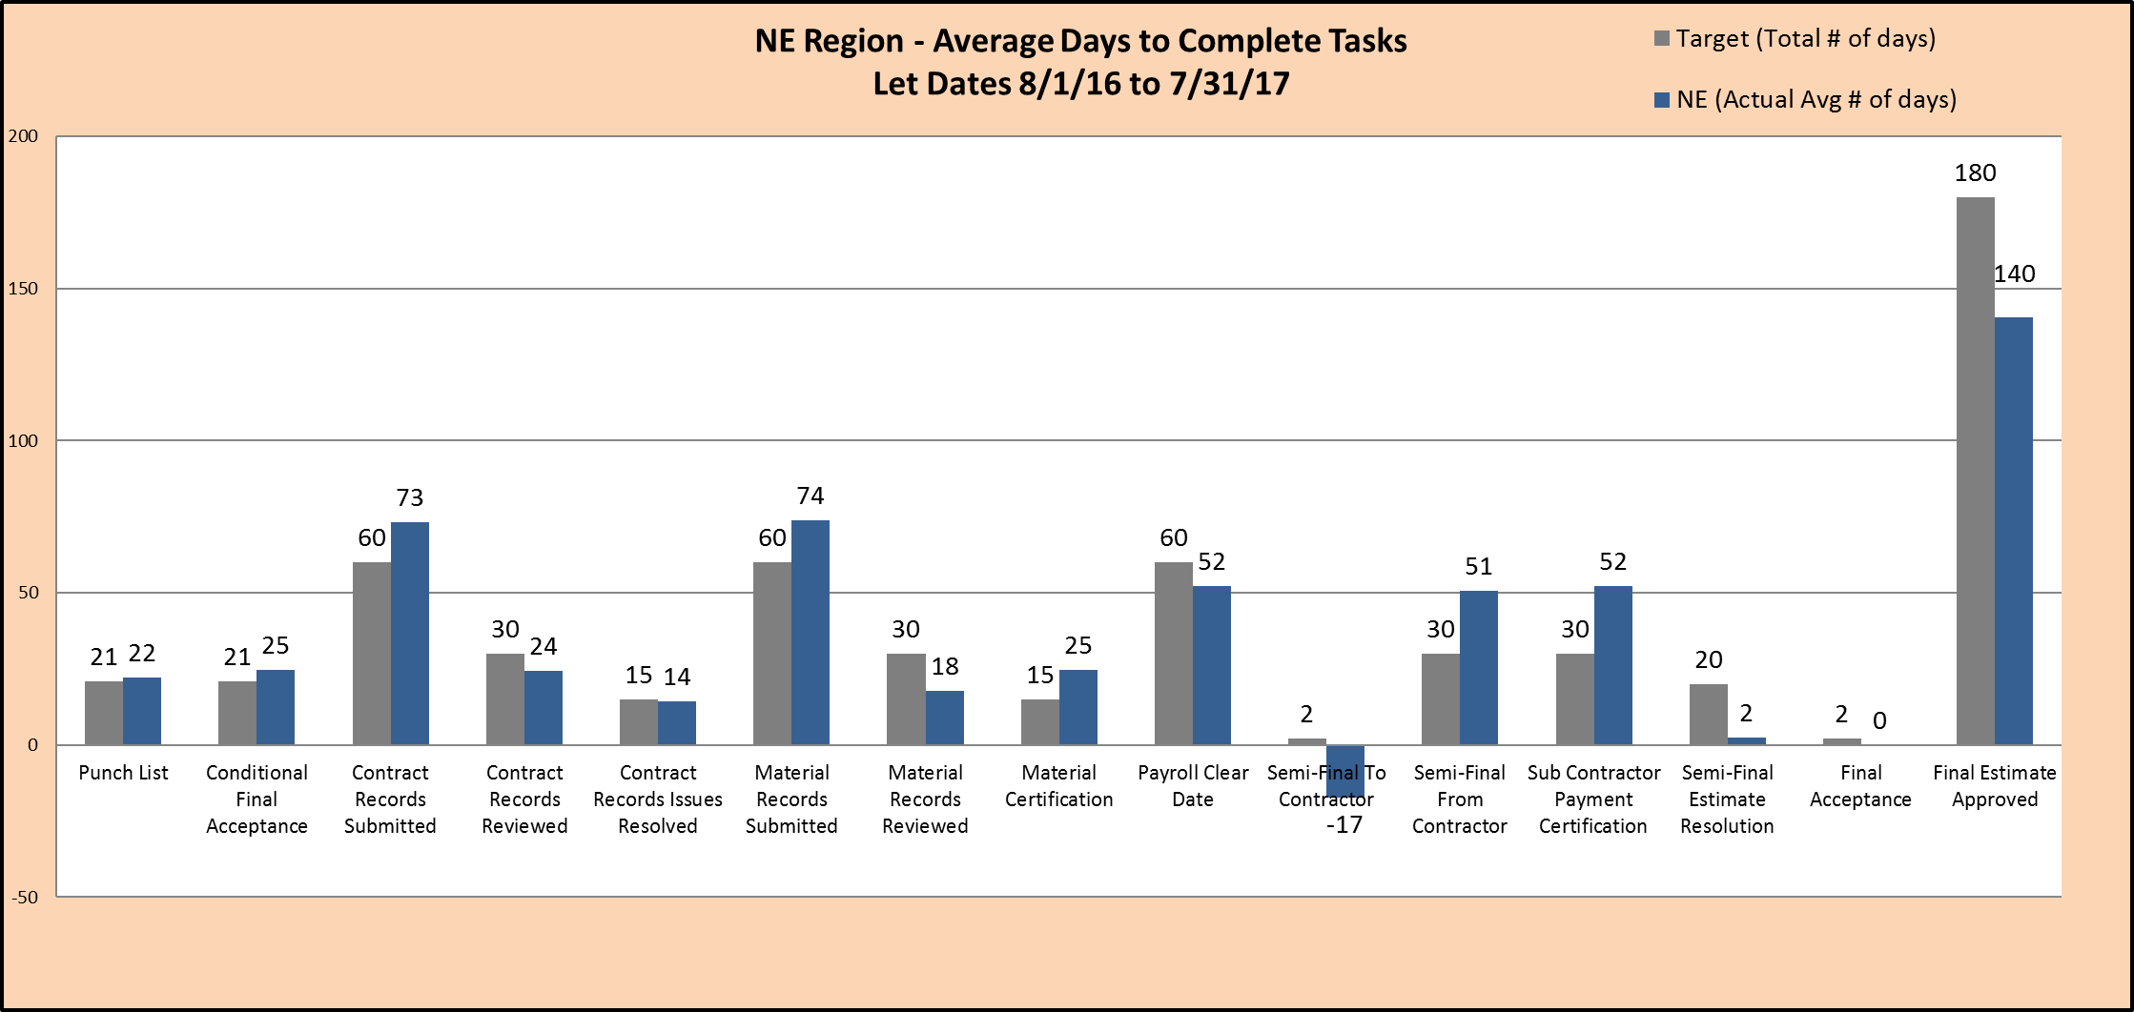
Finals Closeout
Notes:
The average number of days to complete the overall process and each task within the process is also reported on.
Prior to the lean initiative, the project closeout process took an average of 325 days statewide to achieve a final estimate approved. With the new lean process in place, the total number of days has dropped to an average of 199 days statewide.
This graph shows our region averages with the tasks that most often exceed the allotted number of days being:
Conditional Final Acceptance – need to request this letter from CS
Contract Records Issues Resolved – tends to be higher due to outstanding cont mods
Material Certification – while there have been improvements from last year there are often still missing/incorrect certs and nonconforming/non-performance issues
Semi-Final From Contractor – several quantity discrepancies lately

Slide 9



