Slide 1
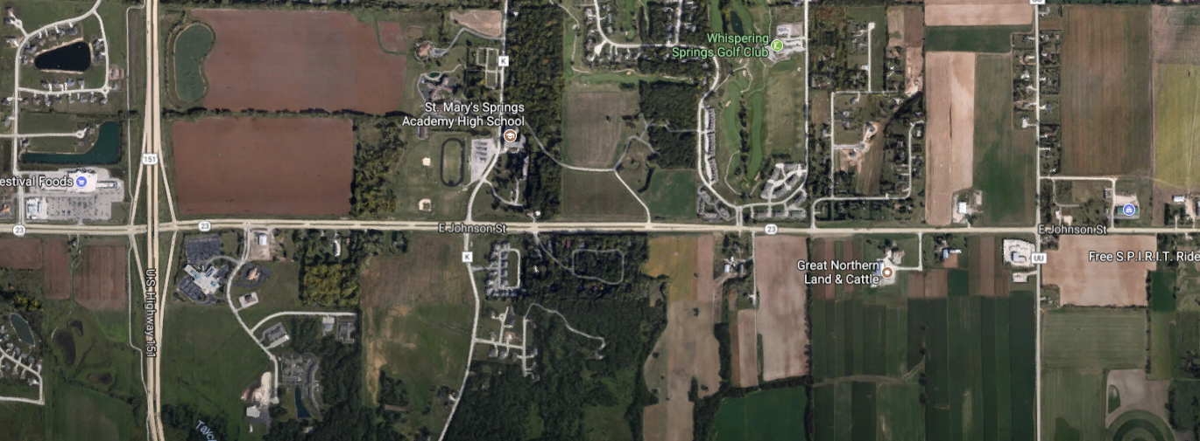
1440-39-30
STH 23
STH 151 – CTH UU
Fond du Lac County
6/23/12, 6PM, CURB
2/14/13, 3PM, TREE, Snow
10/26/12, 1PM, OTH NC, B
4/3/14, Noon, SSS
9/9/13, 9AM, Rear End
2/10/16, 3PM, Rear End
11/5/12, 2PM, OBNFX
3/10/13, 10AM, Rear End, Wet, C
10/13/16, 7AM, Rear End
1/12/16, 7AM, OTHFX, Snow
9/18/15, 5PM, Rear End
1/29/16, 11AM, Angle, C
6/27/15, 2PM, Head On, B
8/20/13, 5PM, Rear End, B
7/1/13, 4PM, Rear End, C
3/7/12, 3PM, Rear End, C
10/28/15, 6PM, Rear End, Wet
4/2/16, 8AM, Rear End, Snow
2/24/12, 5AM, SSS, Snow, B
3/16/13, 4AM, OVRTRN, Snow, B
2/1/15, 5AM, OTH NC, Snow
9/10/13, 2AM, CURB
7/13/15, 9AM, Rear End
11/8/13, 1AM, CURB
5/17/12, 5PM, SSS
8/15/12, 1PM, Rear End
5/12/16, 3PM, Rear End
2/29/16, 3PM, SSS
1/24/14, 4PM, OVRTRN, Snow, C
12/24/14, 11AM, Rear End, Wet
4/10/12, 2PM, SSS, B
7/4/13, 4PM, Angle
12/8/13, 11AM, Angle, C
3/11/12, 4PM, Head On
12/21/15, 3PM, Rear End, Wet
9/14/12, 6PM, TF SIG
1/12/12, 10AM, OT PST, Snow
11/25/13, 7PM, Angle, Wet
4/3/14, 11AM, OVRTRN, B
9/13/15, 7AM, Angle, C
11/1/15, 3PM, No control
11/2/13, 6PM, Rear End, Wet
11/22/16, 10AM, TF SIG, B
1/29/12, Noon, SSS, Wet
2/2/13, 9PM, SSOP
35 MPH
45 MPH
9/7/13, 3PM, SSOP
8/2/12, 7AM, SSS
6/15/16, 7PM, Angle, Wet
55 MPH
7/11/14, 2PM, SSS
11/21/15, 6AM, DITCH, Ice, B
8/2/16, 5PM, SSS
1/16/13, 8PM, OT ANML
7/28/12, 3PM, DITCH
12/14/13, 9AM, TF SIGN, Snow
3/29/15, 8AM, Rear End
10/1/16, 8PM, OTH NC, Wet
3/23/16, 3PM, Rear End, Snow
12/26/14, 5AM, OVRTRN, Ice, C
2/1/15, Noon, DITCH, Snow
1/6/15, Midnight, DITCH, Snow
12/14/14, 4AM, DITCH, Wet
12/28/15, 2PM, TF SIGN, Snow
4/7/16, 7AM, Angle, Snow, K
3/1/16, 6AM, DITCH, Snow
6/9/14, 6AM, SSOP, A
3/1/16, 6AM, OVRTRN, Snow
10 CONTROLLING CRITERIA
Design Speed
Lane Width
Shoulder Width
Horizontal Curve Radius
Super elevation Rate
SSD
Max Grade
Cross Slope
Vertical Clearance
Design Loading Structural Capacity
2/21/12, 9AM, Angle, Wet, B
5/7/14, 8AM, Rear End, C
6/28/13, 2PM, Rear End, C
4/3/12, 9AM, Rear End, C
10/2/12, 2PM, SSOP
11/24/13, 4PM, SSOP, B
2/14/13, 3PM, Angle, Snow
9/16/13, 4PM, Rear End
8/30/13, 1PM, Rear End
3/19/15, 6AM, Angle
7/15/15, 9AM, RTR
11/28/15, 3PM, Rear End
1/29/15, 10AM, Rear End, Wet
2/19/14, 4PM, Rear End, C
9/16/15, 5PM, Rear End, C
5/23/13, 5PM, Rear End
3/12/16, 5AM, Angle
1/18/12, 8PM, OT PST
4/27/12, 7AM, Rear End
2/10/16, 3PM, Rear End
4/6/14, Noon, SSS
12/2/13, 5PM, Angle
12/17/14, 7AM, SSS
2/18/13, 9PM, GR FAC, Snow
2/8/16, 10PM, TF SIGN, Snow
1/25/14, 9PM, SSS, Ice, C
5/17/13, 11PM, SSS
1/9/16, 5PM, TREE, Ice
2/15/14, 11PM, DITCH, Snow
6/15/15, Midnight, CURB
3/1/16, Noon, Rear End, Snow
7/5/12, 1PM, Rear End
12/16/14, 6PM, CURB, Ice, C
Def#1: Grade of 4.995% exceeds the max. 3.0% for design speed of 60 mph

Slide 2
USH 151 & STH 23 (Johnson) Fond du Lac County
2012 – 2016
Current Crashes
Total – 7.0
Fatal and Injury – 2.6
Property Damage – 4.4
11/1/15, 3PM
N
20,23,
29
USH 151 NB
13
1/18/12, 8PM
3/12/16, 5AM
21
27
9/13/15, 7 AM, C
B
C
C
18
30
19
16
22,24
15
25
5/7/14, 8AM, C
12/21/15, 3 PM, Wet
2/10/16, 3PM
STH 23
C
9/16/15, 5 PM, C
31
1/12/16, 7AM, Snow
B
14
3/19/15, 6 AM
9/18/15, 5 PM
4/3/14, Noon
1/29/16, 11AM, C
LEGEND
17
Injury
Property Damage
Angle
Side Swipe
Rear End
Out of Control
2012
2013
MM/DD/14
MM/DD/15
MM/DD/16
4/3/14, 11AM, OVRTRN, B
USH 151 SB
26,28
AADT
NB On – 2400
NB Off – 4200
SB On – 4800
SB Off – 2200
North – 6200
South – 7350
East – 5850
West - 8250
11/22/16, 10AM, B
2/19/14, 4PM, C
1/29/15, 10AM, Wet
11/28/15, 3 PM
10/13/16, 7AM
7/15/15, 9AM
Monotubes added 5/25/16

