Slide 1
CUF Monitoring + DBE Commitment Modification
Madalena Maestri, EdD, DBE Program Chief
Notes:
Before
Be well prepared with content. Know facts and figures and your audience.
Everyone should be able to read the slides but if NOT, read it to them. Otherwise don’t include it.
Do a final check on microphone and other equipment well before the start time.
Practice the presentation aloud several times. Feel comfortable.
Drink fluids and do something to relax you.
During presentation
Smile and be confident.
Introduce yourself and the organization.
Speak with energy, clearly, and in a reasonable volume so everyone can hear you.
Do not read each line on the slide show – use your own wording and add in examples or additional information which will aid in comprehension.
Talk “friendly” and with the attitude that you are here to provide information and assistance. Have a “win/win” attitude.
If you make an error, politely clarify or correct it. Move on quickly and don’t dwell on it.
If you can’t answer a question, politely indicate you don’t have the information available. Indicate that you will follow-up individually with the requestor.
After presentation
Be available for follow up.
Be prepared for additional comments, questions or clarifications.
Maintain composure.
If you make a promise, be sure to follow up quickly or reassign if appropriate.

Slide 2
Commercially Useful Function
What is a Commercially Useful Function (CUF)?
An activity performed by a DBE subcontractor within approved NAICS code(s) of certification
DBE must schedule work activities, material deliveries, and other components of the work
Where does WisDOT fit in?
Monitoring program to ensure that DBE contractors are:
Performing
Managing
Supervising
As a recipient of Federal funds, per 49 CFR Part 26 -
WisDOT must monitor every contract that DBEs perform on for credit
contracted work
Notes:
Overview should be specific such as listing the goals of the presentation and items to be covered. For example: “Explain Hwy 51 project alternatives.”
Use a verb followed by a brief phase or sentence.
Overview should include time for Q&A or indicate if you intend to take questions during the presentation or prefer that they wait until the end of the presentation.

Slide 3
CUF Monitoring
How do we do it?
Upfront and continuous communication – OBOEC Initiates
DBE Office, Labor Compliance, Project Team, Primes, DBEs
On-site monitoring – Project Leaders
Management, Workforce, & Performance
Controls is own workforce
in daily work operations
Work is performed by DBE
employees
DBE hires/fires personnel
Work is managed by DBE
without interference from
prime
Notes:
Overview should be specific such as listing the goals of the presentation and items to be covered. For example: “Explain Hwy 51 project alternatives.”
Use a verb followed by a brief phase or sentence.
Overview should include time for Q&A or indicate if you intend to take questions during the presentation or prefer that they wait until the end of the presentation.

Slide 4
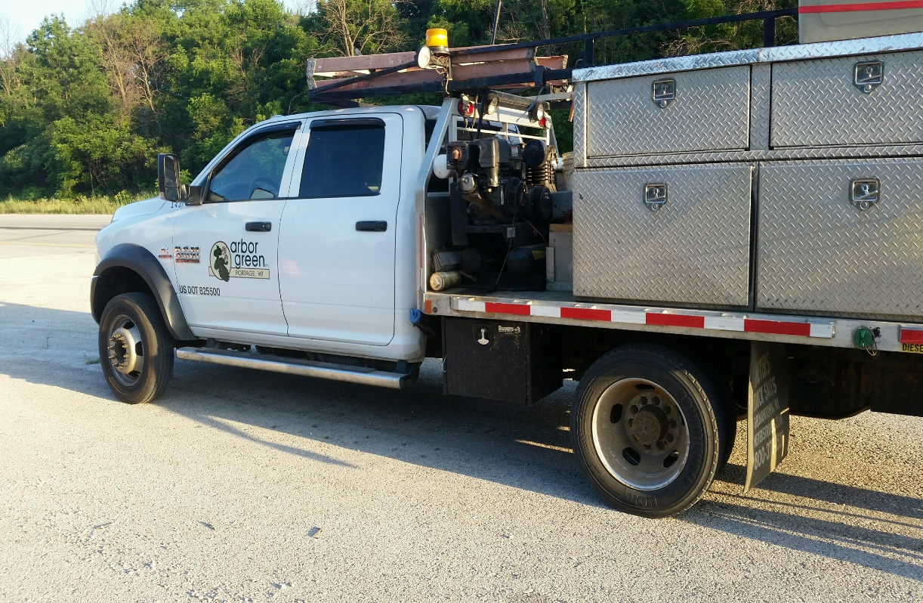
CUF Monitoring
How do we do it?
On-site monitoring – Project Leaders
Equipment
DBE owns the equipment
necessary to perform the
work under the contract
DBE leases necessary
equipment (not from prime)
appropriate personnel to
run the equipment
DBE Supplied Materials
DBE contractor furnishes
and install materials under
contract
Notes:
Overview should be specific such as listing the goals of the presentation and items to be covered. For example: “Explain Hwy 51 project alternatives.”
Use a verb followed by a brief phase or sentence.
Overview should include time for Q&A or indicate if you intend to take questions during the presentation or prefer that they wait until the end of the presentation.

Slide 5
CUF monitoring
How do we do it?
Off-site monitoring – OBOEC
Management
DBE prepares and submits certified payrolls
Verified by Labor Compliance
Supplies & Materials
Negotiating price
Determining quality and quantity
Ordering the materials
Paying for the materials
Verified by DBE Office
DBE is responsible for
Notes:
Overview should be specific such as listing the goals of the presentation and items to be covered. For example: “Explain Hwy 51 project alternatives.”
Use a verb followed by a brief phase or sentence.
Overview should include time for Q&A or indicate if you intend to take questions during the presentation or prefer that they wait until the end of the presentation.

Slide 6
Cuf monitoring
When do we do it?
On every contract with Federal $ that include DBE subcontractors for credit
Pilots underway SE & SW Regions with PODIs – Projects of Division Interest
Spring 2020 – begin monitoring PODIs in NE, NC, NW Regions
DBE Office to coordinate with Chiefs, PMs, PLs
Training available
Forms
Schedule monitoring
Resources
Notes:
Overview should be specific such as listing the goals of the presentation and items to be covered. For example: “Explain Hwy 51 project alternatives.”
Use a verb followed by a brief phase or sentence.
Overview should include time for Q&A or indicate if you intend to take questions during the presentation or prefer that they wait until the end of the presentation.

Slide 7
DBE Commitment modification
What is it?
Any change to approved DT1506 – Commitment to Subcontract to DBE
Addition, reduction, replacement, termination
Why is it important?
DBE Commitment is a contractual obligation
WisDOT must track and verify commitments to FHWA/USDOT
Accuracy of DBE credit data informs goal setting
Adverse impact on small businesses
Notes:
Overview should be specific such as listing the goals of the presentation and items to be covered. For example: “Explain Hwy 51 project alternatives.”
Use a verb followed by a brief phase or sentence.
Overview should include time for Q&A or indicate if you intend to take questions during the presentation or prefer that they wait until the end of the presentation.

Slide 8
DBE Commitment modification
What do we do about it?
Beginning in April 2020 –
All- Enforce requirement that Prime Contractor informs DBE Office before reduction, replacement, termination
Project Leader- Complete change orders whenever applicable
Weekly project meeting is a good time to check in on schedule –
When is DBE expected to be onsite – informs CUF + Commitment
Is DBE expected to do all committed work? If not, why?
Has Prime been in contact with DBE and DBE Office with changes?
DBE Office- track changes; communicate with project team, prime, DBEs, Labor Compliance
Notes:
Overview should be specific such as listing the goals of the presentation and items to be covered. For example: “Explain Hwy 51 project alternatives.”
Use a verb followed by a brief phase or sentence.
Overview should include time for Q&A or indicate if you intend to take questions during the presentation or prefer that they wait until the end of the presentation.

Slide 9
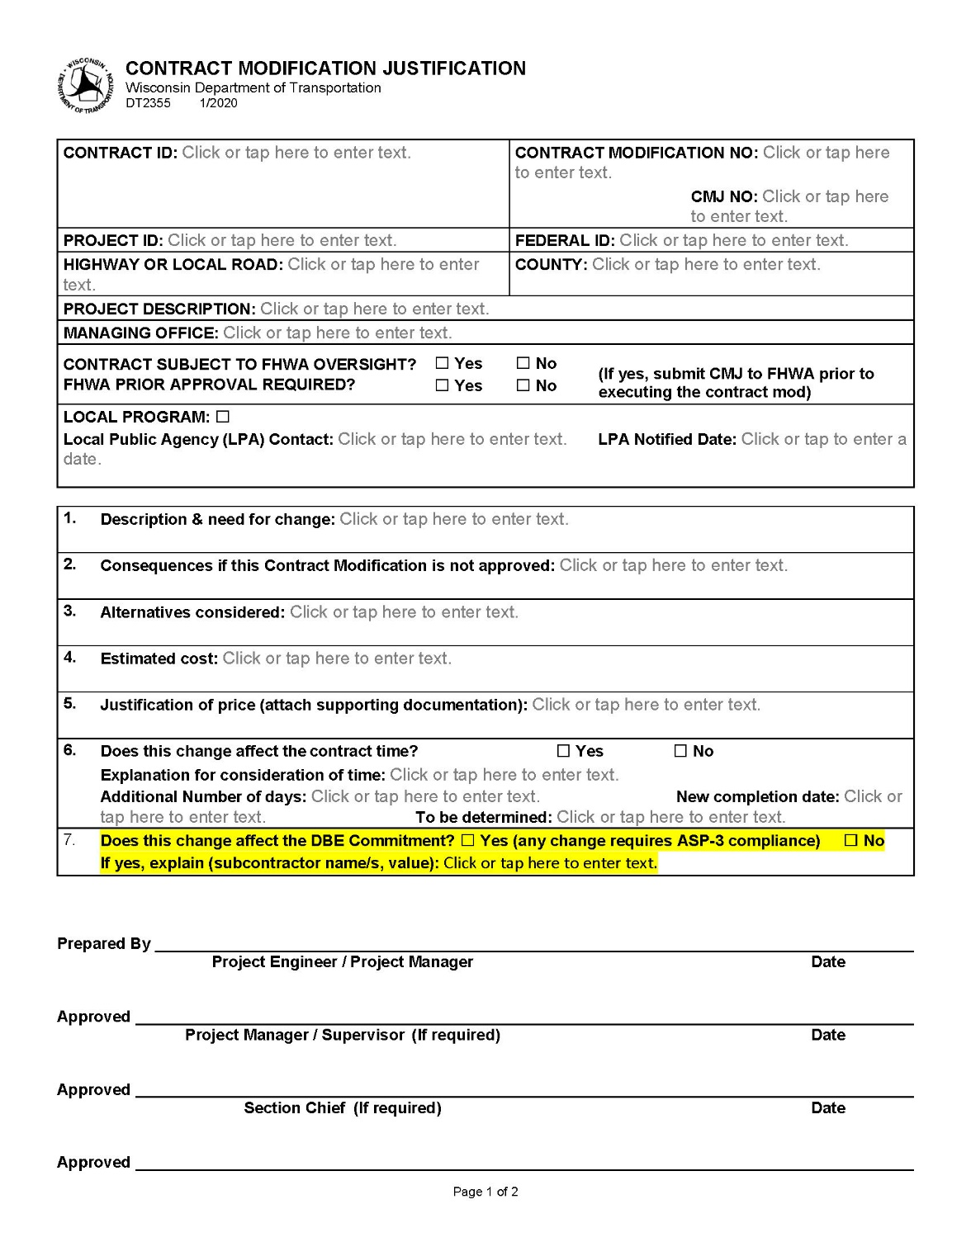
CMJ (DT2355)
Notes:
Overview should be specific such as listing the goals of the presentation and items to be covered. For example: “Explain Hwy 51 project alternatives.”
Use a verb followed by a brief phase or sentence.
Overview should include time for Q&A or indicate if you intend to take questions during the presentation or prefer that they wait until the end of the presentation.

Slide 10
Questions?
Thank you!
Questions, comments, concerns, suggestions:
Madalena Maestri, DBE Program Chief
Madalena.maestri@dot.wi.gov
Office : 608-267-2093
Cell : 608-509-8212
Notes:
Overview should be specific such as listing the goals of the presentation and items to be covered. For example: “Explain Hwy 51 project alternatives.”
Use a verb followed by a brief phase or sentence.
Overview should include time for Q&A or indicate if you intend to take questions during the presentation or prefer that they wait until the end of the presentation.

