Slide 1
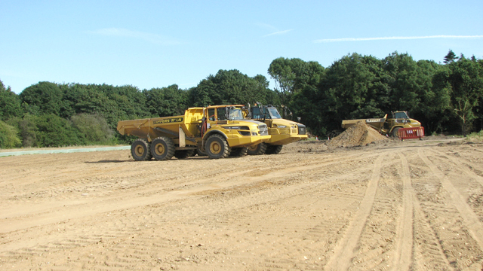
2020 NC REGION CONSTRUCTION CONFERENCE: CLOSING

Slide 2
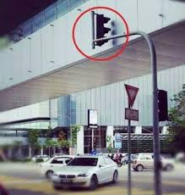

Slide 3
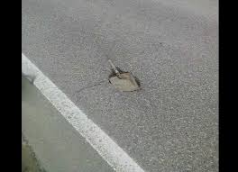

Slide 4
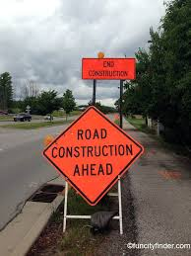

Slide 5
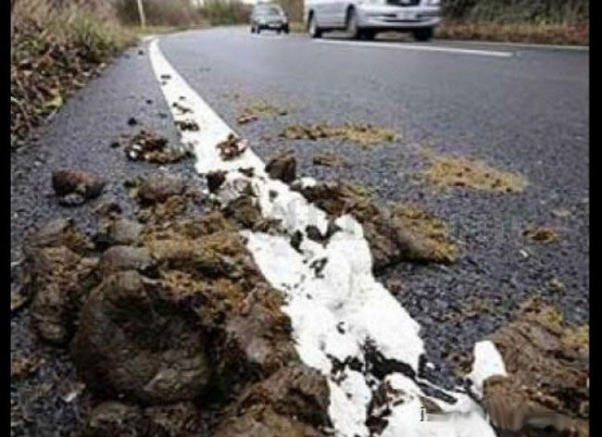

Slide 6
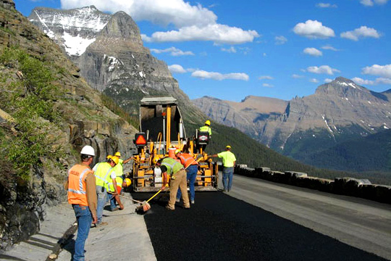
2020 NC REGION CONSTRUCTION CONFERENCE: CLOSING
Thank you
Enjoy
BE Safe

