Slide 1
Erosion Control 2020 Construction Updates
Kevin Kujawa, P.E.
Storm Water and Erosion Control Engineer
North Central Region Construction Conference
Northcentral Technical College, Wausau, WI
February 19, 2020
Notes:
Read me notes regarding this WisDOT PowerPoint template: Standard screen size of 1024 by 768, includes either blue or light gray backgrounds
This WisDOT PowerPoint template has a standard (4:3) aspect ratio (1024 x 768).
Use if you will be doing one of the following:
Presenting with a WisDOT projector that displays in standard (4:3) or 1024 x 768.
Presenting at a conference location which uses projectors that display in standard (4:3) or 1024 x 768.
Use the WisDOT PowerPoint template that has the widescreen (16:9) aspect ratio (1920 x 1080) if you will be doing one of the following:
showing your presentation on a large widescreen television.
showing your presentation using a display in widescreen format.
converting your presentation to video in the future.
Title slide
Slide 1 and slide 8 are layouts for the title slide of your WisDOT presentation. The title of your presentation goes at the top in the white text (for the light gray background) or blue text (for the gray background). The title may be one or two lines.
Managing placeholders
If your presentation does not need all the text placeholders, delete the placeholders you do not need and then you may need to lower or adjust the height between lines.
Various slide layouts
Slides 2 through 6 and 9 through 13 are examples of five slide layouts you may use in your presentation. The headline of each example describes which content placeholders are available in its layout. Review the slide layouts and decide which one best suits your content.
Blank slides
Slides 7 and 14 are blank slides for custom layouts in your presentation.
Ways to transfer a PowerPoint presentation from another design to this template.
The recommended way is to copy text line by line, slide by slide, from the other PowerPoint design. Then paste it into Notepad, copy from Notepad, then return to this template, select the text in the desired placeholder and copy. If you would like to get all your text out of the other design at once, choose file, save as .rtf, then copy all text from the .rtf, paste it into Notepad. Then use the Notepad file to copy the text line by line into this template by selecting the desired placeholder and copying. (Notepad will clear styles from the other PowerPoint design.)
How to paste text and keep template’s font styles and color
Select the text in placeholder, then copy. If copying and pasting text into a slide layout does not preserve the template’s font styles, select text in placeholder and right click on the placeholder and select the first paste option: use destination theme. Doing so will keep your pasted text in the font style and color designed for WisDOT template.
How to add more slides with the layout you want
To add a new slide layout to your presentation: in normal view, on the home tab, select new slide. Slide layout options for the WisDOT template will appear. Select the slide layout you want.
Changing a current slide layout on to a different current slide layout is not recommended.
Changing a current slide layout on to a different current slide layout is not recommended, as sometimes this results in additions of unmatched text and placeholders. It’s best to add a new slide layout to your presentation: in normal view, on the home tab, select new slide. Slide layout options for the WisDOT template will appear. Select the slide layout you want and add new text to this slide layout.
When to choose the light gray background
Slides 1 through 7 have a light gray background. Use with its navy and red type styles. Use if you have positive versions of graphics and logos. Some experts say if you're presenting in a small room with most of the lights on, use a lighter gray background, then the background will tend to fade away while the other components will grab attention. Other experts say that if your copy is kept short and sweet, the lightness or darkness of the background is irrelevant, as viewers then have little to read.
When to choose the blue background
Slides 8 through 14 have a dark blue background. Use with its white and gold type styles. Use if you have reverse or negative versions of graphics and logos. Some experts say if you're presenting with most of the lights off in the room or in a darker presentation area, consider using the blue background color, then the background won't intrude on the message and the lighter components will stand out. Other experts say that if your copy is kept short and sweet, the lightness or darkness of the background is irrelevant, as viewers then have little to read.
Use these sizes and colors of fonts for template with LIGHT GRAY background and standard aspect ratio (1024 x 768).
Font sizes may be adjusted either 2 points smaller or 2 points larger from sizes listed.
Slide 1 with GRAY background
Title text = Arial Narrow Bold, 60 point, Color: navy blue R0 G65 B106, Title text may be one or two lines. 3 or more lines are not recommended.
Name of Presenter = Arial Narrow Bold, 47 point, Color: red R164 G40 B76, Keep to 1 line
Title of Presenter = Arial Narrow, 40 point, Color: red R164 G40 B76, Keep to 1 line
Name of conference or event, Location, City, State = Arial Narrow, 28 point, Color: navy blue R0 G65 B106, Keep to 1 or 2 lines
Month, Day, Year = Arial Narrow Bold, 25 point, Color: red R164 G40 B76, Keep to 1 line
Slides 2, 3, 4, 5, 6 with GRAY background
Example heading = Arial Narrow Bold, 45 point, Color: navy blue R0 G65 B106, Heading may be one or two lines. 3 or more lines are not recommended
Red subhead = Arial Narrow Bold, 39 point, Color: red R164 G40 B76, Keep to 1 line
Bullet 1 = Arial Narrow, 35 point, Color: navy blue R0 G65 B106
Bullet 2 = Arial Narrow, 32 point, Color: red R164 G40 B76
Paragraph text = Arial Narrow, 28 point, Color: navy blue R0 G65 B10
Use these sizes and colors of fonts for template with BLUE background and standard aspect ratio (1024 x 768).
Font sizes may be adjusted either 2 points smaller or 2 points larger from sizes listed.
Slide 8 Title slide with BLUE background
Title text = Arial Narrow Bold, 60 point, Color: white R255 G255 B255, Title text may be one or two lines. 3 or more lines are not recommended.
Name of Presenter = Arial Narrow Bold, 47 point, Color: gold R216 G184 B70, Keep to 1 line
Title of Presenter = Arial Narrow, 40 point, Color: gold R216 G184 B70, Keep to 1 line
Name of conference or event, Location, City, State = Arial Narrow, 28 point, Color: white R255 G255 B255, keep to 1 or 2 lines
Month, Day, Year = Arial Narrow Bold, 25 point, Color: gold R216 G184 B70, Keep to 1 line
Slides 9, 10, 11, 12, 13 with BLUE background
Example heading = Arial Narrow Bold, 45 point, Color: white R255 G255 B255, Heading may be one or two lines. 3 or more lines are not recommended
Red subhead = Arial Narrow Bold, 39 point, Color: gold R216 G184 B70, Keep to 1 line
Bullet 1 = Arial Narrow, 35 point, Color: white R255 G255 B255
Bullet 2 = Arial Narrow, 32 point, Color: gold R216 G184 B70
Paragraph text = Arial Narrow, 28 point, Color: white R255 G255 B255
Contact the WisDOT Learn Center for training in PowerPoint. A link to the WisDOT Learn Center may be found on the dotnet home page.

Slide 2
Overview of presentation
2020 Standard Specifications updates
Erosion Control Implementation Plan (ECIP) form update
Erosion Control online training
Additional resources
Notes:
Some items that I will go over today
Erosion control Standard Specifications updates for 2020
Erosion Control Implementation Plan form has been updated
WisDOT developed erosion control training
And where to go for additional resources

Slide 3
2020 Standard Specifications Updates
628.5.11 – Mobilizations Erosion Control (EC)
628.5.12 – Mobilizations Emergency EC
Failure to mobilize updated from $300 to $500 daily deduct
630.0500 – Seed Water
Water required if rainfall not sufficient after seed germination
Notes:
2020 Standard Specifications Updates
Spec 628.5.11 and 628.5.12 were updated as the dollar amount for failure to mobilize for erosion control was updated. The deductions for the standard mobilization and emergency mobilization are now $500 per day.
Field staff – WS 1074 – erosion control order form updated with this new amount.
Also, the form was converted to a DT form – DT 1074. Form will updated in pantry shortly and on the erosion control website. So use this new form if the project is utilizing the 2020 spec book.
the other big spec update for erosion control - Seed Water is a new bid item in 2020 standard spec. Will help WisDOT get the vegetation we have planted to survive during historically dry months by requiring watering after seed has germinated if rainfall is not sufficient.

Slide 4
ECIP form (DT1073) update
Electronic format
Sections A and B minor changes
Section C, Pollution Prevention is new
Notes:
moving on to the ECIP form update
We updated the old form that was created for paper completion/submission
The new form has expandable, fillable fields to aid in electronic completion
We will quickly go over sections a and b
then we will complete a more in depth review of section c as it is new

Slide 5
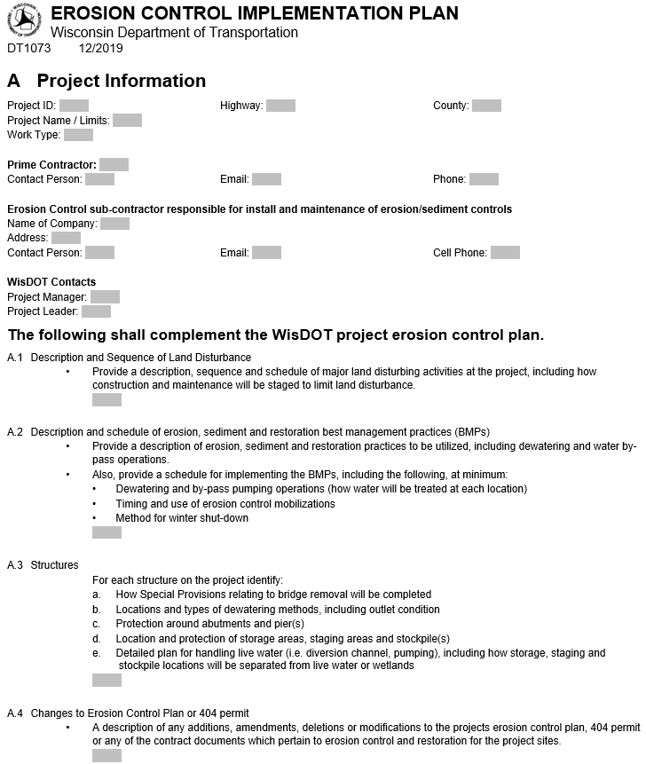
ECIP form, Section A
Previous A.1 is now A. Project Information
A.2 now calls out dewatering and by-pass pumping
Notes:
Section A
first change, note the old A1, project contacts was moved to the top of form to project information. Now has fillable fields are expandable. Note this change updated all of the numbers in section A.
second change, we specifically ask for Dewatering and Bypass pumping details in A2. These are critical details needed for ECIP approval but were not specifically listed previously. By listing we hope to eliminate some of the back and forth emails

Slide 6
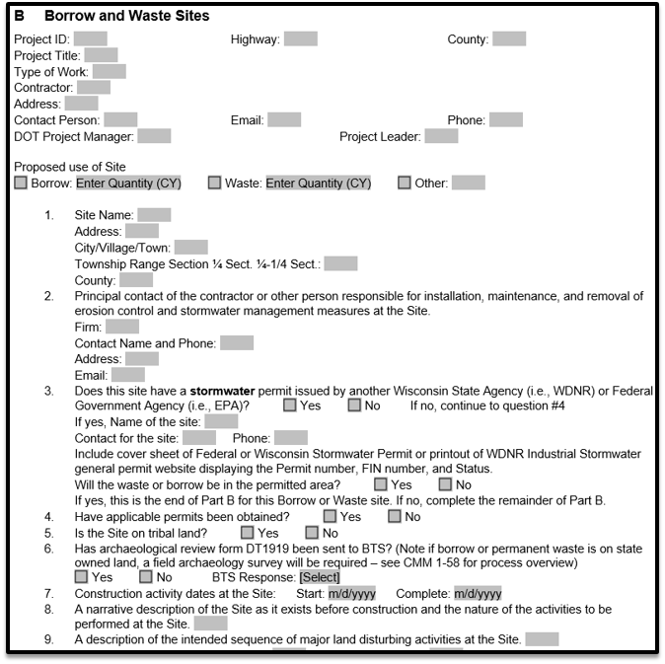
ECIP form, Section B
Proposed use
Quantity moved from question 8
Dropdowns options in question 6 match DT1919 and CMM 1-58
Notes:
Moving on to section B – borrow and waste sites
Added “Proposed use” as this really helps stormwater engineer review the ECIP and understand site operations.
Also now ask for quantity here (moved from old question 8.) again this helps the SWEC determine site operations.
Question 6 - Lynn Cloud updated DT1919, which is the cultural resources review form, she also updated CMM 1-58 with clear overview of process. Question 6 was updated with dropdown boxes to match terminology used on the DT 1919 form.
to all who have had questions regarding cultural resources review in the past, I encourage you to read CMM 1-58 for that helpful overview of cultural resource review process

Slide 7
ECIP form, Section B (continued)
Question 11, removed mention of FEMA floodplain maps
Question 12, removed requirement for runoff coefficient table
Question 13, added WDNR Surface Water Data Viewer option
“+” button for additional sites
Notes:
The remainder of changes to section b are to bring the form up to date and also add more functionality.
old question 11 - eliminate need to attach FEMA floodplain maps - WDNR surface water data viewer layer is OK
old question 12 - language requiring runoff coefficient table was removed from form, inconsistencies in region acceptances and WisDOT already has this in plan
old question 13 - we encourage using the DNR surface water data viewer to show environmental layers but did not have this listed as an option, so we added it.
Finally we added functionality to add additional borrow and waste sites by clicking a “+” symbol at the end of section B to help with formatting

Slide 8
ECIP form, Section C – Pollution Prevention
New section
Designed to meet Transportation Construction General Permit (TCGP)
Straightforward Best Management Practice (BMP) checkboxes
Required on all projects with an ECIP
Can be amended similar to other ECIP sections
Notes:
Section C – Pollution Prevention
Brand new section, effective with December 2019 let
This section was designed to meet requirements from our construction stormwater permit, commonly referred to as the TCGP
we designed it to be straightforward utilizing clear BMPs with checkboxes
this section is required on all projects with an ECIP
Similar to other sections, amendments required if operations change

Slide 9
ECIP form, Section C – Pollution Prevention
Sources of Pollution
BMPs
Material storage and disposal
Equipment fueling
Concrete truck washout
3. Spill control and reporting
Notes:
Overview of the 3 parts to the new section.
we will go over the new parts in more detail in the following slides
first part - sources of pollution
second part – Best Management Practices (what will be done on the project to prevent pollution)
third part - Spill control and reporting (BMPs to mitigate spills and procedure for what to do when a spill happens)

Slide 10
ECIP form, Section C – Pollution Prevention
Sources of Pollution
Notes:
Breaking down the first part of section C - sources of pollution
Contractor submits sources. Helps DOT determine what risks will be present.
Contractor can pick from the 9 common items listed in checkboxes, or if not on list, insert in “other” box

Slide 11
ECIP form, Section C – Pollution Prevention
2. BMPs
Material storage and disposal
Equipment fueling
Concrete truck washout
Notes:
-Moving on to the second part of new section – identifying BMPs to prevent pollution
-Broken up into 3 categories to match our TCGP requirements
1. material storage
2. equipment fueling
3. concrete truck washout
-This slide shows the material storage category
-Four checkboxes are required to be checked. Common sense items, such as:
-not storing items in wetlands
-collecting and disposing of construction waste

Slide 12
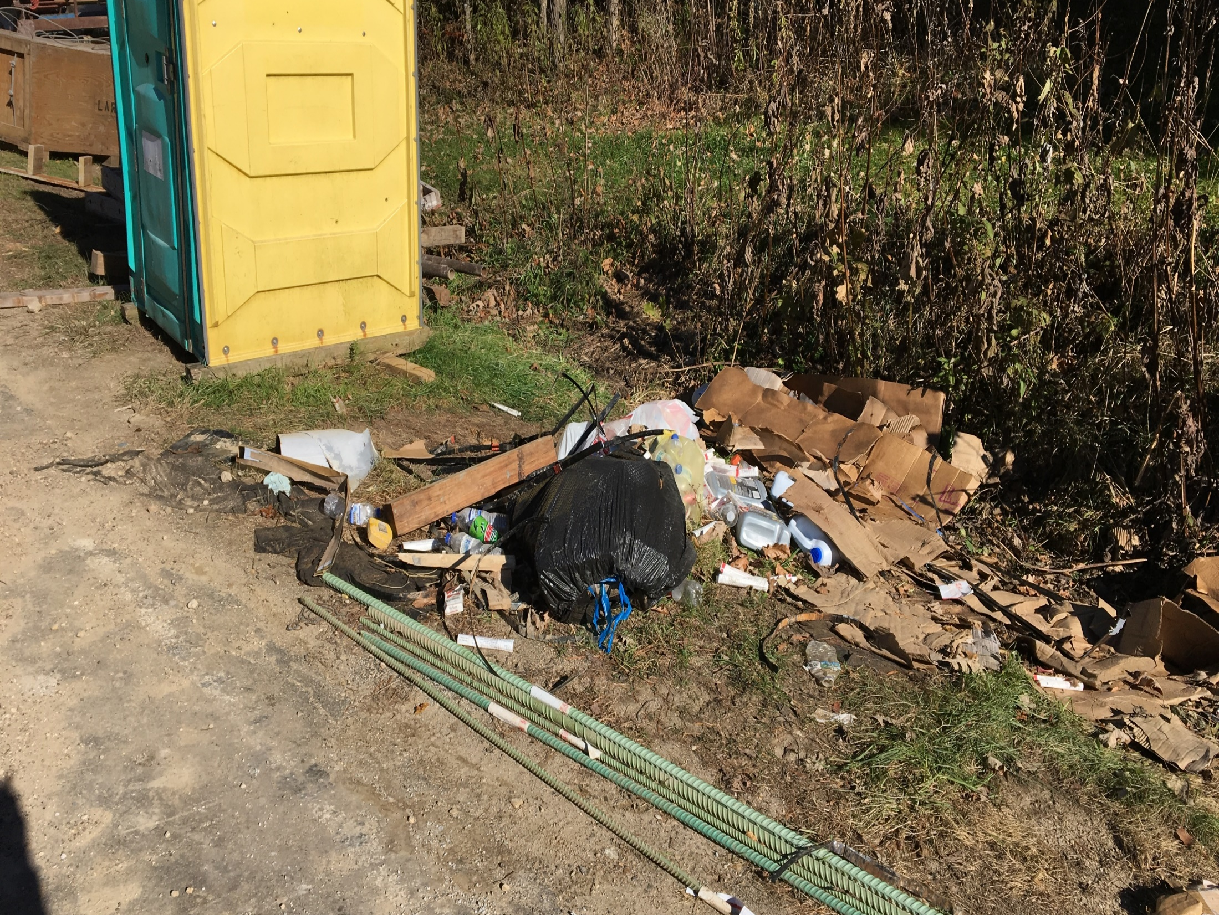
Example showing waste materials not disposed properly
Notes:
Example showing what we are trying to prevent
-construction waste not properly disposed of, possibly in wetland

Slide 13
ECIP form, Section C – Pollution Prevention
2. BMPs
Material storage and disposal
Equipment fueling
Concrete truck washout
Notes:
Second BMP category is Equipment Fueling and maintenance
-For this category, two checkboxes are required to be checked. Again common sense type items
-the first is monitoring and fixing fluid leaks when discovered
-The second is using drip pans to prevent spills and using absorbent materials to cleanup spilled fluids

Slide 14
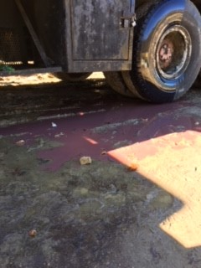
Fix leaks when discovered
Cleanup with absorbent materials
Notes:
Again example showing what we are trying to prevent
-fix fluids leaks when discovered
-use absorbent materials to cleanup

Slide 15
ECIP form, Section C – Pollution Prevention
2. BMPs
Material storage and disposal
Equipment fueling
Concrete truck washout
Prevent washout from running off into:
Surface waters
Wetlands
Drainage conveyance systems
Inlets
Ditches
Curb flow lines
Notes:
Last category is concrete truck washout
-concrete truck washout water is caustic and corrosive with a pH around 12
-safe range of aquatic life is a pH around 6.5 to 9, so concrete truck washout water is harmful to aquatic life.
-We have always been required to prevent pollution from concrete truck washout, however now we will think about and plan concrete truck washout will be managed.
-Main idea here is to prevent concrete truck washout from running off into
-surface water
-wetlands
-drainage conveyances
(drainage conveyances are inlets, ditches and curb flow lines)

Slide 16
ECIP form, Section C – Pollution Prevention
2. BMPs
Material storage and disposal
Equipment fueling
Concrete truck washout (continued)
Notes:
-This slide lists common BMPs that can be used for concrete truck washout
-there are 4 common BMPs to manage concrete truck washout listed here. -Only one BMP is required to be checked.
-If you company has different options or practices for managing concrete truck washout, they can be proposed in “other” box.
-This category, and section, can be amended as the project progresses
-Note the link to a concrete truck washout document we created in consultation with Wisconsin DNR.
It is a10 page document that has photos of the common methods listed in section C of the ECIP.
So please check that guidance document out if you have any questions.

Slide 17
Poor concrete washout operations
Washout running into conveyance (ditch bottom)
Notes:
Example showing what we are trying to prevent.
In this example the concrete truck washout ranoff into the ditch bottom

Slide 18
ECIP form, Section C – Pollution Prevention
Notes:
-Last part to new section is hazardous spill control and reporting.
-Top portion of this part outlines BMPs that will be used in event of a spill. Two checkboxes are required to be checked.
-Remainder of this part details procedure for reporting spills – not a new requirement but more clearly spells out procedure to report spills
-Also lists what a spill is and when it needs to be reported
-that is the end of new section
-we went over fast and it may look like a lot, however we feel it is a pretty straightforward section, ECIP submittals using the form so far this year have gone over very well.
-I encourage you to check out the new form.

Slide 19
ECIP form location
HCCI website
Link in Spec 107.20 (3)
Link in CMM 6-45.2
WisDOT pantry website
WisDOT erosion control website
Google “WisDOT erosion control”
Region Storm Water Engineer
Notes:
Form location
-The new form is required starting with 2020 construction projects.
-New form can be found in many locations:
-HCCI website
-Link in Spec 107.20 (3)
-Link in CMM 6-45.2
-WisDOT pantry website
-WisDOT erosion control website
-Google search
-or if all else fails, reach out to region stormwater engineer

Slide 20
Erosion Control Training
WisDOT developed web based training
WisDOT Learn Center
BMPs, Soil science, ECIP 101, EC Matrices
Water diversion/bypass pumping
Available to Contractors and Consultants
Free of charge
Notes:
-moving on from the new ECIP form
-WisDOT developed a web based erosion control training
- The training is located in the WisDOT Learn Center
-the training goes over our common BMPs including, Silt Fence, inlet protection, dust control, emat
-also details Soil science, ECIP 101, EC matrices, Water Diversion and bypass pumping.
-Historically, we have gotten many questions on bypass pumping/water diversion so we are excited for these modules (to be posted soon)
-Available to Contractors and Consultants
-and its free of charge

Slide 21
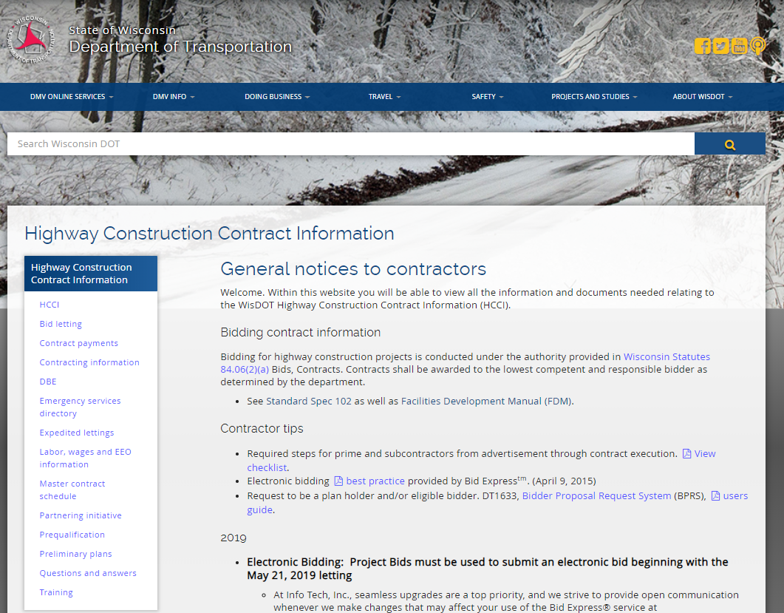
Erosion Control Training
Notes:
For consultants and contractors – To access the training, easiest method is to go to DOT HCCI website
- click training on left section

Slide 22
Erosion Control Training
Notes:
-after clicking the “training” link
-see instructions for logging into the Learn Center
-not hard to register and
-its free of charge

Slide 23
Additional Resources
WisDOT Erosion Control webpage
TCGP guidance document
Permit application (NOI)
Permit amendments
Permit termination (NOT)
Concrete truck washout guidance
Region Storm Water Engineer
Notes:
Many additional resources available for erosion control
Our WisDOT erosion control webpage holds many of these resources
-for consultant/dot staff – we have a TCPG Guidance document which goes over the permit application with the NOI, Permit amendments, and terminating coverage with the (NOT). The guidance document answers most questions that come up.
-again, we have the concrete truck washout guidance document – 10 page document with photos of the common methods listed in section C of the ECIP.
-and As always, ask questions. Call or email region stormwater engineers

Slide 24
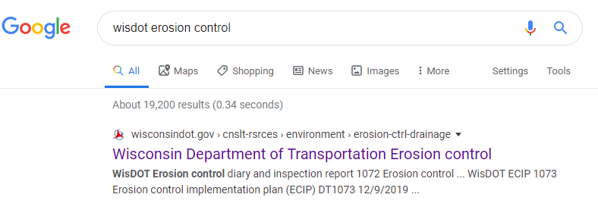
Additional Resources (continued)
Notes:
-the best way to find resources on the erosion control webpage is to search for “WisDOT erosion control” and click on the first link

Slide 25
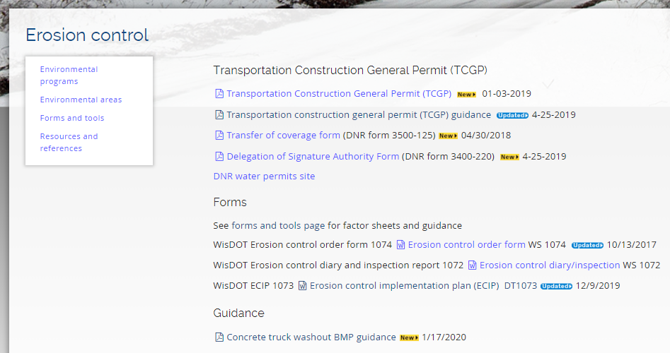
Additional Resources (continued)
Notes:
-All three of the new documents are listed here
-please look at the guidance documents and ECIP form and provide feedback as it helps us improve
– we hope the form update and guidance documents will improve uniformity and consistency among DOT,Contractors and DNR.

Slide 26
Thank you!
Kevin Kujawa, P.E.
Storm Water and Erosion Control Engineer
(715) 315-8027
kevin.kujawa@dot.wi.gov
Notes:
Thank you for your time
Number listed, please reach out with questions

