Slide 1
NCR – Using Box in Construction
Cheryl Simon
NCR Program Controls Engineer
NCR Construction Conference
Wausau
February 2020

Slide 2
Outline
Overview
Expectations
Box App
Box Capture
NCR implementation for 2020 construction

Slide 3
Box Overview
Benefits of Box
Box in construction
Box Drive and Box.com
File structure
Security and permissions
Records retention
Notes:
Box is a cloud based storage system. Box is a secure location that allows us to manage and share documents.
In construction, Box will be the primary location for data and file storage of construction related documents that are not part of other database applications (in other words anything that is not part of AASHTOWare/FieldManager type applications)
Box Drive is the desktop version for access files in Box that WisDOT staff will have access to. Box.com is the web-based component for accessing files in Box that everyone can use. Box Drive allows for use of full versions of Excel/Word/Etc. There are limitations with collaboration when using Box Drive.
Box.com should be used when collaborating and sharing files.
File Structure: WisDOT has developed a statewide uniform file structure to be used for all construction projects using Box. <<File Structure on next slide>>
Security and permissions: WisDOT Box structure includes various built in security features – these are built in and cannot be changed by users. Users can share links or invite others to folders. Security will prevent unauthorized access to confidential folders.
Records retention: part of the benefit to using Box and the uniform file structure is to streamline the records retention process. This is why its important to store files according to the guidance shown in the file structure. This also benefit when it comes to open records requests.
[[Side notes]]
Cloud-based, unlimited storage of files upto 15GB; no VPN needed; accessed via email credentials; free accounts for external users connecting to WisDOT shared info; reduces file storage costs;

Slide 4
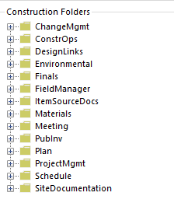
WisDOT Box File Structure for Construction
Notes:
When in Box.com folders have information notations describing what should be included in those folders.

Slide 5
Expectations for using Box in construction
Use on all new 2020 construction projects
Complete training prior to project start
Use statewide file structure
Do not make changes to first tier of file structure
No need to maintain external copies
Notes:
Box will be used on all new 2020 construction projects. Carryover projects are not required to be moved over to box.
There are training videos available for those who are not familiar with Box. Those videos should be completed prior to the start of your projects.
The statewide file structure will be used for all projects Box. If projects currently have files stored elsewhere with another file structures, files should be moved into the proper folders of the new file structure. (If you have had a precon or started to store other documents on the N drive or consultant drive, those files should be moved to the proper folder in Box – for 2020 projects.)
Do not make changes to the top level folders in the statewide folder structures. No not rename any of the folders that are part of the statewide file structure. Folders can be added under any of the “first tier” (top level) under the project id.
Box should be the sole source data location. Do not keep copies on local drives to be moved to Box later. Store them on Box throughout the project.

Slide 6
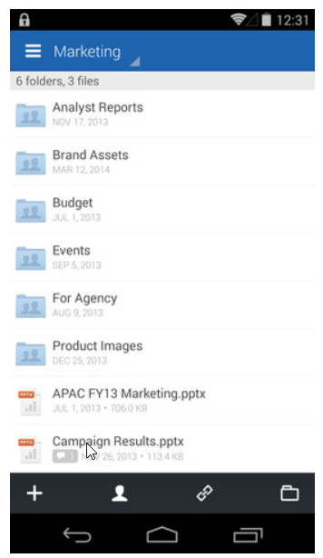
Box App
Access Box content directly from mobile device
Upload photos, videos and other files
Download content to device
Notes:
Box app lets you access all your Box content directly from your mobile device. It lets you upload photos, videos and other files to Box as well as download content to mobile devices.

Slide 7
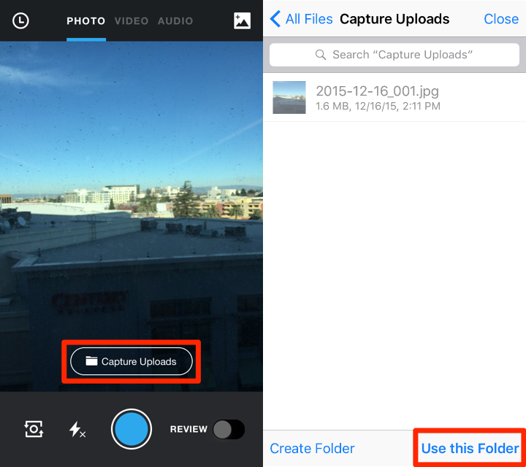
Box Capture
Use mobile device to upload directly to Box
Photos, videos, document scans
Select the location to store documents in Box
Currently only available for iOS
Notes:
The Capture app allows your mobile device to upload directly to Box. You can take photos, videos and document scans on the go and instantly save them to the cloud.
Currently the Capture app is only available for iOS. For Android users, photos can be uploaded into the Box app
[[Side notes]]
Can select the location where photos will be stored within Box.
Can preset metadata tags for easier data collection, storage and searching.
Location needs to be turned on the mobile device

Slide 8
NCR Implementation of Box for 2020 Construction
Folders will be created at start of season
Contact Contract Specialist for access
Contact PM with any procedural questions
Contact IT support with technical issues
Finals process
Notes:
Contract Specialist will create folders for all 2020 construction projects and invite the appropriate consultant staff to the folders prior to start of the project.
Contact Contract Specialist if you cannot access construction files or folders you think you should have access to.
Contact your Project Manager if you have questions about storing files in Box – where certain files need to go, etc.
Contact IT support for technical issues (That would be IT Portal for WisDOT – follow internal company support procedures for consultants).
Thumb drives or FTP sites shouldn’t be need for the Finals process since those files will now be in Box.

