Slide 1
Longitudinal Joint Construction
Steve Hefel P.E.
BTS HMA Supervisor
NORTH CENTRAL REGION CONSTRUCTION CONFERENCE
Northcentral Technical College
Wausau, WI
February 19, 2020
Notes:
Read me notes regarding this WisDOT PowerPoint template: Standard screen size of 1024 by 768, includes either blue or light gray backgrounds
This WisDOT PowerPoint template has a standard (4:3) aspect ratio (1024 x 768).
Use if you will be doing one of the following:
Presenting with a WisDOT projector that displays in standard (4:3) or 1024 x 768.
Presenting at a conference location which uses projectors that display in standard (4:3) or 1024 x 768.
Use the WisDOT PowerPoint template that has the widescreen (16:9) aspect ratio (1920 x 1080) if you will be doing one of the following:
showing your presentation on a large widescreen television.
showing your presentation using a display in widescreen format.
converting your presentation to video in the future.
Title slide
Slide 1 and slide 8 are layouts for the title slide of your WisDOT presentation. The title of your presentation goes at the top in the white text (for the light gray background) or blue text (for the gray background). The title may be one or two lines.
Managing placeholders
If your presentation does not need all the text placeholders, delete the placeholders you do not need and then you may need to lower or adjust the height between lines.
Various slide layouts
Slides 2 through 6 and 9 through 13 are examples of five slide layouts you may use in your presentation. The headline of each example describes which content placeholders are available in its layout. Review the slide layouts and decide which one best suits your content.
Blank slides
Slides 7 and 14 are blank slides for custom layouts in your presentation.
Ways to transfer a PowerPoint presentation from another design to this template.
The recommended way is to copy text line by line, slide by slide, from the other PowerPoint design. Then paste it into Notepad, copy from Notepad, then return to this template, select the text in the desired placeholder and copy. If you would like to get all your text out of the other design at once, choose file, save as .rtf, then copy all text from the .rtf, paste it into Notepad. Then use the Notepad file to copy the text line by line into this template by selecting the desired placeholder and copying. (Notepad will clear styles from the other PowerPoint design.)
How to paste text and keep template’s font styles and color
Select the text in placeholder, then copy. If copying and pasting text into a slide layout does not preserve the template’s font styles, select text in placeholder and right click on the placeholder and select the first paste option: use destination theme. Doing so will keep your pasted text in the font style and color designed for WisDOT template.
How to add more slides with the layout you want
To add a new slide layout to your presentation: in normal view, on the home tab, select new slide. Slide layout options for the WisDOT template will appear. Select the slide layout you want.
Changing a current slide layout on to a different current slide layout is not recommended.
Changing a current slide layout on to a different current slide layout is not recommended, as sometimes this results in additions of unmatched text and placeholders. It’s best to add a new slide layout to your presentation: in normal view, on the home tab, select new slide. Slide layout options for the WisDOT template will appear. Select the slide layout you want and add new text to this slide layout.
When to choose the light gray background
Slides 1 through 7 have a light gray background. Use with its navy and red type styles. Use if you have positive versions of graphics and logos. Some experts say if you're presenting in a small room with most of the lights on, use a lighter gray background, then the background will tend to fade away while the other components will grab attention. Other experts say that if your copy is kept short and sweet, the lightness or darkness of the background is irrelevant, as viewers then have little to read.
When to choose the blue background
Slides 8 through 14 have a dark blue background. Use with its white and gold type styles. Use if you have reverse or negative versions of graphics and logos. Some experts say if you're presenting with most of the lights off in the room or in a darker presentation area, consider using the blue background color, then the background won't intrude on the message and the lighter components will stand out. Other experts say that if your copy is kept short and sweet, the lightness or darkness of the background is irrelevant, as viewers then have little to read.
Use these sizes and colors of fonts for template with LIGHT GRAY background and standard aspect ratio (1024 x 768).
Font sizes may be adjusted either 2 points smaller or 2 points larger from sizes listed.
Slide 1 with GRAY background
Title text = Arial Narrow Bold, 60 point, Color: navy blue R0 G65 B106, Title text may be one or two lines. 3 or more lines are not recommended.
Name of Presenter = Arial Narrow Bold, 47 point, Color: red R164 G40 B76, Keep to 1 line
Title of Presenter = Arial Narrow, 40 point, Color: red R164 G40 B76, Keep to 1 line
Name of conference or event, Location, City, State = Arial Narrow, 28 point, Color: navy blue R0 G65 B106, Keep to 1 or 2 lines
Month, Day, Year = Arial Narrow Bold, 25 point, Color: red R164 G40 B76, Keep to 1 line
Slides 2, 3, 4, 5, 6 with GRAY background
Example heading = Arial Narrow Bold, 45 point, Color: navy blue R0 G65 B106, Heading may be one or two lines. 3 or more lines are not recommended
Red subhead = Arial Narrow Bold, 39 point, Color: red R164 G40 B76, Keep to 1 line
Bullet 1 = Arial Narrow, 35 point, Color: navy blue R0 G65 B106
Bullet 2 = Arial Narrow, 32 point, Color: red R164 G40 B76
Paragraph text = Arial Narrow, 28 point, Color: navy blue R0 G65 B10
Use these sizes and colors of fonts for template with BLUE background and standard aspect ratio (1024 x 768).
Font sizes may be adjusted either 2 points smaller or 2 points larger from sizes listed.
Slide 8 Title slide with BLUE background
Title text = Arial Narrow Bold, 60 point, Color: white R255 G255 B255, Title text may be one or two lines. 3 or more lines are not recommended.
Name of Presenter = Arial Narrow Bold, 47 point, Color: gold R216 G184 B70, Keep to 1 line
Title of Presenter = Arial Narrow, 40 point, Color: gold R216 G184 B70, Keep to 1 line
Name of conference or event, Location, City, State = Arial Narrow, 28 point, Color: white R255 G255 B255, keep to 1 or 2 lines
Month, Day, Year = Arial Narrow Bold, 25 point, Color: gold R216 G184 B70, Keep to 1 line
Slides 9, 10, 11, 12, 13 with BLUE background
Example heading = Arial Narrow Bold, 45 point, Color: white R255 G255 B255, Heading may be one or two lines. 3 or more lines are not recommended
Red subhead = Arial Narrow Bold, 39 point, Color: gold R216 G184 B70, Keep to 1 line
Bullet 1 = Arial Narrow, 35 point, Color: white R255 G255 B255
Bullet 2 = Arial Narrow, 32 point, Color: gold R216 G184 B70
Paragraph text = Arial Narrow, 28 point, Color: white R255 G255 B255
Contact the WisDOT Learn Center for training in PowerPoint. A link to the WisDOT Learn Center may be found on the dotnet home page.

Slide 2
Longitudinal Joint Construction
Longitudinal Joint Basics from IA & FHWA
Where we were
Unification process
Where we are going
Notes:
Implementation will be phased in starting with the February 2020 PSE.
Details of non-PWL joint testing have yet to be worked out.

Slide 3
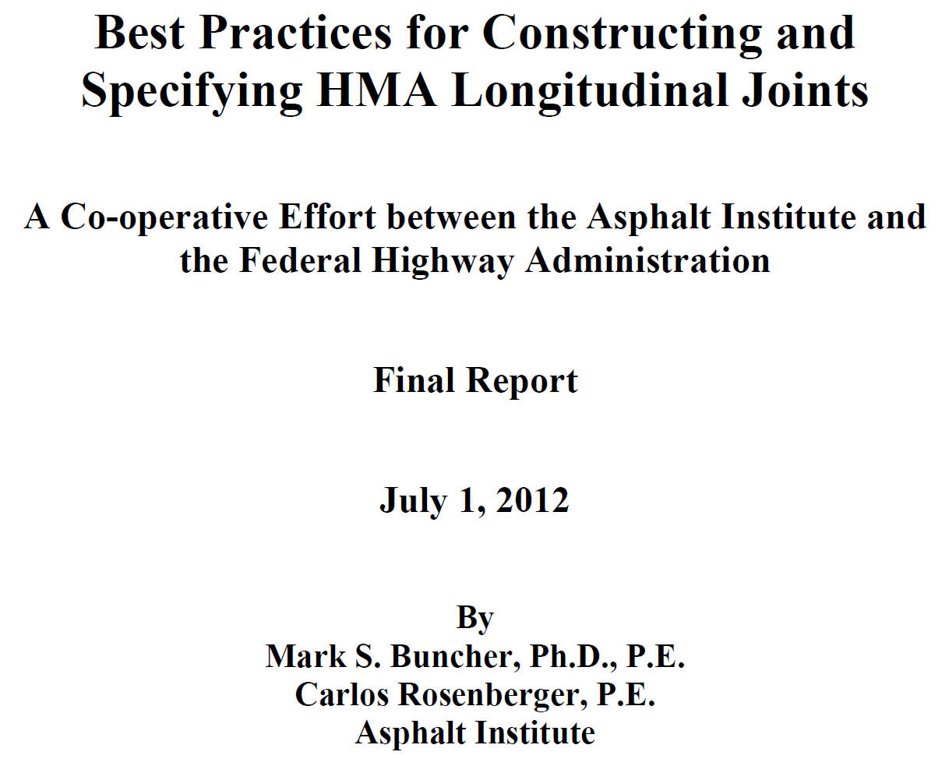
Slides stolen from this

Slide 9
Where We Were
Regions greatly varied on LJC
Match up at end of day
Place vertical joint
Place notched wedge joint
Leave wedge in place
Remove wedge (different special provisions used)
Pay for removal
No separate pay, cost included in?
Notes:
Implementation will be phased in starting with the February 2020 PSE.
Details of non-PWL joint testing have yet to be worked out.

Slide 10
Where We Were
Joint heaters
Some projects did not have joint heaters
Some projects did have joint heaters
Some heaters worked, some did not
Enforcement issue
Much contractor resistance
Notes:
Implementation will be phased in starting with the February 2020 PSE.
Details of non-PWL joint testing have yet to be worked out.

Slide 11
Unified Specifications
TS Managers requested Committee
Committee members:
BTS, BPD, BTO
Each Region
Survey of each Region
Two face to face meetings
Outcome was the white paper from Nov 2019
Notes:
Implementation will be phased in starting with the February 2020 PSE.
Details of non-PWL joint testing have yet to be worked out.

Slide 12
Unified Specifications
Topics
Types of longitudinal joints used (notched wedge, vertical, safety edge, pave wide/over mill)
Drop-offs between lanes open to traffic and traffic safety
Removal of notched wedge joints during construction
Joint heaters
Notes:
Implementation will be phased in starting with the February 2020 PSE.
Details of non-PWL joint testing have yet to be worked out.

Slide 13
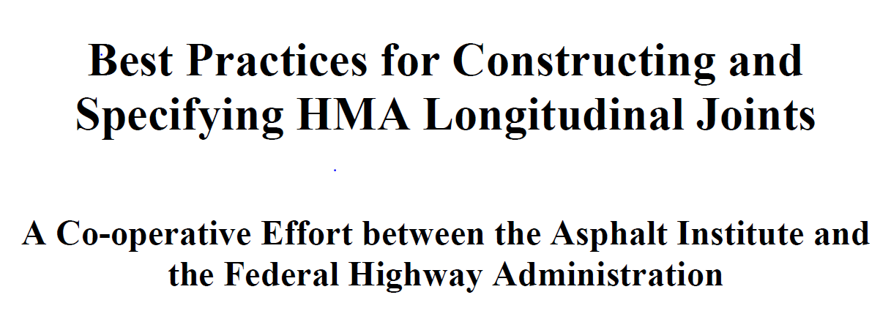
Unified Specifications
Primary Guide
Notes:
Implementation will be phased in starting with the February 2020 PSE.
Details of non-PWL joint testing have yet to be worked out.

Slide 14
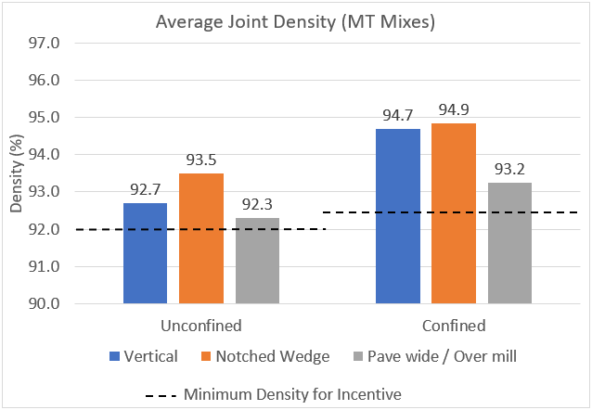
2018 Longitudinal Joint Density SPV Project Results
Notched Wedge
Improved unconfined and confined densities
Increased safety for traveling public
Notes:
Time animation
Notched Wedge performs well and is capable of high density on each side of the joint

Slide 15
Outcome

Slide 16
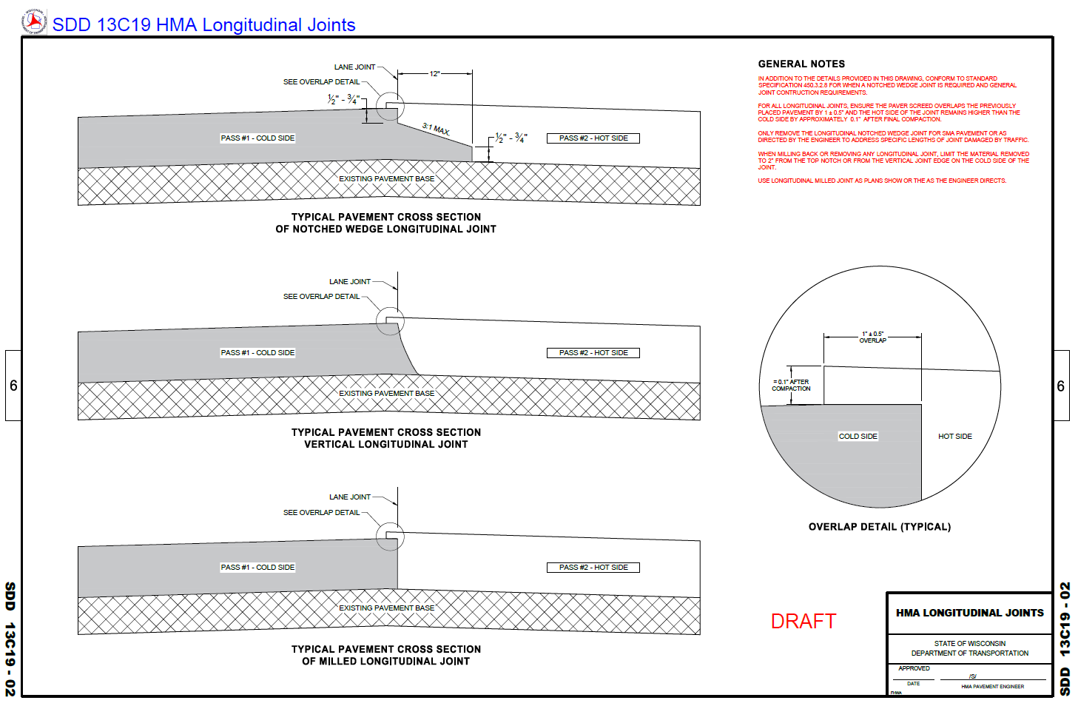
SDD 13C19 updated to all joint types
Notes:
This is the new Standard Detail Drawing for the Construction of Longitudinal Joints. Includes details of the Notched Wedge Joint and the 1” joint overbanding.

Slide 17
Outcome Longitudinal Joint Construction
Feb 2020 PSE
Notched wedge joint on all mainline HMA layers ≥ 1.75”
ASP-6 450.3.2.8 Jointing
Wedge only milled out for SMA and when joint is damaged by traffic as directed by the engineer
Statewide STSP 204-045 used for wedge removal (rarely)
LJD SPV included on all PWL projects
Discontinue use of joint heater STSP, no STP 460-015

Slide 18
Outcome Longitudinal Joint Construction
Aug 2020 PSE
Begin collecting joint density for information on Dec 1 letting
2021 Standard Spec will be edited to require collection of joint density data on all projects that don’t include the LJD SPV

Slide 19
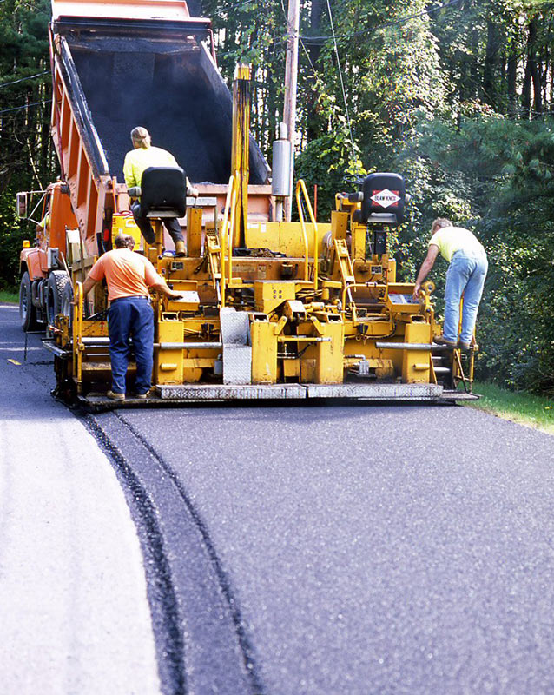
Longitudinal Joint Construction
To assist in construction:
HMA Inspector Training topic
April 15th Rhinelander
April 22nd Wis Rapids
CMM guidance added
Notes:
Implementation will be phased in starting with the February 2020 PSE.
Details of non-PWL joint testing have yet to be worked out.

Slide 20
Longitudinal Joint Construction
CMM 4-58.5 Longitudinal Joints (Spring 2020)
…The paving inspector should pay close attention to the following attributes of notched wedge joints:
Notched wedge final dimensions according to SDD 13c19
Device used to shape wedge and notches to be approved
Steel wheel roller or vibratory plate compactor to provide compaction on the wedge
Tack coat is applied to the wedge and both notches prior to paving the adjacent lane
Drum rollers used to compact the mat are following guidance in CMM 4-61
Notes:
Implementation will be phased in starting with the February 2020 PSE.
Details of non-PWL joint testing have yet to be worked out.

Slide 21
QUESTIONS?

