Slide 1
North Central Region Construction Conference
Tim Hanley, Jesse Jefferson, Jeff Stewart
Project Manager Panel
Northcentral Technical College
Auditorium (CHS 1004)
Wausau, WI
February 19, 2020
Notes:
Read me notes regarding this WisDOT PowerPoint template: Standard screen size of 1024 by 768, includes either blue or light gray backgrounds
This WisDOT PowerPoint template has a standard (4:3) aspect ratio (1024 x 768).
Use if you will be doing one of the following:
Presenting with a WisDOT projector that displays in standard (4:3) or 1024 x 768.
Presenting at a conference location which uses projectors that display in standard (4:3) or 1024 x 768.
Use the WisDOT PowerPoint template that has the widescreen (16:9) aspect ratio (1920 x 1080) if you will be doing one of the following:
showing your presentation on a large widescreen television.
showing your presentation using a display in widescreen format.
converting your presentation to video in the future.
Title slide
Slide 1 and slide 8 are layouts for the title slide of your WisDOT presentation. The title of your presentation goes at the top in the white text (for the light gray background) or blue text (for the gray background). The title may be one or two lines.
Managing placeholders
If your presentation does not need all the text placeholders, delete the placeholders you do not need and then you may need to lower or adjust the height between lines.
Various slide layouts
Slides 2 through 6 and 9 through 13 are examples of five slide layouts you may use in your presentation. The headline of each example describes which content placeholders are available in its layout. Review the slide layouts and decide which one best suits your content.
Blank slides
Slides 7 and 14 are blank slides for custom layouts in your presentation.
Ways to transfer a PowerPoint presentation from another design to this template.
The recommended way is to copy text line by line, slide by slide, from the other PowerPoint design. Then paste it into Notepad, copy from Notepad, then return to this template, select the text in the desired placeholder and copy. If you would like to get all your text out of the other design at once, choose file, save as .rtf, then copy all text from the .rtf, paste it into Notepad. Then use the Notepad file to copy the text line by line into this template by selecting the desired placeholder and copying. (Notepad will clear styles from the other PowerPoint design.)
How to paste text and keep template’s font styles and color
Select the text in placeholder, then copy. If copying and pasting text into a slide layout does not preserve the template’s font styles, select text in placeholder and right click on the placeholder and select the first paste option: use destination theme. Doing so will keep your pasted text in the font style and color designed for WisDOT template.
How to add more slides with the layout you want
To add a new slide layout to your presentation: in normal view, on the home tab, select new slide. Slide layout options for the WisDOT template will appear. Select the slide layout you want.
Changing a current slide layout on to a different current slide layout is not recommended.
Changing a current slide layout on to a different current slide layout is not recommended, as sometimes this results in additions of unmatched text and placeholders. It’s best to add a new slide layout to your presentation: in normal view, on the home tab, select new slide. Slide layout options for the WisDOT template will appear. Select the slide layout you want and add new text to this slide layout.
When to choose the light gray background
Slides 1 through 7 have a light gray background. Use with its navy and red type styles. Use if you have positive versions of graphics and logos. Some experts say if you're presenting in a small room with most of the lights on, use a lighter gray background, then the background will tend to fade away while the other components will grab attention. Other experts say that if your copy is kept short and sweet, the lightness or darkness of the background is irrelevant, as viewers then have little to read.
When to choose the blue background
Slides 8 through 14 have a dark blue background. Use with its white and gold type styles. Use if you have reverse or negative versions of graphics and logos. Some experts say if you're presenting with most of the lights off in the room or in a darker presentation area, consider using the blue background color, then the background won't intrude on the message and the lighter components will stand out. Other experts say that if your copy is kept short and sweet, the lightness or darkness of the background is irrelevant, as viewers then have little to read.
Use these sizes and colors of fonts for template with LIGHT GRAY background and standard aspect ratio (1024 x 768).
Font sizes may be adjusted either 2 points smaller or 2 points larger from sizes listed.
Slide 1 with GRAY background
Title text = Arial Narrow Bold, 60 point, Color: navy blue R0 G65 B106, Title text may be one or two lines. 3 or more lines are not recommended.
Name of Presenter = Arial Narrow Bold, 47 point, Color: red R164 G40 B76, Keep to 1 line
Title of Presenter = Arial Narrow, 40 point, Color: red R164 G40 B76, Keep to 1 line
Name of conference or event, Location, City, State = Arial Narrow, 28 point, Color: navy blue R0 G65 B106, Keep to 1 or 2 lines
Month, Day, Year = Arial Narrow Bold, 25 point, Color: red R164 G40 B76, Keep to 1 line
Slides 2, 3, 4, 5, 6 with GRAY background
Example heading = Arial Narrow Bold, 45 point, Color: navy blue R0 G65 B106, Heading may be one or two lines. 3 or more lines are not recommended
Red subhead = Arial Narrow Bold, 39 point, Color: red R164 G40 B76, Keep to 1 line
Bullet 1 = Arial Narrow, 35 point, Color: navy blue R0 G65 B106
Bullet 2 = Arial Narrow, 32 point, Color: red R164 G40 B76
Paragraph text = Arial Narrow, 28 point, Color: navy blue R0 G65 B10
Use these sizes and colors of fonts for template with BLUE background and standard aspect ratio (1024 x 768).
Font sizes may be adjusted either 2 points smaller or 2 points larger from sizes listed.
Slide 8 Title slide with BLUE background
Title text = Arial Narrow Bold, 60 point, Color: white R255 G255 B255, Title text may be one or two lines. 3 or more lines are not recommended.
Name of Presenter = Arial Narrow Bold, 47 point, Color: gold R216 G184 B70, Keep to 1 line
Title of Presenter = Arial Narrow, 40 point, Color: gold R216 G184 B70, Keep to 1 line
Name of conference or event, Location, City, State = Arial Narrow, 28 point, Color: white R255 G255 B255, keep to 1 or 2 lines
Month, Day, Year = Arial Narrow Bold, 25 point, Color: gold R216 G184 B70, Keep to 1 line
Slides 9, 10, 11, 12, 13 with BLUE background
Example heading = Arial Narrow Bold, 45 point, Color: white R255 G255 B255, Heading may be one or two lines. 3 or more lines are not recommended
Red subhead = Arial Narrow Bold, 39 point, Color: gold R216 G184 B70, Keep to 1 line
Bullet 1 = Arial Narrow, 35 point, Color: white R255 G255 B255
Bullet 2 = Arial Narrow, 32 point, Color: gold R216 G184 B70
Paragraph text = Arial Narrow, 28 point, Color: white R255 G255 B255
Contact the WisDOT Learn Center for training in PowerPoint. A link to the WisDOT Learn Center may be found on the dotnet home page.

Slide 2
North Central Region Construction Conference
Jeff Stewart
Pedestrian Accommodations
Northcentral Technical College
Auditorium (CHS 1004)
Wausau, WI
February 19, 2020
Notes:
Read me notes regarding this WisDOT PowerPoint template: Standard screen size of 1024 by 768, includes either blue or light gray backgrounds
This WisDOT PowerPoint template has a standard (4:3) aspect ratio (1024 x 768).
Use if you will be doing one of the following:
Presenting with a WisDOT projector that displays in standard (4:3) or 1024 x 768.
Presenting at a conference location which uses projectors that display in standard (4:3) or 1024 x 768.
Use the WisDOT PowerPoint template that has the widescreen (16:9) aspect ratio (1920 x 1080) if you will be doing one of the following:
showing your presentation on a large widescreen television.
showing your presentation using a display in widescreen format.
converting your presentation to video in the future.
Title slide
Slide 1 and slide 8 are layouts for the title slide of your WisDOT presentation. The title of your presentation goes at the top in the white text (for the light gray background) or blue text (for the gray background). The title may be one or two lines.
Managing placeholders
If your presentation does not need all the text placeholders, delete the placeholders you do not need and then you may need to lower or adjust the height between lines.
Various slide layouts
Slides 2 through 6 and 9 through 13 are examples of five slide layouts you may use in your presentation. The headline of each example describes which content placeholders are available in its layout. Review the slide layouts and decide which one best suits your content.
Blank slides
Slides 7 and 14 are blank slides for custom layouts in your presentation.
Ways to transfer a PowerPoint presentation from another design to this template.
The recommended way is to copy text line by line, slide by slide, from the other PowerPoint design. Then paste it into Notepad, copy from Notepad, then return to this template, select the text in the desired placeholder and copy. If you would like to get all your text out of the other design at once, choose file, save as .rtf, then copy all text from the .rtf, paste it into Notepad. Then use the Notepad file to copy the text line by line into this template by selecting the desired placeholder and copying. (Notepad will clear styles from the other PowerPoint design.)
How to paste text and keep template’s font styles and color
Select the text in placeholder, then copy. If copying and pasting text into a slide layout does not preserve the template’s font styles, select text in placeholder and right click on the placeholder and select the first paste option: use destination theme. Doing so will keep your pasted text in the font style and color designed for WisDOT template.
How to add more slides with the layout you want
To add a new slide layout to your presentation: in normal view, on the home tab, select new slide. Slide layout options for the WisDOT template will appear. Select the slide layout you want.
Changing a current slide layout on to a different current slide layout is not recommended.
Changing a current slide layout on to a different current slide layout is not recommended, as sometimes this results in additions of unmatched text and placeholders. It’s best to add a new slide layout to your presentation: in normal view, on the home tab, select new slide. Slide layout options for the WisDOT template will appear. Select the slide layout you want and add new text to this slide layout.
When to choose the light gray background
Slides 1 through 7 have a light gray background. Use with its navy and red type styles. Use if you have positive versions of graphics and logos. Some experts say if you're presenting in a small room with most of the lights on, use a lighter gray background, then the background will tend to fade away while the other components will grab attention. Other experts say that if your copy is kept short and sweet, the lightness or darkness of the background is irrelevant, as viewers then have little to read.
When to choose the blue background
Slides 8 through 14 have a dark blue background. Use with its white and gold type styles. Use if you have reverse or negative versions of graphics and logos. Some experts say if you're presenting with most of the lights off in the room or in a darker presentation area, consider using the blue background color, then the background won't intrude on the message and the lighter components will stand out. Other experts say that if your copy is kept short and sweet, the lightness or darkness of the background is irrelevant, as viewers then have little to read.
Use these sizes and colors of fonts for template with LIGHT GRAY background and standard aspect ratio (1024 x 768).
Font sizes may be adjusted either 2 points smaller or 2 points larger from sizes listed.
Slide 1 with GRAY background
Title text = Arial Narrow Bold, 60 point, Color: navy blue R0 G65 B106, Title text may be one or two lines. 3 or more lines are not recommended.
Name of Presenter = Arial Narrow Bold, 47 point, Color: red R164 G40 B76, Keep to 1 line
Title of Presenter = Arial Narrow, 40 point, Color: red R164 G40 B76, Keep to 1 line
Name of conference or event, Location, City, State = Arial Narrow, 28 point, Color: navy blue R0 G65 B106, Keep to 1 or 2 lines
Month, Day, Year = Arial Narrow Bold, 25 point, Color: red R164 G40 B76, Keep to 1 line
Slides 2, 3, 4, 5, 6 with GRAY background
Example heading = Arial Narrow Bold, 45 point, Color: navy blue R0 G65 B106, Heading may be one or two lines. 3 or more lines are not recommended
Red subhead = Arial Narrow Bold, 39 point, Color: red R164 G40 B76, Keep to 1 line
Bullet 1 = Arial Narrow, 35 point, Color: navy blue R0 G65 B106
Bullet 2 = Arial Narrow, 32 point, Color: red R164 G40 B76
Paragraph text = Arial Narrow, 28 point, Color: navy blue R0 G65 B10
Use these sizes and colors of fonts for template with BLUE background and standard aspect ratio (1024 x 768).
Font sizes may be adjusted either 2 points smaller or 2 points larger from sizes listed.
Slide 8 Title slide with BLUE background
Title text = Arial Narrow Bold, 60 point, Color: white R255 G255 B255, Title text may be one or two lines. 3 or more lines are not recommended.
Name of Presenter = Arial Narrow Bold, 47 point, Color: gold R216 G184 B70, Keep to 1 line
Title of Presenter = Arial Narrow, 40 point, Color: gold R216 G184 B70, Keep to 1 line
Name of conference or event, Location, City, State = Arial Narrow, 28 point, Color: white R255 G255 B255, keep to 1 or 2 lines
Month, Day, Year = Arial Narrow Bold, 25 point, Color: gold R216 G184 B70, Keep to 1 line
Slides 9, 10, 11, 12, 13 with BLUE background
Example heading = Arial Narrow Bold, 45 point, Color: white R255 G255 B255, Heading may be one or two lines. 3 or more lines are not recommended
Red subhead = Arial Narrow Bold, 39 point, Color: gold R216 G184 B70, Keep to 1 line
Bullet 1 = Arial Narrow, 35 point, Color: white R255 G255 B255
Bullet 2 = Arial Narrow, 32 point, Color: gold R216 G184 B70
Paragraph text = Arial Narrow, 28 point, Color: white R255 G255 B255
Contact the WisDOT Learn Center for training in PowerPoint. A link to the WisDOT Learn Center may be found on the dotnet home page.

Slide 3
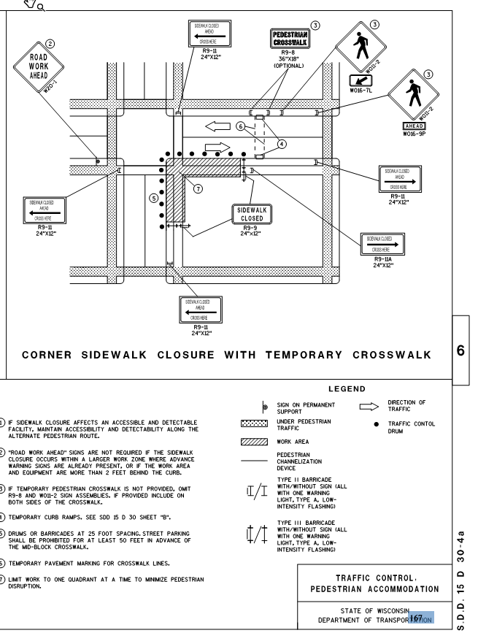
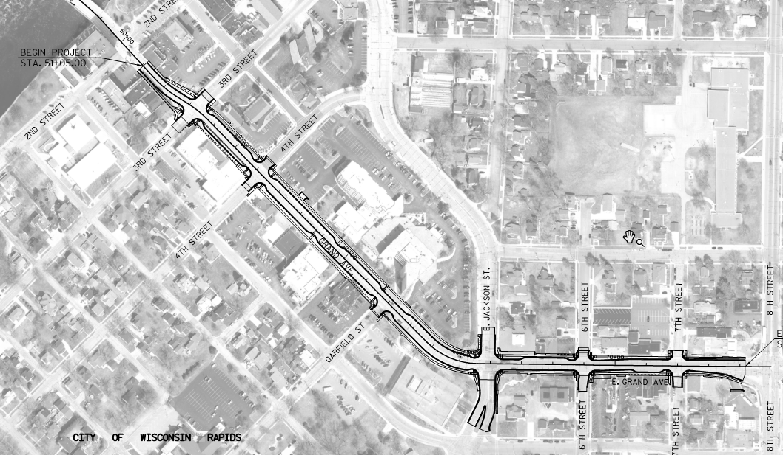
East Grand Avenue Reconstruction – Wisconsin Rapids
Pedestrian Accommodation - As shown in the Plan

Slide 4
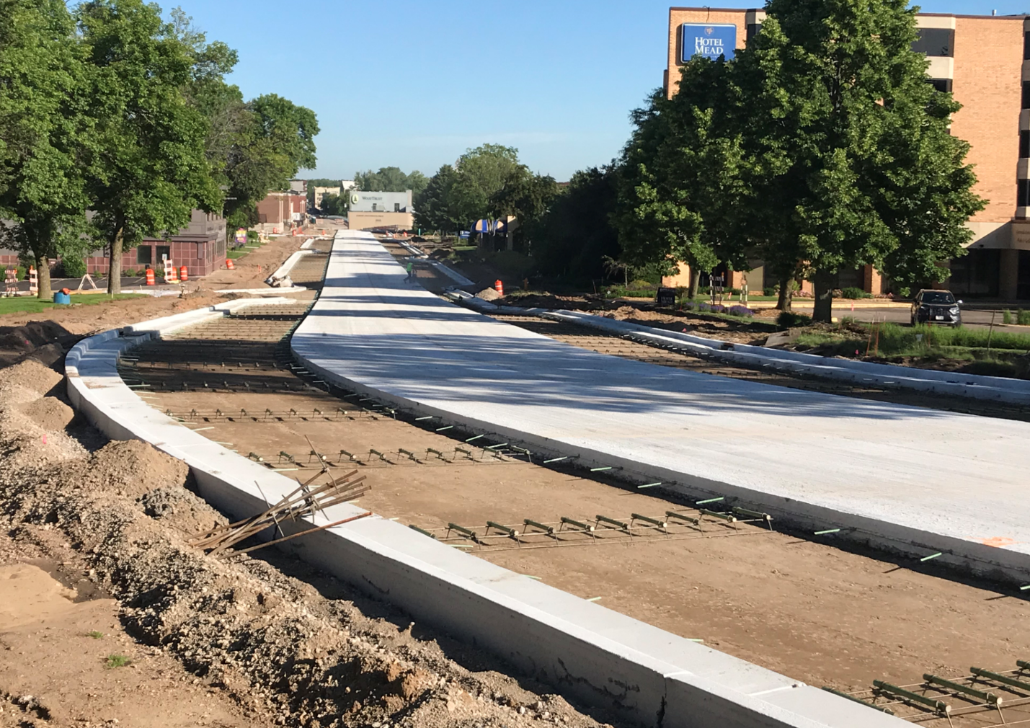
Pedestrian Accommodation – Conditions in the field

Slide 5
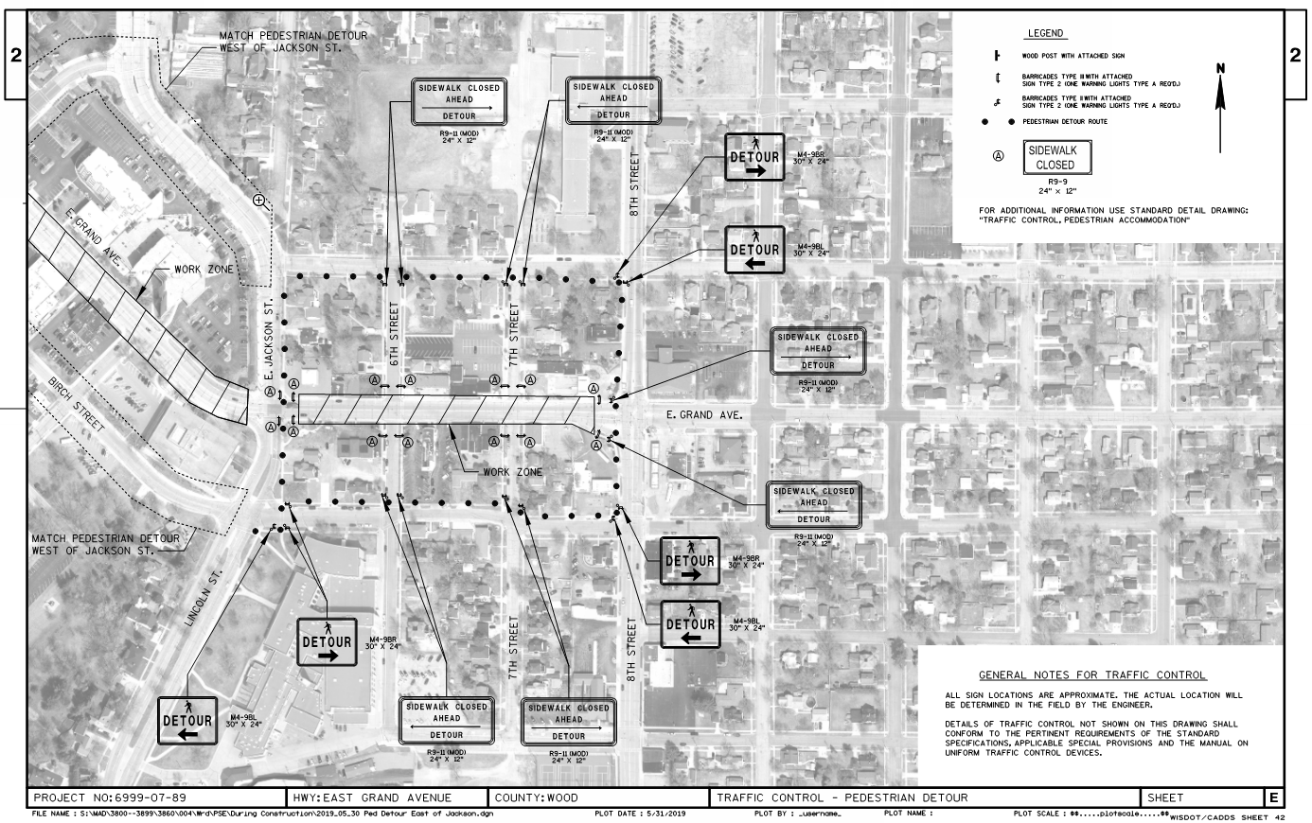
Pedestrian Accommodation Solution – Pedestrian detour outside of project on parallel streets

Slide 6
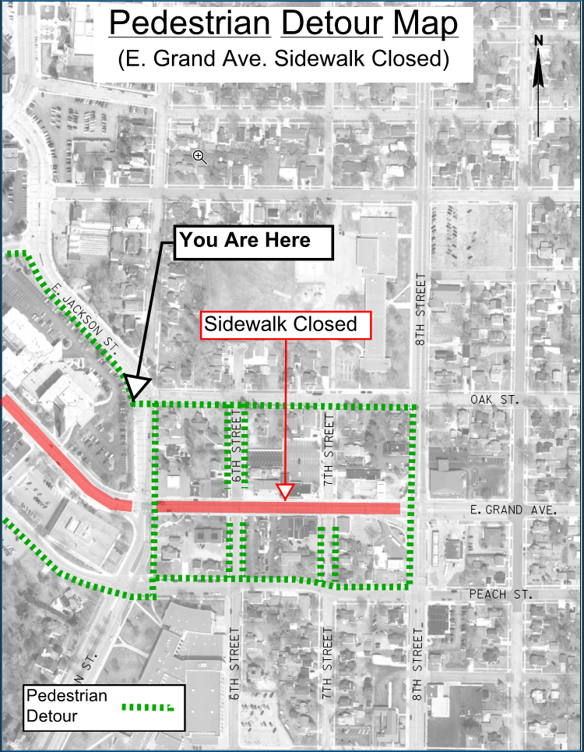
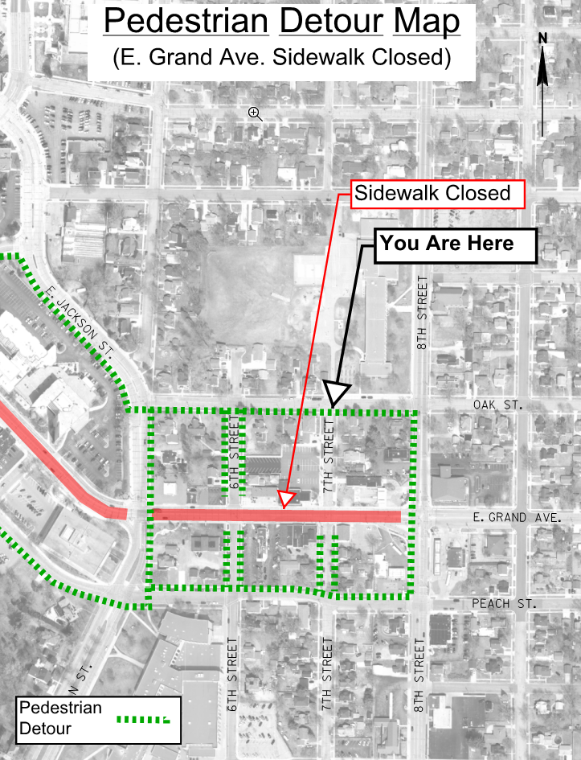
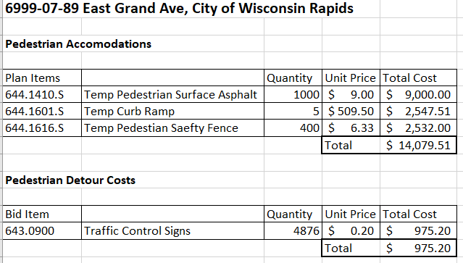
Pedestrian Accommodation Solution – Pedestrian detour signing

Slide 7
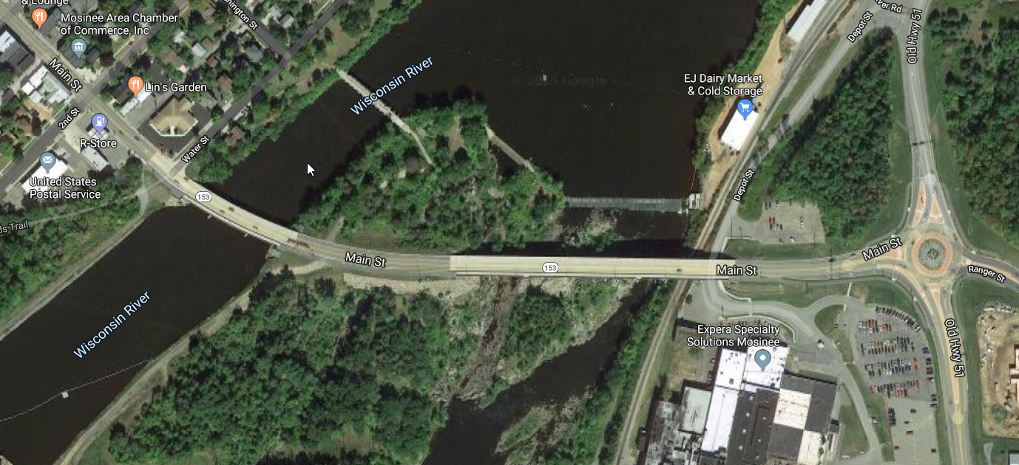
Bridge Polymer Overlay - Mosinee

Slide 8
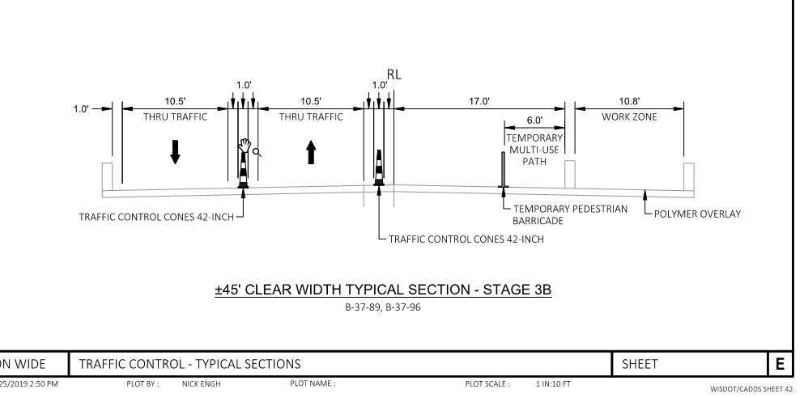
Pedestrian Accommodation - As shown in the Plan

Slide 9
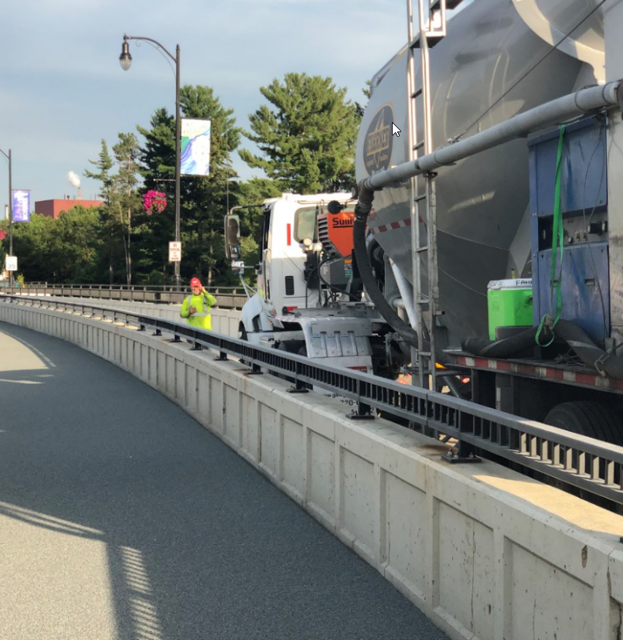
Pedestrian Accommodation – Conditions in the field

Slide 10
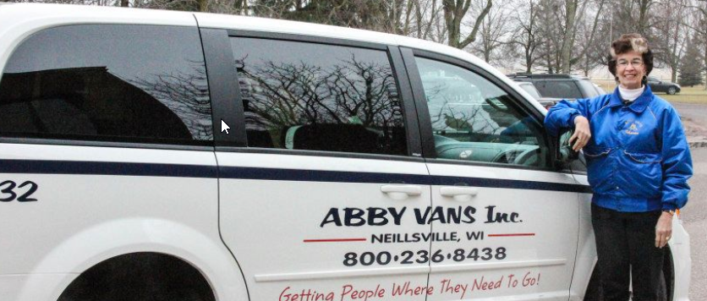
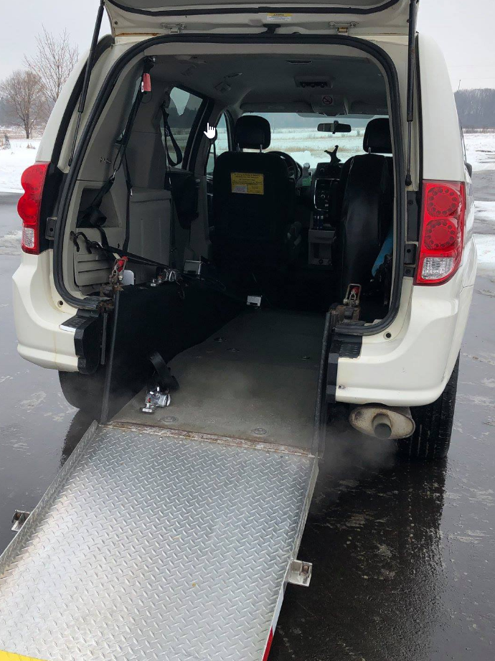
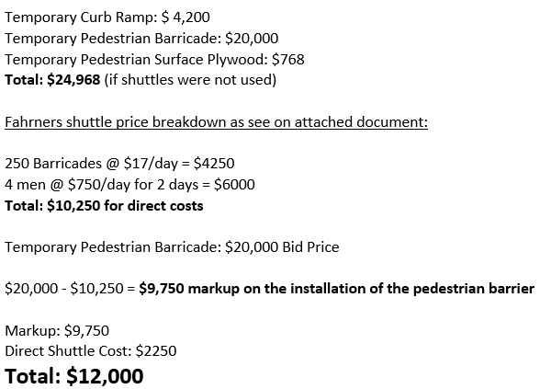
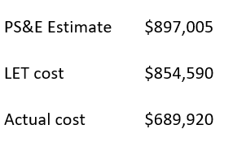
Pedestrian Accommodation Solution proposed by contractor – Shuttle bus – Abby Vans
Two day operation – 10 pedestrians per day – handled bikes, all pedestrians, and disabled.

