Slide 1
Construction Communication 1.01
David Pilon, PE
NC Region Construction Conference
February 19, 2020
Notes:
Read me notes regarding this WisDOT PowerPoint template: Standard screen size of 1024 by 768, includes either blue or light gray backgrounds
This WisDOT PowerPoint template has a standard (4:3) aspect ratio (1024 x 768).
Use if you will be doing one of the following:
Presenting with a WisDOT projector that displays in standard (4:3) or 1024 x 768.
Presenting at a conference location which uses projectors that display in standard (4:3) or 1024 x 768.
Use the WisDOT PowerPoint template that has the widescreen (16:9) aspect ratio (1920 x 1080) if you will be doing one of the following:
showing your presentation on a large widescreen television.
showing your presentation using a display in widescreen format.
converting your presentation to video in the future.
Title slide
Slide 1 and slide 8 are layouts for the title slide of your WisDOT presentation. The title of your presentation goes at the top in the white text (for the light gray background) or blue text (for the gray background). The title may be one or two lines.
Managing placeholders
If your presentation does not need all the text placeholders, delete the placeholders you do not need and then you may need to lower or adjust the height between lines.
Various slide layouts
Slides 2 through 6 and 9 through 13 are examples of five slide layouts you may use in your presentation. The headline of each example describes which content placeholders are available in its layout. Review the slide layouts and decide which one best suits your content.
Blank slides
Slides 7 and 14 are blank slides for custom layouts in your presentation.
Ways to transfer a PowerPoint presentation from another design to this template.
The recommended way is to copy text line by line, slide by slide, from the other PowerPoint design. Then paste it into Notepad, copy from Notepad, then return to this template, select the text in the desired placeholder and copy. If you would like to get all your text out of the other design at once, choose file, save as .rtf, then copy all text from the .rtf, paste it into Notepad. Then use the Notepad file to copy the text line by line into this template by selecting the desired placeholder and copying. (Notepad will clear styles from the other PowerPoint design.)
How to paste text and keep template’s font styles and color
Select the text in placeholder, then copy. If copying and pasting text into a slide layout does not preserve the template’s font styles, select text in placeholder and right click on the placeholder and select the first paste option: use destination theme. Doing so will keep your pasted text in the font style and color designed for WisDOT template.
How to add more slides with the layout you want
To add a new slide layout to your presentation: in normal view, on the home tab, select new slide. Slide layout options for the WisDOT template will appear. Select the slide layout you want.
Changing a current slide layout on to a different current slide layout is not recommended.
Changing a current slide layout on to a different current slide layout is not recommended, as sometimes this results in additions of unmatched text and placeholders. It’s best to add a new slide layout to your presentation: in normal view, on the home tab, select new slide. Slide layout options for the WisDOT template will appear. Select the slide layout you want and add new text to this slide layout.
When to choose the light gray background
Slides 1 through 7 have a light gray background. Use with its navy and red type styles. Use if you have positive versions of graphics and logos. Some experts say if you're presenting in a small room with most of the lights on, use a lighter gray background, then the background will tend to fade away while the other components will grab attention. Other experts say that if your copy is kept short and sweet, the lightness or darkness of the background is irrelevant, as viewers then have little to read.
When to choose the blue background
Slides 8 through 14 have a dark blue background. Use with its white and gold type styles. Use if you have reverse or negative versions of graphics and logos. Some experts say if you're presenting with most of the lights off in the room or in a darker presentation area, consider using the blue background color, then the background won't intrude on the message and the lighter components will stand out. Other experts say that if your copy is kept short and sweet, the lightness or darkness of the background is irrelevant, as viewers then have little to read.
Use these sizes and colors of fonts for template with LIGHT GRAY background and standard aspect ratio (1024 x 768).
Font sizes may be adjusted either 2 points smaller or 2 points larger from sizes listed.
Slide 1 with GRAY background
Title text = Arial Narrow Bold, 60 point, Color: navy blue R0 G65 B106, Title text may be one or two lines. 3 or more lines are not recommended.
Name of Presenter = Arial Narrow Bold, 47 point, Color: red R164 G40 B76, Keep to 1 line
Title of Presenter = Arial Narrow, 40 point, Color: red R164 G40 B76, Keep to 1 line
Name of conference or event, Location, City, State = Arial Narrow, 28 point, Color: navy blue R0 G65 B106, Keep to 1 or 2 lines
Month, Day, Year = Arial Narrow Bold, 25 point, Color: red R164 G40 B76, Keep to 1 line
Slides 2, 3, 4, 5, 6 with GRAY background
Example heading = Arial Narrow Bold, 45 point, Color: navy blue R0 G65 B106, Heading may be one or two lines. 3 or more lines are not recommended
Red subhead = Arial Narrow Bold, 39 point, Color: red R164 G40 B76, Keep to 1 line
Bullet 1 = Arial Narrow, 35 point, Color: navy blue R0 G65 B106
Bullet 2 = Arial Narrow, 32 point, Color: red R164 G40 B76
Paragraph text = Arial Narrow, 28 point, Color: navy blue R0 G65 B10
Use these sizes and colors of fonts for template with BLUE background and standard aspect ratio (1024 x 768).
Font sizes may be adjusted either 2 points smaller or 2 points larger from sizes listed.
Slide 8 Title slide with BLUE background
Title text = Arial Narrow Bold, 60 point, Color: white R255 G255 B255, Title text may be one or two lines. 3 or more lines are not recommended.
Name of Presenter = Arial Narrow Bold, 47 point, Color: gold R216 G184 B70, Keep to 1 line
Title of Presenter = Arial Narrow, 40 point, Color: gold R216 G184 B70, Keep to 1 line
Name of conference or event, Location, City, State = Arial Narrow, 28 point, Color: white R255 G255 B255, keep to 1 or 2 lines
Month, Day, Year = Arial Narrow Bold, 25 point, Color: gold R216 G184 B70, Keep to 1 line
Slides 9, 10, 11, 12, 13 with BLUE background
Example heading = Arial Narrow Bold, 45 point, Color: white R255 G255 B255, Heading may be one or two lines. 3 or more lines are not recommended
Red subhead = Arial Narrow Bold, 39 point, Color: gold R216 G184 B70, Keep to 1 line
Bullet 1 = Arial Narrow, 35 point, Color: white R255 G255 B255
Bullet 2 = Arial Narrow, 32 point, Color: gold R216 G184 B70
Paragraph text = Arial Narrow, 28 point, Color: white R255 G255 B255
Contact the WisDOT Learn Center for training in PowerPoint. A link to the WisDOT Learn Center may be found on the dotnet home page.

Slide 2
Effective construction communication
Reduces stress on the worksite.
Wisdot has developed tools and processes to facilitate good communication on our projects
If used correctly, these tools can facilitate problem solving

Slide 3
Tools, what tools???
Timely Decision Making Manual
Preconstruction Meetings
Weekly Progress Meetings / weekly look ahead schedules.
Line of Communication on project
Designated Materials Person Contractor/WisDOT
Partnering Meeting Guidance

Slide 4
Timely Decision Making Manual
https://wisconsindot.gov/Pages/doing-bus/eng-consultants/cnslt-rsrces/rdwy/admin.aspx
Find it through the pantry software link under statewide manuals and guides
Or on the HCCI website under contracting information

Slide 5
Preconstruction Conference
Your Regional Preconstruction meeting form incorporates project Lines of Communication.
Make the preconstruction meeting a positive start to your project.

Slide 6
Preconstruction Conference
Send out the meeting notes ahead of the precon so the contractor has an idea what is going to be covered at the meeting
Suggest you pose additional questions to the contractor regarding his operations and schedule prior to the meeting to encourage discussion at the meeting.
Highlight a few of the changes in ASP 6 (especially this year)

Slide 7
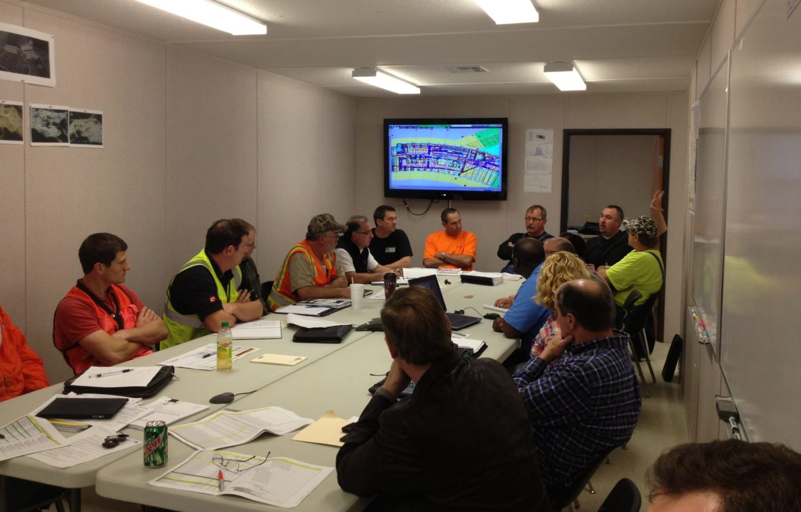
Construction Partnering
Definition: is a project management practice where transportation agencies, contractors and other stakeholders create a team relationship of mutual trust and IMPROVED COMMUNICATIONS.

Slide 8
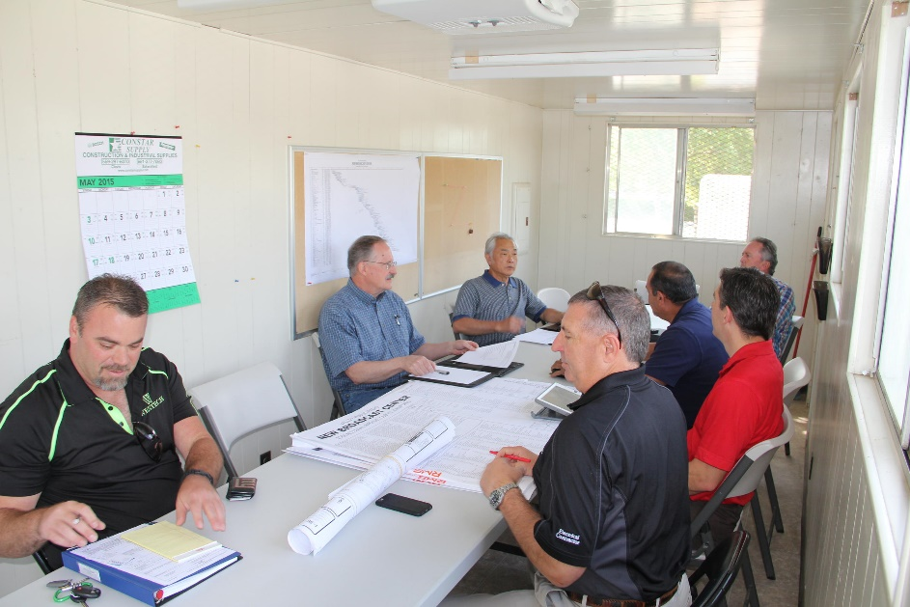
Weekly meeting
Should be 20 minutes to 45 minutes in length.
Take good notes.
Encourage attendance.
Keep the meeting moving. Schedule solving problems with a smaller group after meeting

Slide 9
Weekly Meeting
Important topics
Agenda!
Controlling item/contract time.
Utilities, environmental, traffic control, EEO
CCO’s
Outstanding issues, RFI’s
Materials issues / missing documentation

Slide 10
3 Week Look Ahead
Important takeaways
Anticipate controlling item(s) of work
Inspection/materials needs
Set up pre pour/ pre pave meetings.
Anticipate needed lane closures/ staging switches
Highlights potential conflicts in schedule

Slide 11
104.4 Request for Information
Can be initiated by either party, Contractor or state
Documents the information gathering process.
2 forms to document the process
Question(s) should be reasonable
Explain why a response is necessary to fulfill contract obligations
Provide a response time.
Suggest using when there is difficulty in obtaining contractor updated schedules

Slide 12
104.3 Contractor Notification has been revised.
Contracts let prior to December 19 still use the old method.
Old method below.
104.3.2 Contractor initial oral communication
104.3.3 Contractor 2 day written notice
104.3.4 Engineer 1 day written acknowledgement
104.3.5 Contractor 5 day written Statement
104.3.6 Engineer 5 day written response.
If this doesn’t resolve the problem, then it becomes a claim.

Slide 13
104.3 Contractor Notification has been revised.
ASP 6 Effective December 2019 Contracts.
New method.
104.3.2 Contractor Initial oral notification
104.3.3 Contractor 5 day written notification (basically the information required for a claim).
104.3.4 Region 1 day written acknowledgement.
104.3.5 Engineer 5 day written response. May ask for more information form the contractor.
104.3.6 Region Final Decision 10 business days after receiving additional information, or from the Contractor 5 day written notification.
Notes:
If not resolved in 104.3 it becomes a claim.

Slide 14
104.3.3 Contractor 5 day written notification
contents
Executive summary
Contractors Basis of Entitlement. (Should Be the reason that a Change order is required under the contract)
Contractors request for damages.
Supporting documentation

Slide 15
104.3.6 Region Final Decision
3 options
Confirm or Deny the request for CCO
Contractor may then pursue as a claim under 105.13
3rd party advisory opinion (one person DRB)
Used on SE Mega teams for major issues.

Slide 16
Have a great construction season!!

