Slide 1
Construction Conference
February 19, 2020
Structure Drainage
Use of Surface Drain, TBT Curb
Tim Hanley

Slide 2
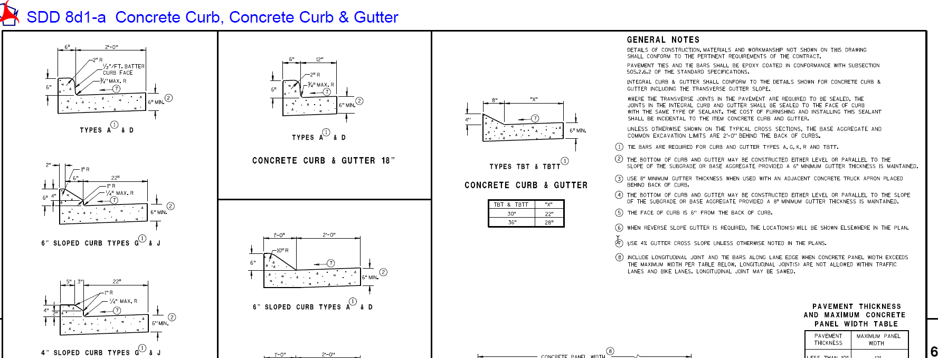
TBT Curb

Slide 3
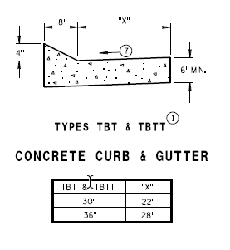
TBT and TBTT Curb

Slide 4
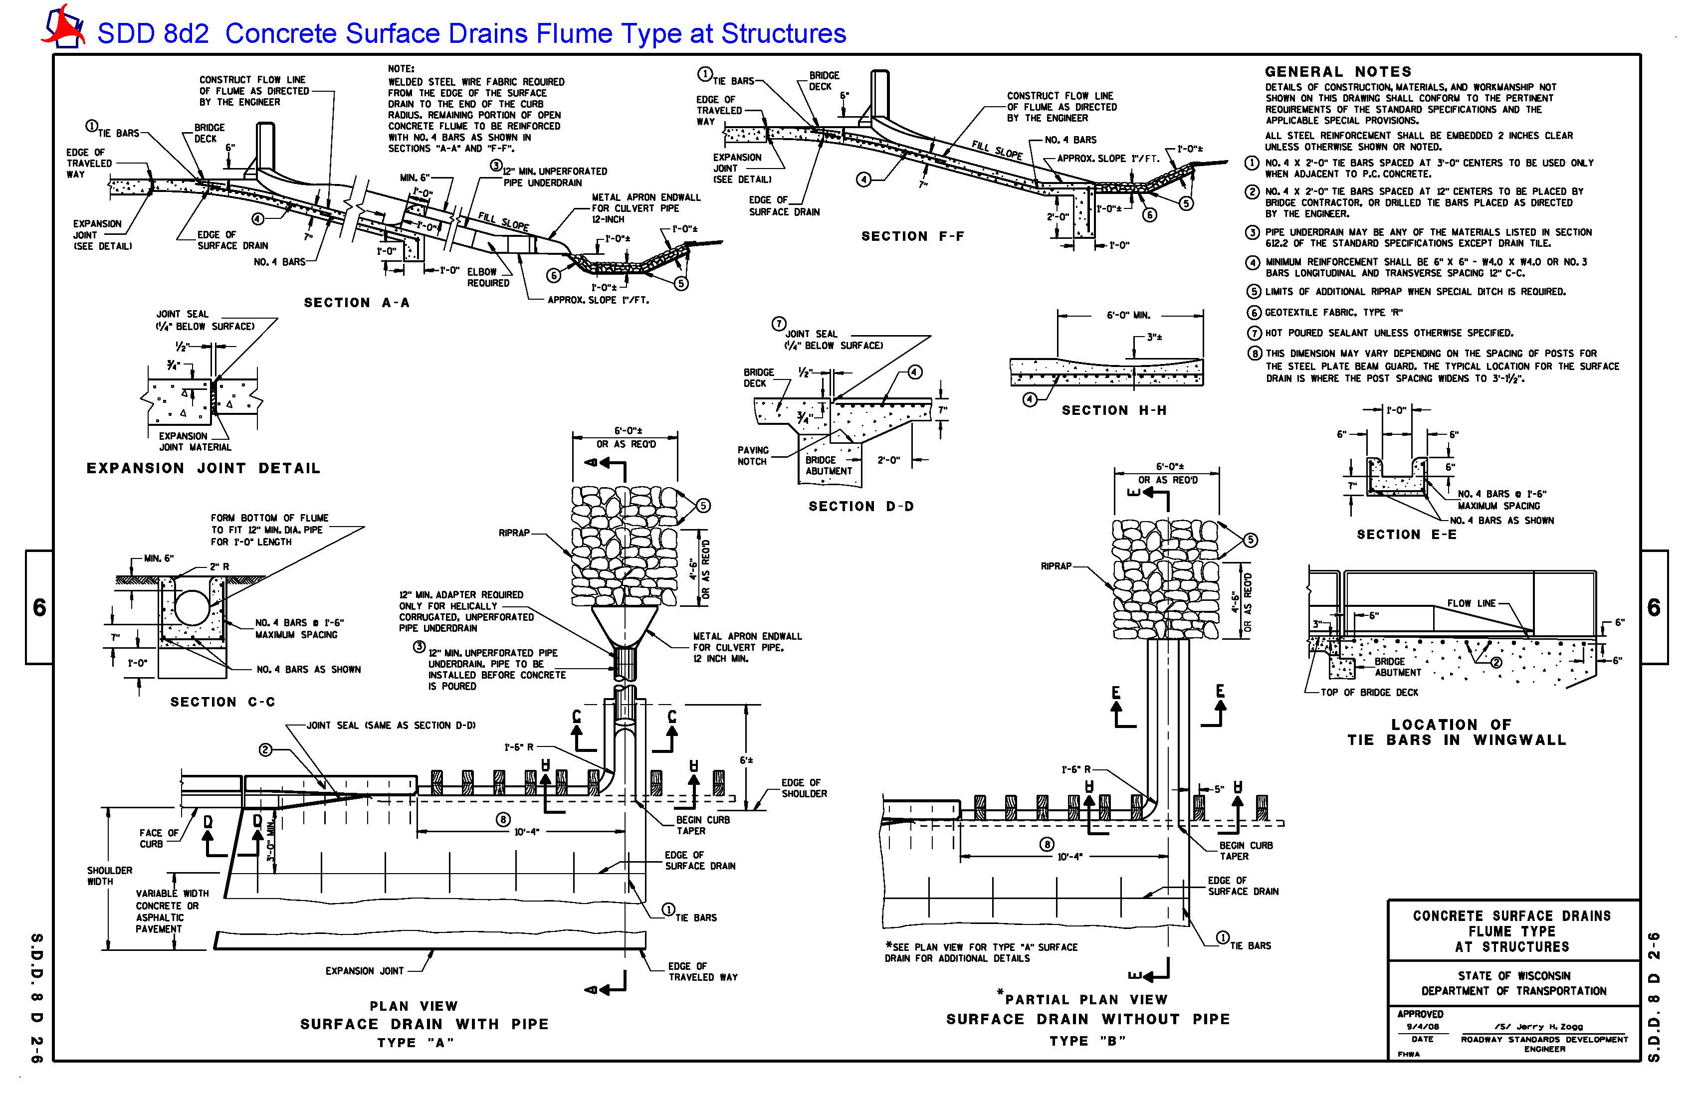
Surface Drain Standard Detail
Prior to Feb 2020

Slide 5
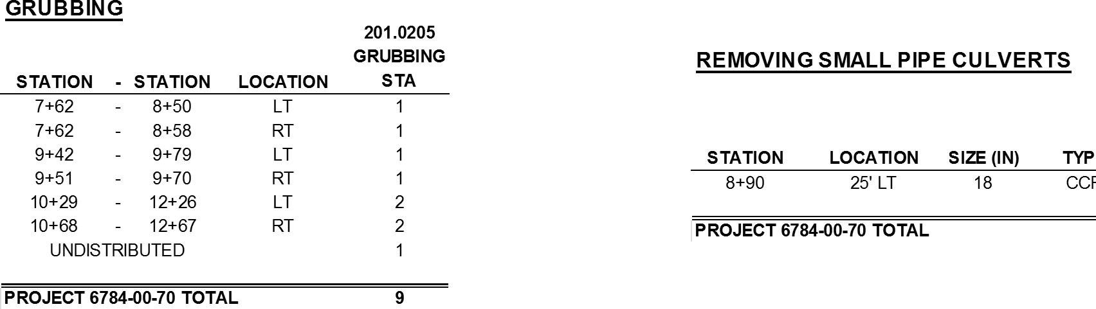
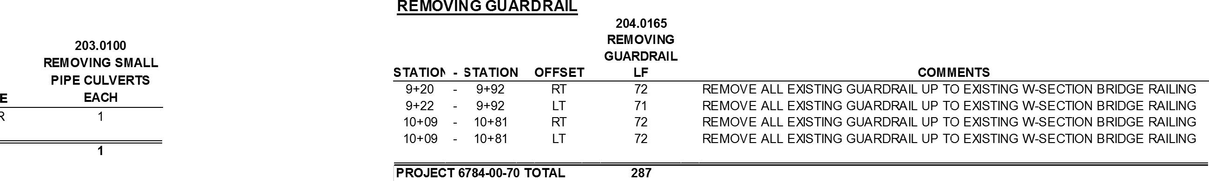
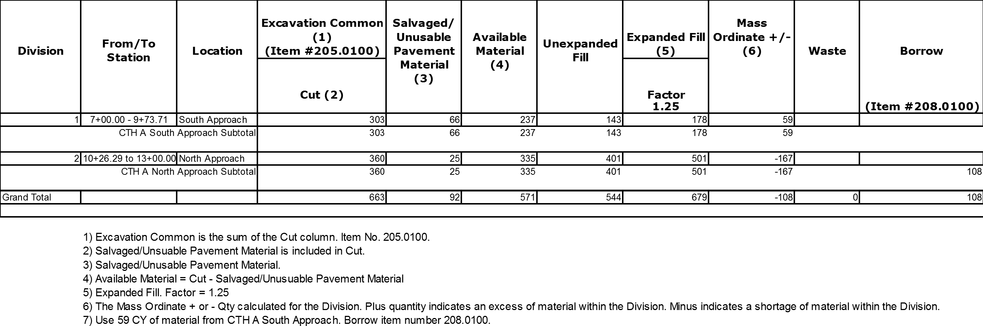
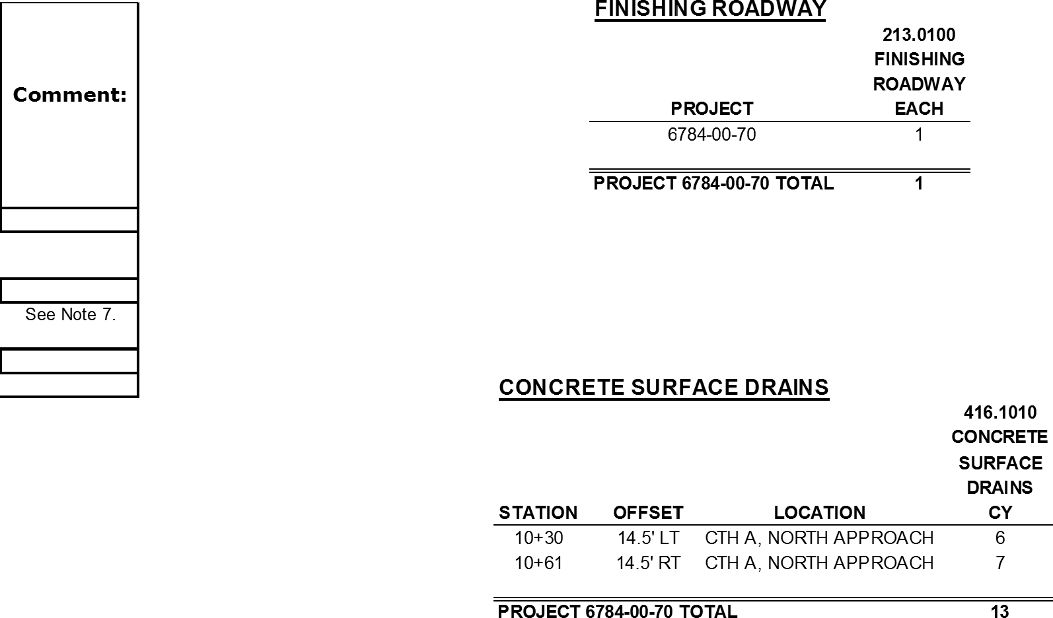
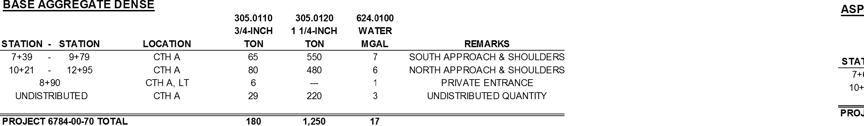
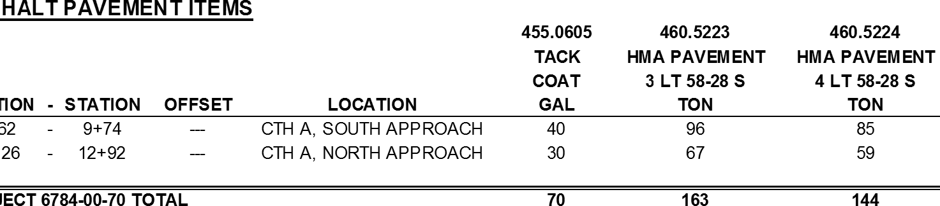


Slide 6
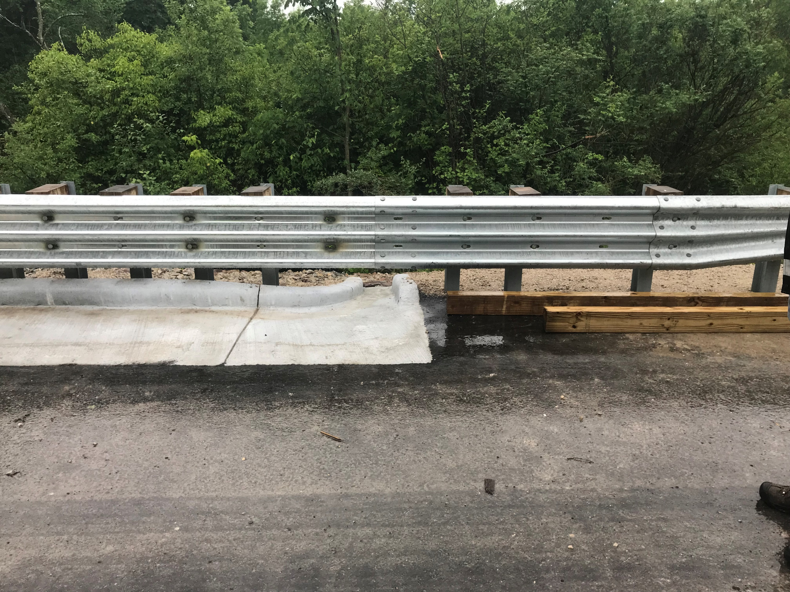
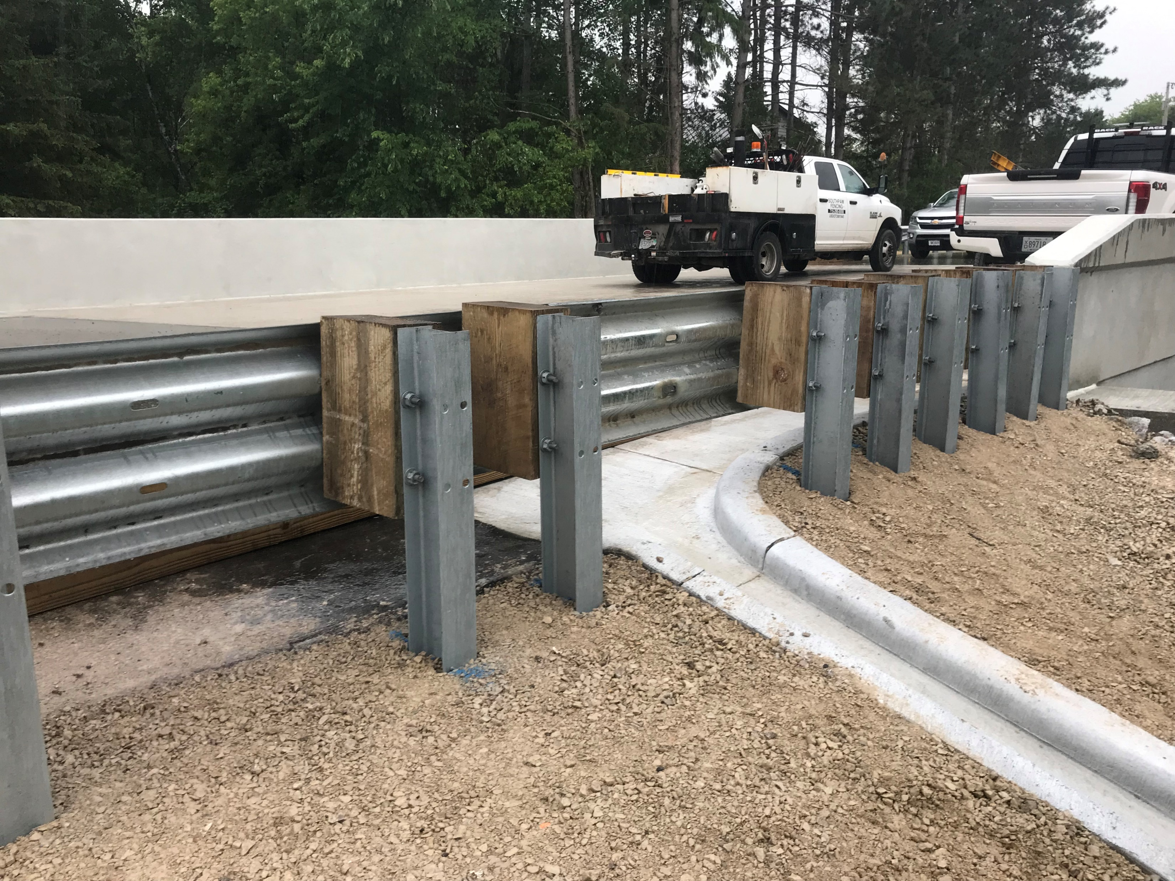
Constructed – Wrong curb type and location

Slide 7

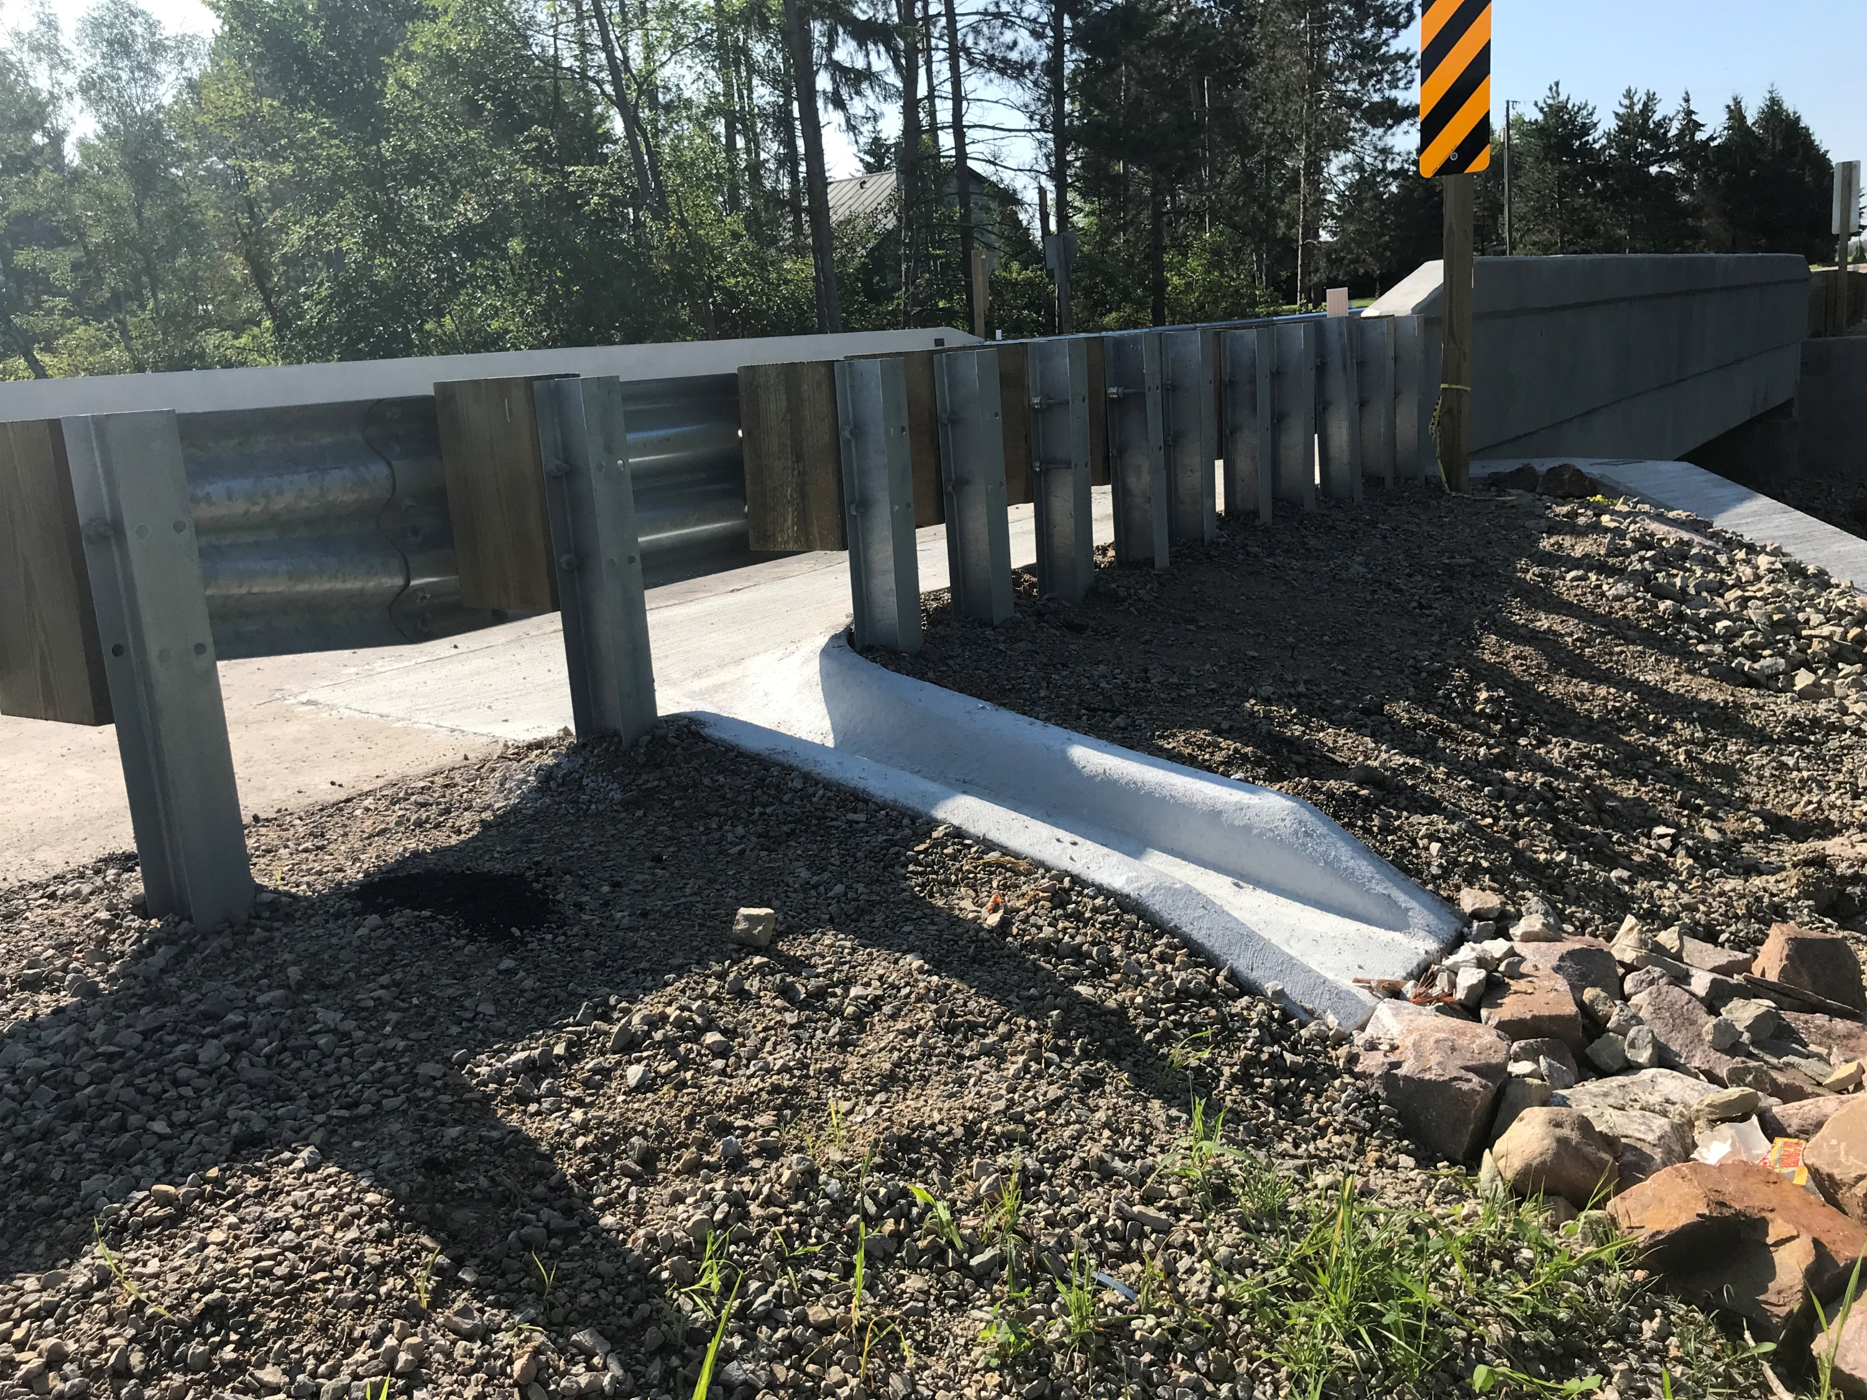
Corrected – Location and Curb Type TBT

Slide 8
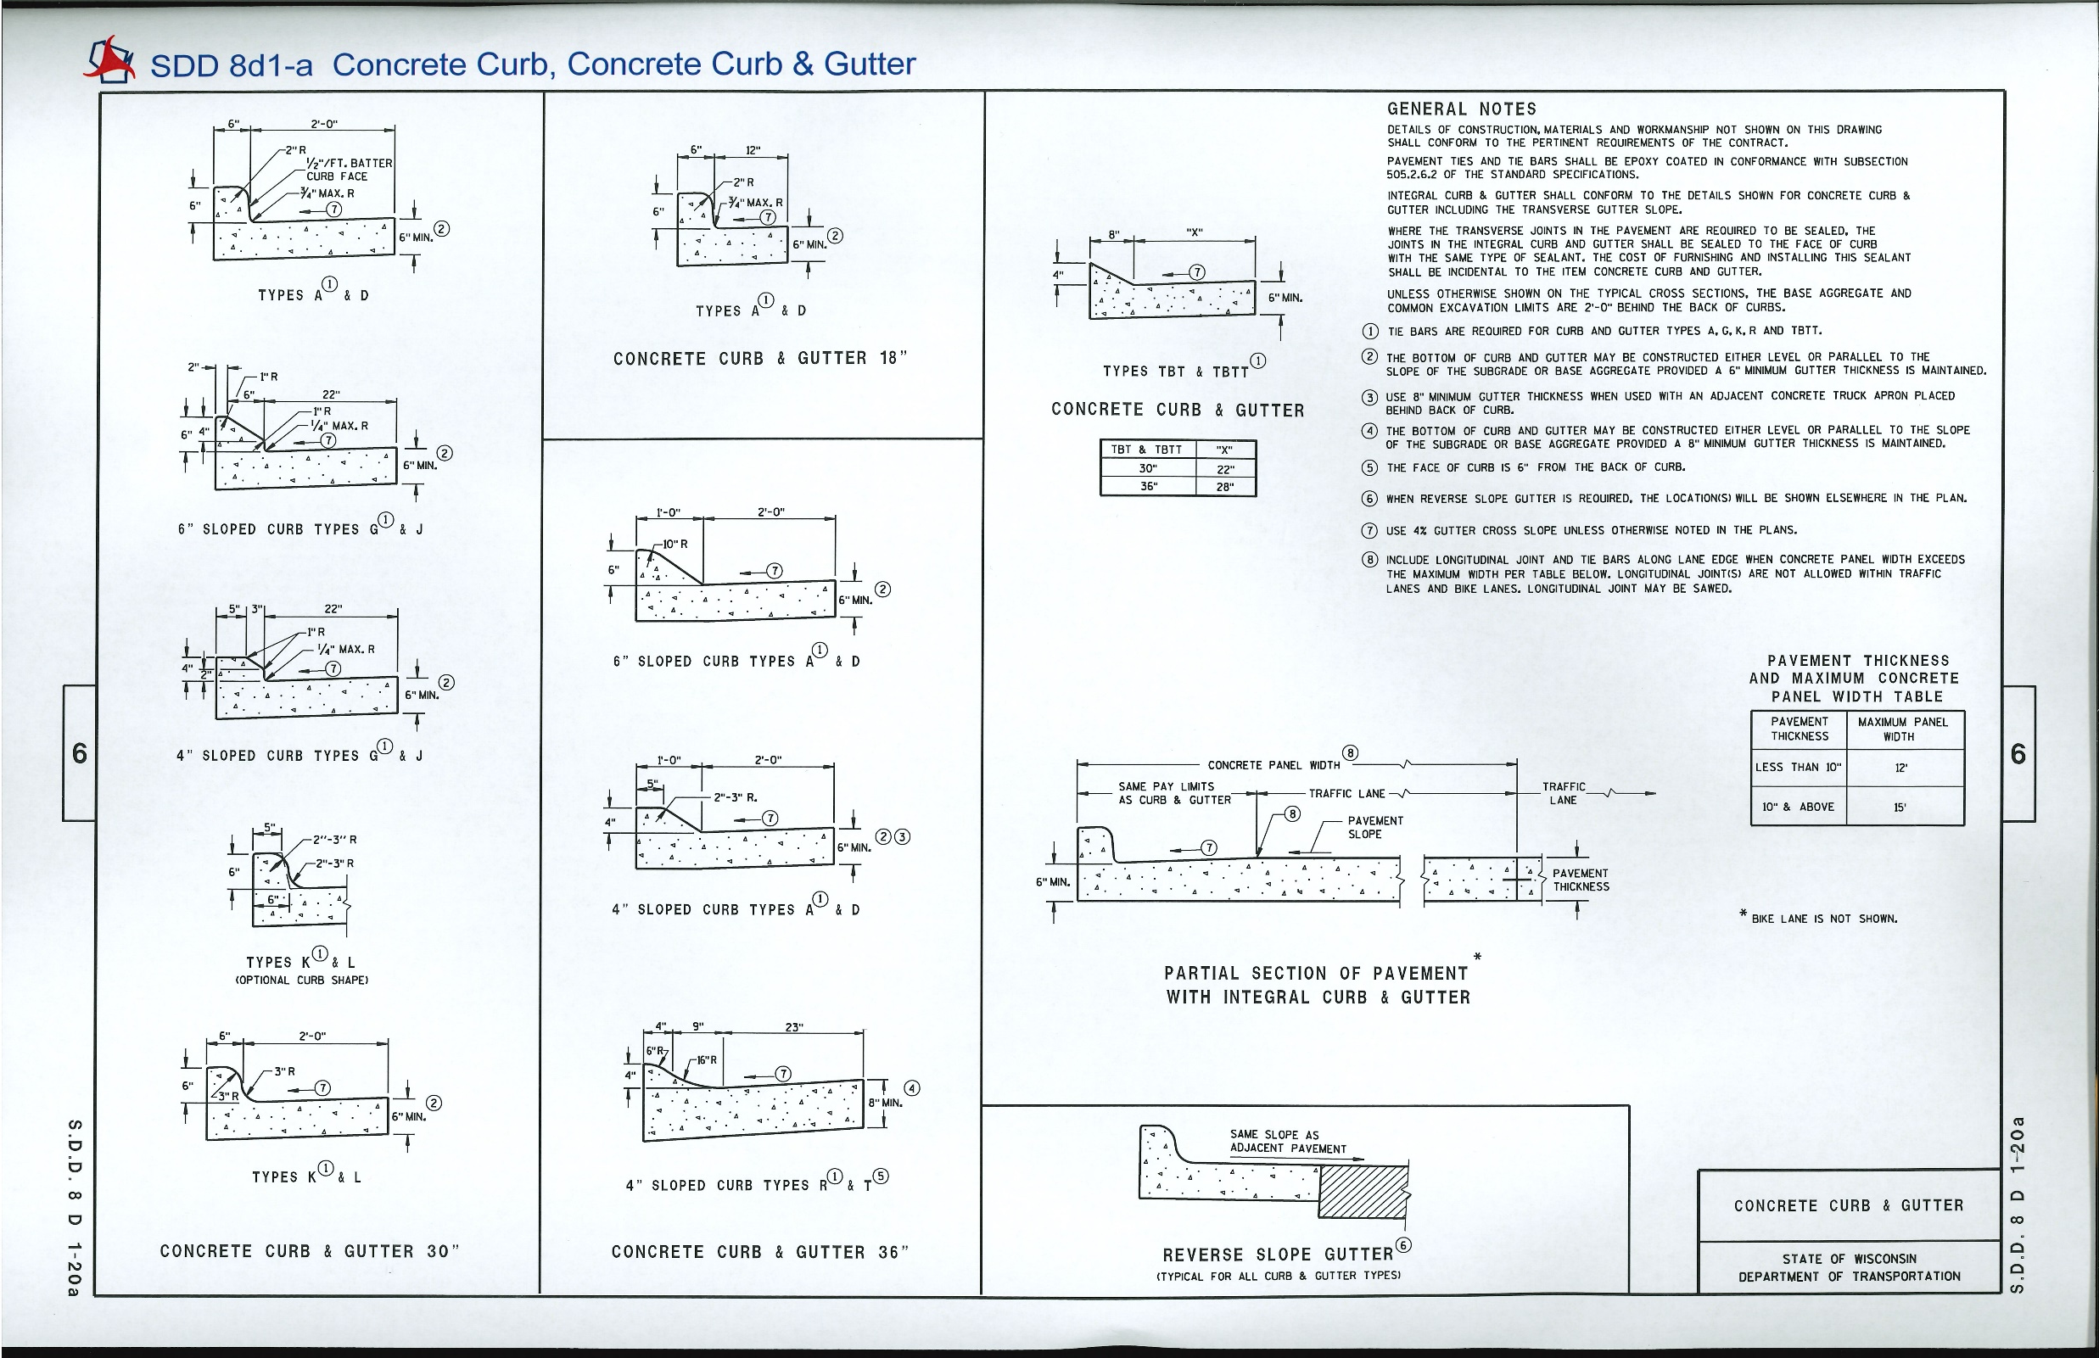
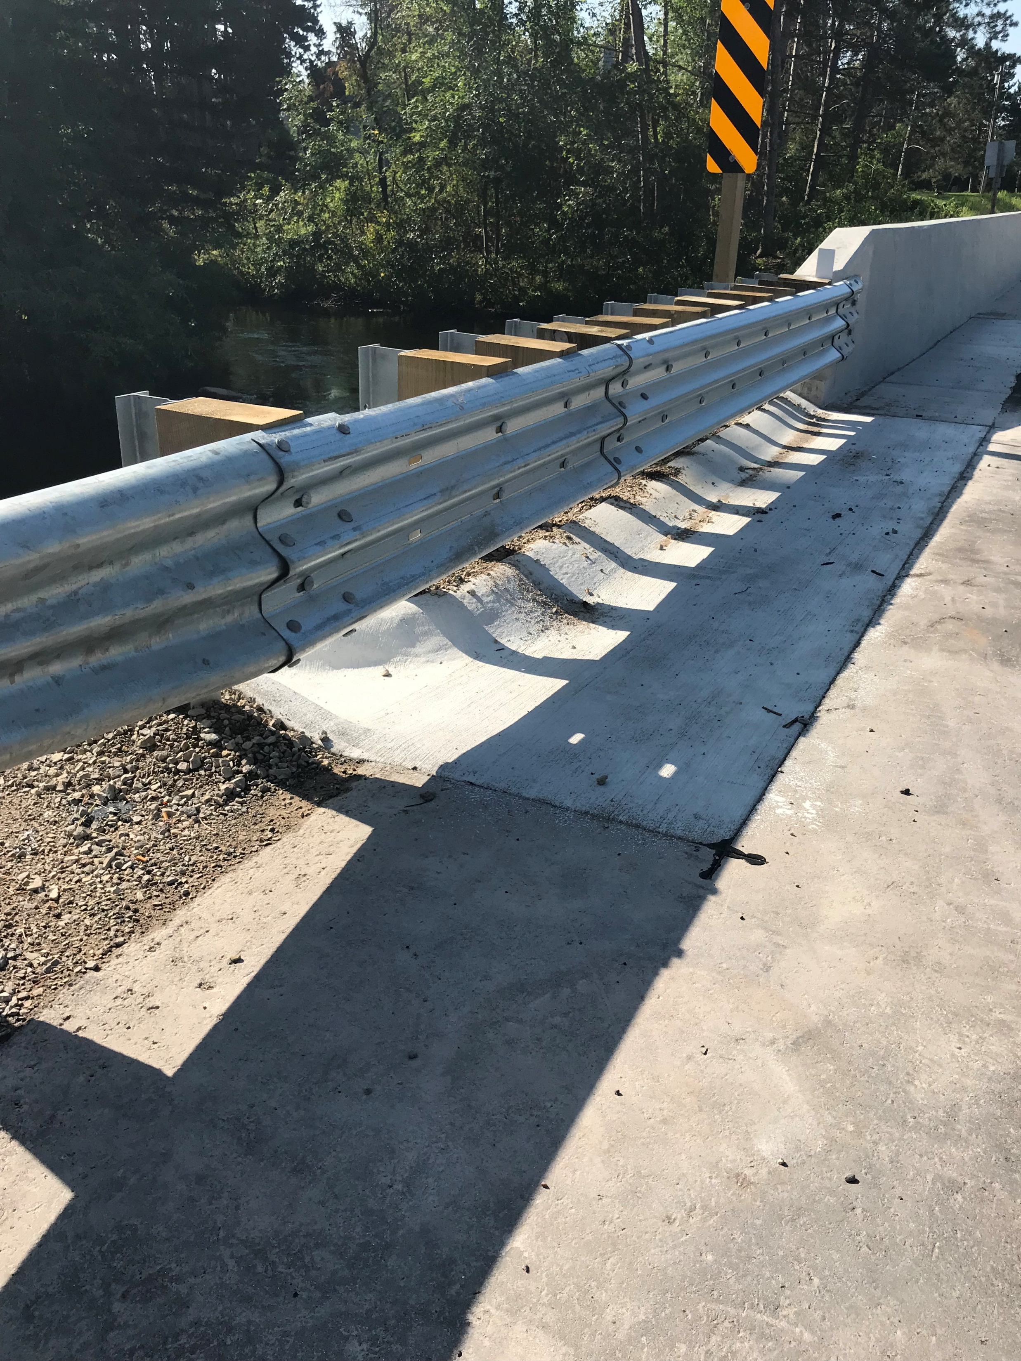
TBT Curb

Slide 9
Key Notes
Be aware that TBT Curb exists and where it is used
Recognize that Surface drain Standard Details don’t illustrate TBT curb use prior to February 2020
Check your construction project details
February 2020 new Standard Detail Drawings moving forward

