Slide 1
Work Zone & LCS Updates
Cara Abts
Regional Traffic Engineer
NC Region Construction Conference
Wausau, WI
February 19, 2020

Slide 2
Lane Closure System
Notes:
FIRST, I’m going to go over a few things in the LANE CLOSURE SYSTEM.

Slide 3
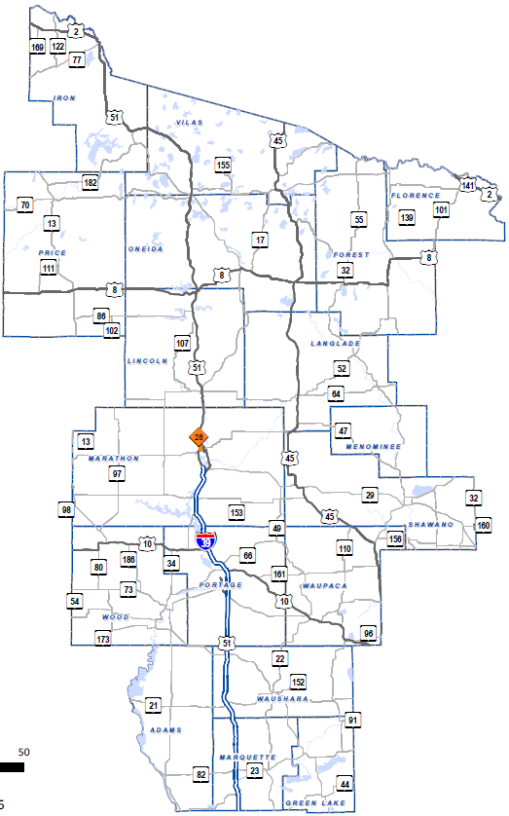
LCS Routes
Priority Routes in the North Central Region
  I-39/US 51, WIS 29, US 10
  WisDOT RTE approves
Non-Priority Routes
  WisDOT Construction Project Leaders approve
Notes:
The PRIORITY and NON-PRIORITY ROUTES and APPROVAL AUTHORITY has NOT CHANGED in this region. If your CLOSURE is on the PRIORITY ROUTE (the ones in RED), I am the one to ACCEPT IT.
Please EMAIL me the PROJECT ID, LANE CLOSURE IDs, and ANYTHING I SHOULD KNOW about the closures.
I try to get priority route closures approved quickly. If I have an OUT OF OFFICE MESSAGE, please email my supervisor, Jim Volkmann.
If you are a NEW construction project leader or NEW TO WORKING IN THIS REGION, please EMAIL ME, and I will set you up with the PROPER AUTHORIZATION.

Slide 4
Quick LCS Notes
Get closures entered early. When in doubt, enter one!
Enter Priority Route Closures by Thursday PM
Closures longer than 2 weeks: Manually Complete in WisLCS when finished or edit end date as needed
Notes:
I want to EMPHASIZE ENTERING closures EARLY. I understand contractors and weather can impact construction schedule. WHEN IN DOUBT, ENTER A CLOSURE. It can be DELETED if NOT NEEDED.
Please enter priority route closures by THURSDAY afternoon for the following week. This will help ensure that I can REVIEW and APPROVE them and you get them entered WITHIN the ADVANCED NOTIFICATION REQUIREMENTS.
ALL CLOSURES lasting LONGER than 2 WEEKS must be MANUALLY COMPLETED or EDITED. If you don’t, expect an email from me.

Slide 5
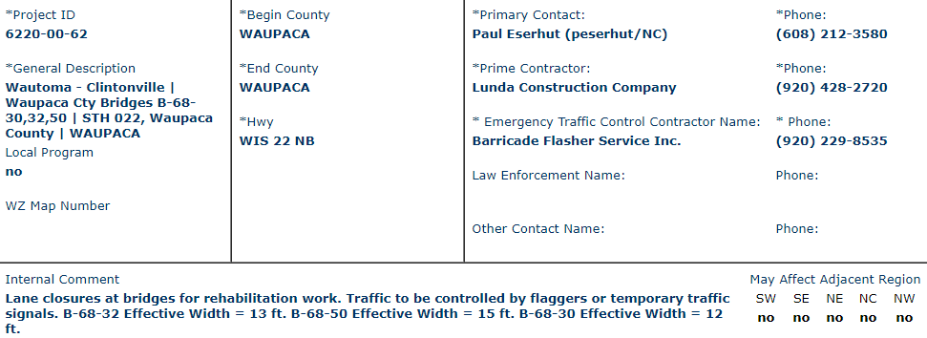
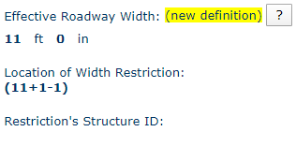

Additional Information in LCS
Please include effective width
calculation somewhere
Notes:
When you’re filling out the LCS entry, it is important to provide a GOOD DESCRIPTION.
Here is an EXAMPLE of one we had that was WELL DONE with a DETAILED DESCRIPTION noting how the work will be done.
This is USEFUL to the REVIEWERS and to OSOW PERMITTING.
INCLUDE the EFFECTIVE WIDTH calculation on ALL ENTRIES except FULL CLOSURES.

Slide 6
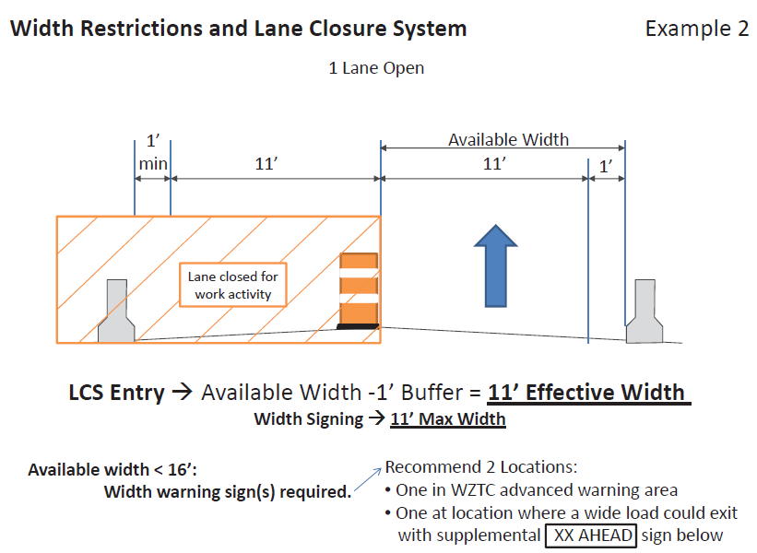
“Effective Width”
Example 1
Notes:
What is EFFECTIVE WIDTH? This is the DISTANCE from the TRAFFIC CONTROL to the EDGE OF PAVEMENT MINUS ONE FOOT.

Slide 7
Where to Modify Entries?
Has the entry
been accepted yet?
NO
YES
Under
ACCEPT
Under
MODIFY
If you modify the dates on a priority route closure, please send me an email with a quick description why.
Notes:
If an entry HASN’T BEEN ACCEPTED yet, you will find it in the ACCEPT tab. Otherwise, it will be in MODIFY.
After submitting, you can only EDIT the DATES and TIMES of an entry. For all OTHER CHANGES, contact me.
If you make ANY CHANGE to a priority route entry, EMAIL ME with a QUICK DESCRIPTION WHY.

Slide 8
Flagging Updates
Notes:
Many of you have heard rumblings about CHANGES to FLAGGING OPERATIONS this year, so let’s move on to those.

Slide 9

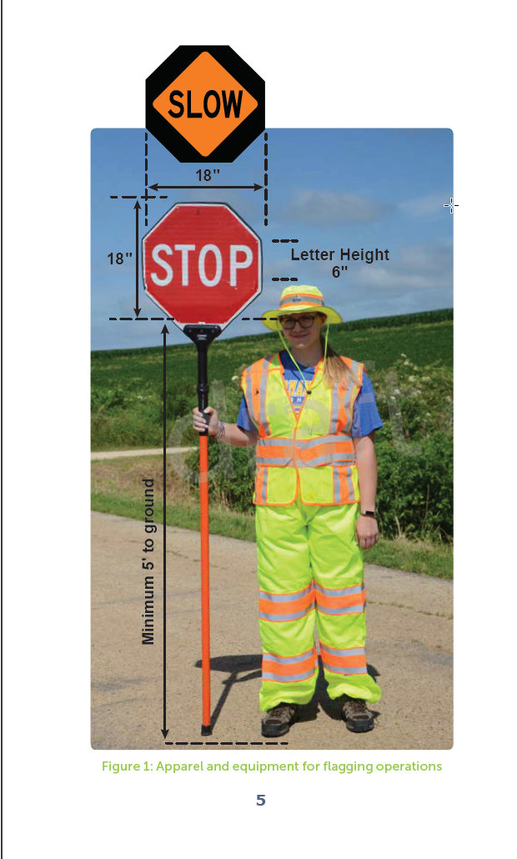
Flagger Certification
Flagger certification required to work on state hwys and/or LET projects
  (2020 Std Spec 104.6.1.2.2)
4 hrs classroom/8 hrs field training required
PDF available at https://wisconsindot.gov/dtsdManuals/
traffic-ops/manuals-and-standards/
flagger.pdf
Notes:
New for 2020: Flagger certification documentation must be provided to the ENGINEER before FLAGGING. There will be a reminder of this to the CONTRACTOR at the PRE-CONSTRUCTION CONFERENCE.
FLAGGERS must complete 4 HOURS of CLASSROOM TRAINING and 8 HOURS of ON-THE-JOB TRAINING to be certified.
FLAGGERS or their FOREMAN are REQUIRED to CARRY flagger certification card ON SITE. A PICTURE of the card is also permitted. BTO is NOT keeping a DATABASE of flagger certification.
Flaggers are also required to follow the Wisconsin Flaggers Handbook, which is new this year. A PDF is available online on the WisDOT Traffic Ops manuals page.

Slide 10
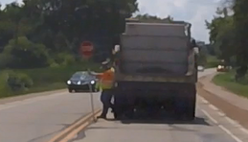
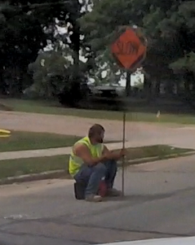
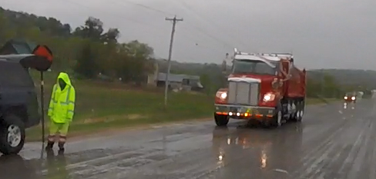
Flagging Reminders
Flaggers need to have an escape route
Flaggers need to be standing and attentive
Notes:
Last year, FLAGGERS statewide were seen to be TOO CLOSE to their VEHICLES, leaving them with NO ESCAPE ROUTE.
INATTENTIVE or SITTING FLAGGERS were seen, as well.
If you see INCORRECT FLAGGING ACTIVITY, ask to see their FLAGGER CERTIFICATION
If they are NOT certified, SHUT DOWN THE JOB until a certified replacement flagger can be found

Slide 11
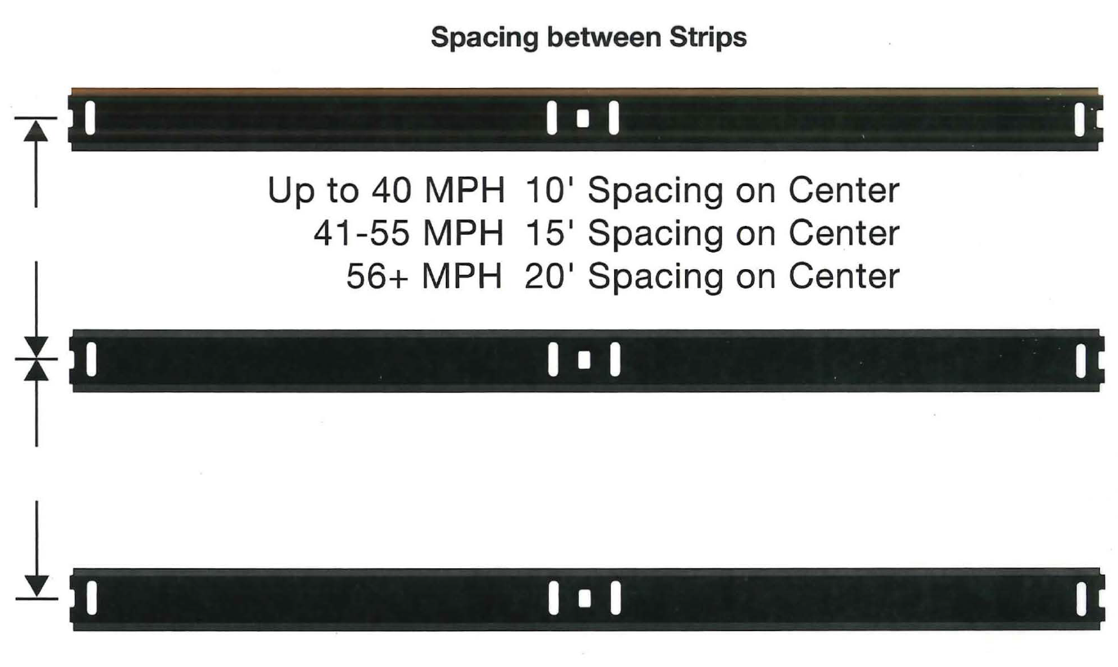
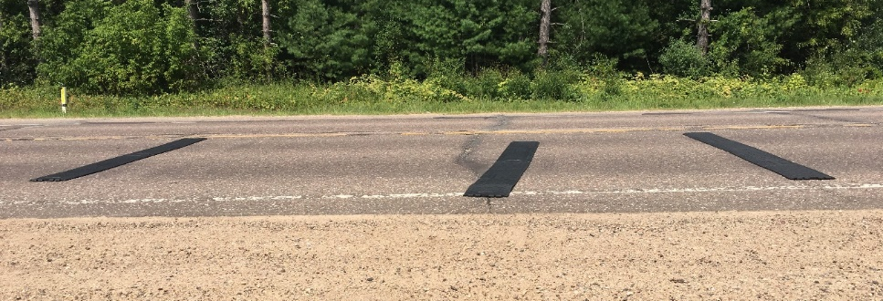
Temporary Portable Rumble Strips
Added to Flagging Standard Detail Drawing
1 array leading in to flagging location
Follow manufacturer’s spacing guidelines
Reset if shifted
Notes:
TEMPORARY PORTABLE RUMBLE STRIPS have been ADDED to the FLAGGING SDD.
1 ARRAY required in each direction. They are not needed when flagging on IMPROPER ROAD SURFACES like FRESH ASPHALT or GRAVEL.
RUMBLE STRIPS need to be SPACED per MANUFACTURER’S GUIDELINES, MONITORED and RESET if shifting occurs.

Slide 12
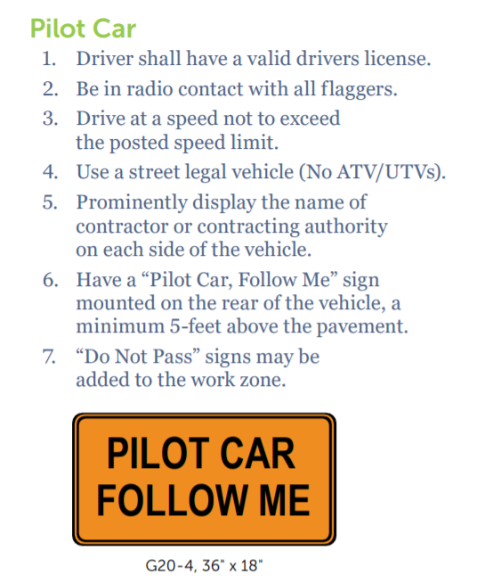
Pilot Cars
Pilot cars required when:
  Flaggers > 2 miles apart
  Curves reduce sight distance < 400 feet
Notes:
PILOT CARS are now REQUIRED by STANDARD SPEC if the FLAGGING DISTANCE is GREATER than 2 MILES or if CURVES reduce SIGHT DISTANCE to LESS than 400 FEET.
Pilot cars are used to control speed and where the traffic is going.

Slide 13
Work Zone Updates
Notes:
Those FLAGGING ITEMS will be CLOSELY MONITORED when BUREAU OF TRAFFIC OPERATIONS staff conduct WORK ZONE REVIEWS this construction season.
There are a few other TOPICS to NOTE for 2020

Slide 14
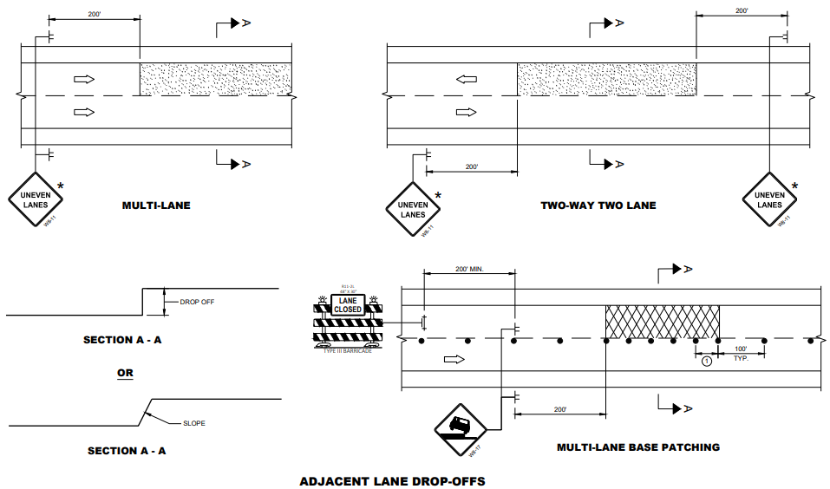
New Drop-Off Spec in 2020
104.6.1.2.3: Drop-Off & Hazard Protection
Adjacent Lanes:
  No vertical difference of 2” or more at the end of work day
  Less than 2”, use Drop-Off Signing SDD (15D39)
Notes:
New in the 2020 standard spec: DROP-OFF policy.
ADJACENT LANES may have a VERTICAL DIFFERENCE of LESS THAN 2 inches OVERNIGHT with the appropriate drop-off signing

Slide 15

Drop-Offs, cont.
< 8’ from lane (2” or more, or steeper than 3:1):
  Delineate by end of work day
  Eliminate within 72 hours or before end of work week
0 – 8’
2”+ or
> 3:1
Notes:
Vertical differences of 2 INCHES OR MORE within 8 feet of the traveled way MUST be DELINEATED by the END of the WORK DAY and ELIMINATED within 72 hours or by the END of WORK WEEK, whichever comes first.

Slide 16
Drop-Offs, cont.
8’ to 15’ from lane:
  4” or more: Delineate by end of work day
  12” or more: Eliminate or shield w/barrier within 72 hours
8 – 15’
4”+
Notes:
There are ADDITIONAL REQUIREMENTS for drop-offs 8 to 15 feet from the traveled way, but they follow the end of the work day or 72 hours/END OF WORK WEEK restrictions.

Slide 17
WisTMP Reminders
Attach Project Amendments to the WisTMP
Monitor TMP
UPDATE TMP as needed and document changes
Post Construction Project Evaluation (FDM 11-50-5.11)
Project Close Out at the end of the project
Notes:
The TRANSPORTATION MANAGEMENT PLAN is a LIVING DOCUMENT.
Please ATTACH AMENDMENTS to the TMP for better documentation.
Construction Staff needs to MONITOR the TMP to verify the QUEUE/DELAY are as predicted, MITIGATION STRATEGIES are effective, and whether lane closure HOURS are ACCEPTABLE or NEED ADJUSTMENT.
UPDATE the TMP to reflect CHANGES in the FIELD (like STAGING or EQUIPMENT changes), DOCUMENT INCIDENTS and COMPLAINTS involving the public. COMPLETE and attach POST-EVALUATION SUMMARY to WisTMP. These can be done as ATTACHMENTS or COMMENTS in the TMP.
All construction project managers: please change project from 90% to COMPLETED for Project Close Out in the WisTMP System after construction. If you don’t have PM access to a TMP, contact the design PM and let them know the project can be completed.

Slide 18
Smart Work Zones
Smart Work Zone Equipment
  Queue Warning System
  Dynamic Late Merge System (“Zipper Merge”)
  Basic Queue Warning System
Questions? Contact:
  Erin Schoon
    Erin.Schoon@dot.wi.gov
    414.313.6841
Notes:
We have some PROJECTS with SMART WORK ZONE EQUIPMENT being used this construction season. SMART WORK ZONES include Queue Warning Systems, Dynamic Late Merge, Basic Queue Warning Systems
If your project has a smart work zone deployment and you have QUESTIONS or would like a REVIEW of the proposed plan from the vendor, reach out to BTO – Erin Schoon

Slide 19
Work Zone Crashes
DOTWorkZoneCrashes@wisconsin.gov
Information to be provided:
  Project ID and Location
  Crash Severity (PDO, injury A/B/C, fatal)
  Crash Type (rear-end, head-on, ROR, SSS, fixed, etc.)
  Time of Day
  End of Queue
  Did the crash occur due to a work zone set-up?
Notes:
BTO is CONTINUING to TRACK WORK ZONE CRASHES. Please send an email with some crash details to that address as soon as you are made aware of a crash in the work zone.
BTO will do FIELD REVIEWS of CRASHES in WORK ZONES depending on SEVERITY, especially FATAL crashes

Slide 20
2020 Construction Season
Email or call Cara about…
  Priority Route LCS Entries/Modifications
  TMP Questions / Work Zone Crashes / etc.
  Construction Schedules
  Traffic Stage Change Dates
Notes:
So, FINALLY, let’s BE IN TOUCH this summer. Contact me about LCS entries, TMP issues, work zone crashes, you name it.
And finally, I’d like to get out to more projects this summer. I CAN’T ATTEND all pre-cons, but please send me a PROJECT SCHEDULE when it’s available and let me know when SIGNIFICANT CHANGES TO WORK ZONES will be occurring. I will, in turn, LET YOU KNOW if and when I’ll be coming out to your project.

Slide 21
Questions?
Cara Abts
  715.421.8024 / 715.459.4788
  Cara.Abts@dot.wi.gov
Jim Volkmann
  715.365.5773
  Jim.Volkmann@dot.wi.gov
Notes:
I look forward to working with you this construction season.
Let’s try to make YOU and the PUBLIC as SAFE and AWARE of our WORK ZONES as we can.
Any questions?

Slide 22
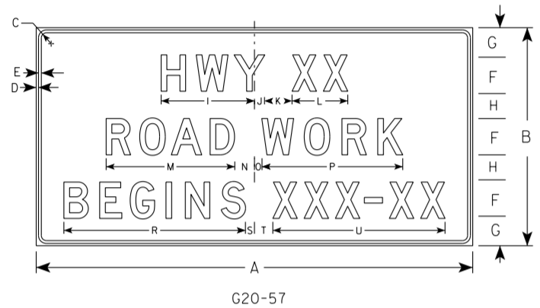
Road Work Begins Signs
G20-57
Used instead of PCMS
Placed 7 days before construction begins
Removed when construction starts
Notes:
A note on WORK ZONE SIGNING. The G20-57 ROAD WORK BEGINS signs are being used in place of PCMS on most smaller projects to inform drivers of upcoming construction activity IN THIS REGION.
These are to be PLACED at the PROJECT LIMITS 7 DAYS before construction starts and REMOVED with the WORK ZONE SETUP
Please DON’T leave these signs up when drums go up.

Slide 23
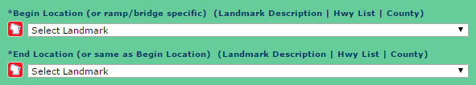
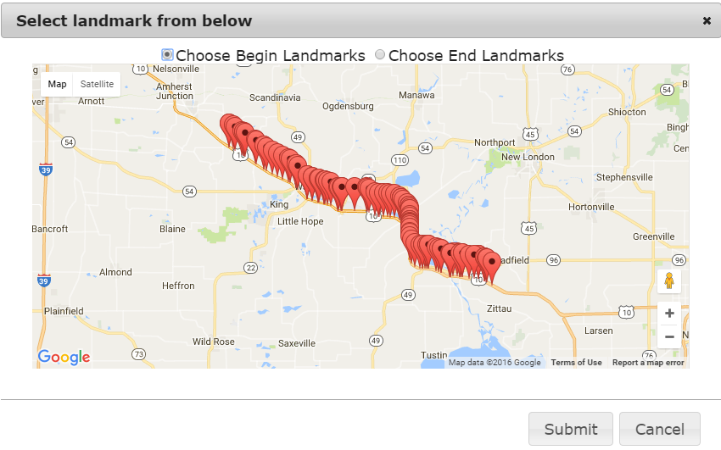
Mapping Feature
Notes:
It’s now EASIER TO FIND your closure LIMITS. CLICK on the RED AND WHITE ICON here. That POPS UP a MAP with all the LISTED POINTS shown.
Please use this feature to more accurately identify your closure limits.

Slide 24
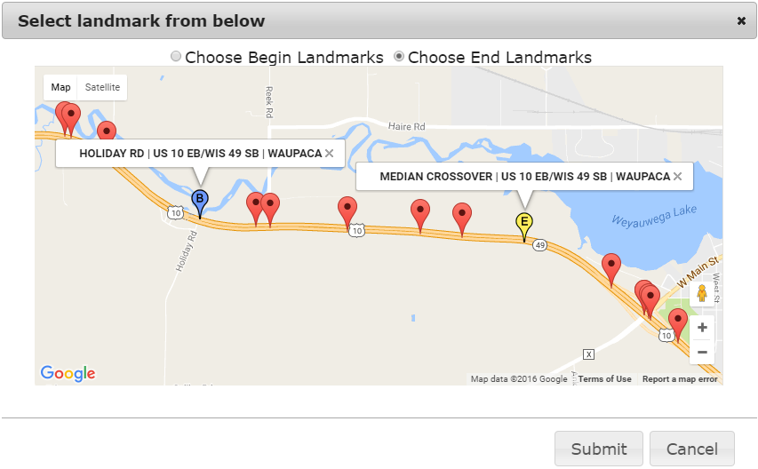
Mapping Feature, cont.
Select the toggle at the top, then select the point.
  (B)egin, (E)nd
Remember your highway direction!
  Select points in the direction of travel.
Once set, hit Submit.
Notes:
TO USE, select TOGGLE at the top, then select BEGIN or END POINT.
BE AWARE of the HIGHWAY DIRECTION and SELECT POINTS in the DIRECTION of TRAVEL.

Slide 25
LCS Advanced Notification
Closure affecting OSOW < 16’ available width < 15’ effective width | MINIMUM Notification
Lane and shoulder closures | 7 days
Full roadway closures | 7 days
Ramp closures | 7 days
Detours | 7 days
Closures not affecting OSOW
Lane and shoulder closures | 3 business days
Modifications to any LCS entry | 3 business days
ALL DATES ARE BY WHEN LCS NEEDS TO BE APPROVED
Notes:
Here are the CURRENT ADVANCED NOTIFICATION DATES for LCS entries. If EFFECTIVE WIDTH is LESS than 15 FEET, we NEED the entry APPROVED in the system AT LEAST a WEEK in advance. If there is more width, it’s 3 BUSINESS DAYS.
These dates should be used UNLESS your project’s SPECIAL PROVISIONS STATE OTHERWISE. Then use those.
We understand the NEED for QUICK TURN-AROUNDS in construction. If you have a SITUATION that ESCALATES, CALL CARA ASAP.

Slide 26
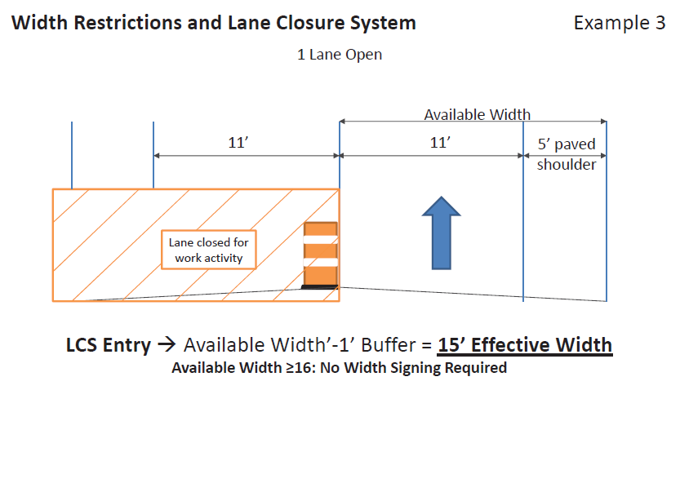
“Effective Width”
Example 2

Slide 27
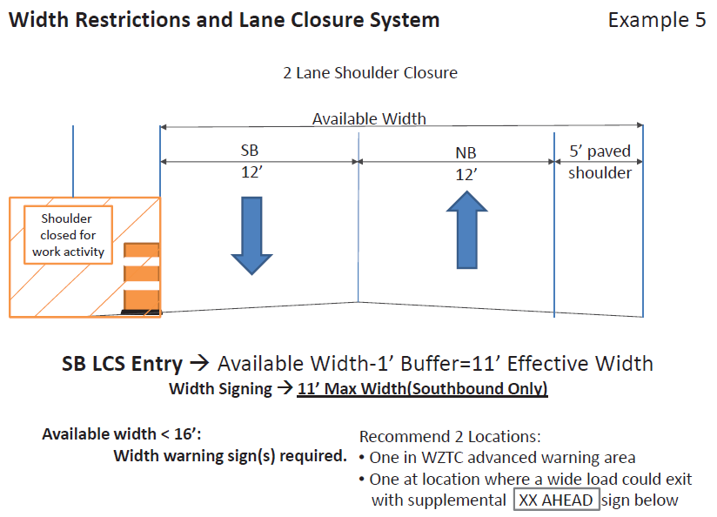
“Effective Width”
Example 3
Notes:
Even CLOSURES on 2-LANE ROADWAYS need EFFECTIVE WIDTH ENTERED.

