Slide 1
Construction Bookkeeping
Stacy Hagenbucher
Project Manager/QA Construction
NCR Construction Kickoff
Wausau, WI
February 19, 2020

Slide 2
Getting Started
Guidance
CMM
Standard Specifications
Final Process
Regional Documentation
Notes:
We all think we know it – but it changes every year.
Attend the spec training.
Sign up for update mailing list https://www.content.dot.wi.gov/content/lyris/rdwy-standards.htm
Recheck when in the field.
Look for checklists.

Slide 3
Getting Started
Guidance
Pantry – Its still there
https://awpkb.dot.wi.gov/Content/constr/PantryFiles/
Delete Old Files
Online Version
Notes:
Jen has said it.
I will say it again – REMOVE PANTRY from your computers.
Its old, its outdated.
We can tell when you aren’t using updated versions.

Slide 4
Files
Most common used and not completed correctly
Engineers Diary
Inspectors Diary
Contract Modification Justification
Contract Modification
DQI
Notes:
Many times as a PM you need to go back and look at documentation – whether in the finals process or if issues come up later. These are the items that are showing up with the most issue, and are also the meat and potatoes of what we expect from our field staff to provide.

Slide 5
Project Diaries
Engineers Diaries
Log all staff on site that day
Log important discussions
Weather
Can import Inspectors diaries
Need one for each day – even weekends.
Note Meetings that were held
This is what PM can see in Project tracking
Charge Time
Notes:
Engineers Diaries
Log all staff on site that day - including all DOT staff that visit the site
Log important discussions – What information that you talked about with contractor – this is especially important on items that go into a RFI, CRI or claim process that has documented timelines
Weather – This needs to be the overarching consistant place to document the weather, as each inspector may document differently – must coincide with days charged on working day contracts, and should be referenced on weekly meetings.
Can import Inspectors diaries – this is helpful for PM’s viewing in Project Tracking
Need one for each day – even weekends – on ALL contracts.
Note Meetings that were held – Were weekly meetings held? Where start up meetings held? Materials placement?
This is what PM can see in Project tracking
Charge Time

Slide 6
Project Diaries

Slide 7
Project Diaries
Inspector Diaries
All contractors on site
Men/Hours
Equipment/Hours
Location of work
Any direction given
Breakdowns of any equipment
Any discussions held between contractor and inspector
Initials of inspector
Notes:
Inspector Diaries
All contractors on site – Every contractor needs a diary written about the.
Men/Hours – If you know names, add them
Equipment/Hours – Be specific
Location of work (STA’s and offsets)
Any direction given – If you told a contractor to stop, if you reminded them of spec, document
Breakdowns of any equipment, and how it impacted the site
Any discussions held between contractor and inspector
Initials of inspector

Slide 8
Project Diaries
Inspector Diaries (cont)
Materials
Where are they coming from
Who is hauling
Testing & Results
Who is doing the testing
Where was it
Looking at your diary – in four months, can you tell exactly what was done that day?
Notes:
Inspector Diaries (cont)
Materials
Where are they coming from
Who is hauling
Testing & Results
Who is doing the testing
Where was it
Looking at your diary – in four months, can you tell exactly what was done that day?

Slide 9
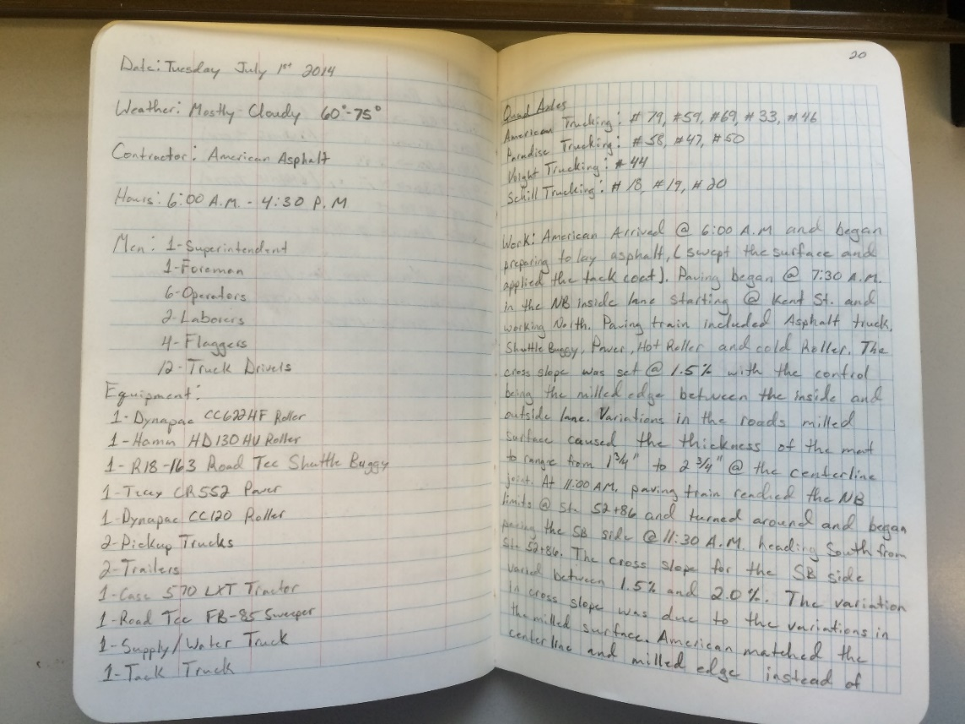
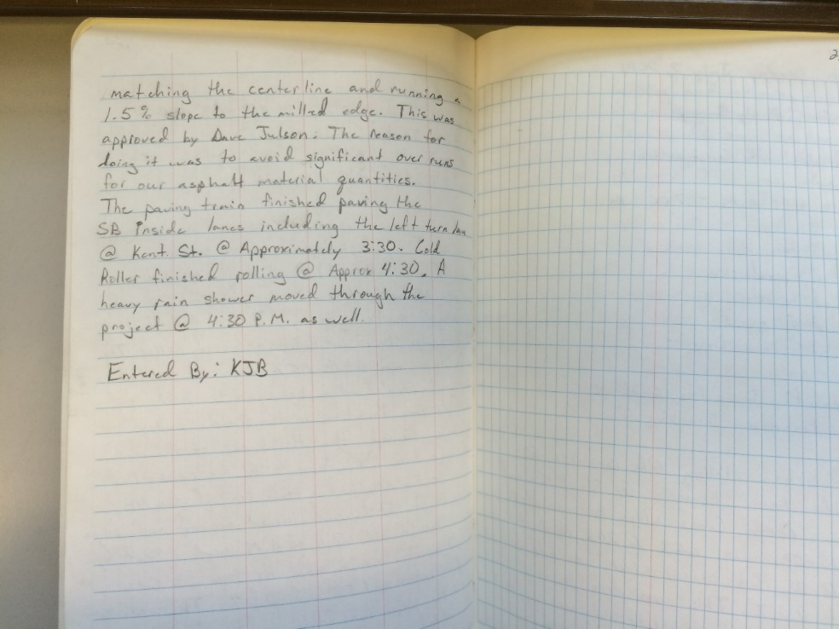
Inspectors Diaries

Slide 10
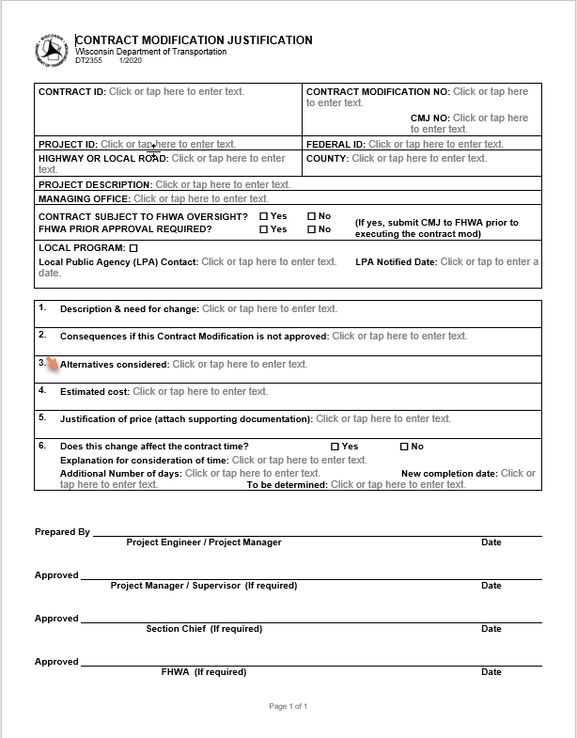
Contract Modification Justifications
The WHY!
Why is the Con Mod being done
What lead to it
The is where the explanation belongs!
Need viable resources for justification of prices. Bidx is great resource.
If you cannot use Bidx, justify through quick men/hours calc
Notes:
Justifications are coming a long way, but the still need improvement.
Need to justify costs. Bidx, previous project, force account quick calculation on items not easily found. Show how and why the price was okay. Some markup for it being a con mod is expected, but shouldn’t be a huge increase.
This form has been changed for locals, and as stated before, while we want to inform locals, we will not stop a con. Mod if they refuse to sign, we are still in control of the contract, but we must give them the opportunity to review.

Slide 11
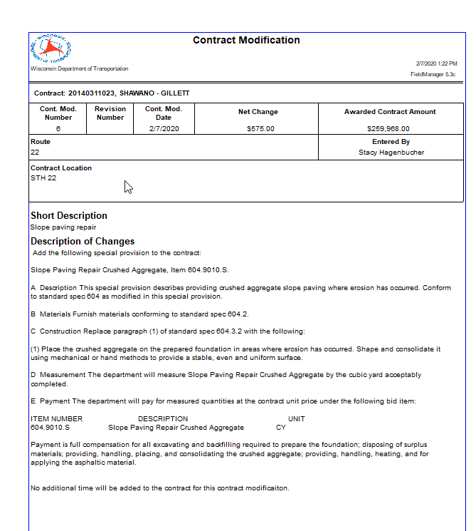
Contract Modifications
Reads just like Specifications
NO justification
Reason code is TWO LETTERS
NO JUSTIFICATION
Notes:
No Justification.
I repeat.
NO JUSTIFICATIOn.
This reads like the specification and special provisions.
Needs a Description, Material, Construction, Measurement and Payment section.
In the items area there is a reason code area – this is Two letters, and nothing else. Justification is for the contract justification document.

Slide 12
DQI
Fill these out as accurately as possible.
Comments mean more than the numbers.
Be as specific as possible.
Fill these out with the contractor near the end of construction.
Make them constructive
Design or Construction related
Notes:
DQI –
We no longer have an extensive plan evaluations that is duplicate of this form, so comments on the DQI have become a necessity. Why are you rating the plan as such, what was good? What was bad? Where did you struggle? Make it constructive as well, not all issues in the field could have been prevented in Design, so don’t push blame to the wrong area.

Slide 13
