Slide 1
Welcome!
NCR Construction Kickoff
Wausau, WI
February 19, 2020

Slide 2
Construction Trivia
NCR Construction Kickoff
Wausau, WI
February 19, 2020

Slide 3
A reporter calls you and asks for an interview, what do you do?
A. Panic and start to hyperventilate.
B. Tell them everything you know.
C. Direct them to our region communications manager.

Slide 4
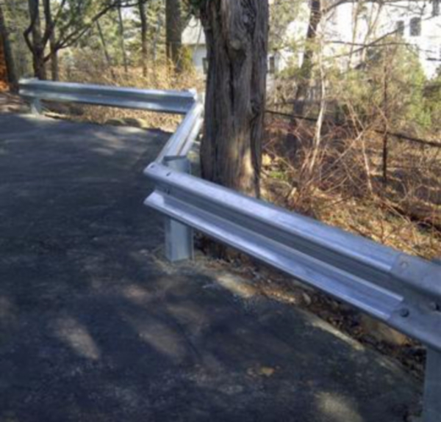
A guardrail crew just finished installing posts, how many do you need to check for proper length?
A. 5 Posts
B. 5 %
C. 15%

Slide 5
Your contract records have been reviewed. How long do you have to make corrections?
A. As long as you want. You are a busy person.
B. 30 days
C. 15 days – You don’t want Carrie after you.

Slide 6
You receive a CRI concept from your contractor in the field, what do you do?
Fill out CRI Validation Form to share with your Project Manager, Region Oversight engineer and Construction QA Engineer. As well as the Validation Team
B. Talk with your PM about it.
C. Approve it, we always want to save money.

Slide 7
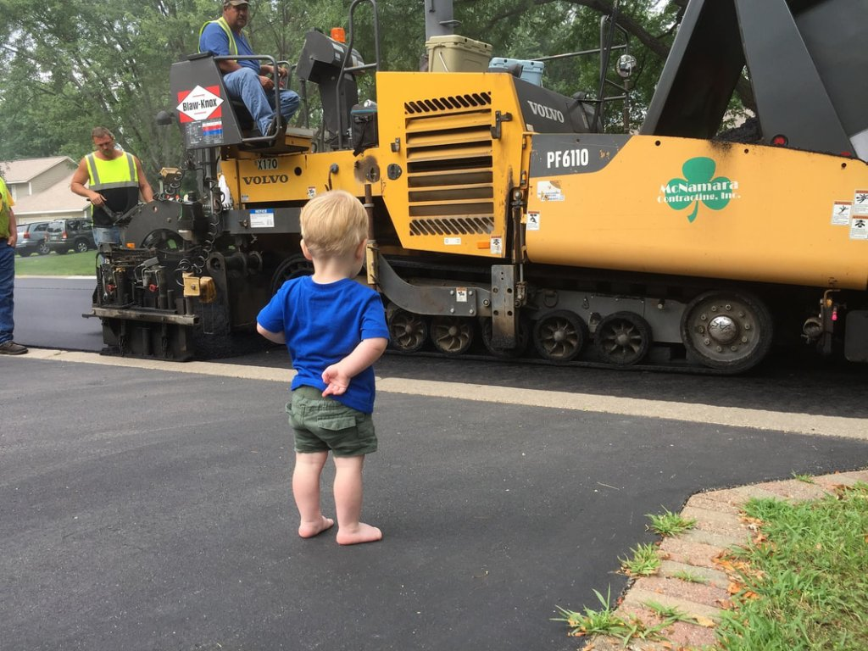
Approximately how many tons of mix are in a PWL test strip?
A. 650 Tons
B. 700 Tons
C. 750 Tons
D. First days worth

Slide 8
You need to add a 24” culvert pipe to the project. What can you do to justifiy the price.
A. Use BidX
B. Use previous projects in the area.
C. Verify with an estimated cost to deliver the materials and a quick men/equipment hours calculation
D. All of the above

Slide 9
What date do you need to submit the curb ramp compliance worksheet to Dave Meurett by?
A. When Finals are done
B. When the project is substantially complete
C. By Jan 1st, after construction completed.

Slide 10
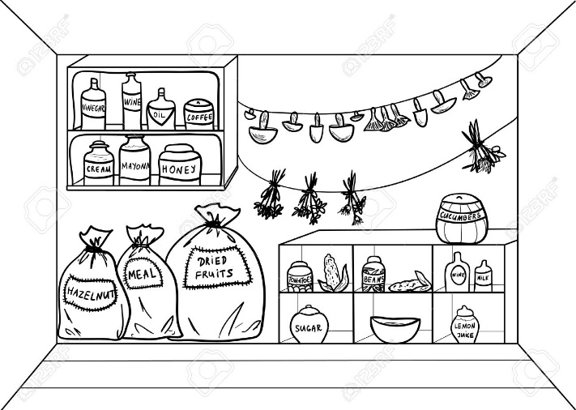
Where do you find your Pantry information?
A. What is Pantry?
B. On your computer
C. Under the Aashtoware Knowledge Base on the WisDOT site.

