Slide 1
Project Manager Panel
Notes:
Before
Be well prepared with content. Know facts and figures and your audience.
Everyone should be able to read the slides but if NOT, read it to them. Otherwise don’t include it.
Do a final check on microphone and other equipment well before the start time.
Practice the presentation aloud several times. Feel comfortable.
Drink fluids and do something to relax you.
During presentation
Smile and be confident.
Introduce yourself and the organization.
Speak with energy, clearly, and in a reasonable volume so everyone can hear you.
Do not read each line on the slide show – use your own wording and add in examples or additional information which will aid in comprehension.
Talk “friendly” and with the attitude that you are here to provide information and assistance. Have a “win/win” attitude.
If you make an error, politely clarify or correct it. Move on quickly and don’t dwell on it.
If you can’t answer a question, politely indicate you don’t have the information available. Indicate that you will follow-up individually with the requestor.
After presentation
Be available for follow up.
Be prepared for additional comments, questions or clarifications.
Maintain composure.
If you make a promise, be sure to follow up quickly or reassign if appropriate.

Slide 2
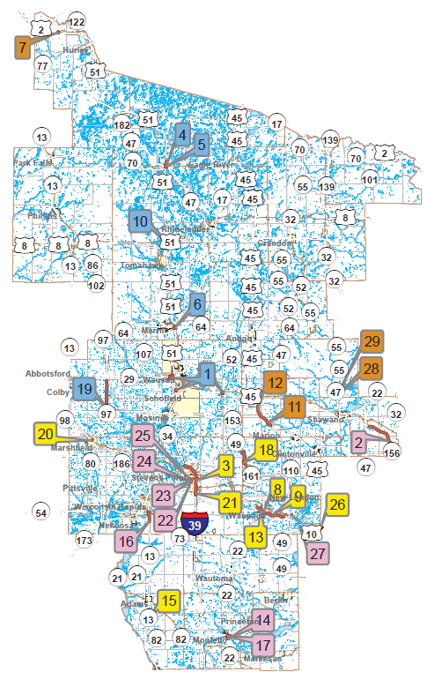
State Projects
Notes:
Overview should be specific such as listing the goals of the presentation and items to be covered. For example: “Explain Hwy 51 project alternatives.”
Use a verb followed by a brief phase or sentence.
Overview should include time for Q&A or indicate if you intend to take questions during the presentation or prefer that they wait until the end of the presentation.

Slide 3
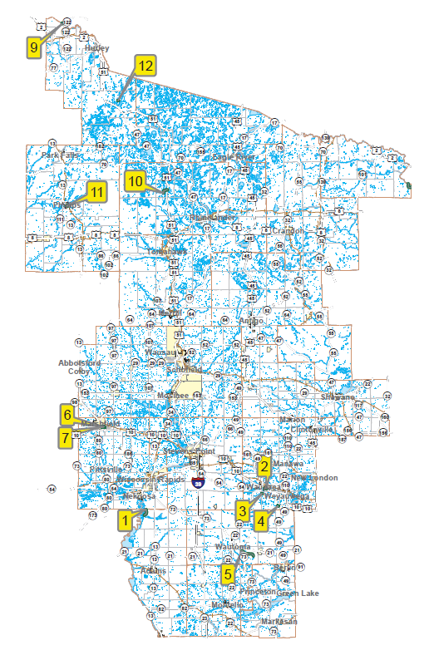
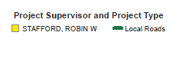
Local Projects
Notes:
Provide facts, figures and objective data will help to keep the audience focused.
Review political, financial or other information.
Dispel misinformation.

