Slide 1
NC Region Construction Conference -Traffic Section-
February 2018

Slide 2
LCS Routes
Priority Routes in the North Central Region
I-39/US 51, WIS 29, US 10
WisDOT RTEs will approval
Non-Priority Routes
WisDOT Project Leaders and Coordinators will approve
Notes:
There are 2 PRIMARY ROUTE TYPES in the LCS: PRIORITY and NON-PRIORITY.
The priority routes in the NC Region are I-39, US 51 to US 8, all of WIS 29, 4 lane portions of US 10, and BUS 51 around the interstate. I APPROVE CLOSURES on these routes.
For ALL OTHER HIGHWAYS, CONSTRUCTION PROJECT LEADERS will APPROVE the closures. If you are a NEW construction project leader in this region and DON’T have LIMITED ACCEPTANCE AUTHORIZATION yet, please LET ME KNOW.

Slide 3
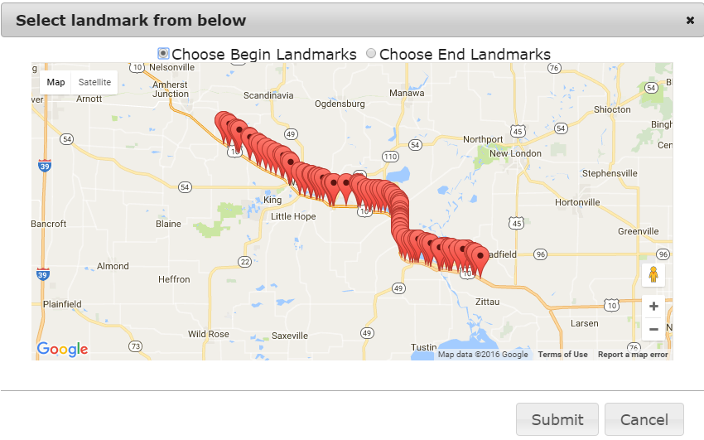
New for 2017: Mapping Feature
Notes:
NEW MAPPING FEATURE introduced in FALL 2016.
It’s now EASIER TO FIND your closure LIMITS. CLICK on the RED AND WHITE here. That POPS UP a MAP with all the LISTED POINTS shown.

Slide 4
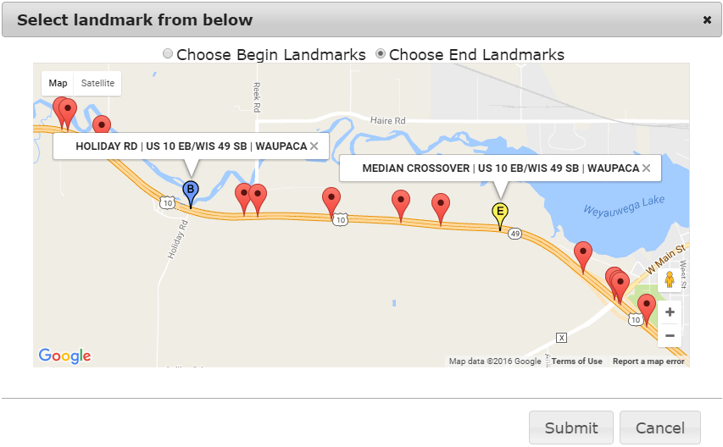
Mapping Feature, cont.
Select the toggle at the top, then select the point.
(B)egin, (E)nd
Remember your highway direction!
Select points in the direction of travel.
Once set, hit Submit.
Notes:
TO USE, select TOGGLE at the top, then select BEGIN or END POINT.
BE AWARE of the HIGHWAY DIRECTION and SELECT POINTS in the DIRECTION of TRAVEL.

Slide 5
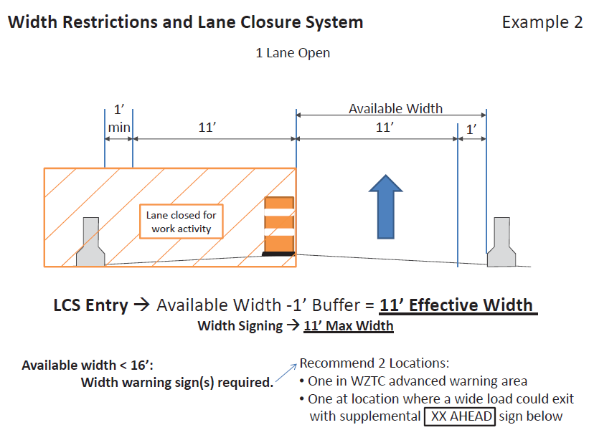
“Effective Width”
Example 1

Slide 6
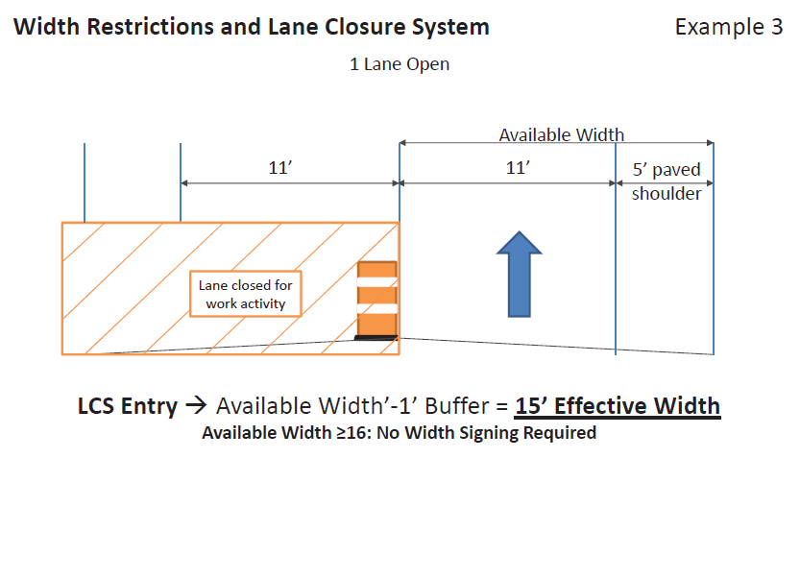
“Effective Width”
Example 2

Slide 7
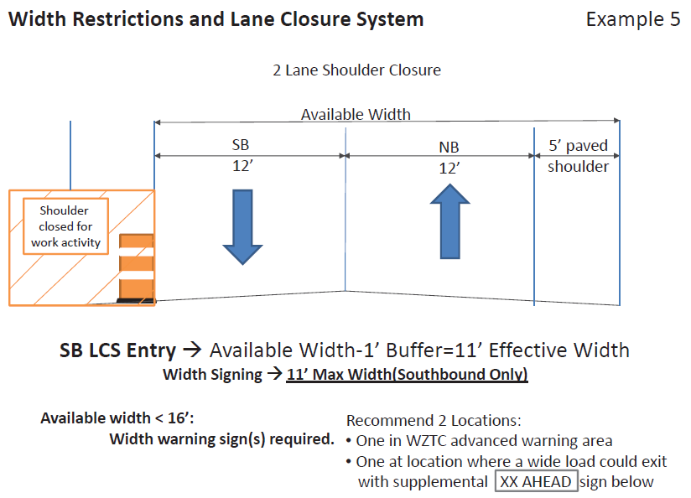
“Effective Width”
Example 3

Slide 8
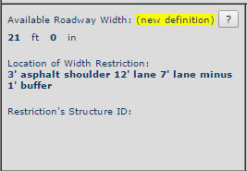
Additional Information in LCS
Please include effective width
calculation somewhere
Effective Roadway Width:
Notes:
When you’re filling out the LCS entry, it is important to provide a GOOD DESCRIPTION.
Here is an EXAMPLE of one we had that was WELL DONE with a DETAILED DESCRIPTION noting how the work will be done.
This is USEFUL to US as REVIEWERS and to OSOW PERMITTING.
INCLUDE the EFFECTIVE WIDTH calculation on ALL ENTRIES REGARDLESS OF ROUTE!

Slide 9
FAQs: Where to Modify Entries?
Has the entry
been accepted yet?
NO
YES
Under
ACCEPT
Under
MODIFY
If you modify the dates on a priority route closure, please send me (Cara) an email with a quick description why. No additional worksheets needed.
Notes:
If an entry HASN’T BEEN ACCEPTED yet, you will find it in the ACCEPT tab. Otherwise, it will be in MODIFY.
After submitting, you can only EDIT the DATES and TIMES of an entry. For all OTHER CHANGES, CONTACT CARA.
If you make ANY CHANGE to a priority route entry, SEND CARA an email with a QUICK DESCRIPTION WHY. No updated worksheets needed.

Slide 10
LCS Advanced Notification (as of 4/15/16)
Closure affecting OSOW < 16’ available width < 15’ effective width | MINIMUM Notification
Lane and shoulder closures | 7 days
Full roadway closures | 7 days
Ramp closures | 7 days
Detours | 7 days
Closures not affecting OSOW
Lane and shoulder closures | 3 business days
Modifications to any LCS entry | 3 business days
ALL DATES ARE BY WHEN LCS NEEDS TO BE APPROVED
Notes:
Here are the CURRENT ADVANCED NOTIFICATION DATES for LCS entries. If EFFECTIVE WIDTH is LESS than 15 FEET, we NEED the entry APPROVED in the system AT LEAST a WEEK in advance. If there is more width, it’s 3 BUSINESS DAYS.
These dates should be used UNLESS your project’s SPECIAL PROVISIONS STATE OTHERWISE. Then use those.
We understand the NEED for QUICK TURN-AROUNDS in construction. If you have a SITUATION that ESCALATES, CALL CARA ASAP.

Slide 11
Timeline for Approvals
Can take 2-3 days to get LCS entries approved
Depends on staff availability
Providing all requested information early reduces the turnaround time
Cara Abts is accepting all priority route closures
Brent Matthews is the back up
(email him only if I have an out of office message)
Non-priority route closures can be accepted by the construction project leader
Notes:
Providing ALL the REQUESTED INFORMATION early will REDUCE the TURNAROUND time to get your entries approved and into the system.
WHEN IN DOUBT, ENTER A CLOSURE. It can be DELETED if NOT NEEDED.
Cara tries to get priority route closures approved quickly. If Cara has an OUT OF OFFICE MESSAGE, please email her supervisor, Brent Matthews.
Non-priority route closures should be accepted by the construction project leader when filling out the entry.

Slide 12
WisDOT BTO Work Zone Updates

Slide 13
WisTMP
Attaching Project Amendments to the WisTMP
FDM 11-50-5.7.5 - Monitor TMP
FDM 11-50-5.7.6 Post Construction Project Evaluation
Did queue exceed what was approximated in the analysis of the TMP?
Did the mitigation strategies work?
What changes were made during construction that impacted the TMP? (allowable lane closure hours, work hours, etc.)
Total number if incidents/crashes that occurred?
Any complaints from public?
Project Close out at the end of the project
Notes:
SOME NOTES on TRANSPORTATION MANAGEMENT PLANS:
ATTACH AMENDMENTS (after 90% approval) to the TMP for better documentation.
Construction Staff needs to MONITOR the TMP to verify the QUEUE/DELAY are as predicted, MITIGATION STRATEGIES are effective, lane closure HOURS are ACCEPTABLE or NEED ADJUSTMENT,
Also DOCUMENT INCIDENTS and COMPLAINTS involving the public.
Attach POST-EVALUATION SUMMARY to WisTMP (See FDM 11-50-5.7.6)
All construction project managers: please change project from 90% to COMPLTED for Project Close Out in the TMP System

Slide 14
Work Zone Crashes
Report any Work Zone crashes to WisDOT BTO mailbox: DOTWorkZoneCrashes@wisconsin.gov
FDM 11-50-5.7.5, CMM 1-45.8.2
BTO is working on a crash report form to be filled out by construction staff
Information to be provided:
Project ID and Location
Crash Severity (PDO, Injury A/B/C, Fatal)
Crash Type (Rear-end, Head-On, ROR, SSS, Fixed, etc)
Time of Day
End of Queue
Did the crash occur due to a work zone set-up?
Notes:
BTO is looking to better TRACK WORK ZONE CRASHES since not all crashes are captured in the NEW DT4000 crash report forms
BTO will do FIELD REVIEWS of CRASHES in WORK ZONES depending on SEVERITY, especially FATAL crashes (as is done in other states)
We understand CRASHES MAY OCCUR when you are NOT ON SITE, but try to get some information pertaining to the crash and send it over.
BTO set up a SEPARATE MAILBOX that the information can be sent to, and a FORM will be DISTRIBUTED this spring for field staff to fill out.

Slide 15
Questions?
Contact Information
Erin Schoon
Erin.Schoon@dot.wi.gov
414.220.6803
Andy Heidtke
Andrew.Heidtke@dot.wi.gov
414.322.4185

Slide 16
Questions?
Cara Abts
715.421.8024
cara.abts@dot.wi.gov
Brent Matthews
715.421.8312
brent.matthews@dot.wi.gov

Slide 17
LCS Importance for OSOW
Superload is used to route OSOW loads
LCS information is automatically transferred to Superload twice daily
Only entries with an effective width are transferred
→ Enter effective width for ALL entries
Document each instance in which an OSOW load gets stuck as a result of untimely or inaccurate LCS entries

