Slide 1
North Central Region Construction Communications
Kristin McHugh
WisDOT Communications Manager
Project Leader Workshop
2018

Slide 2
Construction communication expectations
Information
Weekly
Accurate
Customer in mind
TIMELY

Slide 4
Construction communication expectations
Pictures!
Pictures!
Pictures!
When something starts
When something changes
When something closes
When something opens
Anything that will help us tell the story

Slide 5
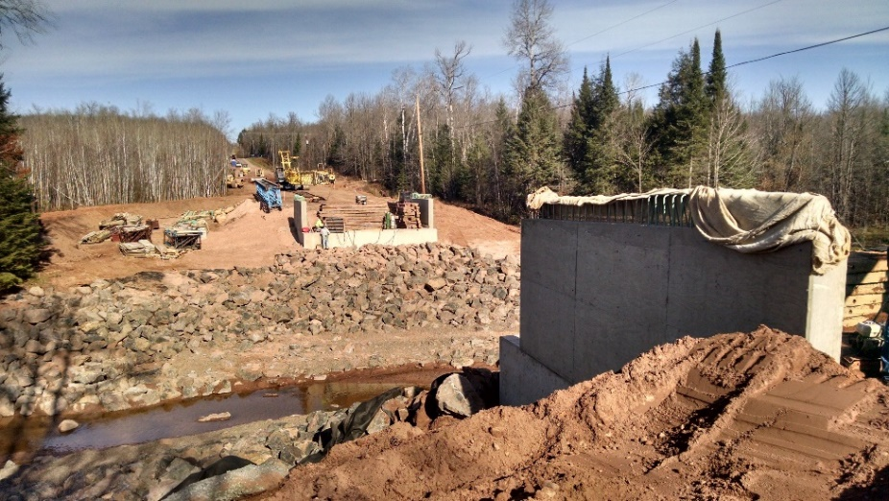
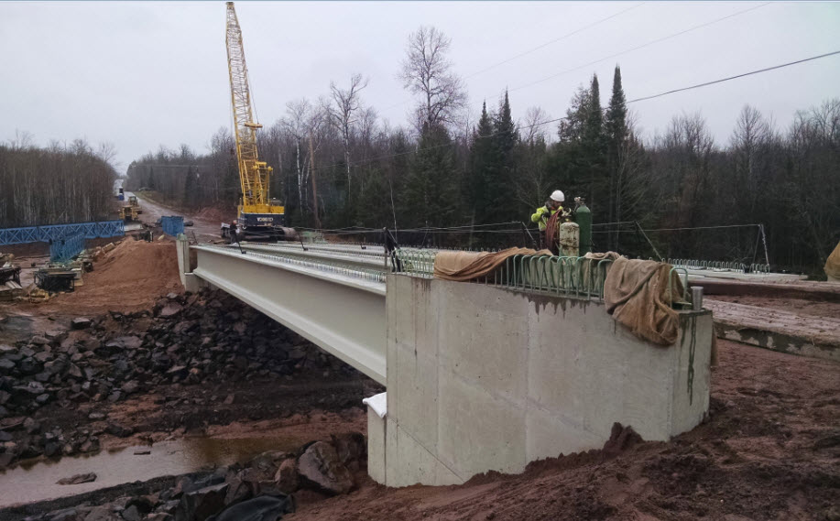
Telling stories with pictures Before, during, and after

Slide 6
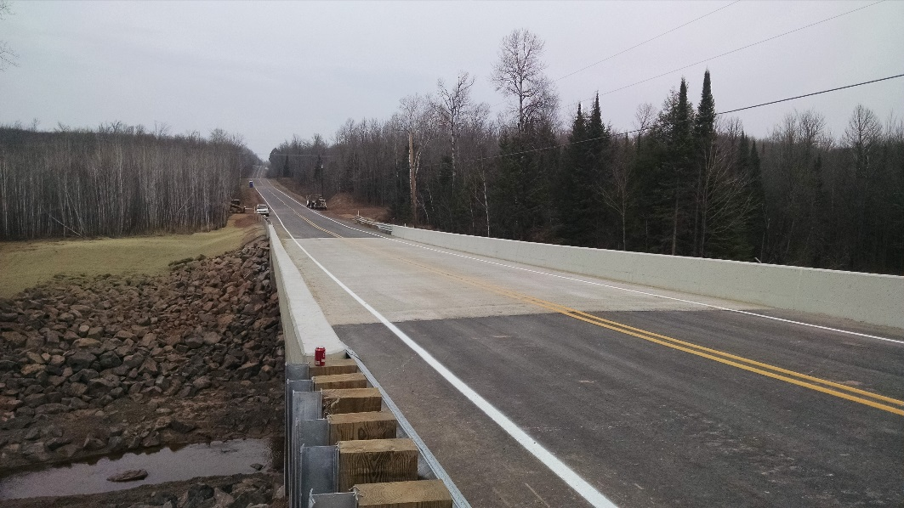
Telling stories with pictures Before, during, and after

Slide 7
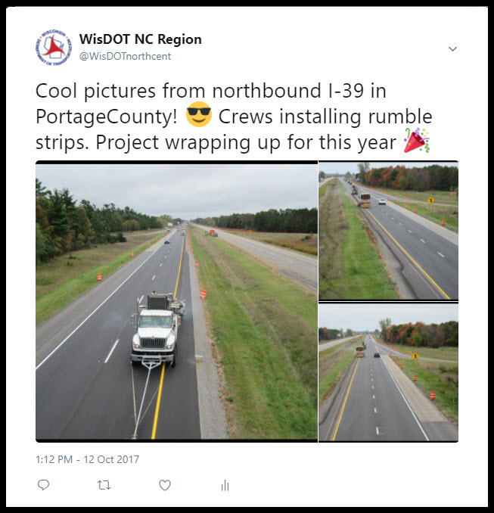
Telling stories with pictures Before, during, and after

Slide 8
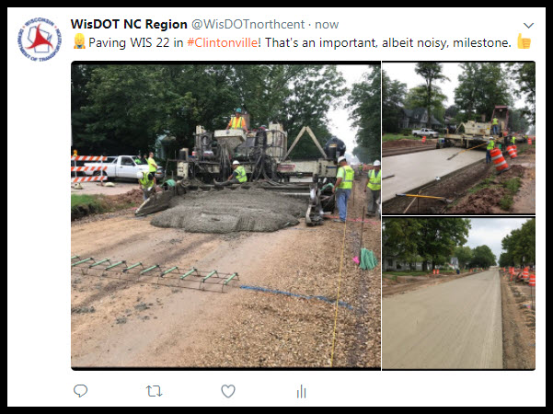
Telling stories with pictures Before, during, and after

Slide 9
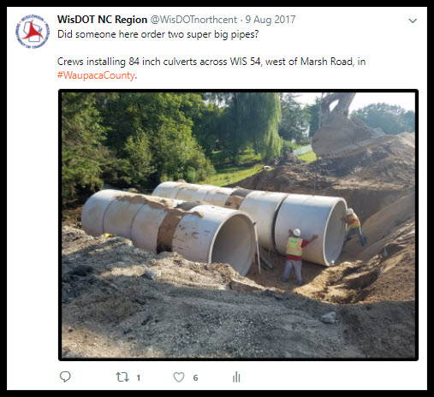
Telling stories with pictures Before, during, and after

Slide 10
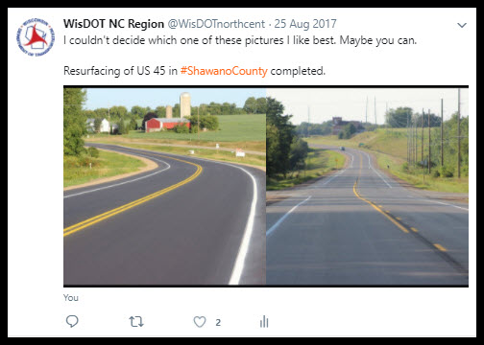
Telling stories with pictures Before, during, and after

Slide 11
Miscellaneous extras
Potential issues
Good news
Media and legislative contacts
Incidents
Events

Slide 12
Thank you!
Questions?

