Slide 1
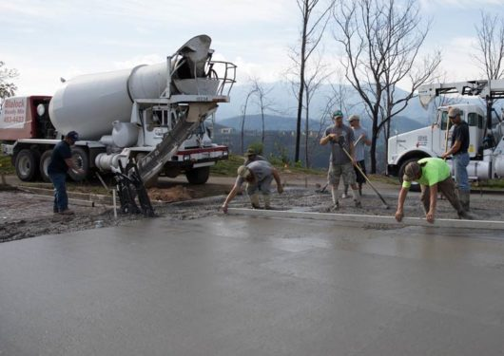
Project Leadership Workshop
Materials - 2018
March 13, Rhinelander

Slide 2
Staffing
Rhinelander
John Brophy
715-493-3085
Lab
715-365-5735
Wisconsin Rapids
Jeff Michalski
715-421-8339
715-459-4791
Lab
715-421-8060

Slide 3
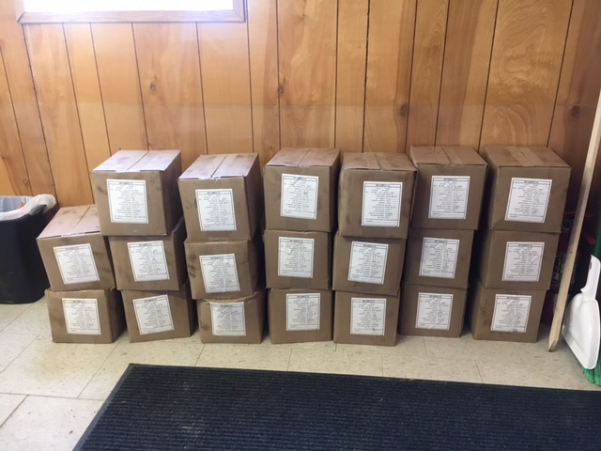
HMA
Project staff responsibilities.
Selecting all QV random numbers.
Collecting all QV samples.
Collecting all QC retained samples.

Slide 4
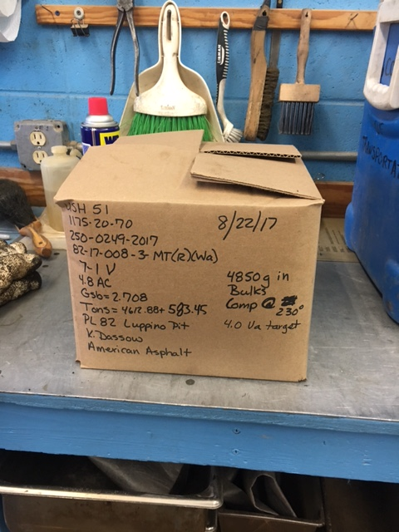
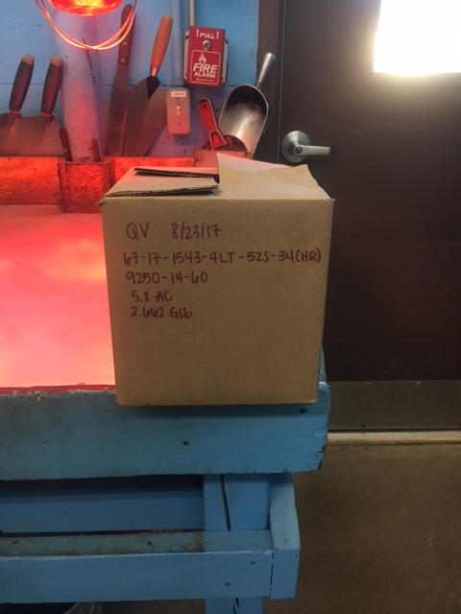
Collecting QV samples
Correct
Incomplete

Slide 5
A change in HMA mix designs
A change in AC grade.
Same mix design, same 250 number.
Example:
4 LT 58-28S
4 LT 58-34S
Changing from a HMA (275 degrees) to a WMA (235 degrees) design.
Is a different mix design, needs a different 250 number, and another set of random numbers.

Slide 6
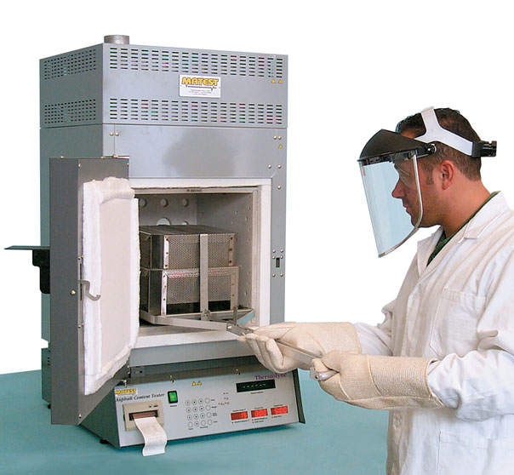
Ignition oven
Will be run on all HMA samples for PWL projects to check AC content.
AC content will be run on regular QMP projects starting in 2019.
Aggregate correction factor specific for each oven and mix design.

Slide 7
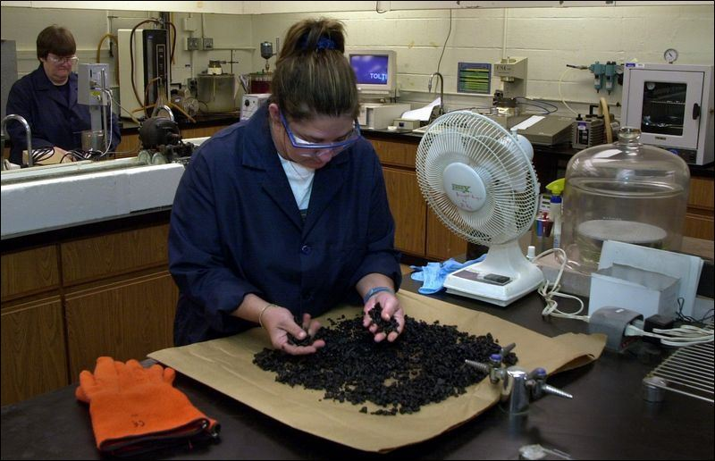
HMA – Air Void Regression
ASP-6, December 2016 lets.
Mix designs, still design to 4.0% air voids in lab.
Lowered to 3.0% air voids (target) in the field.

Slide 8
HMA – Dispute Resolution
QV sample falls outside of 2.0 – 4.3% air void range.
C.O. Materials will test the QV retained (that failed) and any needed forward and backward QC-retained samples (until they pass).

Slide 9
2018 PWL projects
1166-12-80, I-39, Plainfield to Stevens Point, Portage County
  4 LT 58-28S 7970 tons
  4 MT 58-28S 49500 tons
  4 MT 58-28H 1500 tons
1600-22-81, Clintonville, Shawano County
  3 MT 58-28S 22380 tons
  4 MT 58-28S 17407 tons

Slide 10
2018 PWL projects
6380-04-77, STH 97, Stratford to Goodrich, Marathon County
  5 LT 58-28S 35560 tons

Slide 11

2018 PWL projects
Start up day requires 5 day notice (by specification).
Pre-pave meeting with contractor.
Pre-pave meeting between project staff and regional materials.

Slide 12
WisDOT Longitudinal Joint
Special Provision
Plans are to add this to a couple of 2018 construction projects.
$0.40 / linear foot pay adjustment.

Slide 13
WisDOT Longitudinal Joint
(6) Minimum reduced by 1.5% at longitudinal joint with lateral confinement.
(7) Minimum reduced by 3.0% at longitudinal joint with no lateral confinement.

Slide 14
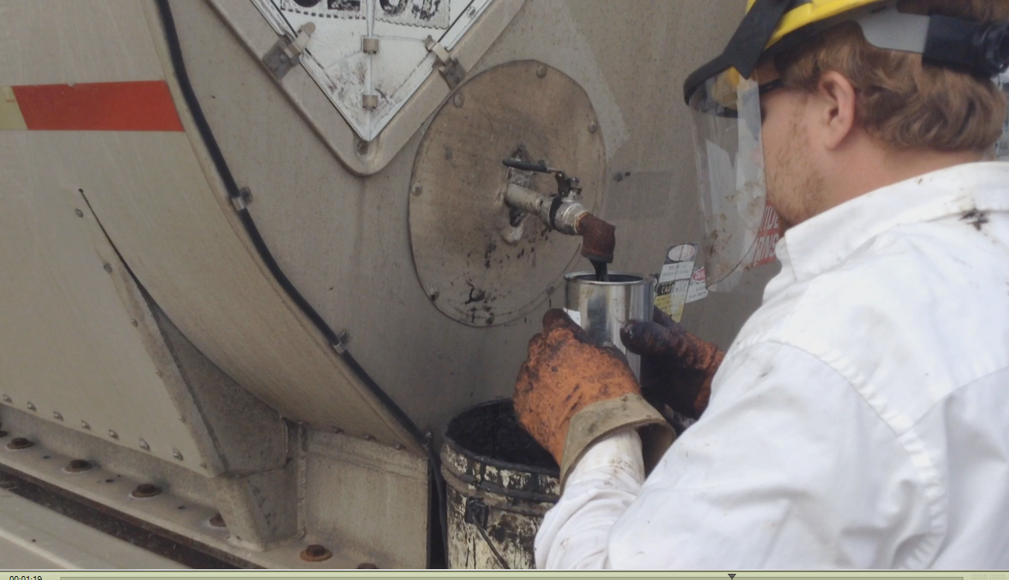
AC sampling frequency (new)
Truck sample – optional on all project.
In-line sampling based on one per 15000 HMA.
Projects under 1000 tons of mix in-line sample is optional.

Slide 15
AC sampling frequency
All AC samples must be observed by a DOT representative (no exceptions).
Include full name on sample card.

Slide 16
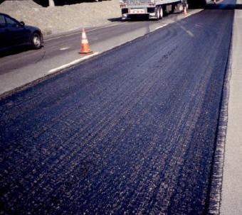
Tack coat
One sample per project for quantities greater than 2500 gallons.

Slide 17
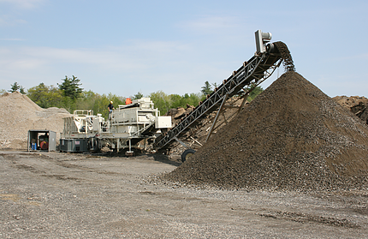
Base course – stockpile sampling
Stockpile sampling prior to placement for each grade and each source.
QV (X > 500 tons)
QC (no minimum)
QV and QC are separate samples, but done at the same time.

Slide 18
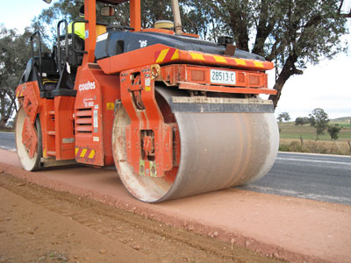
Base course – random numbers
Materials audit issue - QV random numbers.
Audit emphasizes the need to compute, document, and retain in your materials records.
Jeff and I will check as part of our materials field reviews.

Slide 19
QV base course – stockpile and placement
Must notify the contractor’s Materials coordinator by email two hours before sampling to allow for contractor to witness the sampling.
Results need to be back to the contractor in two business days.

Slide 20
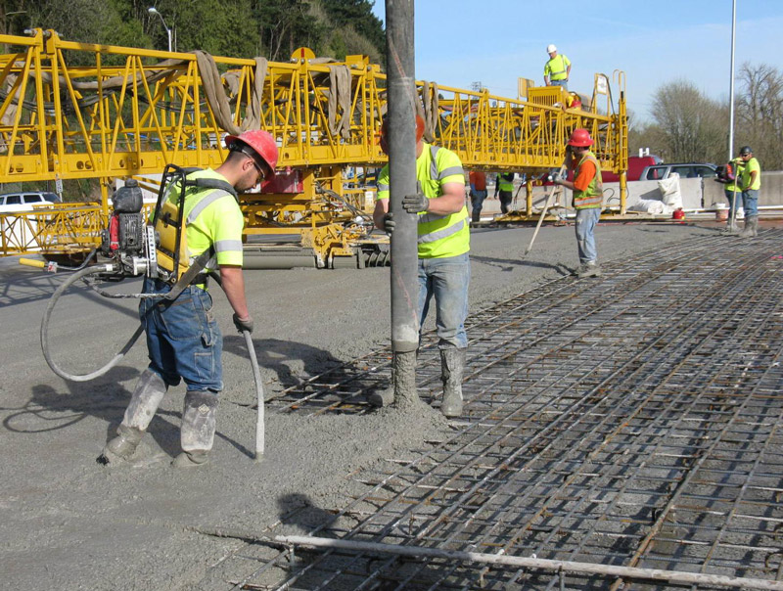
Dropping off of samples
Security codes, available on request.
QMP samples – two day turnaround.
Central Office samples – Stores truck (two week cycle).

Slide 21
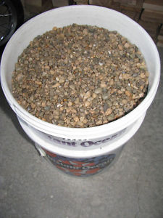
Sample sizes
Sample sizes, keep to 60 pounds maximum.
Buckets.
Bags, moisture is critical.

Slide 22
Importance of observing sampling
Asphalt cement.
Hot mix asphalt samples.

Slide 23
IA reviews
IA goal is review all samplers and testers on our projects.
John Brophy 715-493-3085
Jeff Michalski 715-459-4791

Slide 24
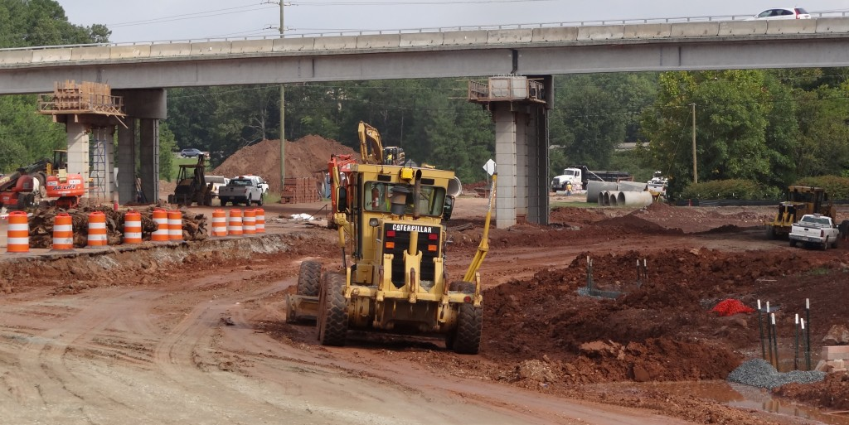
Questions and Answers

