Slide 1
WisDOT North Central Region Labor Compliance
2018 Project Leader Workshop

Slide 2
WisDOT Labor Compliance Specialists
Eastern Wisconsin
Lead - Jason Johnson (920) 492-5728 (NE)
Teresa Rademacher (920) 492-5657 (NE Mega)
Jennifer Lubinski (262) 548-5634 (SE)
Margaret Powers (262) 521-5337 (SE Mega)
Janice Sindic (262) 548-5923 (SE Mega)
NW
Western Wisconsin
Lead - Laurie Dolsen (715) 392-7977 (NW)
Stephanie Jaecks (715) 365-5732 (NC)
Tim Alston (608) 242-8040 (SW)
Rebecca Porter (608) 245-2648 (SW) Deb Henning (608) 884-1178 (SW Mega)
Julie Harkinson (608) 772-5169 (SW Mega)
Diane Zimmer (608) 884-1179 (SW Mega)
Crystal Wilson (608) 264-8700 (SW Mega)
NC
NE
Labor Compliance Investigations (Statewide)
Lead - Natalia Vega (262) 521-5358 (SE)
Teresa Rademacher (920) 492-5657 (NE) Boula Xiong (608) 267-7354 (SW)
Aeronautics (Statewide)
Shannon Clary (608) 264-7607 (SW)
Crystal Wilson (608) 264-8700 (SW)
SW
SE
2/02/17

Slide 3
Support between project leader and LCS: Making a difference
Daily Diaries - cross-checked with CRCS reporting
Details and accuracy are valuable
Enter name of the trucking company and number on the truck
Hours, work, equipment, # of employees
FIT send for LCS to view
Let LCS know
If you’re notified employees have issues with pay
Updates to project schedule
Substantially Complete
Triggers automatic email to LCS
Finals process recommendation 60 days for LCS to issue PCD
If you back date, PCD & finals process already behind

Slide 4
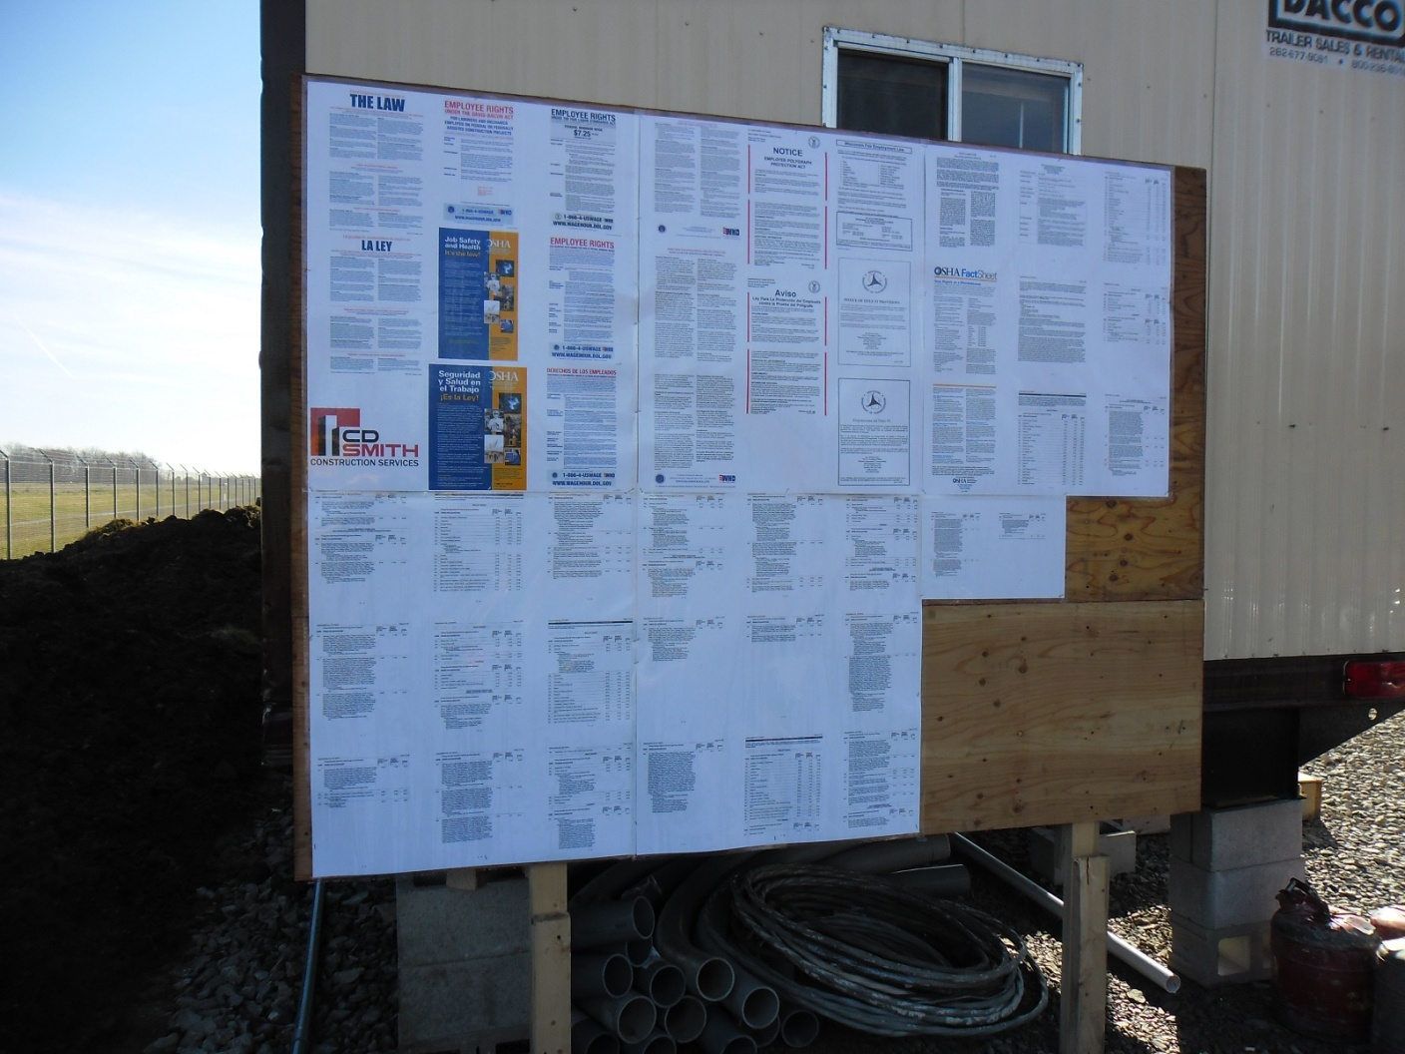
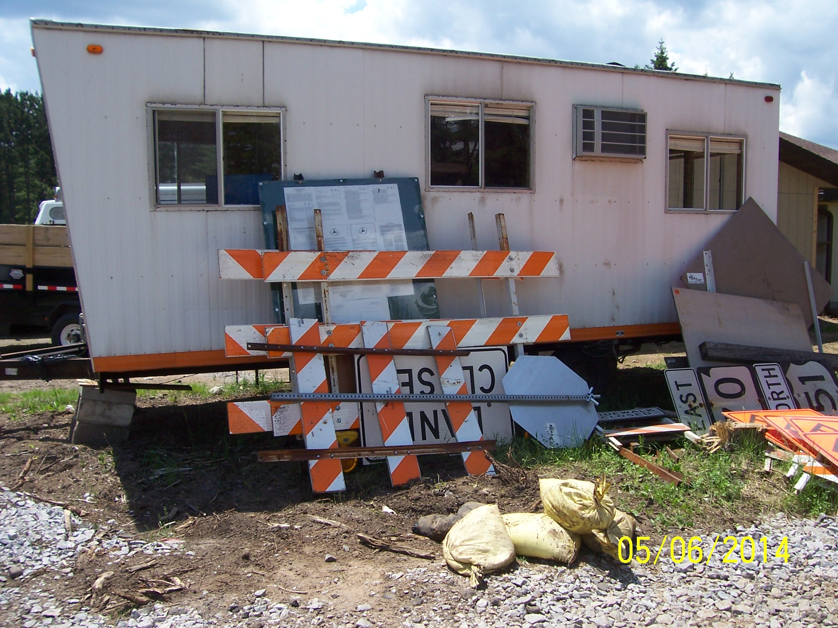
Construction Bulletin Board
Not Acceptable
PERFECT!!!!
Not Acceptable

Slide 5
Field observations on Job Site Bulletin Boards
Checklist provided at precon - complete and return prior to 1st estimate.
Posters must be maintained & readable at all times:
They should not reduce poster size to fit on board
If print is covered up by bolts used to affix the board to the field office or supports—this must be corrected.
If posters are faded or damaged—replacements need to be requested.
Binders by themselves are not acceptable
Wage Rates can be stacked - if laminated and hung below a sign saying “Wage Rates”
Notes:
Carry over projects – please make sure wage board gets back up
Wage rates – need to be secured, can’t have legs

Slide 6
DBE’s: Why it Matters
If a DBE is not able to complete their contractor work- the contractor must make an effort to replace the DBE with a DBE contractor.
ASP 4 requires we monitor payments entered to DBE’s in the Civil Rights Compliance System
Payments are verified during the closeout process and you will be asked about this if there are little to no payments made to the DBE firms
If work is reduced- regional LCS needs to know about it. Along with the DBE office. Contact LCS with quantity change when happens.
Compliance Assessment Program Review or CAP Review by FHWA monitors the DBE program throughout the project to ensure the goals and requirements are being met and enforced.

Slide 7
Investigations Unit: How project staff can assist with resolution
Project Staff Assistance with Holding Prime Accountable
Withholding payments – required to hold final payment.
Discuss LC issues at weekly meetings
Communications from Investigators
Copied on written notifications to contractors
Updates at PM meetings (some regions)
Complexity and Time Frame
Varies by projects involved, timeframe, and violations
Other government agency involvement
WisDOT Recourse
Referral for suspension/debarment – case by case basis
Referral of case to other government agencies
Notes:
Communication from Project staff is crucial at this point.

Slide 8
Prevailing Wage Laws
Notes:
Letting date determines what rules are enforced for your contract

Slide 9
Act 59- Repeal of Wisconsin’s Prevailing Wage Law
Applies to all WisDOT projects let on or after September 23, 2017
State funded only projects will no longer include any prevailing wage requirements.
Does not affect enforcement of Federal Davis-Bacon Act by USDOL or FHWA on projects with federal funds.
Notes:
Projects with federal dollars will still have prevailing wages

Slide 10
ASP 9-S Electronic labor data submittal for State Funded Only Projects
Labor data no longer entered/collected via CRCS
Labor data will now be collected via Workforce Utilization Report
Microsoft Excel or compatible spreadsheet
Details on HCCI site
Subs electronically submit labor data to prime via excel spreadsheet within 14 calendar days of the end of each quarter
Prime electronically submits all collected labor data to regional LCS within 21 calendar days of the end of each quarter
Notes:
http://wisconsindot.gov/hcciDocs/contracting-info/asp-9-s.pdf
http://wisconsindot.gov/Pages/doing-bus/civil- rights/labornwage/default.aspx

Slide 11
NEW TRUCKING

Slide 12
What has changed….
84.062 was repealed- state funded projects not required prevailing wage rates & ASP 9-S requires spreadsheets
Supplemental Required Contact Revisions (Revised)
Repealed law language was removed
Duplicate info contained in FHWA 1273 has been removed
Trucking was added
Resource list was added
Trucking (Federally Funded)
Covered hauls must be from a dedicated AND virtually adjacent source (round trip)
Excavated material or spoil hauled to a site specifically indicated in the contract (round trip)
Delivery of material by employee of a bona fide material supplier are not covered
Defined navigable waters provided by the US Coast Guard & US DOL

Slide 13
What hasn’t changed….
Projects let in Jan. 2017 being carried over- requires state wages issued by DWD and federal wage rate determinations issued by U.S. DOL
Projects let in Feb. 2017 through Nov. 2017 need to follow state statue 84.062 (Heavy 15, Highway 10 or Sewer and Water 8). These were issued by US DOL
Federally funded projects require prevailing wages issued by US DOL
All federally funded projects require payrolls in CRCS

Slide 14
THANK YOU
Notes:
Thank you for continuing to partner with us to achieve compliance. It is greatly appreciated!!
Any specific questions I will be around during breaks

