Slide 1
Construction 2018 Updates – The Odds and Ends
Stacy Hagenbucher

Slide 2
Final Process – How are we doing?
Statewide Goal – 55% of projects Complete in 180 days

Slide 3
Final Process – How are we doing?

Slide 4
Final Process – How are we doing?
Substantially Complete Date
Starts Clock – FOR EVERYONE
Conditional Final Acceptance
After Punchlist is completed – relieves contractor of maintenance
Finals Boxes and Materials
Notes:
DON”T Backdate Substantial Complete Date – You are not the only one on the clock for the goals in the system.
Conditional Final Acceptance – Needs to be completed, and more timely at that.
State – we have been pushing limits on work to be completed – but we are missing more and more goals for getting finals in on time for checking.

Slide 5
Areas for Improvement on Finals
Punchlist/All Work Complete
Back to in house checking – Rhinelander and Wisconsin Rapids
Pay Items
Be specific on location of items – drawn on plans, or STA and offset.
Project Level Checking
Make sure this is done on all calculations
Initial all sheets
Explanation of Variation
Does your explanation have enough detail

Slide 6
Lessons Learned
CRI
Are all costs accounted for?
Is it the same product?
Does it meet standards?
Staging – review your plans closely to anticipate issues
Notes:
CRIs – we had many CRI’s in our projects this year. A few were project specific, many involved staging changes. Make sure it qualifies as a CRI – Not just elimination of items, needs effort on the contractors end – expedited forces, changing the plan, buts still meeting standards.
Additional Lessons Learned may be covered under Project Manager Panel, so don’t want to go into it too much here.
In general we are doing a good job at anticipating issues ahead of time. Another fresh push though. If you project has staging – review the plans. See if what was proposed is feasible. Plans are guidelines and not everything is caught in review.. Its seems like the traffic staging is where we have the biggest issues in the field. So please take the time to review the staging plans and try to anticipate problems before you get there. Common things I see missed on plans are grade changes between stages, or drainage issues during construction. Try to review these items to try and avoid issues.

Slide 7
Lessons Learned – Field Observations
Contract Modifications
The Contract Modification is an extension of your special provisions and should read JUST LIKE THEM.
Justifications – Be specific, reference Bidx, project ids.
Use existing bid items –
Don’t add SPV. Rock Bags
Use 628.7570 Rock Bags
Tack
Not optional – not even between new layers of asphalt
Notes:
Contract Modifications –
We are 90% of the way there, but I am still seeing some modifications that are not in the specification layout. This is a contract document, and needs to be laid out like the rest of the contract. Justifications – be as specific as possible, Bidx is a great resource, and if you reference other projects, include the ids.
Finally – if you add or modify an existing bid item – use the correct bid items, not a SPV. – this allow to better track which items are consistently being added to projects.

Slide 8
2018 Construction
Tracking – New options available for tack
QS & MS – work with PM & CO – SHOULD be able to change
Contractor IS responsible for cleanup
PWL –
New Spreadsheets available soon on WisDOT QMP Page
New Guidelines books available prior to construction
Work with the Contractor
Understand when items are truly beyond scope and when they aren’t.
Notes:
Tracking continues to be a problem on asphalt paving projects – higher rate of tack, and trucks getting on it too soon, leads to tires having pick up – leaving residue especially on corners.
New materials are being allowed this year – work with your PM and BTS to approve the products. If they use the usual SS – tracking is the contractors responsibility for clean up.
Percent within limits – we have 3 projects this year. Spreadsheets for this process can be found on the DOT QMP page, new spreadsheets should be coming soon that are updated for easier use. A handout of guild lines will also be made available in the next couple month with the frequently asked questions and best practices in it.

Slide 9
Pantry
Updated Pre-Con Agenda
Take out items that do not apply to your project.
Overall a few items were renamed
Removed HMA Density Sheet – this is to be done in MTS.

Slide 10
ACM Update
AASHTOWare is Coming . . . .
When?
Dave Castleberg will let us know at Construction Standards training!

Slide 11
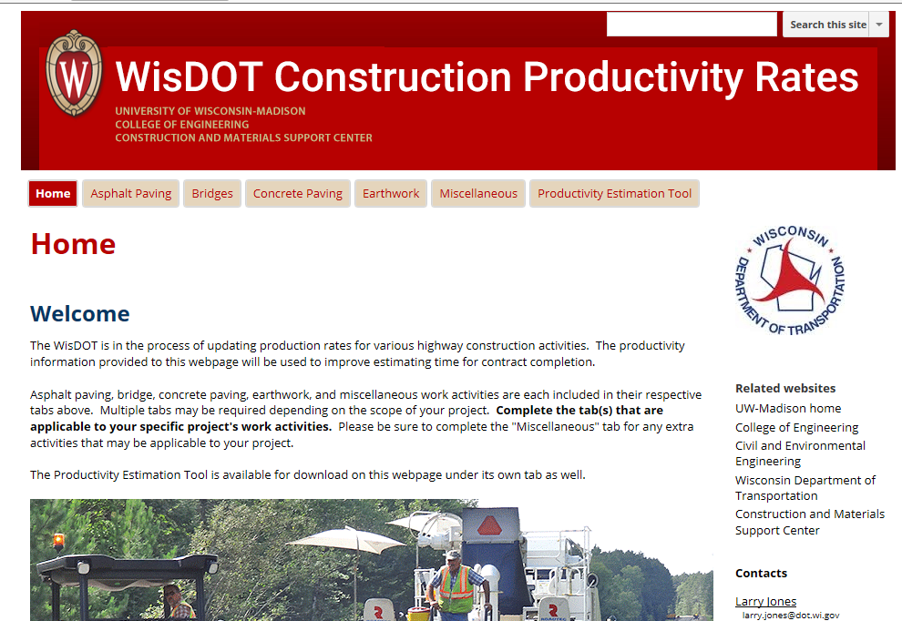
Construction Productivity
Online –
Complete at least once per project
Notes:
I will be sending out the link to the webpage – but data gathering on construction productivity is still ongoing. I want to receive an email when this is completed – should be completed at least once per project, and on larger, multi year projects it should be completed at least once a year. Still need to be done.

Slide 12
Critical Inspection
The guide has been updated for this year. Includes recommended experience levels.
Located - WisDOT webpage, under resources.
Continuous – Concrete Pours, Asphalt Placement, Pipe/Storm Sewer Installations
Know WHAT you are to be checking and noting in your diaries.
Notes:
Critical inspection.

Slide 13
Upcoming Training
Construction Standards/Material Quality Control
March 14th at Mid-State Technical College – Wisconsin Rapids
March 15th at NCR – Rhinelander Office
Work Zone Traffic Control Inspection Training
February 27th at NCR– Wisconsin Rapids Office
February 28th at NCR – Rhinelander Office
Earthwork Inspection
March 8th - Waukesha
Notes:
These are the upcoming construction related trainings across the state: They are available in Learncenter and the consultant side of learncenter. More training will be available as the spring continues.

Slide 14
Thank You!

