Slide 1
608-469-0456 david.pilon@dot.wi.gov

Slide 2
“Pet Peeve Bid items”
Items that contractors routinely use to ruin the field staff’s day.
Volume 1 of ?

Slide 3
390.0303 – Base Patching Concrete
390.0305 – Base Patching Concrete SHES
Used when overlaying concrete with asphalt.
416.1710 – Concrete Pavement Repair
416.1715 – Concrete Pavement Repair SHES
15 feet in length and under.
416.1720 – Concrete Pavement Replacement
416.1725 – Concrete Pavement Replacement SHES
Over 15’ in length to 300’ in length
Used when the concrete repair/replacement is the finished surface

Slide 4
Similarities…..
items include the cost of removal of the existing concrete pavement.
items do not include payment for sawcuts for removal.
measured for payment by the S.Y.
are considered Ancillary Concrete for materials purposes.
items do not include payment for Drilled Tie Bars and Drilled Dowel Bars.
items have 3 unique standard detail drawings that should be in your plans.
  UNIQUE to the bid item.

Slide 5
Differences…..
Materials.
390.0303 – Base Patching Concrete Type B Family Concrete(400 lbs. cement /CY)
390.0305 – Base Patching Concrete SHES Follow 416.2 (846 lbs cement/CY)
Opening Strength 2000 psi.
416.1710 – Concrete Pavement Repair Type C Family Concrete (660 lbs. cement/CY)
416.1715 – Concrete Pavement Repair SHES Follow 416.2 (846 lbs cement/CY)
416.1720 – Concrete Pavement Replacement Type C Family Concrete (660 lbs. cement/CY)
416.1725 – Concrete Pavement Replacement SHES Follow 416.2 (846 lbs cement/CY)
Opening Strength 3000 psi

Slide 6
Consolidation and Strike off
390.0303 – Base Patching Concrete hand methods
390.0305 – Base Patching Concrete SHES hand methods
(You may see the power rolling pin)
416.1710 – Concrete Pavement Repair Vibrator and Vibrating Screed
416.1715 – Concrete Pavement Repair SHES Vibrator and Vibrating Screed
416.1720 – Concrete Pavement Replacement** Vibrator and Vibrating Screed
416.1725 – Concrete Pavement Replacement SHES** Vibrator and Vibrating Screed
** contractor may want to use a concrete paver on longer patches

Slide 7
Surface Finish.
390.0303 – Base Patching Concrete Strike off flush
390.0305 – Base Patching Concrete SHES Strike off flush
416.1710 – Concrete Pavement Repair Tined or Turf Drag
416.1715 – Concrete Pavement Repair SHES Tined of Turf Drag
416.1720 – Concrete Pavement Replacement Tined or Turf Drag
416.1725 – Concrete Pavement Replacement SHES Tined or Turf Drag

Slide 8
Field Staff Day is Ruined….
Base Patching/ Concrete Repair projects usually…
Have the contractor show up unannounced with a large workforce.
Plenty of inspectors required.
Lots to measure / keep track of
  Full Depth Sawcuts
  Patch size.
  Usually at least 2 mix designs running and being placed concurrently
  Drilled Dowel Bars
  Drilled Tie Bars
  Quality checks to make sure work is being done according to plan.

Slide 9
Field Staff Day is Ruined….
Contractor will want to be paid for Tie Bars and Dowel Bars, and will usually challenge the quantity for these items in the plans.
Contractor usually forgets the word….
Drilled
We only pay for Drilled tie bars and Drilled dowel bars. The rest are incidental.

Slide 10
Field Staff Day is Ruined….
Contractor wants to argue the amount of sawcuts ….after the fact.
See item 690.0250, Sawing Concrete for guidance on measurement
Contractor may want to argue the need for additional sawcuts
Contractor may want to argue that “everyone else pays for additional sawcuts”
Contractor may want to be paid for sawcuts along the asphalt shoulder.

Slide 11

Contractor will want to argue that the quantity of SHES patches/repairs paid for is wrong based on which type of patch has the higher price.
Keep good records on all patching/repair quantities
Keep good records on material used for each patch/repair
Keep records on SHES patches/repairs placed for the contractor’s convenience.

Slide 12
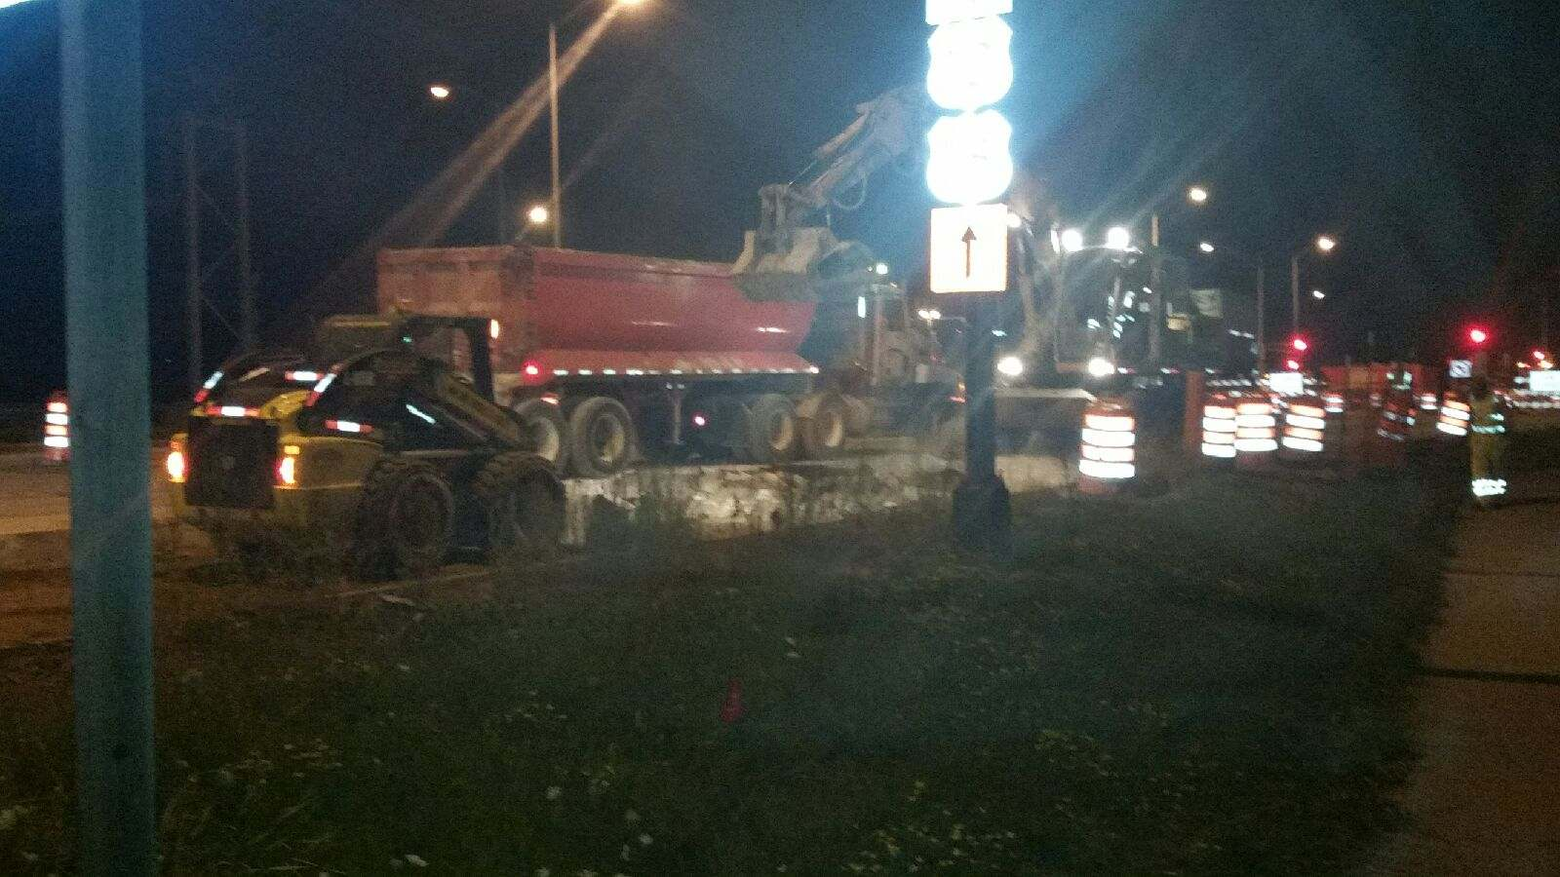
When doing SHES work, it is becoming state practice to do this work at night.

Slide 13
Field Staff Day is REALLY Ruined….
The SHES patches don’t set up and you have to open for traffic!!!
.

Slide 14
608-469-0456 david.pilon@dot.wi.gov

