Slide 1
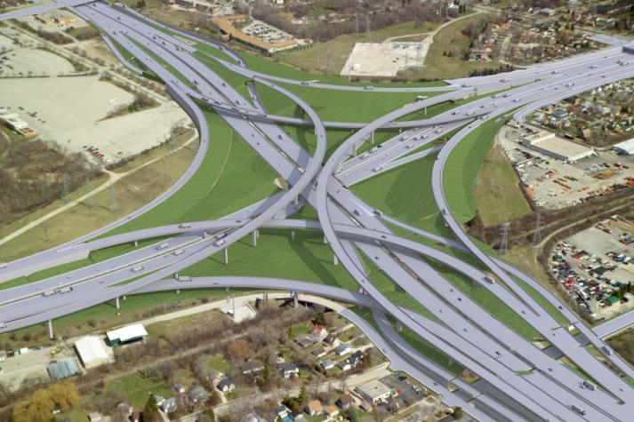
Drilled Shaft Base Grouting – Zoo Interchange Project
Midwest Geotechnical Conference
East Lansing, Michigan
October 18, 2016
Bob Arndorfer
Notes:
Before
Be well prepared with content. Know facts and figures and your audience.
Everyone should be able to read the slides but if NOT, read it to them. Otherwise don’t include it.
Do a final check on microphone and other equipment well before the start time.
Practice the presentation aloud several times. Feel comfortable.
Drink fluids and do something to relax you.
During presentation
Smile and be confident.
Introduce yourself and the organization.
Speak with energy, clearly, and in a reasonable volume so everyone can hear you.
Do not read each line on the slide show – use your own wording and add in examples or additional information which will aid in comprehension.
Talk “friendly” and with the attitude that you are here to provide information and assistance. Have a “win/win” attitude.
If you make an error, politely clarify or correct it. Move on quickly and don’t dwell on it.
If you can’t answer a question, politely indicate you don’t have the information available. Indicate that you will follow-up individually with the requestor.
After presentation
Be available for follow up.
Be prepared for additional comments, questions or clarifications.
Maintain composure.
If you make a promise, be sure to follow up quickly or reassign if appropriate.

Slide 2
Project Background
Located in Milwaukee
SE Part of State
Largest WisDOT Project to Date - >$1B
Biggest Part is Zoo Core Interchange
Flyovers With Three Levels
65 Bridges ≈ 1.2M sqft Bridge Deck
5 Year Construction Program
Build Under Traffic
Notes:
Overview of the Unit or Sections place within BTS, Employees

Slide 3
Project Background – Cont’d.
Complex Urban Site
Many Utilities In This Congested Area
Consultant Design
First WisDOT Use of Shaft Base Grouting (i.e. Tip Grouting or Post Grouting)
First Use of Non-redundant Deep Foundations
Completed Shaft Load Test Program – 6 Shafts, Presented at 2013 MWGC
Notes:
Overview of the Unit or Sections place within BTS, Employees

Slide 4
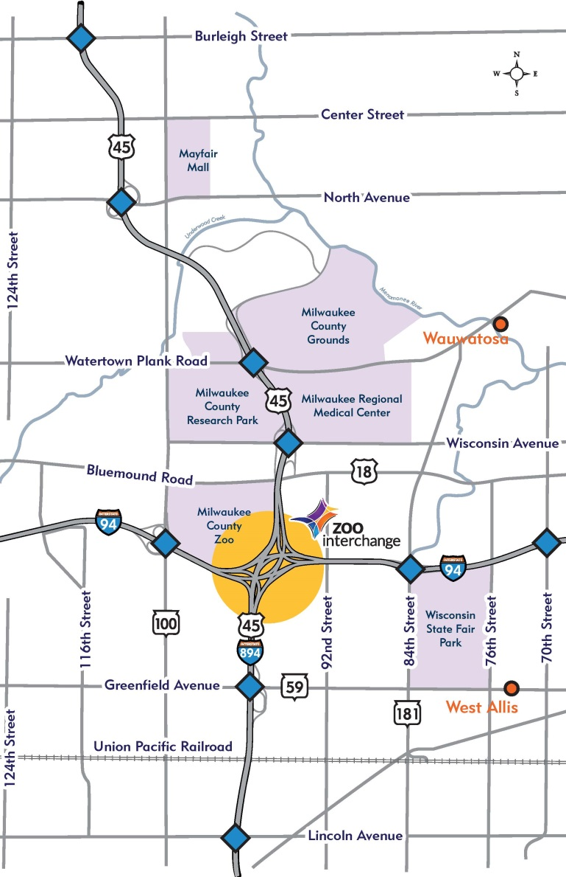
General Map
System-System Interchange
Major Players Involved
Adjacent to County Zoo
Notes:
Overview of the Unit or Sections place within BTS, Employees

Slide 5
Rendition of Zoo Core Interchange
Notes:
Overview of the Unit or Sections place within BTS, Employees

Slide 6
Geotechnical Site Characteristics
Glacial Till/Outwash Soils
Generally Consists of Clays and Silts That Can Be Mixed With Sands, and Sand Layers
Can Find Layers of Sand/Gravel With Cobbles
Profile is Not Very Consistent Between Borings
Blow Counts 10-50
Unconfined Compressive Strengths 1.5-4.5 tsf
Dolomite Bedrock Generally 120’ Deep
Watertable Generally 10-25’ Deep
Notes:
Overview of the Unit or Sections place within BTS, Employees

Slide 7
Typical Soil Profile
Notes:
Overview of the Unit or Sections place within BTS, Employees

Slide 8
Why Drilled Shafts?
WisDOT Uses Shafts Sparingly
Limited Number of Shaft Contractors in Wi
Foundation Demands
Tall piers
Large overturning moments
Large axial loads
Large lateral loads
Would require large pile substructers
Speed of Construction
Notes:
Overview of the Unit or Sections place within BTS, Employees

Slide 9
Why Drilled Shafts – Cont’d.?
Footing Constraints – Smaller Footprint
Limited physical room for foundations
Underground utility conflicts
Overhead clearance problems
Staging/Traffic sequencing issues
Cost Competitive
Notes:
Overview of the Unit or Sections place within BTS, Employees

Slide 10
Base Grouting
Been Done in US Over Last 15 Years – Generally Not Used On Many D-B Projects
Most Done By Applied Foundation Testing (AFT) From Florida
Benefits in Loadings/Resistance Factors
Concern Over Non-redundant Foundations
Limited Experience With Large-diameter Shafts
But, Limited AASHTO Guidance on Design Methodology and How to Include Benefits in Design Process – FHWA Current Research
Notes:
Overview of the Unit or Sections place within BTS, Employees

Slide 11
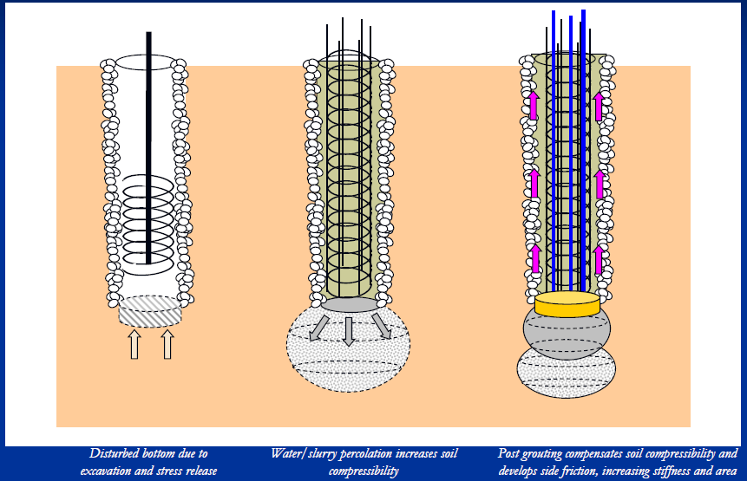
Base Grouting Basics
Notes:
Overview of the Unit or Sections place within BTS, Employees

Slide 12
Benefits of Base Grouting
Increase Usable Base Resistance (Higher ϕ)
Preloading base
Improving base soils – compaction/permeation
Increasing tip area – In some cases
Improve side resistance – upward grout movement
Decrease Settlement
Improve Reliability of Base Resistance
Reduce Construction Risk – Increase Confidence Level
Shorter or Smaller Shafts
Notes:
Overview of the Unit or Sections place within BTS, Employees

Slide 13
Benefits Cont’d.
Acts as a Partial ‘Load Test’ to Confirm Design Assumptions
Improve Strain Compatabiliy Between Base and Shaft - Skin Friction and End Bearing Resistances Act Simultaneously
Produces an Upward Reaction to ‘Pre-load’ Side Friction
Compresses Base Soils to Reduce Soil Disturbance Due to Drilling Operations
Generally Used For Granular Base Soils
Notes:
Overview of the Unit or Sections place within BTS, Employees

Slide 14
What Base Grouting Is Not
Is Not a True Load Test Unless Base Grout Pressures Are Equal to Applied Loads + Shaft Dead Load
Is Not a Substitute For Proper Shaft Construction Operations/Inspection and Base Cleaning
Does Not Remediate Shaft Defects/Issues
Not All Base Grouters Are Equal
Notes:
Overview of the Unit or Sections place within BTS, Employees

Slide 15
Base Grouting Design
How To Account for Base Grouting In Design?
Design Based on GEC 10 and AASHTO Code
No AASHTO Guidance on Shaft Design Methodology When Base-Grouted
Neither Design Guide Provides Resistance Factors When Base Grouting is Done
Worked With Ben Rivers and Jerry DiMaggio on Design Methodologies/Resistance Factors
Notes:
Overview of the Unit or Sections place within BTS, Employees

Slide 16
Base Grouting Design – Cont’d.
2012 FHWA/ADSC Synthesis Report On Post-Grouting of Drilled Shafts
2015 Workshop on Post-Grouted Shafts – FHWA, DFI, ADSC, CalTrans
Use Tip Capacity Multiplier (TCM) Factor
TCM Used to Increase Base Resistance
Computed By Following GEC 10
Methodology Based on Tip Founded in Granular Soils
No Guidance If a Reduction Factor Should be Applied to TCM Value (Used 1.0)
Notes:
Overview of the Unit or Sections place within BTS, Employees

Slide 17
Base Grouting Design – Cont’d.
Shaft Side and Base Resistances are Based on Vertical Displacement of 5% of Diameter
This value is excessive for serviceability
Used design value of 1”
Checked Both Service and Strength Limits, Service Generally Controlled
Bulb
Notes:
Overview of the Unit or Sections place within BTS, Employees

Slide 18
Base Grouting Design – Cont’d.
Used 0.7 Reduction Factor (AASHTO for Load Tests) for Both Side and Base Resistances
Reduced by Another 20% for Non-redundant Application
May Need to Consider Site Variability Factor
WisDOT Final Shaft Reduction Factor of 0.56
Neglect Side Resistance 0-5’ Below Ground Surface (BGS)
Limit Side Resistance 5-10’ BGS to 1000 psf
Notes:
Overview of the Unit or Sections place within BTS, Employees

Slide 19
Drilled Shaft Background
Large (8 & 10’ϕ) Single Shafts (Non-redundant) Under Many Piers – 1st for WisDOT
30-40% of Shaft Resistance in Side Friction
Base Grouting Allowed Shorter Shaft Lengths
Alternative Foundation Designs in Plans – On 18 of 51 Flyover Ramp Foundations
Pre-qualified Drilled Shaft Contractors
Large-diameter (>6 feet diameter) + Base-grouted
6 approved (Case, Kiewit, Malcolm, Michels, Walsh)
Notes:
Overview of the Unit or Sections place within BTS, Employees

Slide 20
Base Grouting – Spec. Highlights
Required Prequalified Shaft and Base-Grouting Contractor Teams
Grout: 2500 psi @ 28 Days
Grout Pump of 800 psi Required
Redundant Grout/Flush Pump Required on Site
Base Gravel Pack Allowed
End Grouting Criteria Set
Notes:
Overview of the Unit or Sections place within BTS, Employees

Slide 21
Base Grouting Criteria
Need to Meet One of the Following 3 Criteria
All of the Following Are Met:
Minimum Grout Volume
Minimum Grout Pressure
Minimum Upward Movement – 0.125”
Maximum shaft upward movement – 0.4”
Grouting pressure reaches maximum rating of the pressure grouting equipment and lines (800 psi min.) This usually governed.
All Shafts Took Min. Grout Volume, and Most Had Just Under 0.125” Movement
Notes:
Overview of the Unit or Sections place within BTS, Employees

Slide 22
Base Grouting Aspects
CSL Tubes Used to Deliver Grout
Sleeve-port (Tube-a-Manchette [TAM]) Grout Tube Delivery System Used
W/C Ratio: Generally 0.4 - 0.6
Design Pressures Range from 450-600 psi
Grout Volumes Exceeded Min. Required
Some Shafts Needed Second Stage of Grouting, and One Took Three Stages
Digital Level Used to Measure Movement
Notes:
Overview of the Unit or Sections place within BTS, Employees

Slide 23
Grouting Equipment
Notes:
Overview of the Unit or Sections place within BTS, Employees

Slide 24
Grouting Equipment
Notes:
Overview of the Unit or Sections place within BTS, Employees

Slide 25
Grouting Equipment
Notes:
Overview of the Unit or Sections place within BTS, Employees

Slide 26
Bottom Grout Tubes
Notes:
Overview of the Unit or Sections place within BTS, Employees

Slide 27
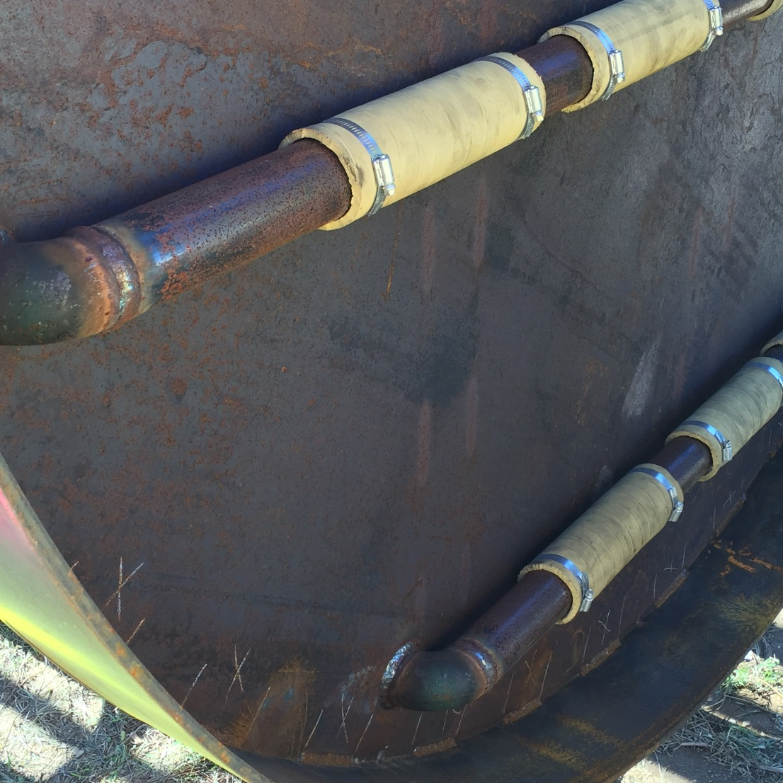
Bottom Grout Tubes – Cont’d.
Notes:
Overview of the Unit or Sections place within BTS, Employees

Slide 28
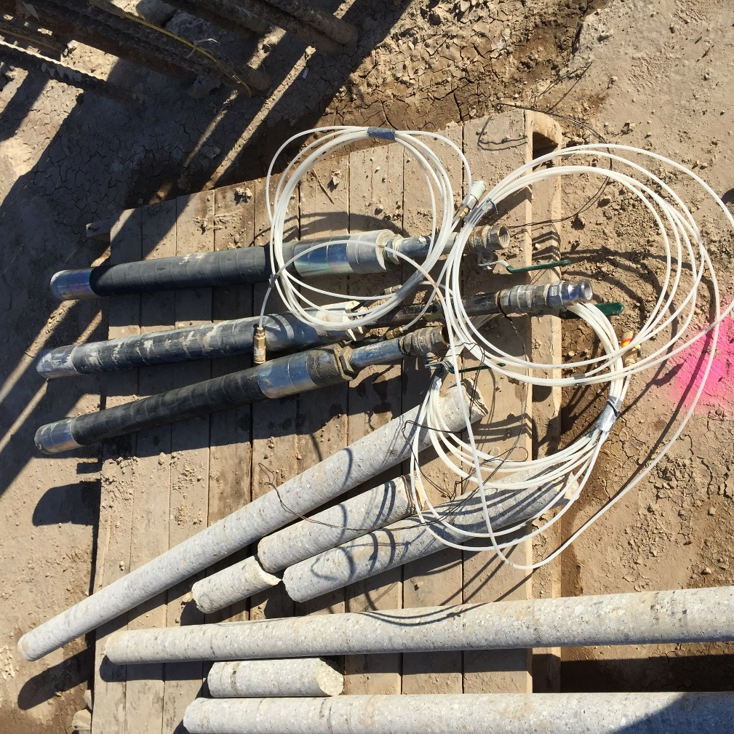
Packer Tubes
Notes:
Overview of the Unit or Sections place within BTS, Employees

Slide 29
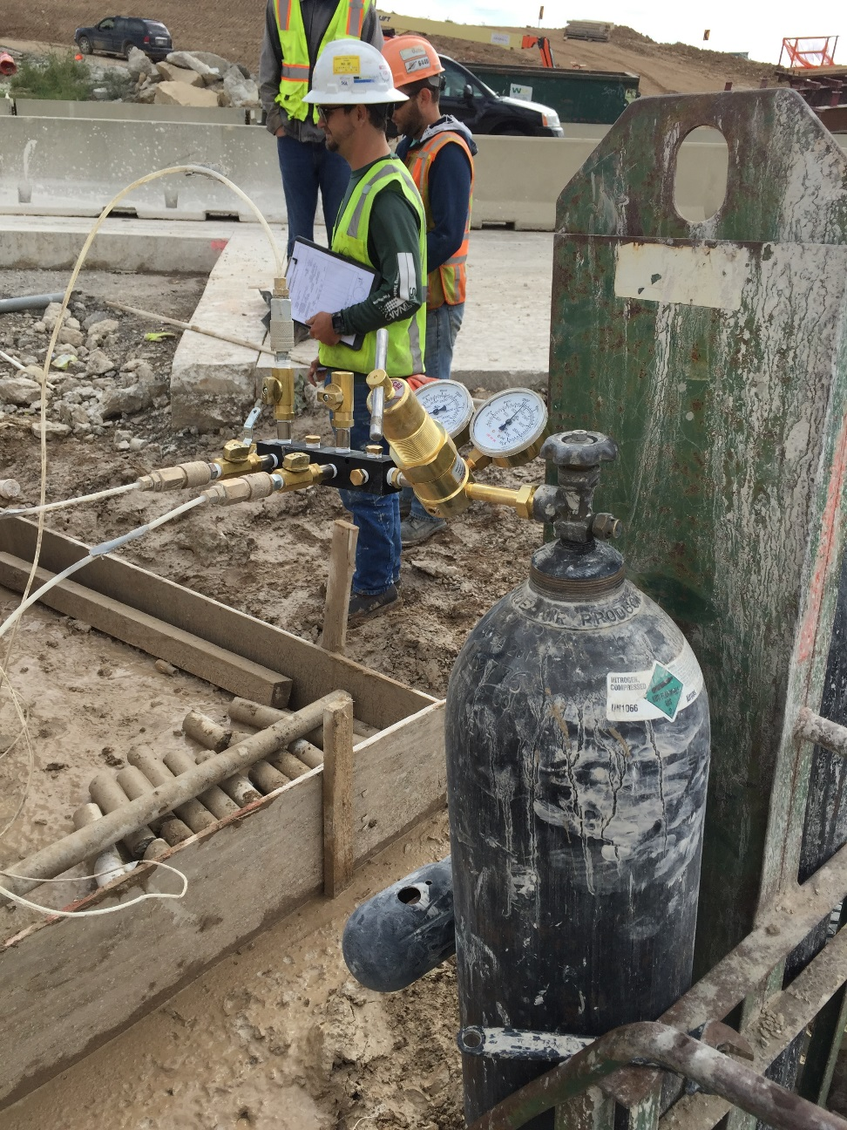
Packer Manifold Controls
Notes:
Overview of the Unit or Sections place within BTS, Employees

Slide 30
Starting to Pump Grout
Notes:
Overview of the Unit or Sections place within BTS, Employees

Slide 31
Grouting – Before Lock-off
Notes:
Overview of the Unit or Sections place within BTS, Employees

Slide 32
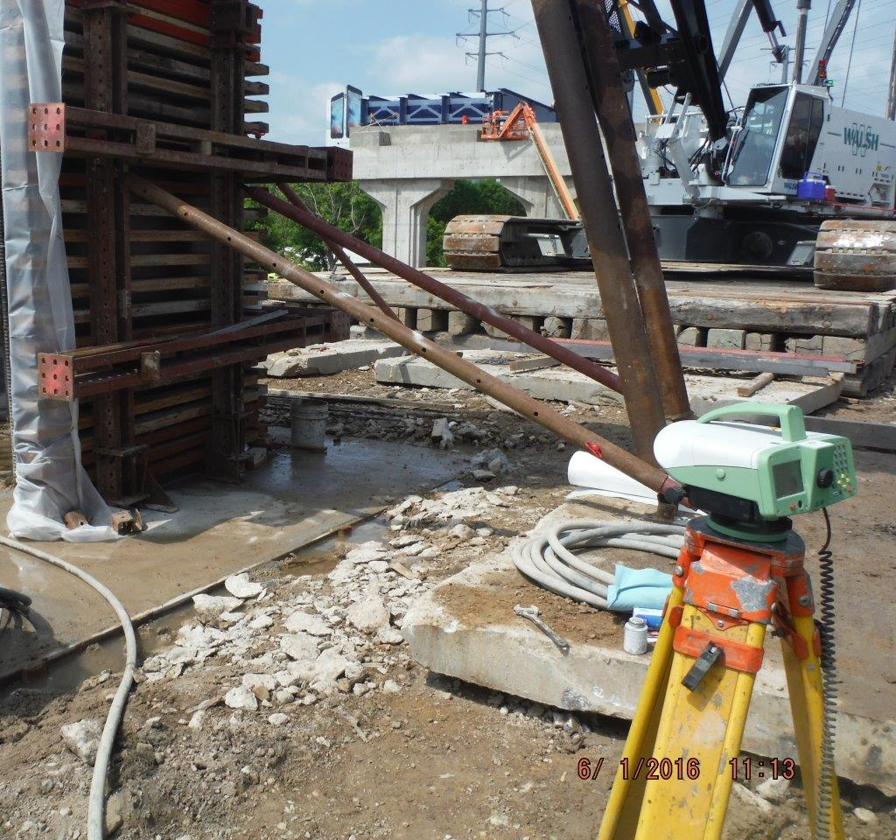
Measuring Movement
Notes:
Overview of the Unit or Sections place within BTS, Employees

Slide 33
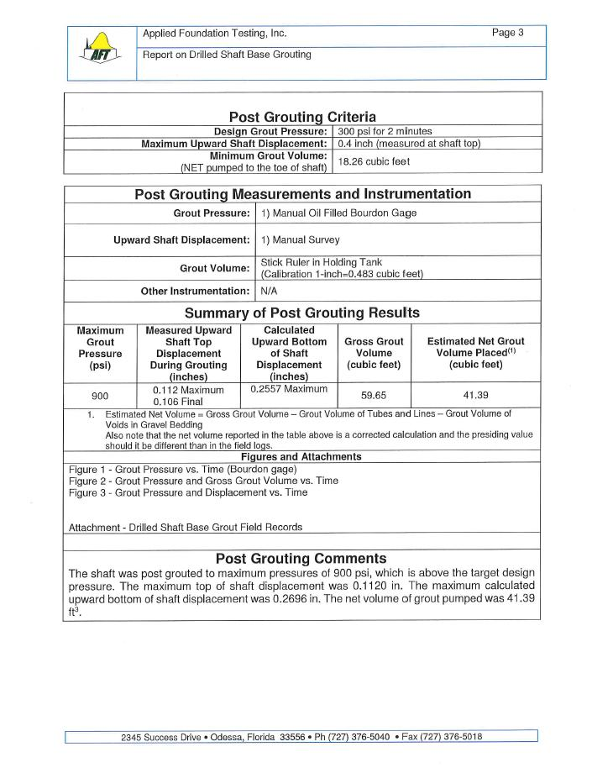
Field Grout Report
Notes:
Overview of the Unit or Sections place within BTS, Employees

Slide 34
Field Grout Pressure vs Volume
Notes:
Overview of the Unit or Sections place within BTS, Employees

Slide 35
Field Grout Pressure vs Movement
Notes:
Overview of the Unit or Sections place within BTS, Employees

Slide 36
Things We Learned
Need Proper Grouting/Pumping Equipment in Good Operating Condition
Redundant Grout Delivery System is Good
Recommend Using Experienced Contractor
Need to Make Real-time Decisions During Grouting Operations
Used Clean Granular Gravel Pack
Does Take Some Time to Complete
Notes:
Overview of the Unit or Sections place within BTS, Employees

Slide 37
Things We Learned – Cont’d.
Can Still Have Shaft Issues, Even With Base Grouting
Base Grouting Does Not Remediate Shaft Defects/Issues
Base Grouting Is Not a Substitute For Proper Shaft Construction Operations/Inspection and Base Cleaning
Notes:
Overview of the Unit or Sections place within BTS, Employees

Slide 38
Base Grouting Costs
3 Bidders
Alternate Foundations: 1-Shafts, 2-Piles
Item | Unit | Bidder 1* | Bidder 2 | Bidder 3
Base Grouting | Each | $10,700 | $22,000 | $2,000
59”ϕ Shaft | Lin Ft | $805 | $1350 | $1370
98”ϕ Shaft | Lin Ft | $1120 - $1400 | $2000 | $2370
118”ϕ Shaft | Lin Ft | $1600 - $1650 | $2200 | $3017
Notes:
Overview of the Unit or Sections place within BTS, Employees

Slide 39
Moving Forward
Don’t Have Many Future Projects With Extensive Shaft Needs
When WisDOT Does Use Shafts, Generally Involves Multiple 3-4’ϕ Shafts
Will Incorporate Lessons Learned From Zoo Projects
Will Probably Use Base Grouting Again if Have Similar Demands/Applications
Notes:
Overview of the Unit or Sections place within BTS, Employees

Slide 40
Questions
Questions?
Notes:
Overview of the Unit or Sections place within BTS, Employees

