Slide 1
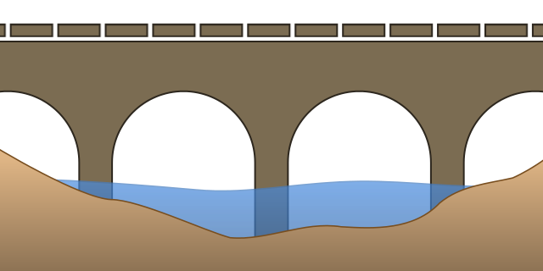
Chippewa River Bridge
Foundation Issues
2017 Midwest Geotechnical Conference
St. Louis, Missouri
Bob Arndorfer
Notes:
Before
Be well prepared with content. Know facts and figures and your audience.
Everyone should be able to read the slides but if NOT, read it to them. Otherwise don’t include it.
Do a final check on microphone and other equipment well before the start time.
Practice the presentation aloud several times. Feel comfortable.
Drink fluids and do something to relax you.
During presentation
Smile and be confident.
Introduce yourself and the organization.
Speak with energy, clearly, and in a reasonable volume so everyone can hear you.
Do not read each line on the slide show – use your own wording and add in examples or additional information which will aid in comprehension.
Talk “friendly” and with the attitude that you are here to provide information and assistance. Have a “win/win” attitude.
If you make an error, politely clarify or correct it. Move on quickly and don’t dwell on it.
If you can’t answer a question, politely indicate you don’t have the information available. Indicate that you will follow-up individually with the requestor.
After presentation
Be available for follow up.
Be prepared for additional comments, questions or clarifications.
Maintain composure.
If you make a promise, be sure to follow up quickly or reassign if appropriate.

Slide 2

Background
Issues With a Project Currently Under Construction
Will Not Be Able to Provide Complete Story as Repairs Are Not Started
Important Enough to Discuss at This Conference

Slide 3
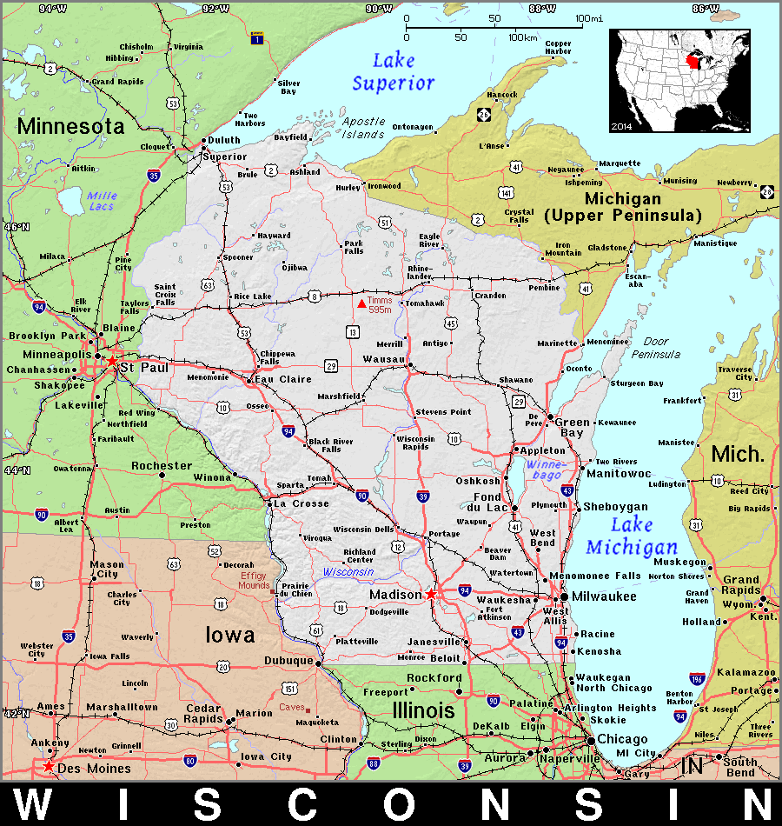
Project Location Map

Slide 4
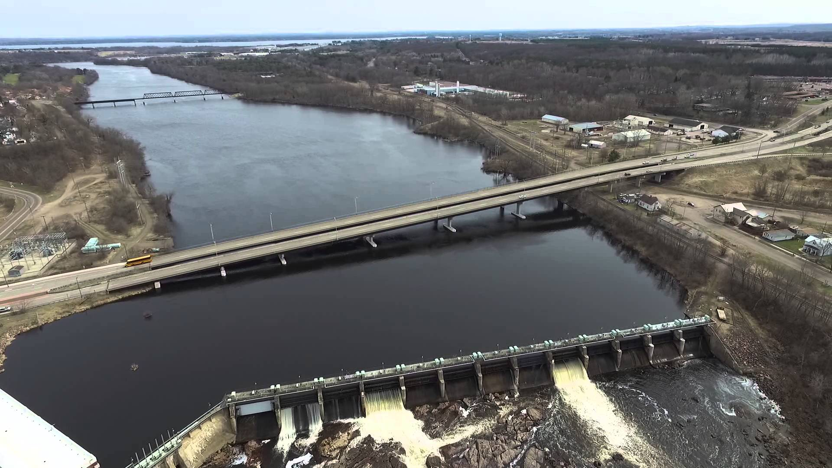
Plan View of Site

Slide 5
Background of Site
Two Adjacent Bridges: NB [B-146] & SB [B-147]
Carry STH 124 over Chippewa River, 1100’ Long
Each Carries 2 Lanes Traffic, 25,000 ADT
Just Upstream of Electric-Generating Dam
In Area of Shallow Granite Bedrock
Different Age Bridges – Constr. Sequence
  Older (1932), Existing SB
  Adjacent New NB Built 1992, Traffic Moved to NB
  SB Reconstructed 1994, Traffic Moved to Both Bridges

Slide 6
B-147 Bridge Specifics
Southbound Bridge
  11 Spans
  Originally Built in 1932
  Closer Bridge to the Dam
  Founded on Spread Footings (Massive Pier Foundations)
  New Superstructure and Piers (Above Water) in 1994
  Pier 4 of B-147 lines up with adjacent Pier 3 of B-146

Slide 7
B-146 Bridge Specifics
Northbound Bridge
  9 Spans, 160’ Main Channel Spans
  Piers 1-5 Located in Water
  Built 1991-1992
  Piers - Spread Footings Founded on Granite Bedrock
  Bedrock – 40 tsf Minimum Allowable Bearing Capacity*
  Applied Structure Loads of Approximately 9 tsf
  Little/no Overburden Above Rock
  Footings Approx. 17’ x 27’, With Hammerhead Piers
  Combo Footing/Seal Foundations (Tremie Poured in Water) – 10-15’ Thick

Slide 8
Bedrock Surface Below Dam
Location

Slide 9
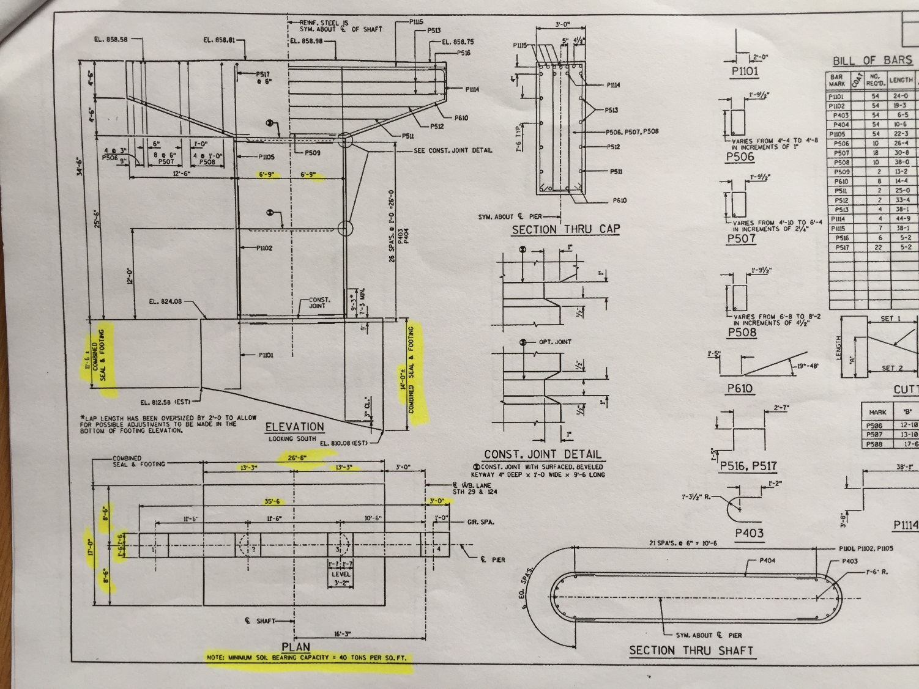
Routine Underwater Inspections
1995/97 Underwater Inspections Indicate Scour Issues at Pier 3 of B-146

Slide 10
Scour Repairs - 2000
Scour Repairs Developed to Address Issues
Proposed Repairs
  Clean Overburden to Bedrock Surface
  Place Grout Bags Around Entire Footing Perimeter
  Grout Under Edges of Existing Footing
  Let Cost of $25k – Next Low Bidder is $56k??
Repairs Appeared to Have Solved Issues

Slide 11
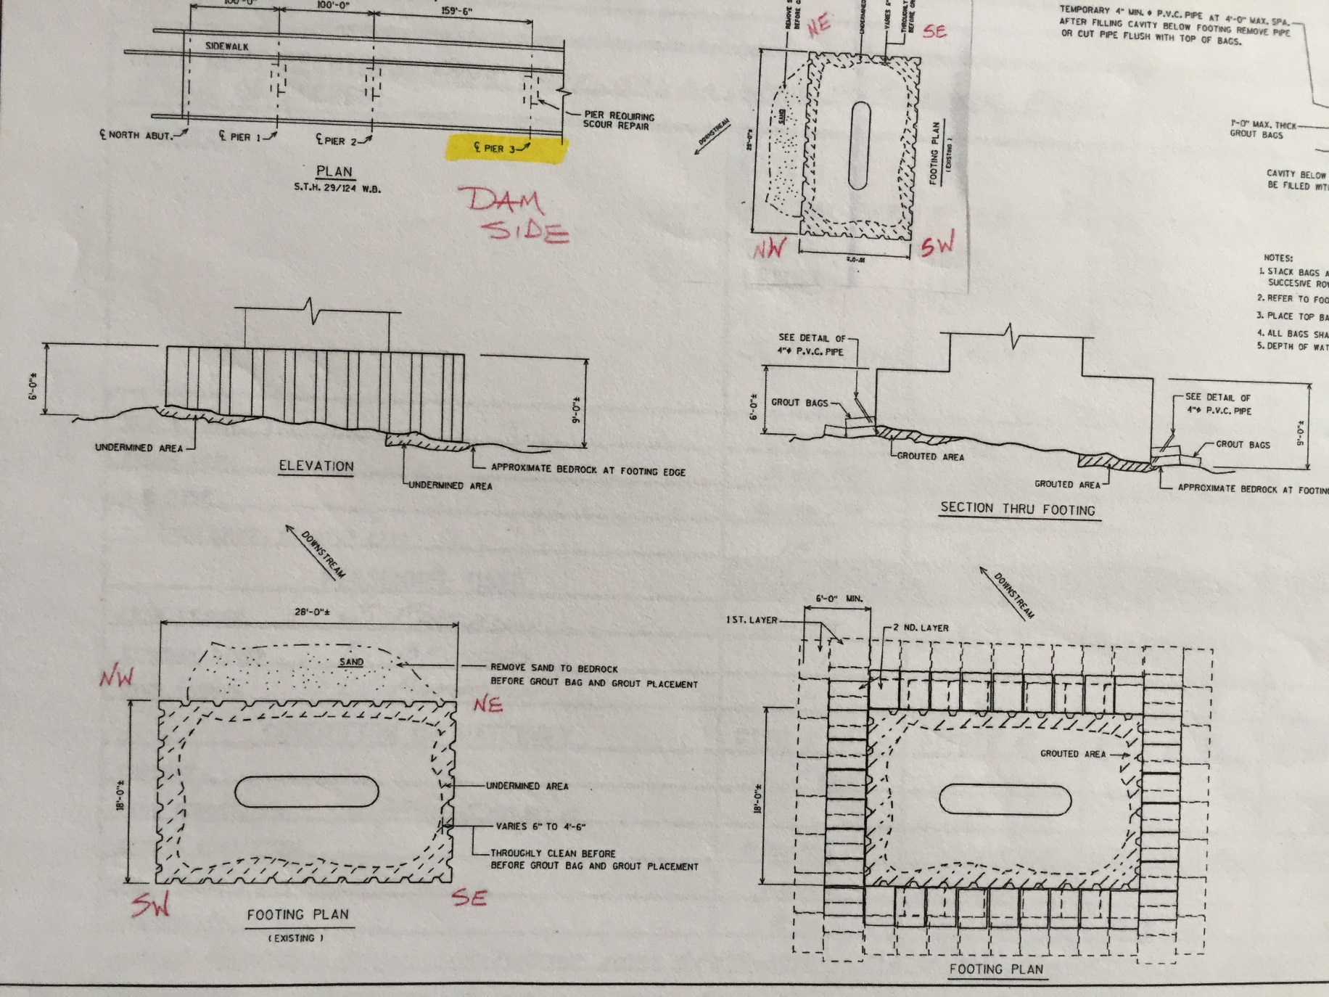
2000 Scour Repair Plans

Slide 12
Scour Issues Re-appear
Mid/Late-2000 Underwater Inspections Indicate Scour Issues Had Re-appeared at Pier 3 and Also Pier 4 of B-147
Main Water Flow Near These Two Piers
Plan Developed to Address Scour Issues and Other Superstructure Maintenance Work
Construction – Summer 2017

Slide 13
2017 Construction Plan
Proposed Work
  Replace Deck Joints and Abutment Backwalls
  Place Polymer Deck Overlay
  Grout Bag Repair at two Piers (Pier 3 [B-146] & Pier 4 [B-147]) {Similar Method as Previous Scour Remediation Work}
Completion Date - Fall 2017

Slide 14
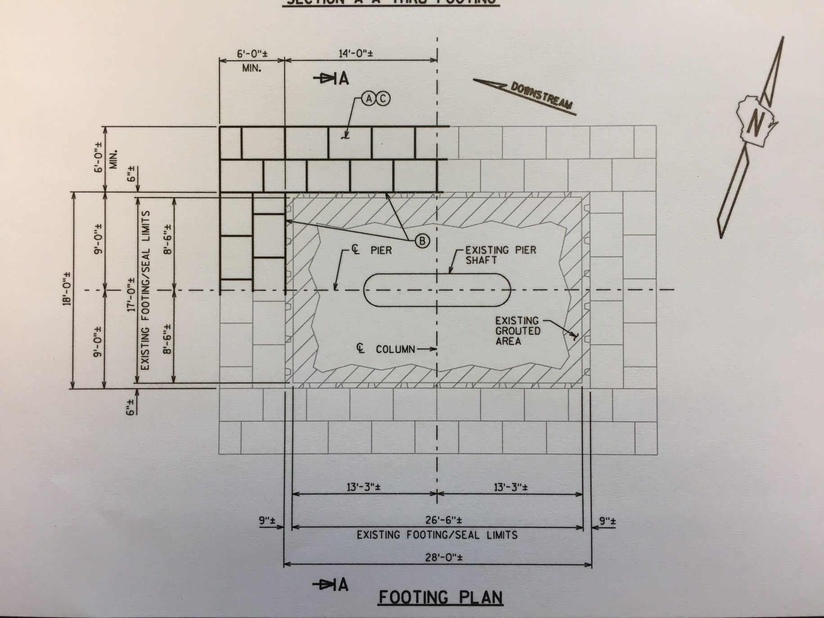
Repair Plans

Slide 15
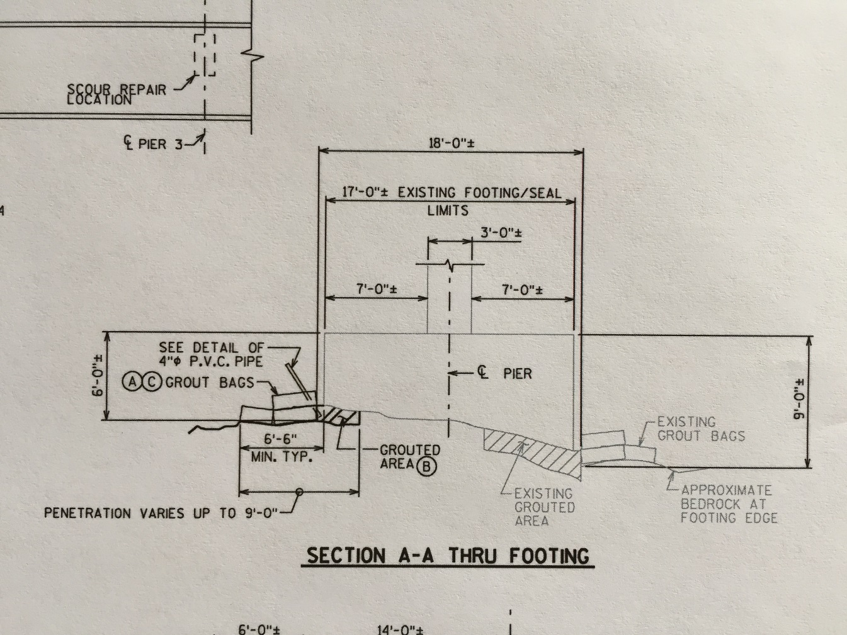
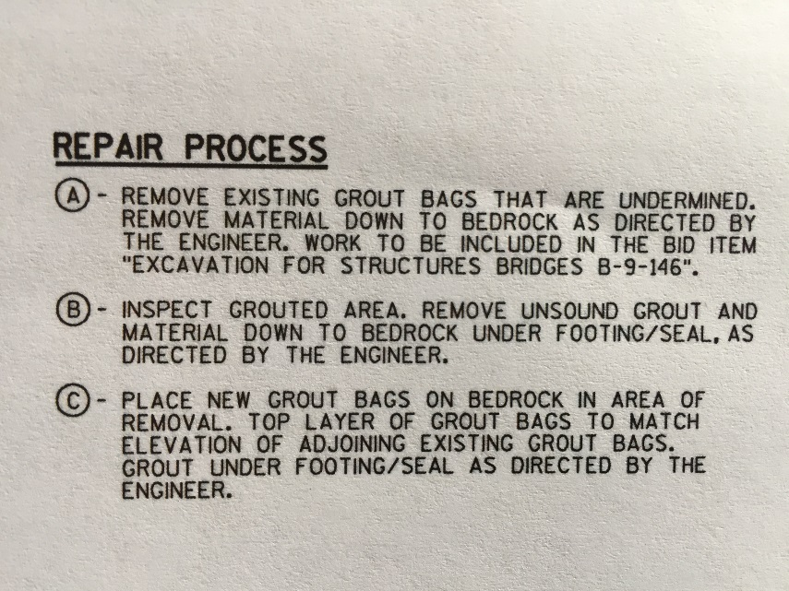
Repair Plans – Cont’d.

Slide 16
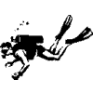
Foundation Repairs
Prior to Beginning 2017 Scour Work, Contractor Dives Pier 3 of B-146 and Finds Issues
  Footing Much Thicker than Construction Plans
  Not All Previous Grout Bags in Place
  Bags Located 3-4’ Above Streambed Elevation
  Apparent Scouring Under Grout Bags
  Appears There is Undermining Below Footing
  Contractor Concern for Worker Safety
  Claims Changed Conditions
As a Result: Department Decides to Drill Through Existing Footing at Pier

Slide 17
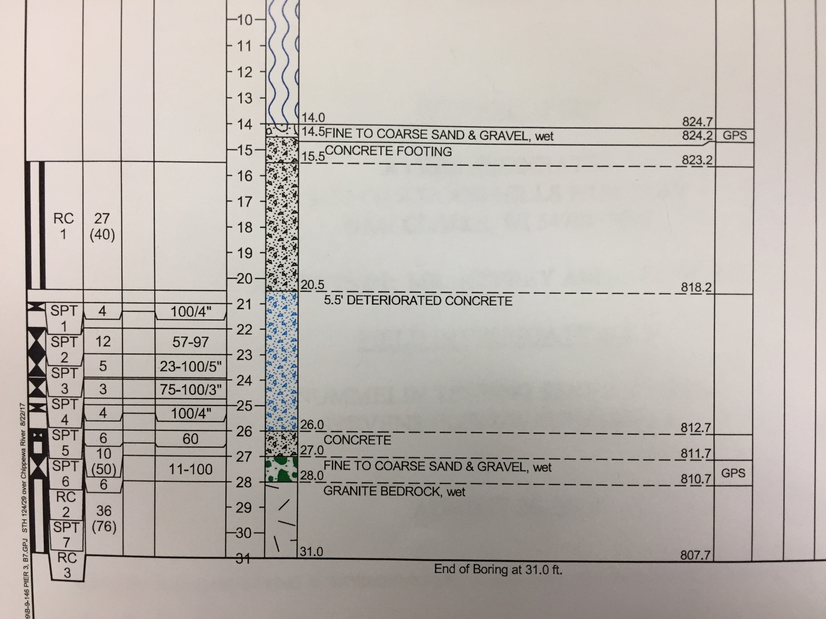
Pier 3 Boring 1
Drill a Second Hole

Slide 18
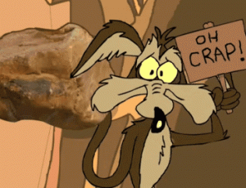
Boring Results
Found 5.5’ Deteriorated Areas of Concrete Within the Footing
Found 1.0’ of Native Sand/Gravel Between Base of Footing and Bedrock
Now What??
Drill Second Hole in Pier

Slide 19
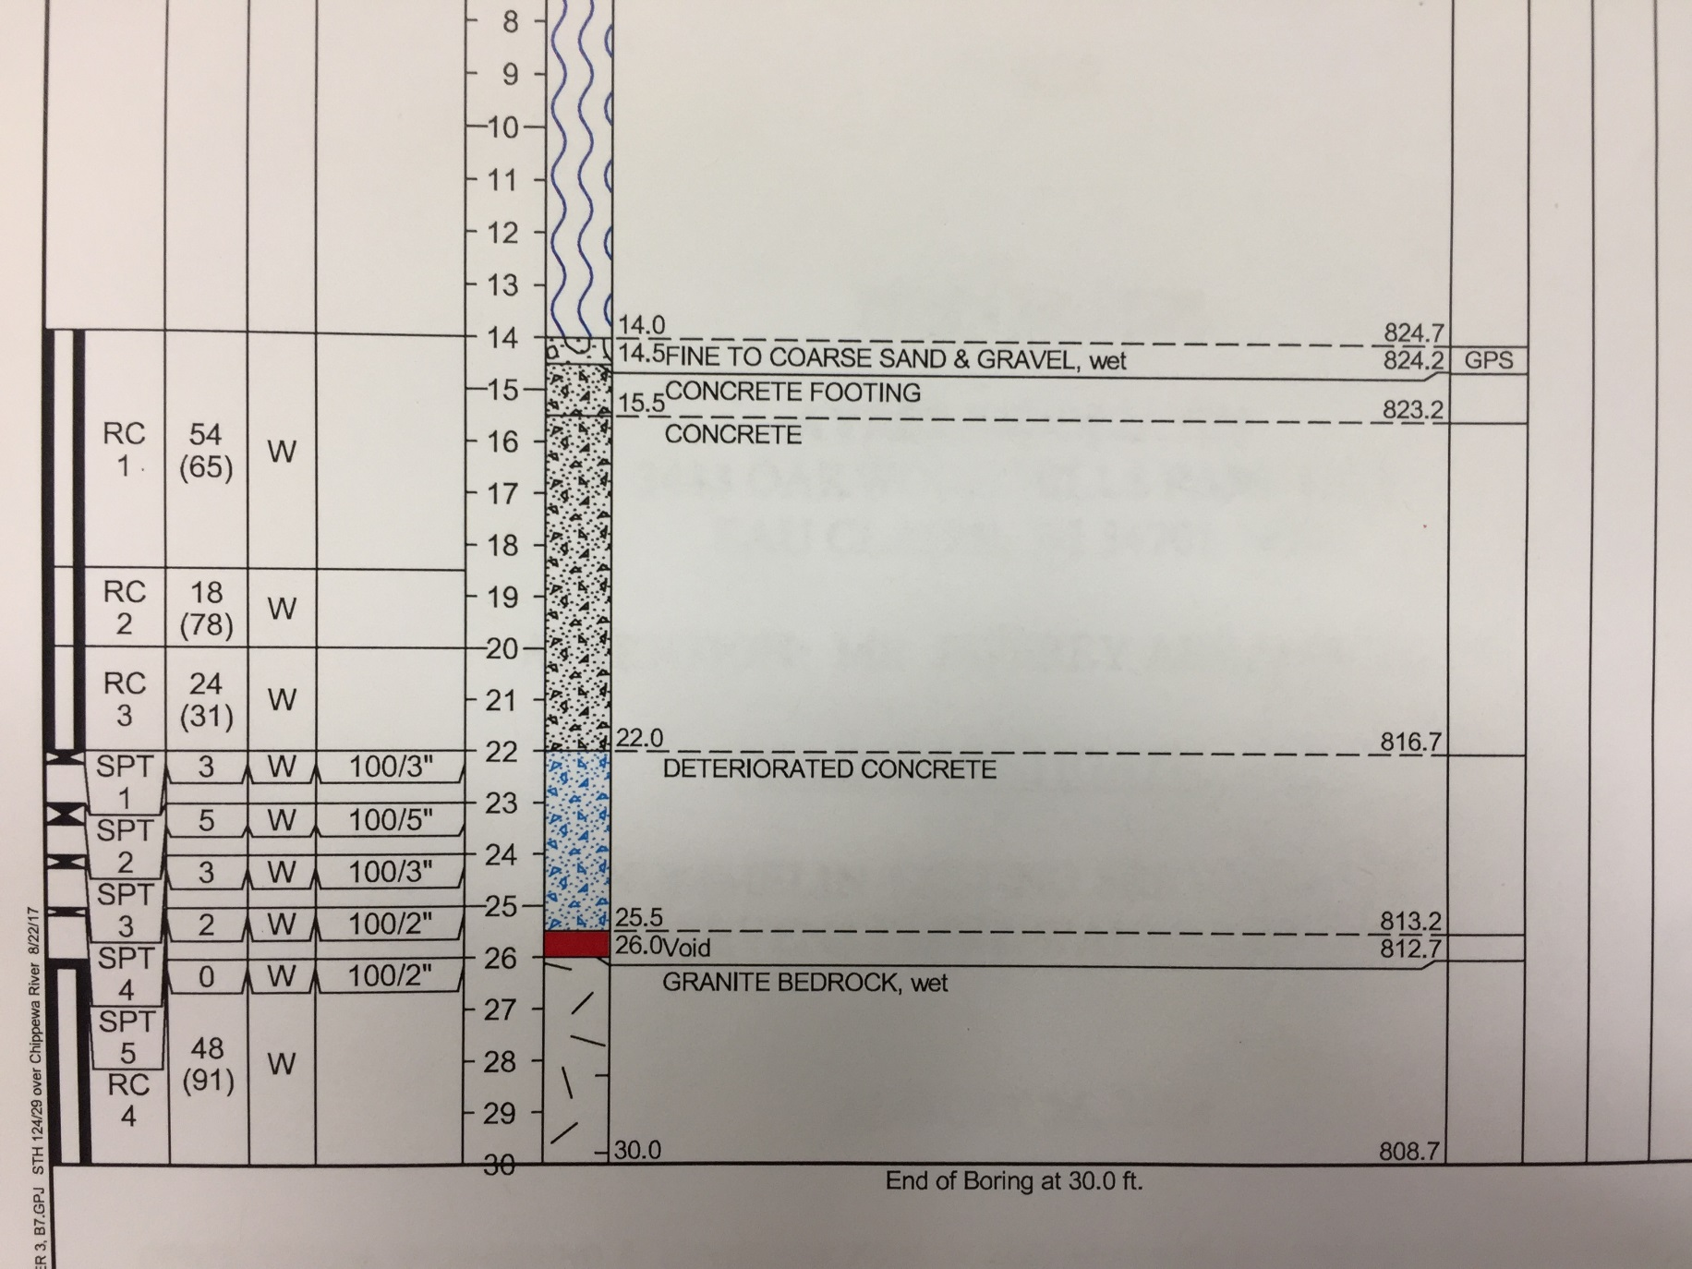

Pier 3 Boring 2

Slide 20

Second Hole Results
Found 4.5’ Deteriorated Concrete at Base
Found 6” Void at Footing/Rock Interface
Things Getting Worse??
Where Do We Go From Here?

Slide 21

Considerations
Structure Has Been Open For 25 Years
Have Had Scour Issues - No Foundation Movement/Issues
Obviously Not All Footings Supported on Void/Sand/Gravel, or it Would Have Moved.
How Significant Are the Issues?
Elected to Error on Conservative Side – Action Needed
Closed Bridge – Traffic Issues

Slide 22
On-Going Constr. Project Work
Took Approximately 1 Week to Mobilize Barge/Rig and Complete Two Borings
During That Time
  Project Required Staged Construction (B-146 First)
  B-146 Closed (All Traffic Move to Adjacent Bridge)
  Working on Deck Repairs to B-146
  Completed B-146 Deck Repairs – Moved Traffic From Adjacent Bridge to B-146 at 10 AM on Friday
  Decision Made at Noon Friday to Remove All Traffic From B-146 Until Dept. Had More Information

Slide 23
Construction Work – Cont’d.
During Intervening 2-hour Period, Contractor Removed Abut. Backwalls and Approaches
Could Not Move Traffic Back – Emergency Detour Needed – Another Bridge, Local Roads
Detour Lasted About 2 weeks Until Repairs Made to B-147 and Traffic Moved Back
Because of Need to Limit Detour Time, All Let Contract Repairs to B-147 Deck Not Completed
B-146 Remained Closed

Slide 24

Detailed Forensic Work
Review of Original Bridge Plans and Construction Records
Review 2000 Scour Remediation Plans/Records
Review Maintenance Underwater Inspection Records
Began Additional Borings At All Water Piers

Slide 25
Findings
Construction As-Builts/Records
  Original Pier Excavations Appeared to Go Well
  Combination Footing/Seal Foundations
  Piers 1-5 Were Tremie-poured
  Daily Diaries Show No Issues With Tremie Pours
  Variable-thickness Footings Due to Variable Bedrock Surface
  No As-Built Notes of Differences From Plan, Other Than Footing at Pier 3 Was Raised 1 foot Due to Higher Rock Surface
Piers Built in Winter

Slide 26
Findings – Cont’d.
Additional Borings At All Water Piers (1-5)
  At Least 2 Borings Through Each Footing
  Some From Barge, Some Through Deck
  Top/Bottom of Footings Not Level
  Some Borings Indicated Good Footing/Rock Contact
  Piers 1, 2, and 4: (2 borings each)
    Good Existing Footing Concrete
    Some Zones of Sand/Gravel at Rock Interface
  Piers 3 (6 borings), and 5 (5 borings):
    Zones of Deteriorated/bad Concrete In Existing Footing
    Some Zones of Sand/Gravel/Void at Rock Interface

Slide 27
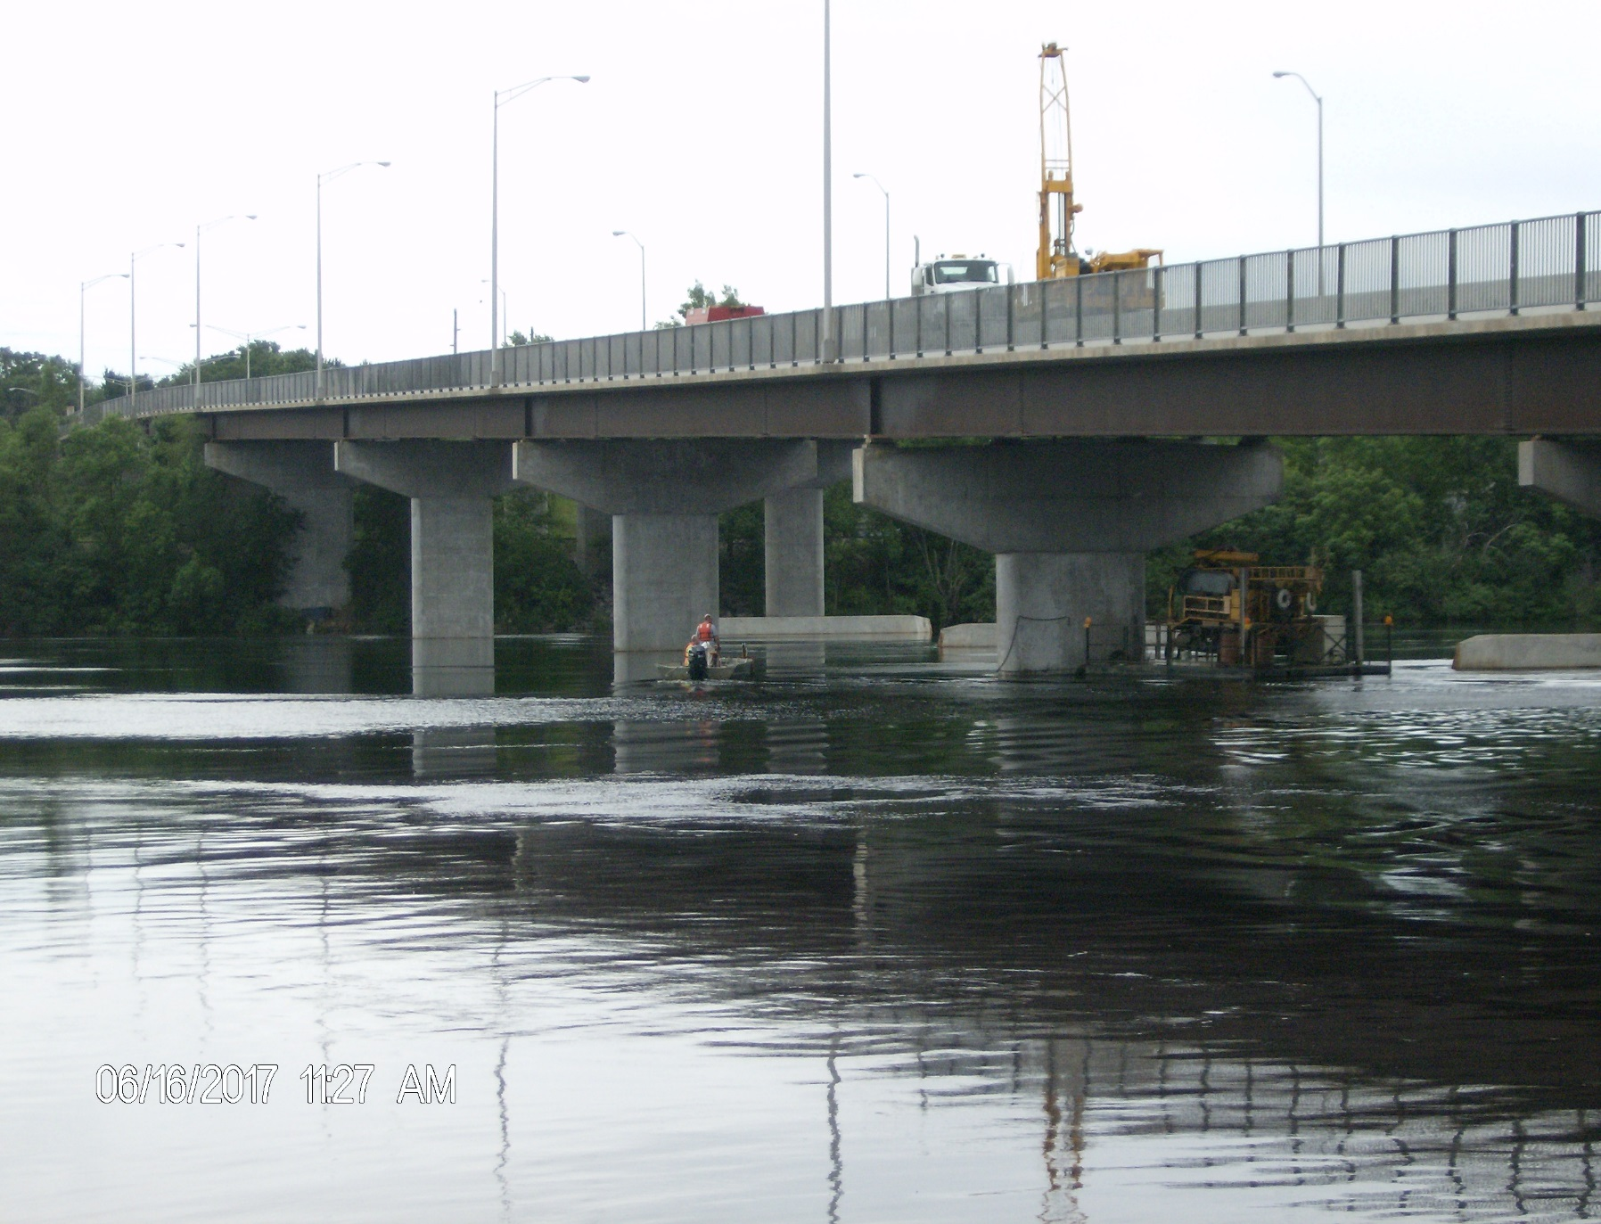
Drilling Operations – Pier 3

Slide 28
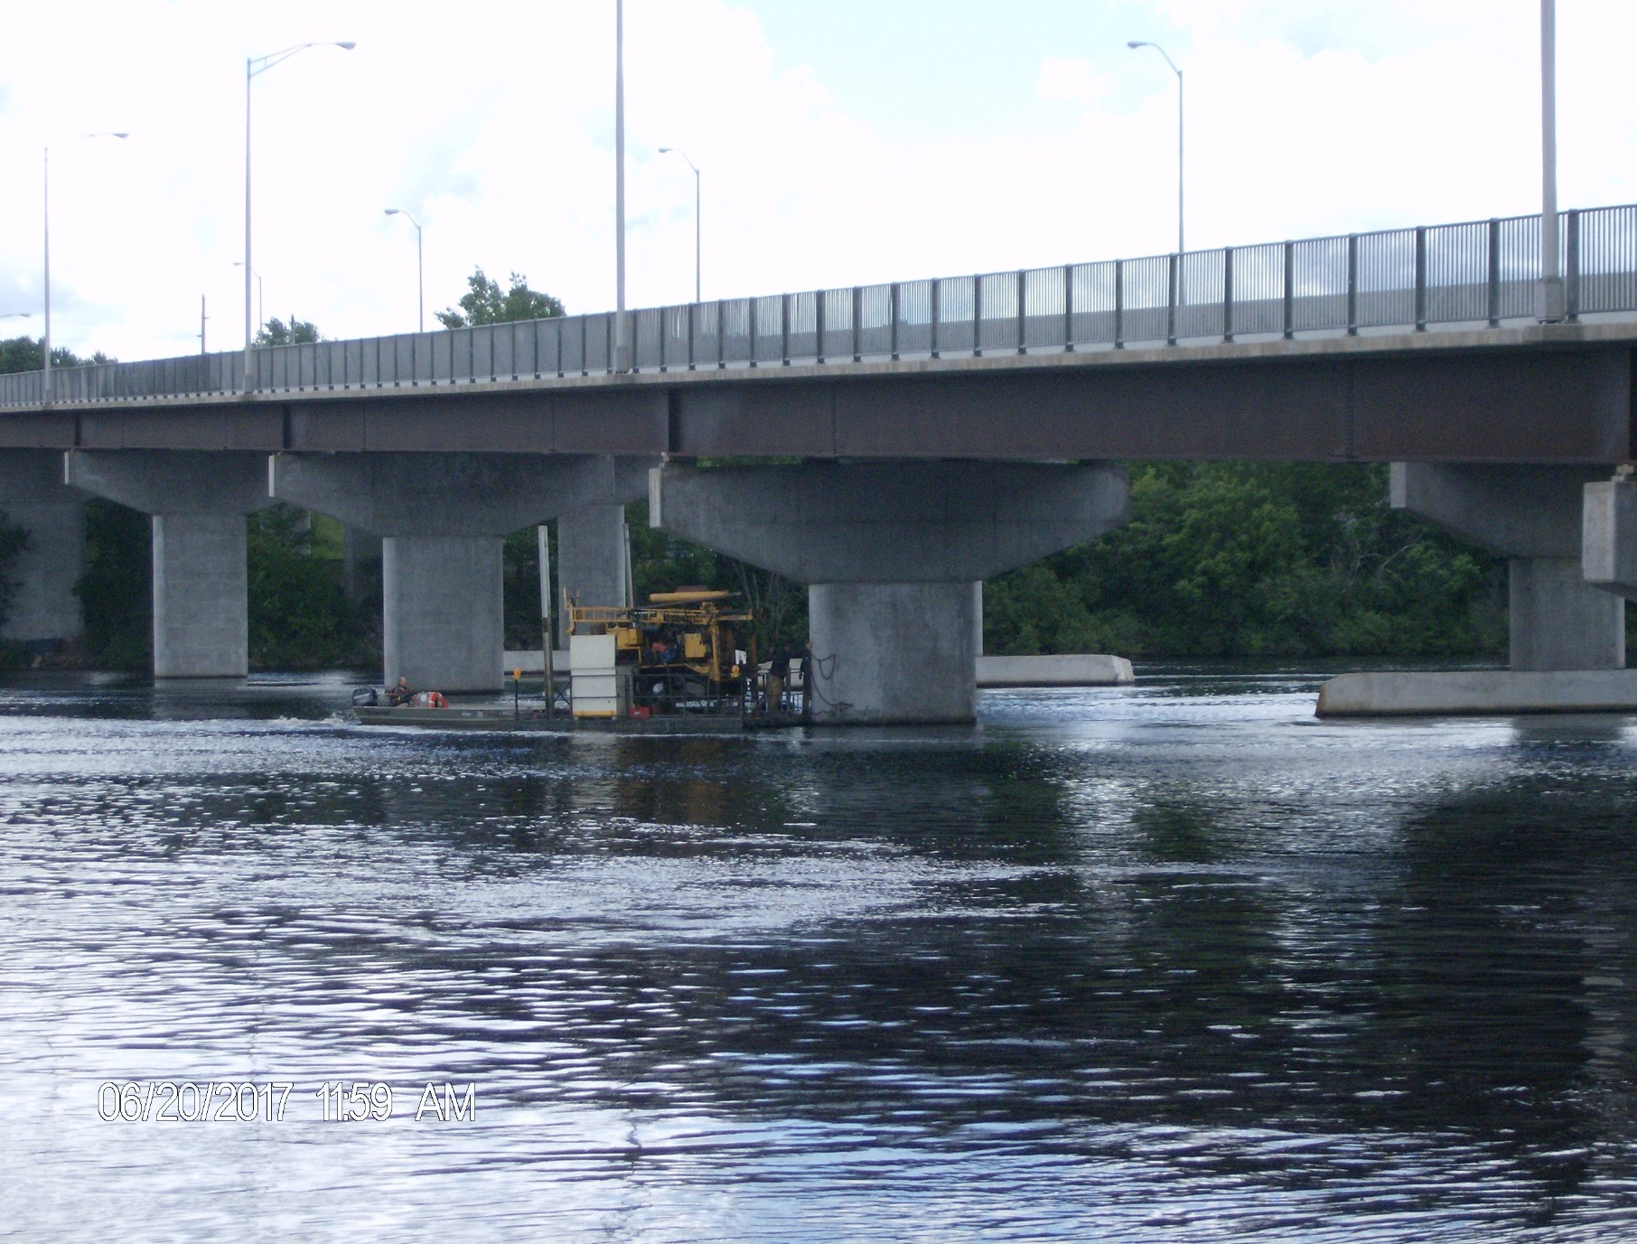
Adjacent Piers

Slide 29
Additional Investigation
Deeper Bedrock Cores – At Piers 3 and 5
Break Rock Cores to Determine Granite Strength – 21,000 psi
Grain Size Analysis of Sand/Gravel at Interface for Potential Pressure Grout Design

Slide 30

What Happened?
Difficulty of Pouring Tremie Footings
  Working in Relatively Deep (15’) Water
  Shallow Bedrock With Little/No Overburden
  Variable Bedrock Surface, Jointing
  Difficult to Get Good Cofferdam Embedment and Footing/Rock/Cofferdam Seal
  Hard to Determine How Clean Rock Surface Is Before Pour
  No Way to See What is Going on During Pour
Bad Combination of Factors
Notes:
Overview of the Unit or Sections place within BTS, Employees

Slide 31
Conclusions
Surmise Sand and Gravel Was Present When Footing Was Poured
  Does Not Appear to be Concrete Sand/Gravel
  Could Not Have Been Result of Scour, if Footing Was Originally on Rock
Poor Concrete is Confined and Provides Adequate Strength to Transfer Load
Enough of Footing Is on Competent Rock/Confined Sand & Gravel to Preclude Past Bearing Issues and/or Movement

Slide 32

Questions/Decisions
Is Remediation Needed?
Extent of Remediation?
What Footings Need Remediation?
Same Treatment for All Piers?
Decisions
  Conservative Approach Desired
  Piers 3 & 5 (Bad Concrete) – New Foundation Support
  Piers 1, 2, & 4 – Scour Protection (Grout Bags) and Pressure Grout Under Footings

Slide 33
Factors Affecting New Foundation
Desire to Get Done in 2017 – Bridge Currently Closed
Need to Minimize Timeframe to Complete Adjacent Bridge Deck Work
Use Existing Contract/Contractor If Possible
Overhead Clearance Issues
Proximity of Adjacent Bridge
Presence of Previous Remediation Grout Bags
Corrosion Concerns Near Water Surface

Slide 34
Factors – Cont’d
Little Overburden Over Bedrock
Working in 15’ of Water
Unknowns/Variability of Existing Footings and Interface Conditions
Possible Need to Penetrate Thick Existing Footings
Location of New Footings - Unsupported Pile Length, Aesthetics, Boat Safety

Slide 35

Repair Alternatives Considered
Micropiles Through Existing Footings
Drilled Shafts Outside Existing Footing
Open-ended Pipe Piles Outside Existing Footing (Contractor Idea)
Conservatively Neglected Any Support From Existing Spread Footing
Build New Footing – What Elevation?
Structurally Tie to Existing Pier Shafts

Slide 36
Preliminary Repair Options
Worked With Existing Project Contractor
Asked Them to Consult With Three Specialty Designers
  Hayward Baker
  Nicholson
  Schnabel
Department Also Spoke to Same Three Specialty Designers/Contractors and FHWA
Initially Micropiles Large Diameter Pipe Piles Micropiles

Slide 37
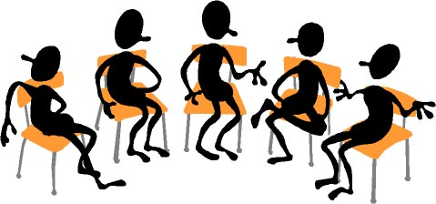
Contractor Design
WisDOT Has Little Micropile Experience
Contractor to Complete Design
Design-Build Approach
Prime – Zenith Technology Inc.
Designer – Engineering Partners (Minneapolis)
Specialty Contractor – Veit (Minneapolis area)
Brennan – Scour Remediation

Slide 38
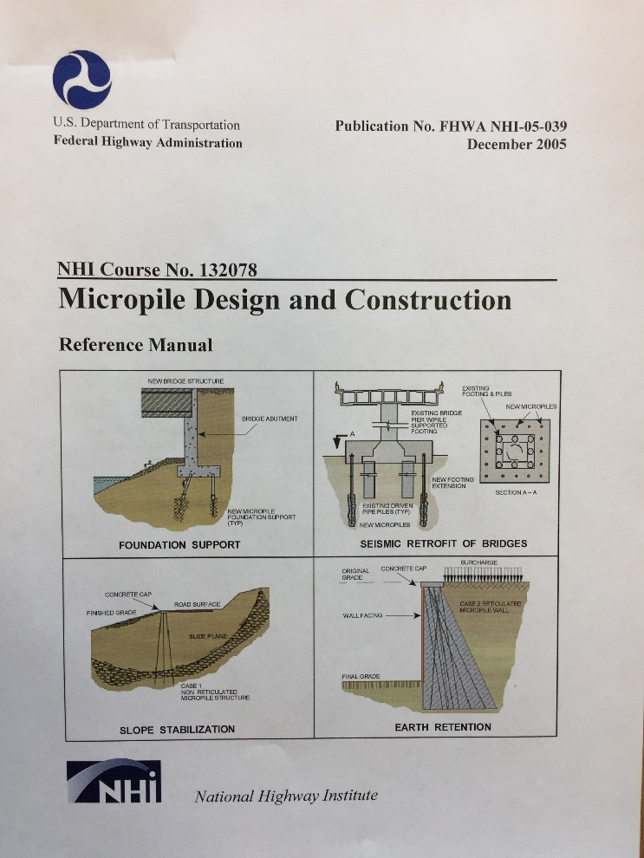
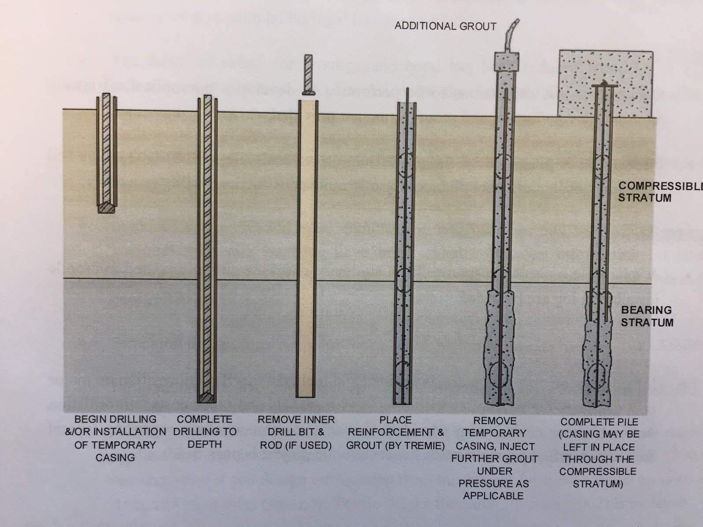
Micropile Manual and Installation

Slide 39
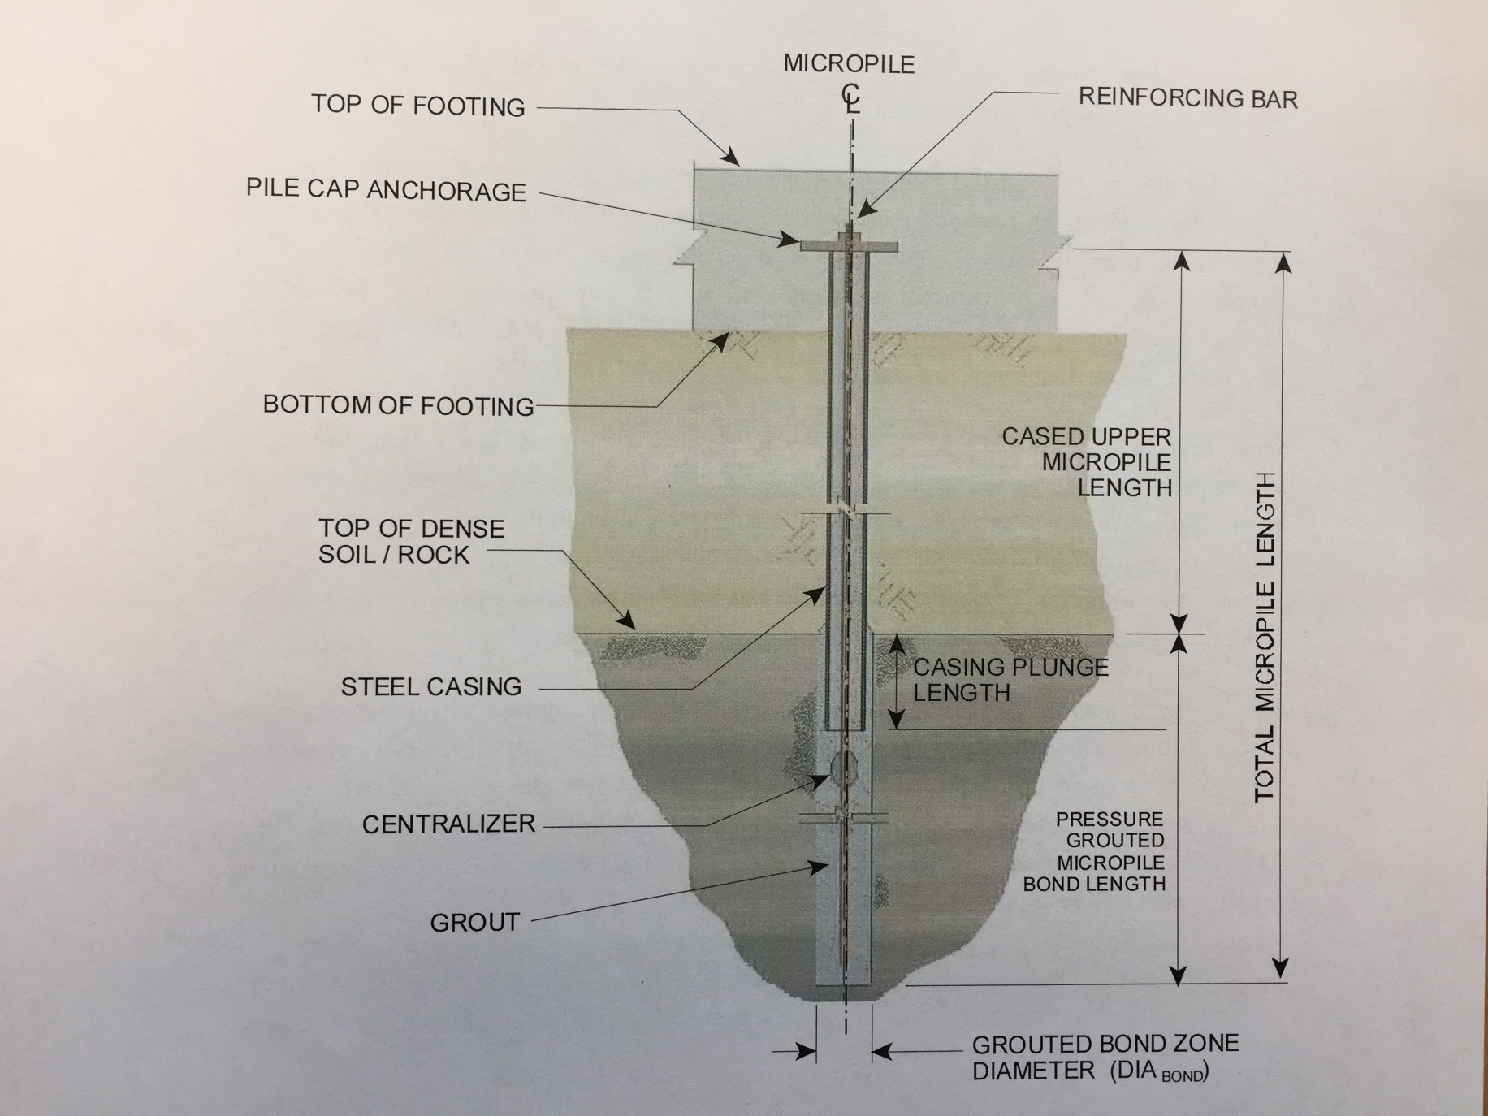
Micropile Schematic

Slide 40

Final Repair Design – Piers 3 & 5
Discount Any Strength/Resistance of Existing Footing
14 Micropiles Through Each Existing Footing
Pressure Grout Within Existing Footings as Necessary – While Drilling Micropiles
Build New Footing - 21’ x 10’ x 4.5’ Thick

Slide 41
Repair Design – Piers 3 & 5
New Footing Base Located 1’ Below Existing Waterline – Avoid Ice Concerns
Tie New Footing to Existing Pier Shaft
Widen Existing Pier Shaft, Extend Up to Hammerhead
24” Casing From Top of Existing Footing To Bottom of New Footing (Reinforced)

Slide 42
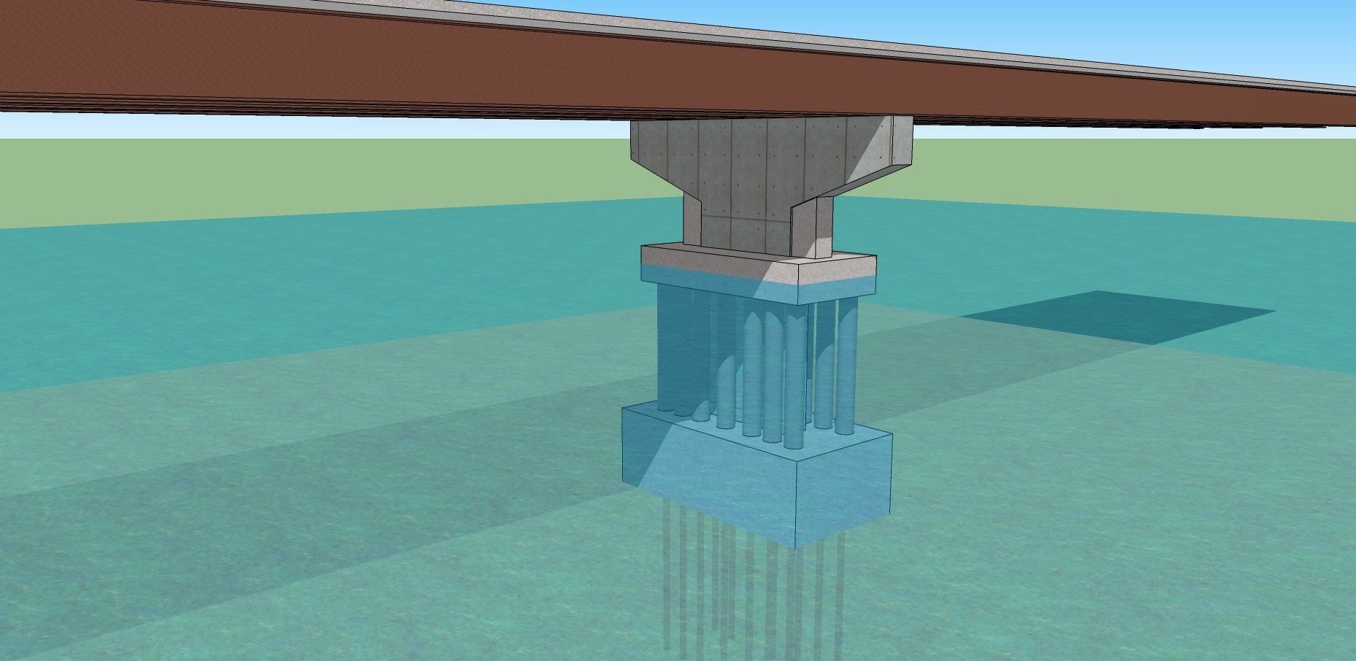
Schematic of Micropile Design
Piers 3 and 5

Slide 43
Design Process/Assumptions
WisDOT Structures Provides Design Loads
Existing Concrete Footings Provide Adequate Lateral Resistance to Buckling
Secondary 24” Outer Casing is Reinforced, and Provides:
  Lateral Stability
  Corrosion Protection
  Aesthetics

Slide 44
Design Assumptions – Cont’d.
Micropile Design
  Use 9.625” OD x 0.545” Wall Diameter Micropiles
  Capacity Only Based on Friction With Bedrock (10’)
  Neglect End Bearing Resistance
  Grout-to-Bedrock Bond 300 psi Nominal Resistance
  Grout-to-Bedrock Bond Resistance Factor of 0.55.
  Micropile Structural Capacity Based on Steel Casing and Center Reinforcing Bar (2.25” Diameter Bar)
  4000 psi Grout in Micropile
  Factored Axial Compression of 575 kips, Tension of 180 kips/micropile

Slide 45
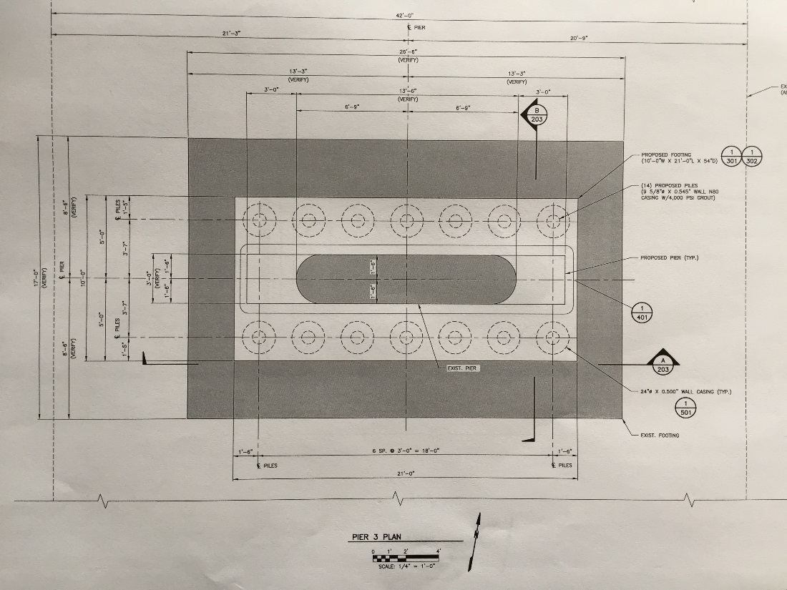
Plan View of Footing
Deeper Bedrock
Break Rock

Slide 46
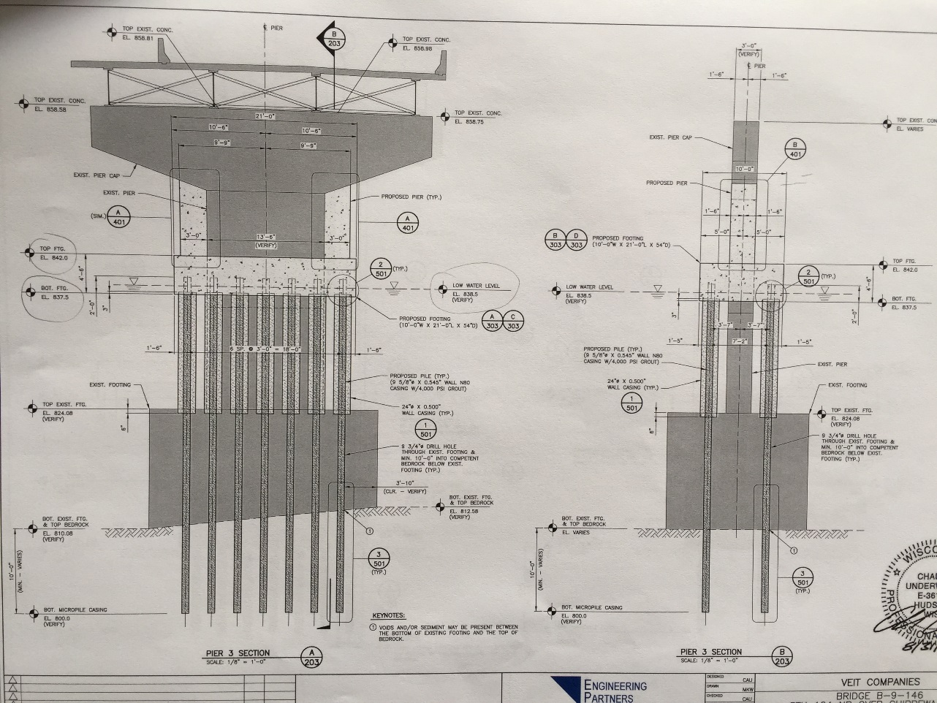
Pier Elevation Plans

Slide 47
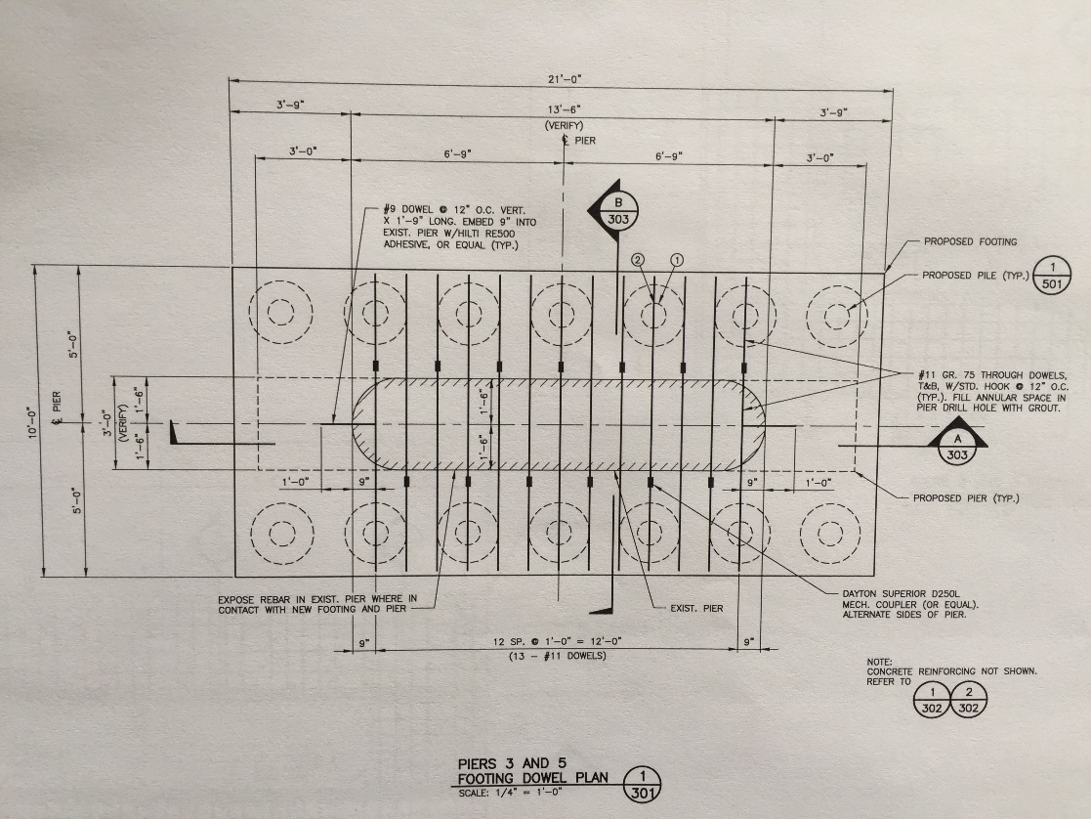
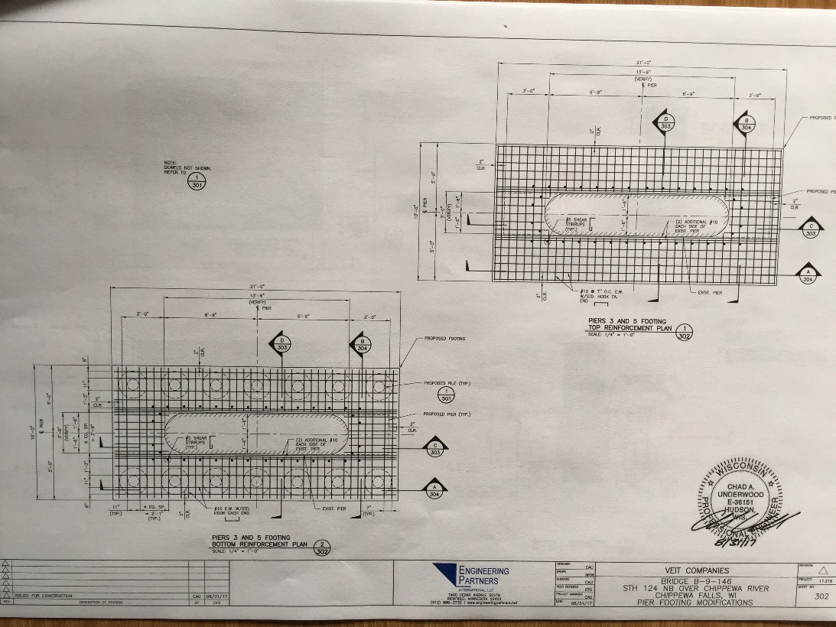
Footing/Connection Details
Deeper Bedrock
Break Rock

Slide 48
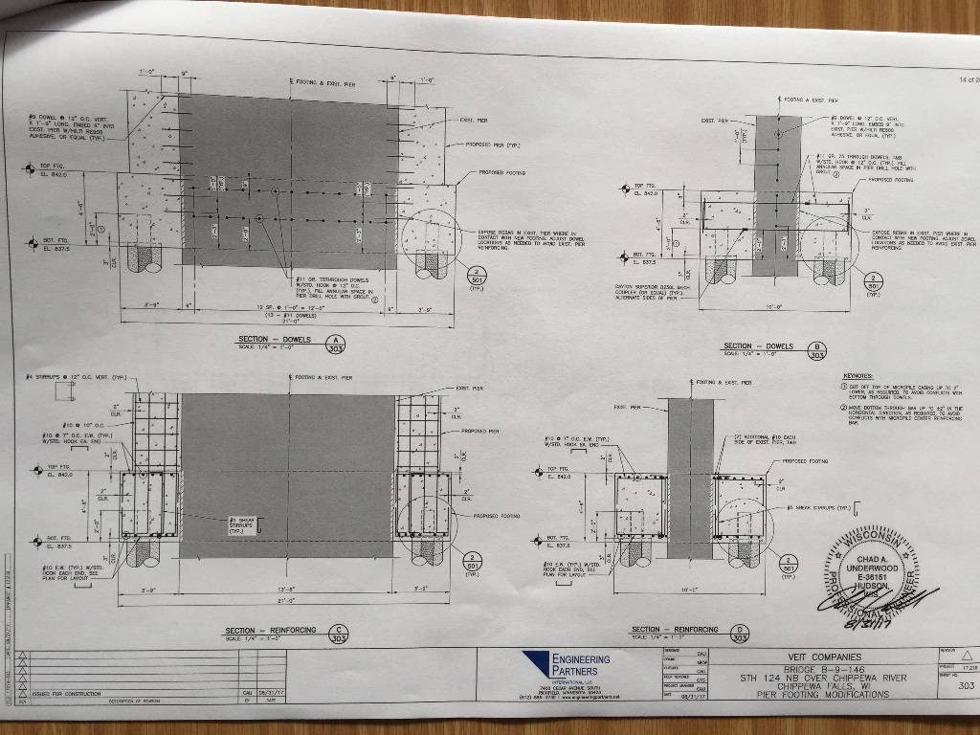
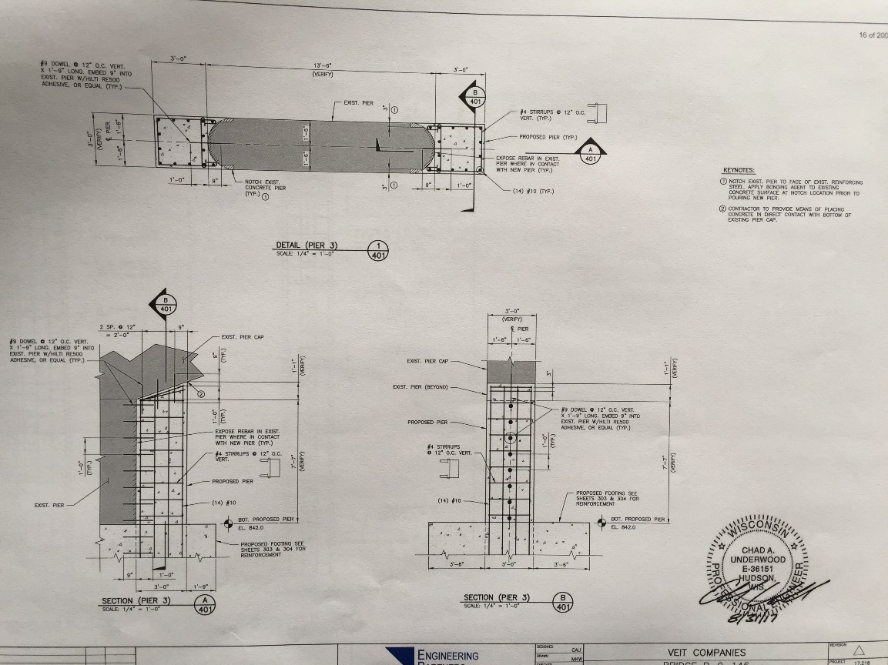
Pier Connection Details
Deeper Bedrock
Break Rock

Slide 49
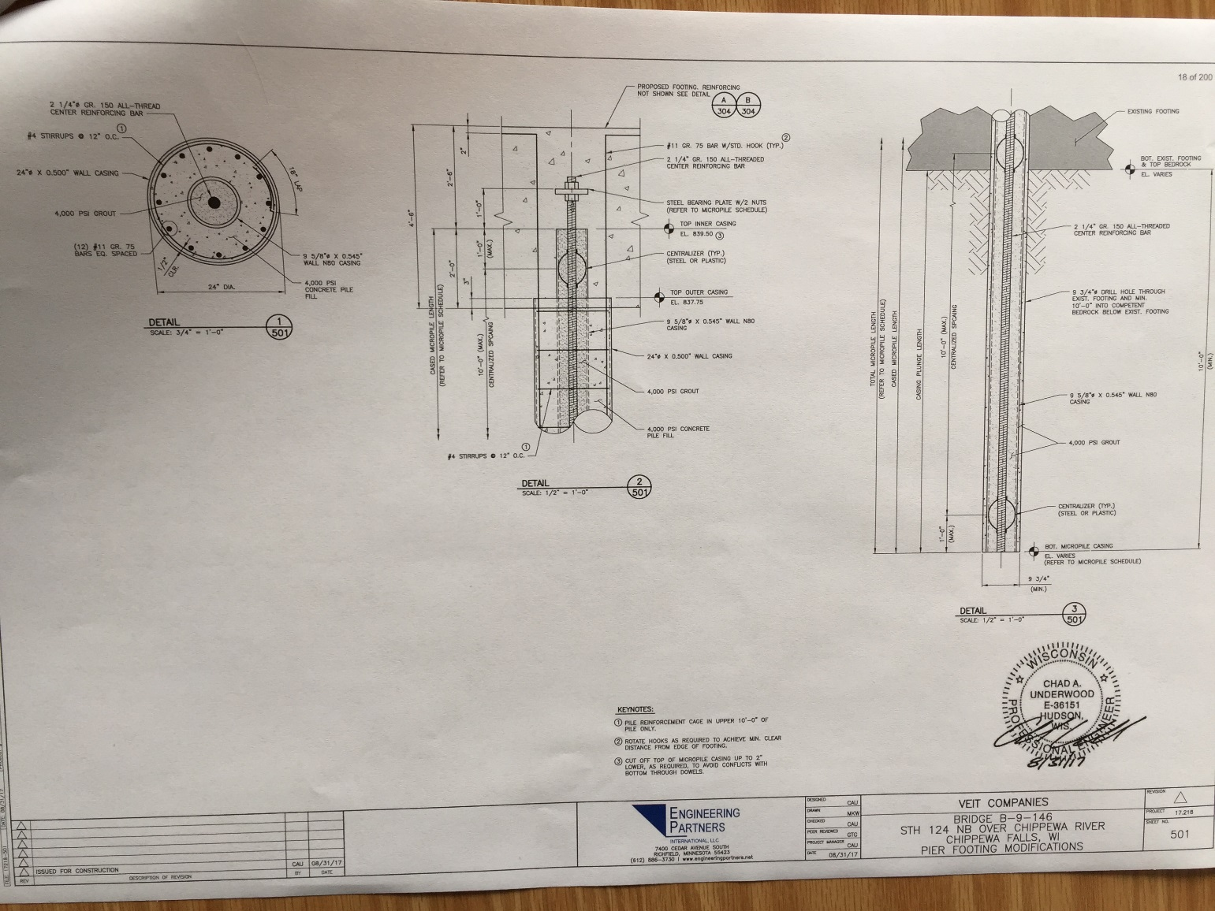
Micropile Plans

Slide 50


Current Status
Final Design – Essentially Done
Construction Next 2-3 Months
Specifications, Inspection Needs, Load Tests?
Potential Construction Issues – TBD
Open Both Bridges Over Winter, Complete Adjacent Bridge Work Next Spring
Early Cost Estimates for 2 Piers - $1.3M
No Final Plans or Costs Developed for Remediation at Other Three Piers Yet

Slide 51


Questions
Spread Footing Tremie Pours Can Be Difficult and Deceiving

