Slide 1
Structures
Box Culverts
Bridges
Walls

Slide 2
Box Culverts, Bridges and Walls
DESIGN
The Structure Survey Report
Foundation Investigation and Report
CONSTRUCTION
Box Culvert Foundation and Backfill
Bridge Foundation Support: Pile and Spread Footings
Bridge Approaches
Retaining Wall Types and What to Look For

Slide 3
The Structure Survey Report
What Information is Important to You
What to Look For

Slide 4
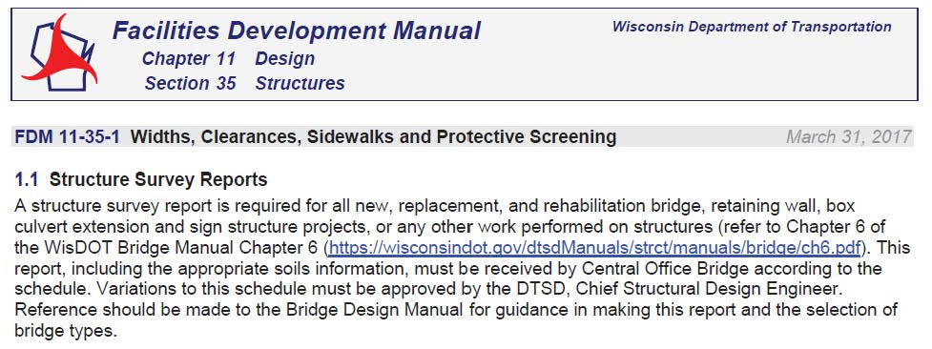
Facilities Development Manual 11-35-1

Slide 5
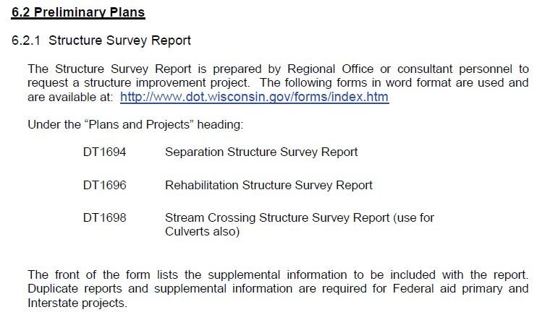
Bridge Manual 6-2

Slide 6
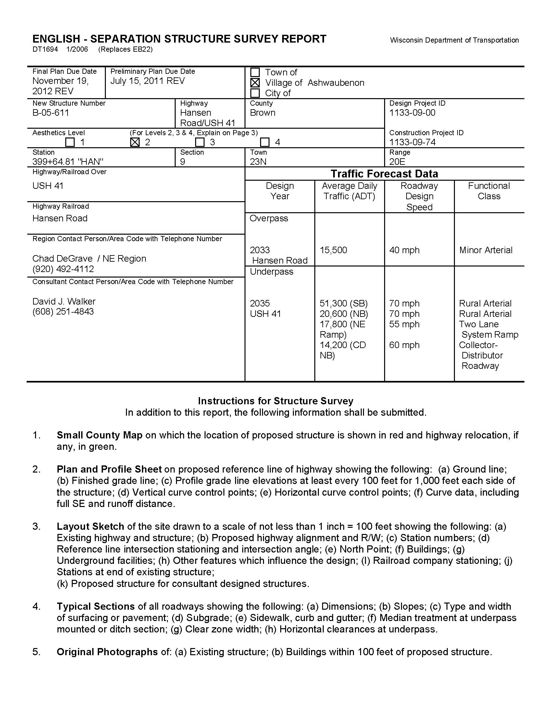

Slide 7
Foundation Investigations
Geotechnical Manual
2. Soil Borings
3. Unusual Circumstances

Slide 8
Geotechnical Manual
https://wisconsindot.gov/Pages/doing-bus/eng-consultants/cnslt-rsrces/default.aspx

Slide 9
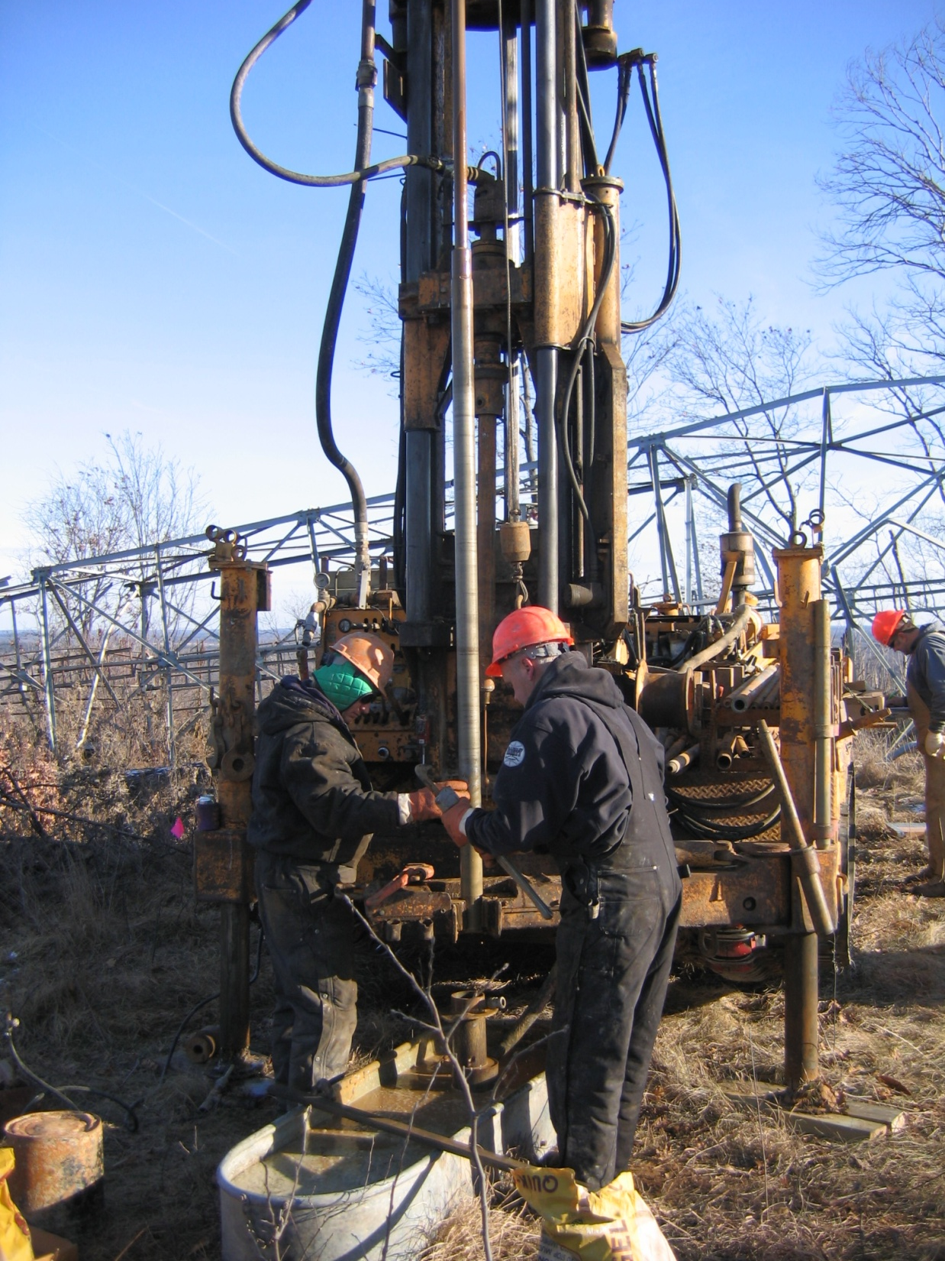
WisDOT Drill Crew

Slide 10
The Site Investigation Report (SIR)
Sometimes Called the Geotechnical Report or the Foundation Report
What Information is Important to You
What to Look For

Slide 11
Construction
Construction and Materials Manual
2. Standard Specifications
Plans
4. Site Investigation Report

Slide 12
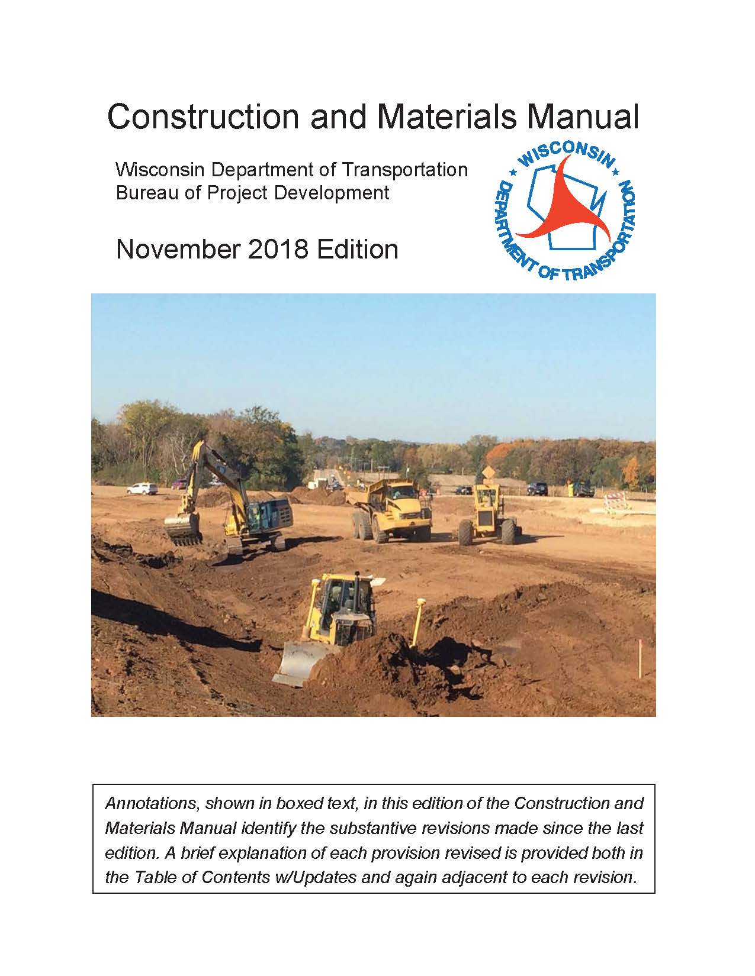

Slide 13
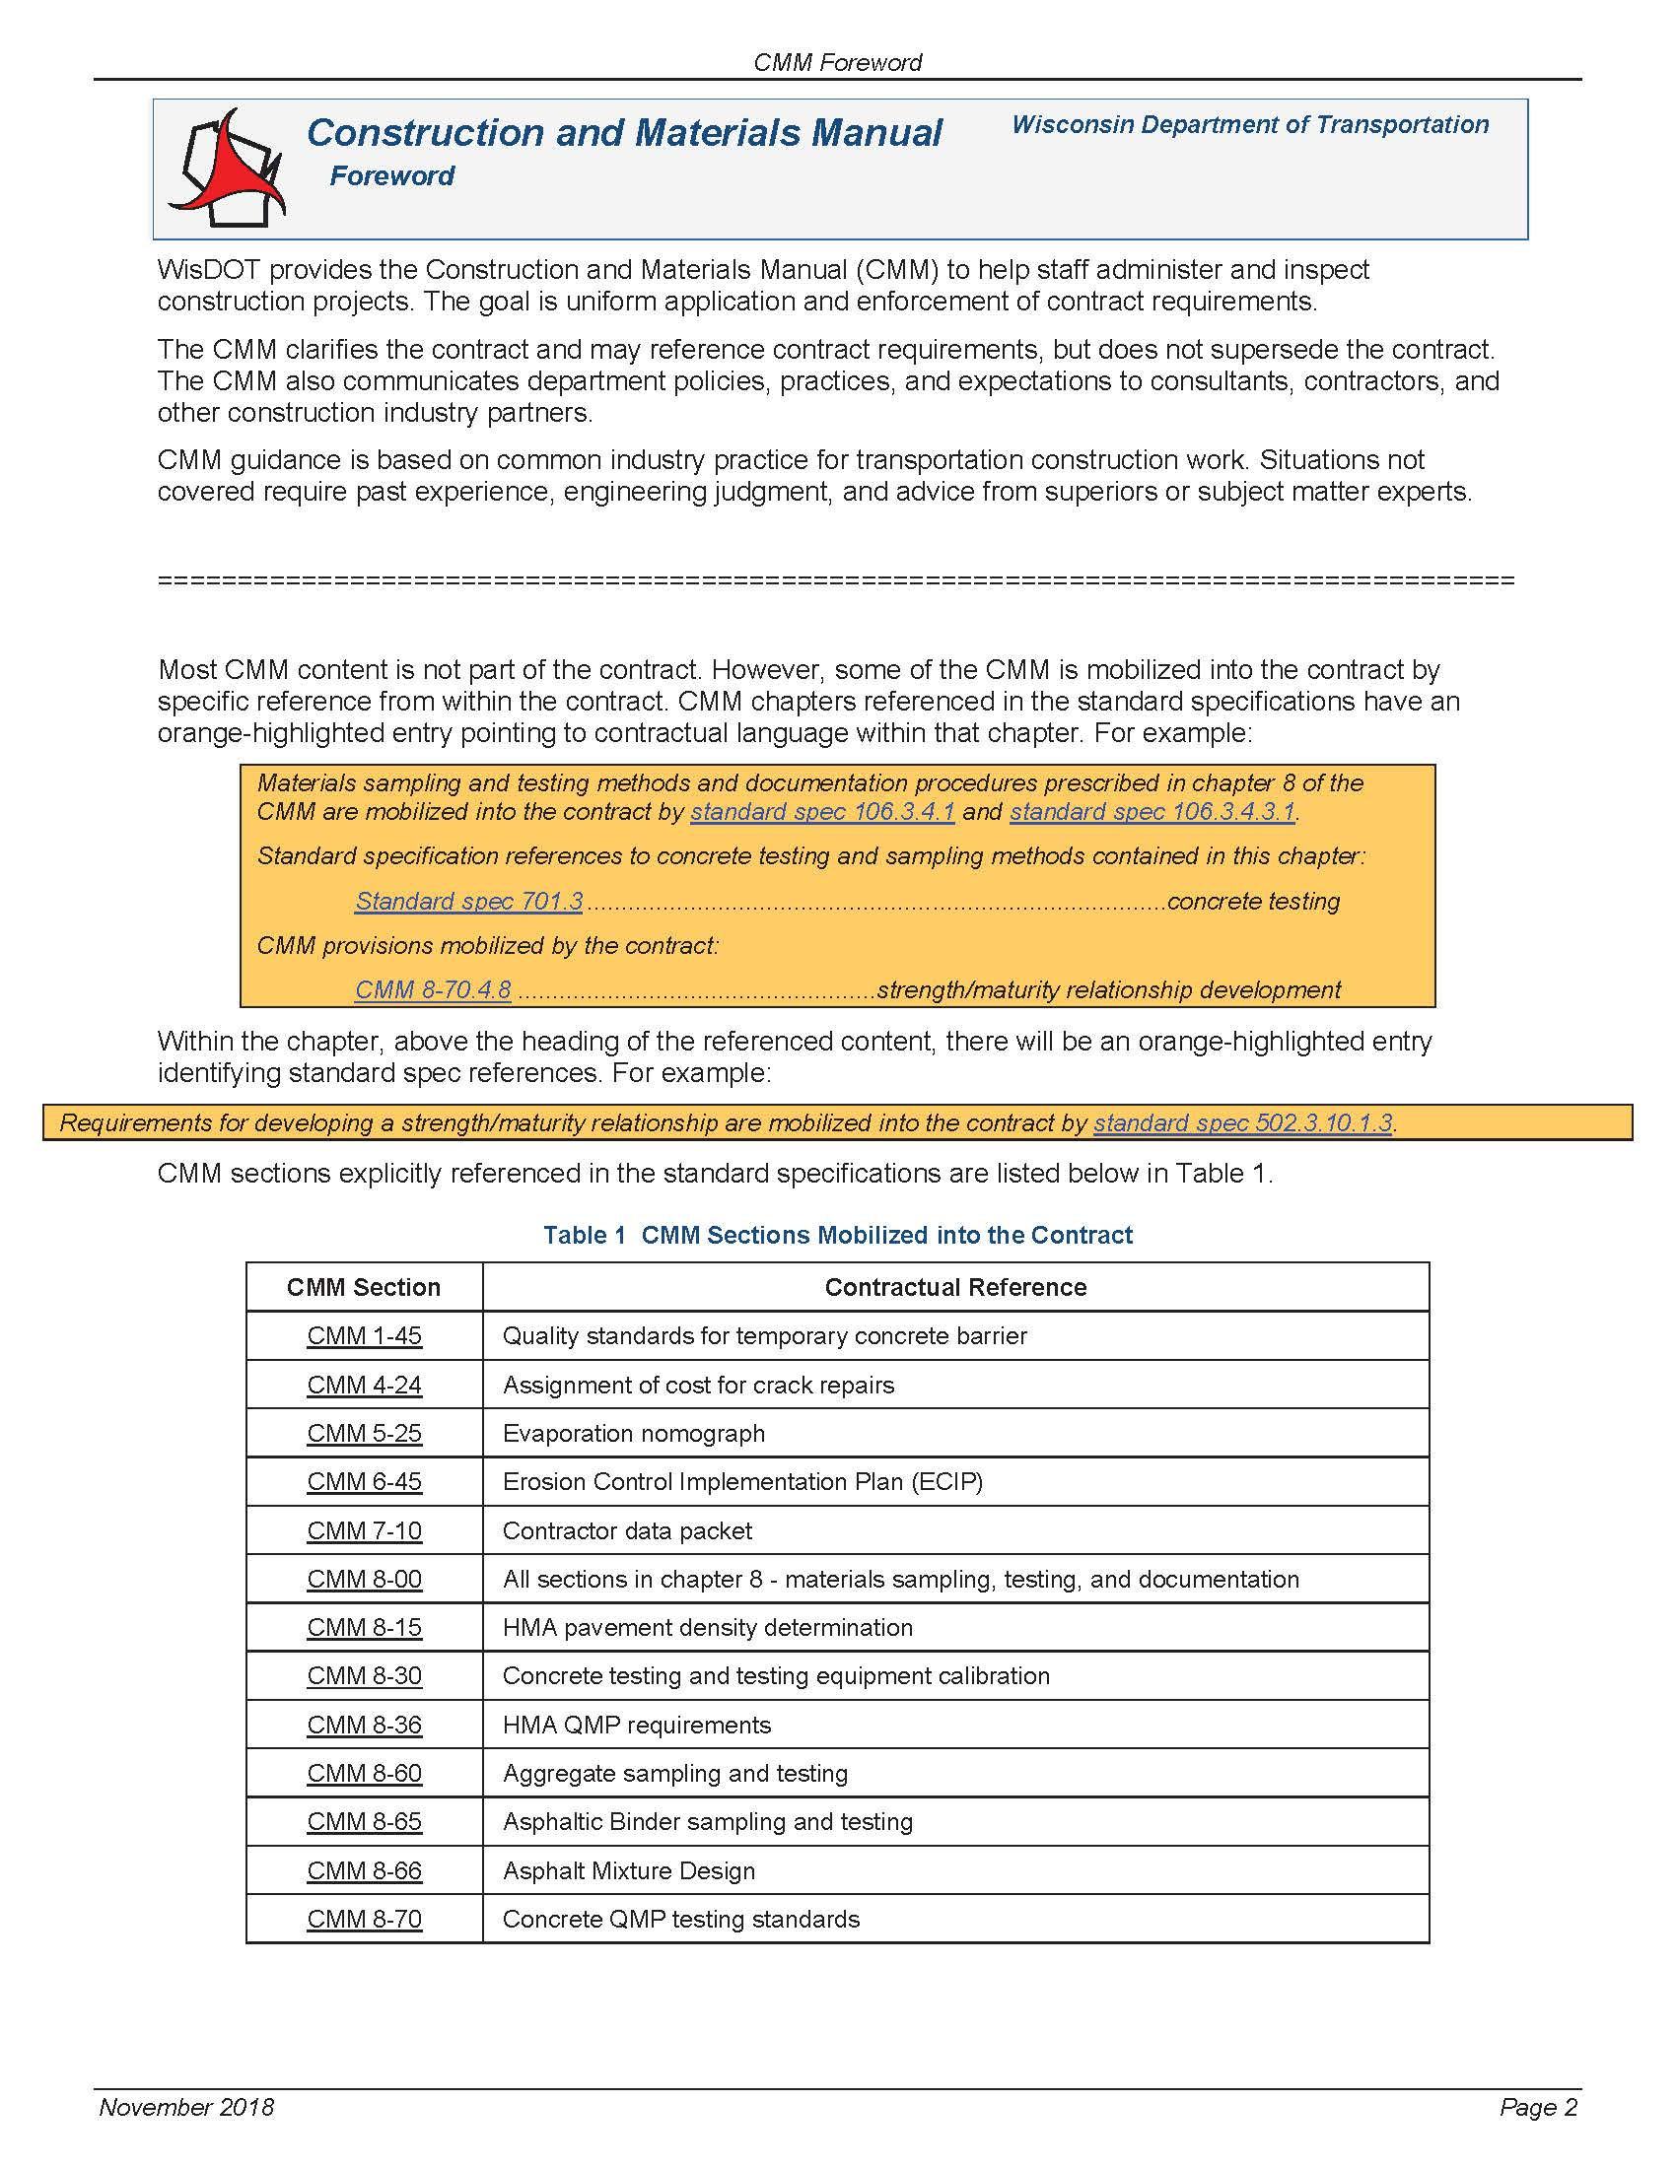

Slide 14
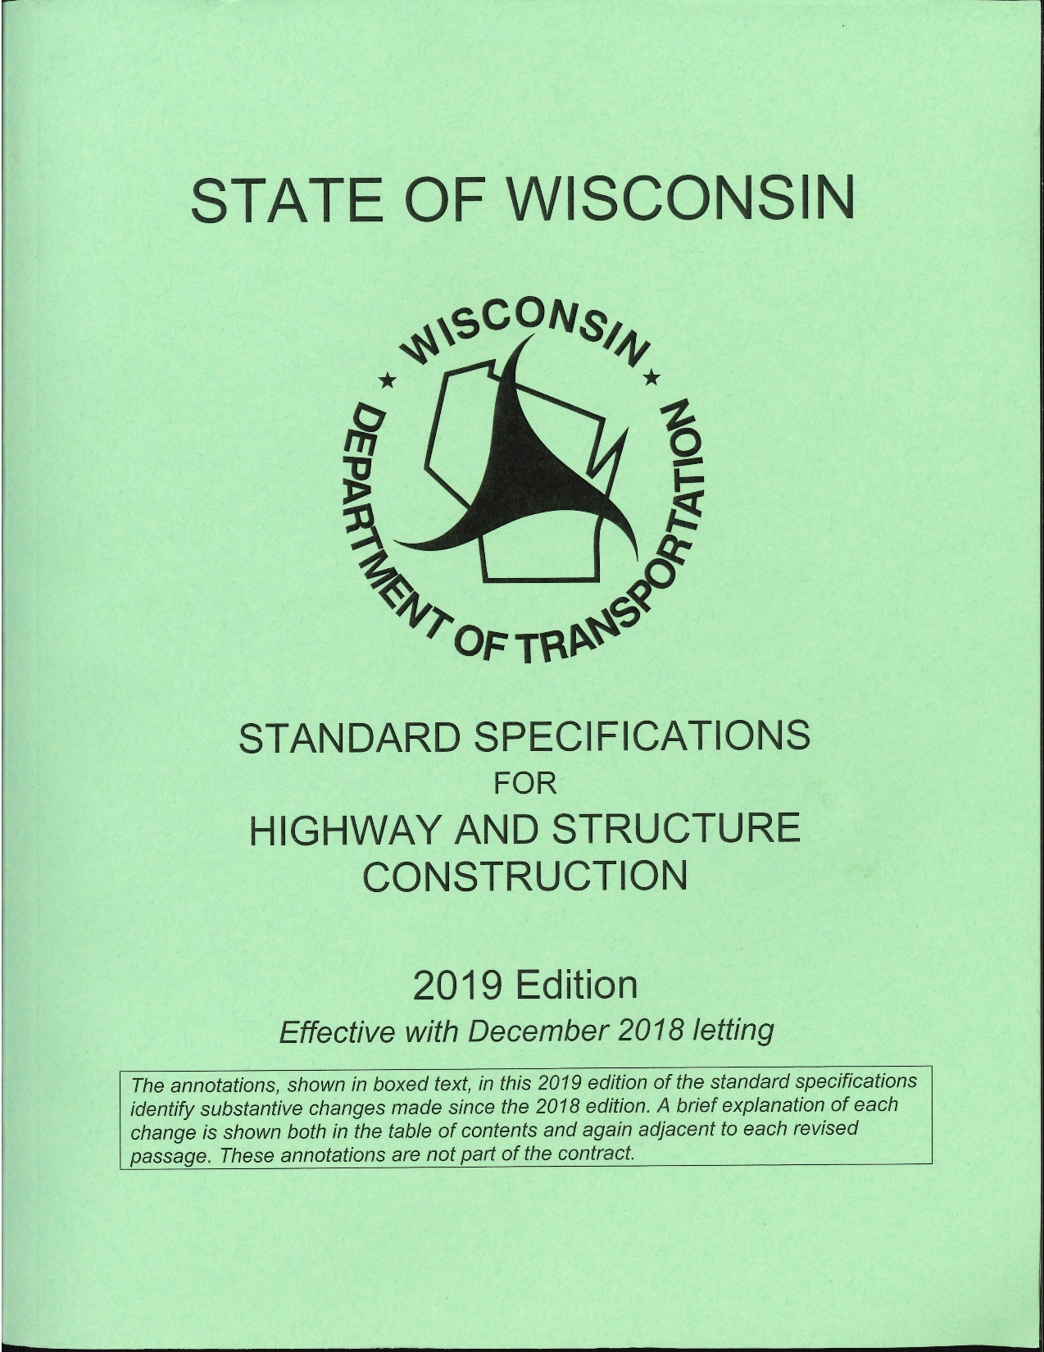

Slide 15
Box Culverts Foundation & Backfill
Plans and Specification
Inspection of the Foundation
3. Placing on Bedrock, Crushed Rock or Gravel
4. Backfill Material
5. Backfill Compaction
6. Backfilling the Top of the Culvert

Slide 16
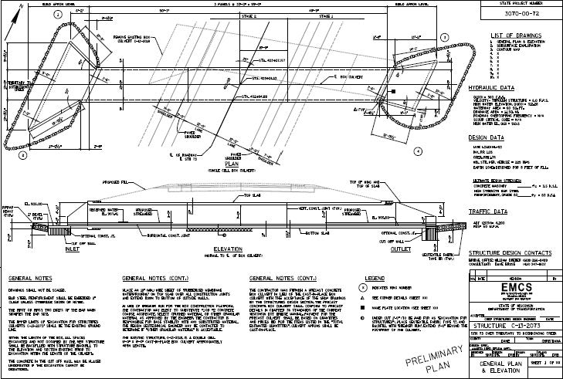

Slide 17
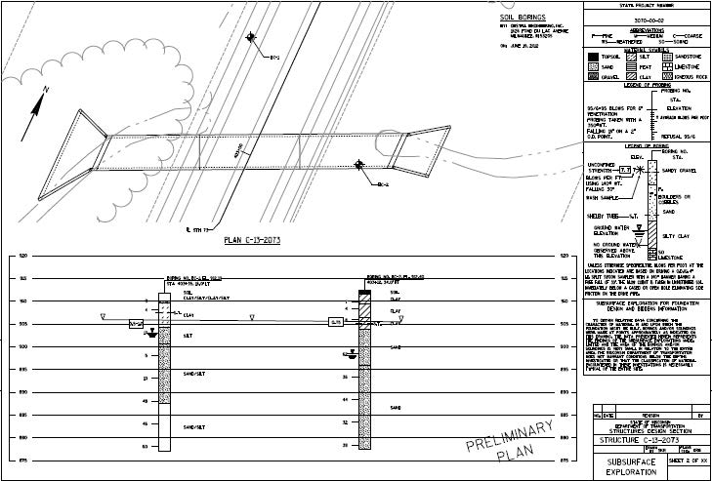

Slide 18
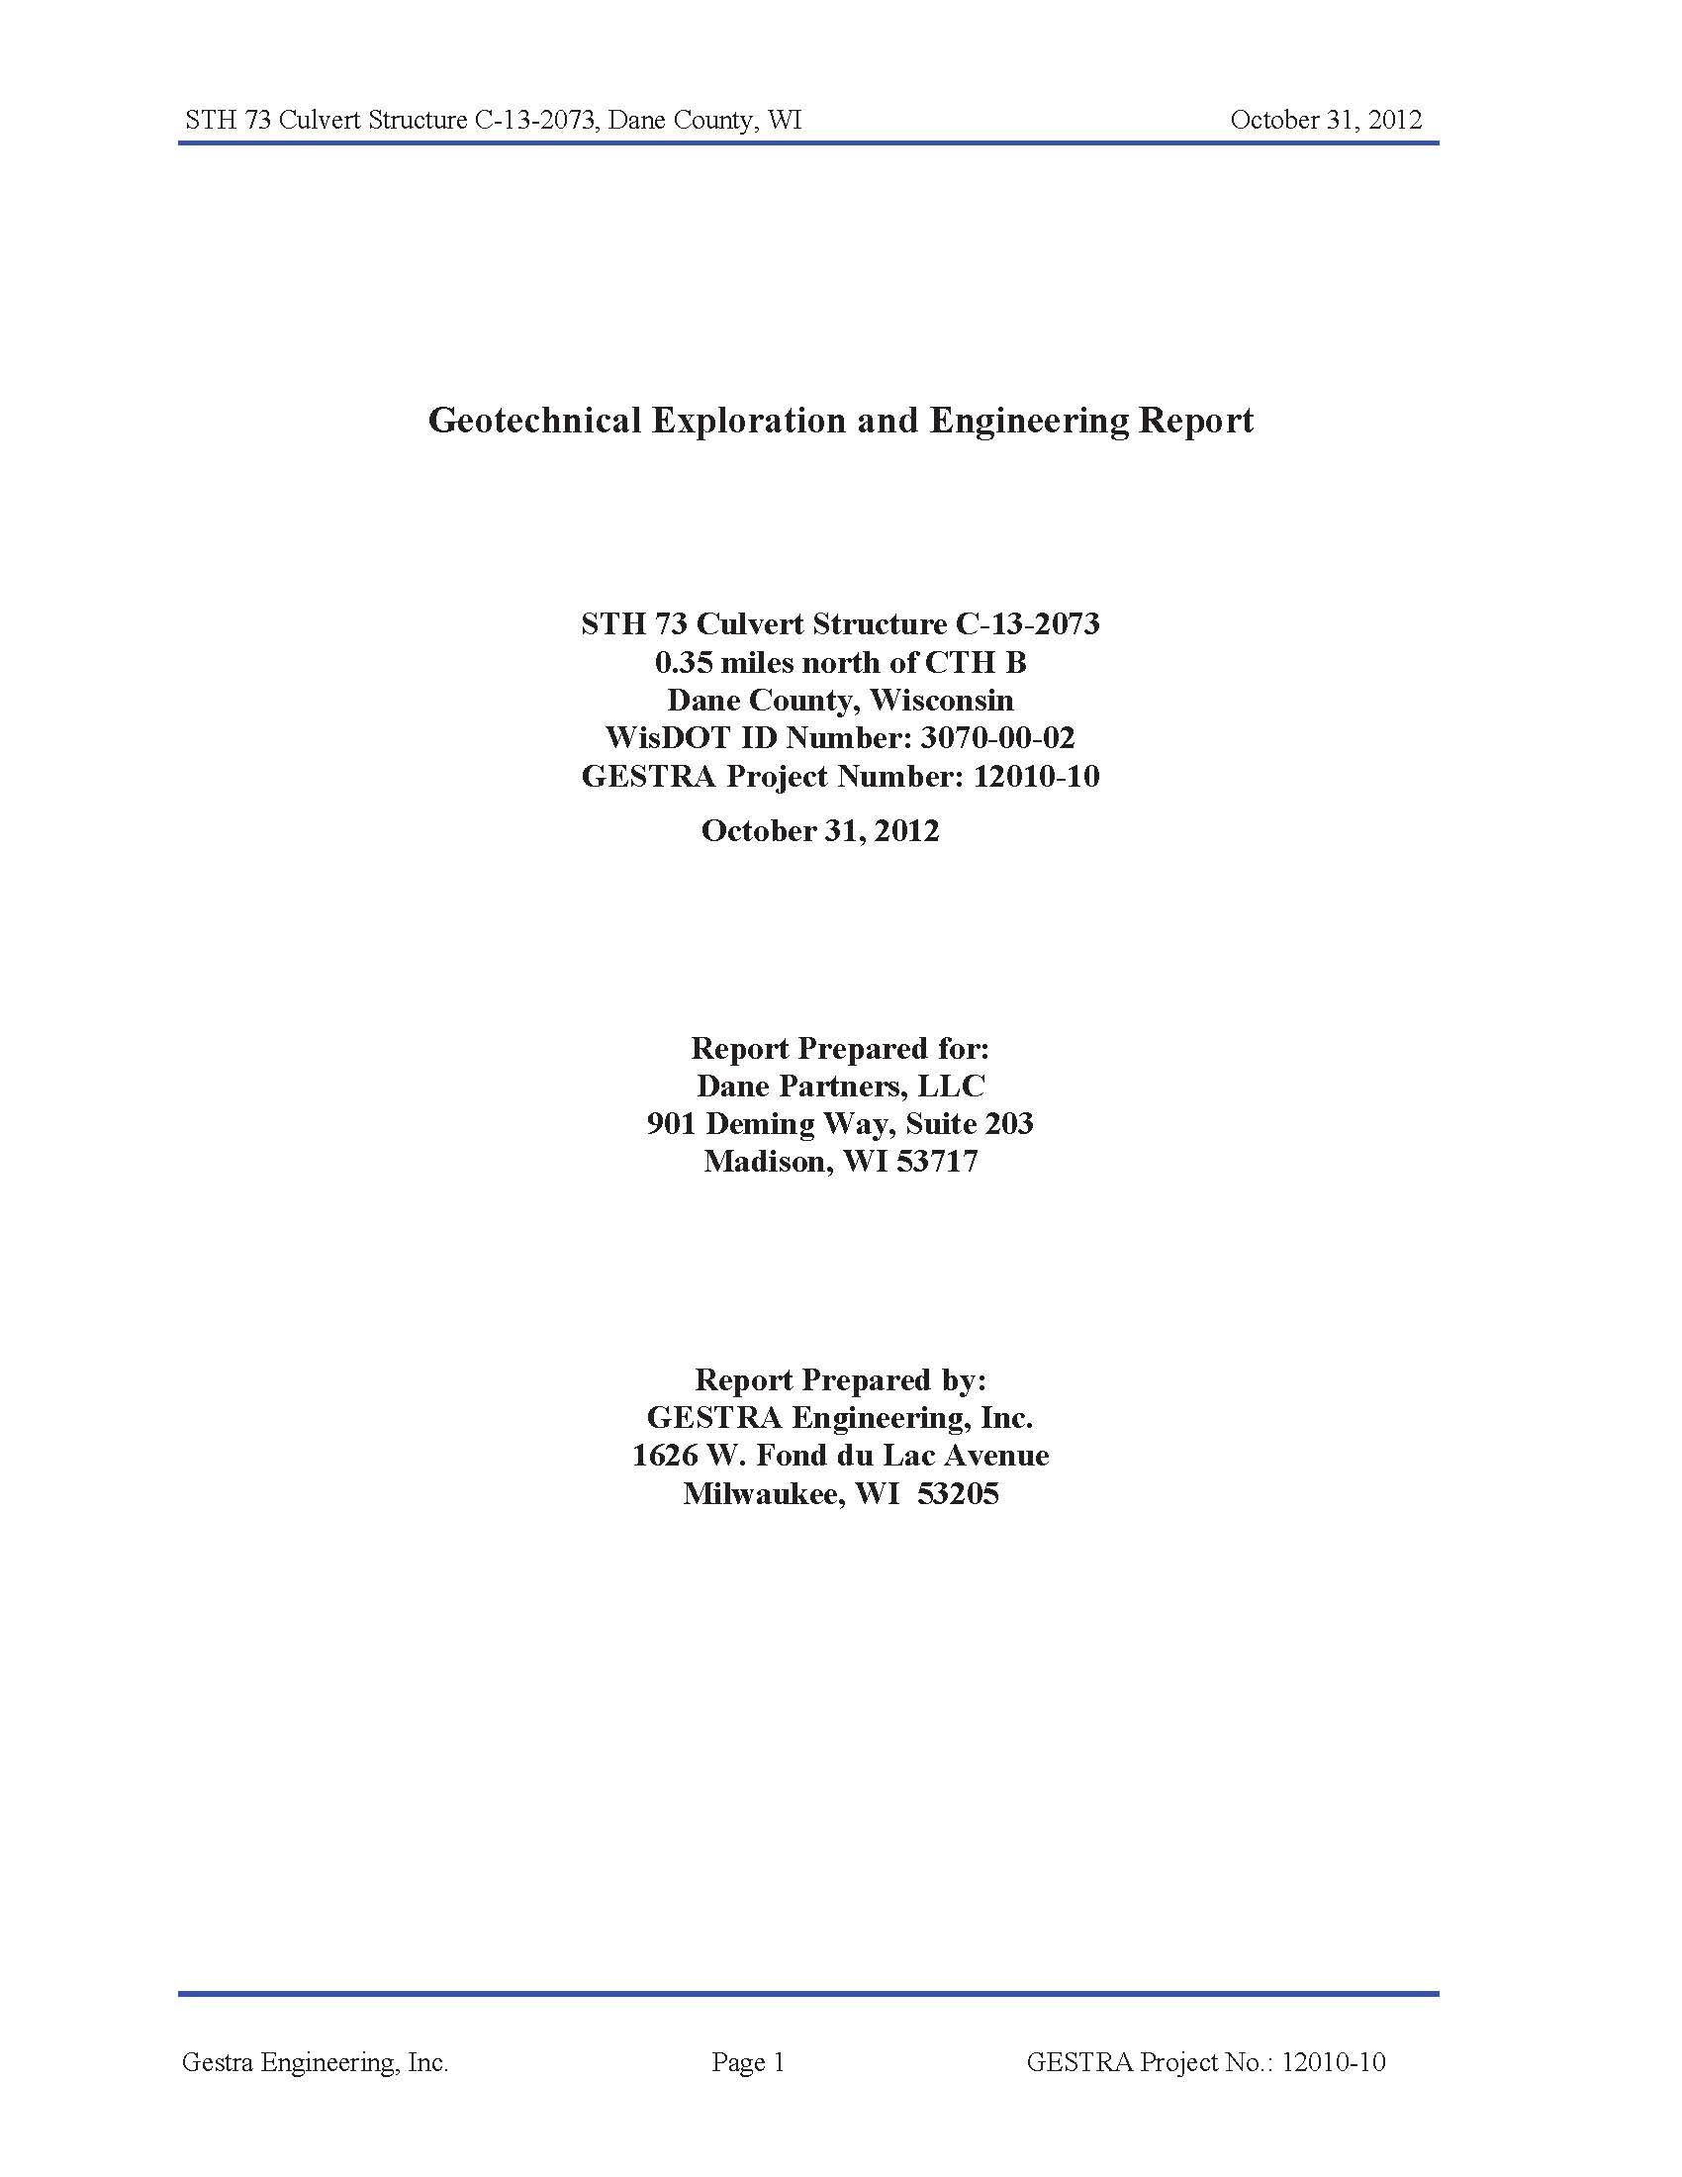

Slide 19
Geotechnical Report - Recommendation

Slide 23
Bridges
Deep Foundations (Piles and Drilled Shafts)
Shallow Foundations (Spread Footings)

Slide 24
Piles
Types of Piles and What They Do
Steel H-Piles
Cast-In-Place Concrete (CIP)
Other
Design Pile Length
3. I Can’t Get Bearing or Damage Pile

Slide 25
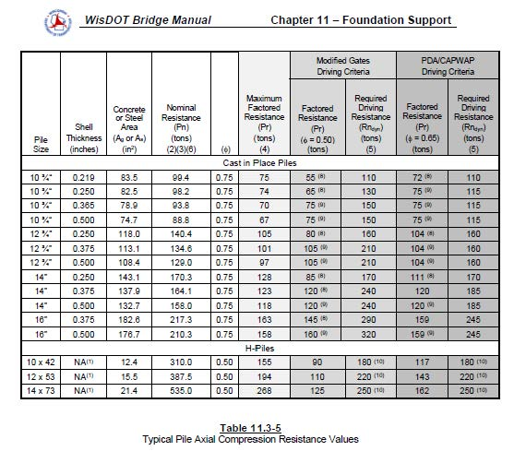

Slide 26
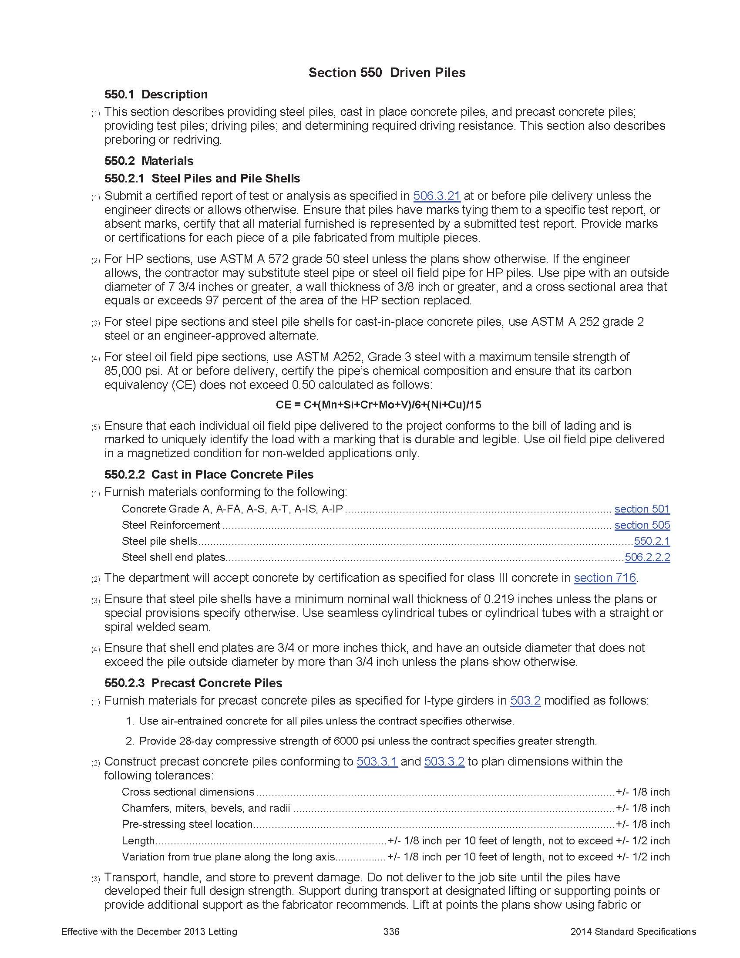

Slide 27
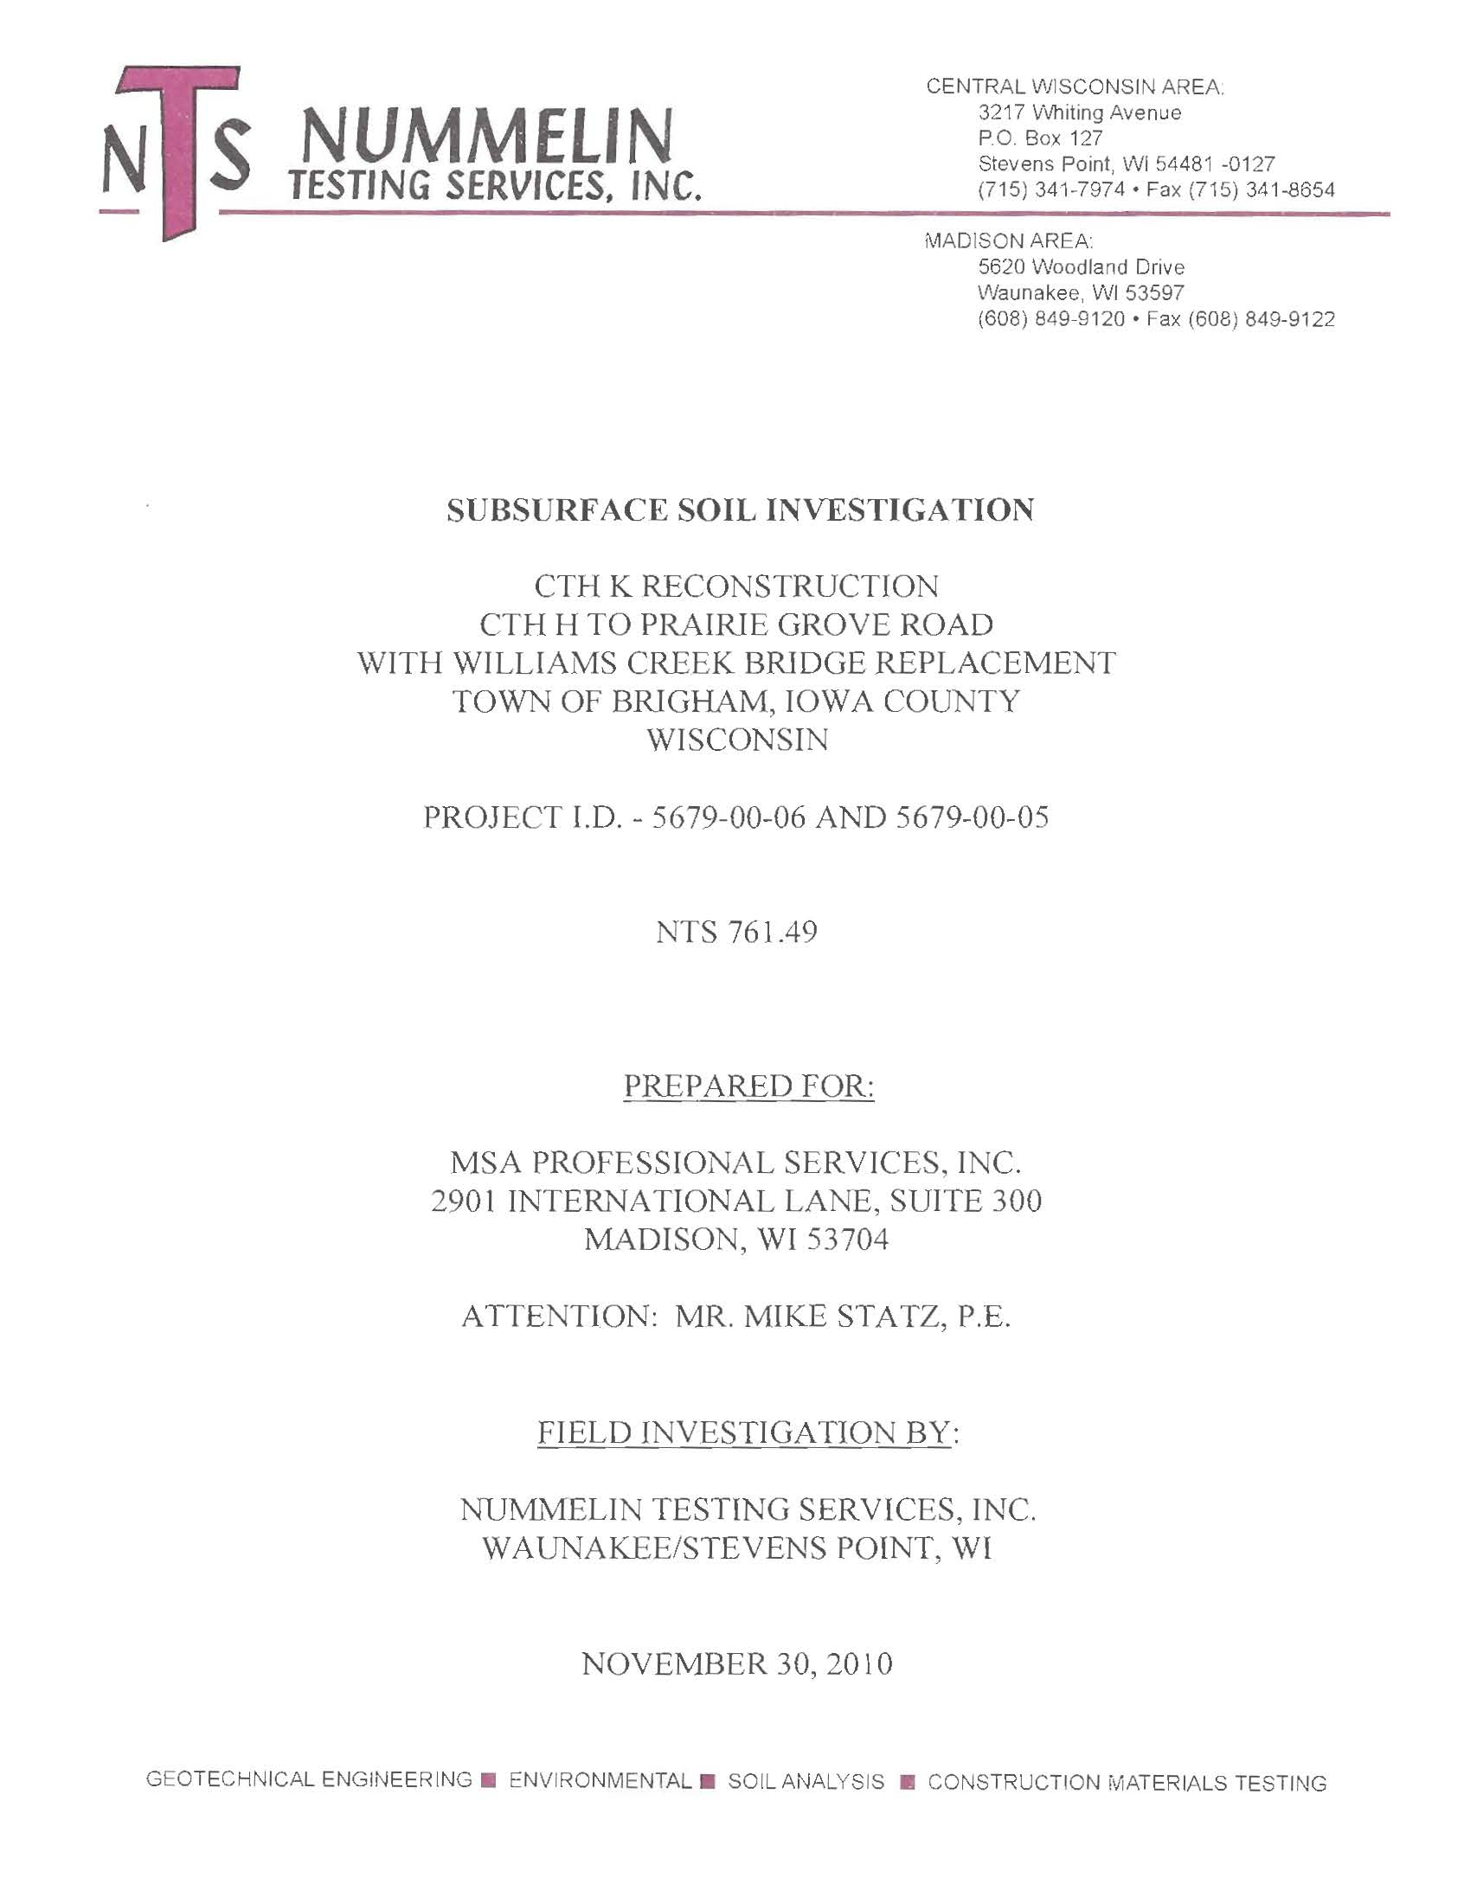

Slide 28
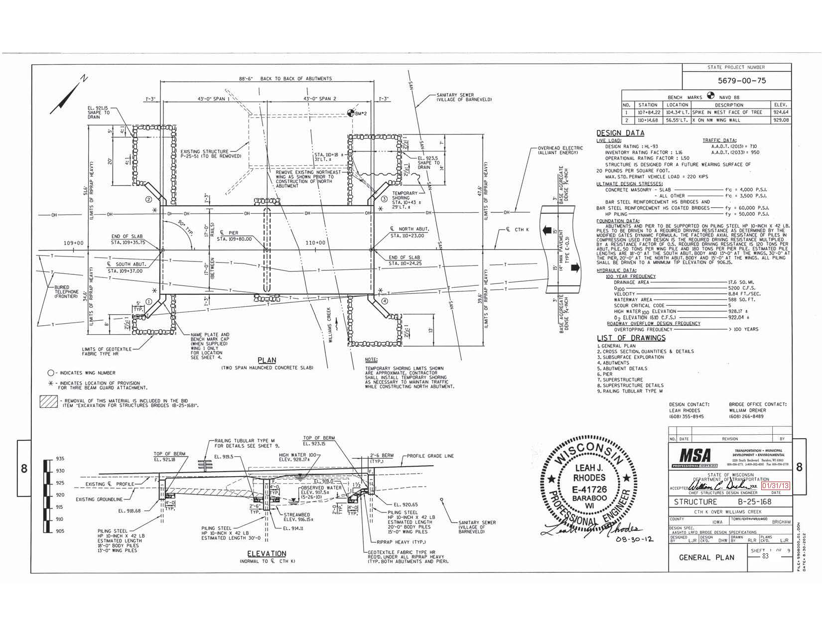

Slide 30
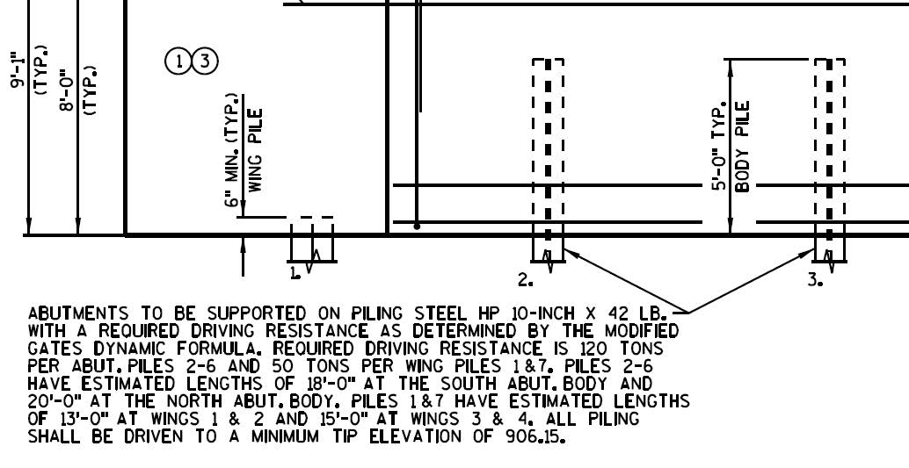

Slide 31
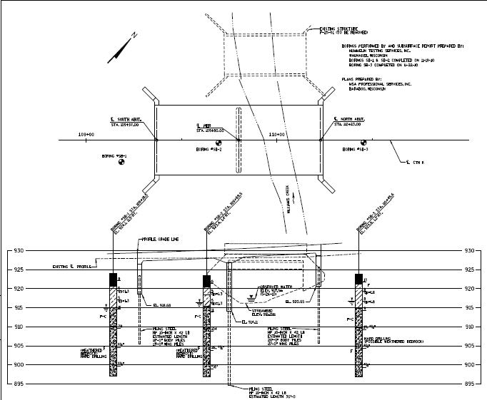

Slide 32
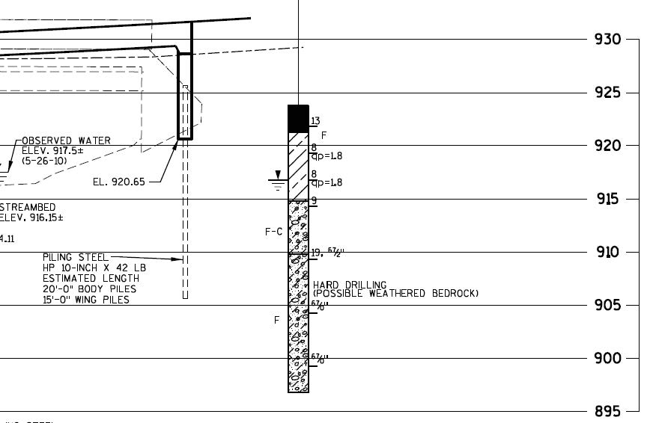

Slide 33
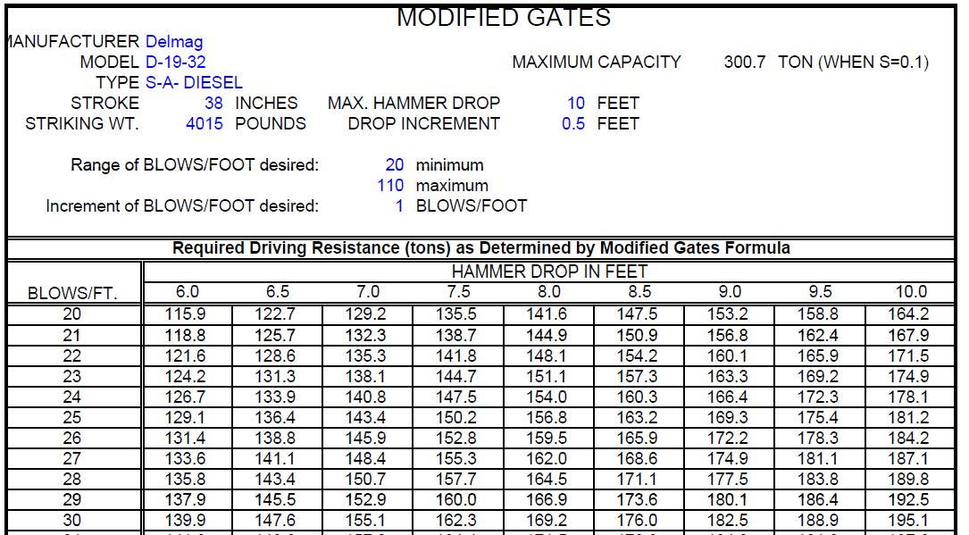

Slide 34
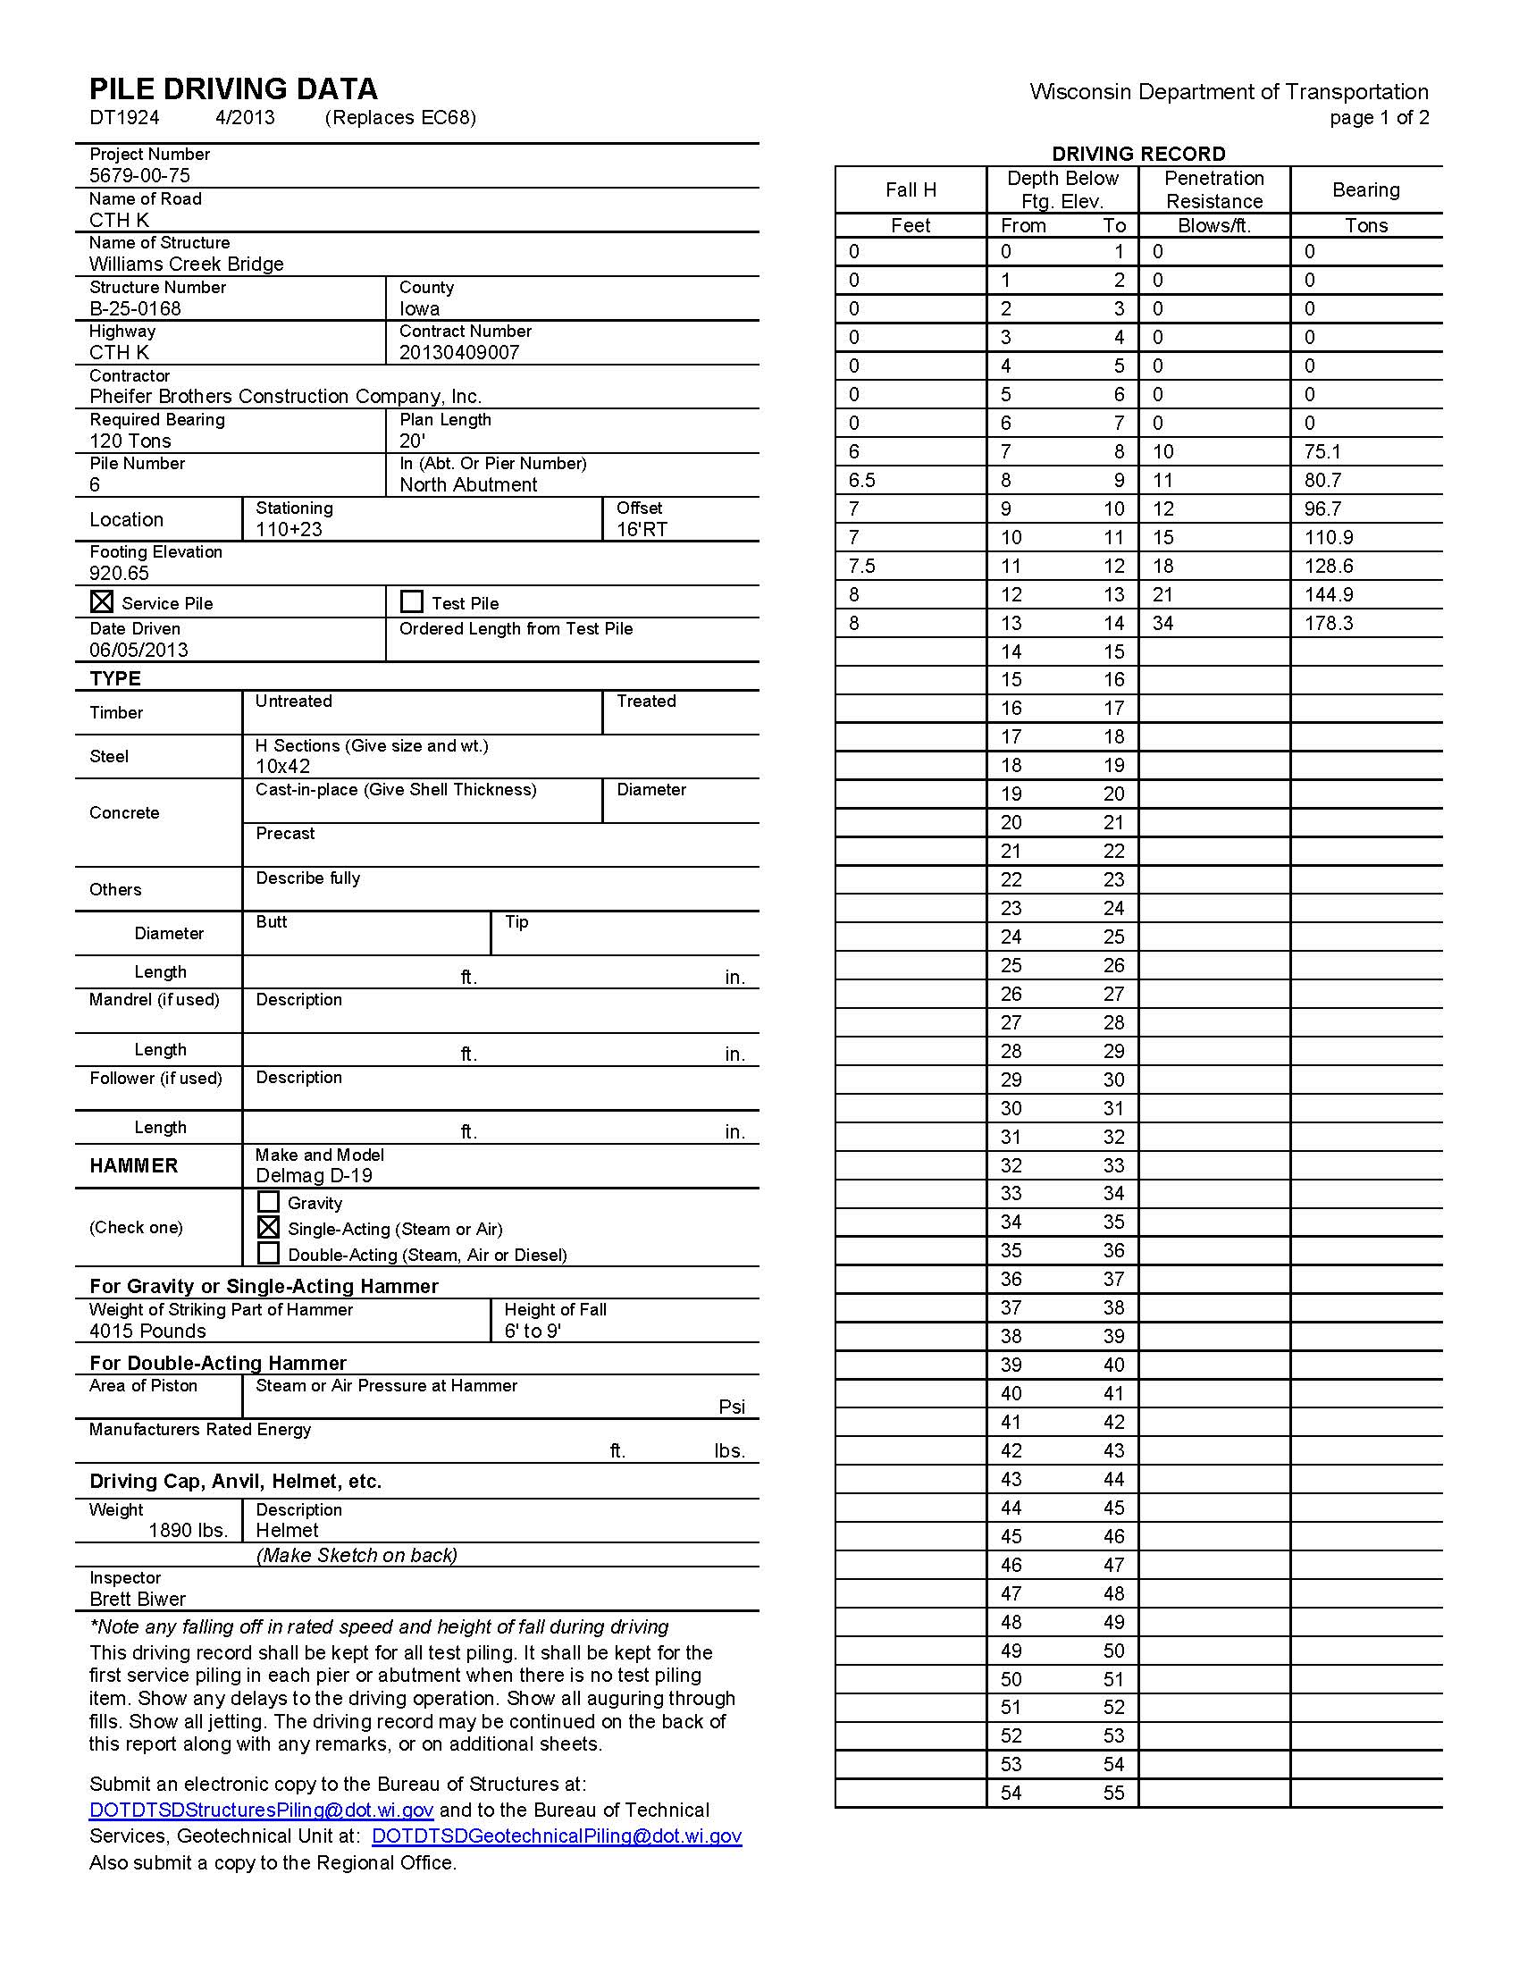
Form DT1924
Send to who?

Slide 35
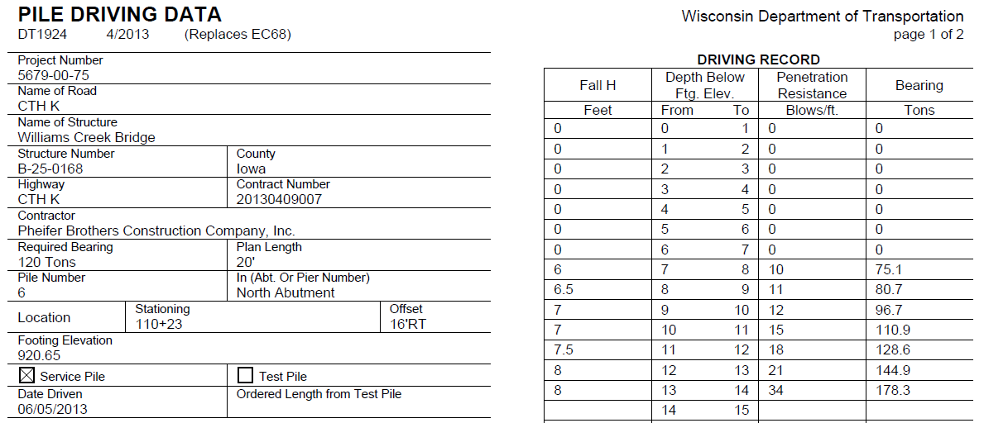

Slide 37
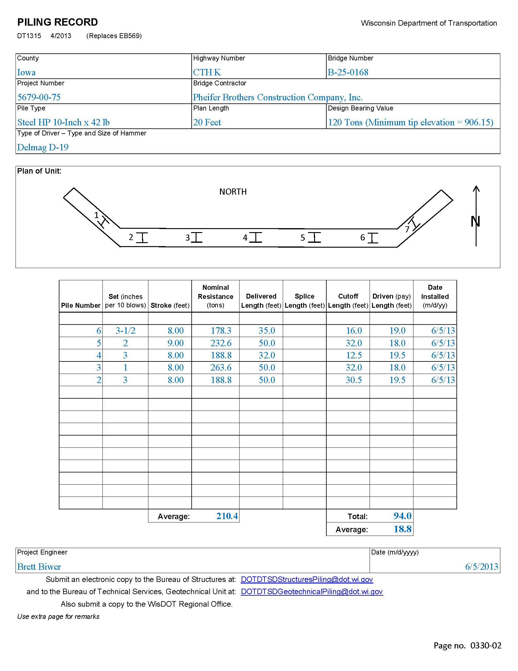
Form DT1315
Send to who?

Slide 38
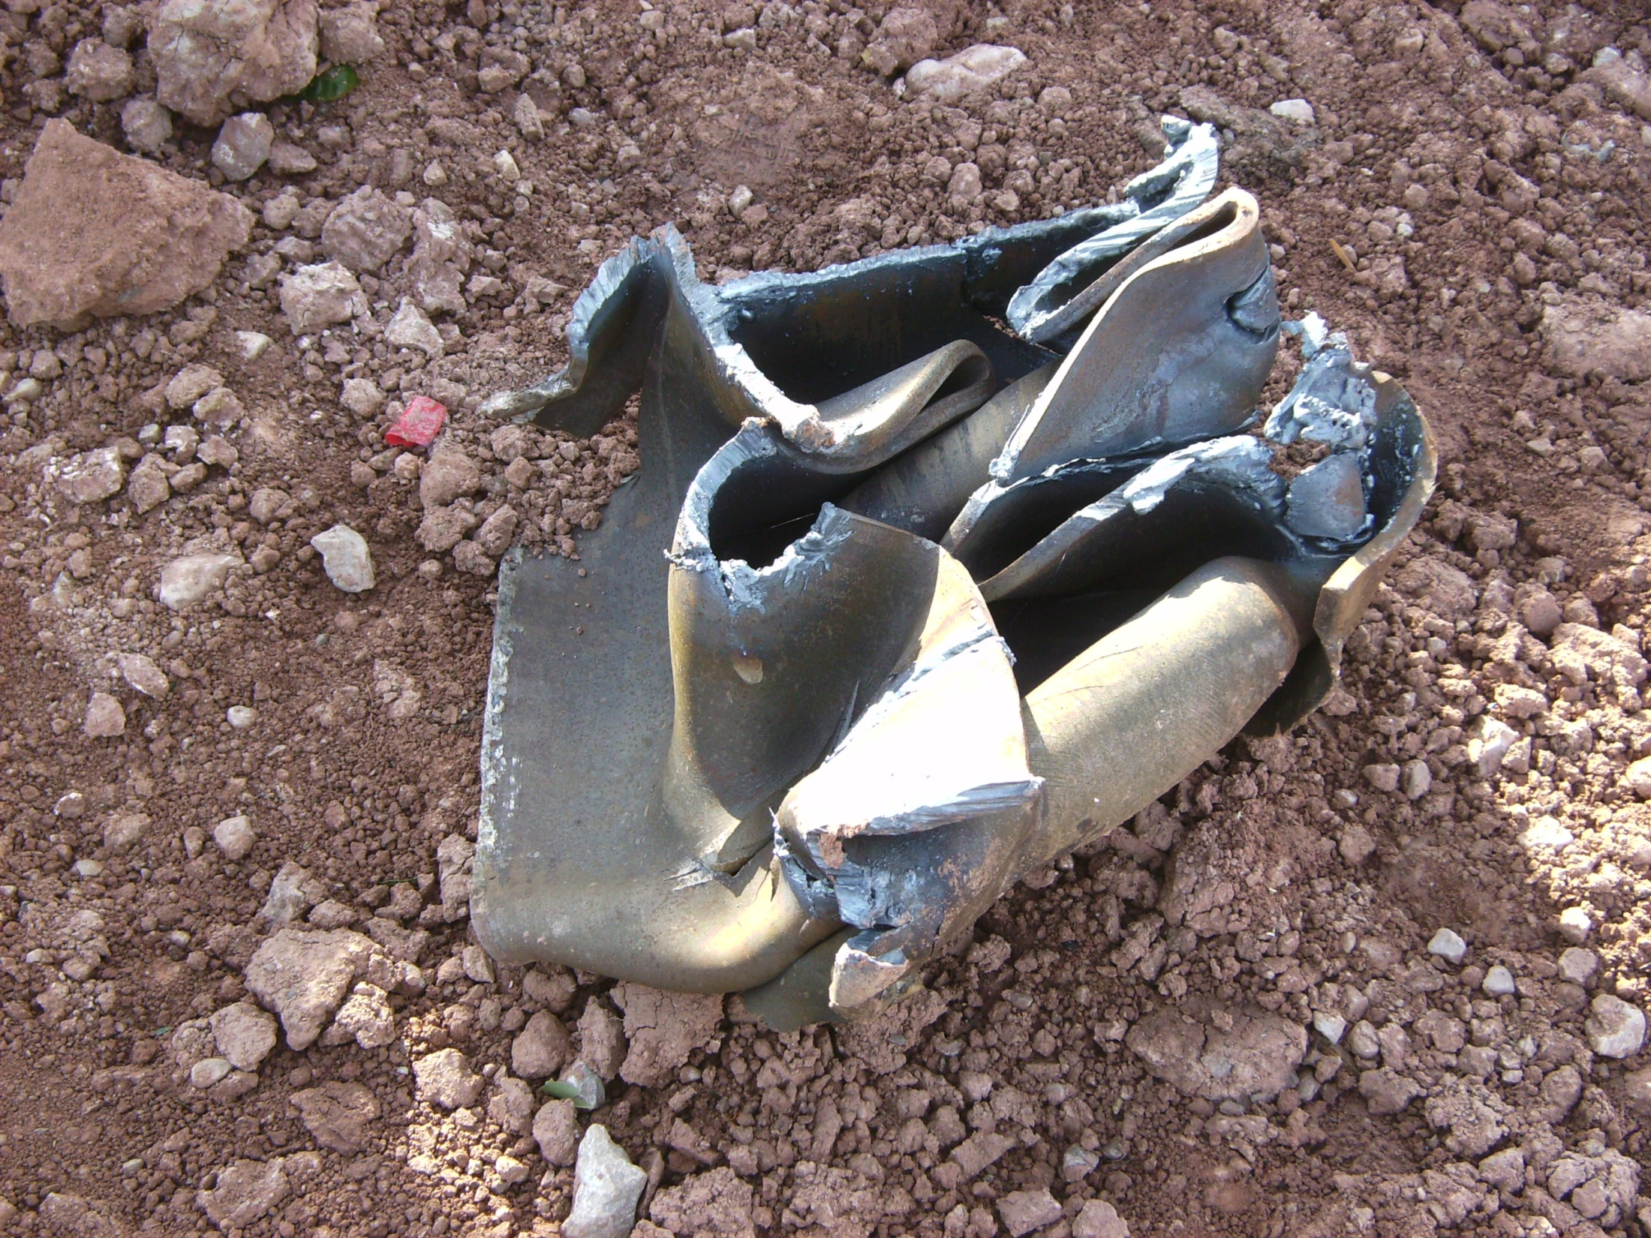

Slide 39
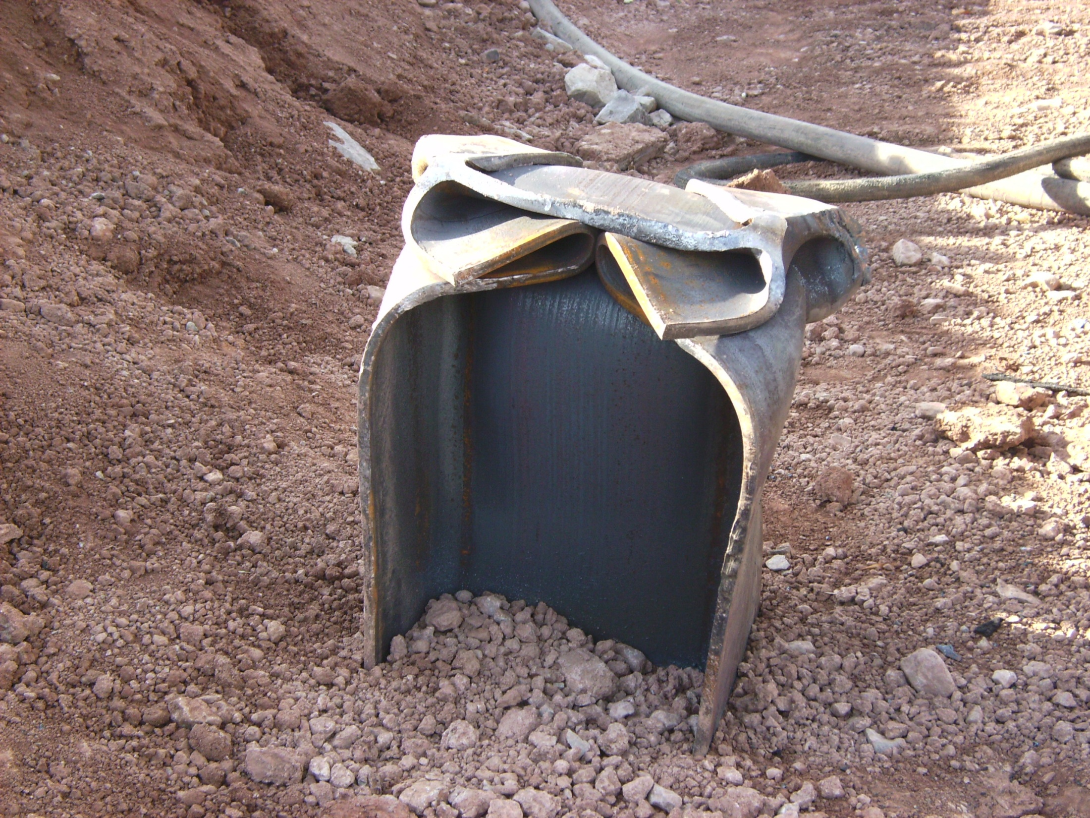

Slide 40
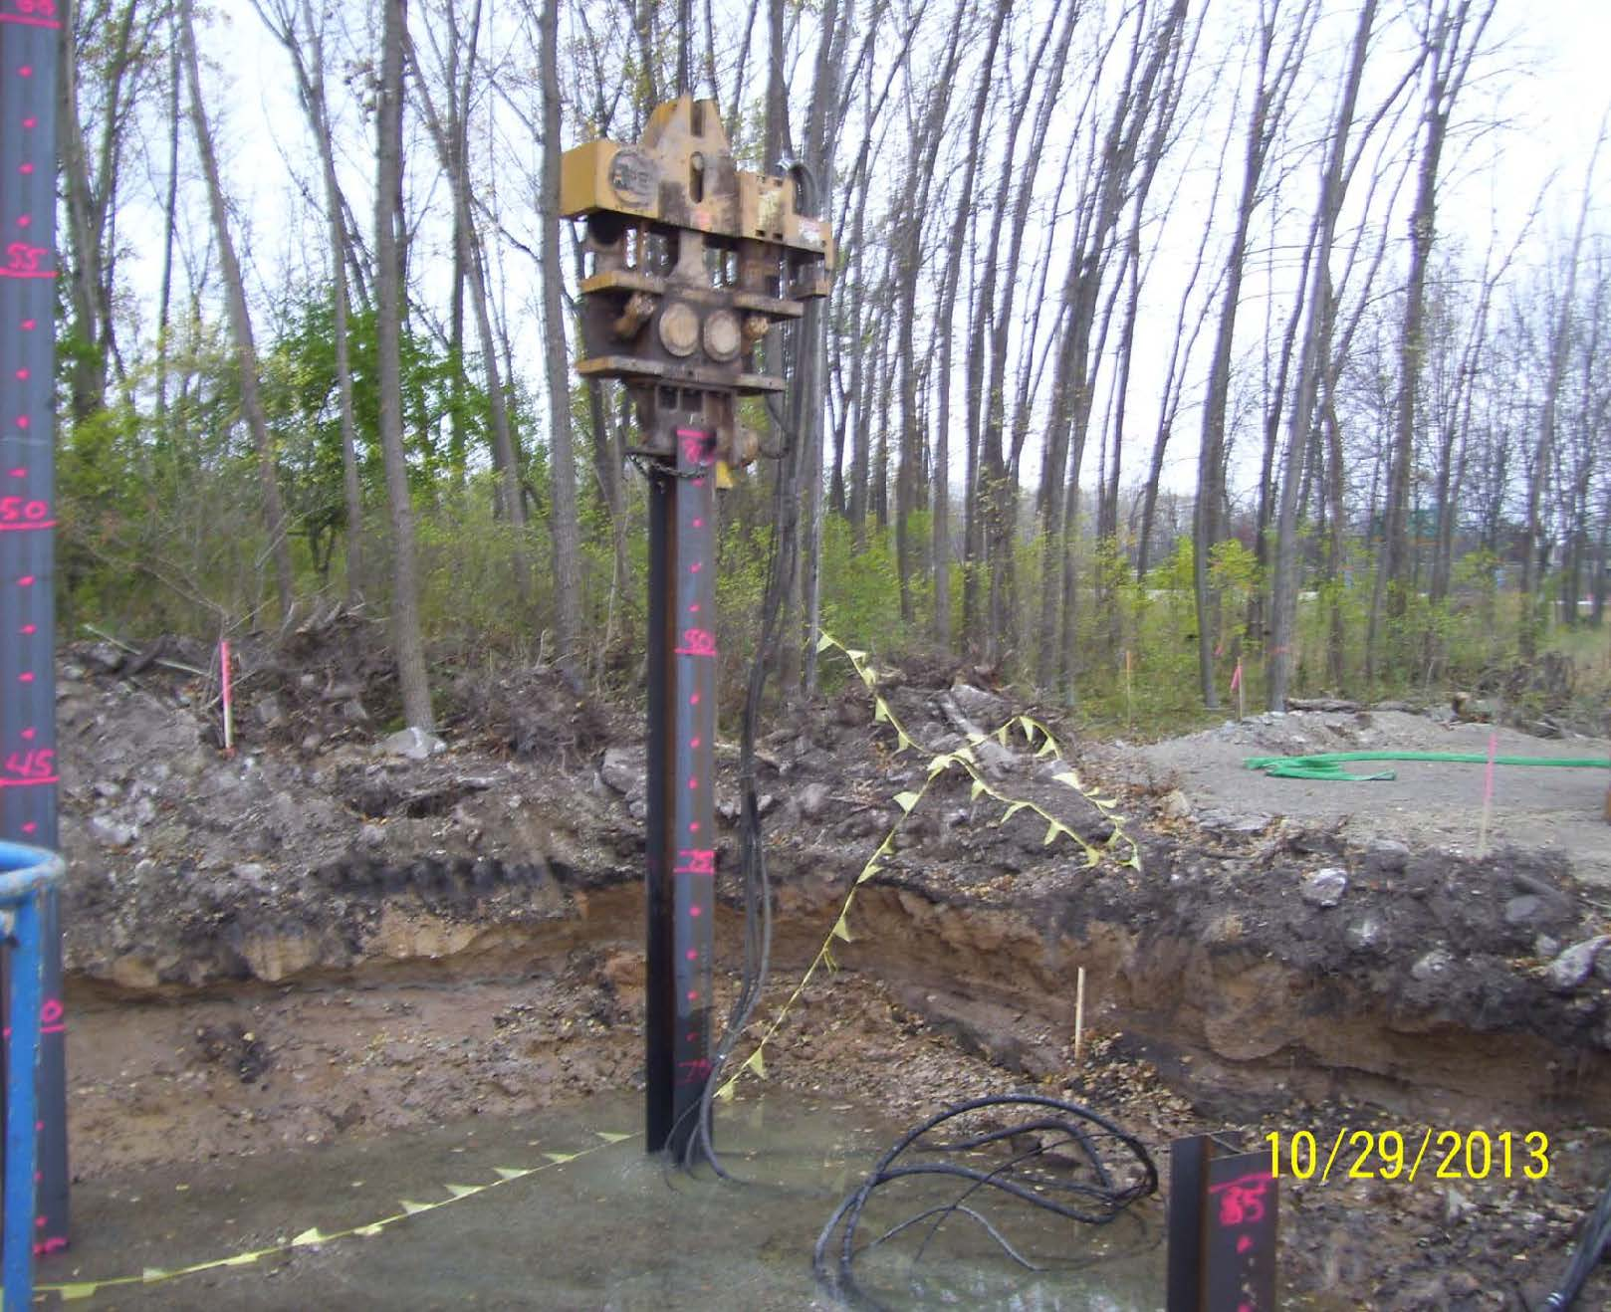

Slide 41
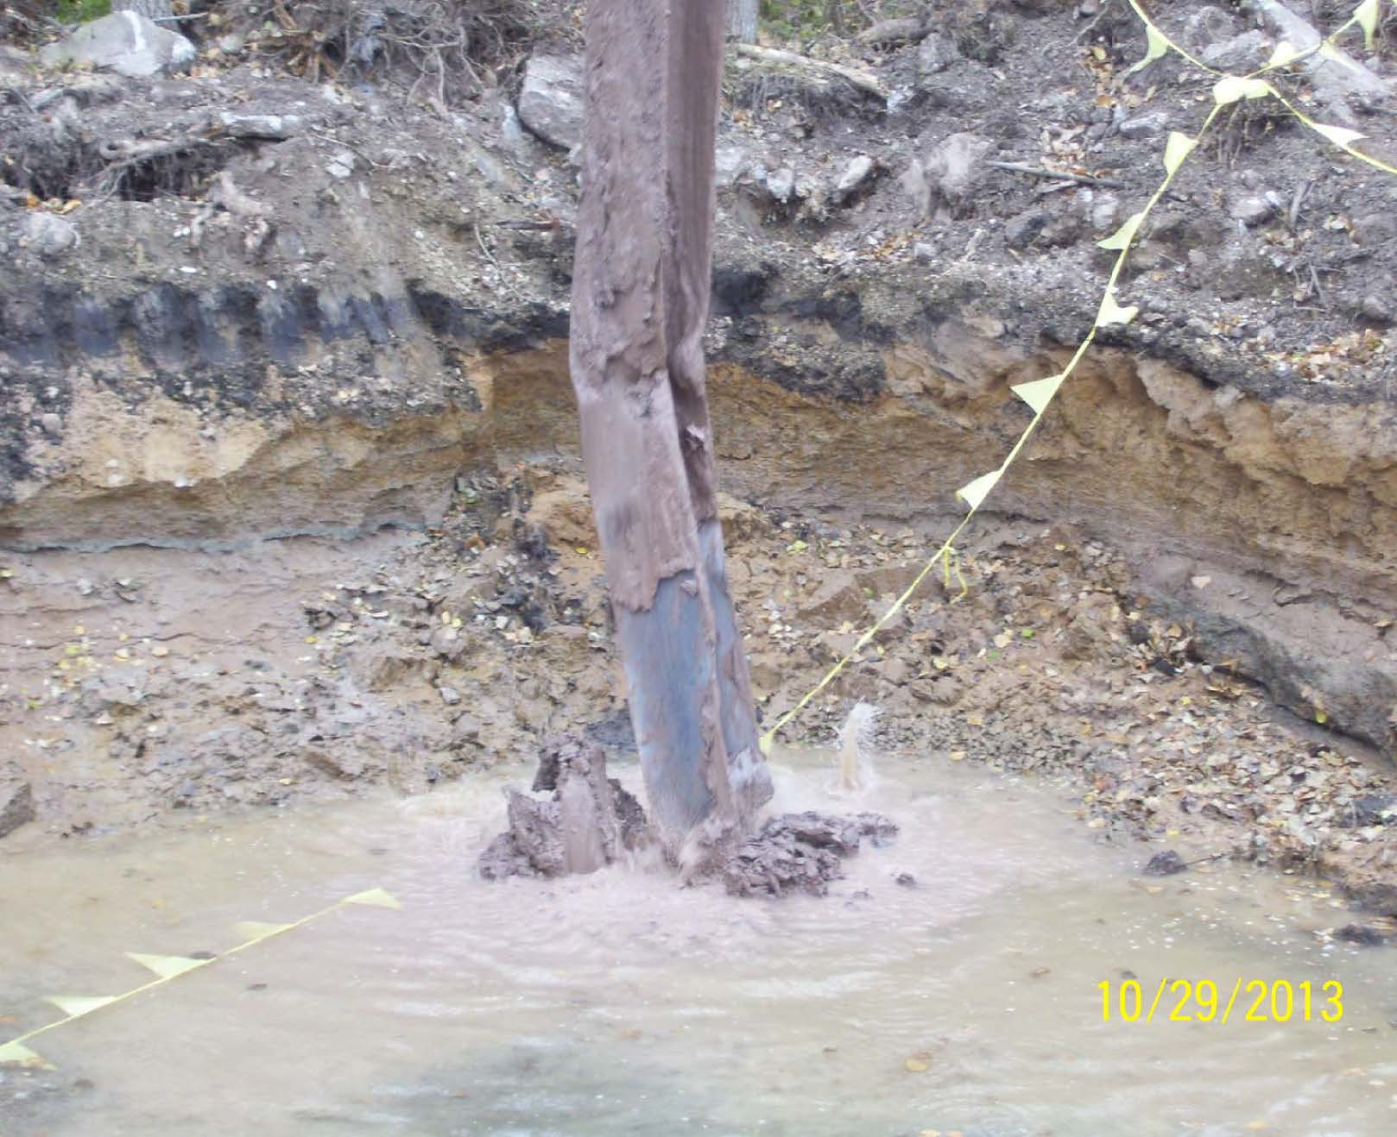

Slide 42
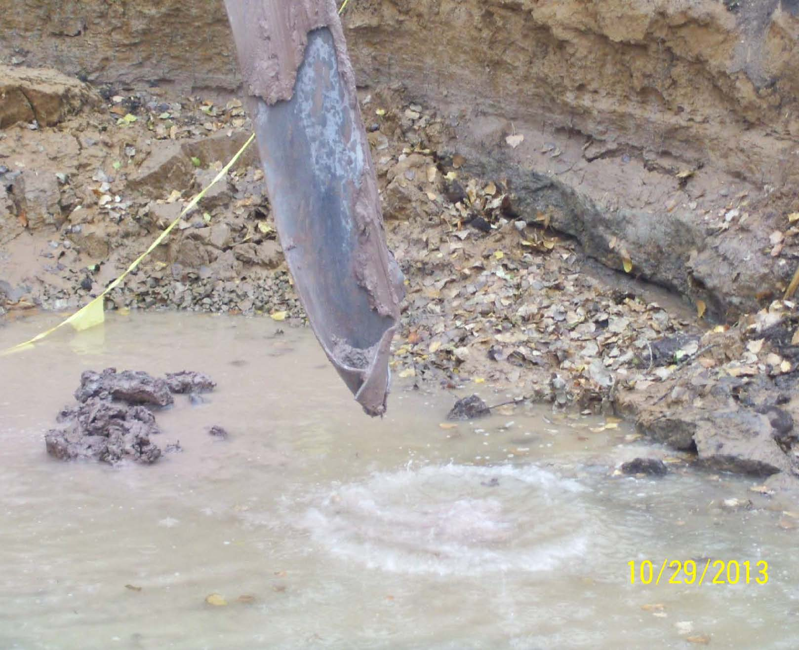

Slide 43
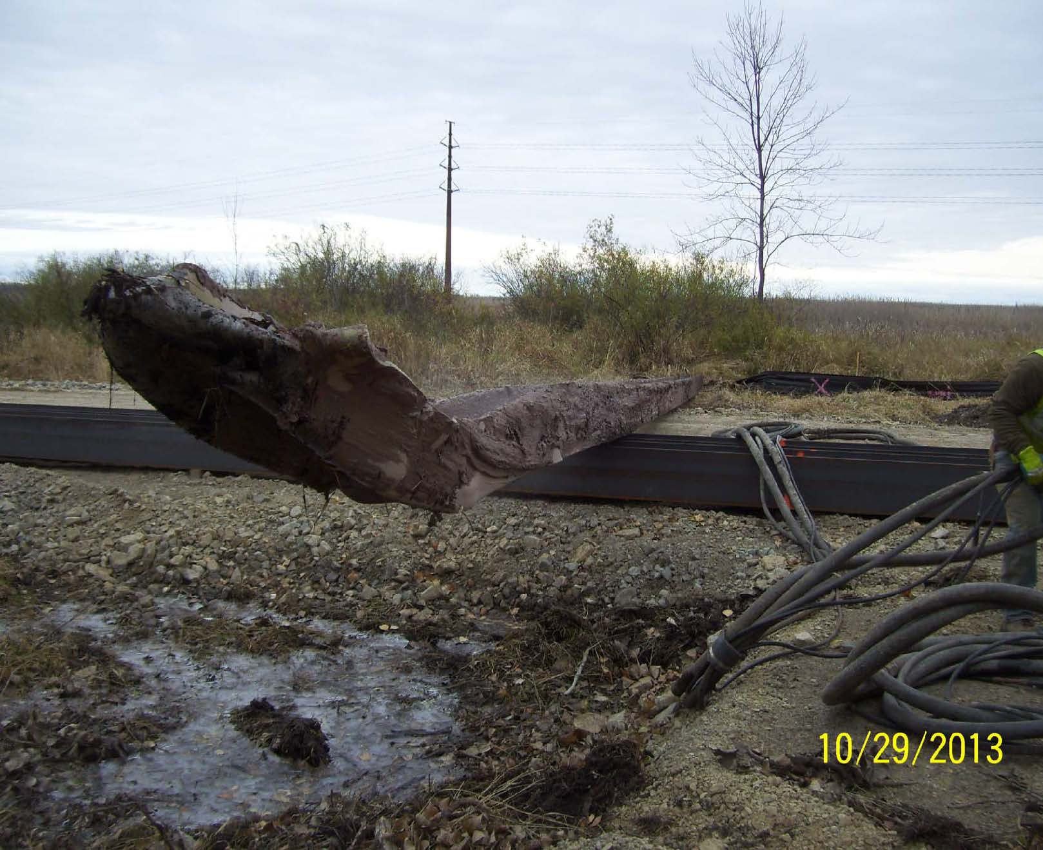

Slide 44
Spread Footings
What to Look for With Spread Footings
Review Plans and Site Investigation Report to Determine What Bearing Strengths are Necessary
Check Stability of Footing Base Elevation – Drive Bar or Rod Below Base
Check if Sidewall and Base Soils Correlate to Soil Borings
Observe Difficulty of Excavating Material
Contact Regional Soils Engineer as Needed

Slide 45
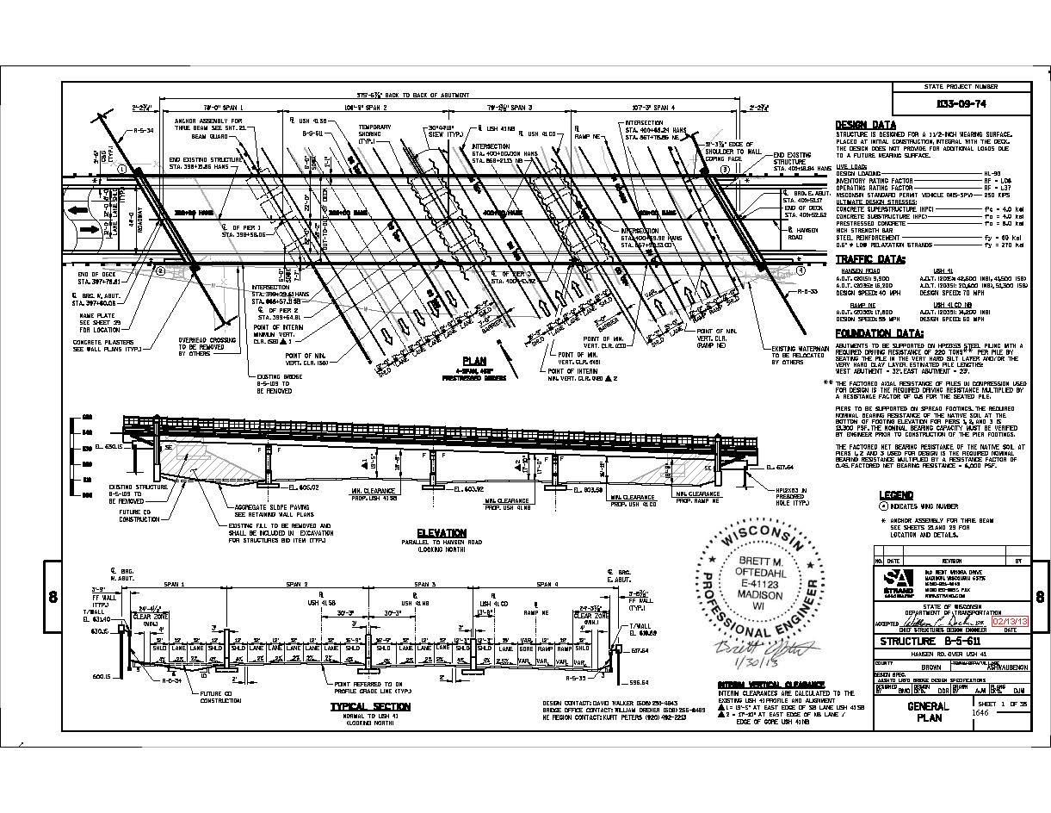

Slide 46
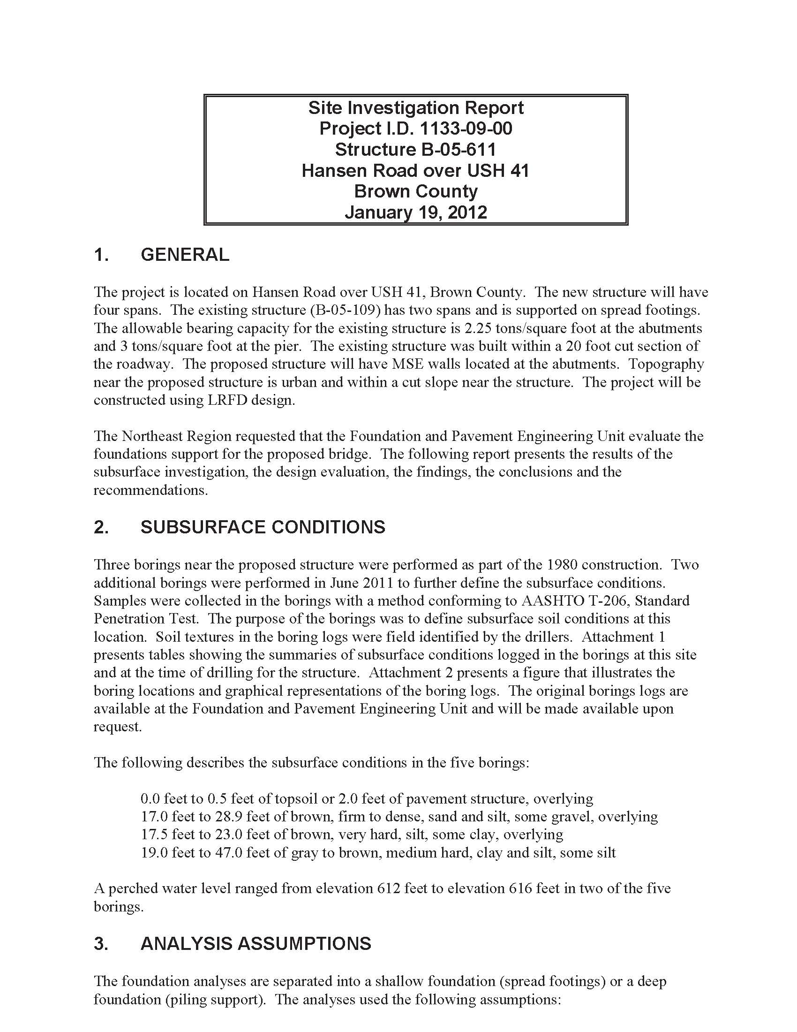

Slide 48
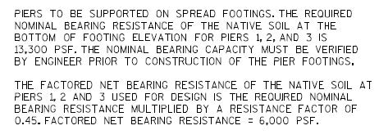

Slide 49
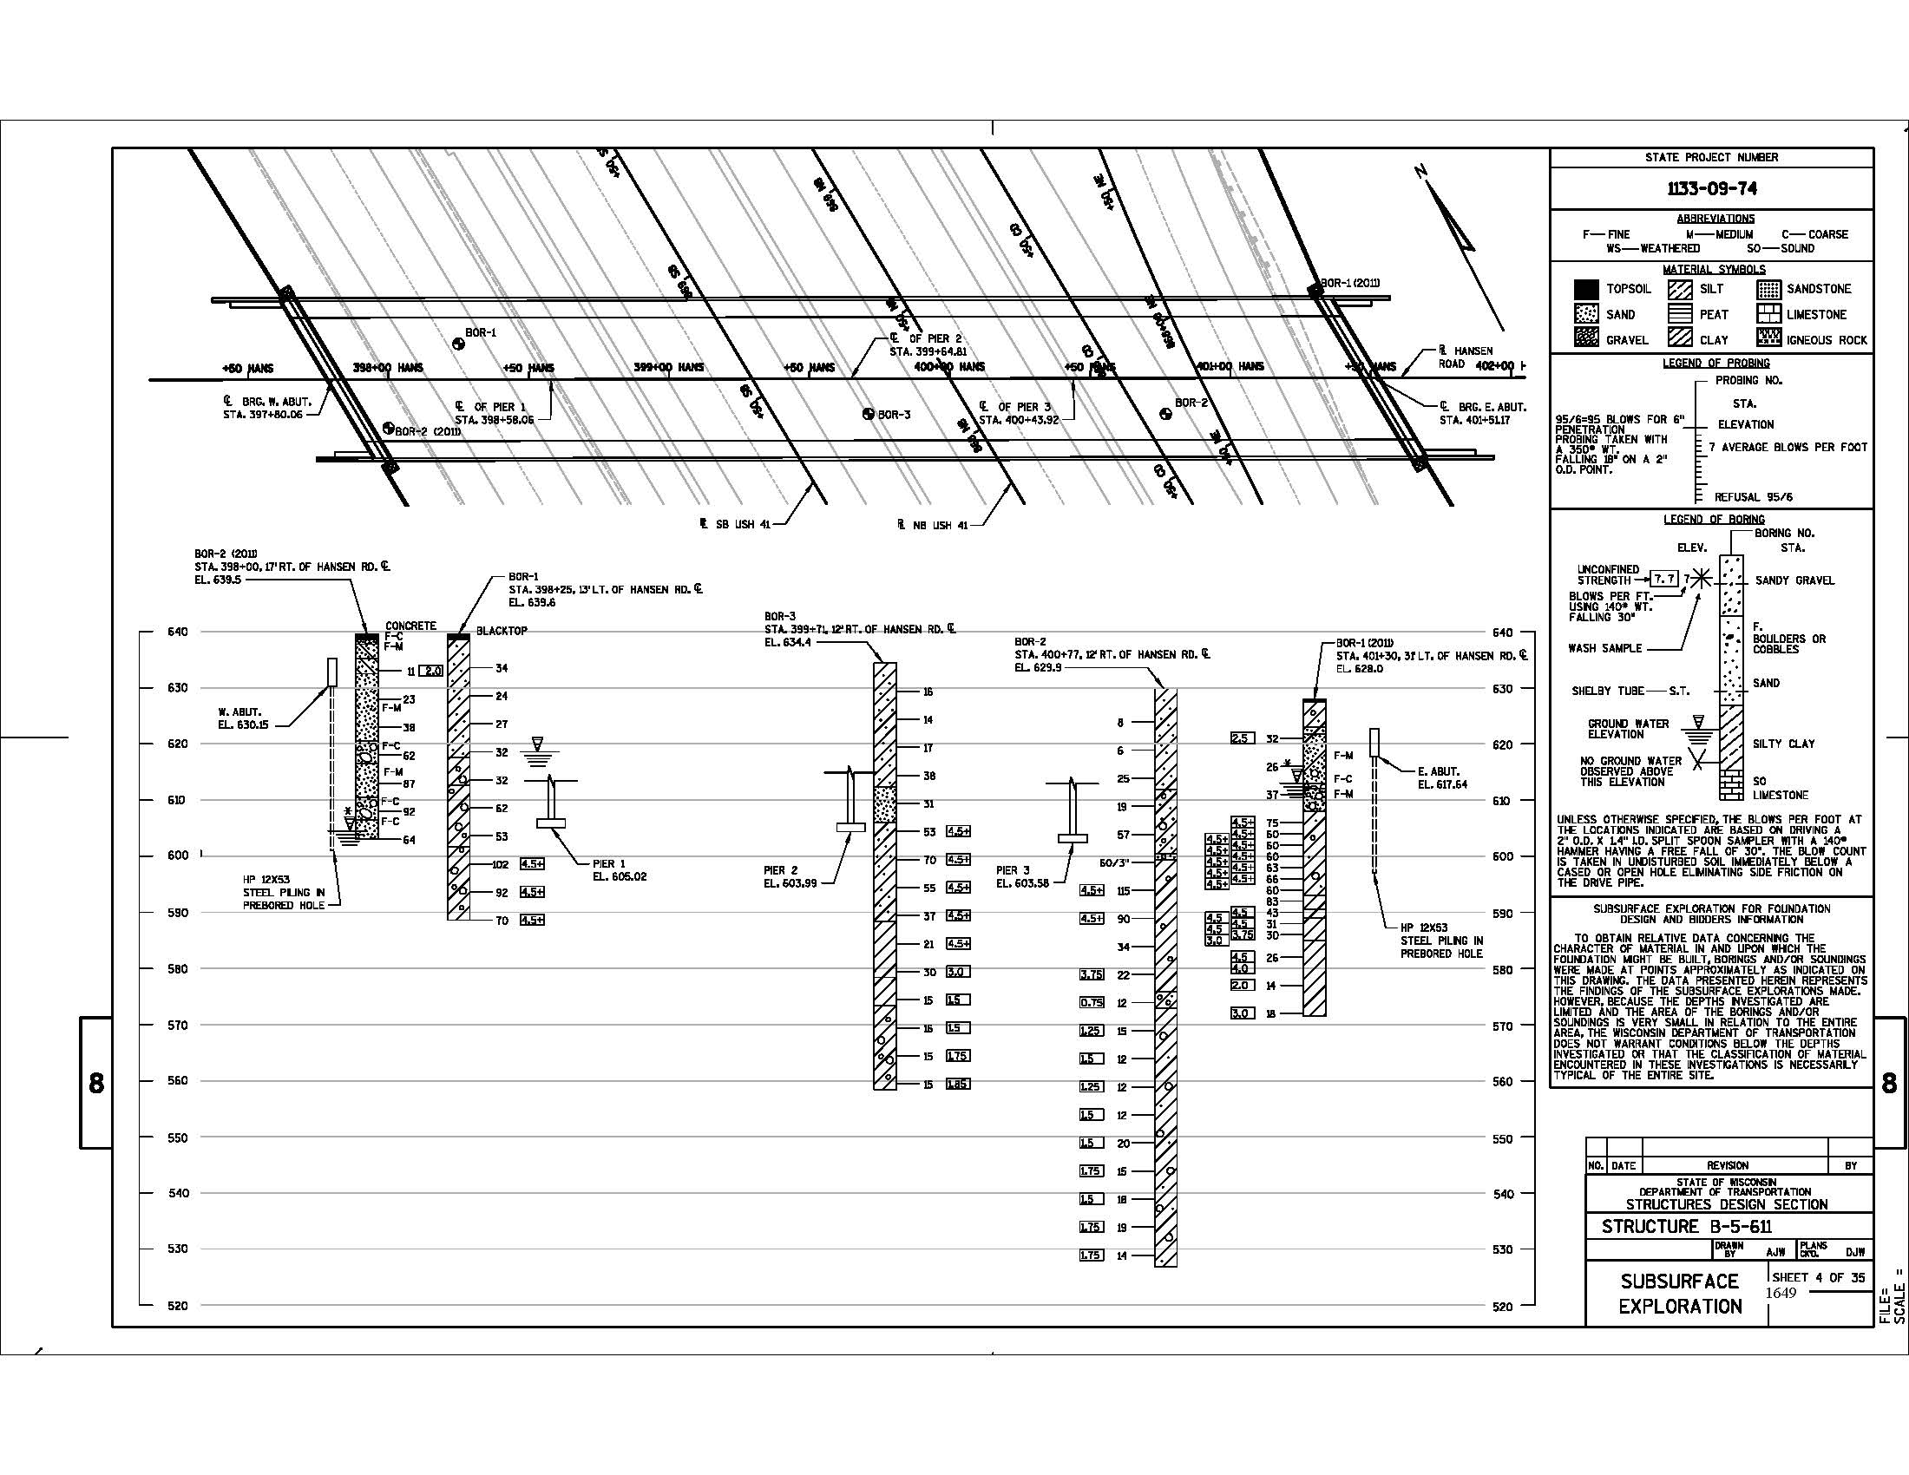

Slide 50
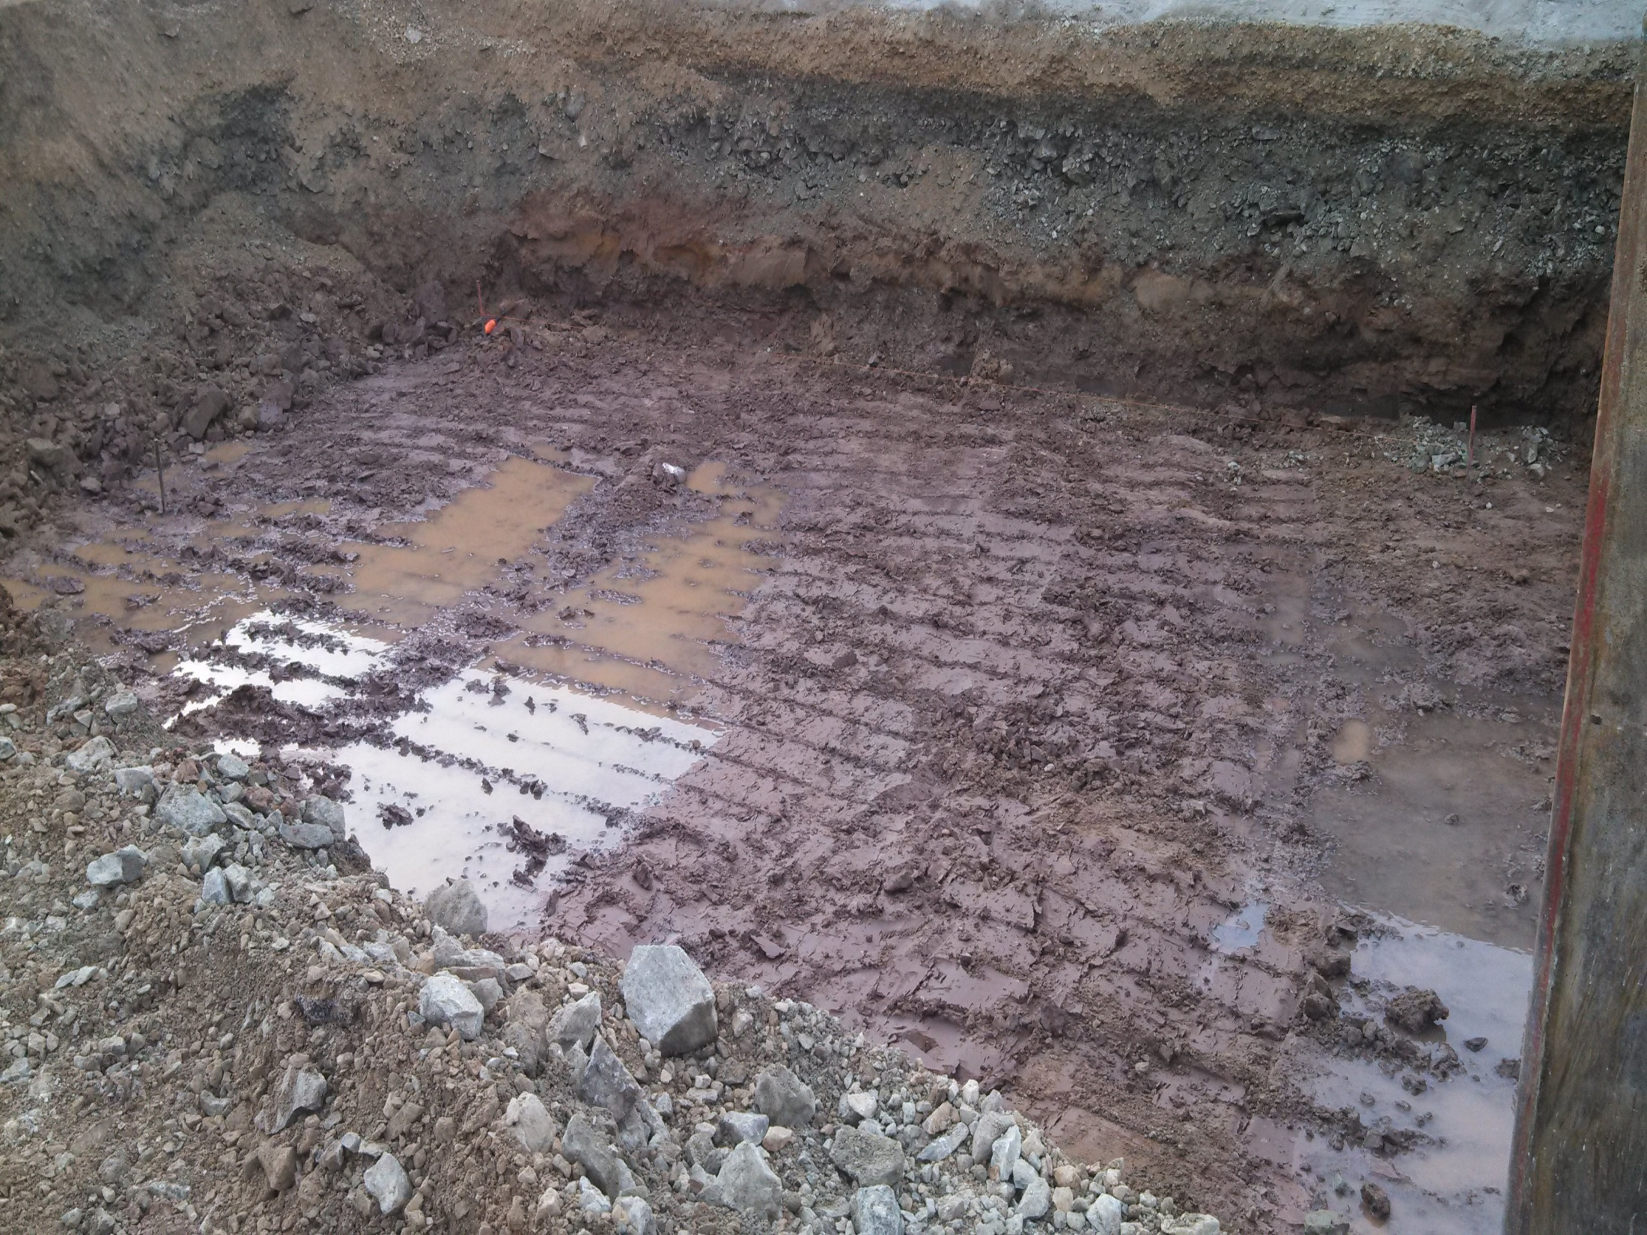

Slide 51
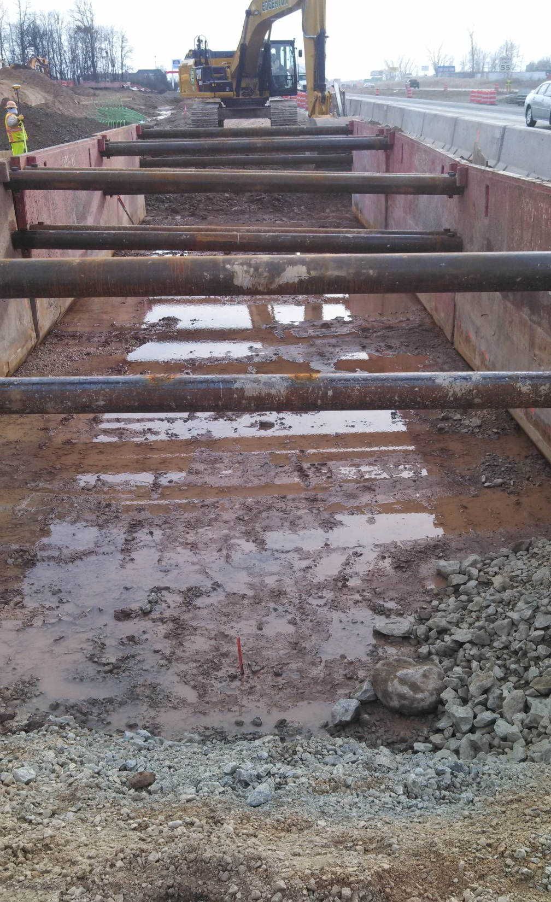

Slide 52
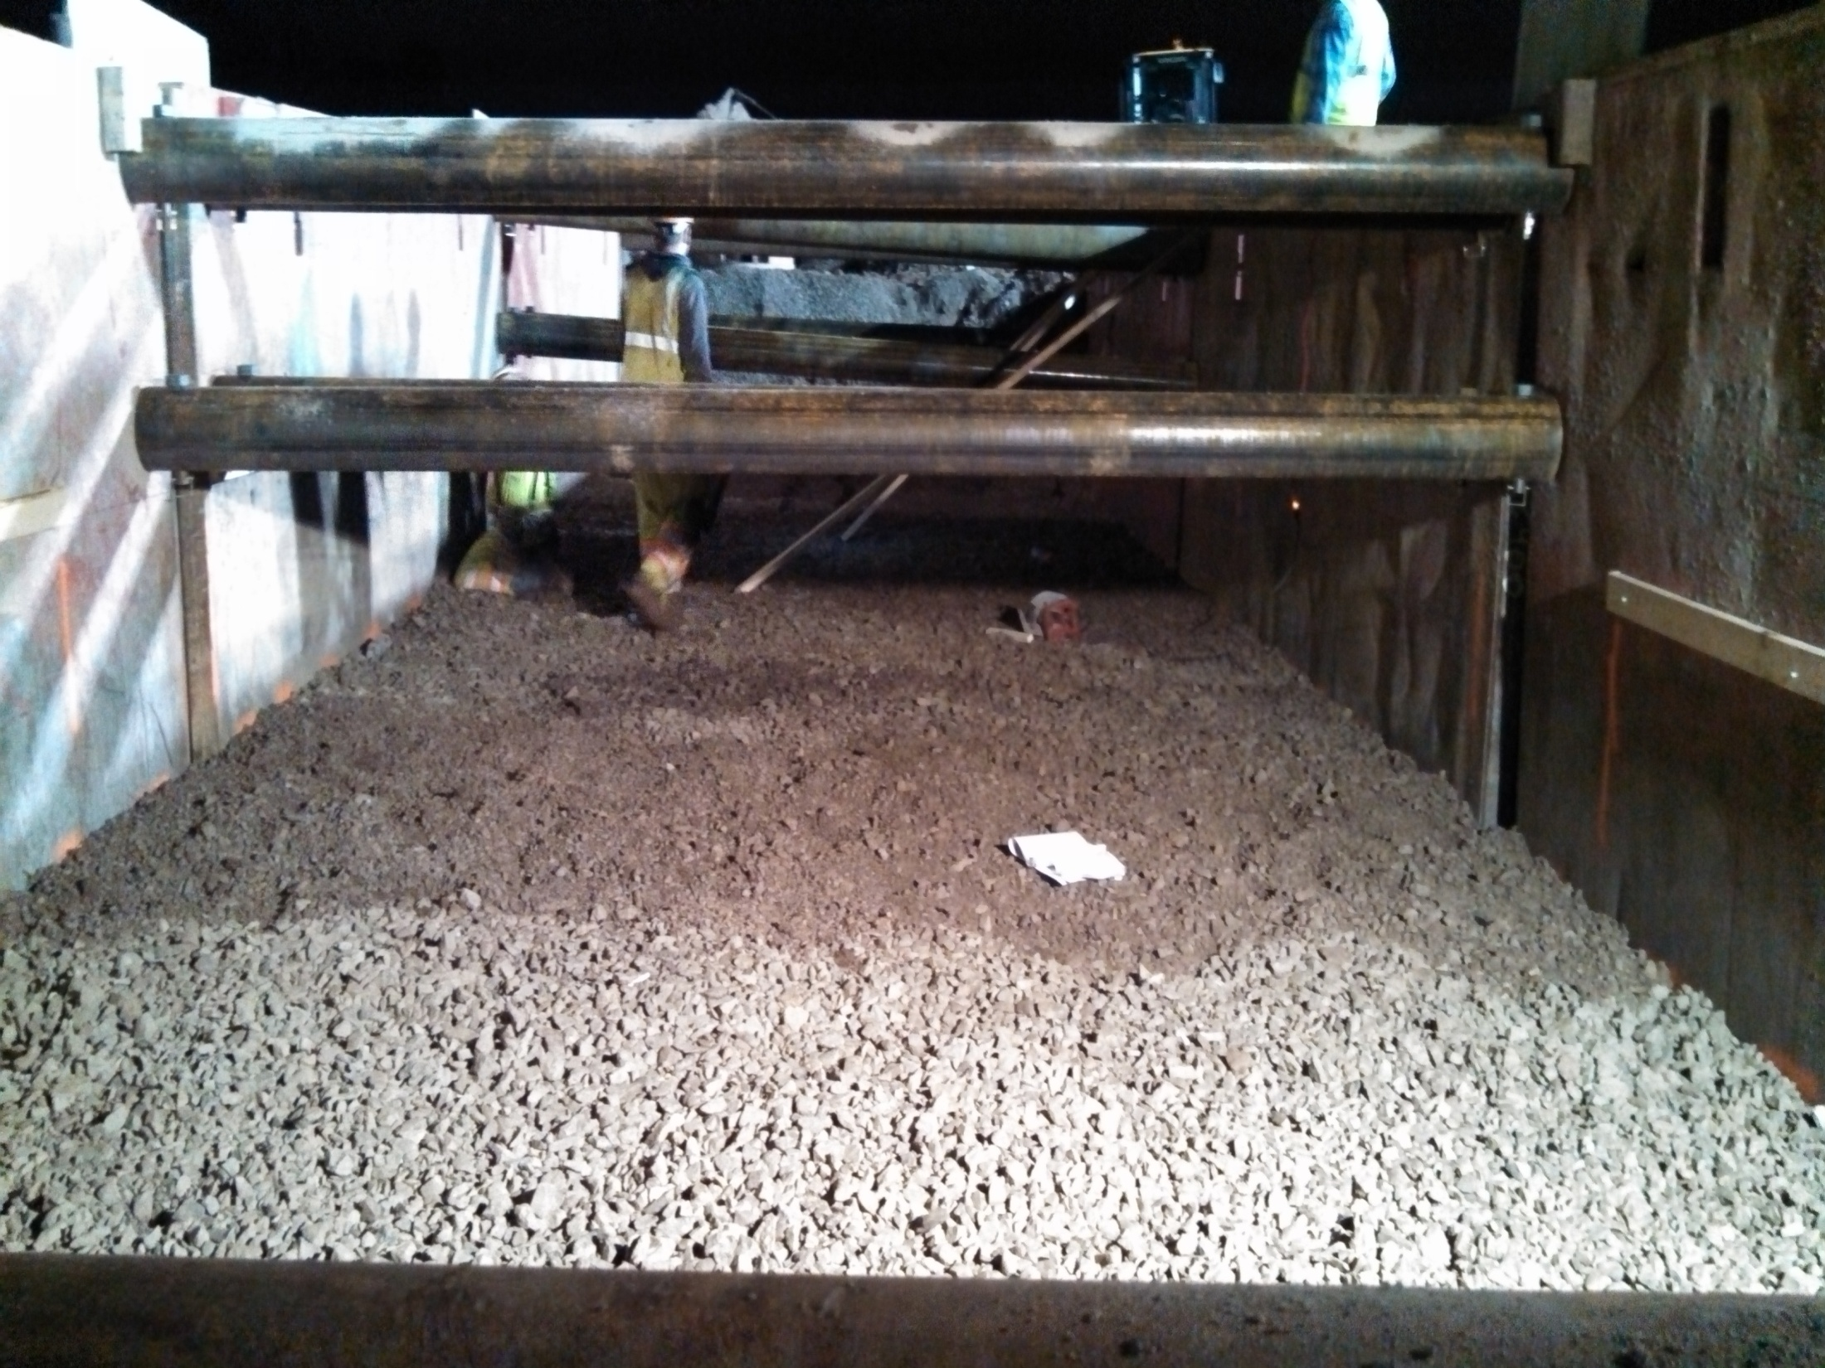

Slide 53
Bridge Approaches
Special Treatments
Rock and Clear Stone Under The Footing
3. Compaction Behind the Footing
4. Transition to Normal Grade Line (Blue Top)

Slide 54
Retaining Walls
Types
Site Investigation Report (SIR)
3. Foundation
4. Construction Methods
5. Backfilling

Slide 55
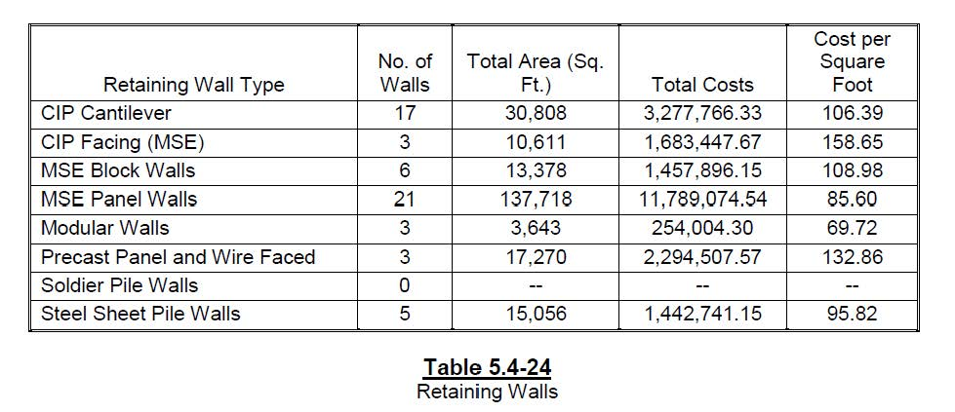
Retaining Walls
2017 Types and Quantities (WisDOT Bridge Manual)

Slide 56
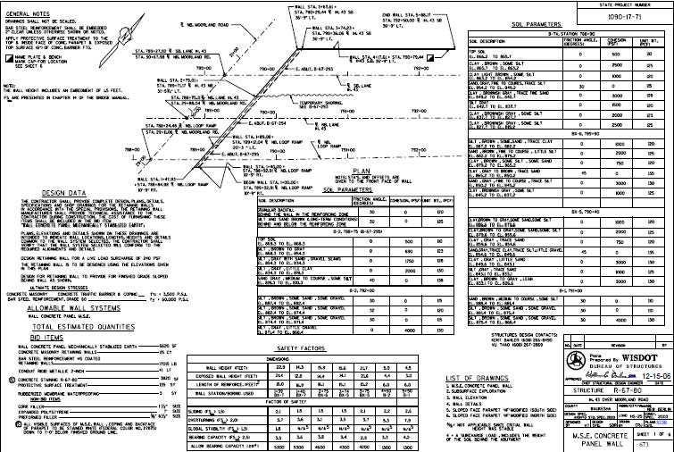

Slide 57
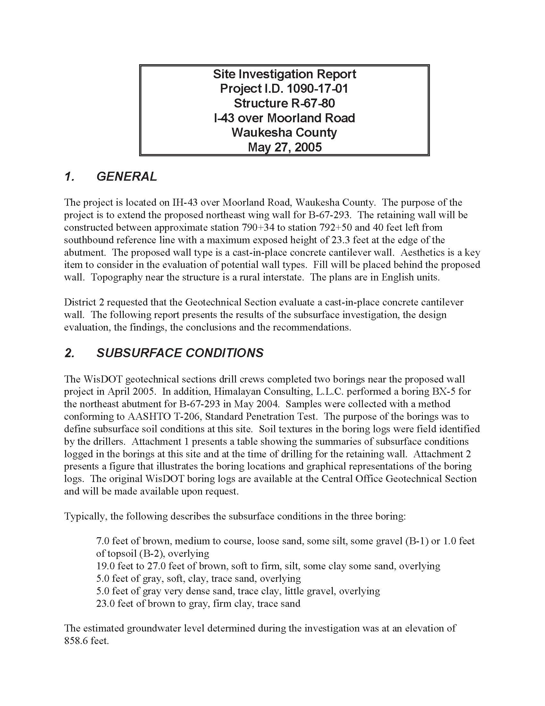

Slide 58
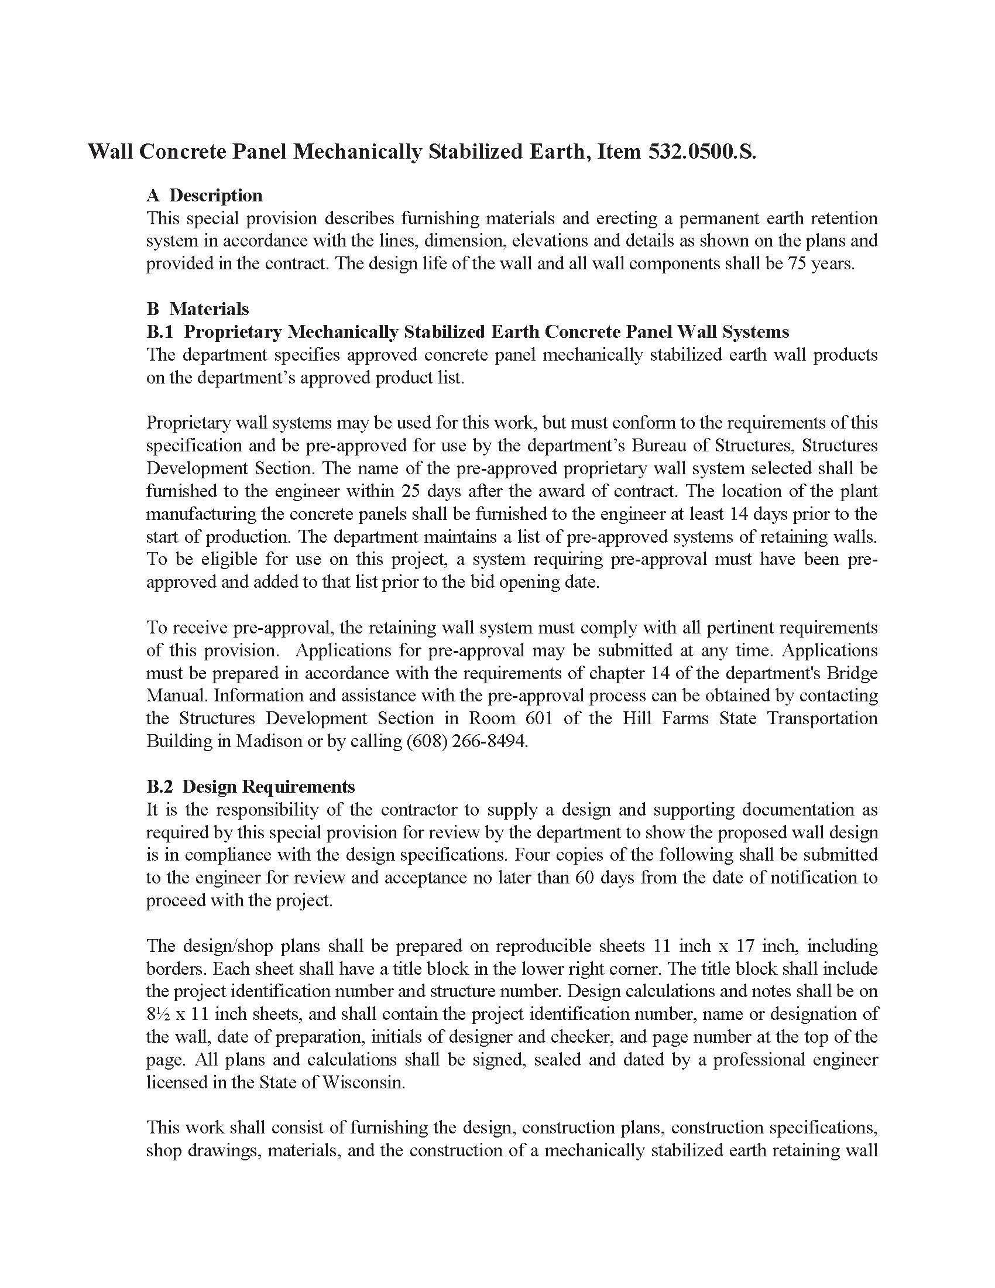

Slide 59
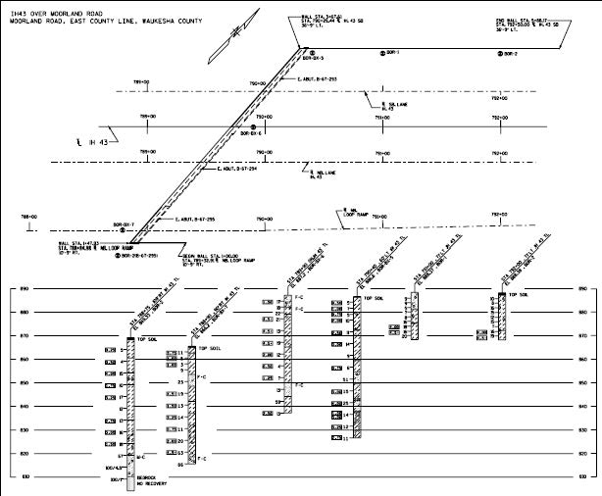

Slide 60
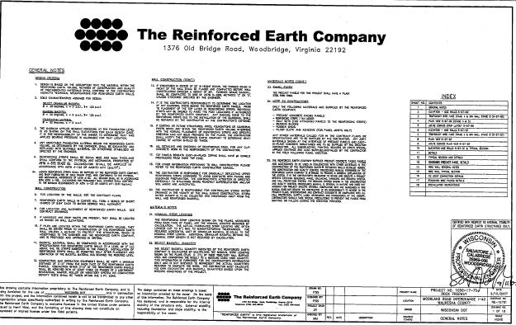

Slide 61
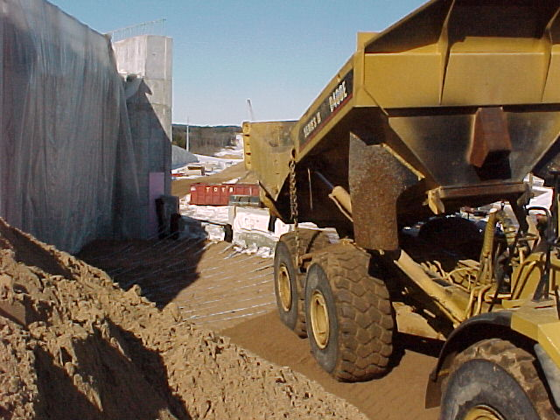

Slide 62
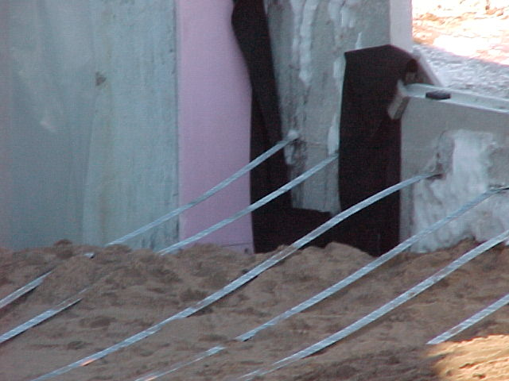

Slide 63
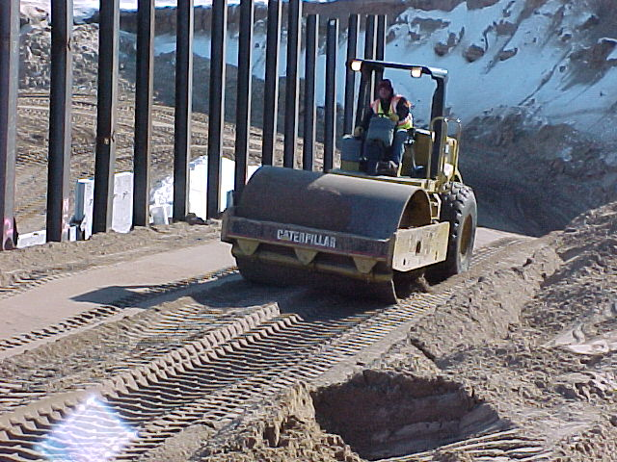

Slide 64
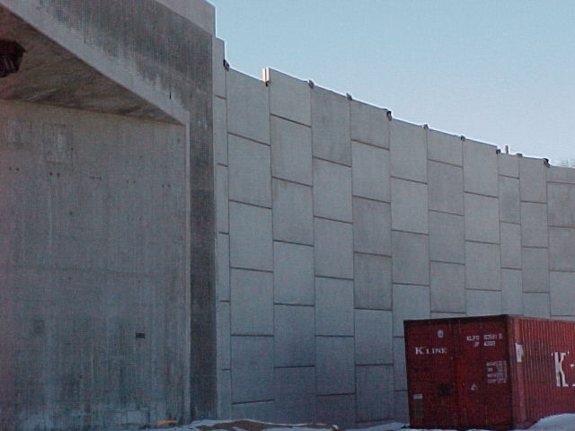

Slide 66
Questions ?

