Slide 1
Structures
Box Culverts
Bridges
Walls

Slide 2
Box Culverts, Bridges and Walls
DESIGN
The Structure Survey Report
Foundation Investigation
CONSTRUCTION
Box Culvert Foundation and Backfill
Bridge Foundation Support: Pile and Spread Footings
Bridge Approaches
Retaining Wall Types and What to Look For

Slide 3
The Structure Survey Report
What Information is Important to You
What to Look For

Slide 4
Facilities Development Manual 11-35-1

Slide 5
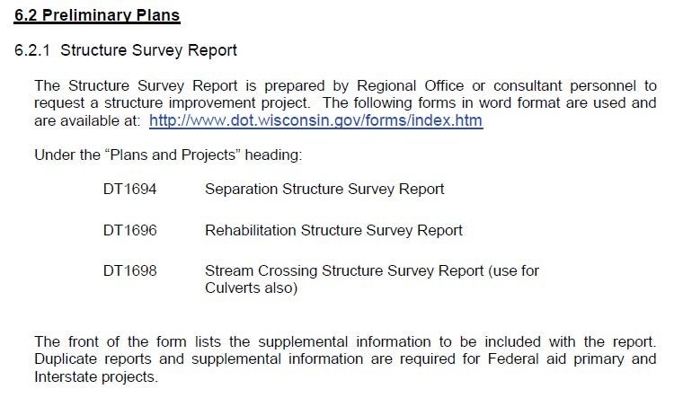
Bridge Manual 6-2

Slide 6
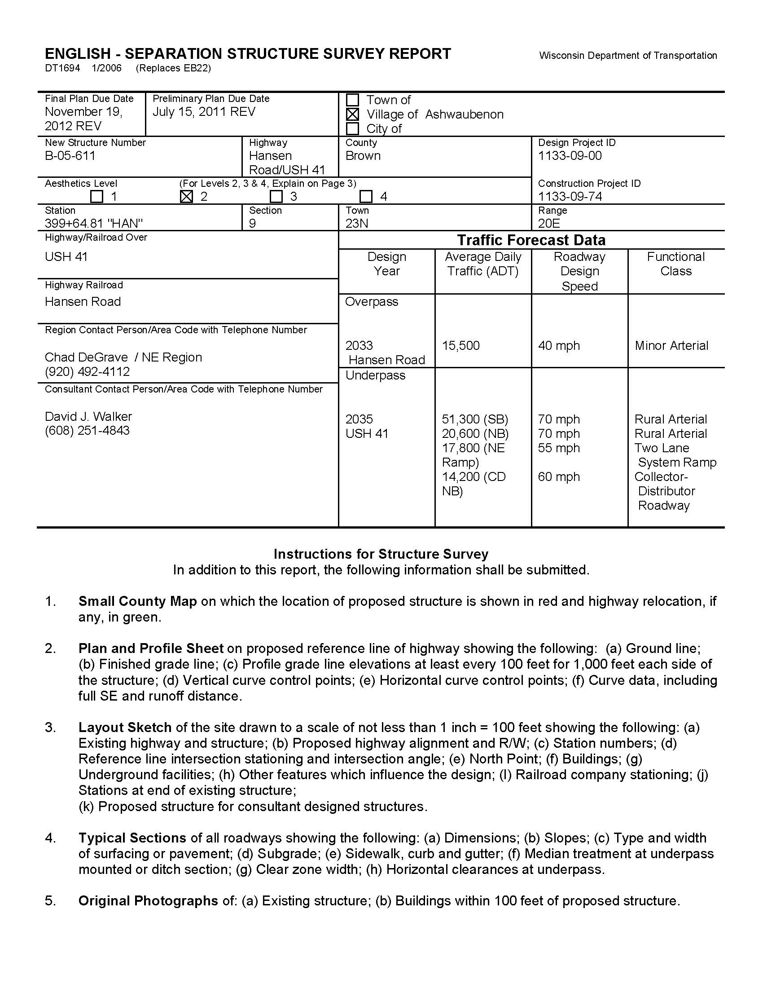

Slide 7
Foundation Investigations
Geotechnical Bulletin #1
2. Soil Borings
3. Unusual Circumstances

Slide 8
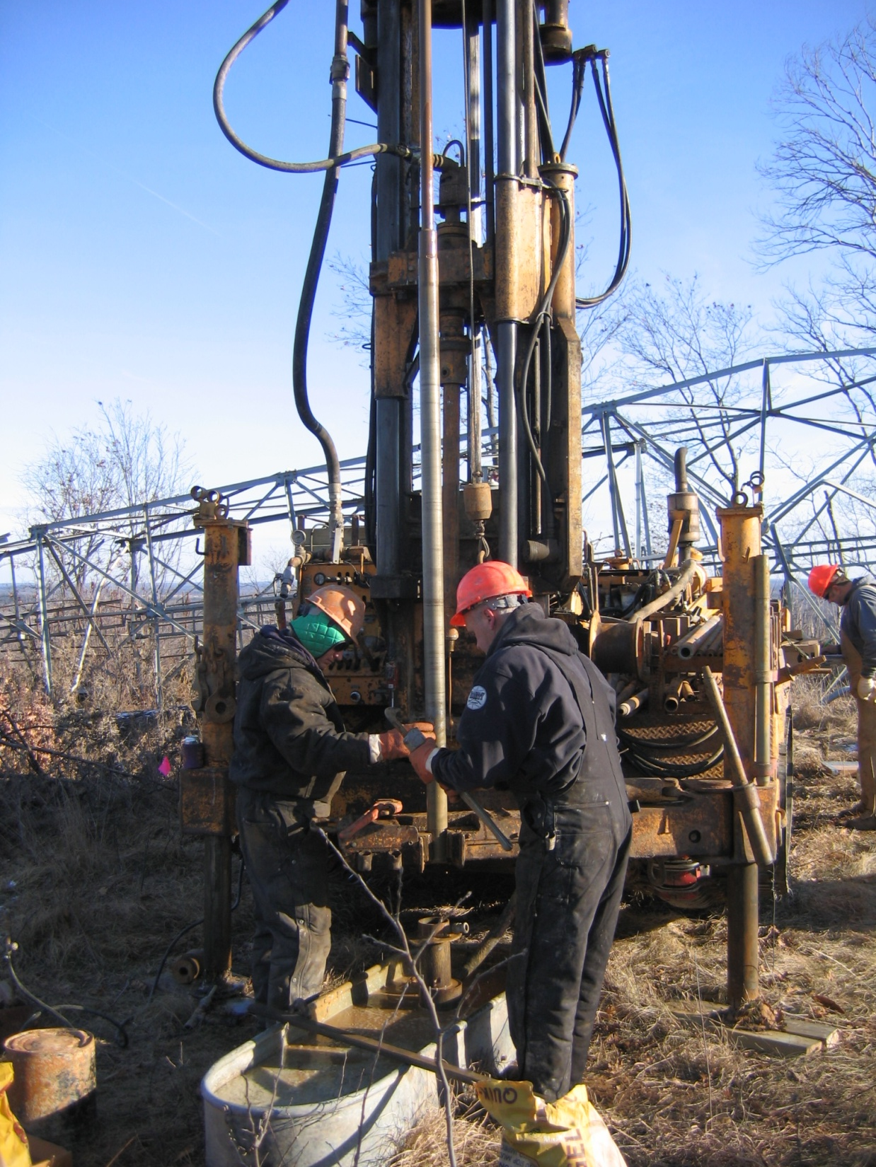
WisDOT Drill Crew

Slide 9
The Foundation Report
What Information is Important to You
What to Look For

Slide 10
Construction
Construction and Materials Manual
2. Standard Specifications
Plans
4. Geotechnical Report

Slide 11
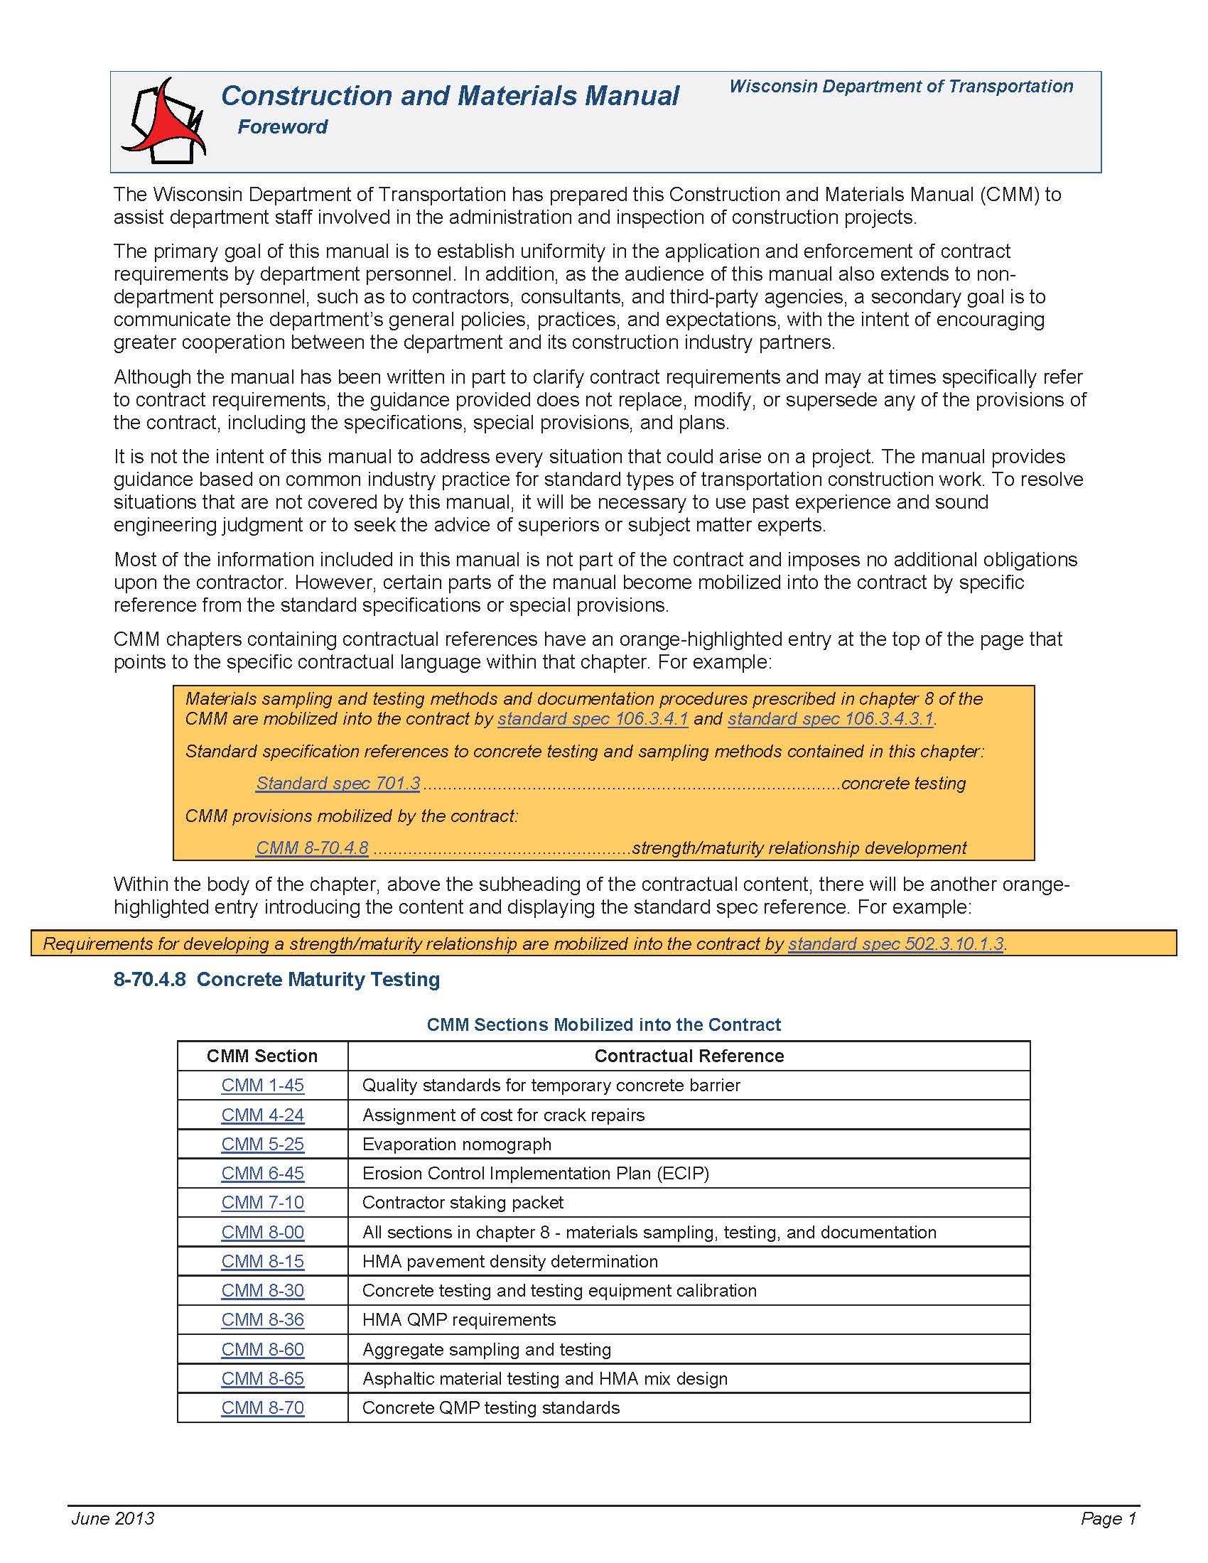

Slide 12
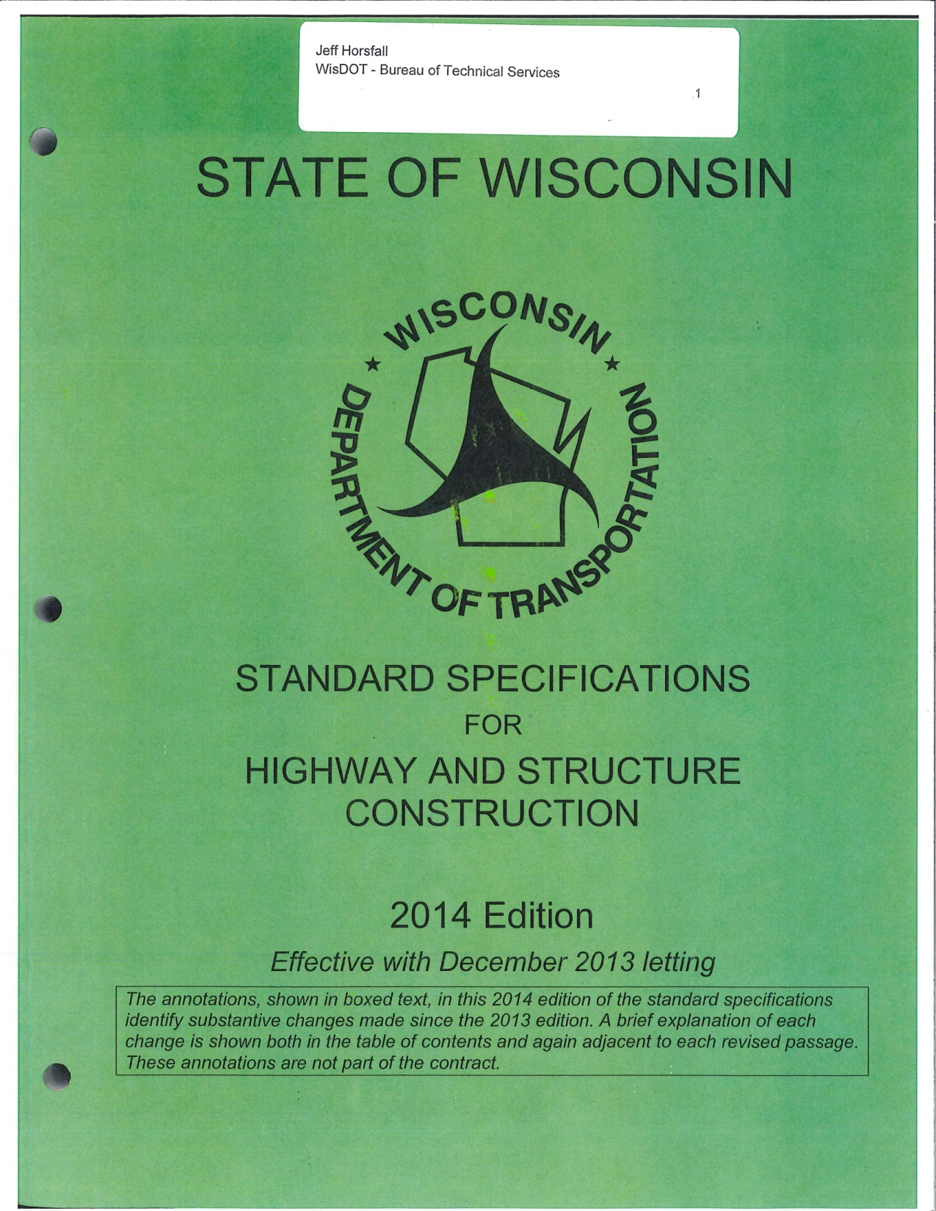

Slide 13
Box Culverts Foundation & Backfill
Plans and Specification
Inspection of the Foundation
3. Placing on Bedrock, Crushed Rock or Gravel
4. Backfill Material
5. Backfill Compaction
6. Backfilling the Top of the Culvert

Slide 14
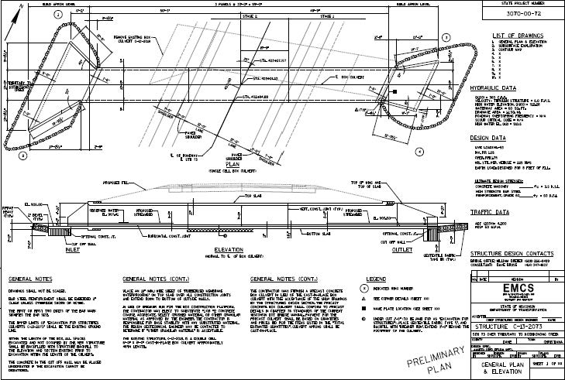

Slide 15
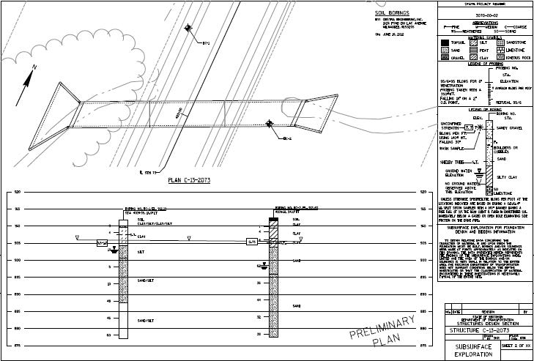

Slide 16
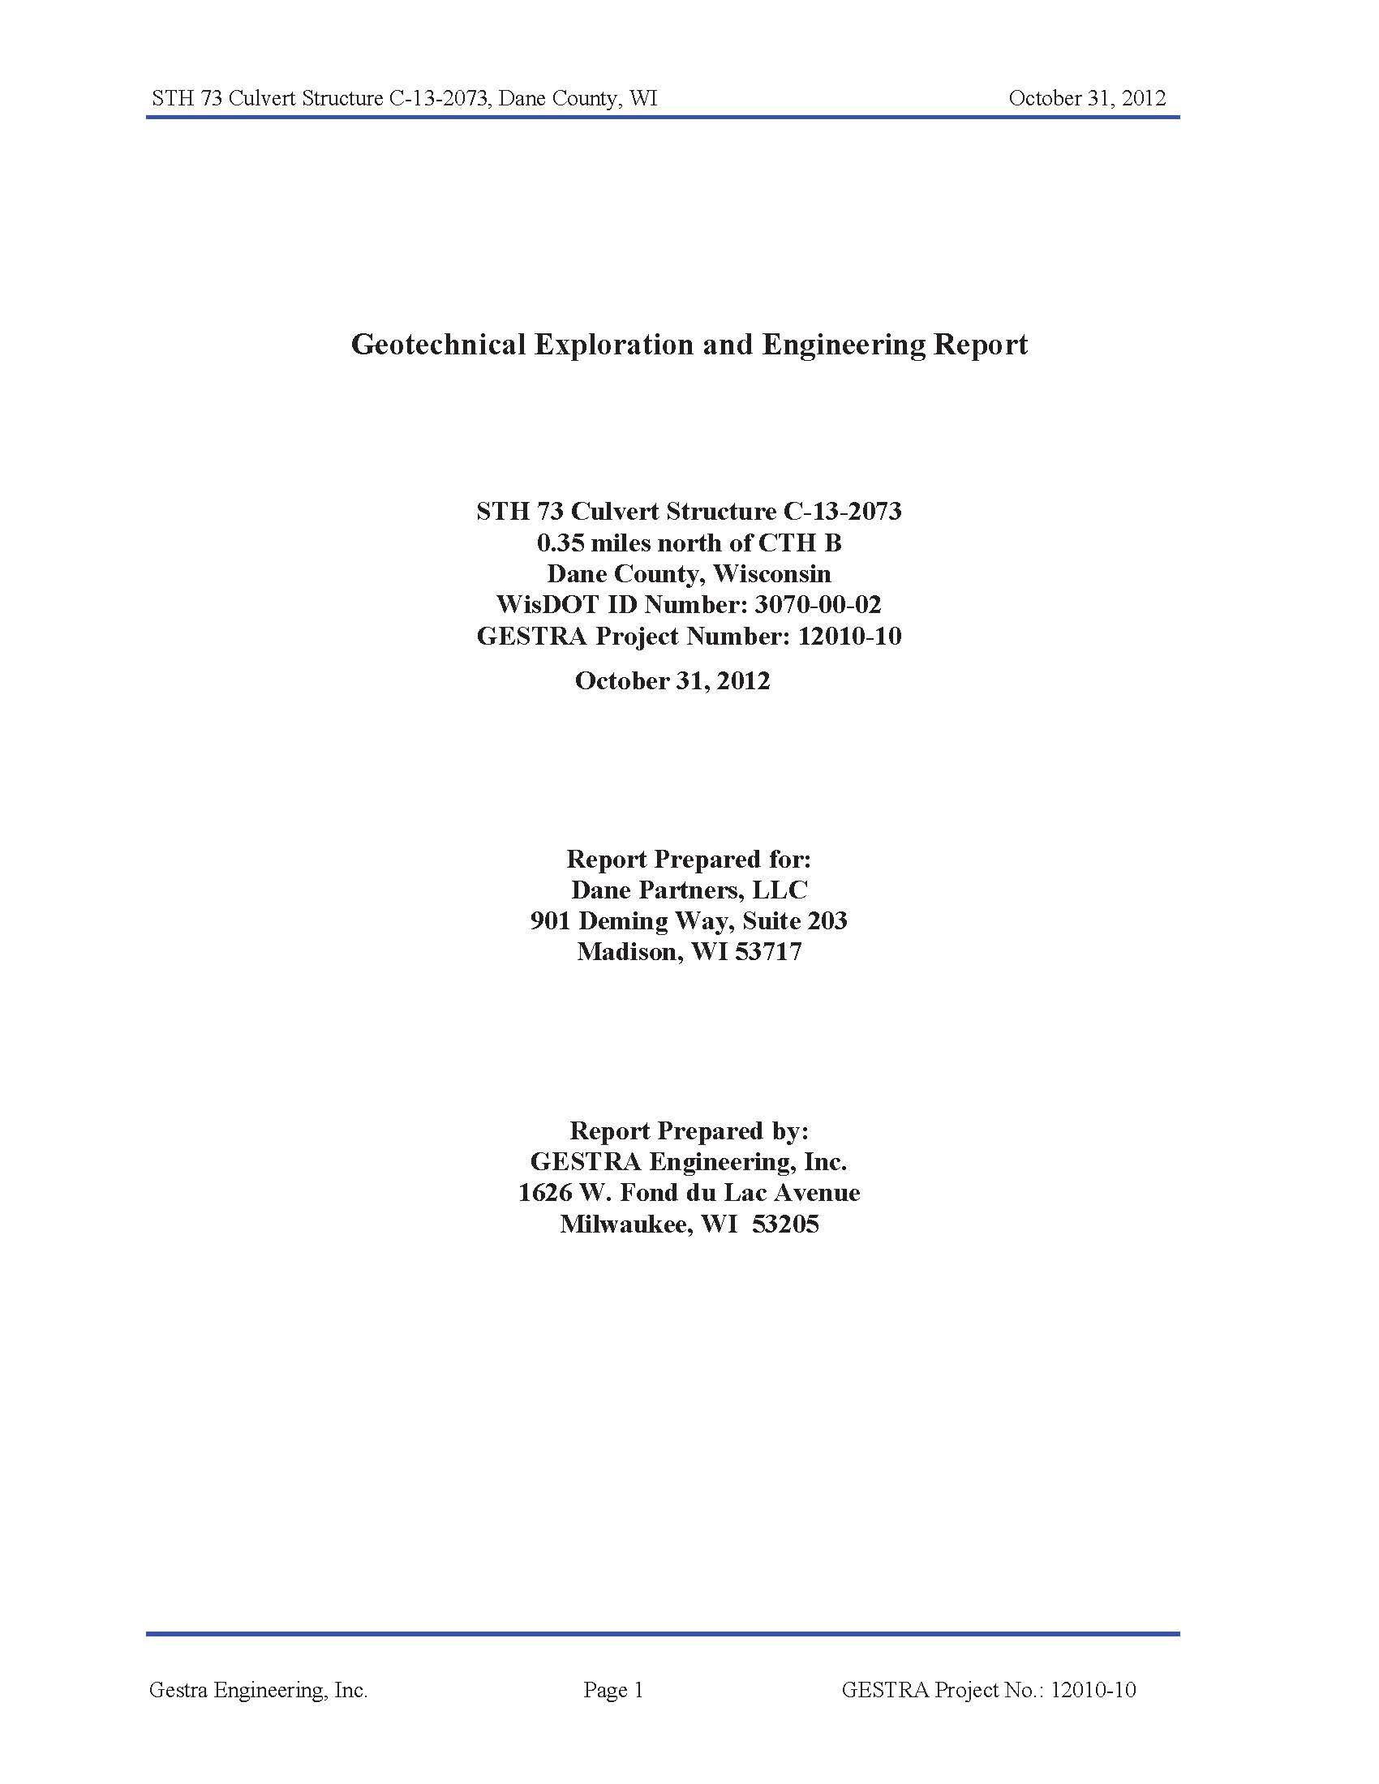

Slide 17
Geotechnical Report - Recommendation

Slide 21
Bridges
Deep Foundations (Piles and Drilled Shafts)
Shallow Foundations (Spread Footings)

Slide 22
Piles
Types of Piles and What They Do
Design Pile Length
3. I Can’t Get Bearing or Damage Pile

Slide 23
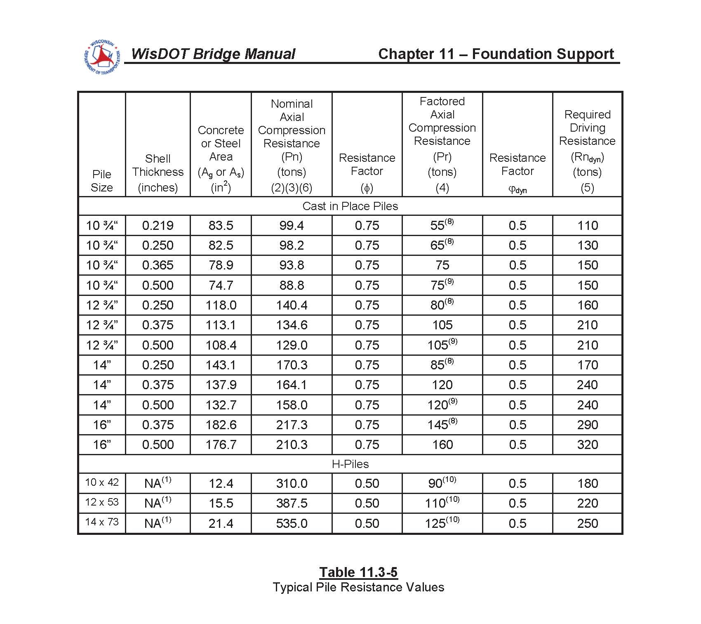

Slide 24
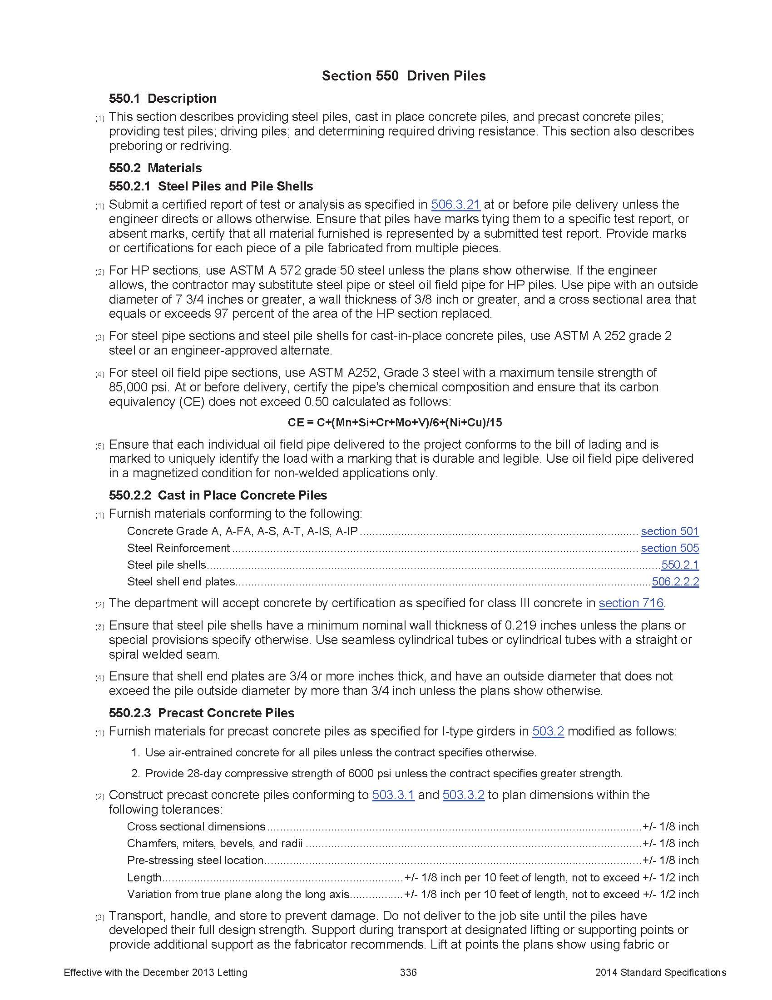

Slide 25
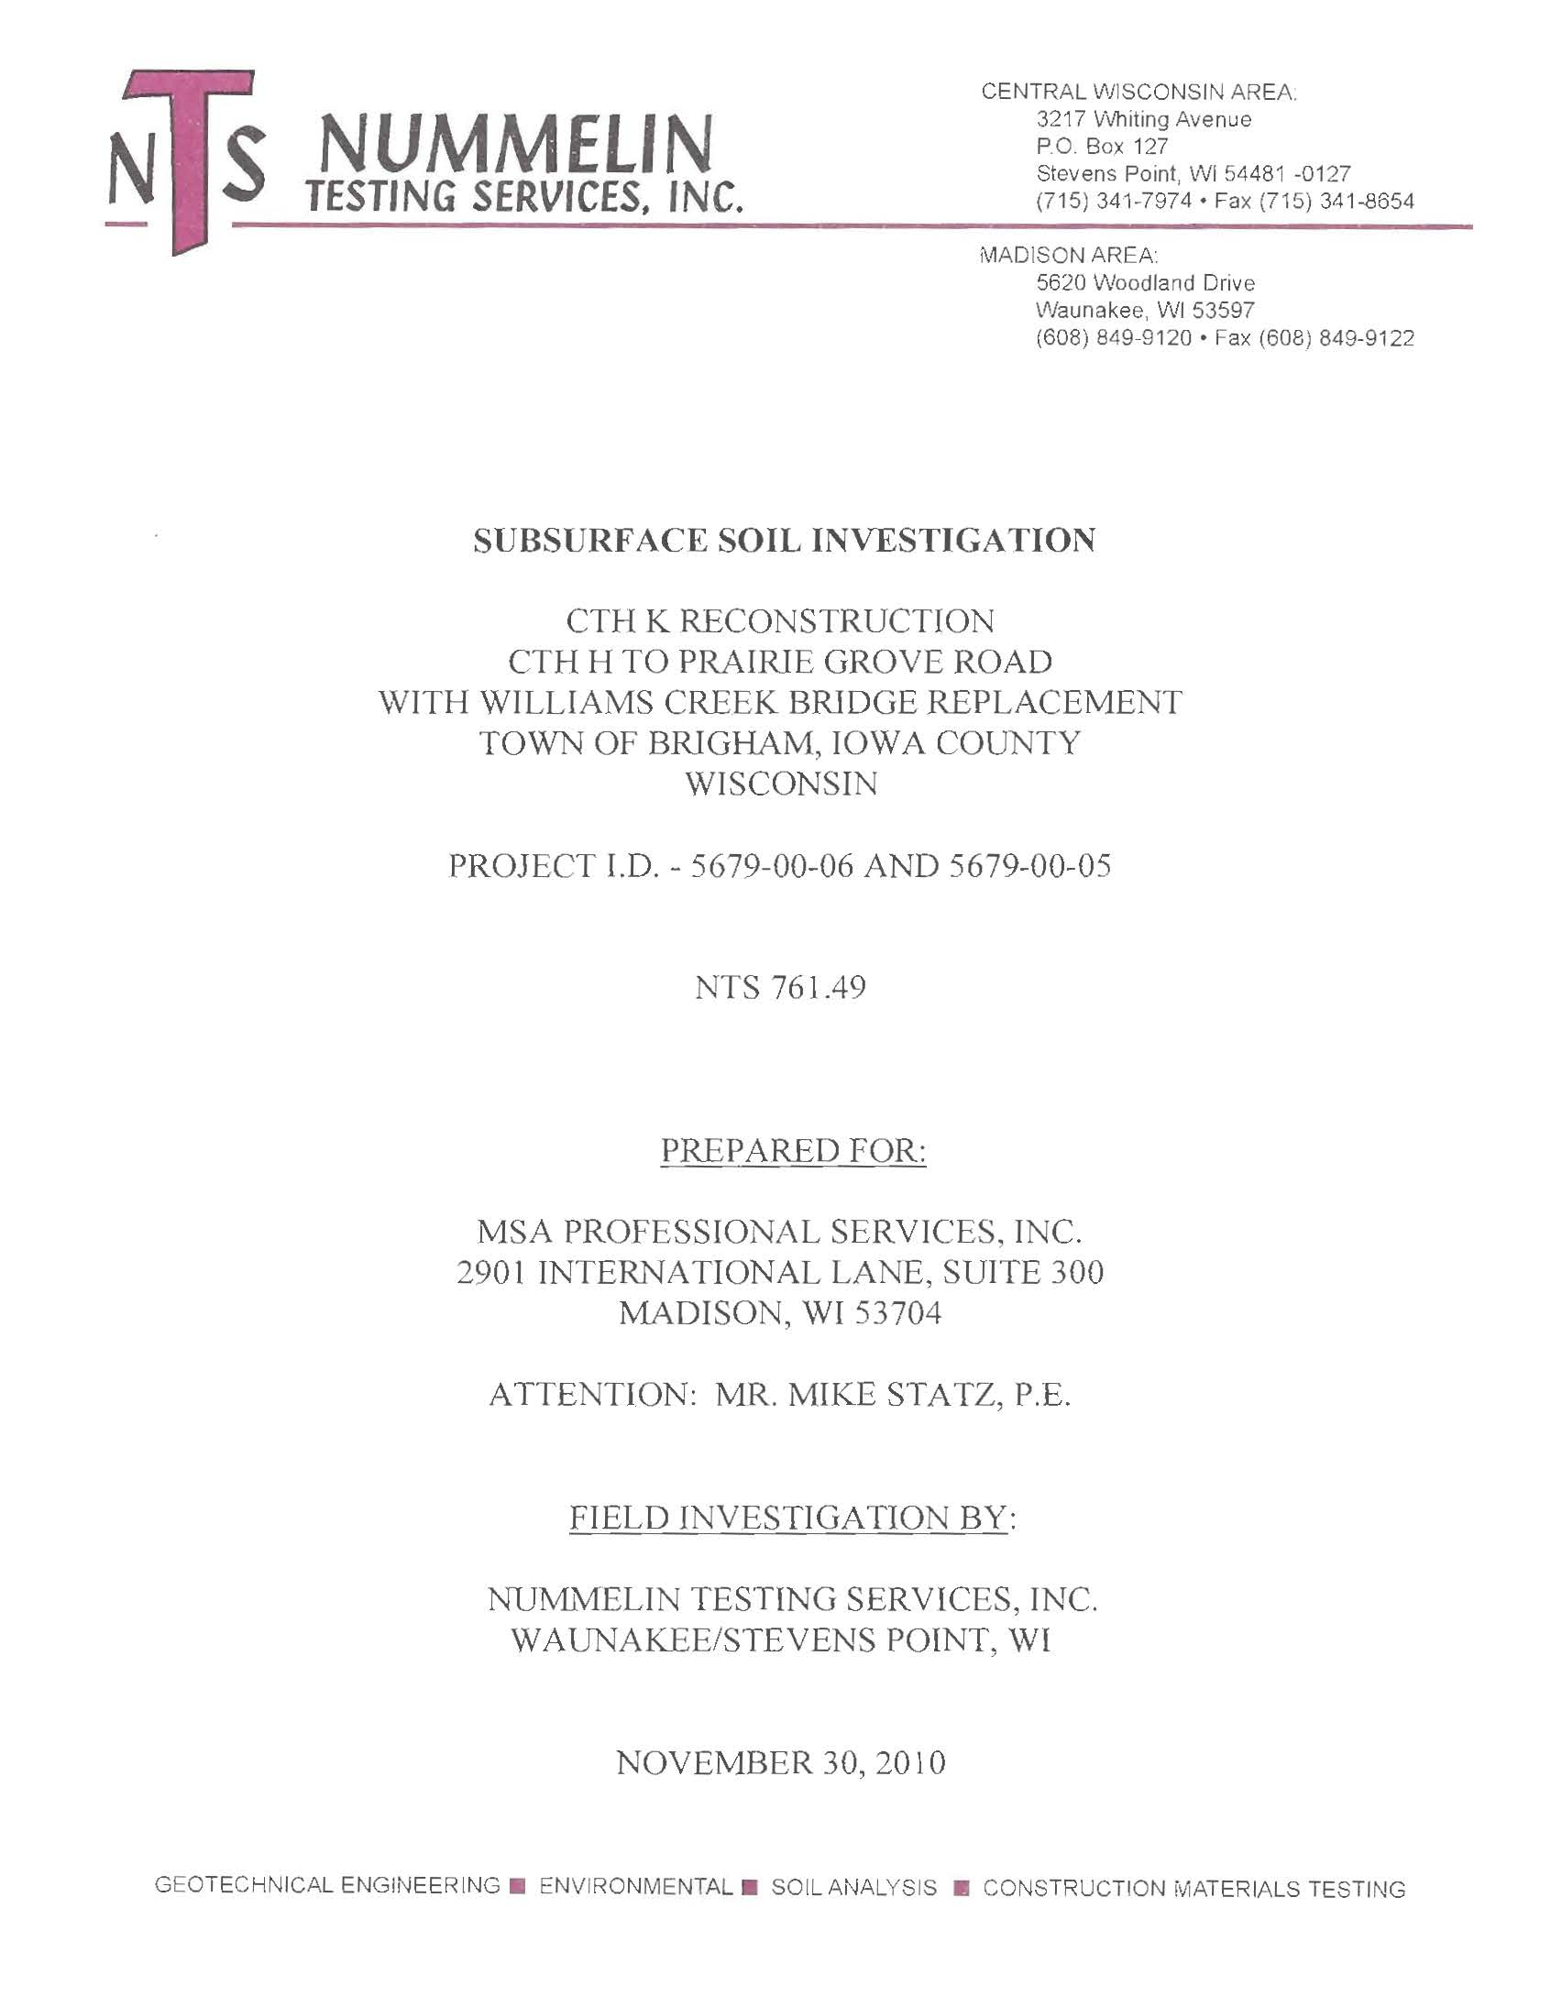

Slide 26
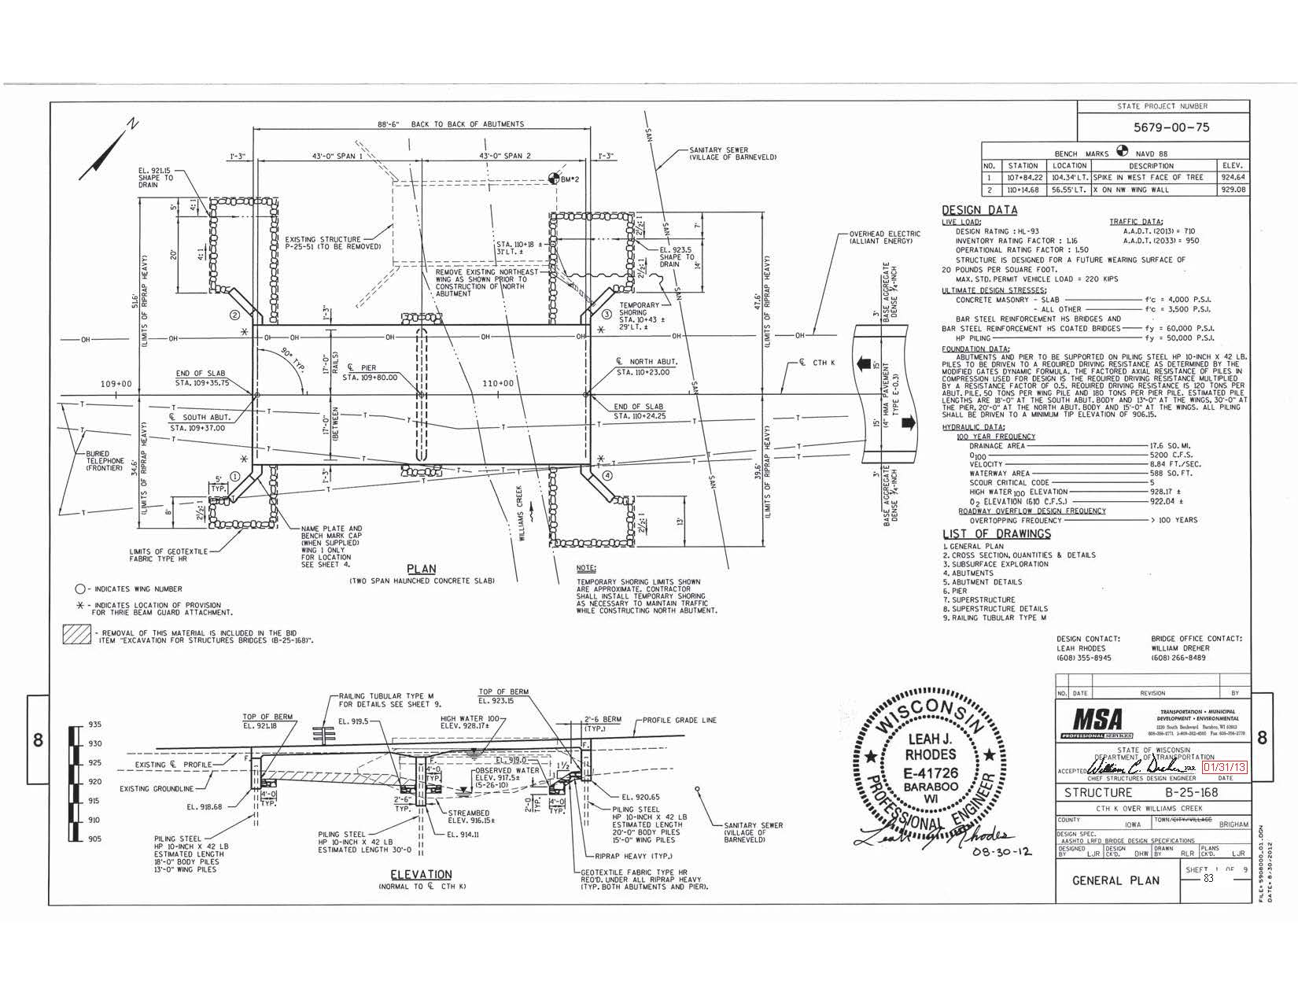

Slide 28
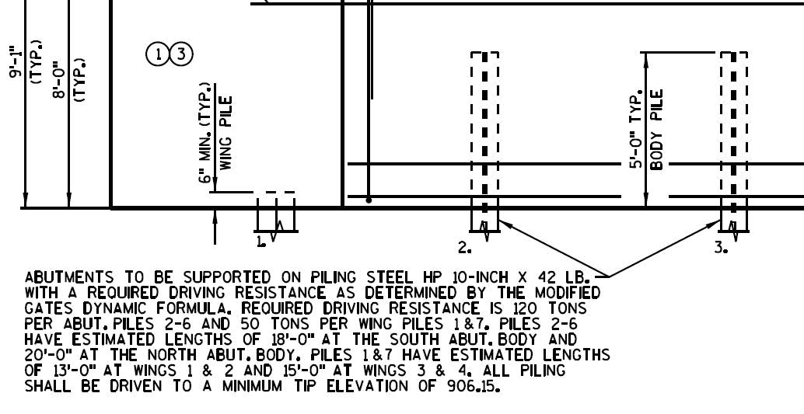

Slide 29
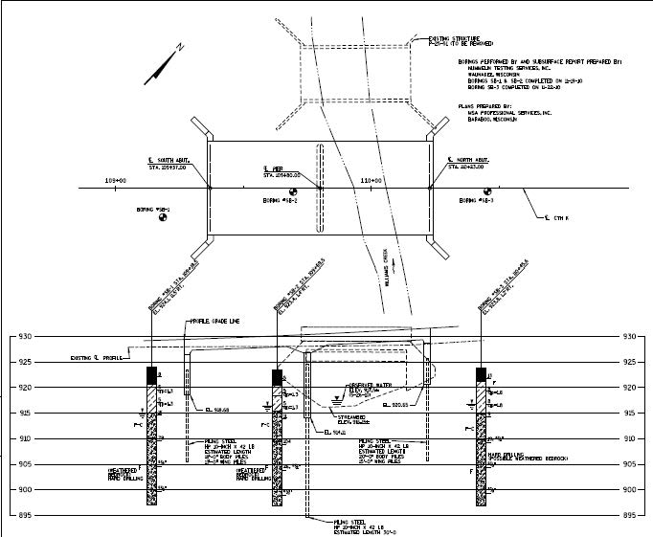

Slide 30
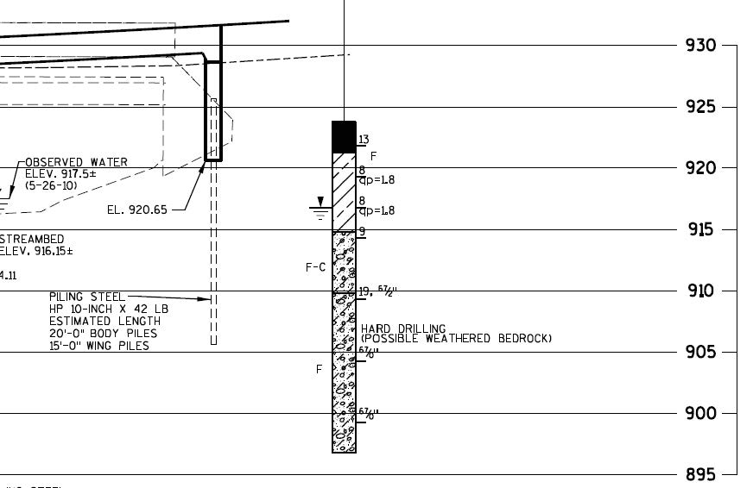

Slide 31
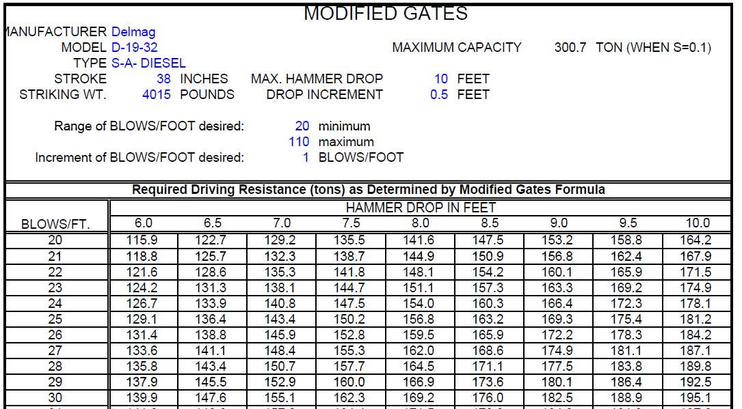

Slide 32
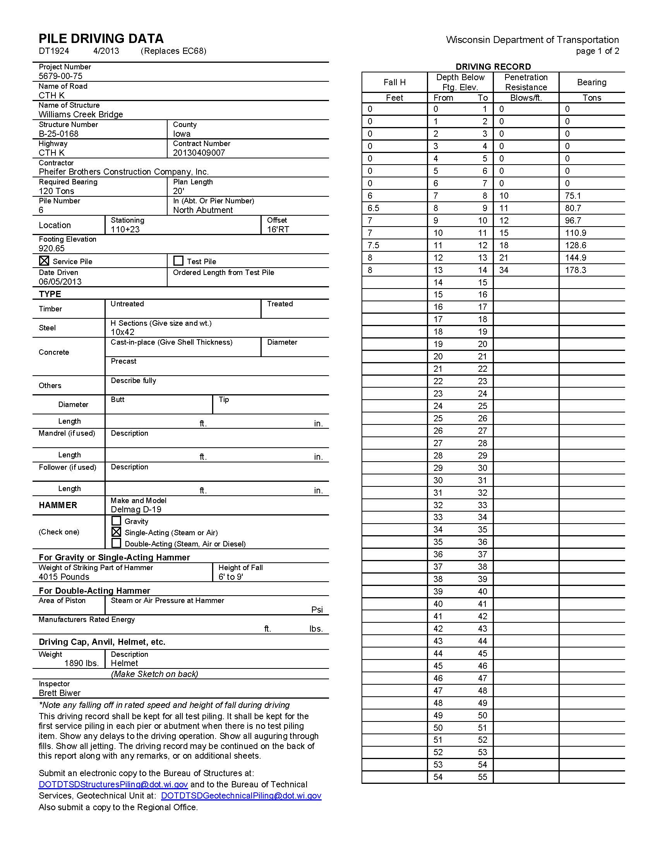

Slide 33
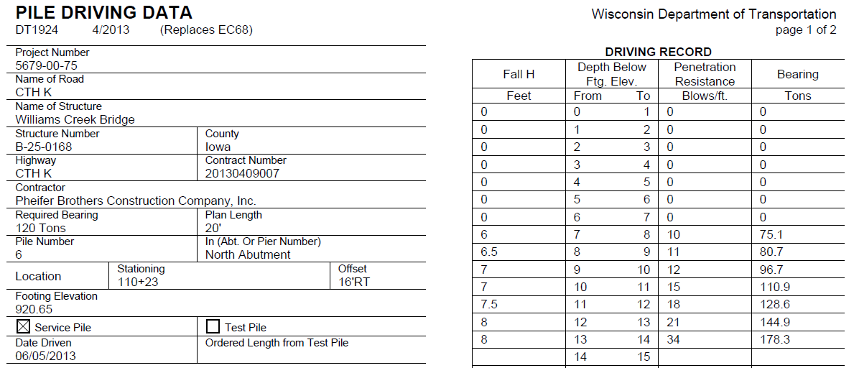

Slide 34
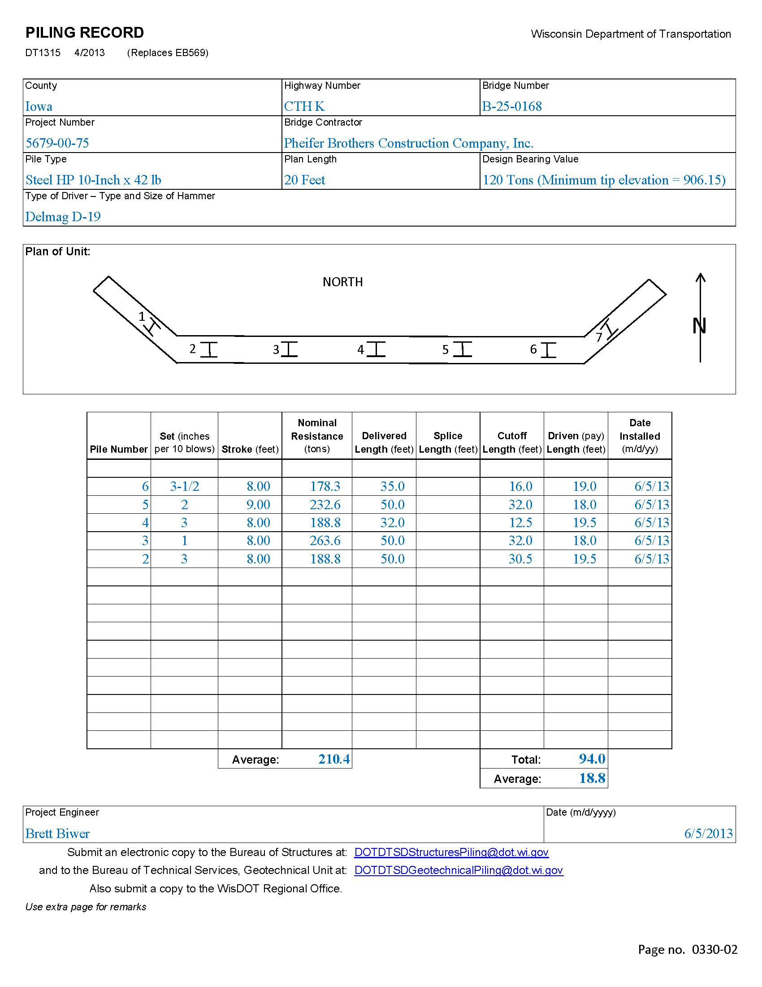

Slide 35
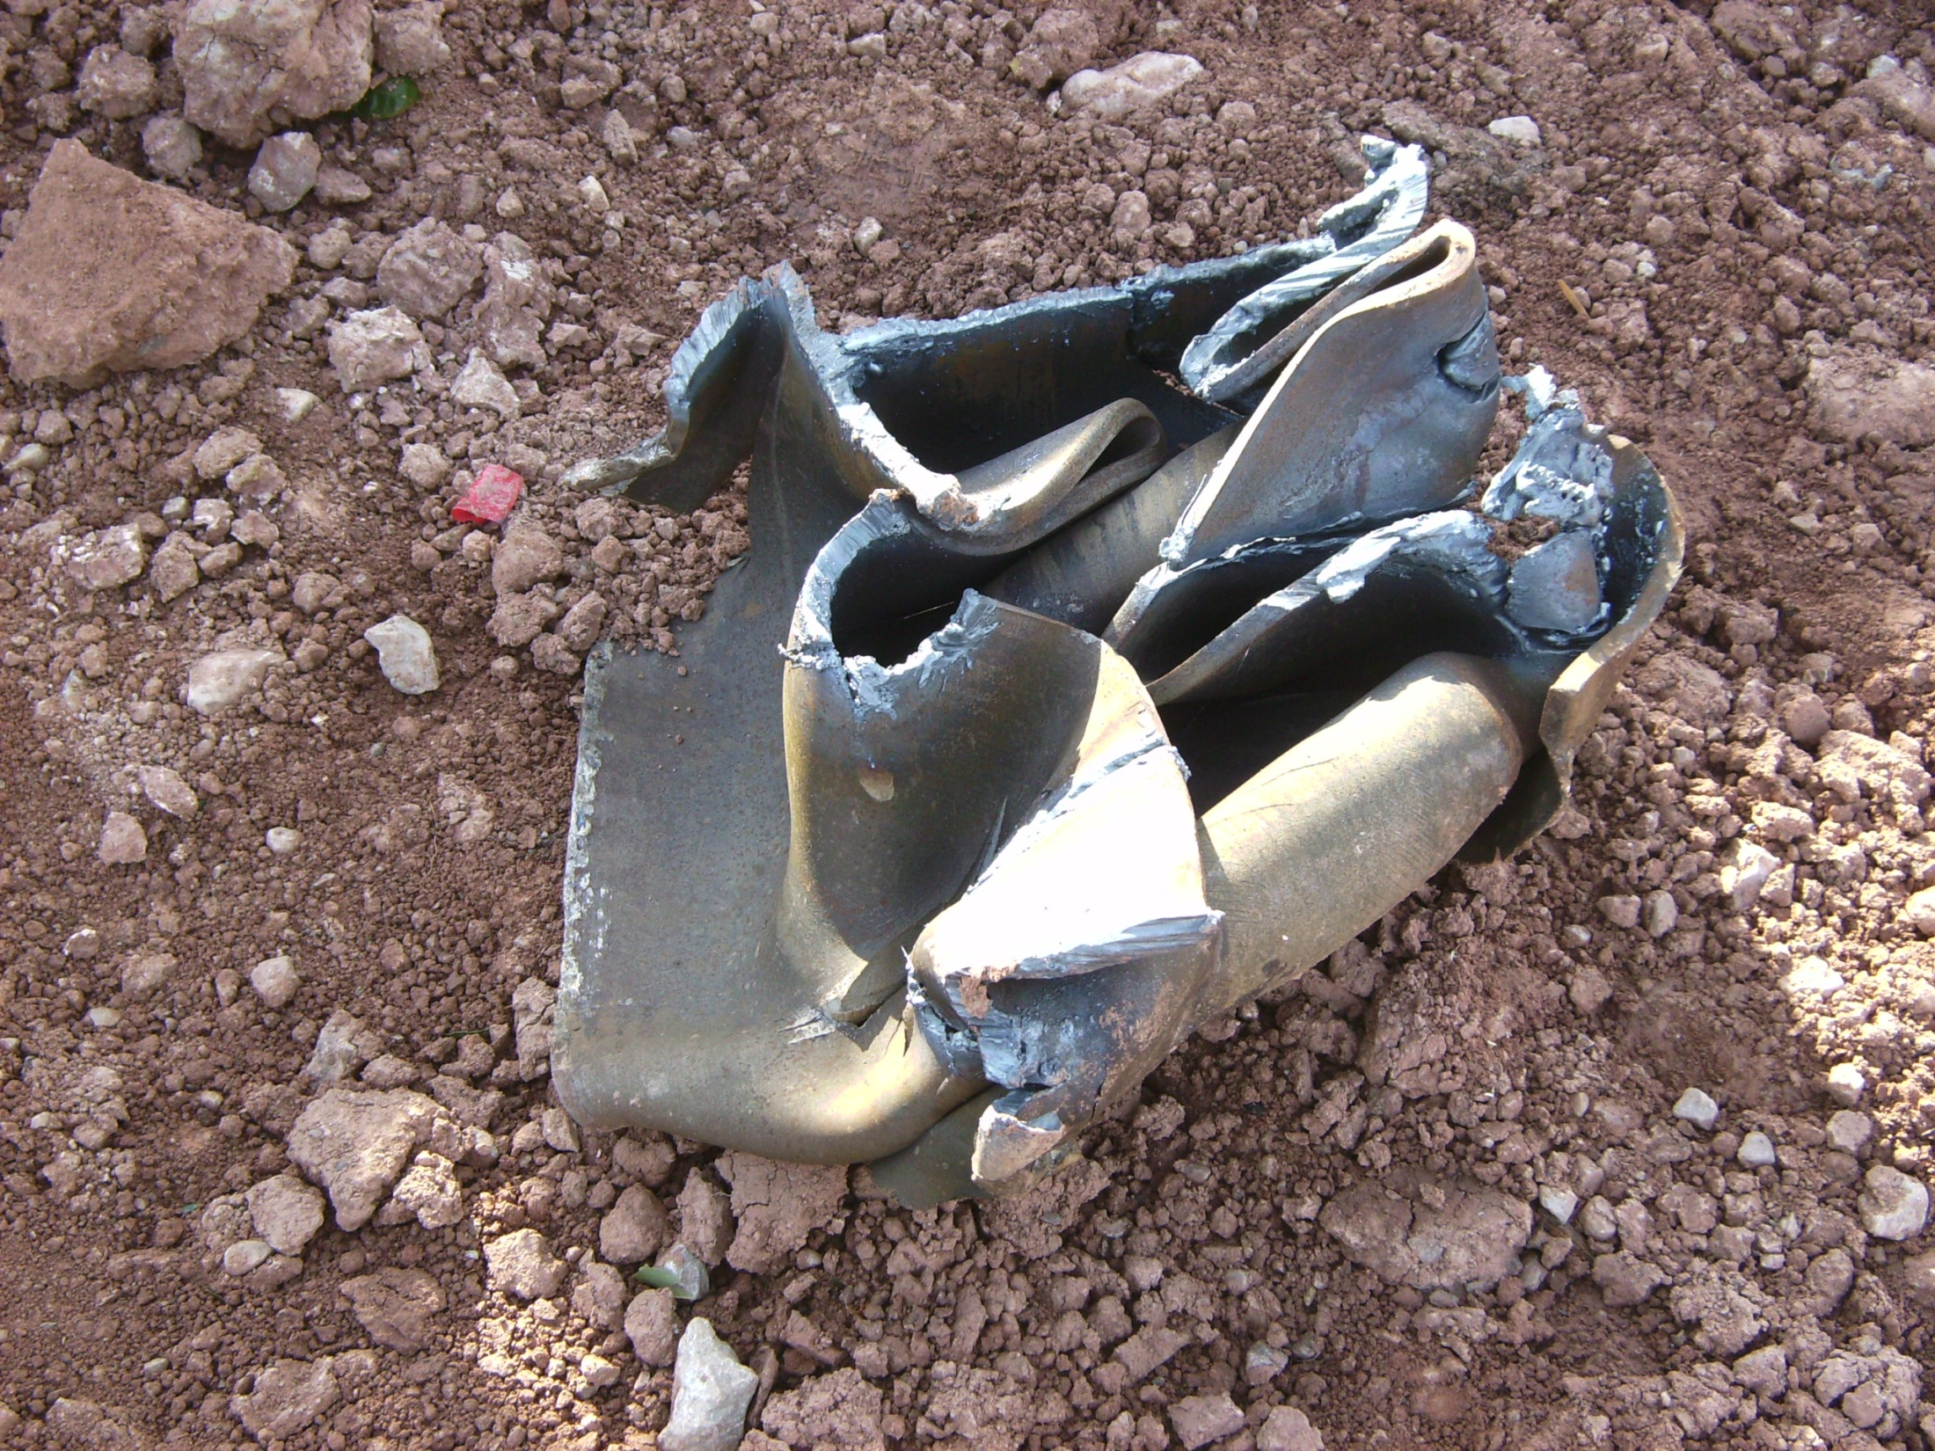

Slide 36
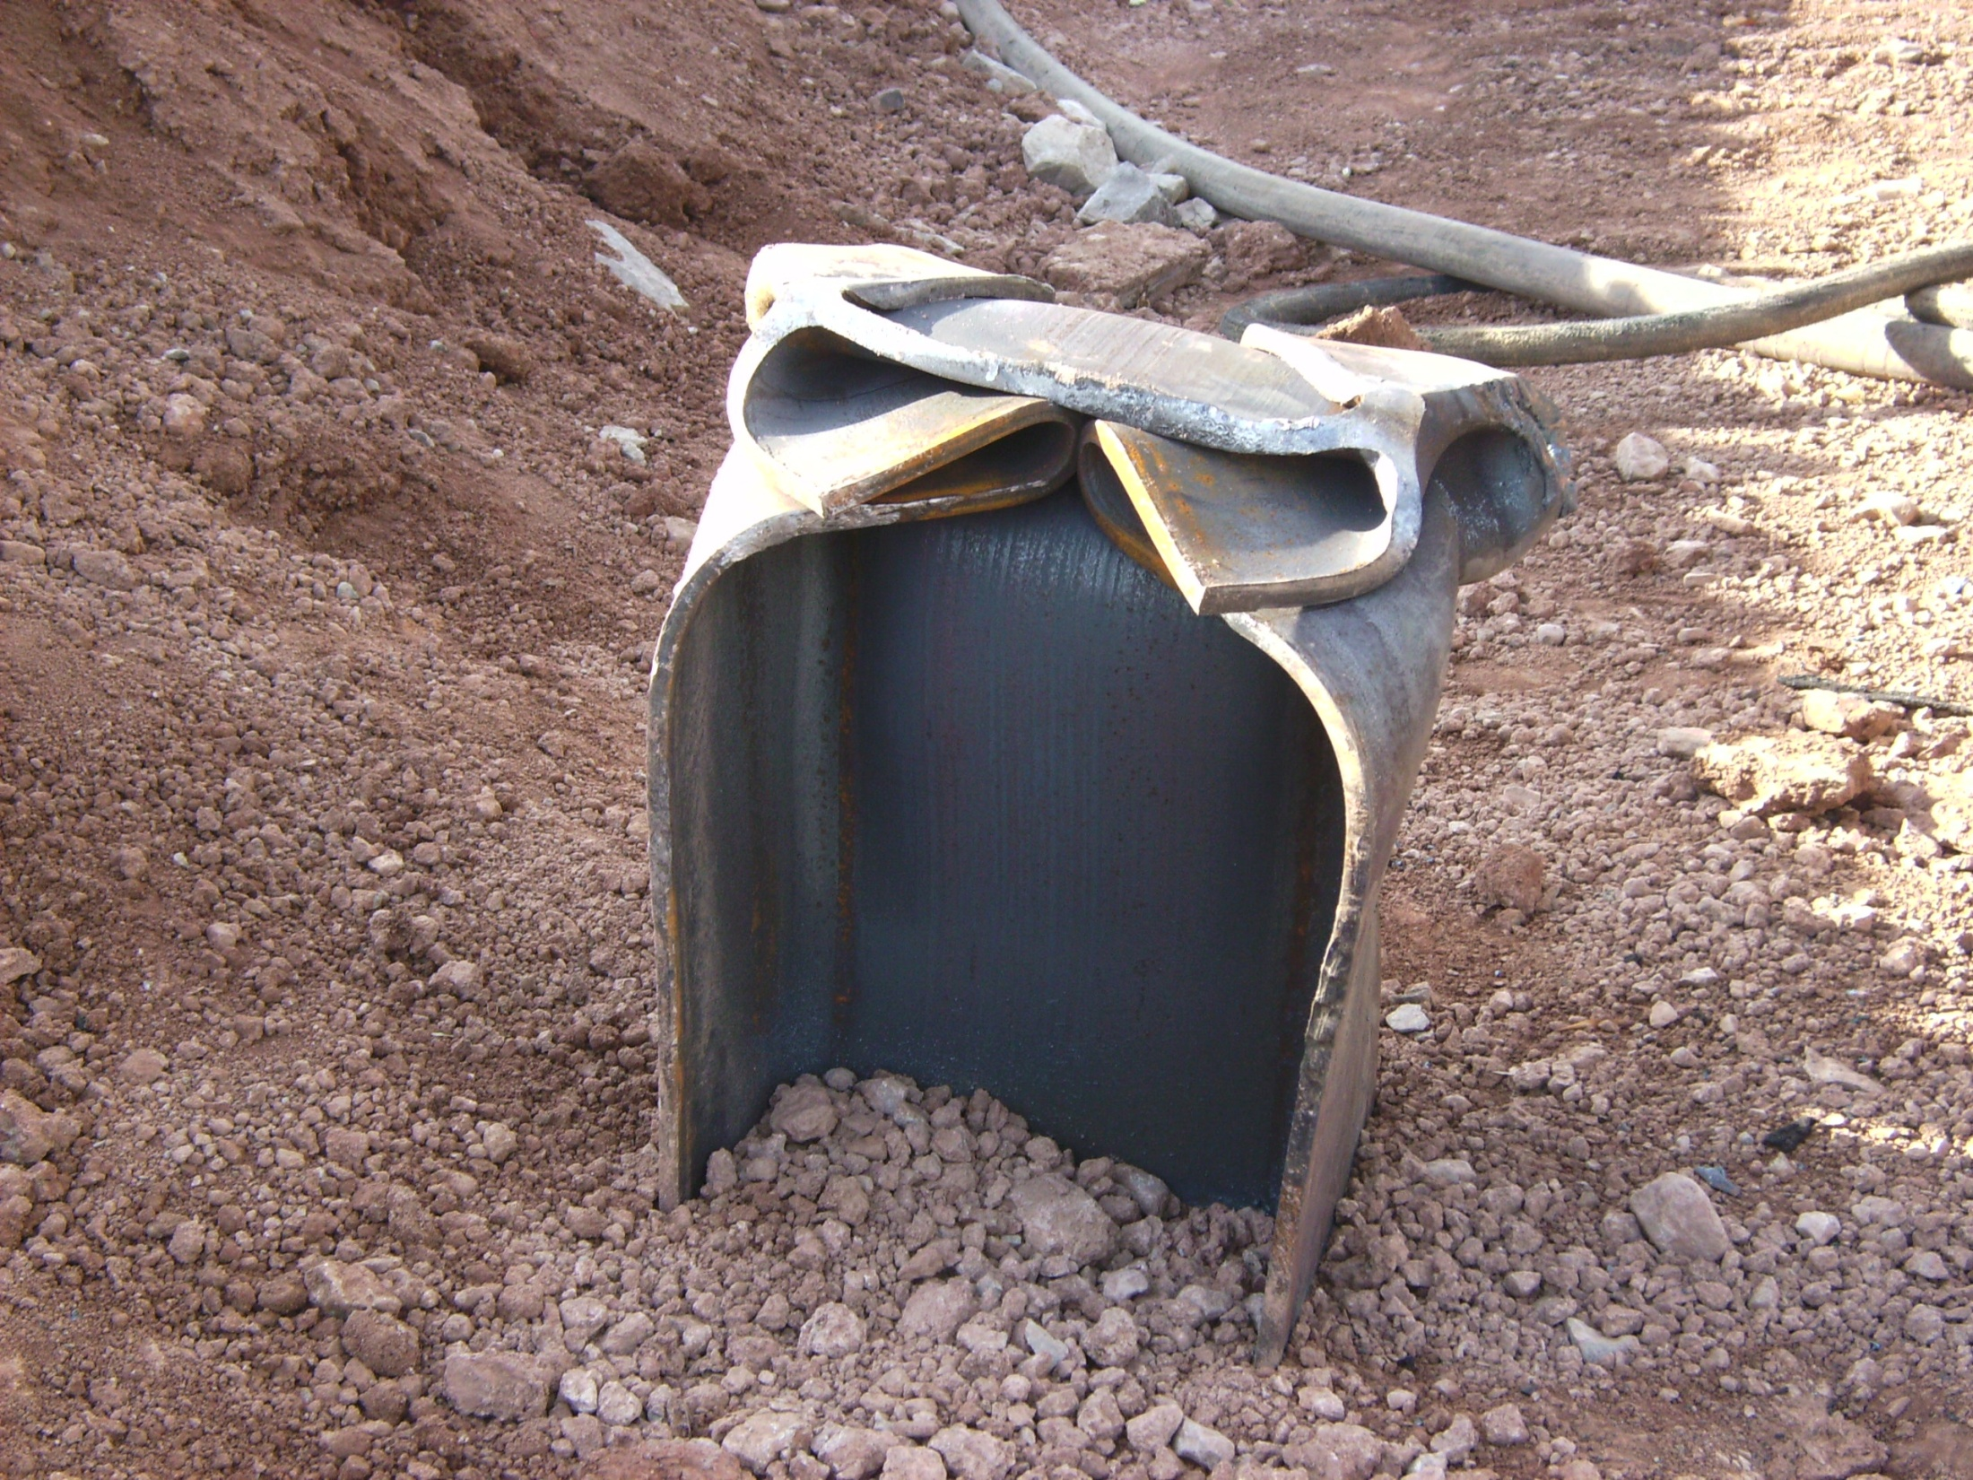

Slide 37
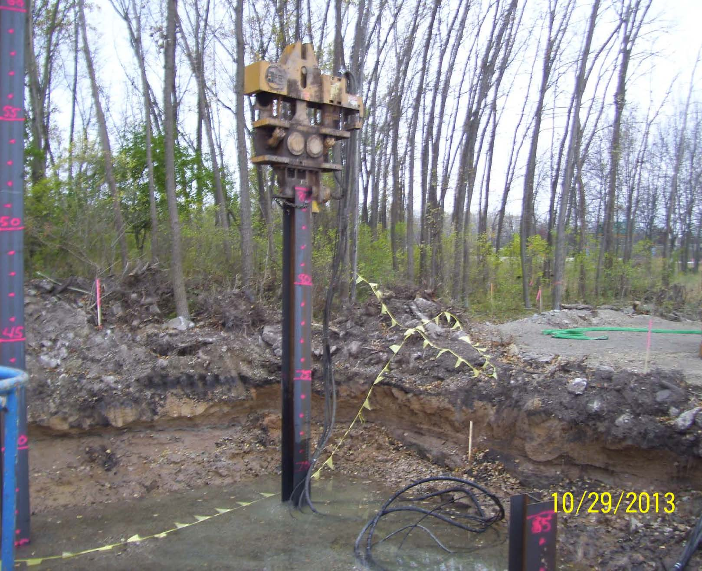

Slide 38
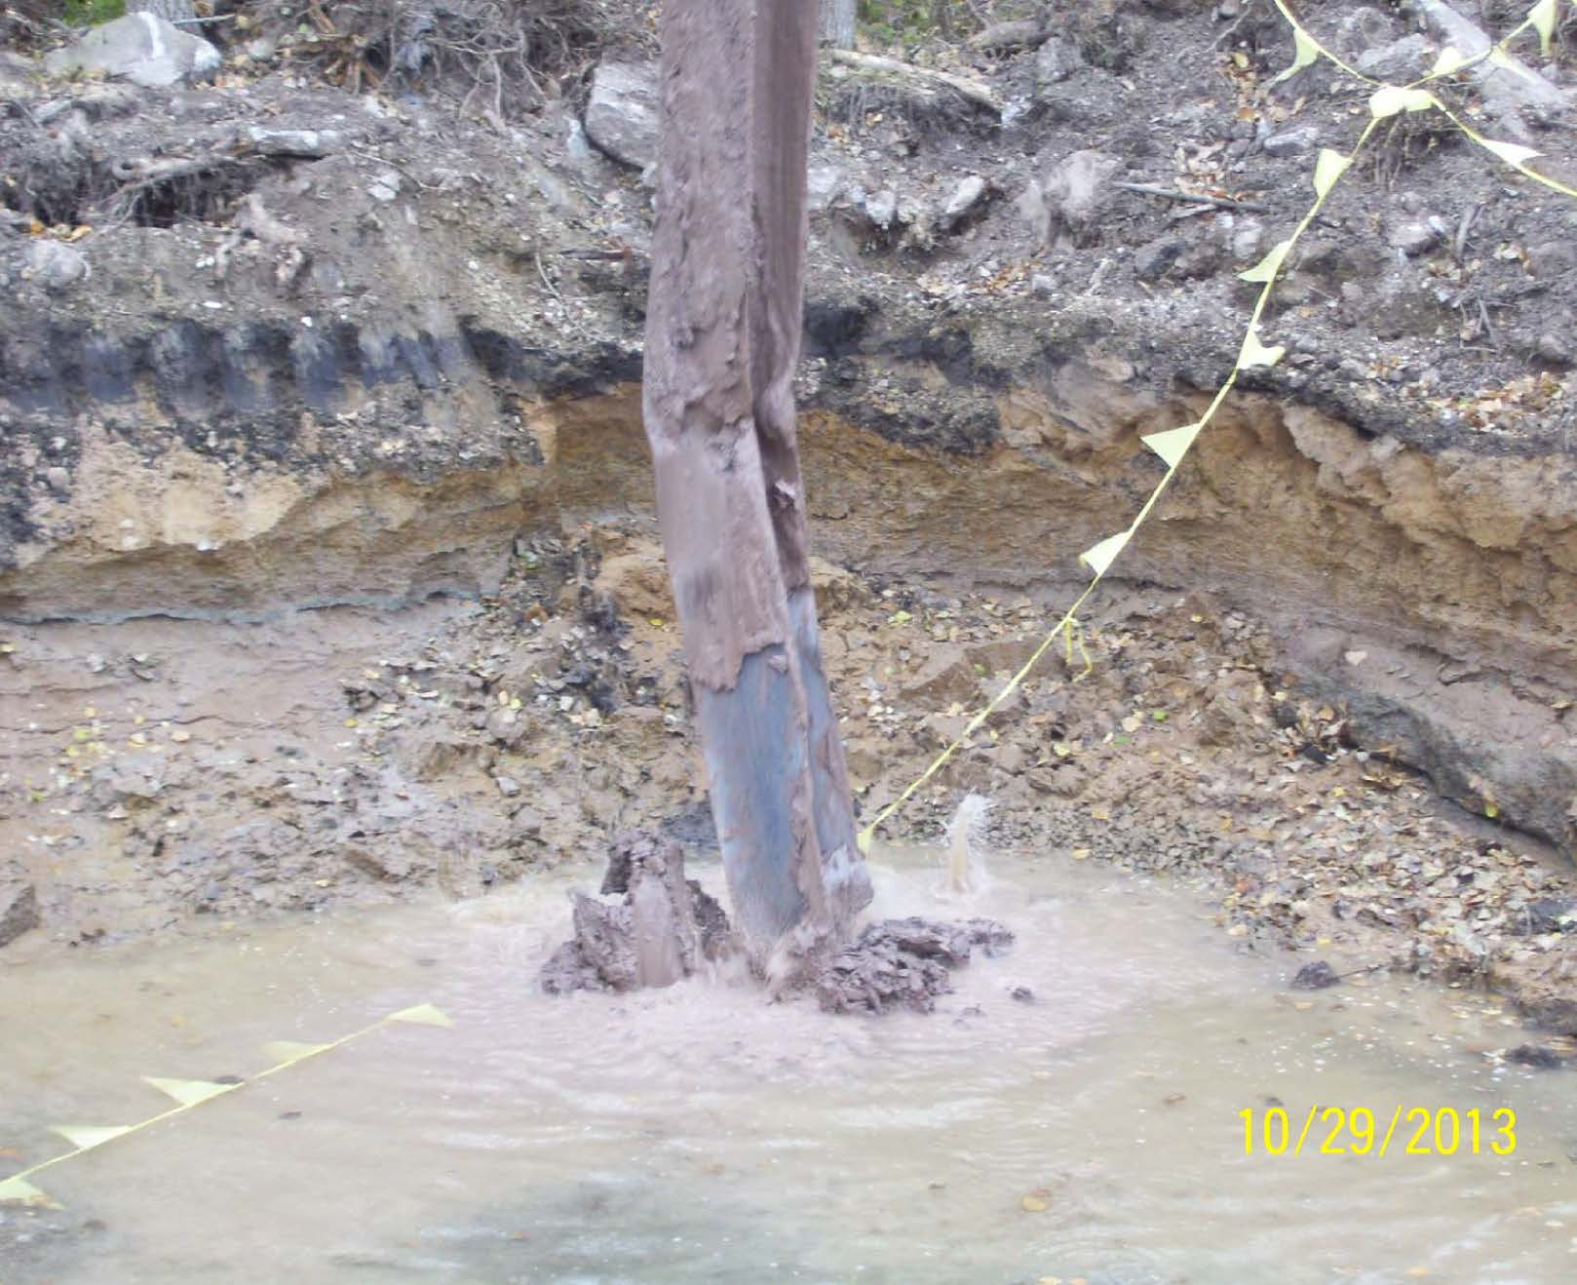

Slide 39
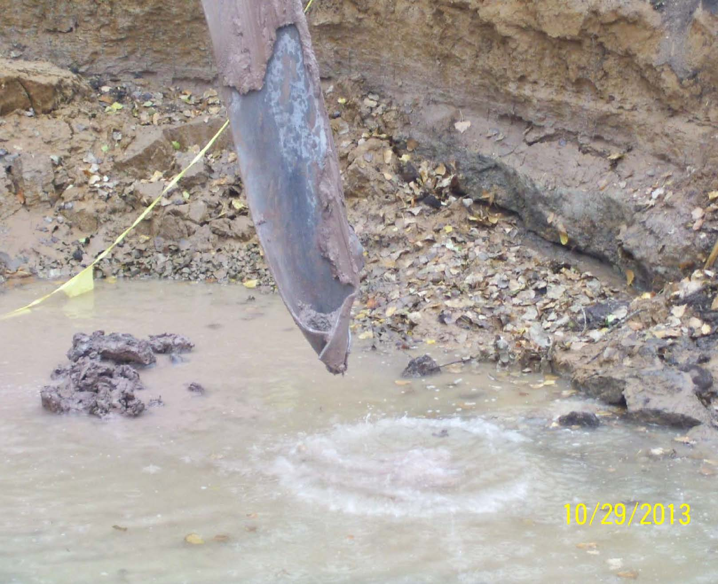

Slide 40
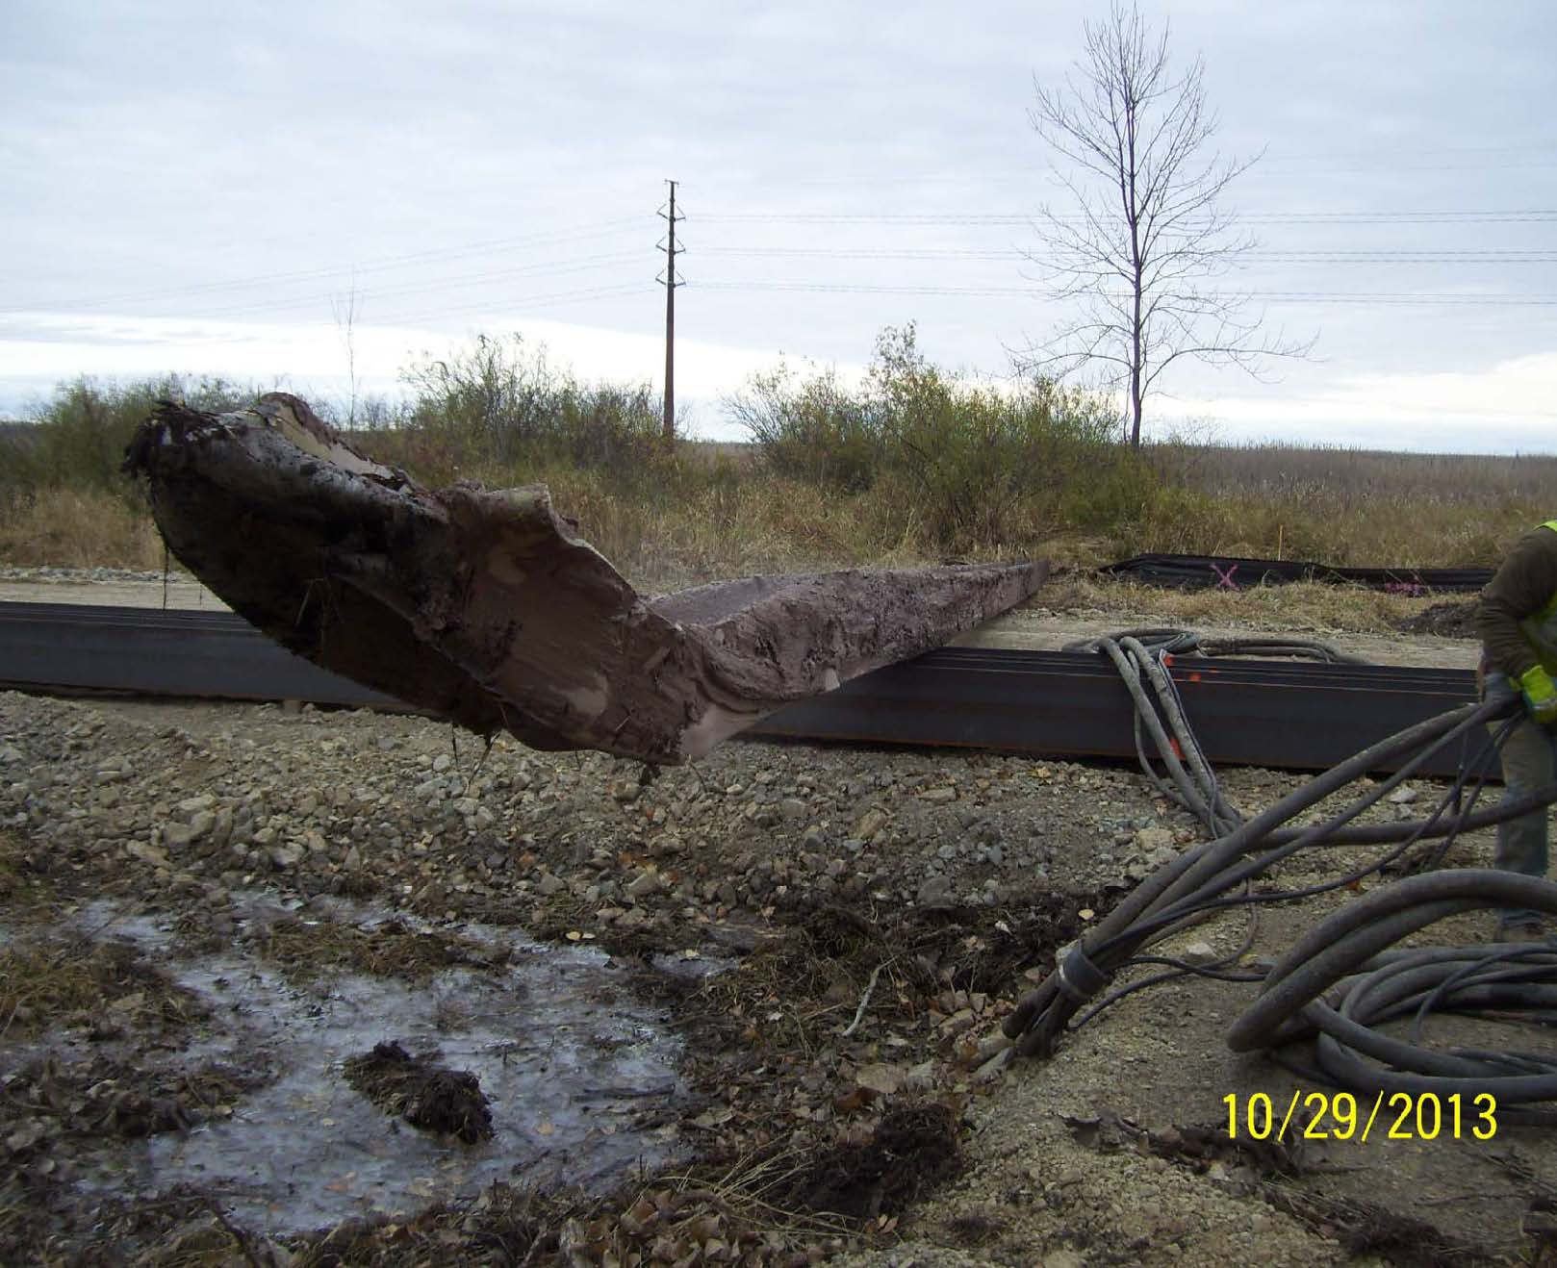

Slide 41
Spread Footings
What to Look for With Spread Footings

Slide 42
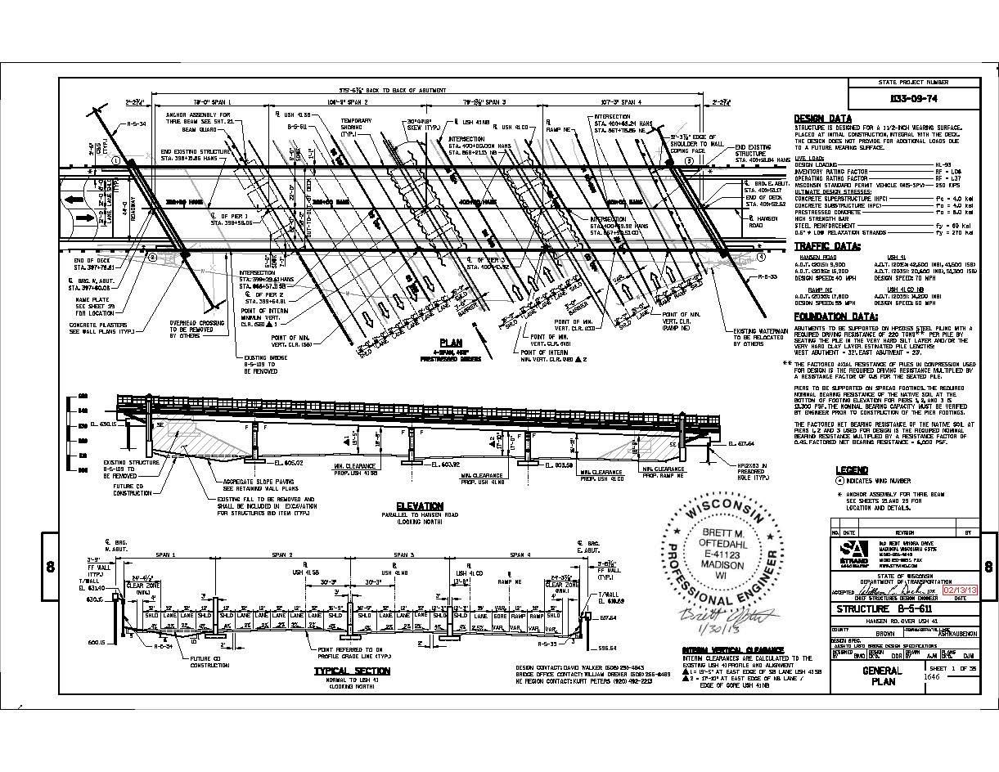

Slide 43
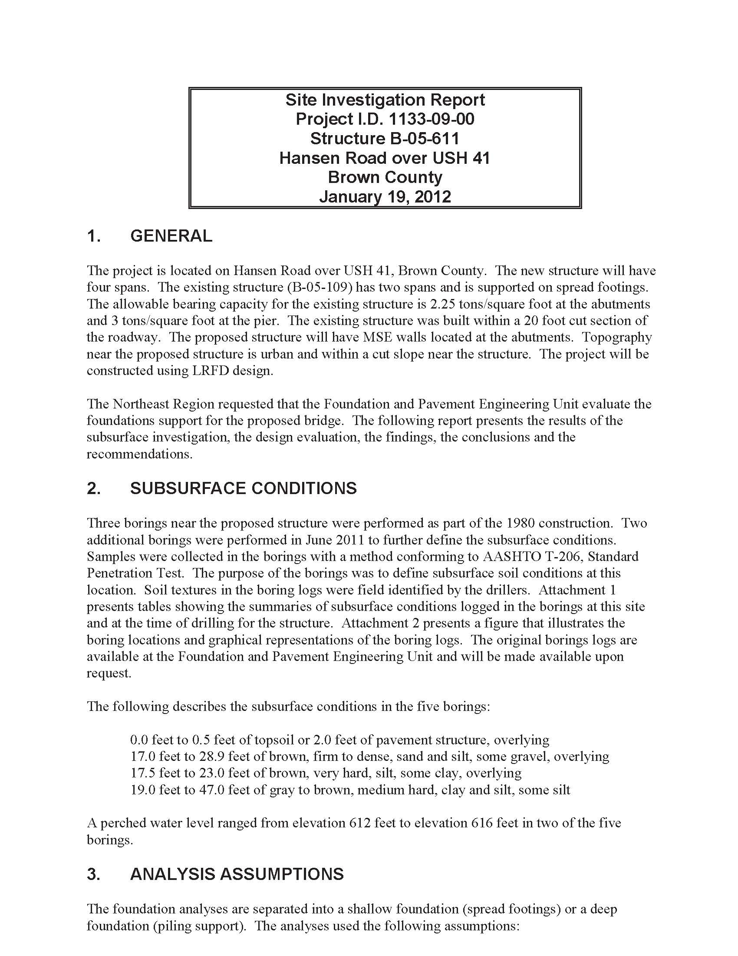

Slide 45
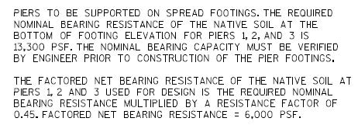

Slide 46
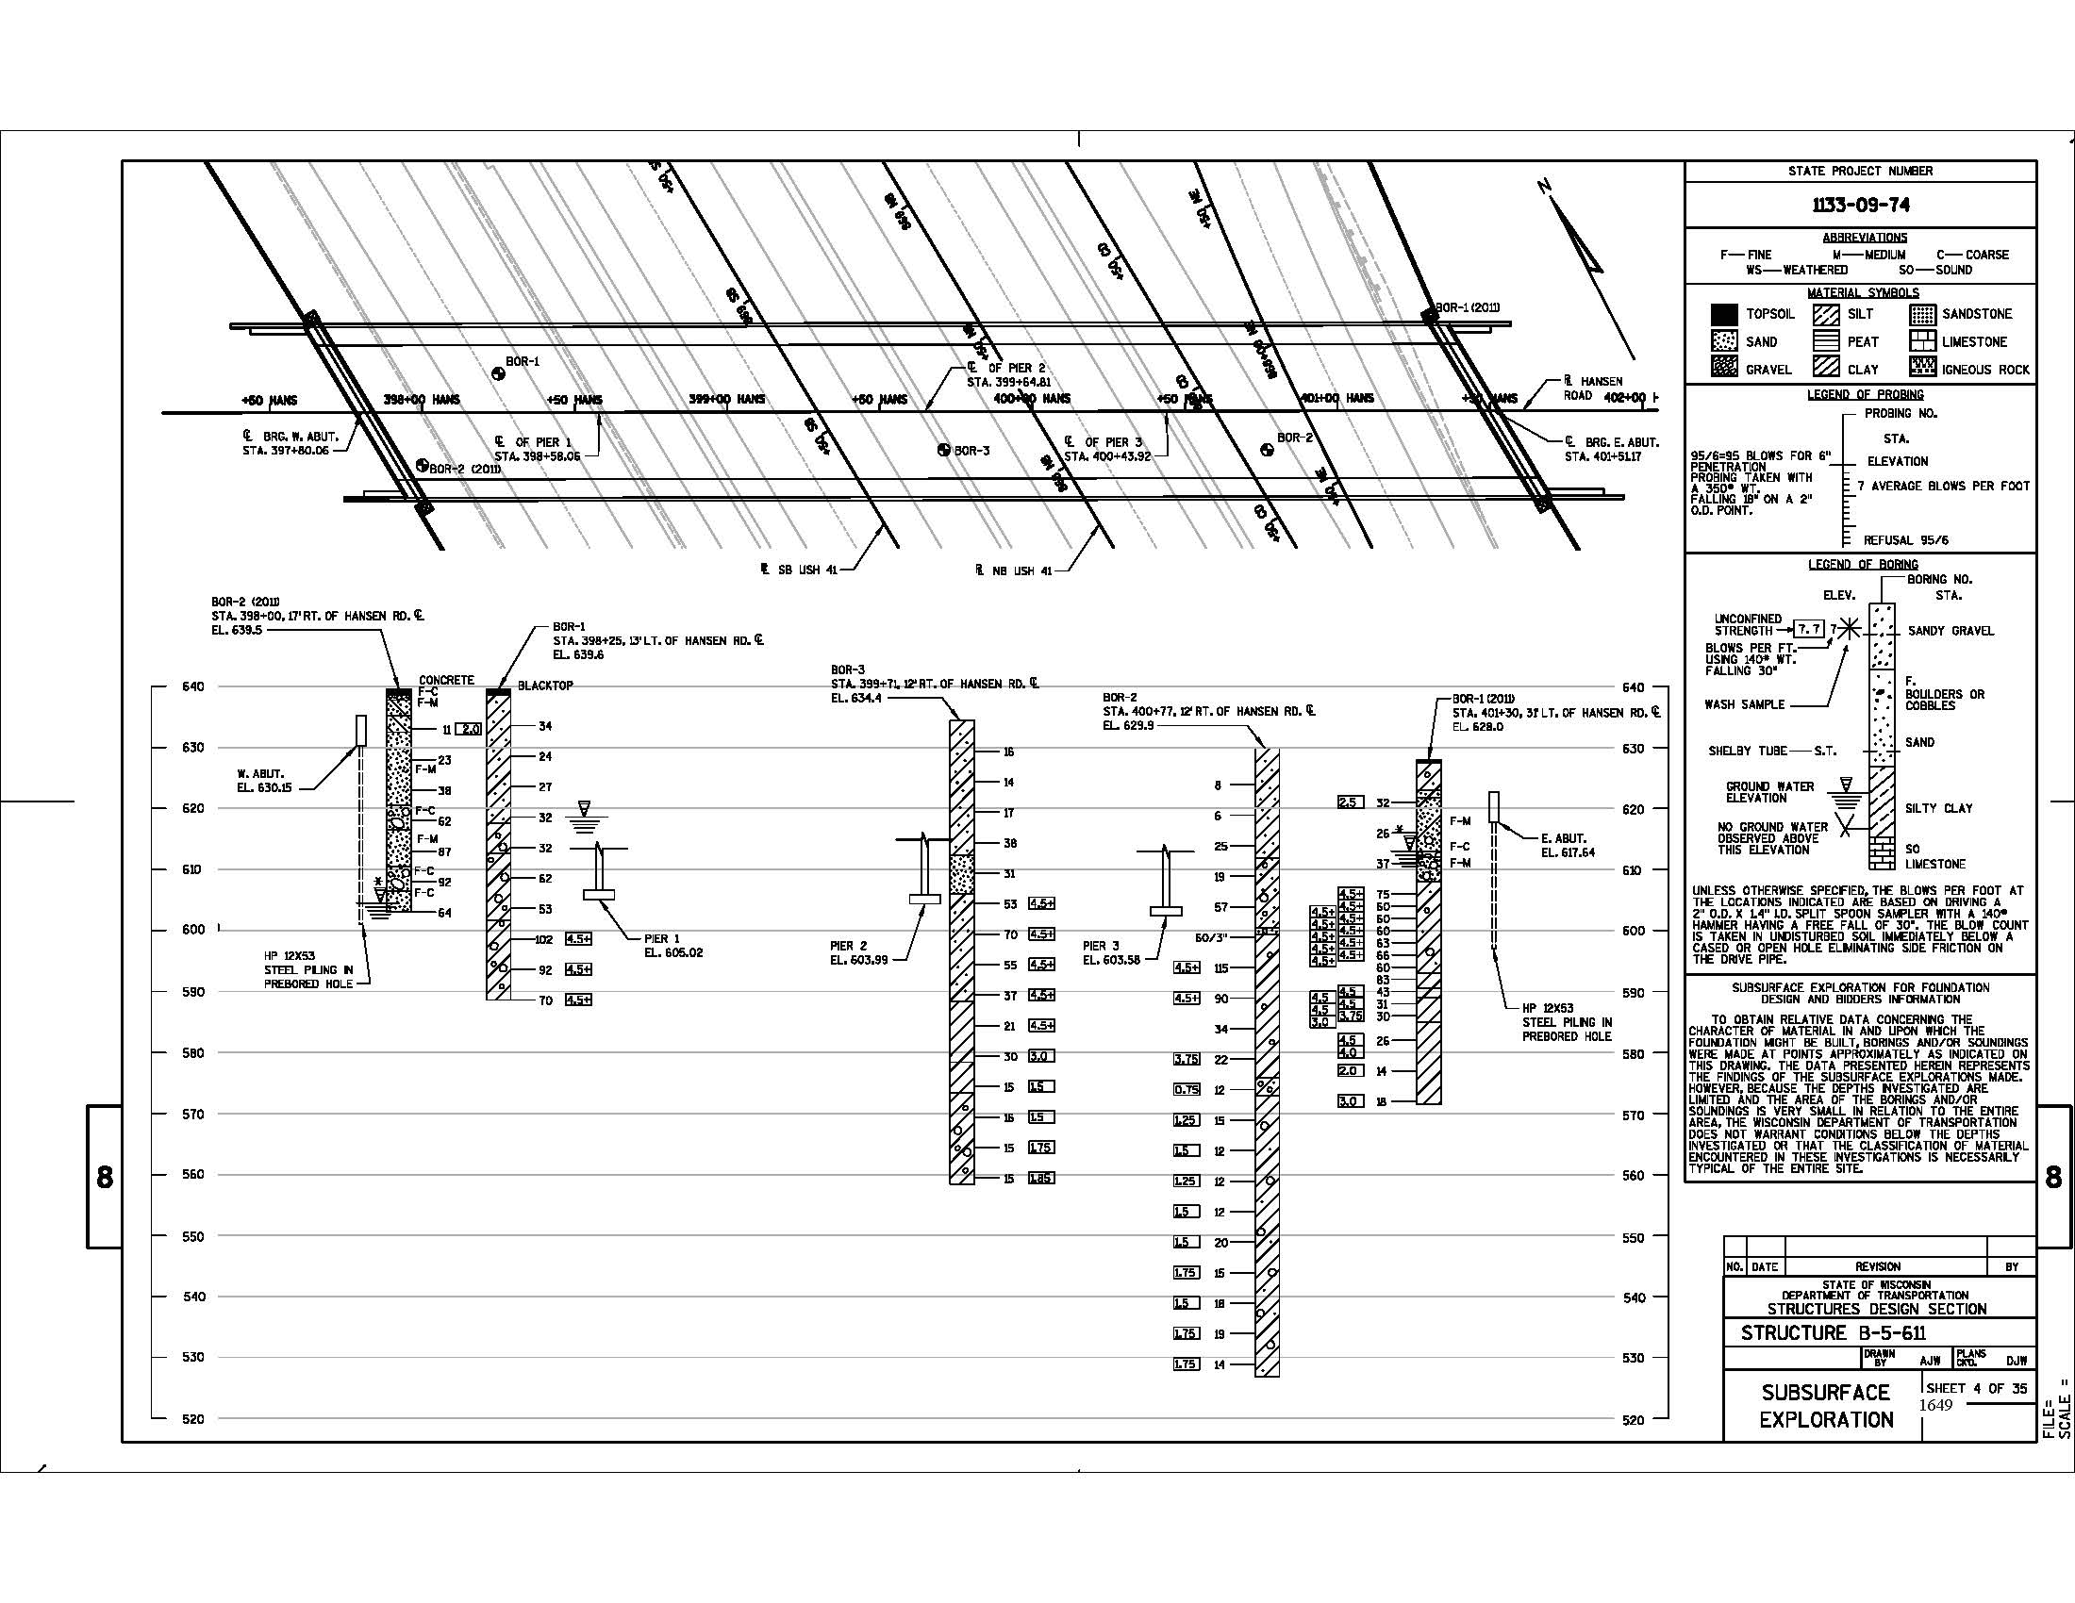

Slide 47
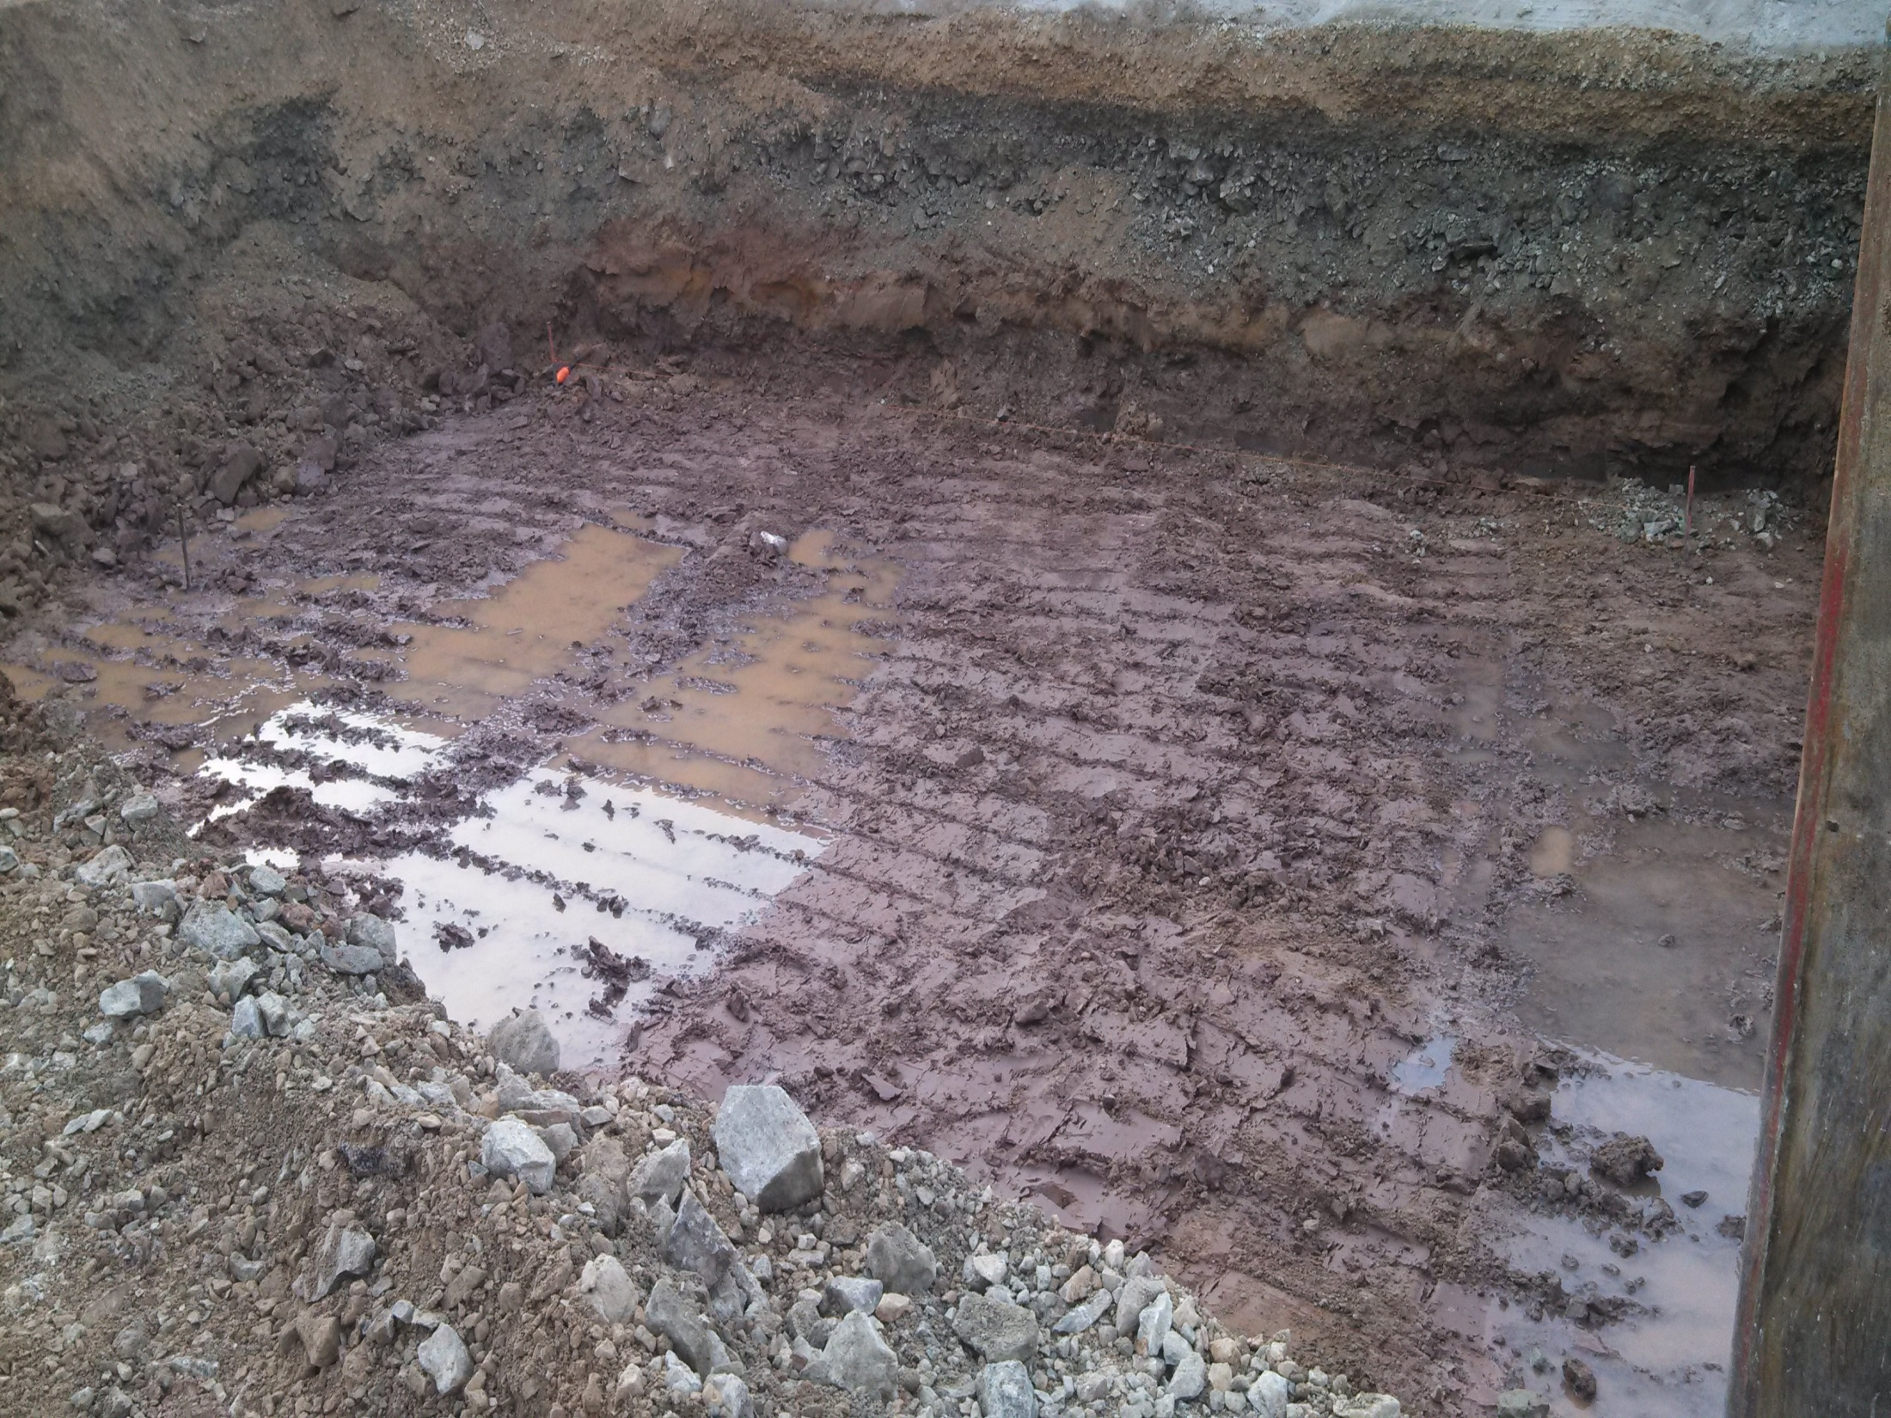

Slide 48
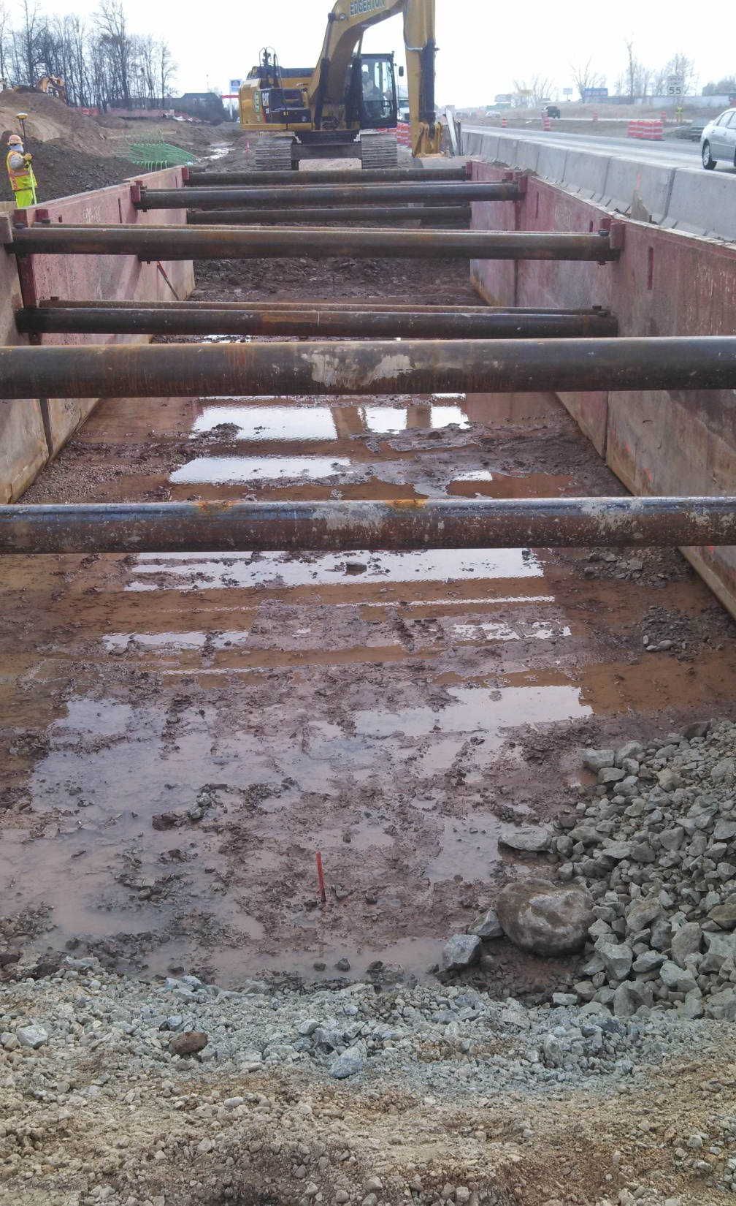

Slide 49
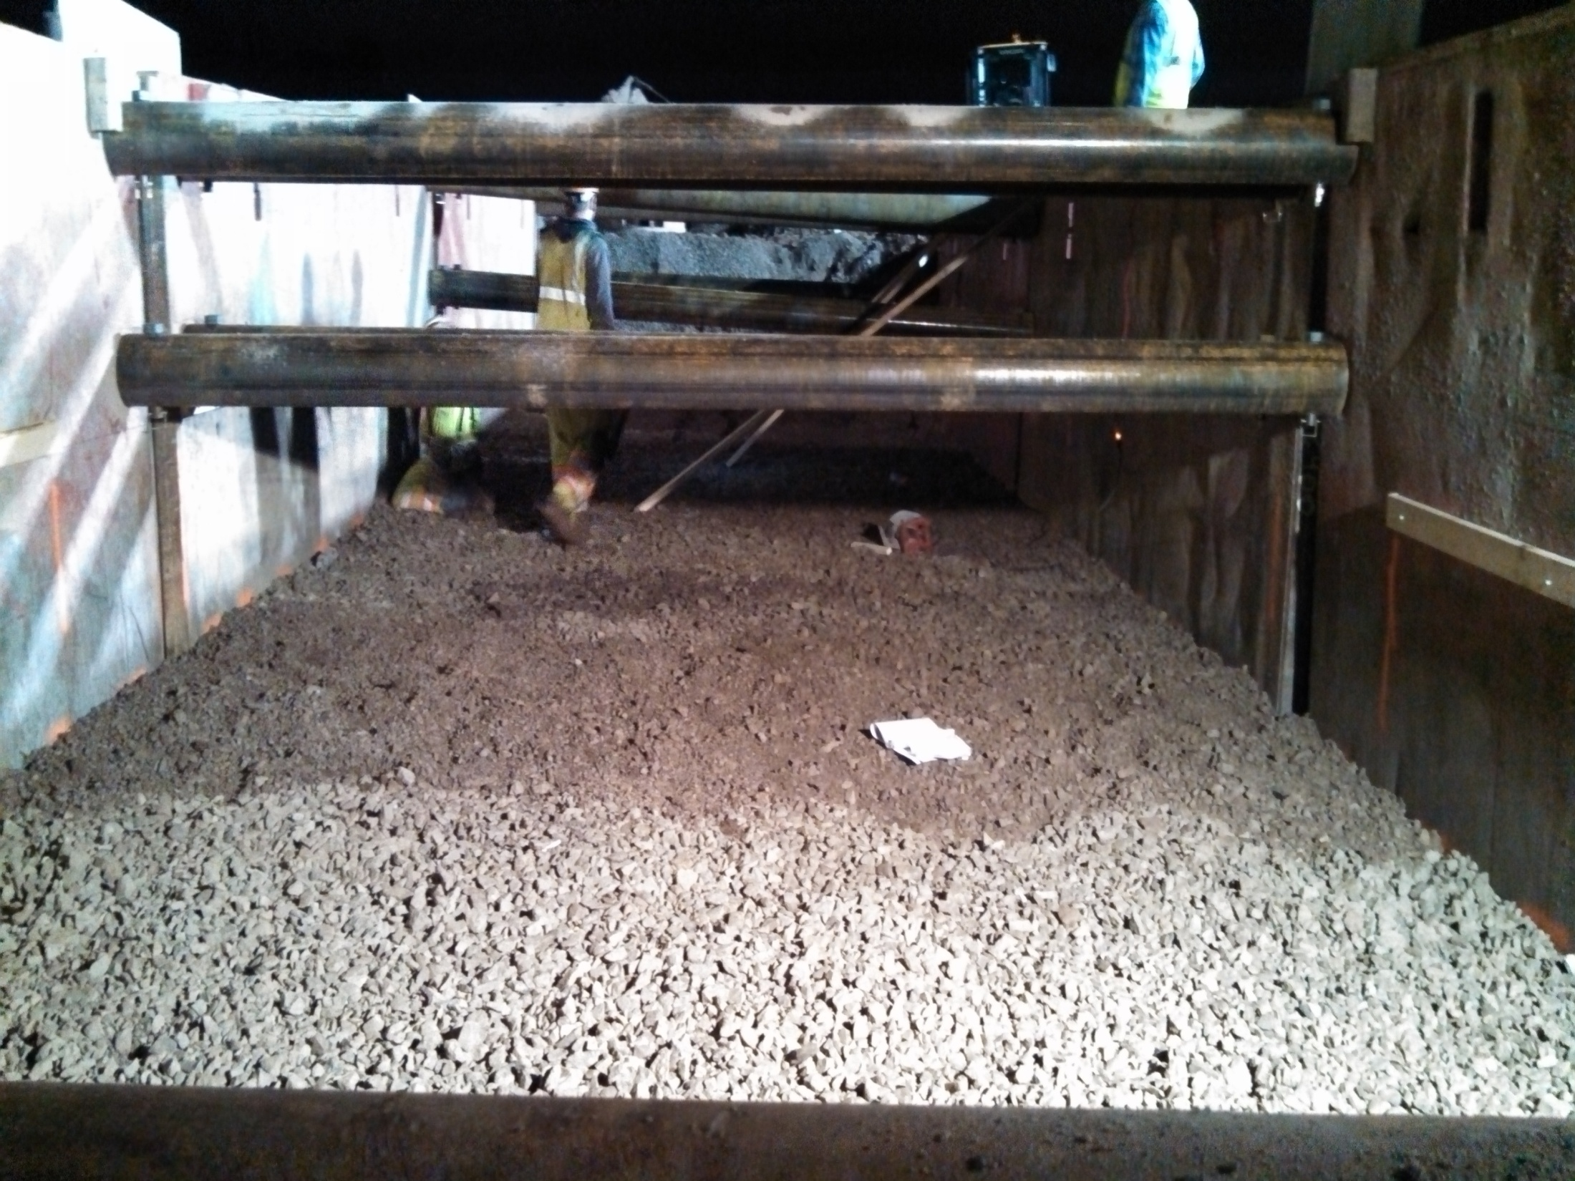

Slide 50
Bridge Approaches
Special Treatments
Rock and Clear Stone Under The Footing
3. Compaction Behind the Footing
4. Transition to Normal Grade Line (Blue Top)

Slide 51
Retaining Walls
Types
Site Investigation Report
3. Foundation
4. Construction Methods
5. Backfilling

Slide 52
Retaining Walls
Types
Cast-in-Place Cantilever Walls (23 in 2013)
Modular Block Walls (8 in 2013)
MSE Walls Concrete Panels (55 in 2013)
MSE Walls Wired Faced (28 in 2013)
Sheet Pile Walls (5 in 2012)
Post and Panel Walls (7 in 2013)

Slide 53
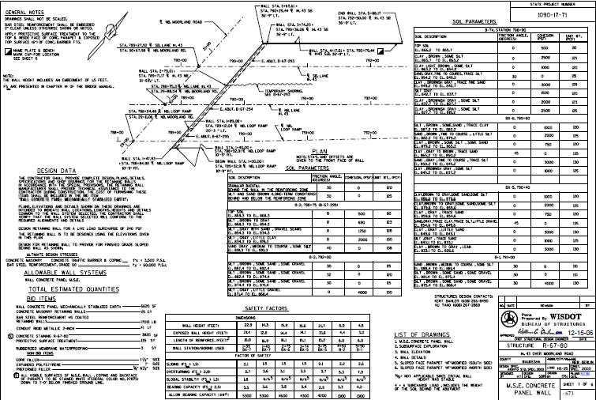

Slide 54
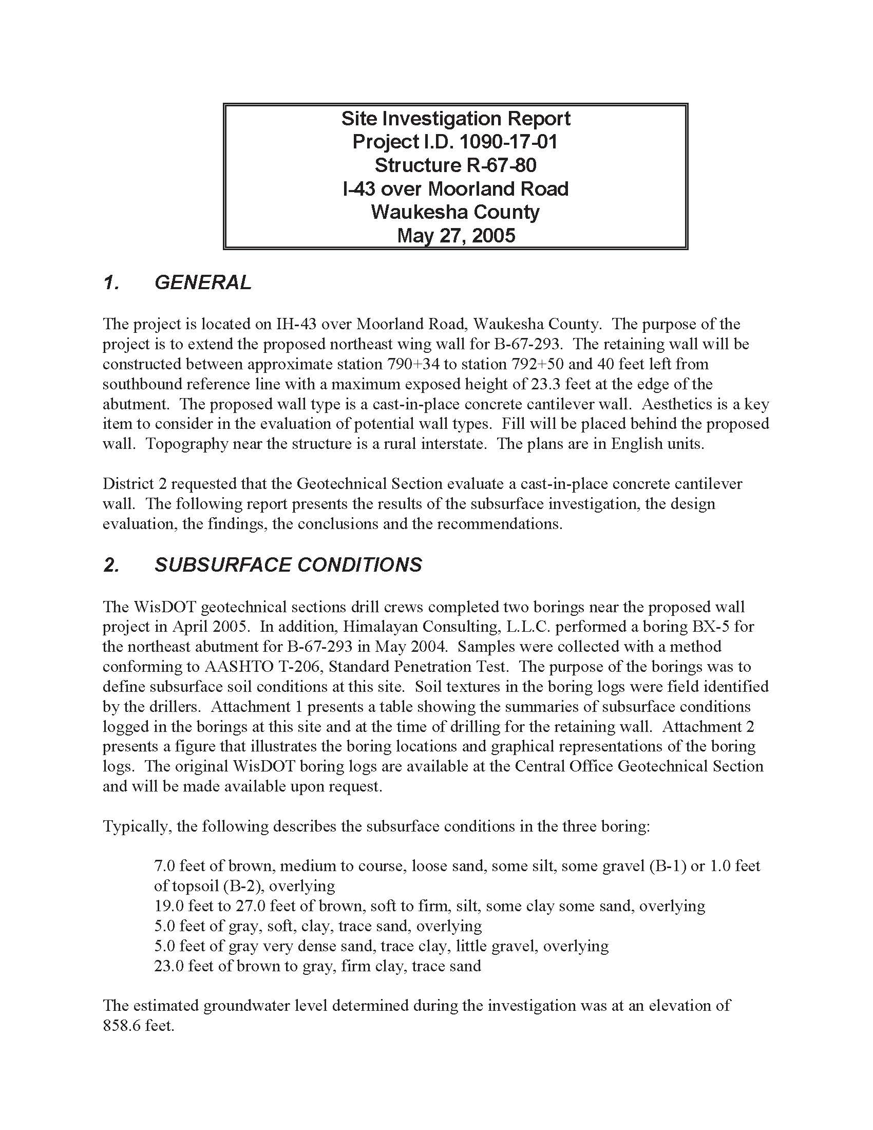

Slide 55
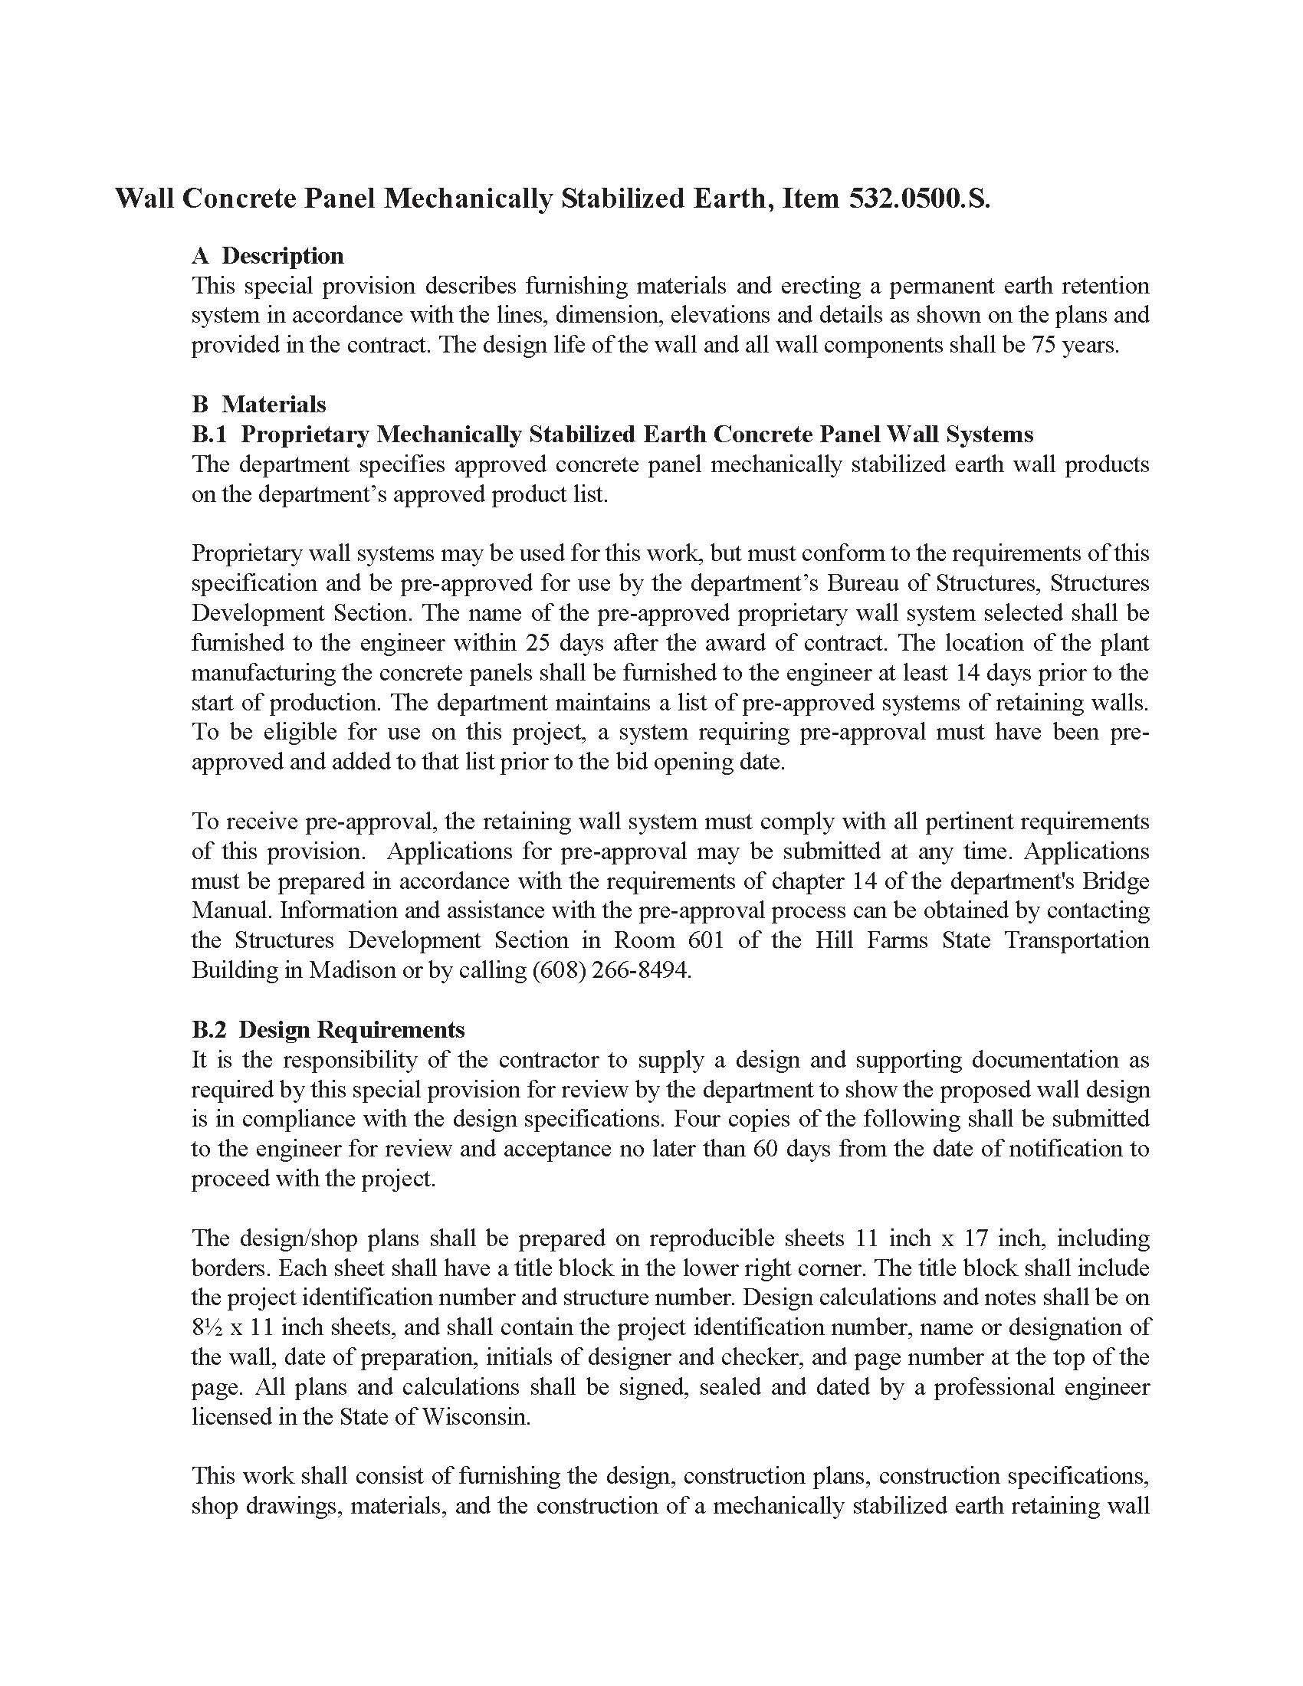

Slide 56
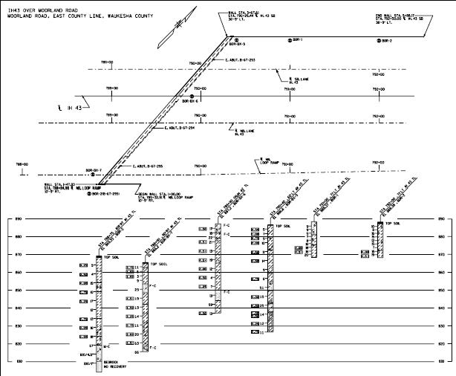

Slide 57
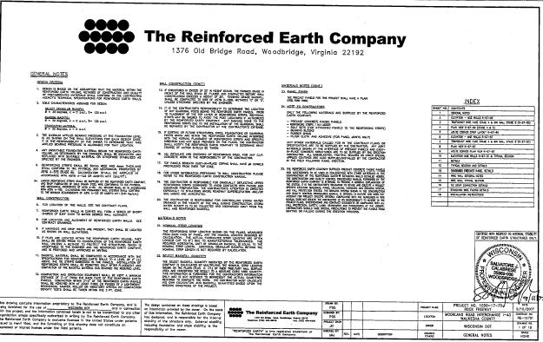

Slide 58
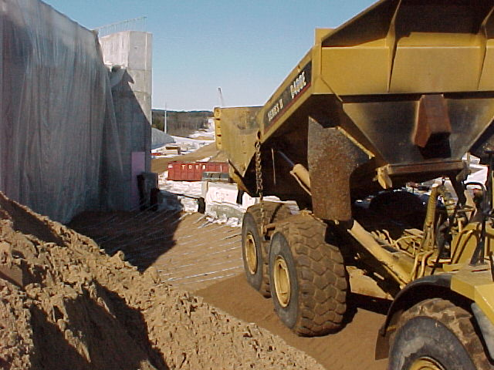

Slide 59
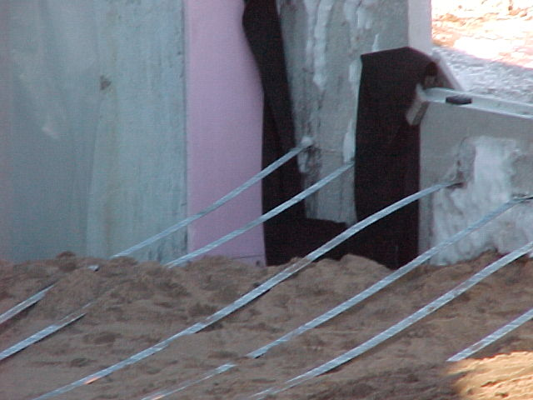

Slide 60
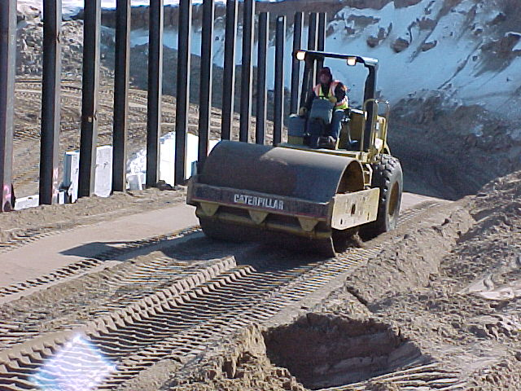

Slide 61
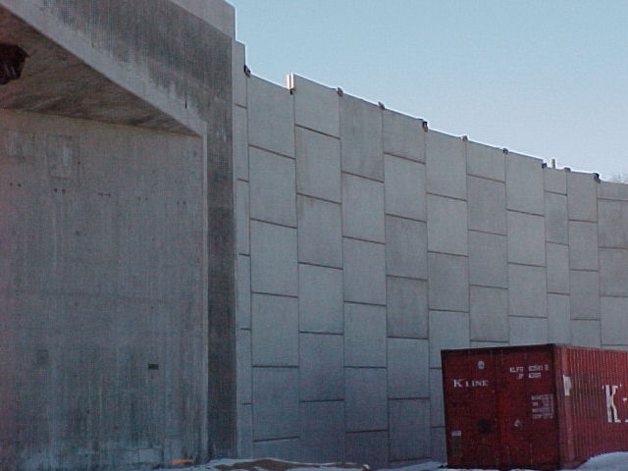

Slide 62
Structures
A Structure Survey Report is Required for all New, Replacement, or the Rehabilitation of all Structures Constructed on DOT Projects?
What are the factors that determine the type of pile or foundation for a structure?
Under certain conditions, the contractor may be required to stop driving a pile nest for a period of time to allow required bearing to be achieved.
There is no concern if soft soils or organics are found at the bottom of a culvert trench because the Designer knew about this in the design process.

Slide 63
Questions ?

