Slide 1
WisDOT Aerial Imagery
2018 WisDOT Utility Conference
Cindy McCallum, Photogrammetry Unit Coordinator
Tiffany Novinska, Aerial Imaging Specialist
Surveying & Mapping Section, Photogrammetry Unit

Slide 2
Introduction
Where is the Photogrammetry Unit within WisDOT?
DTSD, Bureau of Technical Services, Surveying and Mapping Section
Who is the Photogrammetry Unit?
Consists of 9 staff and 1 supervisor
1 aerial imaging coordinator
1 aerial imaging specialist
1 photogrammetry coordinator & editor
1.5 analytical triangulation specialists
3.5 photogrammetry specialists
1 LiDAR specialist

Slide 3
Introduction
What is Photogrammetry?
The process of collecting precise elevation data and creating maps through the use of aerial imagery combined with surveyed ground control and LiDAR point clouds to achieve a vertical accuracy of 3 inches or better.
Why is Photogrammetry needed?
Provides engineering grade base mapping and elevation data for transportation improvement project planning and design.
How is Photogrammetry beneficial?
Allows coverage of a much larger area than conventional survey.
Aerial imagery and LiDAR are literally a snapshot in time of existing conditions which allows staff to return to the same point in time to gather additional data.

Slide 4
Introduction
Cross-divisional partnership between DTIM and DTSD
DTIM Aeronautics provides pilots for DTSD Photogrammetry aerial imagery flight missions.
Photogrammetry unit provides new, recent and historical aerial imagery to multiple areas within WisDOT including:
DTSD – highways, facilities, environmental
Requests originate from the Region Survey Coordinators
DTIM – facilities, airports, rails
OGC – court exhibits, historical review
DSP – investigations, court exhibits, large event strategic planning

Slide 5
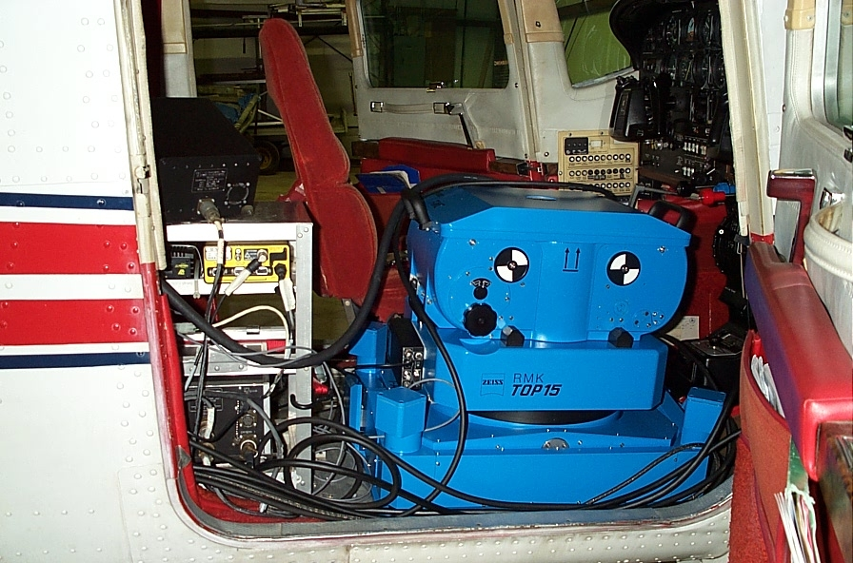
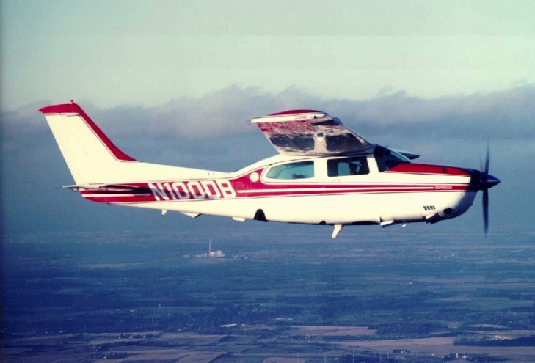
WisDOT aerial imagery equipment
Camera system and aircraft:
Cessna Turbo 210 Aircraft
Zeiss RMK TOP 15 Optical Film Camera

Slide 6
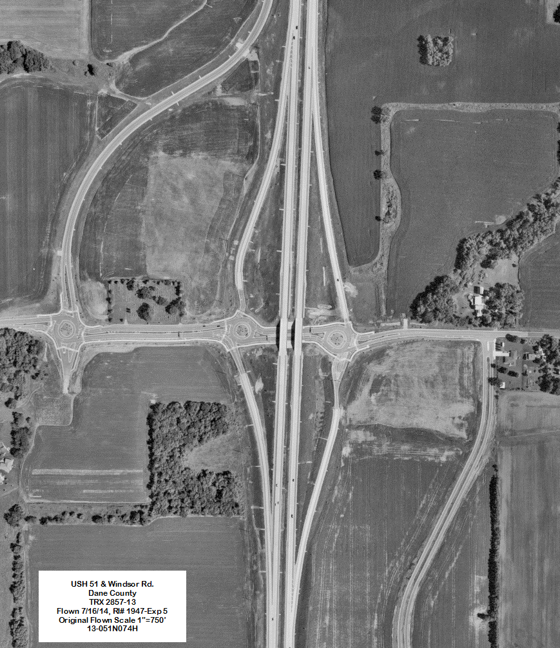
Vertical aerial imagery
Photograph taken looking straight down (nadir)
High resolution images
Inhouse black & white film imagery is scanned at a high resolution
Consulting digital color imagery
Scale varies

Slide 7
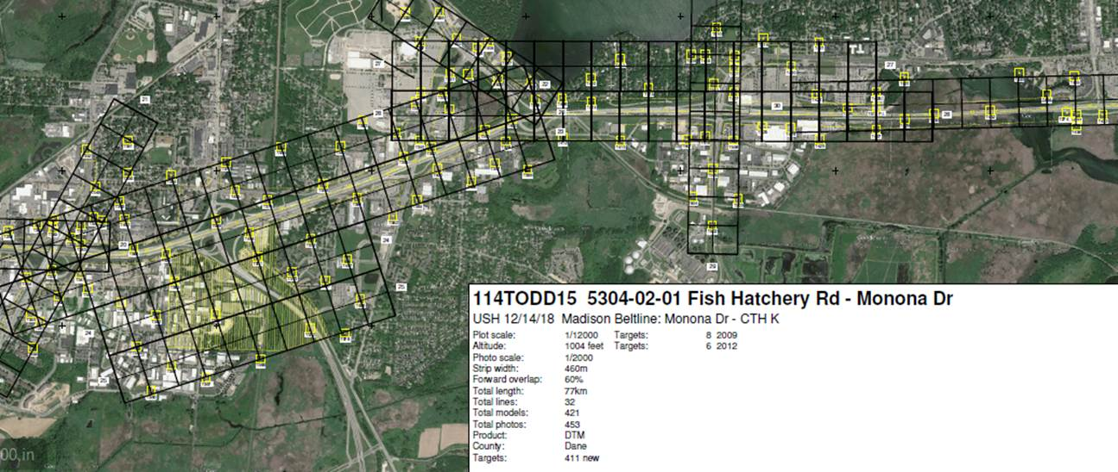
Flights are designed with 60% image overlap to provide stereo viewing to measure elevation and mapping features Portion of a 2015 mapping project: USH 12/14/18, Madison Beltline: Monona Dr. – CTH K
Controlled vertical aerial imagery flight plan

Slide 8
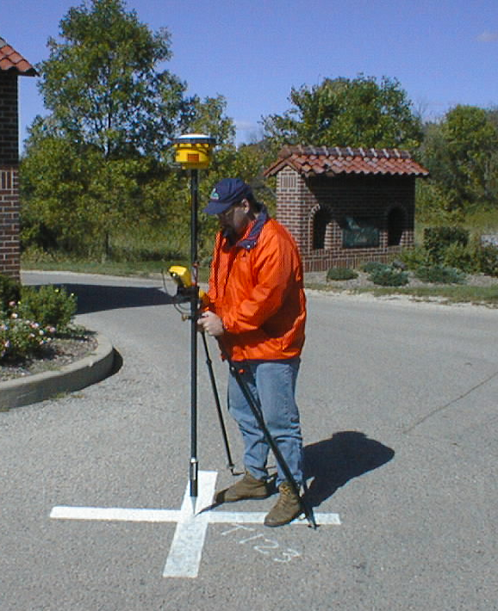
Field survey
Field targeting
Painted or plastic “X” or “T”
Ground control survey
Latitude, longitude, height of targets are measured using GPS
Notes:
The iron pin should be located in the center of the panel.

Slide 9
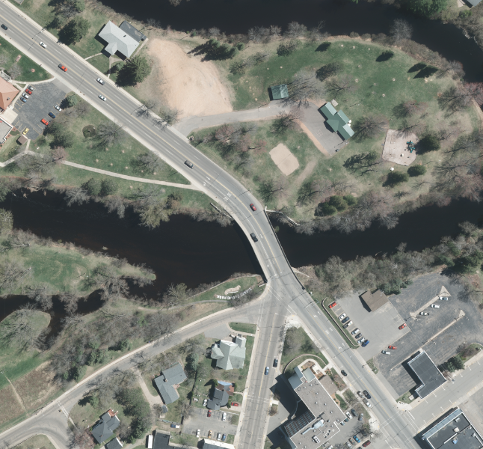
Controlled vertical aerial imagery
Flights require sunny and clear conditions
Spring leaf off conditions: after snow melts, before leaf out

Slide 10
Photogrammetry product uses:
Planning and Scoping studies
Base mapping for preliminary and final design
Base mapping/DTM for current conditions for maintenance, slope studies and wetland mitigation sites
Surface models
Right of way plats
Construction final quantities and payment
Exhibits for reports and public meetings
Public (open records) requests for aerial imagery
Notes:
Most of our controlled vertical imagery is used to create mapping and DTM data for preliminary and final design, planning studies, right of way plats and exhibits.
We’ve also flown projects after construction to compute finals and after everything has been completed to show the existing conditions. This mapping can be used for traffic control plans, staged construction plans, resurfacing projects and for maintenance work. The DTM can be used for slope deficiency studies and beam guard projects.

Slide 11
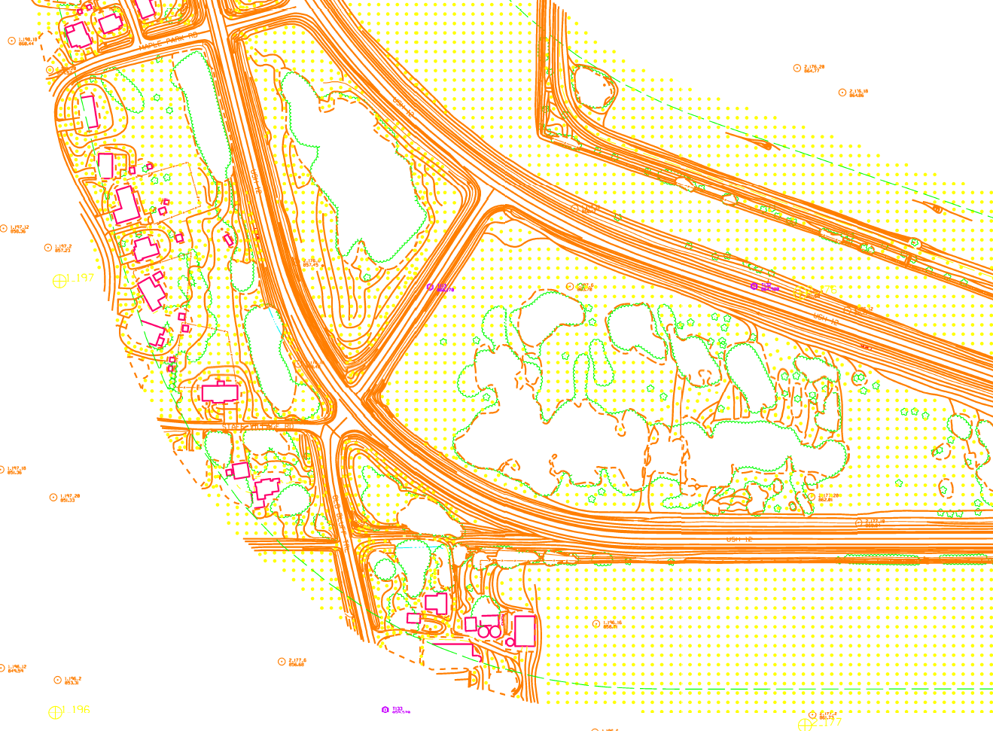
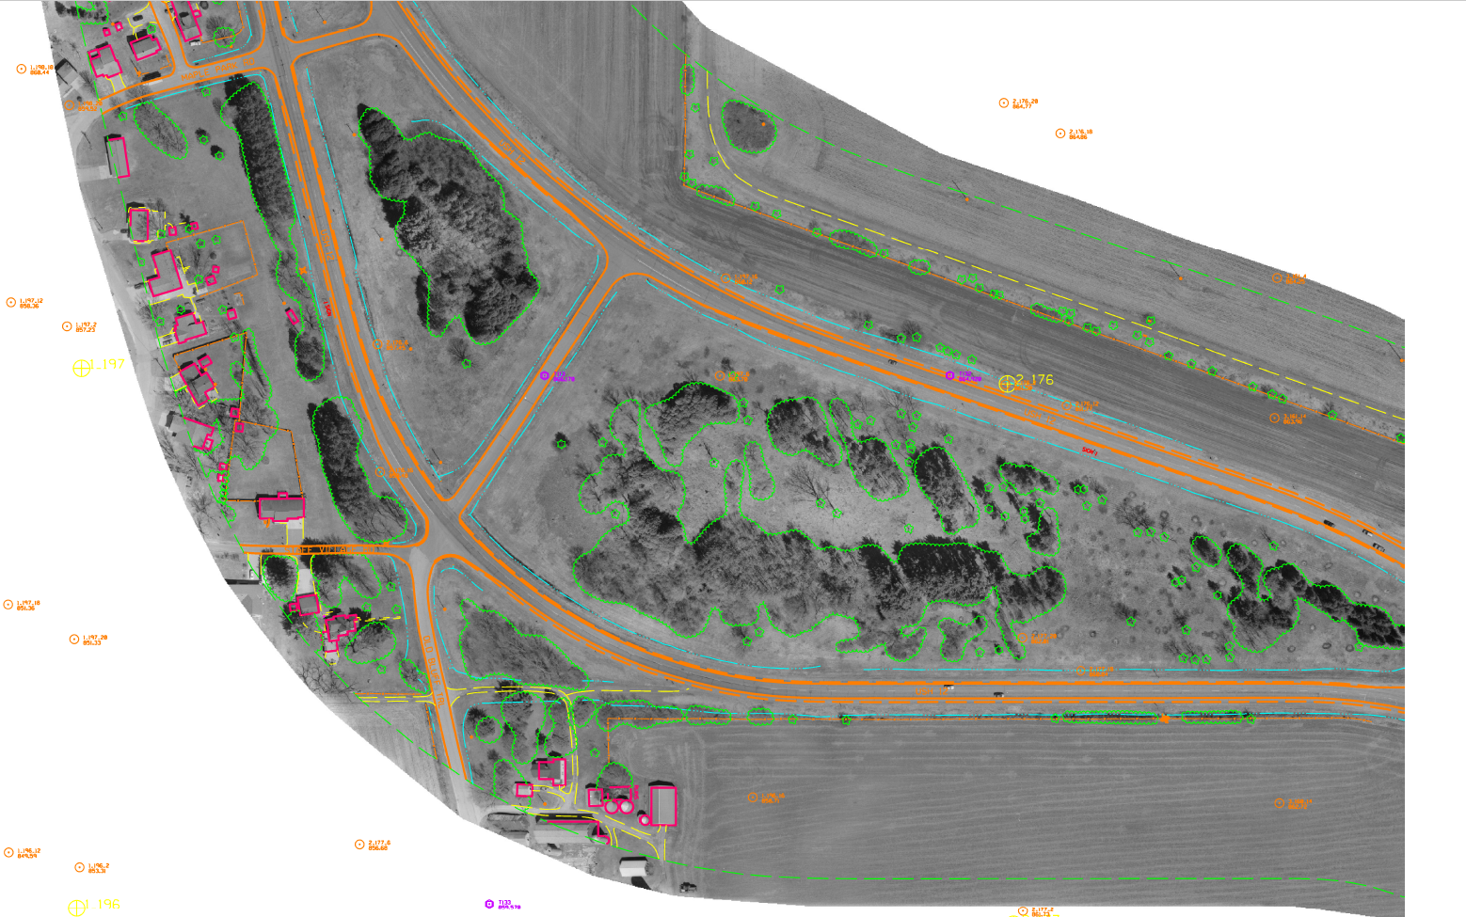
Photogrammetry product examples:
Planimetric mapping and digital terrain model
Orthoimagery – aerial image rectified to planimetric mapping and digital terrain model

Slide 12
Planimetric Mapping
Discrete features: buildings, power poles, single trees
Relative features: culverts, tree lines
Beam guard: center of posts
Roads: level 11, e_rdwy
Shoulders: level 11, dashed, e_rdwy_gravel, e_rdwy_shldrpaved
Notes:
Discrete features have accurate locations.
Buildings are compiled at the outside edge of the roofline, at the roofline elevation.
Power poles are measured on the ground, in the center of the pole.
Relative or representative features are roughly in their correct location and symbolized with generic cells such as culverts and tree lines .
The end of culverts are shown with an arc. A tree canopy is digitized at the average canopy height and shown with the tree line pattern.
The compilers measure the top of the posts of the beam guard. The pattern shows a line going through the posts which isn’t where the guard rail is actually located.
We usually collect the mapping and terrain data at the same time.
We can collect mapping only and deliver it and then collect the DTM data at a later date or not at all.
We fly some projects with very little ground control. These are called expedient planimetric. We won’t provide DTM data from these flights because of the lack of control.

Slide 13
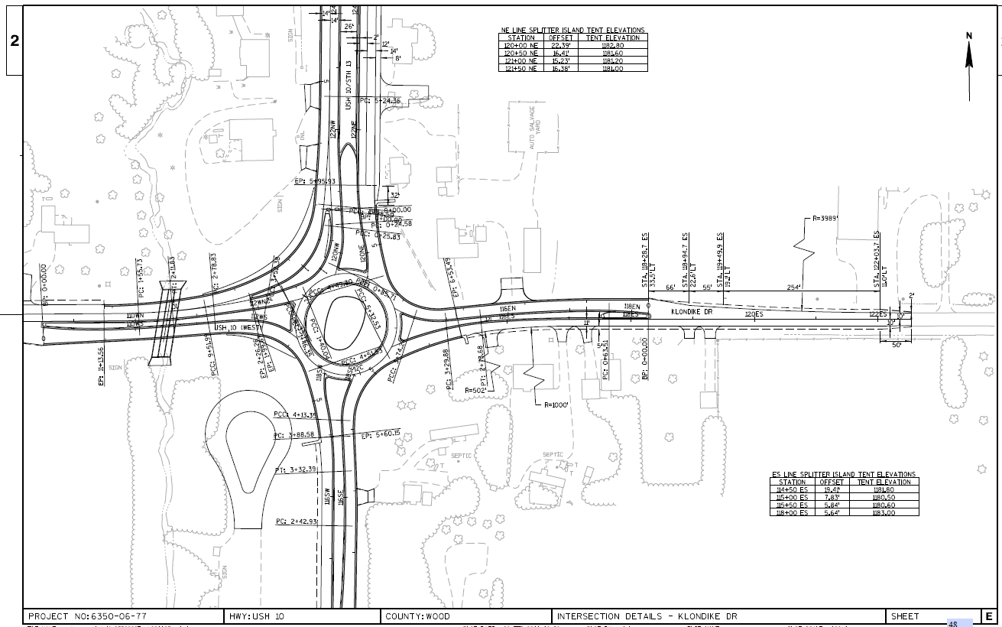
Photogrammetry product example:
Planimetric mapping used as part of a plan set

Slide 14
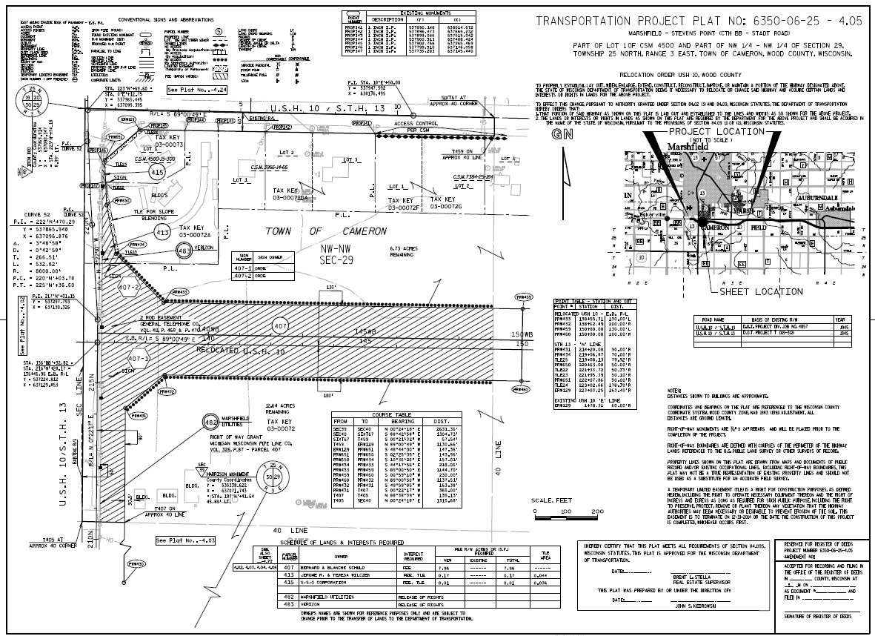
Photogrammetry product example:
Planimetric mapping used for a Transportation Project Plat

Slide 15
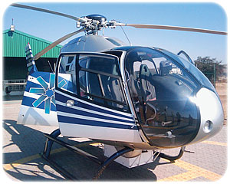
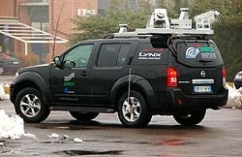
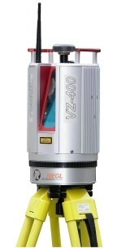
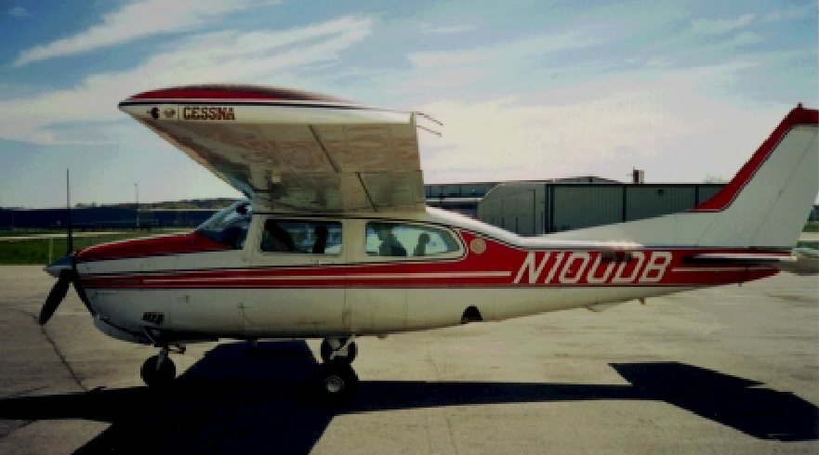
LiDAR Systems (light detection and ranging)
Mobile Mapping
System
Static
(Terrestrial)
Helicopter
Fixed Wing
Notes:
Static LiDAR is collected with the LiDAR instrument on a tripod. WisDOT owns a Riegl VZ-400 static scanner.
Mobile LiDAR is collected with the LiDAR system mounted to a vehicle. The vehicle can typically travel at or near posted speed limits to collect the LiDAR data.
Aerial LiDAR is collected with the necessary LiDAR equipment mounted to the bottom of a helicopter or an airplane.

Slide 16
LiDAR (light detection and ranging):
Mobile system – contract out
Collect information about features along a roadway
Collect accurate elevation on hard surfaces within 70 feet
Aerial (Fixed wing or helicopter system) – contract out
Can show above ground utilities
Used for elevation data for design
Covers a wide area for drainage studies
Static (Terrestrial) – in house
Photogrammetry Unit has one scanner based on a tri-pod
Can show above ground utilities
Used for very accurate elevation data for design
Covers a small area
Notes:
Mobile system has the sensor mounted on top of the vehicle at the back. There are GIS level systems and engineering level systems.

Slide 17
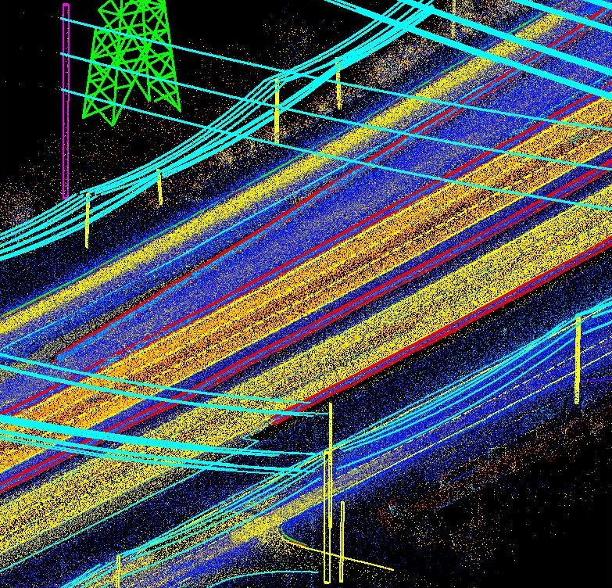
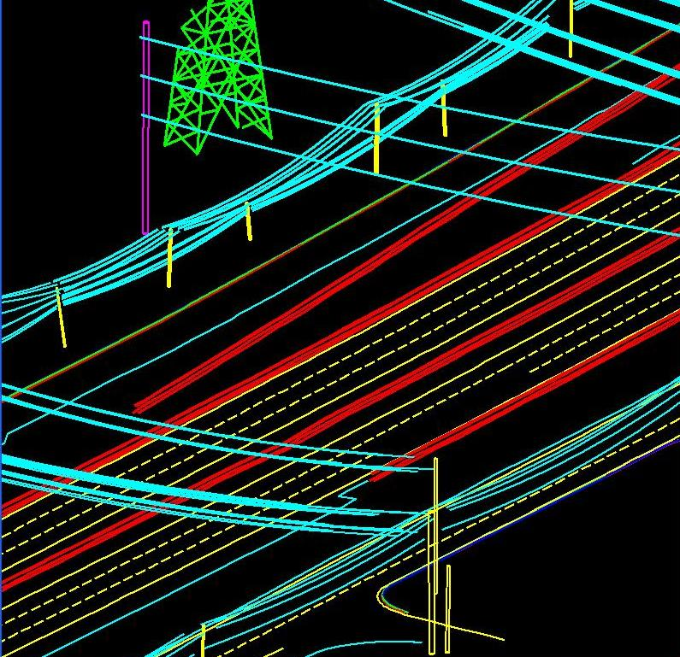
Transmission lines extracted from Lidar
Images courtesy of Quantum Spatial (formerly Aerometric)

Slide 18
Aerial imagery archive (1937 – present)
Variety of areas covered throughout Wisconsin
Most coverage is highway corridor specific
Other areas may be available
Research is required to determine availability
Scale depends on the original intent of the capture
Currently not all historic aerial imagery held by WisDOT is depicted in DOTView
Please contact dotaerialimageryrequest@dot.wi.gov for assistance or call (608) 246-5397 or (608) 246-5392

Slide 19
Aerial imagery archive (1937 – present) DOTView: http://dotnet/dotview/launch-dotview.htm (1975 - present)

Slide 20
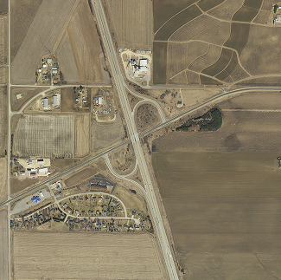
County-wide orthoimagery
Area can be customized to project limits
Provide coordinate system conversion
Image formats compatible with Civil 3D and/or ArcGIS
Years available vary
Resolution may vary

Slide 21
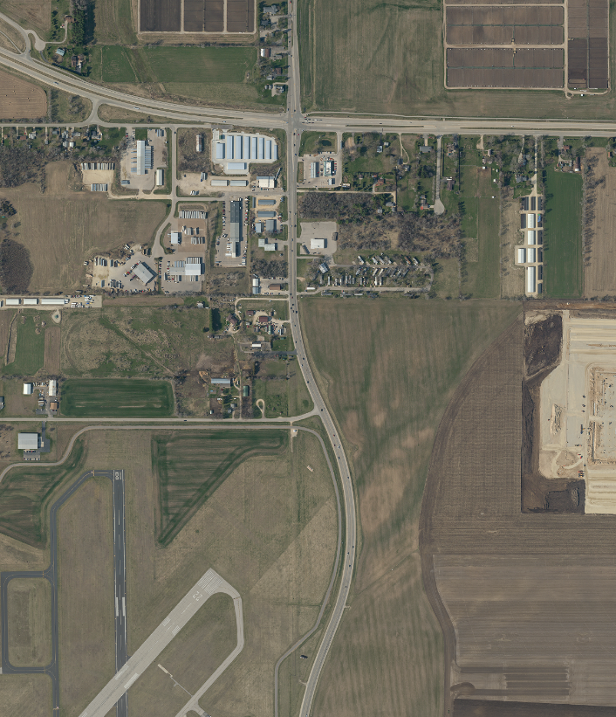
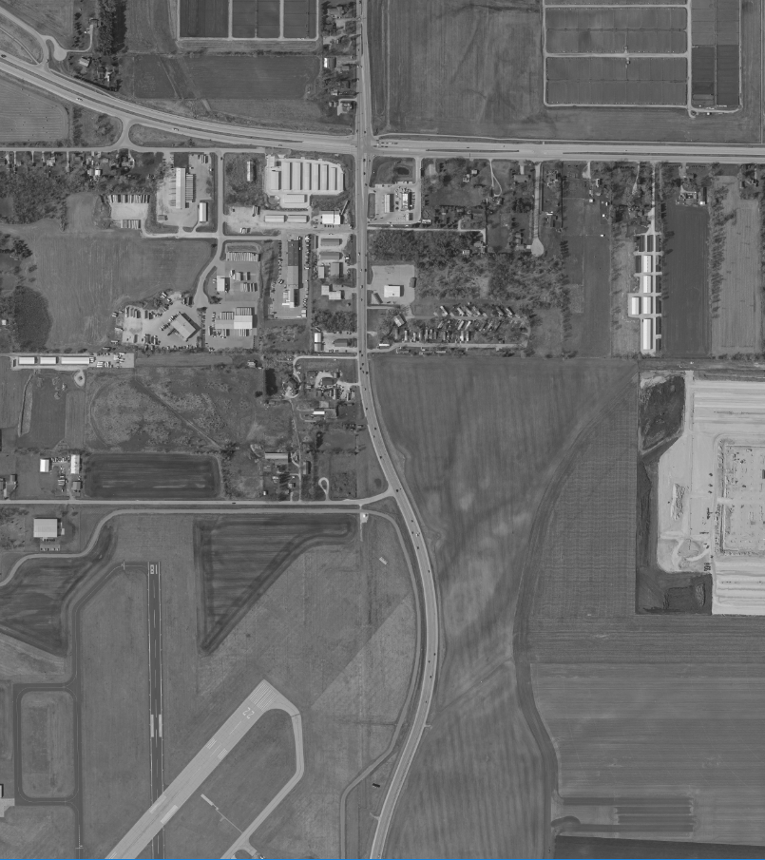
Orthoimagery: Color vs Black & White
Color coded utility features
Can request B&W imagery for contrast with utility features

Slide 22
Oblique aerial imagery
Captured at an angle to the surface of the earth
Unscaled
Medium resolution hand-held digital camera
Provided in jpeg format via LAN or as discussed
Hard copy prints available by request
Imagery certification available by request

Slide 23
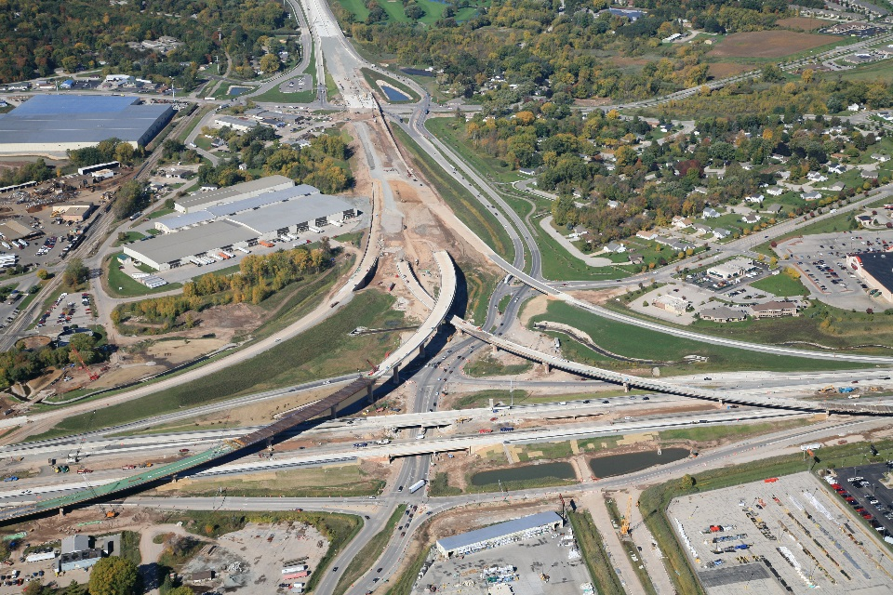
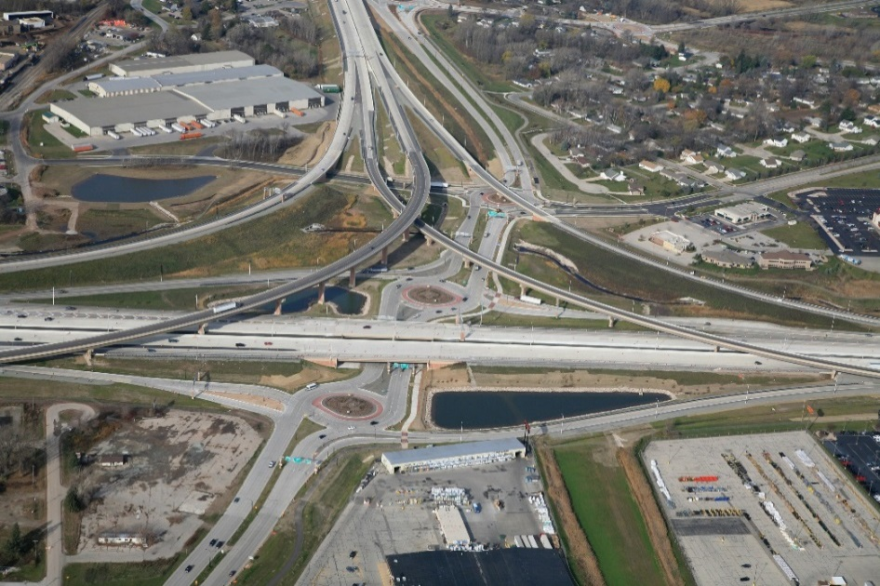
Oblique aerial imagery:
documenting stages of highway construction
08-22-2011
10-08-2013
USH 41/STH 29 Interchange Brown Co
11-05-2014

Slide 24
How to request existing aerial imagery
Provide a map of the area required
Provide a range of years or decades of interest
What is needed?
Vertical and/or oblique aerial imagery?
Orthoimagery/coordinate correct?
What county coordinate system is needed?
Send request via email to: dotaerialimageryrequest@dot.wi.gov
Call (608) 246-5397 or (608)246-5392

Slide 25
Contact information
Cindy McCallum
Photogrammetry Unit Coordinator
Email: cynthia.mccallum@dot.wi.gov
Phone: (608) 246-7944
Tiffany Novinska
Aerial Imaging Specialist
Email: tiffany.novinska@dot.wi.gov
Phone: (608) 246-5397
DTSD, BTS, Surveying & Mapping Section
Photogrammetry Unit
3502 Kinsman Blvd
Madison WI 53704
FAX: (608) 245-8959

Slide 26
Questions?
Thank you!

