Slide 1
2018 REGIONAL UTILITY CONFERENCES BUREAU OF TECHNICAL SERVICES UTILITY UNIT - UPDATE

Slide 2
Central Office – Bureau of Technical Services Acquisition and Services Section - Utility Unit
Norman Pawelczyk
Technical Services
Section Chief
608-266-2362
608-516-6355
Michael Baumann
Statewide Utility Engineer
608-267-4461
608-219-5109
Abby Schmidt
Statewide Utility Engineer
608-266-0319
Connie Bruns
Statewide Utility Projects Coordinator
608-516-6357
Vacant
Statewide Utility Projects Coordinator
Gayle Lindenberg
Central Office Consultant
920-544-4469
920-639-4876

Slide 3
INTERNSHIP Utility Coordination Intern
https://wisc.jobs/public/job_view.asp?annoid=93509&jobid=93023&org=395&class=94290&index=true
Contact: Mitch Weckerly, Human Resources Specialist- Senior, Mitch Weckerly@dot.wi.gov, 608-261-6302.
Job Posting

Slide 5
Current uses
Correspondence Memorandum
(internal document)
Statement of Non-Reimbursement By Utility
(Form DT2245)
Notes:
Cover topics not yet addressed in prior slides, include them as appropriate.
The amount of information should be relevant to allowable time and audience.

Slide 6
Potential uses
Agreements
Release of Rights
1077 Process
1078 Process
Work plan approval
Plan changes
Utility reimbursement
Change orders
Second moves
Notes:
Cover topics not yet addressed in prior slides, include them as appropriate.
The amount of information should be relevant to allowable time and audience.

Slide 7
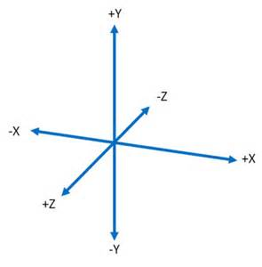
WisDOT Utility 3D Initiative
Notes:
Before
Be well prepared with content. Know facts and figures and your audience.
Everyone should be able to read the slides but if NOT, read it to them. Otherwise don’t include it.
Do a final check on microphone and other equipment well before the start time.
Practice the presentation aloud several times. Feel comfortable.
Drink fluids and do something to relax you.
During presentation
Smile and be confident.
Introduce yourself and the organization.
Speak with energy, clearly, and in a reasonable volume so everyone can hear you.
Do not read each line on the slide show – use your own wording and add in examples or additional information which will aid in comprehension.
Talk “friendly” and with the attitude that you are here to provide information and assistance. Have a “win/win” attitude.
If you make an error, politely clarify or correct it. Move on quickly and don’t dwell on it.
If you can’t answer a question, politely indicate you don’t have the information available. Indicate that you will follow-up individually with the requestor.
After presentation
Be available for follow up.
Be prepared for additional comments, questions or clarifications.
Maintain composure.
If you make a promise, be sure to follow up quickly or reassign if appropriate.

Slide 8
WisDOT Utility 3D Initiative
Investigate 3D data and its Usefulness, Viability, and Return on Investment for utilization in Civil 3D.
Run clash detection
Document Southeast Freeway team practices, processes and workflows from previous projects.
Notes:
Document Southeast Freeway team (SEF) practices, processes and workflows from previous projects. This includes, but is not limited to: data collection, data processing, plan preparation work flows, software tools used for various workflows, delivery requirements, etc.

Slide 9
WisDOT Utility 3D Initiative
Evaluation of 3D utility survey data collection and transfer from permits issued by WisDOT
Transfer data from utility company personnel and subcontractors for use in C3D and 3D models used by the contractors.
Determination of the appropriate construction projects to utilize 3D utility survey data collection and transfer.

Slide 10
WisDOT Utility Lean Project
Improvements and Efficiencies in Utility Coordination
Delegation from Central Office Utilities to Regions
Invoices
Utility Agreement Change Orders
Second Moves
Develop efficiencies for the submittal of Low Value/Low Risk utility agreements
Continue efforts to identify efficiencies in the following areas:
Consistent utility estimation and tools for DOT and utilities
Interpreting and releasing utility land rights
Improve how utility easements and land rights are depicted on right of way plats and utility exhibits
Consistent legal description template development

Slide 11
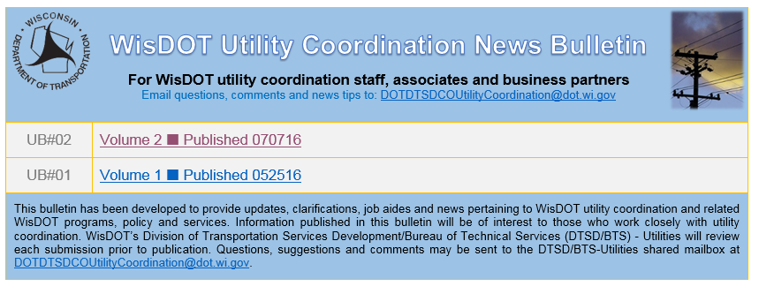
WisDOT Utility Coordination News Bulletin
Questions:
Connie Bruns
Statewide Utility Projects Coordinator 608-516-6357
Notes:
The newsletter is available for the utility companies; currently it hasn’t been sent to them but as part of the next publication (March/April 2017) I am anticipating a registration link for anyone who may want to subscribe to it rather than having to rely on email to send it out.

Slide 12
2018 Meeting Dates:
Thursday April 12th, 2018
Thursday June 21st , 2018 – Location TBD
Thursday, October 18th, 2018
Location: State Patrol Building, 851 S. ROLLING MEADOWS DRIVE, Fond du Lac, WI
Time: 9:30 a.m.

Slide 13
ANNUAL UTILITY CONFERENCES
2018
Northeast Region
Southwest Region
2019
Northwest Region
Northcentral Region
Southeast Region
2020
Statewide Utility Conference

Slide 14
Norman Pawelczyk
Bureau of Technical Services
Acquisition & Services Unit Chief
(Desk) 608-266-2362
(Cell) 608-516-6355

