Slide 1

Buy America
Michael Baumann, WisDOT
February 27, 2018
Southwest Region Annual Utility Conference
Notes:
Good morning.
I am Mike Baumann, one of the Statewide Utility Engineers in the Bureau of Technical Services, Utility Unit.
Surprise, surprise, another year has gone by and Buy America is on the agenda.
But having said that, progress has been made and I believe this year there is an opportunity to resolve the outstanding issues.

Slide 2
Overview of Presentation
Certification – What has been revised?
Predominantly Steel - What does this mean?
EXAMPLE: OH Electric
    Agreement Signed on or before January 15, 2016 – What items must comply?
    Agreement Signed after January 15, 2016 – What items must comply?
    Comparison of Examples
EXAMPLE: Gas Pipeline
    Agreement Signed on or before January 15, 2016 – What items must comply?
    Agreement Signed after January 15, 2016 – What items must comply?
    Comparison of Examples
Buy America Guidance Development – Volunteers?
Questions and Contacts
Notes:
Today, I will be talking about the revised Buy America certification form
The predominantly steel rules that are still in place.
Examples of some items that must comply with Buy America for overhead electric and gas pipelines.
An initiative that WisDOT will be moving forward with this year that should resolve any remaining issues with Buy America.
And finally, an opportunity for you to ask questions about Buy America.

Slide 3
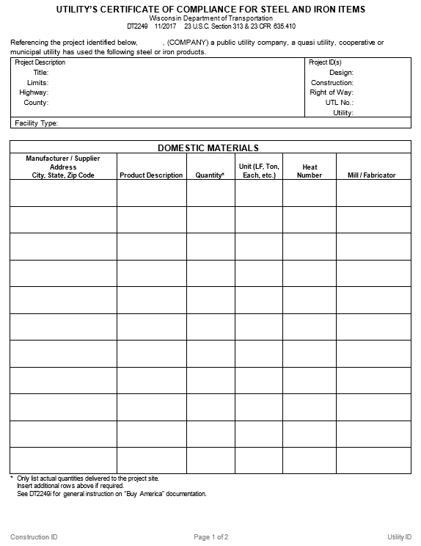
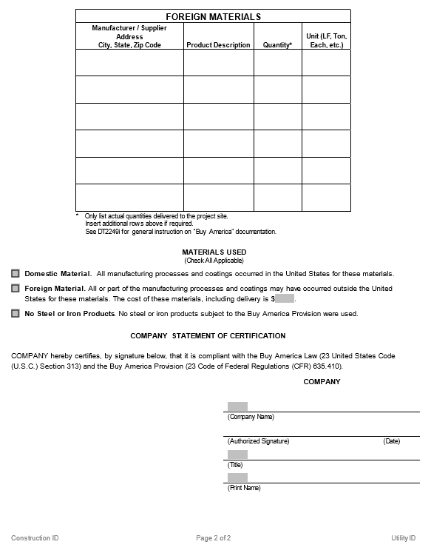
Buy America ”Certification”
Notes:
The first topic is the revised Buy America certification form.
Although you can not read this, this is the front and back side of the form.
One thing to notice is that the general guidance about Buy America is no longer on the back side of the form.
This is because we are going to develop an instructional form that is similar in format to the instructional form for Utility Permits.
Now, let’s go over the changes to each section of the form.

Slide 4
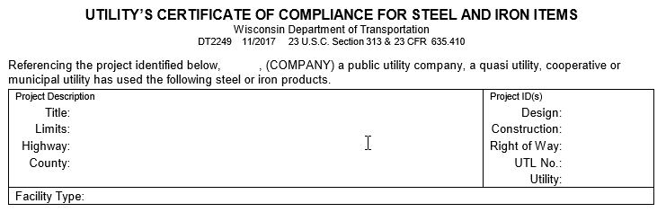
Buy America ”Certification”
Notes:
At the top of the form, we have moved text above the table for the Project Description and Project ID(s).
This text is similar to the text that was once below this table, except that the name of the utility company will be incorporated into this text.
As far as the table itself, we have removed the boxes for the name and address of the utility company.
Finally, we have added a spot to insert the facility type within this table.

Slide 5
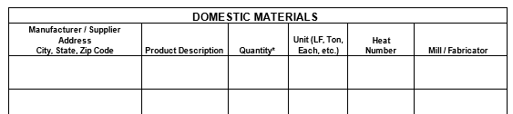

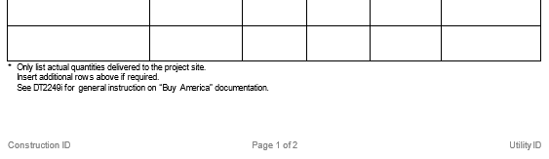
Buy America ”Certification”
Notes:
This is a blow up of the bottom 2/3rds of the first page of the Buy America certification form.
This table is for Domestic Materials.
In other words, this table should only contain predominantly steel and iron items that comply with Buy America.
In addition, this table contains the same columns as on the previous version of the Buy America certification form.
Again, all of the columns should be filled in for each item that is listed.
Also, this table is set up so that additional rows can be added if necessary.
Due to this, WisDOT will be discontinuing the use of the supplemental Buy America form DT2249A.

Slide 6
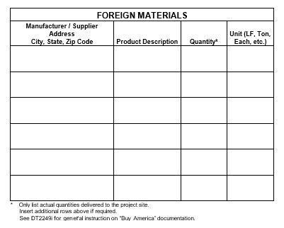
Buy America “Certification”
Notes:
This is a blow up of the top 1/3rd of the second page of the Buy America certification form.
This table is for the Foreign Materials.
In other words, this table should only contain predominantly steel and iron items that do not comply with Buy America.
Due to this, there are two less columns within this table.
Seeing as the materials are not Buy America compliant, it is highly unlikely that the Heat Numbers and a Mill/Fabricator are available.
Again, all of the columns should be filled in for each item that is listed.
Like the Domestic Material table, this table is set up so that you can add additional rows if required.

Slide 7
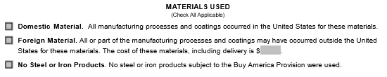
Buy America “Certification”
Notes:
This is a blow up of the middle 1/3rd of the second page of the Buy America certification form.
The language within these options has been changed and the unnecessary language has been removed.
One thing to note is that the revised language is based upon the language used in guidance provided by FHWA.
Hopefully, this provides you with an easier way to cross reference between information sources if you are seeking further clarification.
In addition, this section now requires you to (Check All Applicable) boxes.
This leaves you with four options on how to complete this section of the form.
These options include:
Check only the Domestic Material box as all predominantly Steel and Iron items comply
with Buy America.
Check only the Foreign Material box and enter the total cost for all of the predominantly
steel and iron items that are subject to and do not comply with Buy America.
Check only the No Steel or Iron Products box as no predominantly steel or iron items
were used.
And finally, check both the Domestic and Foreign Material boxes and enter the total cost
of all of the Foreign steel and iron items that are subject to and do not comply with Buy America

Slide 8
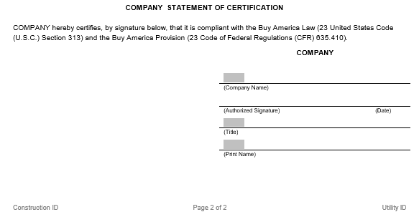
Buy America ”Certification”
Notes:
This is a blow up of the bottom 1/3rd of the second page of the Buy America certification form.
The text within this part of the form use to be at the top of the previous version of the Buy America certification form.
This text was moved here to make it clear what the certification is for and who is certifying that the utility company is in compliance with Buy America.
Finally, minor revisions were made to the signature block.
These include:
Changing from Utility Company to Company
And adding a line for the name of the utility company.

Slide 9
Buy America ”Predominantly Steel”
Definition:
Notes:
Now, let’s move onto our second subject which is predominantly steel.
Even though the United States District Court case eliminated the 90% Threshold and the Miscellaneous Products Exemption, it did not eliminate the requirements that an item must be predominantly steel or iron in order for it to be subject to Buy America.
At this time, the best definition for predominantly steel in Wisconsin is “for the most part; mostly; or mainly”
Although I am but am not saying it, one could make the case that predominantly steel or iron means that more than half of an item must be steel or iron in order for Buy America to apply to that item.
WisDOT has recommended that utility companies consult with their legal counsel when determining if an item is predominantly steel or iron as they would be the ones having to defend the decision.
In addition, utility companies should discuss with their legal counsel if predominantly steel or iron is based upon cost, weight, volume, or all of the above.

Slide 10
Buy America ”Example”
OH Electric Agreement
Signed on or before January 15, 2016
Overhead Electric: Buy America Applicability:
  Wood Pole No, not steel or iron
  Wood Crossarm No, not steel or iron
  Anchor Yes
  Guy No, attachment material
  Ground No, minor hardware
  Overhead Conductor No, attachment material
  Underground Cable No, attachment material
Notes:
Now, let’s move onto our third subject which is examples of overhead electric items and whether or not an item must comply with Buy America.
This first slide is for OH electric items that were part of an agreement that was signed on or before January 15, 2016.
As you can see, only the Anchor must comply with Buy America.
The wood poles and cross arms are not subject to Buy America as they are not made of steel or iron.
The guy wire, overhead conductor, and underground cable are not subject to Buy America as they are attachment materials.
And the ground is not subject to Buy America as it is considered to be minor hardware.

Slide 11
Buy America “Example”
OH Electric Agreement
Signed on or before January 15, 2016
Overhead Electric: Buy America Applicability:
  Terminator No, assembly material
  Clevis Secondary No, assembly material
  Insulator No, attachment material
  Arrestor No, assembly material
  Cutout No, assembly material
  Clevis Deadend No, assembly material
  Switch Disconnect No, less than 90% steel or iron
Notes:
This next slide is a continuation of the OH electric items that were part of the agreement that was signed on or before January 15, 2016.
As you can see, none of these materials must comply with Buy America as they are either considered an assembly material, attachment material, or contain less than 90% steel or iron.

Slide 12
Buy America “Example”
OH Electric Agreement
Signed after January 15, 2016
Overhead Electric: Buy America Applicability:
  Wood Pole No, not steel or iron
  Wood Crossarm No, not steel or iron
  Anchor Yes
  Guy Yes
  Ground Yes
  Overhead Conductor Check predominantly steel or iron
  Underground Cable Check predominantly steel or iron
Notes:
Now let’s look at these same OH electric items, but look at is as if the agreement was signed after January 15, 2016.
As you can see, now the Anchor, Guy, and Ground must comply with Buy America.
In addition, the overhead conductor and underground cable maybe subject to Buy America. This really depends on whether or not these items are classified as predominantly steel or iron.
Finally, the wood poles and cross arms are not subject to Buy America as they are not made of steel or iron.

Slide 13
Buy America “Example”
OH Electric Agreement
Signed after January 15, 2016
Overhead Electric: Buy America Applicability:
  Terminator Check predominantly steel or iron
  Clevis Secondary Check predominantly steel or iron
  Insulator Check predominantly steel or iron
  Arrestor Check predominantly steel or iron
  Cutout Check predominantly steel or iron
  Clevis Deadend Check predominantly steel or iron
  Switch Disconnect Check predominantly steel or iron
Notes:
This slide is a continuation of the OH electric items if they were part of an agreement that was signed after January 15, 2016.
As you can see, now all of these items went from not having to comply with Buy America to having the potential to having to comply with Buy America.

Slide 14
Buy America “Comparison” of OH materials
Applicability on or before January 15, 2016:
  Wood Pole
  Wood Crossarm
  Anchor
  Guy
  Ground
  Overhead Conductor
  Underground Cable
  Terminator
  Clevis Secondary
  Insulator
  Arrestor
  Cutout
  Clevis Deadend
  Switch Disconnect
Applicability after
January 15, 2016:
  Wood Pole
  Wood Crossarm
  Anchor
  Guy
  Ground
  Overhead Conductor
  Underground Cable
  Terminator
  Clevis Secondary
  Insulator
  Arrestor
  Cutout
  Clevis Deadend
  Switch Disconnect
Notes:
Now, let’s look at a side by side comparison of OH electric items.
It is very apparent that the United States District Court case decision has resulted in a lot more items being or maybe being subject to Buy America.
This decision has made it a lot more difficult to comply with Buy America and is why having a clearer definition of predominantly steel is very important.

Slide 15
Buy America ”Example”
UG Pipeline Agreement
Signed on or before January 15, 2016
Pipeline: Buy America Applicability:
  Steel Pipe Yes
  Elbow Yes
  Welding Neck Flange No, attachment material
  Flange Gasket No, less than 90% steel or iron
  Welding Rods Yes
  Stone No, not steel or iron
  Steel Trench box No, temporary item
Notes:
Now, let’s move onto our fourth subject which is examples of gas pipeline items and whether or not an item must comply with Buy America.
This slide is for gas pipeline items that were part of an agreement that was signed on or before January 15, 2016.
As you can see, the Steel Pipe, Elbows and Welding Rods must comply with Buy America.
The remaining items are not subject to Buy America as they are either not made of steel or iron, contain less than 90% steel, considered an attachment material, or were not permanently incorporated as a part of the work.

Slide 16
Buy America “Example”
UG Pipeline Agreement
Signed after January 15, 2016
Pipeline: Buy America Applicability:
  Steel Pipe Yes
  Elbow Yes
  Welding Neck Flange Yes
  Flange Gasket Check predominantly steel or iron
  Welding Rods Yes
  Stone No, not steel or iron
  Steel Trench box No, temporary item
Notes:
Now let’s look at these same gas pipeline items, but look at is as if the agreement was signed after January 15, 2016.
As you can see, now the Steel Pipe, Elbow, Welding Neck Flange, and Welding Rods must comply with Buy America.
In addition, the Flange Gasket maybe subject to Buy America. This really depends on whether or not this item is classified as predominantly steel or iron.
Finally, the Stone and Steel Trench Box are still not subject to Buy America as they are not made of steel or iron or were not permanently incorporated as a part of the work.

Slide 17
Buy America ”Comparison” of UG Pipeline Materials
Applicability on or before January 15, 2016:
  Steel Pipe
  Elbow
  Welding Neck Flange
  Flange Gasket
  Welding Rods
  Stone
  Steel Trench Box
Applicability after January 15, 2016:
  Steel Pipe
  Elbow
  Welding Neck Flange
  Flange Gasket
  Welding Rods
  Stone
  Steel Trench Box
Notes:
Just like for the OH electric items, let’s look at a side by side comparison of the gas pipeline items.
Note that the United States District Court case decision does not appear to have as much of an effect on which items are or maybe subject to Buy America.
This maybe why we are not hearing about as much difficulty complying with Buy America for gas pipelines.

Slide 18
Buy America ”Guidance Development”
FHWA and WisDOT met in mid-December 2017
WisDOT now has opportunity to clarify Buy America requirements
These requirements will be based upon:
    Federal Code and Guidance
    Court Cases
    Guidance from other states
    Defining predominantly steel or iron
Notes:
Now, let’s move onto our fifth subject which is Buy America Guidance Development.
Seeing as WisDOT has been discussing Buy America issues with FHWA, FHWA has been looking into ways to resolve these issues.
In mid December, FHWA set-up a meeting with WisDOT in which they proposed a means to resolve some of the issues by following in the footsteps of what some other states have done.
By following what other states have done, WisDOT believes there is an opportunity for making the Buy America requirements easier to follow and easier to be in compliance with.
WisDOT believes this is possible and we will remain in compliance with Federal Code and the United States District Court case decision.
It really hinges on working together in order to come up with definition of predominantly steel or iron that will resolve the issues with all or a majority of the items that are hard to find in compliance with Buy America.

Slide 19
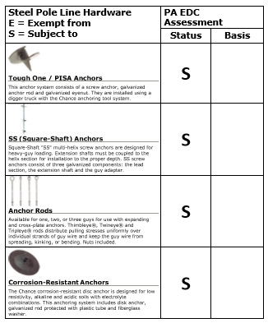
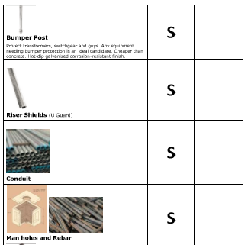
Buy America ”Guidance Development”
The following are examples from PennDOT:
Notes:
One option that may help clarify what items must be complaint with Buy America is to follow what the Pennsylvania DOT has done.
This slide shows an example of the guidance that they have developed in-regards to Buy America.
WisDOT would like to discuss this with the representatives of the various utility types within Wisconsin in order to see if this is something that we should work together on and develop similar guidance for some or all of the facility types.
Please note, the full PennDOT guidance document is available on the internet.
I just want to make it clear that this document is only useful in Wisconsin for agreements that have been signed on or before January 15, 2016.

Slide 20
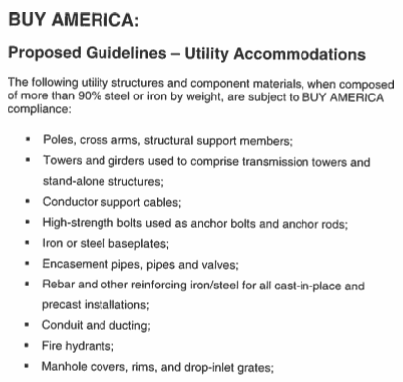
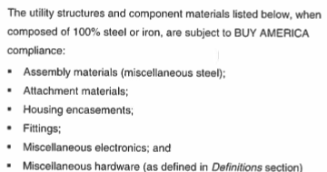
Buy America “Guidance Development”
The following is an example from TxDOT:
Notes:
Another option that may help clarify what items must be complaint with Buy America is to follow what the Texas DOT has done.
This slide shows a portion of the guidance that they have developed in-regards to Buy America.
This guidance was developed after the United States District Court case decision.
WisDOT would like to discuss this with representatives of the various utility types within Wisconsin in order to see if something similar to this could aid in defining predominantly steel.
Please note, WisDOT is not comfortable with following this exactly as written as it is eerily similar to what the United States District Court decision struck down.

Slide 21
Buy America ”Guidance Development”
This is your opportunity . . .
to assist WisDOT in clarification of
Buy America requirements.
Please become an active member of WisDOT’s Buy America Development Team.
Notes:
So WisDOT would like you or maybe have you recommend someone from your company to assist with this effort and become an active member of WisDOT’s Buy America Development Team.
Please note that this applies to everyone at the utility company. Recently, I spent some time discussing items in this presentation with a lineman at WPS and it turned out to very helpful.
You can feel free to contact me if you have any questions about this opportunity.
My contact information is on the next slide.

Slide 22


Buy America “Questions and Contacts”
Any questions?
Contact information:
  Mike Baumann
  715-421-7393
  michael.baumann@dot.wi.gov
Notes:
Now, our final topic is an opportunity for you to ask questions about Buy America.
The subject of which we have grown to love!!!

