Slide 1
Invoice Submittals
Bobbie Keck – WisDOT Utility Coordinator
February 27, 2018 - SW Region Utility Conference
Notes:
Before
Be well prepared with content. Know facts and figures and your audience.
Everyone should be able to read the slides but if NOT, read it to them. Otherwise don’t include it.
Do a final check on microphone and other equipment well before the start time.
Practice the presentation aloud several times. Feel comfortable.
Drink fluids and do something to relax you.
During presentation
Smile and be confident.
Introduce yourself and the organization.
Speak with energy, clearly, and in a reasonable volume so everyone can hear you.
Do not read each line on the slide show – use your own wording and add in examples or additional information which will aid in comprehension.
Talk “friendly” and with the attitude that you are here to provide information and assistance. Have a “win/win” attitude.
If you make an error, politely clarify or correct it. Move on quickly and don’t dwell on it.
If you can’t answer a question, politely indicate you don’t have the information available. Indicate that you will follow-up individually with the requestor.
After presentation
Be available for follow up.
Be prepared for additional comments, questions or clarifications.
Maintain composure.
If you make a promise, be sure to follow up quickly or reassign if appropriate.

Slide 2
Invoices for a Lump Sum Agreement
Are a very basic invoice.
The scope of work was previously agreed to and the dollar amount was established in the estimate.
Invoice should be in the agreed to amount shown on the approved Lump Sum Agreement.
Include the following project information on your invoice:
Construction Project ID
Utility Project ID
Utility ID Number (Parcel #)
Notes:
Overview should be specific such as listing the goals of the presentation and items to be covered. For example: “Explain Hwy 51 project alternatives.”
Use a verb followed by a brief phase or sentence.
Overview should include time for Q&A or indicate if you intend to take questions during the presentation or prefer that they wait until the end of the presentation.

Slide 3
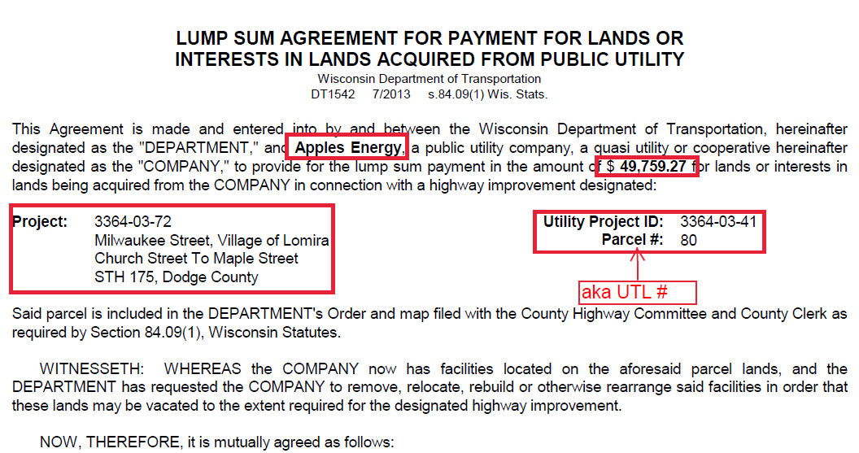
Project Information can be found on the
Lump Sum Agreement document
Notes:
Provide facts, figures and objective data will help to keep the audience focused.
Review political, financial or other information.
Dispel misinformation.

Slide 4
Invoice Checklist for : Lump Sum Agreement
Invoice
Completed DT2249 Utility’s Certificate of Compliance for Steel and Iron Items (aka Buy America Form)
Including any required documentation
Optional: Include a copy of the Approved Lump Sum Agreement and Estimate
Notes:
Clarify issues or answer anticipated questions.
Often the audience does not clearly understand the benefits of the project and may therefore make up their own assumptions which can be inaccurate.
Use the benefits to refute contentious issues. Use factual information on “hot topics” to divert anger and lessen the chance for misunderstanding.

Slide 5
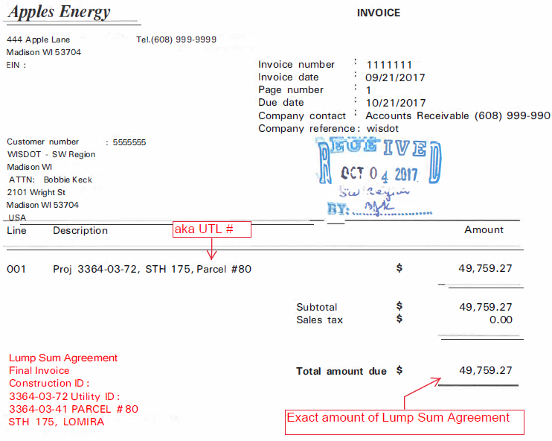

Slide 6
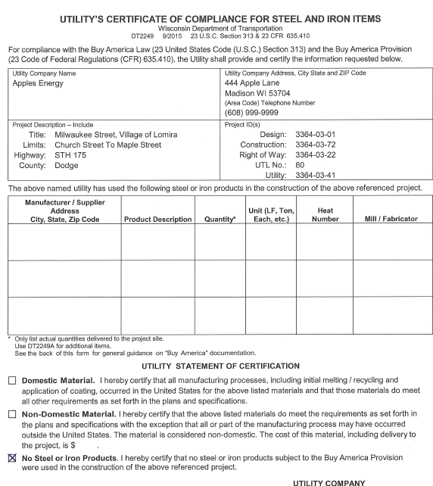

Slide 7
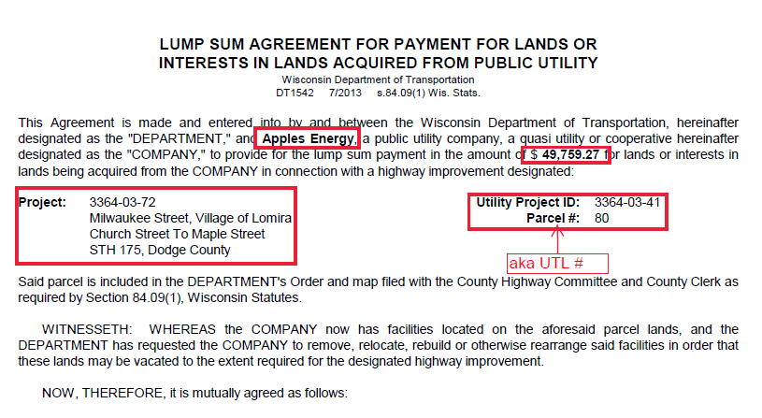

Slide 8
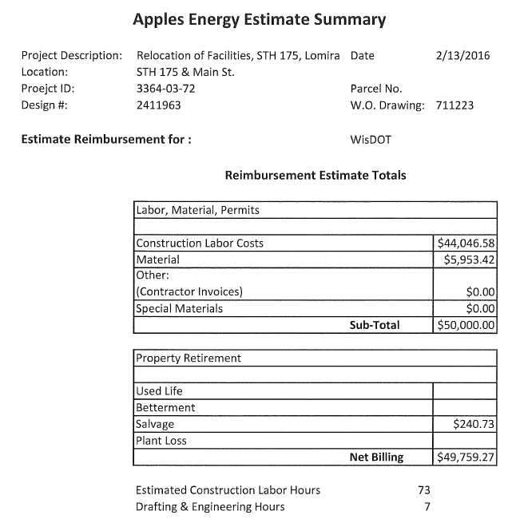

Slide 9
Invoices for an Audit Agreement
Invoices need to be more detailed
Billing should contain a statement by the utility that the invoice represents actual charges incurred of the work agreed to in the estimate.
Show WisDOT’s compensable percentage share
Indicate if it is a Partial Invoice or a Final Invoice
Notes:
Provide data, facts and figures.
Photos or graphics will enhance retention and understanding.
Consider grouping key periods such as the past 6-12 months and the next 6-12 months.
Be sure to link to hot topics and accurately address those concerns.

Slide 10
An invoice for the exact amount of the estimate is not acceptable
Invoices that provide only the dollar amount and project identification information is insufficient for an audit agreement
Supporting documentation is needed to explain how the total actual cost was arrived at
Include any credits that may apply:
Used Life
Betterment
Salvage
Plant Loss

Slide 11
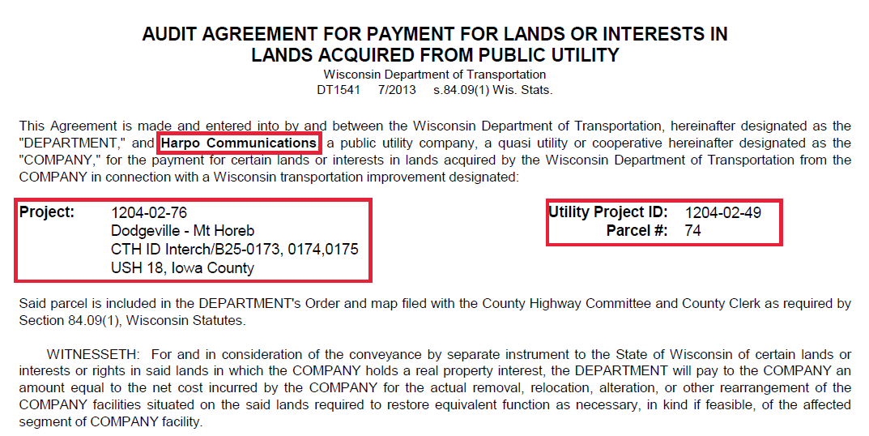
Project Information can be found on the Audit Agreement document
Notes:
Provide facts, figures and objective data will help to keep the audience focused.
Review political, financial or other information.
Dispel misinformation.

Slide 12
Invoice Checklist for: Audit Agreement
Invoice
Audit Agreement Final Cost Summary
Supporting Documents
Completed DT2249 Utility’s Certificate of Compliance for Steel and Iron Items (aka Buy America Form) Include any required documentation
Optional: Include a copy of the Approved Audit Agreement and Estimate showing WisDOT’s compensable percentage share
Notes:
Clarify issues or answer anticipated questions.
Often the audience does not clearly understand the benefits of the project and may therefore make up their own assumptions which can be inaccurate.
Use the benefits to refute contentious issues. Use factual information on “hot topics” to divert anger and lessen the chance for misunderstanding.

Slide 13
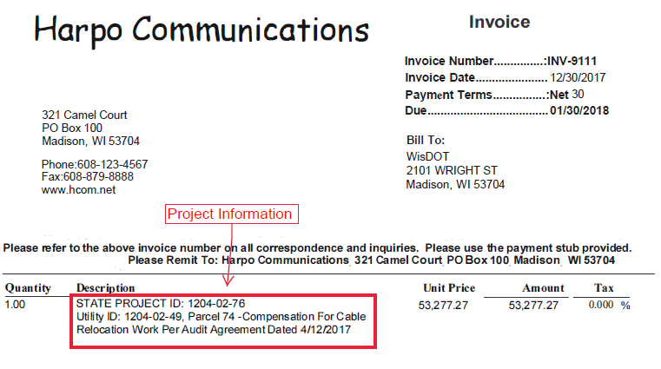

Slide 14
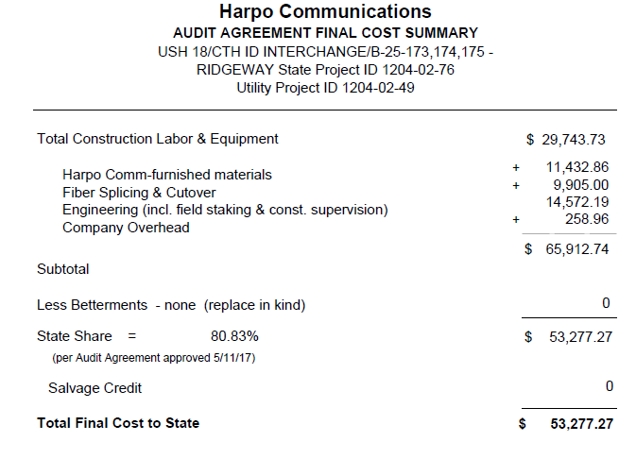

Slide 15
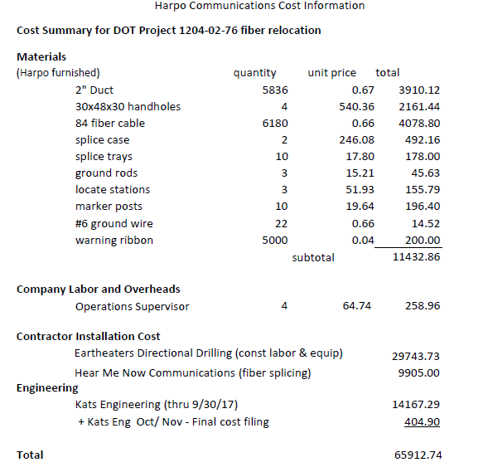

Slide 16
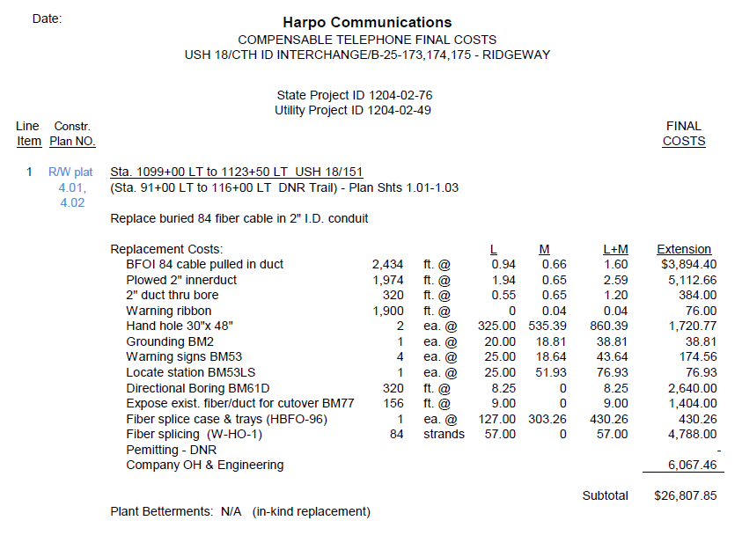

Slide 17
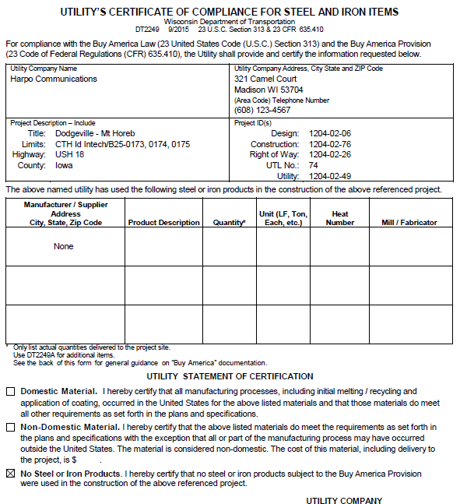

Slide 18
WisDOT Region Office Review
Invoice is reviewed for billing accuracy
Must coincide with the estimate agreement
Completeness (all appropriate documents are there)
Verifies that the relocation work has been completed
If the estimate was based on a percentage of the total work order cost the percent used at the time of billing should be the same

Slide 19
When there are discrepancies or questions regarding the invoice that cannot be resolved a DT1568 “Notice of Good Faith Dispute/Improper Invoice” will be sent to the Utility
A response to the DT1568 “Notice of Good Faith Dispute/Improper Invoice” is required within 10 business days, by either providing the information requested on the form or letting WisDOT know when the requested information will be submitted

Slide 20
Reminders
Utilities should invoice WisDOT within 1 year of the completion of the associated highway work.* For this purpose, the completion of the highway work is defined as having the project seeded and mulched, or open to traffic if it is late in the calendar year.
Referenced in the Lump Sum agreement in item 3
Referenced in the Audit agreement in item 4

Slide 21
Buy America Compliance information *
Referenced in the Lump Sum agreement in item 4
Referenced in the Audit agreement in item 4

Slide 22
Lump Sum Agreement

Slide 23
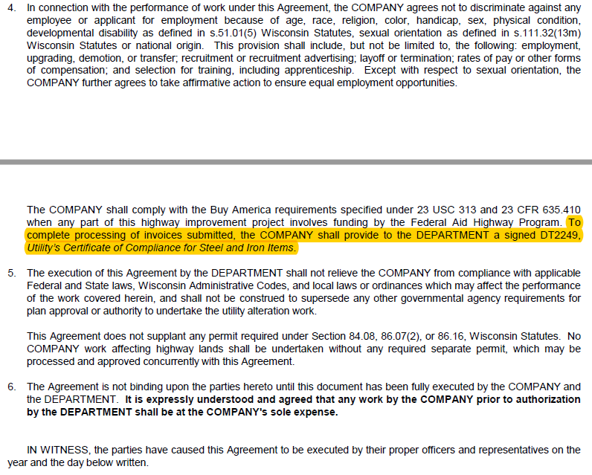

Slide 24
Audit Agreement

Slide 25
QUESTIONS about an invoice ??
SW Region Utility Coordinators
SW Region La Crosse Office
Jill Noel (608) 785-9907
Shane Smith (608) 789-5953
SW Region Madison Office
Bobbie Keck (608) 246-3829
Debby Kozol (608) 243-3372

