Slide 1

Utility Accommodation Policy & Permitting Updates
2018 Region Utility Conferences

Slide 2
Today’s topics
2017 achievements: Permit form and UAP revised
Permit issuance
Work start and finish dates
Location maps
Permit drawings – what’s missing – what’s added
Pavement restoration
Don’t do this…
  Overhead line clearance
  Intersections and roundabouts
  Potholing
  Tree or vegetation cutting/spraying
  Casing

Slide 3
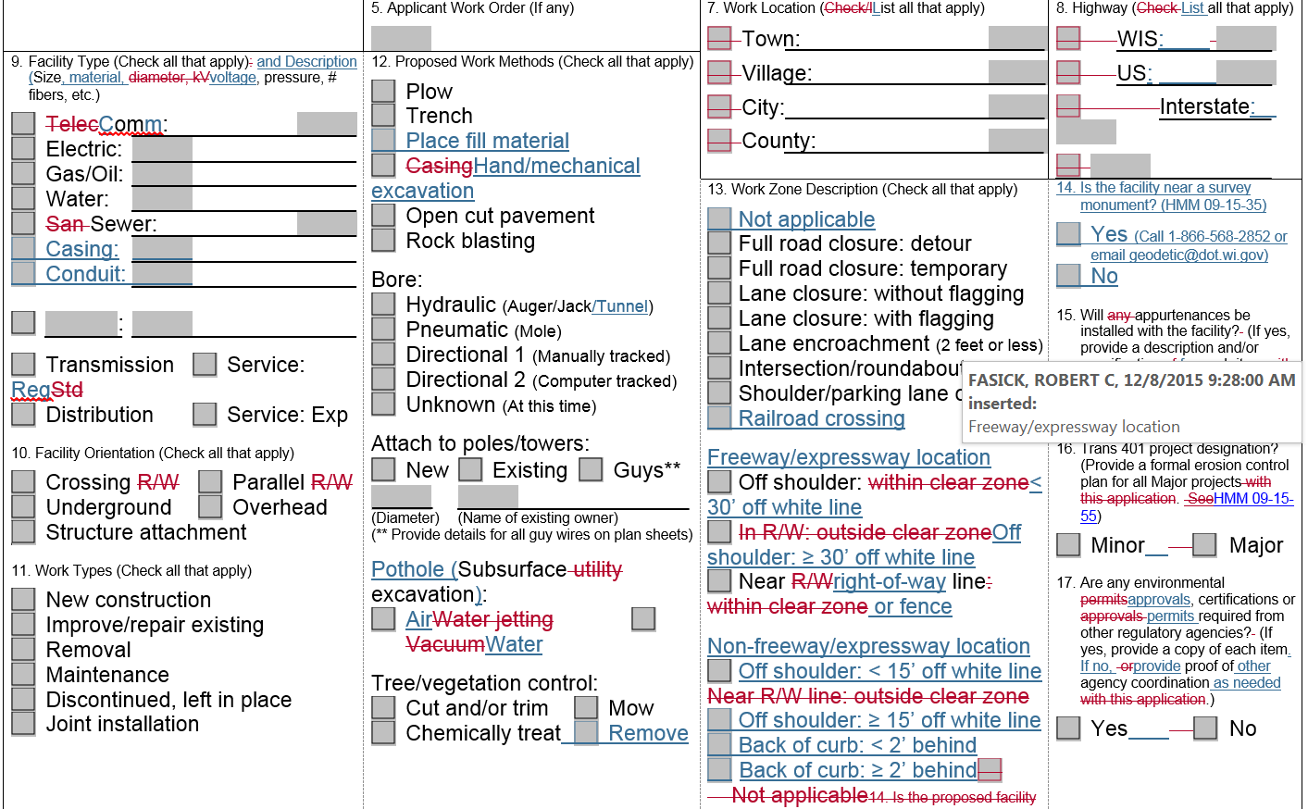
Permit form revisions

Slide 4
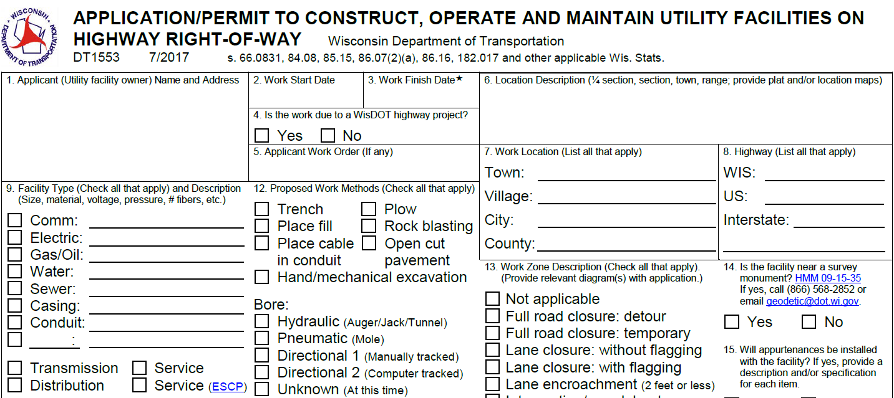
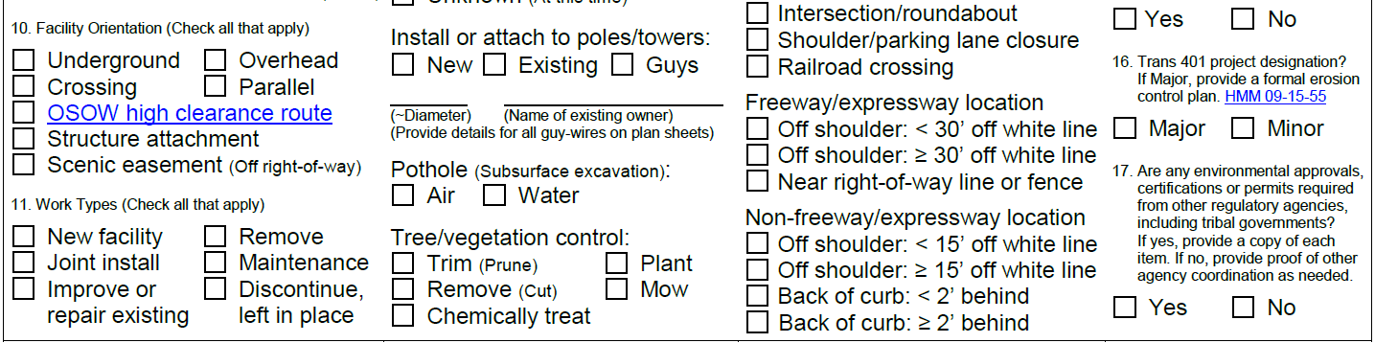

Slide 5
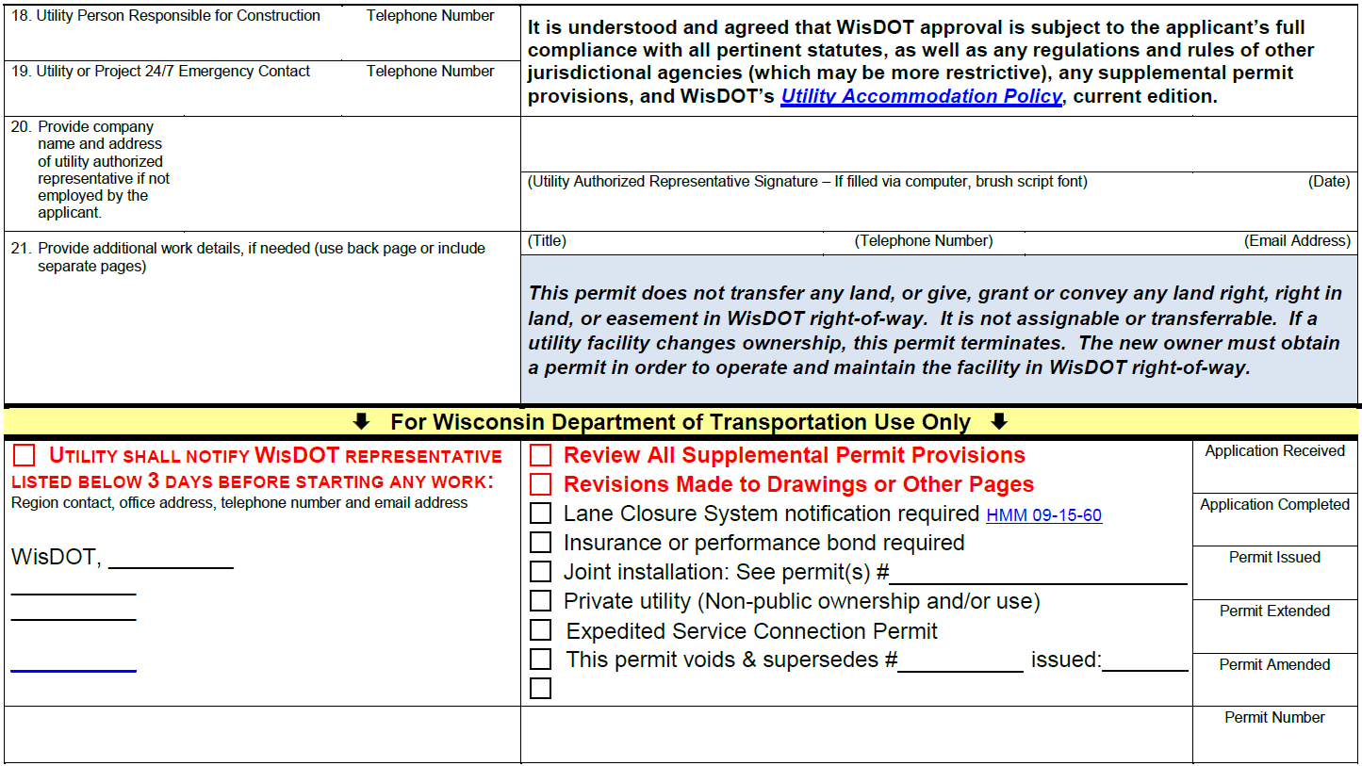

Slide 6
PREVIOUS

Slide 7
Proposed indemnification
Similar to other state contracts
HOLD HARMLESS: The permittee will indemnify and save harmless the State of Wisconsin and all of its officers, agents and employees from all suits, actions, or claims of any character brought for or on account of any injuries or damages received by any persons or property resulting from the operations of the permittee, or of any of its contractors, in prosecuting work under this permit.

Slide 8




Slide 9
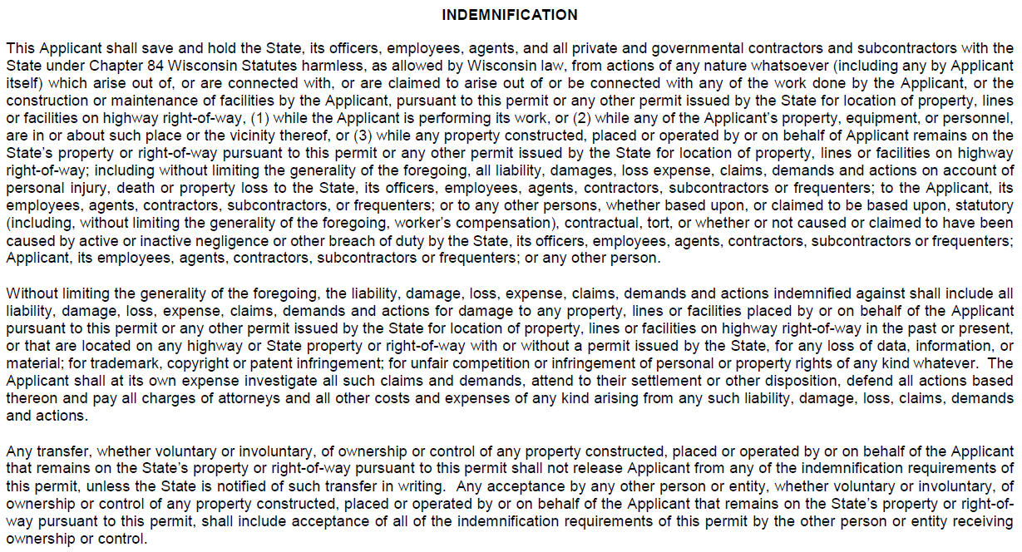
CURRENT

Slide 10
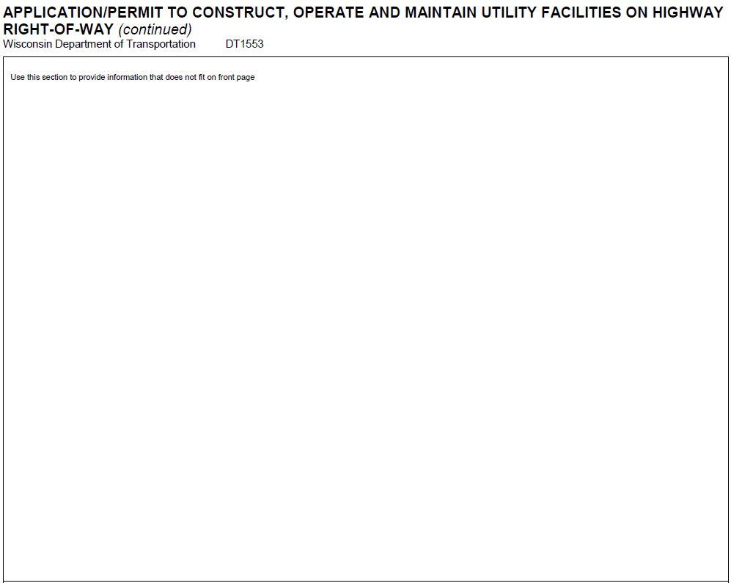

Slide 11
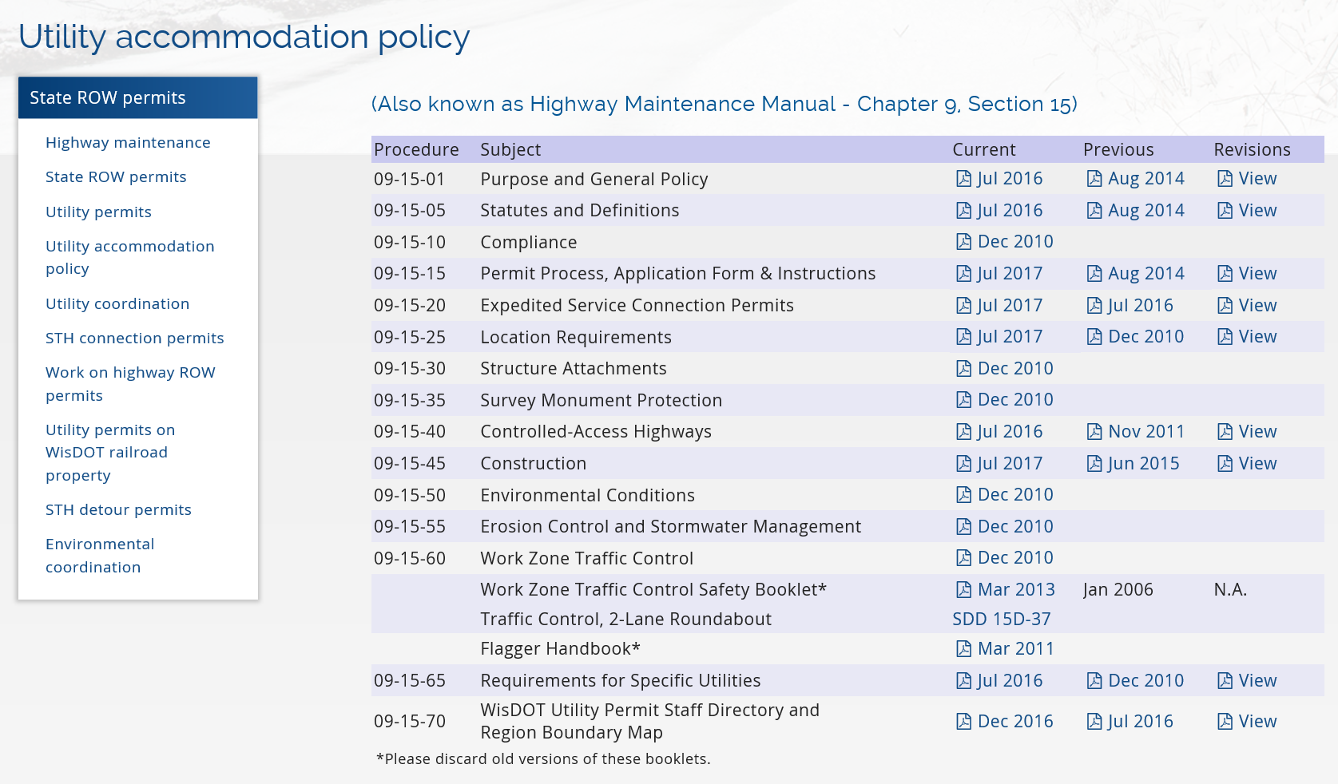
UAP – Revisions

Slide 12
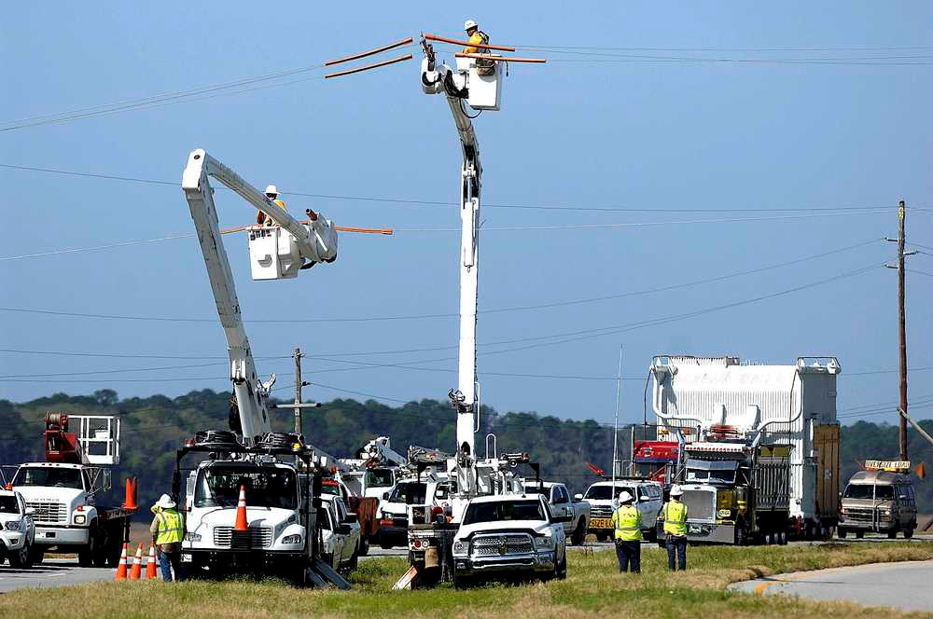
Overhead line clearance
UAP revised to aid overheight freight movement

Slide 13

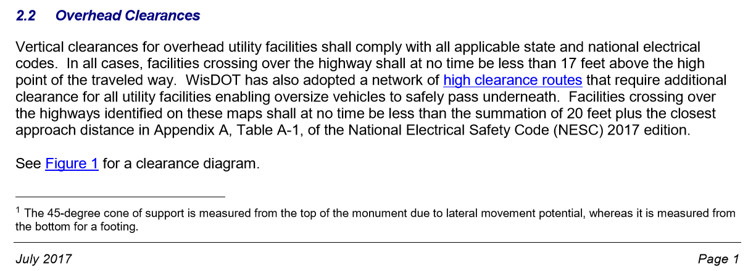
Overhead line clearance
HMM 09-15-25, Location Requirements
Special thanks to electric utilities for helping WisDOT to develop the proper NESC language

Slide 14
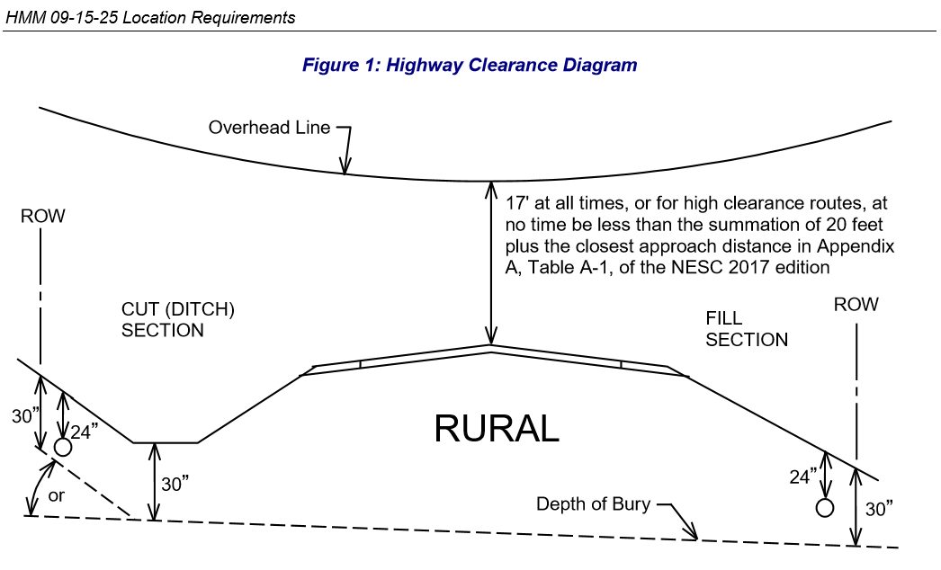


Slide 15
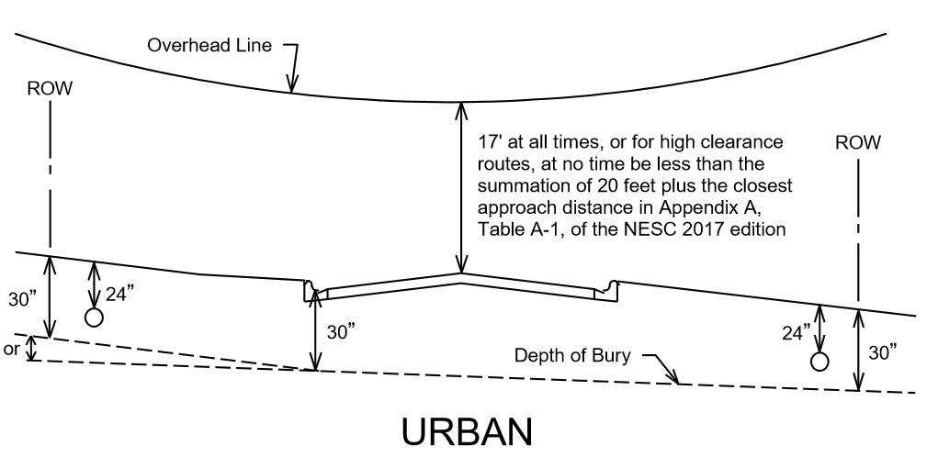

Slide 17
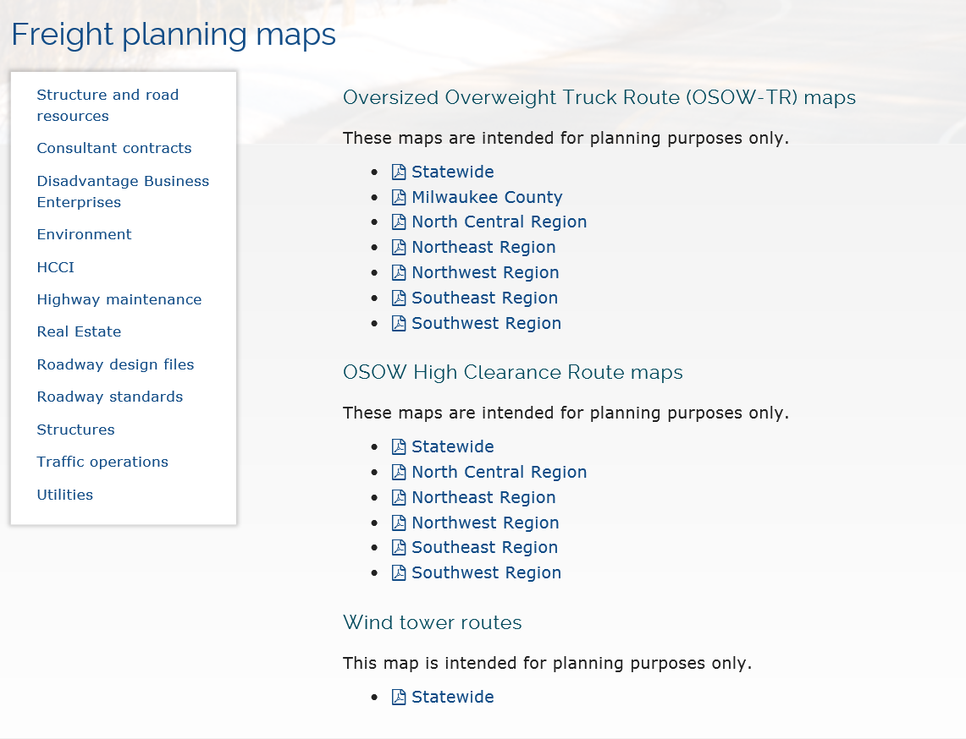

Slide 18
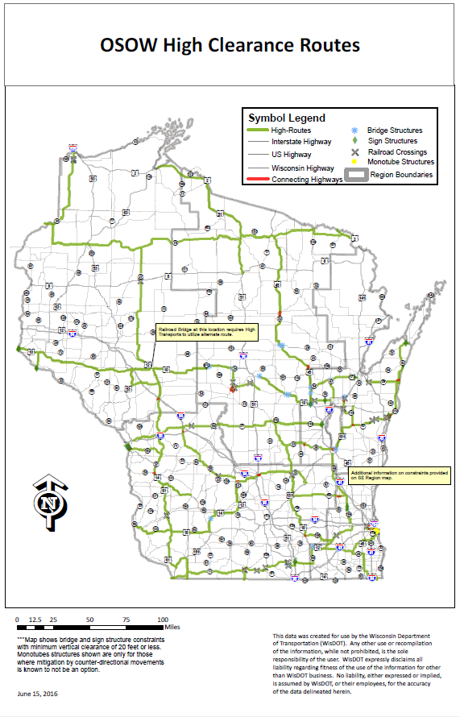
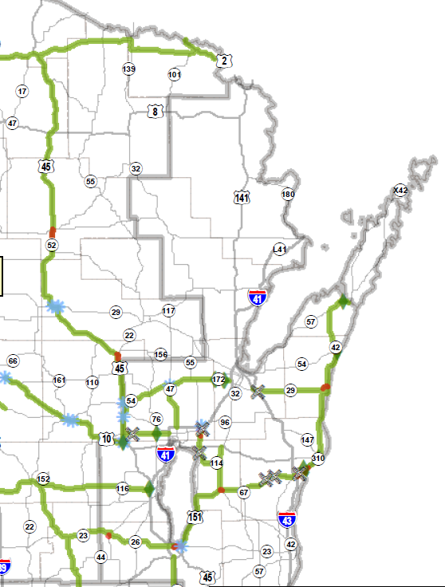
NORTHEAST REGION

Slide 19
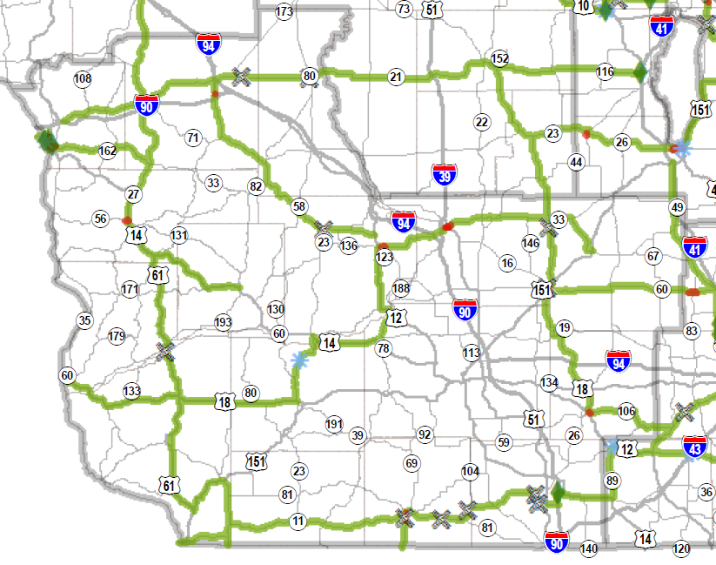
SOUTHWEST
REGION

Slide 20
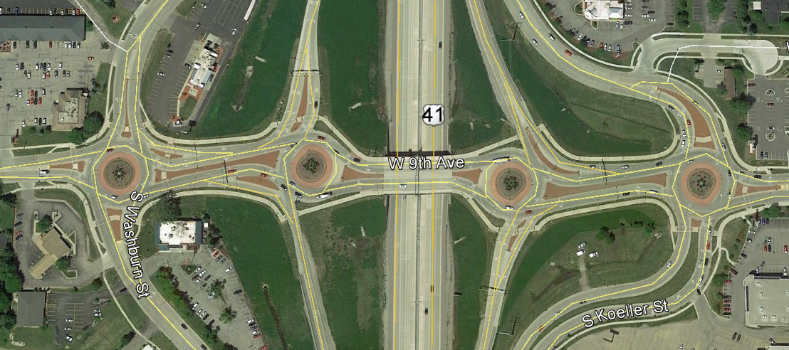
Intersections and roundabouts
New language in HMM 09-15-25
I-41 @ 9th Ave, Oshkosh

Slide 21
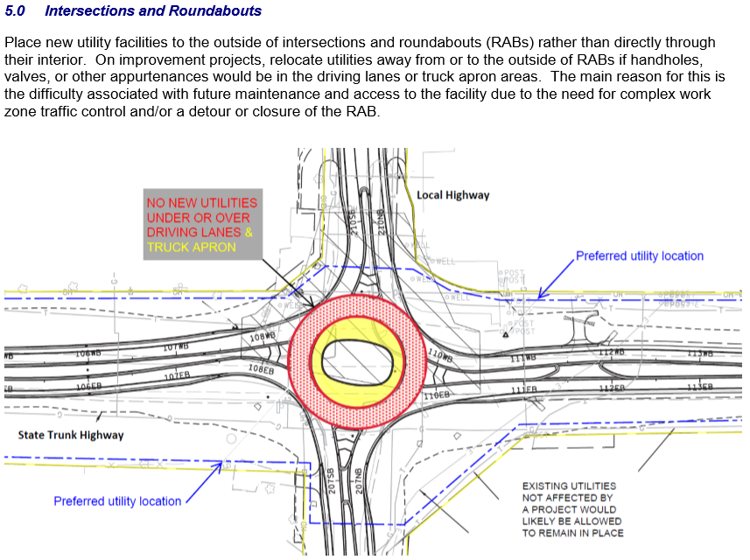

Slide 22
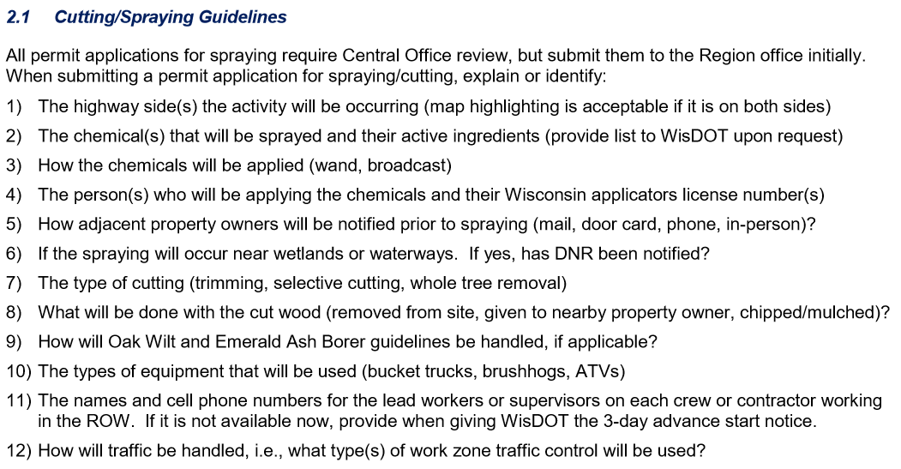
Permits involving tree or vegetation cutting/spraying

Slide 23
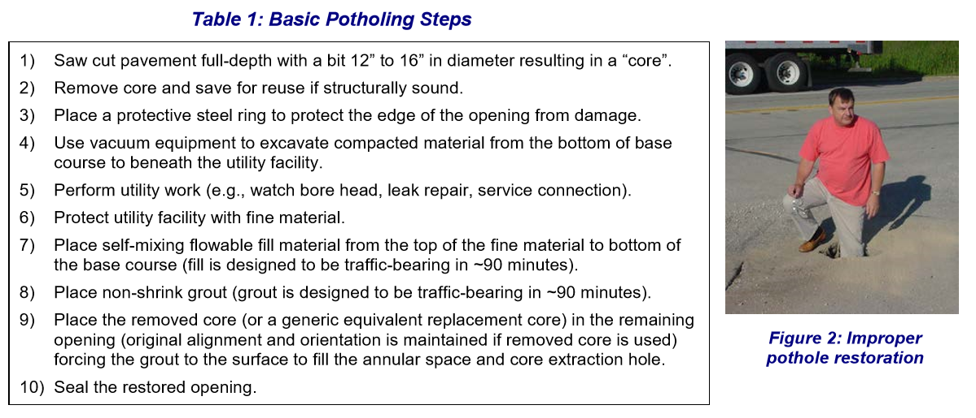
Subsurface utility excavation Potholing
HMM 09-15-45, Section 3.3

Slide 24
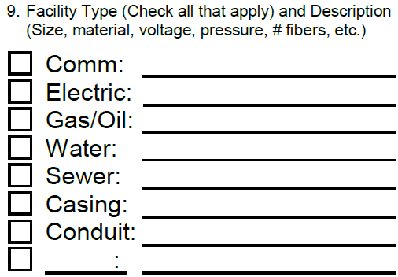
Casing:
HMM 09-15-45
Section 3.5
WisDOT does not require casing
WisDOT recommends casing:
  For facility protection
  To aid in future expansion
  To eliminate future boring costs
When casing is used, extend it at least:
  2 feet beyond the toe of slope
  3 feet beyond the ditch line
  2 feet beyond the curb in an urban section

Slide 25
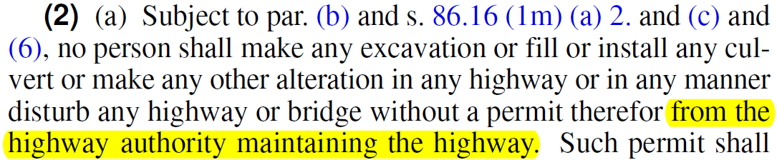
Permit Issuance:
Maintaining Highway Authority
Wis. Stat. 86.07(2)(a) – Digging in highways…
WisDOT issues permits on state trunk highways (STHs)
Local governments issue permits on their highways
  Includes connecting highways
On STHs, potential problems with parking areas, terraces and sidewalks in municipalities
  Typically WisDOT does not maintain these areas

Slide 26

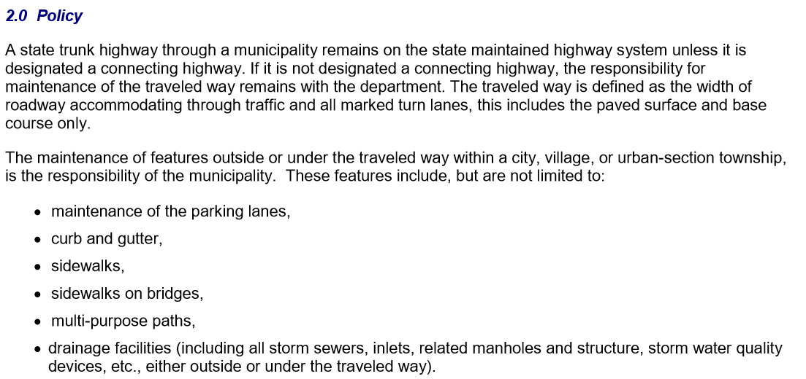

Slide 27
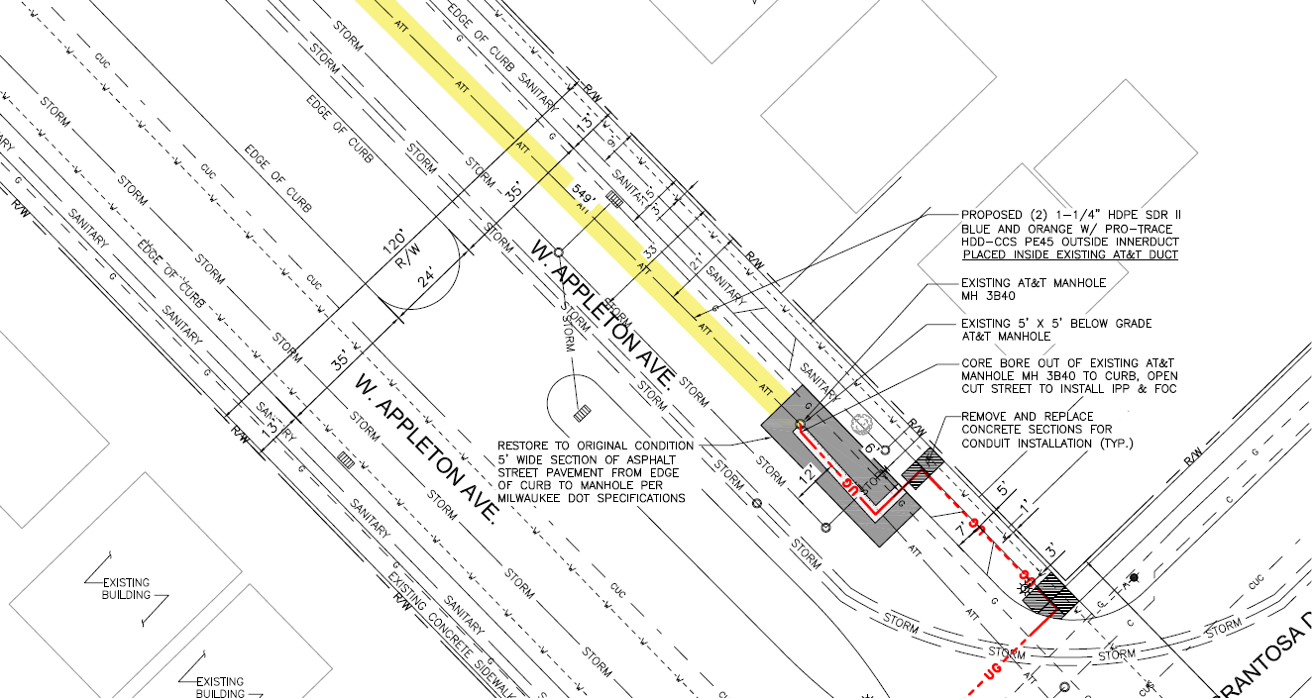

Slide 28
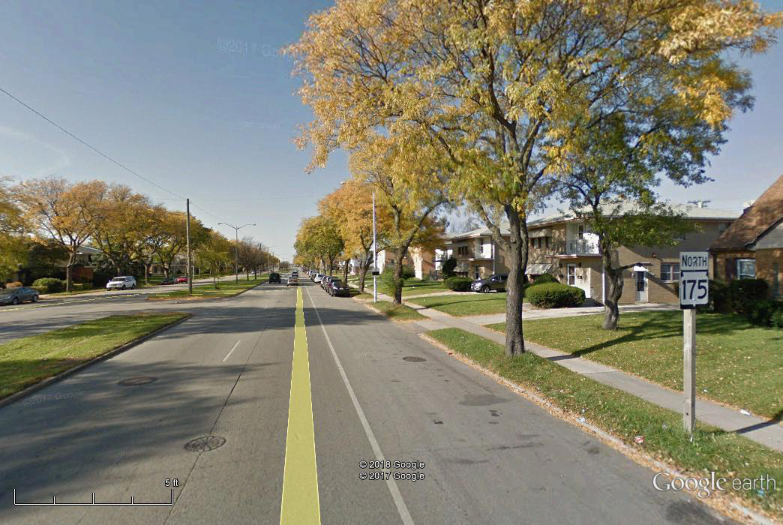

Slide 29
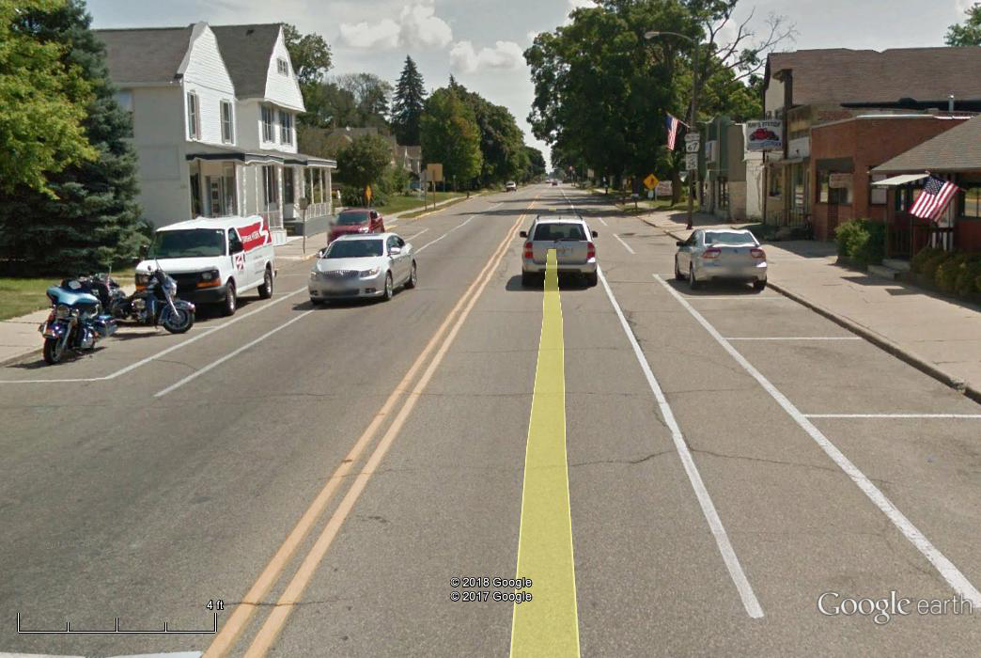
WIS 67, Walworth

Slide 30
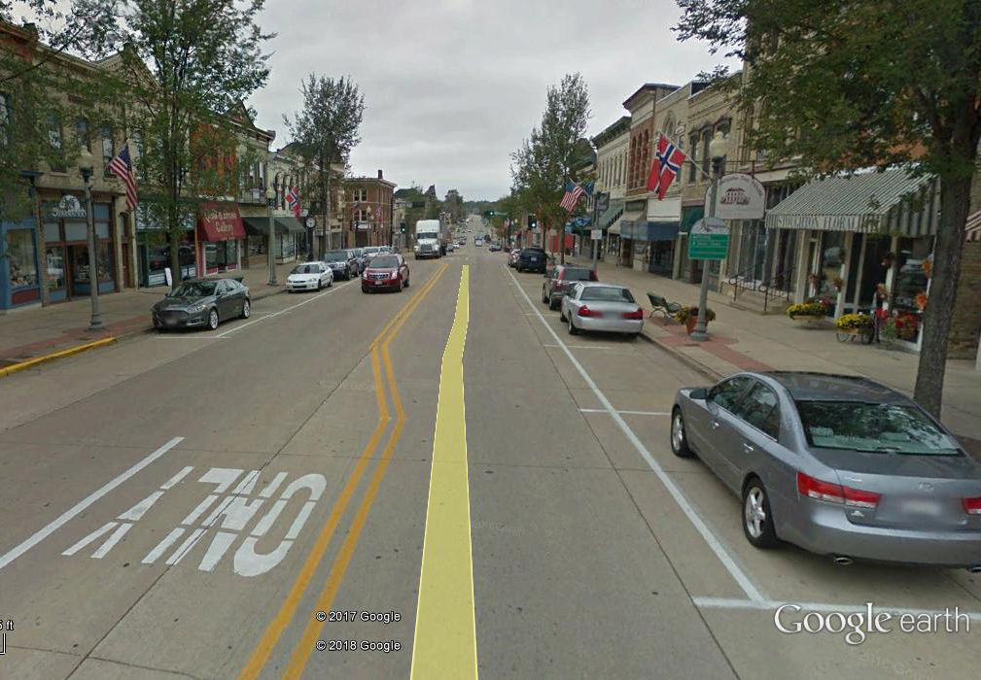

Slide 31
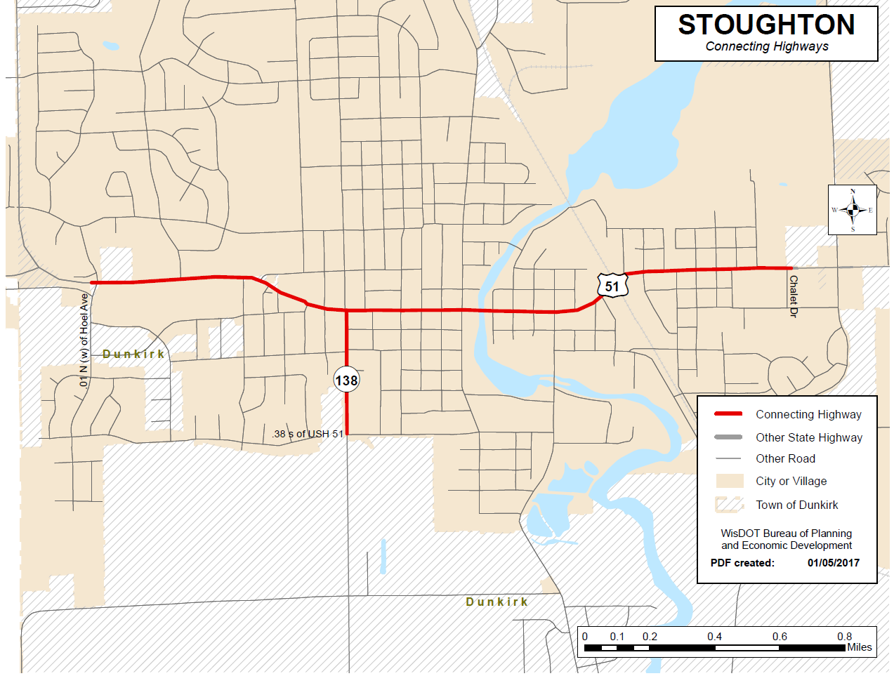

Slide 32
Permit Issuance:
Region v. Central Office (BHM)
Region offices issue most permits
Bureau of Highway Maintenance issues permits for:
  Expedited service connections (Not individual requests for service)
  The longitudinal occupation of interstates, freeways, and freeway/expressway mixes (hybrids) HMM 09-15-40
    Communications (including cellular), electric transmission
    20-year occupation fee involved
  All longitudinal installations of private utility facilities
  All installations not in conformance with, or exceptions to, the Utility Accommodation Policy
    These two items also require FHWA approval

Slide 33
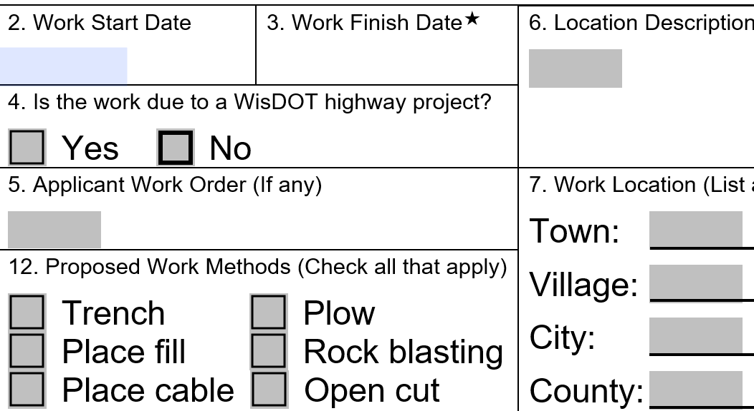
Work Start & Finish Dates

Slide 34
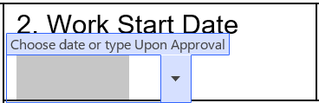
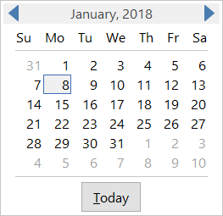
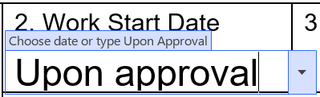
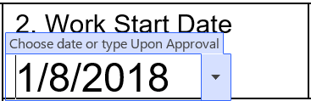

Slide 35

Work Start and Finish Dates:
Why are they important?
Issuance of other utility permits
Issuance of work on highway ROW permits
Planned or emergency maintenance work
Permanent Restoration
OSOW freight movement
Utility coordination: improvement projects
Calls from the public, businesses, press, etc.
WisDOT needs to know when you are working

Slide 36
★
Includes permanent restoration. If the permitted work has not started by the “Work Finish Date”, this permit is null and void. If the permitted work has started, but has but has not bee completed by the “Work Finish Date”, the work shall not be completed unless authorized through an approved written time extension or a subsequent permit. ANY PERMIT ISSUED IS REVOCABLE

Slide 37
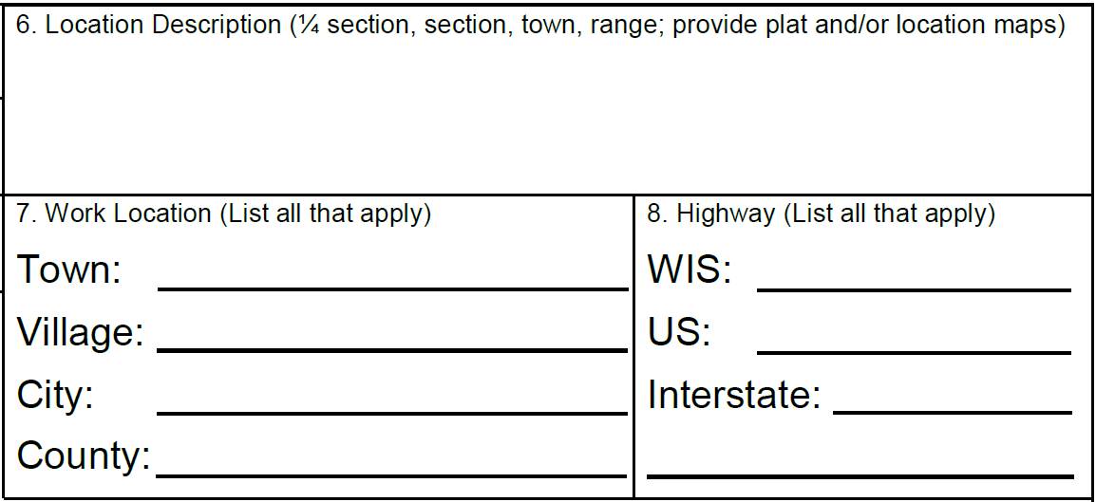
Location maps

Slide 38
County map from WisDOT website

Slide 39
Plat map

Slide 40
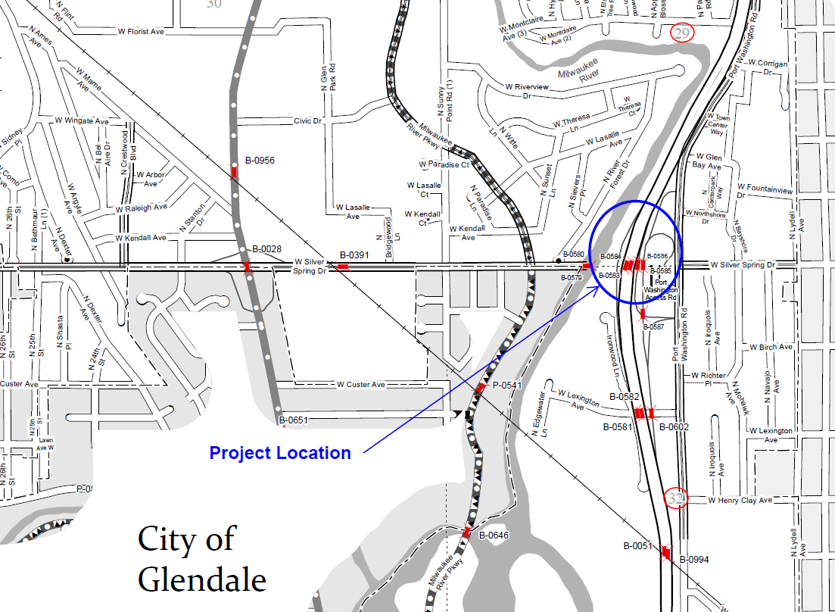
Municipal map

Slide 41
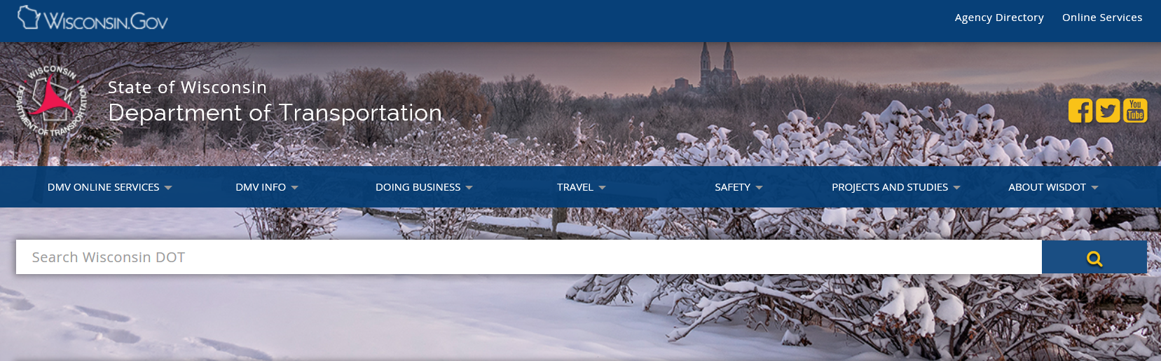
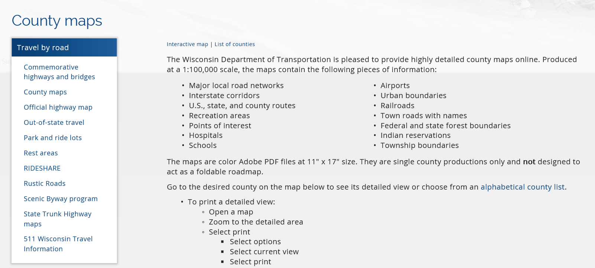

Slide 42
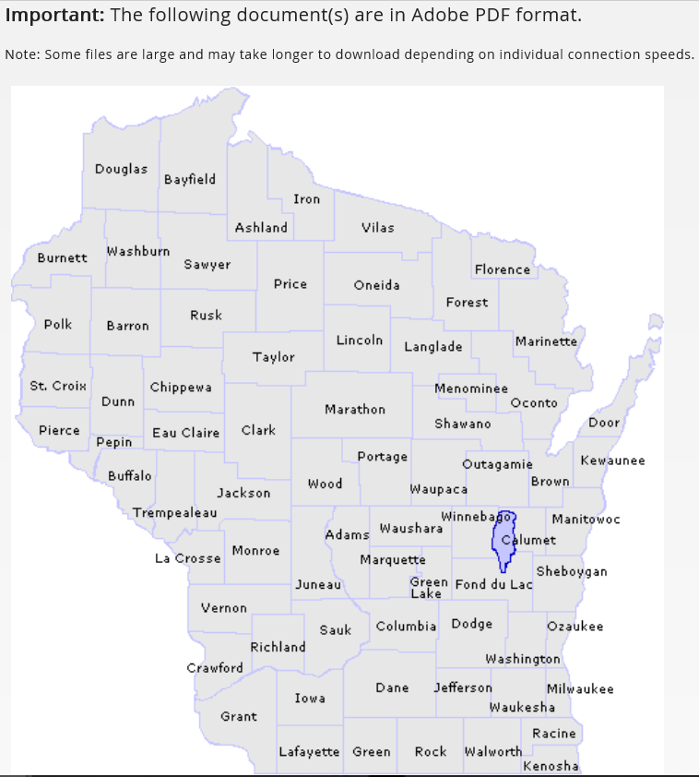

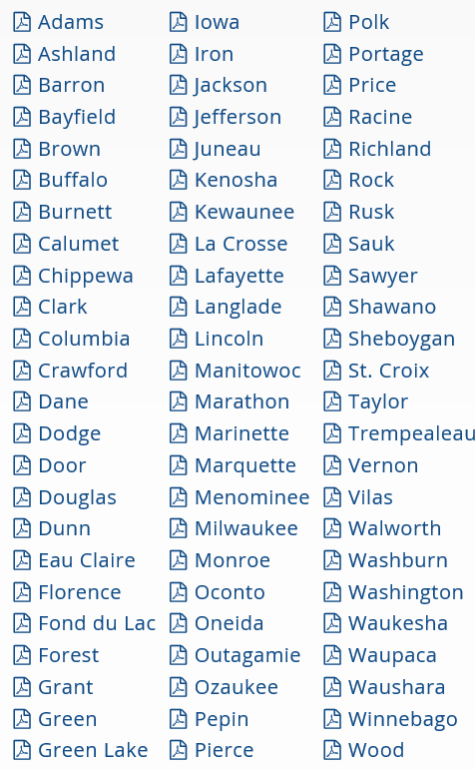

Slide 43
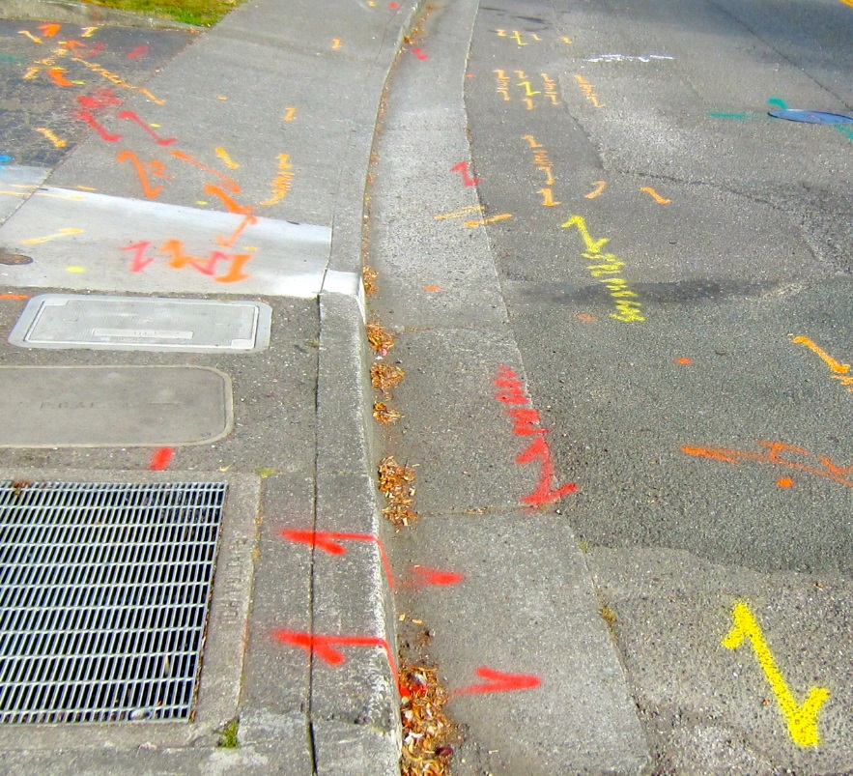
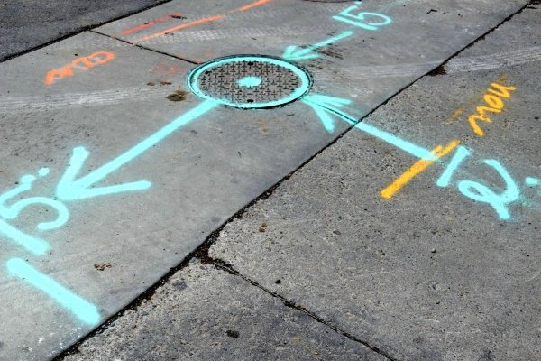
HMM 09-15-15 Permit Drawings

Slide 44
Provide dimensions from known points
Right-of-way line
Fence
Edge of pavement
Edge of travel lane
  White stripe
Centerline
Other utilities
Scale
Stationing
Section lines

Slide 45
What’s missing with an application…
Erosion control plans
Traffic control plans
  Medium to larger projects
Environmental approvals, etc.
  DNR, ACOE correspondence, wetland maps
  Arch/Historical sites
  Tribal coordination
3-day notice sent to WisDOT
Appurtenances (not labeled, described, etc.)

Slide 46
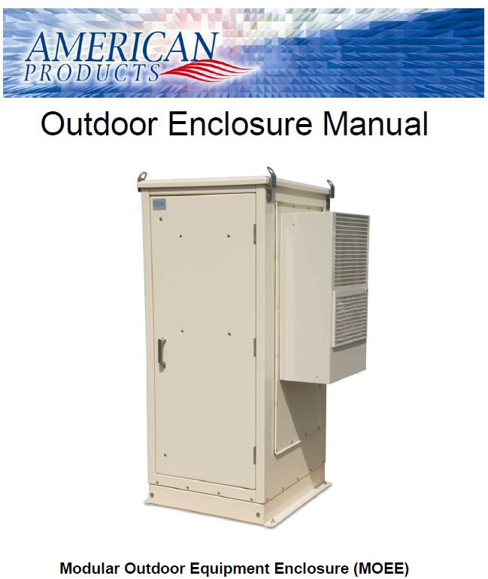
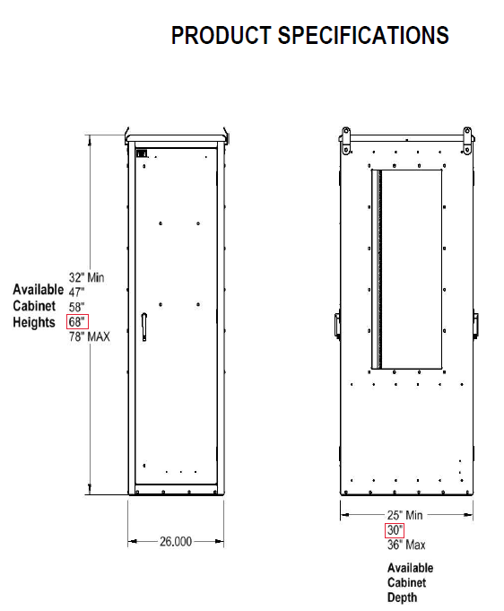

Slide 47
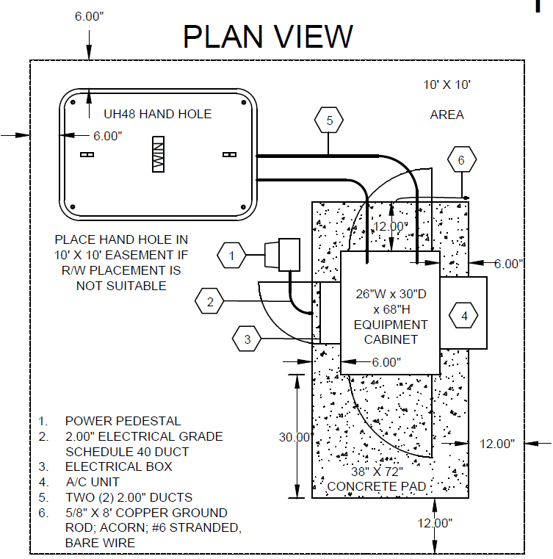

Slide 48
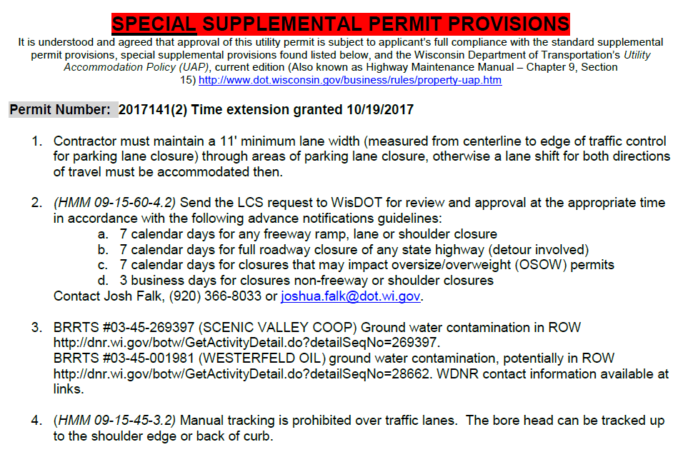
What may be added…

Slide 49
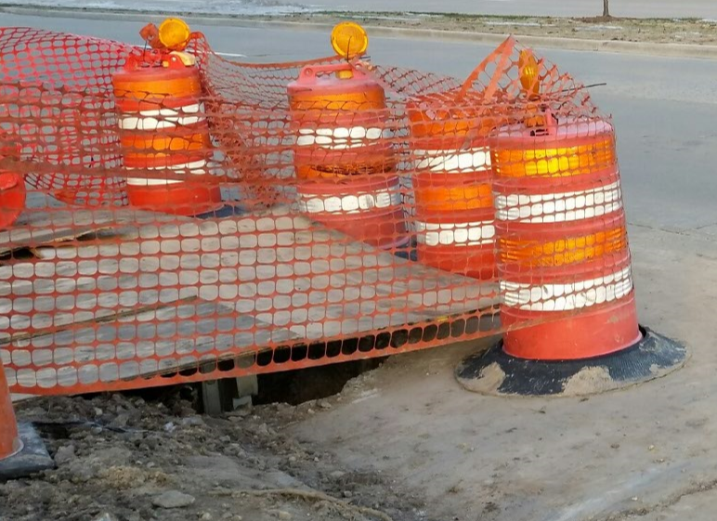
Pavement Restoration
Need to do better – starts with the excavation
Pavement must be sawcut

Slide 50
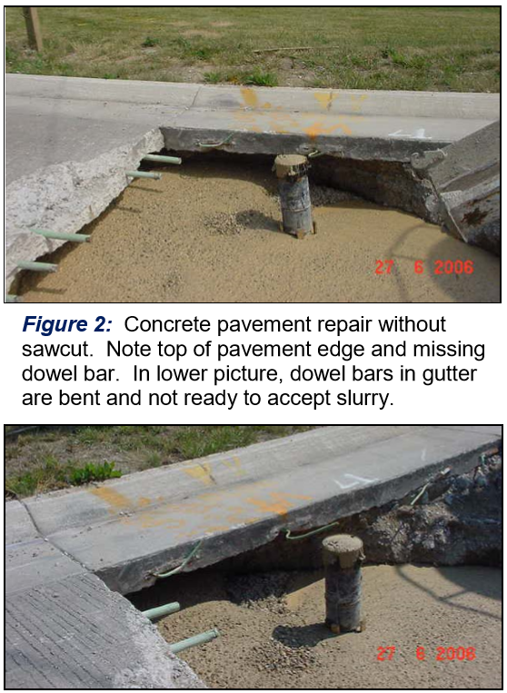
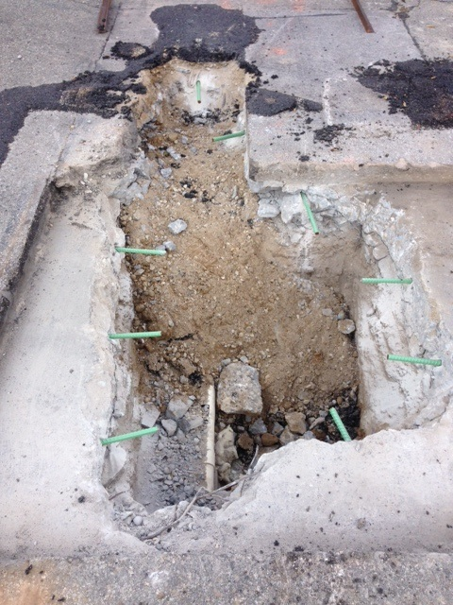
Don’t do this…

Slide 51
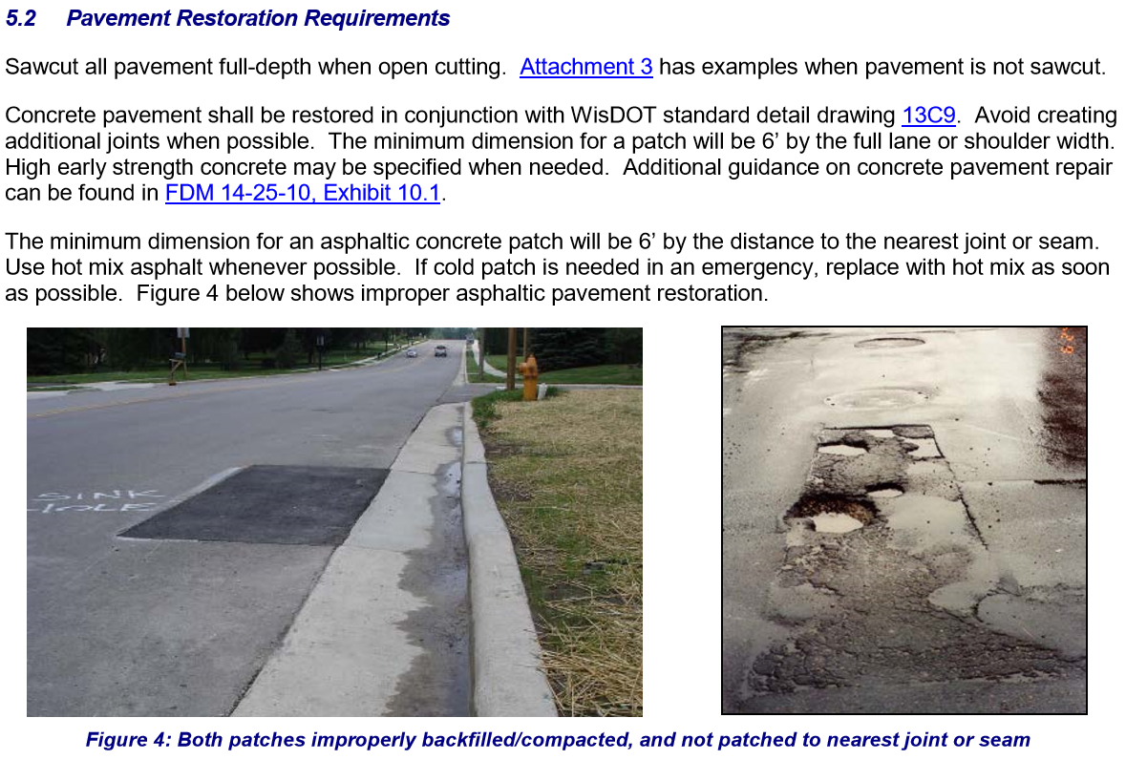
HMM 09-15-45

Slide 52
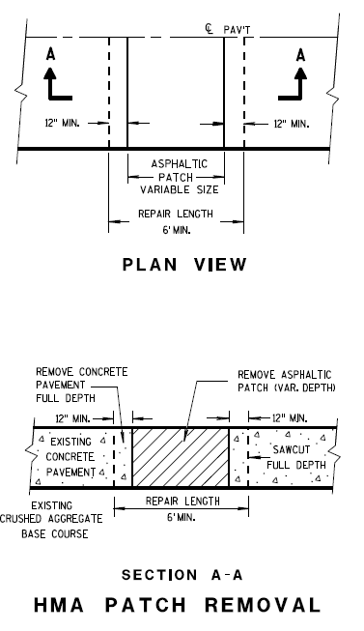
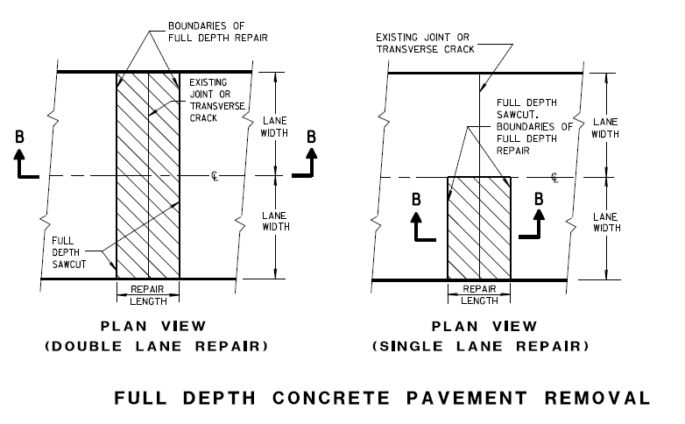





SDD 13C9

Slide 53


Slide 54


Before
After

Slide 55


Before
After

Slide 56


Don’t do this…

Slide 57


Don’t do this…

Slide 58

PLEASE don’t do this…

Slide 59


Central Office is moving…
My new address effective February 28:
Bureau of Highway Maintenance
4822 Madison Yards Way, 5th Floor South
Madison, WI 53705
- or -
Bureau of Highway Maintenance
PO Box 7986
Madison, WI 53707-7986

Slide 60

Where can WisDOT’s Utility Accommodation Policy be found?
http://wisconsindot.gov/Pages/doing-bus/real-estate/permits/utility-uap.aspx
Scan the QR code on the agenda

Slide 61

Comments, questions, criticisms, concerns…
Bob Fasick
State ROW Permits Engineer
(608) 266-3438
robert.fasick@dot.wi.gov
This presentation is available at:
ftp://ftp.dot.wi.gov/dtsd/bhm/permits/utility/region-utility-confs/

