Slide 1
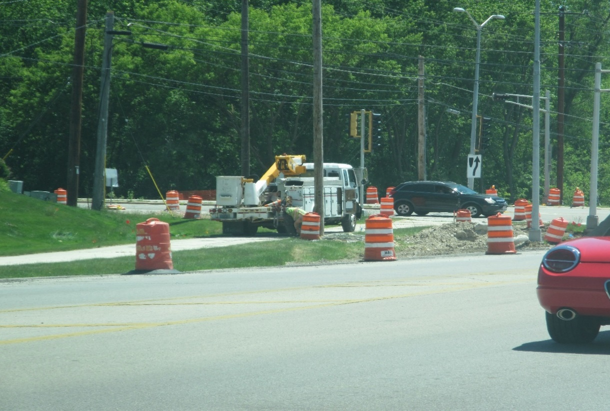
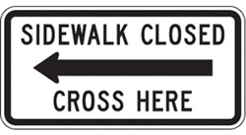
2019 Annual Utility Conference February 2019
Rebecca Klein, PE
WisDOT SE Regional Work Zone Engineer

Slide 2
MUTCD (Manual on Uniform Traffic Control Devices)
Section 6A.01 General states the following:
The needs and control of all road users (motorists, bicyclists, and pedestrians within the highway, or on private roads open to public travel (see definition in Section 1A.13). Including persons with disabilities in accordance with the Americans with Disabilities Act of 1990 (ADA), Title II, Paragraph 35.130) through a TTC zone shall be an essential part of highway construction, utility work, maintenance operations, and the management of traffic incidents.
Notes:
MUTCD and ADA (both are Federal documents) states that pedestrian safety must be considered while designing work zones. Need to protect pedestrians in all work zones whether its for construction activities, maintenance activities, utilities activities, incident management, etc. These guidelines and manuals is the foundation of providing temporary pedestrian accommodations on all work zones within Wisconsin.

Slide 3
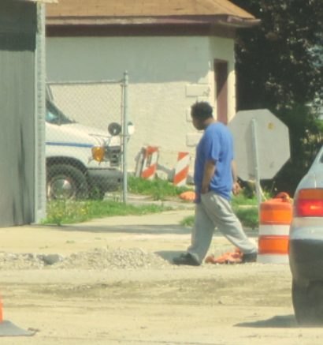
Examples

Slide 4
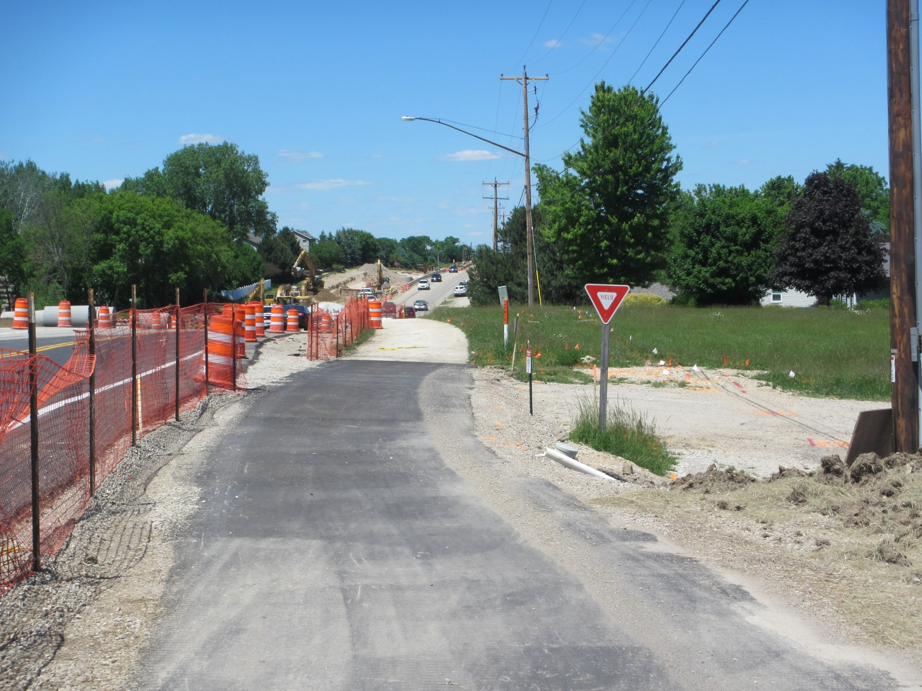
Good or Bad Example?
GOOD
Notes:
I don’t have a lot of “great examples”, but this is one good example. (Waukesha County)
What makes this a good example?
Sidewalk is clearly defined
Sidewalk is wider than 5’
Protected from construction activities
Clean sidewalk
No obstructions or temporary or existing sidewalk

Slide 5
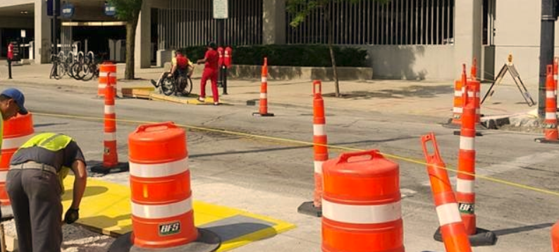
Good or Bad Example?
GOOD
Notes:
Here is another really good example. (Milwaukee County)
What makes this a good example?
The temporary sidewalk has been clearly delineated through the work zone
Pedestrian barrier between live traffic and temporary sidewalk
ADA compliant curb ramps
protected from construction activities
Clean of debris
There are no obstructions on temporary sidewalk

Slide 6
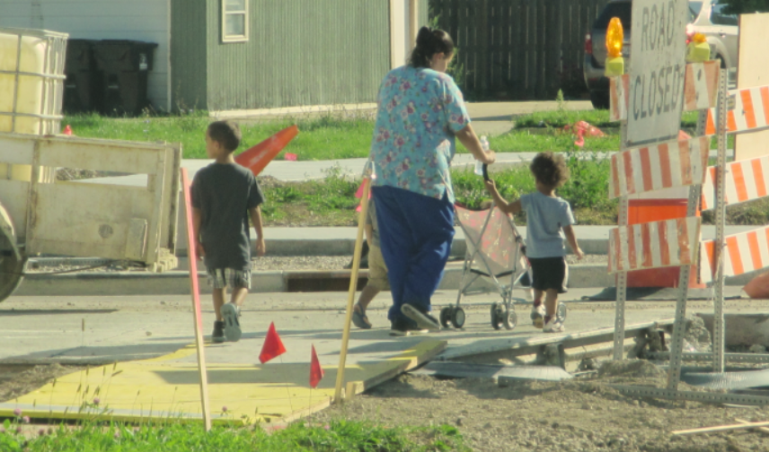
Good or Bad Example?
BAD
Notes:
Work in progress example. (Racine County)
Positives:
Temporary sidewalk is defined.
It’s kind of protected from construction activities
Uses existing crosswalks – so no “new” pedestrian traffic movement
It can be improved by:
Providing protection from drop-offs
Including an ADA complaint hard surface from existing sidewalk to the temporary curb ramp
ADA compliant detectable curb ramp
A couple of things to remember:
Think about the safety of pedestrians through your work zones.
Verify that pedestrian route(s) are clearly marked and defined.
Verify that sight lines for pedestrians-motorists within a pedestrian route are sufficient such that both driver and pedestrian can identify the other when turning or crossing.
Verifying that all signing and pavement markings for pedestrian routes are clearly distinguishable.
Temporary pedestrian facilities shall be visible and include accessibility features consistent with the features in the existing facility.
Verify that there are no obstacles on pedestrian route.
When there are bus stops within the work zone, this is a completely different approach.
Need to work with transit authority to determine if they would like to keep the bus stop, move it, or temporary suspend the stop.
If needing to maintain it, need to verify that pedestrians are protected to/from bus stop. Protected from work zone vehicles, work operations, equipment, etc.
Construction drop-offs must be protected from pedestrians if 2” or greater exists.

Slide 7
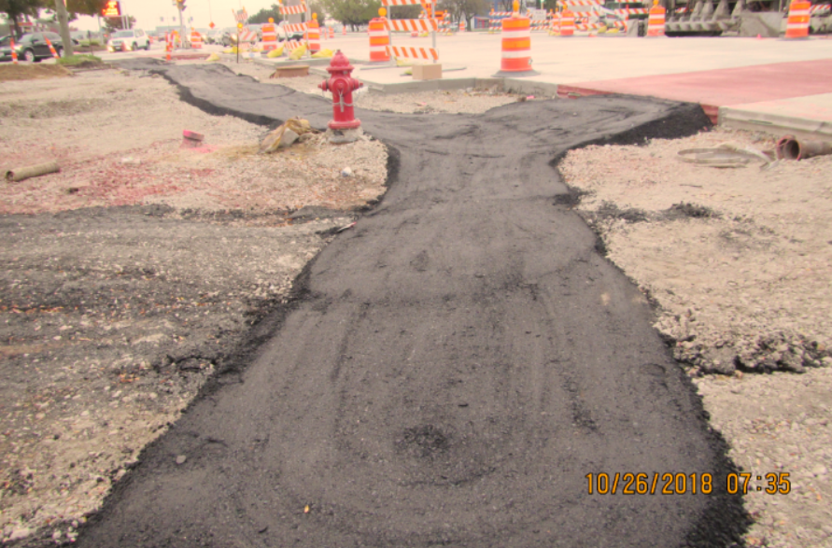
Good or Bad Example?
BAD
Notes:
Work in progress example. (Milwaukee County)
Positives:
Temporary sidewalk is defined.
It’s kind of protected from construction activities
Uses existing crosswalks – so no “new” pedestrian traffic movement
It can be improved by:
Providing protection from drop-offs
ADA compliant slopes (1.5 +-.5%) and cross-slopes (8.33%)
ADA compliant detectable warning field

Slide 8
Good or Bad Example?
BAD
Notes:
(Racine County)
Bad example. Why?
Blocking sidewalk for any length of time is unacceptable. Need temporary pedestrian accommodations that is at least 4’ wide for 200’. Then you will need a 5’ wide for 5’ for a “passing lane” for two wheelchairs. I see this a lot with utilities because they usually say “I will only be here for a short amount of time.” This short amount of time is unacceptable and short amount usually indicates a day or so.
What is the simplest way to improve this situation?
Verify that all work operations, equipment, outriggers, etc are not on the sidewalk.
How can this be improved?
Utilize sidewalk on other side? But need signs to direct pedestrians.
Sidewalk diversion around the obstruction, but diversion must be ADA compliant, clearly defined, protected from construction activities, protect from drop-offs.
Use flaggers to help pedestrians through work areas.
Provide a sidewalk detour, which is a last resort since pedestrians will not “re-trace” their steps and detours may be long which can be unreasonable to a disabled person.

Slide 9
Good or Bad Example?
BAD
Notes:
Why is this bad? (Racine County)
Cannot obstruct sidewalk for any length of time without providing for alternate pedestrian accommodations.
What is the simplest way to improve this situation?
Verify that all work operations, equipment, outriggers, etc are not on the sidewalk.
How can this be improved?
Utilize sidewalk on other side? But need signs to direct pedestrians.
Sidewalk diversion around the obstruction, but diversion must be ADA compliant, clearly defined, protected from construction activities, protect from drop-offs.
Use flaggers to help pedestrians through work areas.
Provide a sidewalk detour, which is a last resort since pedestrians will not “re-trace” their steps and detours may be long which can be unreasonable to a disabled person.

Slide 10
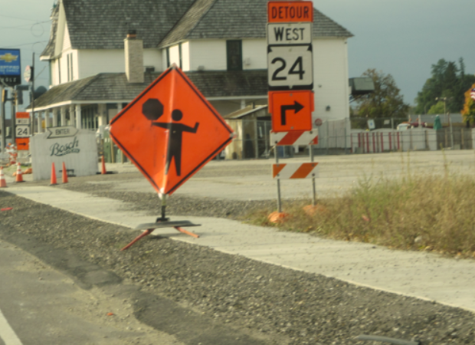
Good or Bad Example?
BAD
BAD
Notes:
Bad example. (Lower left is from Racine County. Upper right is from Milwaukee County.)
Why are these wrong?
Does not provide temporary pedestrian accommodations around open sidewalk and debris.
Does not provide the necessary signs to indicate a sidewalk closure.
Does not protect pedestrian from the drop-off or possible drop-off.
Signs cannot be placed on sidewalk without temporary pedestrian accommodations.
How can these be improved?
Utilize sidewalk on other side? But need signs to direct pedestrians.
Sidewalk diversion around the obstruction, but diversion must be ADA compliant, clearly defined, protected from construction activities, protect from drop-offs.
Use flaggers to help pedestrians through work areas.
Provide a sidewalk detour, which is a last resort since pedestrians will not “re-trace” their steps and detours may be long which can be unreasonable to a disabled person.
Move sign off sidewalk.

Slide 11
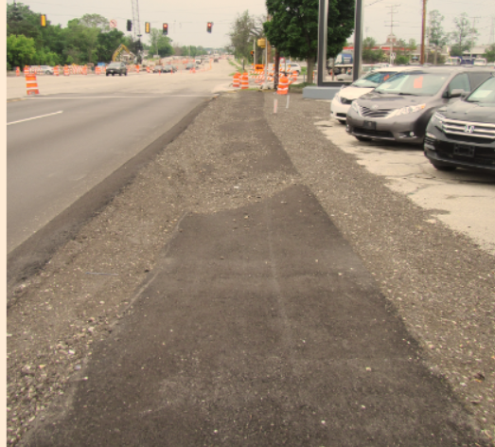
Good or Bad Example?
BAD
BAD
Notes:
Bad example. (Lower left is from Milwaukee County. Upper right is from Racine County.)
Why are these wrong?
Racine County does not provide any temporary pedestrian accommodations (upper right).
Does not provide the necessary signs to indicate a sidewalk closure.
Milwaukee County has too much debris on sidewalk that its not passable with a wheelchair.
How can these be improved?
Utilize sidewalk on other side? But need signs to direct pedestrians.
Sidewalk diversion around the obstruction, but diversion must be ADA compliant, clearly defined, protected from construction activities, protect from drop-offs.
Use flaggers to help pedestrians through work areas.
Provide a sidewalk detour, which is a last resort since pedestrians will not “re-trace” their steps and detours may be long which can be unreasonable to a disabled person.

Slide 12
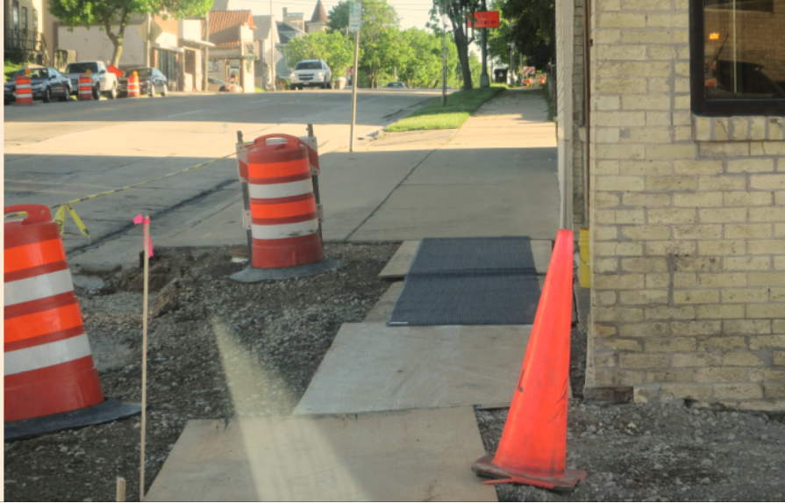
Good or Bad Example?
BAD
BAD
Notes:
Bad example. (Racine County)
Why are these examples bad?
Not detectable.
Not protected from drop offs.
Not protected from construction activities.
No detectable warning fields.
Not ADA compliant surface (not slip resistant).
How can we improve these facilities?
Provide a non-slip resistant surface
Provide detectable warning fields
Protect pedestrians from construction activities and/or drop-offs
Provide a “kick board” along the surface (for blind people)
Provide a slope and cross-slope ADA compliant surface
Temporary pedestrian facilities must be representative of existing pedestrian facilities.

Slide 13
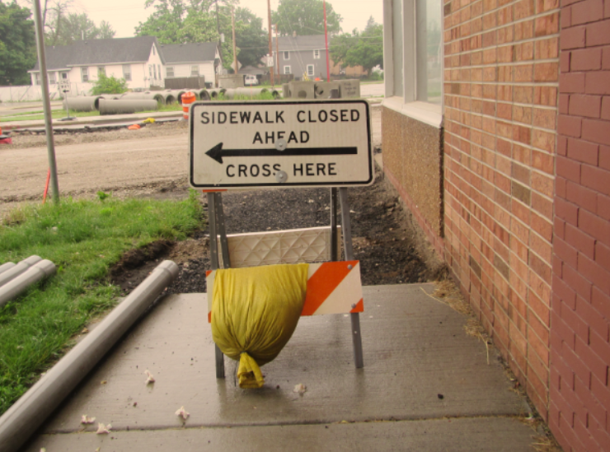
Good or Bad Example?
BAD
BAD
Notes:
Bad example. (Racine County and Milwaukee County)
This example is not as easy to identify what is incorrect.
Why are these examples bad?
The sidewalk closure signs are directly prior to the closure.
The signs are directing pedestrians to cross here, but there is no existing pedestrian facility or ADA compliant pedestrian facility to push the pedestrians to cross to avoid the work zone. (There is no companion sidewalk or curb ramp system.)
How can we correct these circumstances?
Change sign from “SIDEWALK CLOSED AHEAD CROSS HERE” to “SIDEWALK CLOSED”.
Sign are best placed on a type III barricade since they are 8’ wide and forces a pedestrian to physically walk around the obstruction.
Place “SIDEWALK CLOSED AHEAD CROSS HERE” sign at the closest intersection which would be prior to the closure. You need to close the sidewalk prior to the actual closure of the sidewalk.
Use pedestrian detour signs to direct pedestrian around the block to avoid the work area.
Could use a sidewalk diversion to bypass the sidewalk closure.
Could use the sidewalk on the opposite side if in an urban setting with sidewalks on both sides.

Slide 14
Questions?
Notes:
Thank you for your time.

Slide 15
Contact Information
Rebecca Klein, PE
WisDOT Southeast Region
Southeast Regional Work Zone Engineer
Cell: 262-822-5947
Email: rebecca.klein@dot.wi.gov

