Slide 1
American Transmission Company Mount Pleasant Tech Interconnection Project (Supporting Foxconn)
David Hollenberger
February 14, 2019

Slide 2
Agenda
Introduction – David
Who is American Transmission Co. (ATC)?
Mount Pleasant Tech Interconnection Project
Landowners & real estate
Q&A
Notes:
David will give a quick overview of agenda

Slide 3
American Transmission Co.
ATC was formed in 2001
Transmission-only electric utility, headquartered in Pewaukee, WI
Service area covers central and eastern WI, U.P. and portions of IL and MN
Owns and operates over 9,600 miles of transmission lines and 560 substations
In the past 10 years ATC has upgraded more than 895 miles or transmission lines and built 367 miles of new transmission lines
Notes:
David
Over the past ten years, we have:
upgraded more than 895 miles of transmission line,
improved 105 electric substations,
built 25 new transmission lines (367 miles)
connected 1,980 MW of new generation at 12 sites,
Includes 430 MW of renewable generation at 6 sites
saved customers more than $100 million a year in reduced energy costs with access to the marketplace and lower line losses,
increased import and export capability, and
improved transmission reliability.

Slide 4
ATC Service Territory

Slide 5
Foxconn Technology Group
Global leader in manufacturing services for the computer, communication and consumers electronics industry
Current facilities in Asia, Europe and Latin America
Forthcoming facility in Mount Pleasant, Wis. – advanced display manufacturing campus comprised of multiple buildings to produce liquid crystal display (LCD) panels for various industries.

Slide 6
What does this mean for ATC?
Electric load required for Foxconn’s operations will be the largest load connected to ATC’s transmission system at a single substation
Initial electric load estimated at 200 megawatts, but line designed at 230 MW to accommodate anticipated regional economic growth
Power used by Foxconn at full capacity will be enough to power approximately 150,000 households

Slide 7
ATC Location to Foxconn
ATC

Slide 8
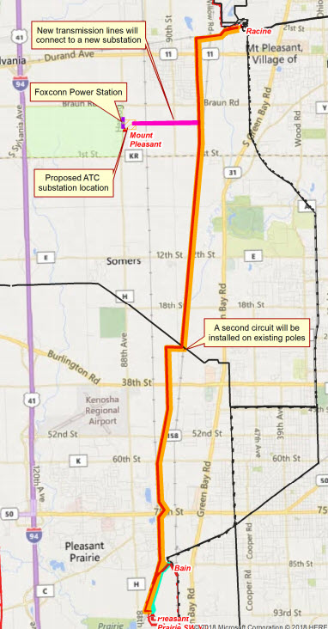
Connection with Foxconn
Mount Pleasant Tech
Interconnection Project
Foxconn connection will be to an existing 345kV line

Slide 10
Project components
A second transmission line circuit along an existing 12-mile, 345-kilovolt transmission line,
Two new double-circuit, 1.2-mile-long 345-kV transmission lines,
A new substation near the Foxconn campus,
Modifications at the Racine and Elm Road substations, Pleasant Prairie switchyard and
Four underground 138-kV transmission lines to electrically connect the new ATC substation to the Foxconn-owned substation.

Slide 11
Unique challenges of this project
Unprecedented, compressed duration to prepare and file regulatory application
Prior to PSC approval:
Install underground vaults
Finalize design engineering
Procure materials
Significant level of coordination with other infrastructure initiatives supporting the development, including local and state entities overseeing: water, roads, sewer, natural gas and others

Slide 12
Project schedule
Approval from PSC: August 2018
Start substation construction: September 2018
Major Deliveries: March, April, and May 2019
Start transmission line construction: February 2019
Project in-service: December 2019
Project cost: $117 million

Slide 13
Construction Photos – in the beginning….

Slide 14
Early grading for water retention and storage

Slide 15
South half of substation

Slide 16
North half of substation

Slide 17
Substation as of end of the year
Foxconn Site
ATC Substation

Slide 18
ATC and Foxconn working together
Foxconn Site
ATC Substation

Slide 19
Geeky Facts about the Substation
33 Acres purchased for Electrical substation, 3 retention ponds and future We Energies substation
Over 168,000 linear feet of electrical conductor – about 32 miles
Over 18,000 of specialty underground conductor to connect ATC power to Foxconn
Over 5300 cubic yards of concrete for foundations

Slide 20
Landowners & real estate
Minimal landowners impacted in this project - (1.2 miles new right-of-way, 2 private landowners)
Landowner preference for preferred route
ATC local relations and real estate representatives worked directly with landowners
Acquisition follows Chapter 32 of WI Statutes

Slide 21
Questions

Slide 22
ATC Contacts
ATC website: atcllc.com
Barbara Mikolajczyk, Major Project Manager bmikolajczyk@atcllc.com
262-506-6804
David Hollenberger, Manager Real Estate
dhollenberger@atcllc.com
262-832-8625

