Slide 1
6-Year Plan Highlights
State 3R/Backbone/Majors
& State Local Program
2019 Southeast Region Utility Conference
February 14, 2019

Slide 2
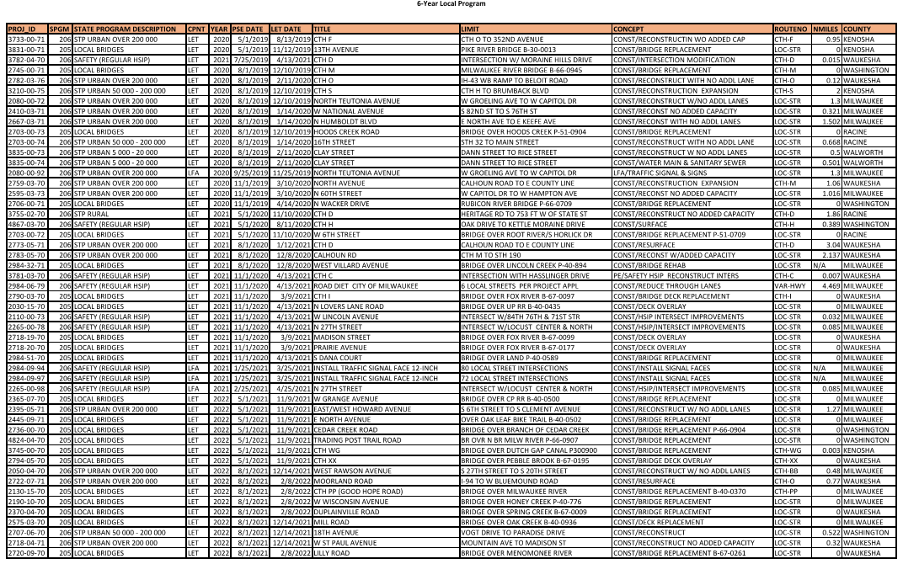
Local 6-Year Program Overview

Slide 3
Local Program 3210-00-75 CTH S
CTH H to Brumback Blvd.
Village of Somers, Kenosha County
Reconstruction with Expansion, Intersection Improvements, Traffic Signals and 8-ft Multi-Use Path along North Side of CTH S.
2.0 Miles
60% Plans Submitted October 31, 2018
Ongoing Utility Coordination
August 1, 2019 PS&E
December 10, 2019 Letting

Slide 4
Local Program 2759-03-70 North Ave. Calhoun Rd. to E County Line
CTH M - Waukesha County
Reconstruction with Expansion, Intersection Improvements, Traffic Signals and Pedestrian Accommodations.
1.06 Miles
1078 Plan Prepared Dec 2018.
Conducted Several Utility Coordination Meetings
November 1, 2019 PS&E
February 11, 2020 Letting
N

Slide 5
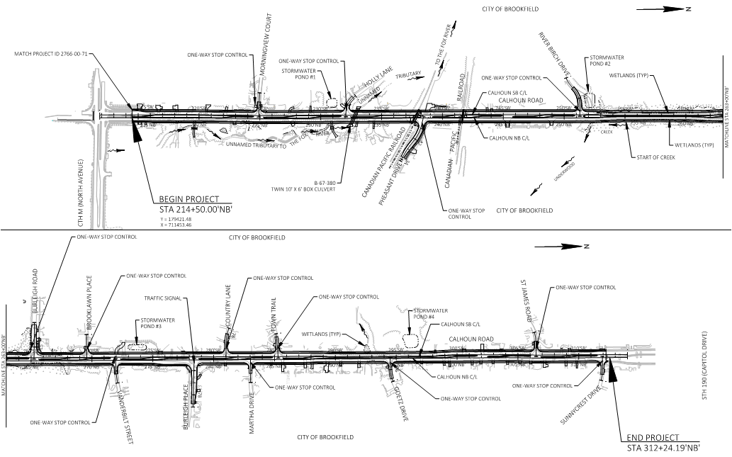
Local Program 2783-05-70 Calhoun Road: CTH M to STH 190
City of Brookfield - Waukesha County
Reconstruction with Expansion, Intersection Improvements, Bicycle and Pedestrian Accommodations.
At-Grade CPRR Crossing
2.137 Miles
Anticipated 1078 Plan Submittal July 2019.
August 1, 2020 PS&E
December 8, 2020 Letting

Slide 6
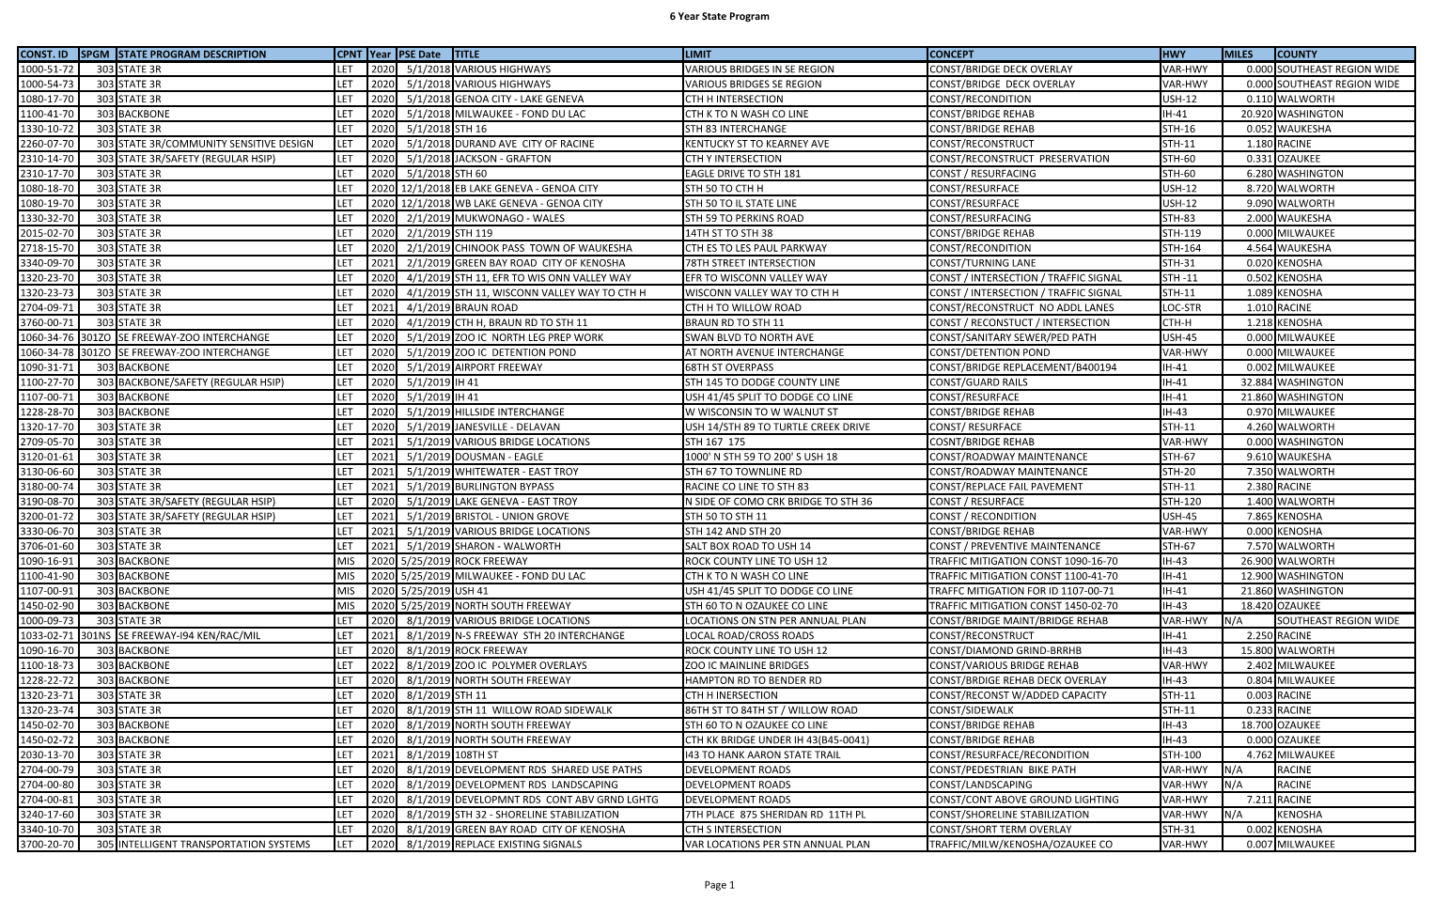
State 6-Year Program Overview

Slide 7
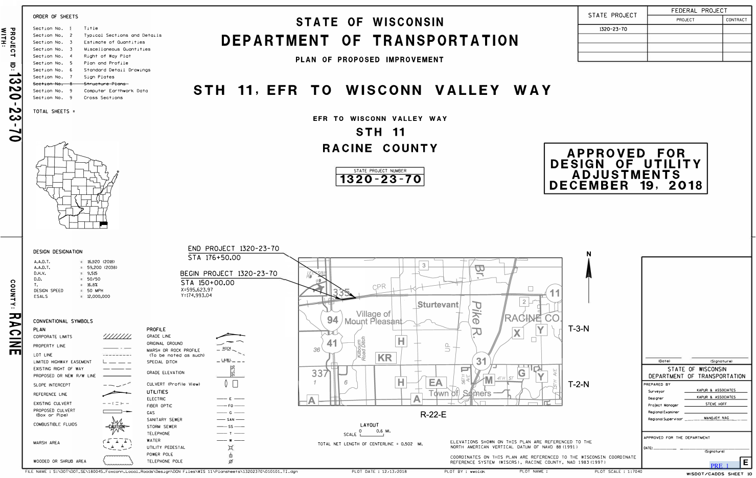
1320-23-70 STH 11, EFR to Wisconn Valley Way

Slide 8
1320-23-70 STH 11, EFR to Wisconn Valley Way (continued)
Reconstruction, including storm sewer, the STH 11 / Wisconn Valley Way intersection, and traffic signals
0.502 Miles
1078 Package Submitted Dec 2018.
April 1, 2019 PS&E
July 9, 2019 Letting
(Tied Bid & Let as one project with 1320-23-73)
N

Slide 9
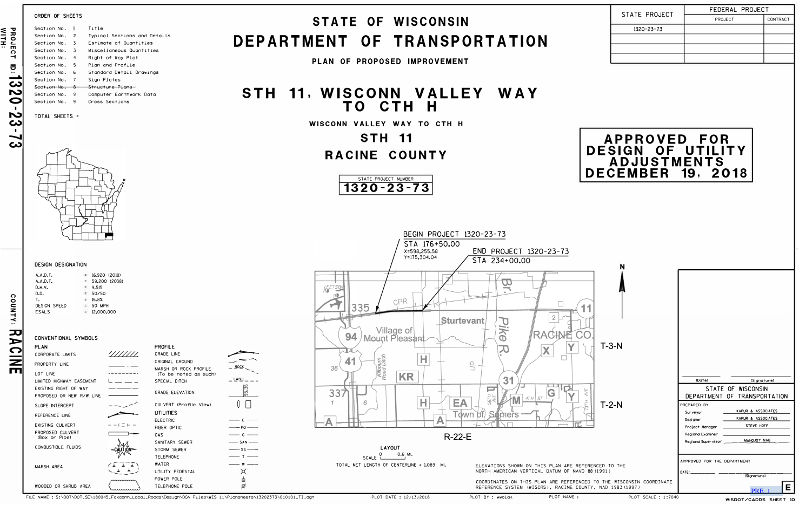
1320-23-73 STH 11, Wisconn Valley Way to CTH H

Slide 10
1320-23-73 STH 11, Wisconn Valley Way to CTH H (continued)
Reconstruction
Including storm sewer
STH 11 / International Drive intersection
Traffic signals
1.089 Miles
1078 Package Submitted Dec 2018.
April 1, 2019 PS&E
July 9, 2019 Letting
(Tied Bid & Let as one project with 1320-23-70)

Slide 11
1320-23-73 STH 11, Wisconn Valley Way to CTH H (continued)

Slide 12
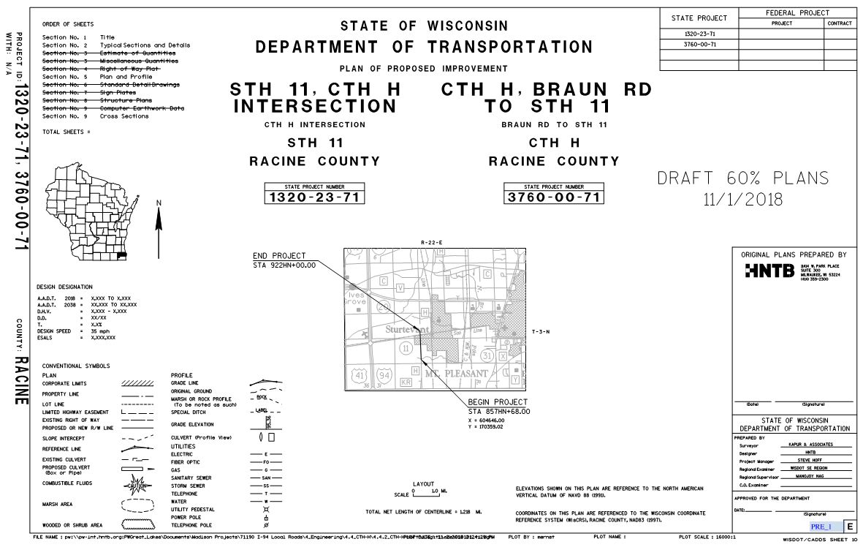
1320-23-71 & 3760-00-71 CTH H, Braun Rd. to STH 11

Slide 13
1320-23-71 & 3760-00-71 CTH H, Braun Rd. to STH 11 (continued)
Reconstruction, including storm sewer, intersection and traffic signals
1.218 Miles
August 1, 2019 PS&E
December 10, 2019 Letting
N

Slide 14
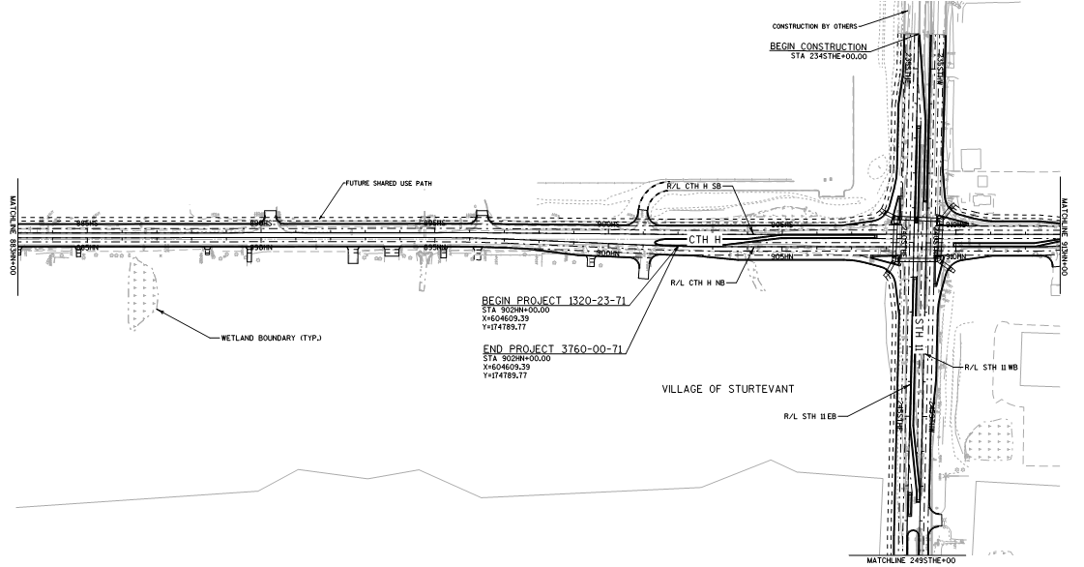
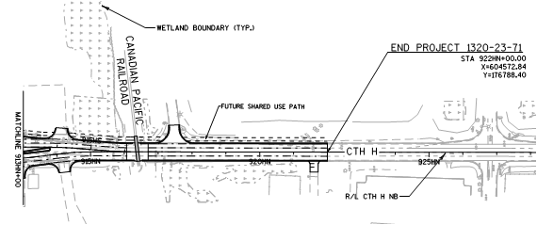
1320-23-71 & 3760-00-71 CTH H, Braun Rd. to STH 11 (continued)
N
N

Slide 15
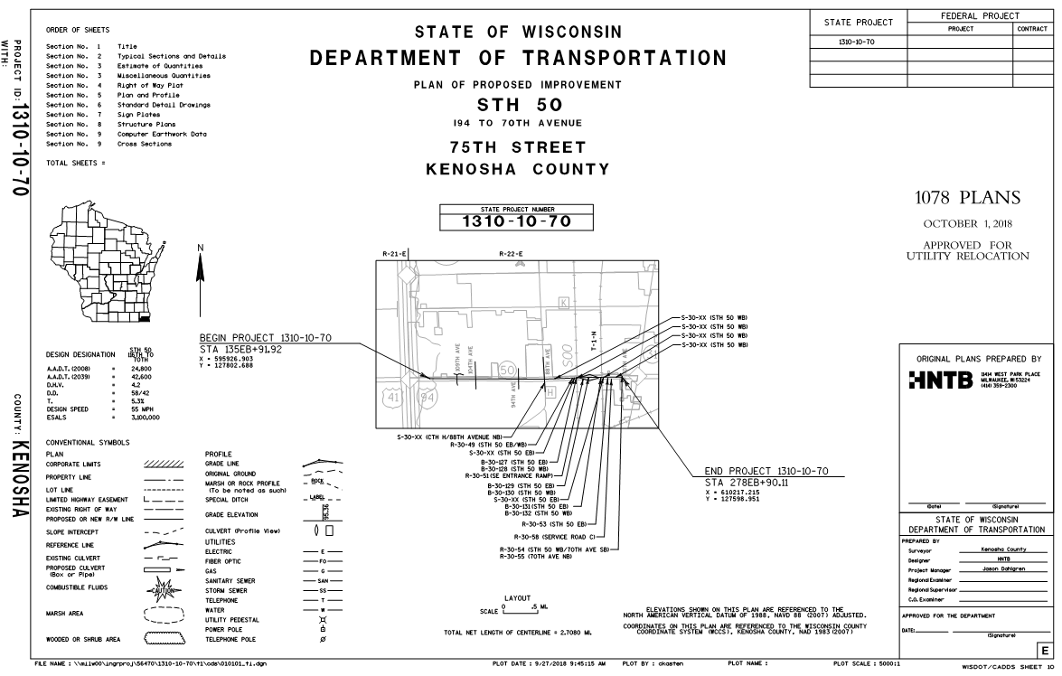
1310-10-70 STH 50, IH-94 to 70th Street – Phase 1 / West Leg

Slide 16
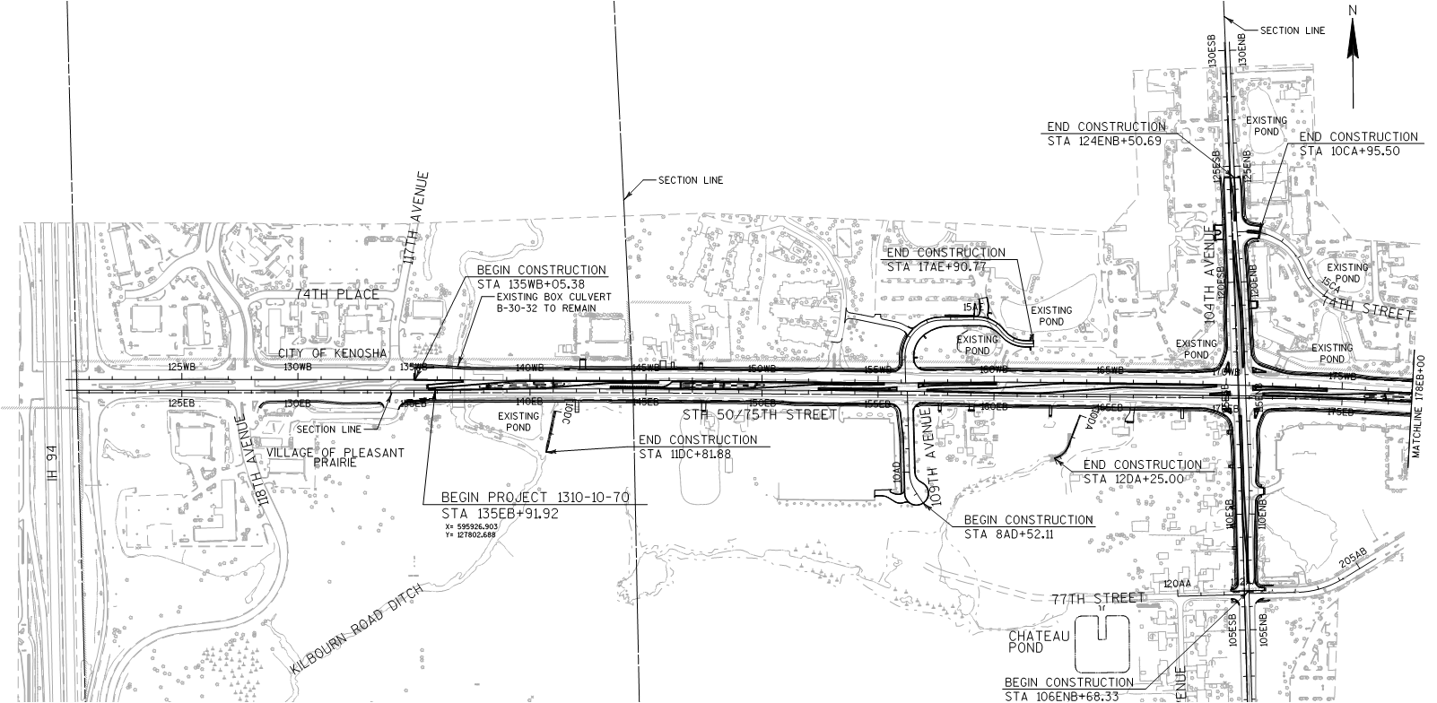
1310-10-70 STH 50, IH-94 to 74th Street – Phase 1 / West Leg (Cont.)

Slide 17
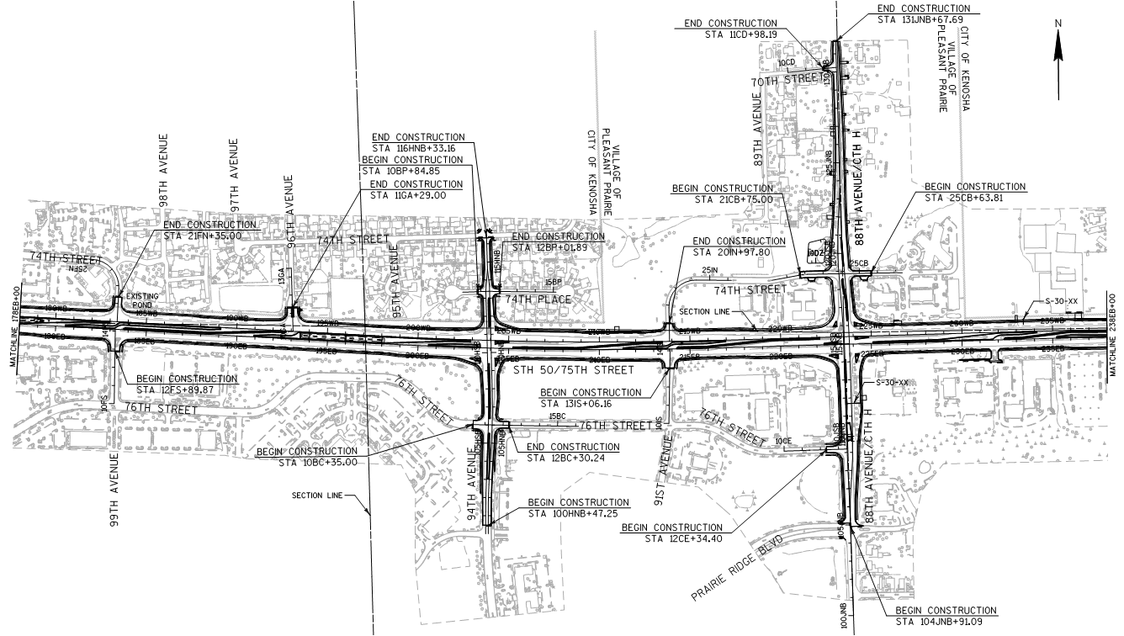
1310-10-70 STH 50, IH-94 to 74th Street – Phase 1 / West Leg (Cont.)

Slide 18
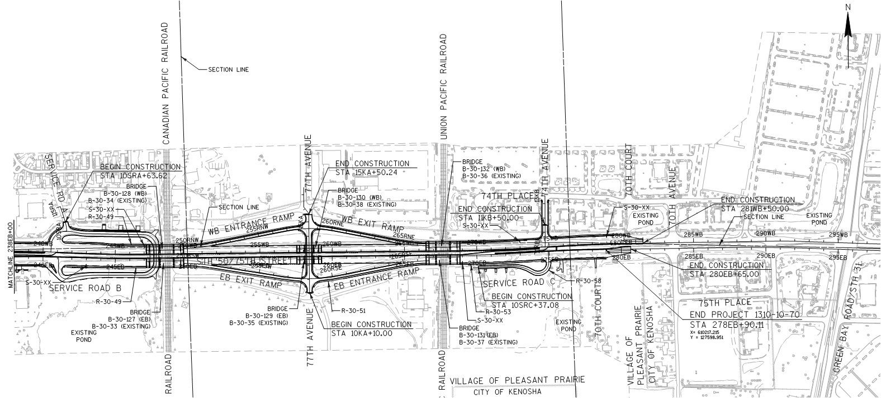
1310-10-70 STH 50, IH-94 to 74th Street – Phase 1 / West Leg (Cont.)

Slide 19
1310-10-70 STH 50, IH-94 to 74th Street – Phase 1 / West Leg (Cont.)
Reconstruction
Numerous design modifications to avoid or minimize utility conflicts
New structures over both UPRR & CPRR with potential conflicts to facilities within RR ROW.
Conducted Utility Coordination Meetings
2.708 Miles
1078 Package Submitted April 2018
Revised June 2018 & October 2018.
Workplans are currently being reviewed
Current Schedule
May 1, 2020 PS&E
August 2020 Letting

Slide 20
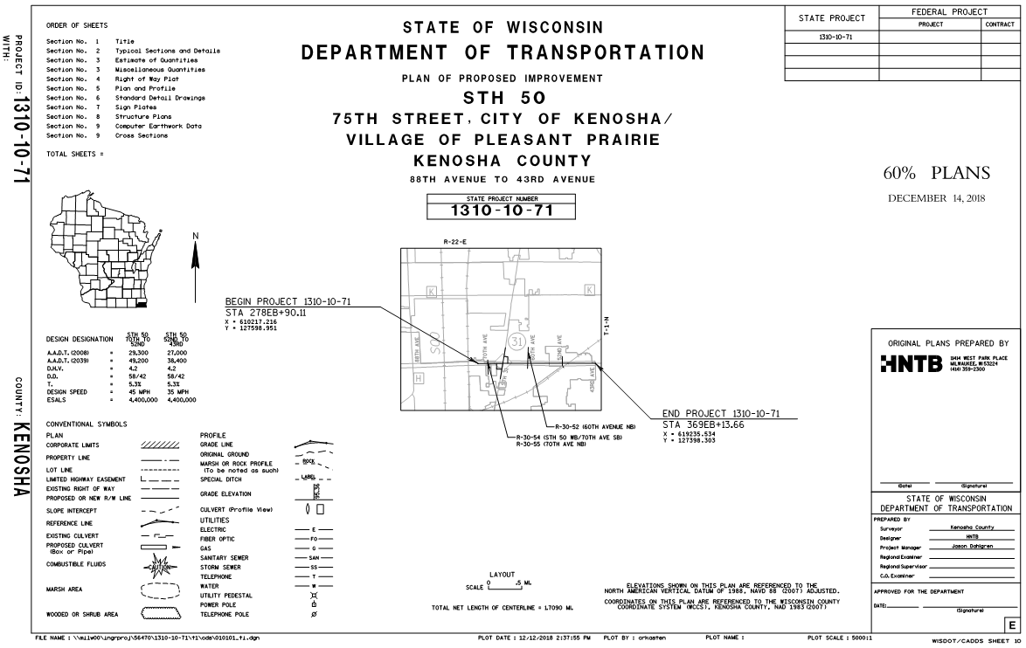
1310-10-71 STH 50, 70th Ave. to 43rd Ave. – Phase 2 / East Leg

Slide 21
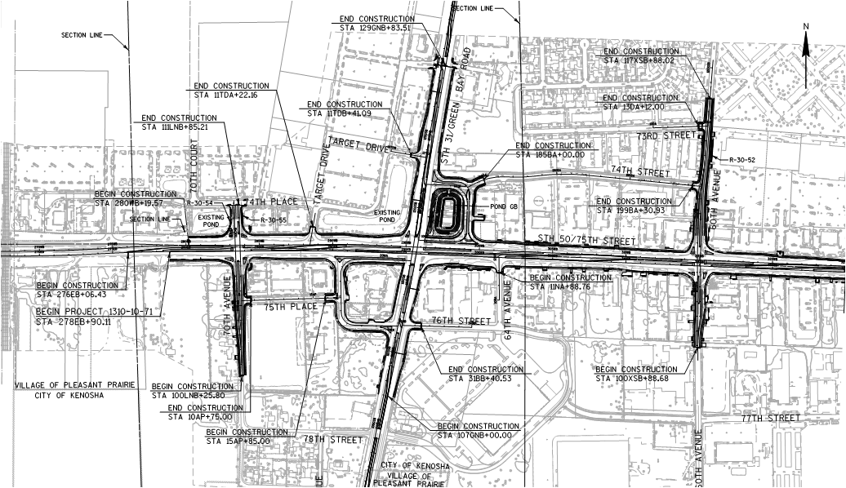
1310-10-71 STH 50, 70th Ave. to 43rd Ave. – Phase 2 / East Leg (Cont.)

Slide 22
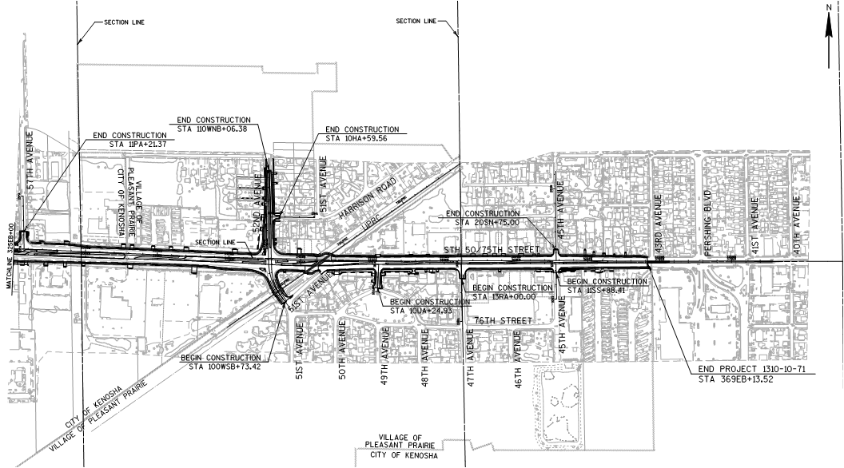
1310-10-71 STH 50, 70th Ave. to 43rd Ave. – Phase 2 / East Leg (Cont.)

Slide 23
1310-10-71 STH 50, 70th Ave. to 43rd Ave. – Phase 2 / East Leg (Cont.)
Reconstruction
Numerous design modifications to avoid or minimize utility conflicts
“Jug-Handle” style intersection with STH 31
At-Grade Intersection with UPRR
Conducted Utility Coordination Meetings
1.709 Miles
1078 Package Anticipated Submittal February 2019
Current Schedule
May 1, 2021 PS&E
August 2021 Letting
Note: Project ID 1310-10-72 STH 50 Frontage Roads Schedule may be revised pending further discussions with the City of Kenosha. Currently 5/1/2019 PS&E

Slide 24
Potential Schedule Revisions to STH 50 Projects 1310-10-70 & 1310-10-71: Combined Letting
Recent FHWA Cost Estimate Review Workshop
Numerous recommendations - including:
Combining lets for potential cost savings and minimizing coordination issues between multiple contractors.
Delaying lets to late in the calendar year for Major Projects to allow more effective time for contractor review of plans, which may result in additional cost savings on the bids
Workshop Recommendations Currently under review
If accepted and funding is available, potential revised schedule dates would be:
August 1, 2020 PS&E
December 8, 2020 Letting

Slide 25
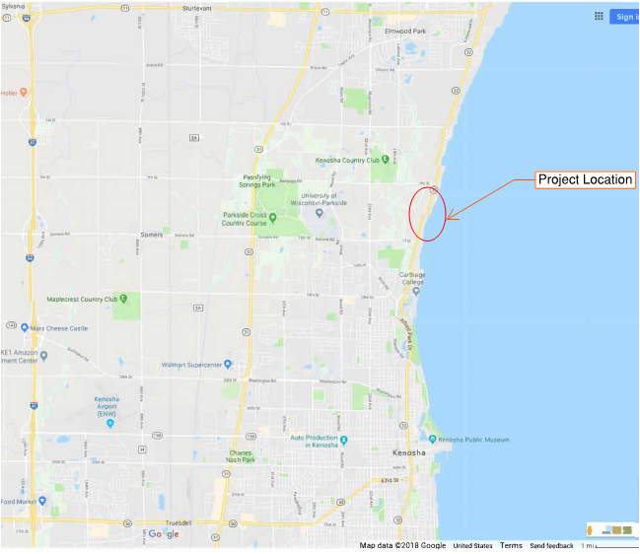
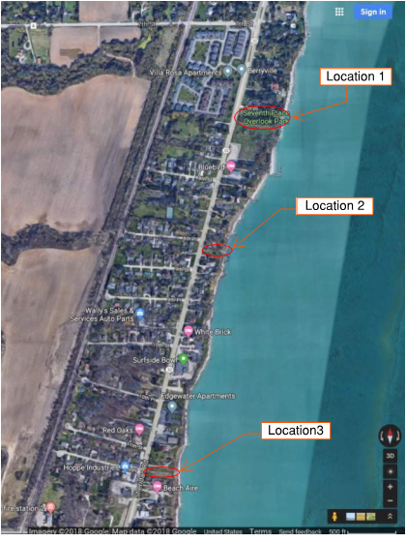
3240-13-60 STH 32, Shoreline Stabilization, Kenosha County
Location 1
7th Place
Location 2
875 Sheridan
Road
Location 3
11th Place

Slide 26
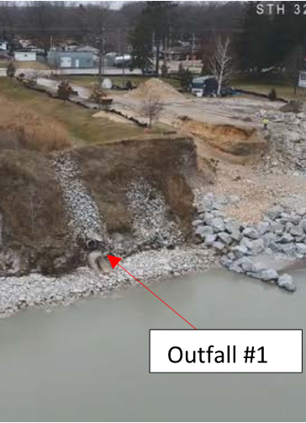
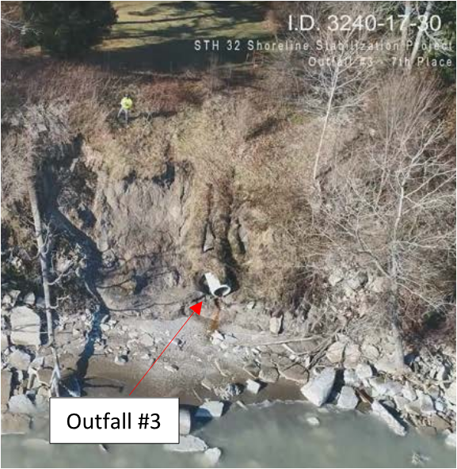
3240-13-60 STH 32, Shoreline Stabilization, Kenosha County (Continued)

Slide 27
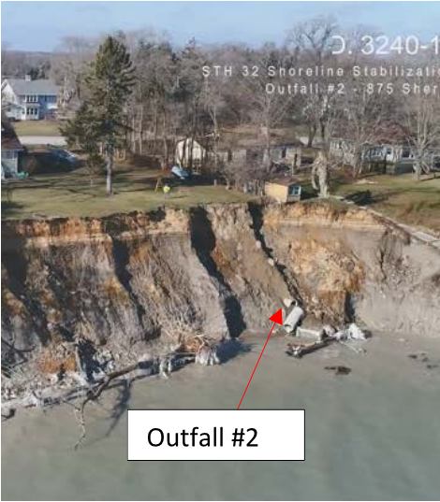
3240-13-60 STH 32, Shoreline Stabilization, Kenosha County (Continued)
Erosion caused by higher Lake Michigan levels with possible contributions from adjacent land owner slope reinforcements.
Bluff heights at Outfalls 1 & 3 are approx. 25 feet with 2:1 slopes
Bluff height at Outfall 2 is approx. 45 feet with significantly steeper slope.

Slide 28
3240-13-60 STH 32, Shoreline Stabilization, Kenosha County (Continued)
1077’s submitted November 2018
Anticipated 1078 submittal March/April 2019
August 1, 2019 PS&E
December Letting
Depending on selected alternative, majority of work would occur near the outfalls, with minimal or temporary construction access related impacts to existing utilities along STH 32.
However, one alternative for Outfall 2 would disconnect the outfall and divert the drainage to Outfalls 1 & 3. If that is selected, it would likely require a separate project and schedule due to the need for reconstructing STH 32 and resolving conflicts with Sanitary, Water and other facilities.

