Slide 1
2019
REGIONAL UTILITY CONFERENCES
BUREAU OF TECHNICAL SERVICES
UTILITY UNIT - UPDATE

Slide 2
Central Office – Bureau of Technical Services
Acquisition and Services Section - Utility Unit
Connie Bruns
Statewide Utility Projects Coordinator
608-266-3832
608-516-6357 (c)
Andy Devos
Statewide Utility Projects Coordinator
608-267-0307
608-228-4337 (c)
Gayle Lindenberg
Central Office Consultant
920-544-4469
920-639-4876 (c)
Norman Pawelczyk
Technical Services
Section Chief
608-266-2362
608-516-6355 (c)
Michael Baumann
Statewide Utility Engineer
608-267-4461
608-219-5109 (c)
Abby Schmidt
Statewide Utility Engineer
608-266-0319
608-286-0774 (c)

Slide 3
INTERNSHIP
Utility Coordination Intern
https://wisc.jobs/public/job_view.asp?annoid=93509&jobid=93023&org=395&class=94290&index=true
2019 Intern Flyer.pdf
For questions, please contact:
Denise R. Foster, Human Resource Specialist 715-855-7665
denise.foster@wisconsin.gov

Slide 4


Slide 5
WisDOT has created several templates in DocuSign to assist utility coordination efforts.
  The first form being tested is the DT1077
  Shane Smith (SW Region Utility Coordinator)
  Dylan Gates (SE Region Utility Engineer) to test the process.

Slide 6

  During the testing period
  Shane & Dylan will be working with some utility companies to help develop a process for sending the notices and receiving the system maps for those projects where they are required to return them.
  We encourage utility companies who are part of this testing phase to provide as much feedback to create a process that works best for the department and the utility companies.

Slide 7
Testing will begin on the DT1078, DT1541 and DT1542 in the next few weeks.
DT1077 – Proposed Highway Improvement Notice
DT1078 – Project Plan Transmittal
DT1541 – Audit Agreement
DT1542 – Lump Sum Agreement
Notes:
Cover topics not yet addressed in prior slides, include them as appropriate.
The amount of information should be relevant to allowable time and audience.

Slide 8
WisDOT Utility Lean Project
Team consisted of Central Office and Region Utility Coordination Staff
Utility Agreement Change Orders, 2nd Move and Invoice review & approval process delegated to the regions
Goal – To streamline the process by eliminating over-processing
Reduction of process steps:
  UACO/2nd Moves – 76%
  Invoices – 74%
Notes:
Changes / Next Steps
Updated policy and delegated the review and approval responsibility to the regions
Developed job aids to enable seamless transition to the regions
BTS Utility Unit will conduct audits of region records
Identify and document weak areas, if any
Develop a plan to get back on track:
Update job aids and policy as needed
Conduct training as needed

Slide 9
Impact
Realign central office staffing resources
Quicker approval times
Less delays during construction
Quicker payments to utilities
Less interest paid on late invoices
Notes:
Margaret Liedtke

Slide 10
Utility Coordination Newsletter
Purpose
  Provide updates pertaining to WisDOT utility coordination and related WisDOT programs
  Utility industry updates
Intended audience
  WisDOT utility coordination staff, associates and business partners

Slide 11
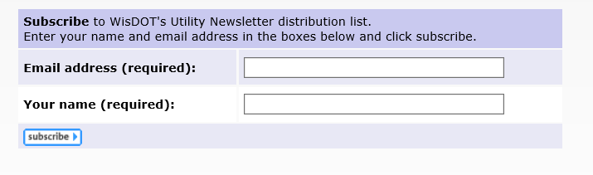
Utility Coordination Newsletter
The newsletter is published online at:
  https://wisconsindot.gov/Pages/doing-bus/eng-consultants/cnslt-rsrces/util/utilnewsletter.aspx
To receive updates, subscribe here:

Slide 12
DIGGERS HOTLINE
Andy DeVos (BTS Statewide Utility Project Coordinator) joined the Diggers Hotline Advisory Board (AB)
The AB meets 6 times a year in New Berlin. The AB meets right after the Diggers Hotline Board of Directors meeting.
On January 9th, 2019 Diggers Hotline rolled out the new Geocall ProPortal on-line ticket request program.
One of the new features of the new program is the “No-Show” ticket option. If a utility facility isn’t located in the required time frame a “No-Show” ticket can be filed with Diggers Hotline which notifies the utilities that still need to locate their facilities.
Diggers Hotline will be tracking the “No-Show” tickets and reporting out the results at the AB meetings.
Notes:
It’s their new program to request locates on-line that replaces TelDig. My understanding is that it’s a big upgrade in the backround, but for the users it will look similar. It also adds other types of locate requests i.e., project tickets.

Slide 13
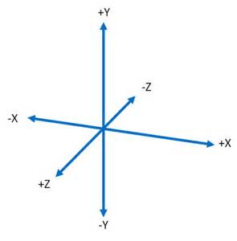
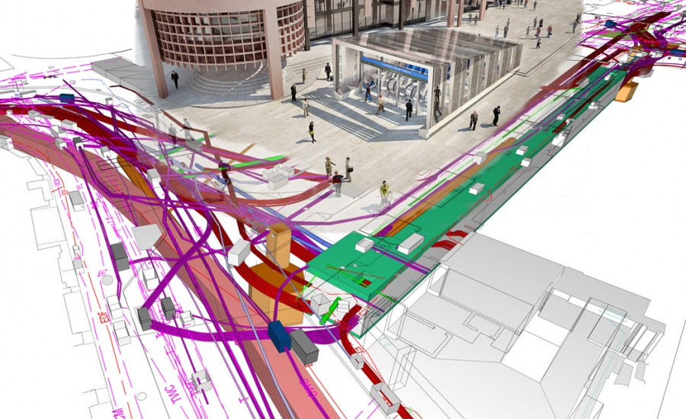
WisDOT Utility
3D Initiative
Notes:
Before
Be well prepared with content. Know facts and figures and your audience.
Everyone should be able to read the slides but if NOT, read it to them. Otherwise don’t include it.
Do a final check on microphone and other equipment well before the start time.
Practice the presentation aloud several times. Feel comfortable.
Drink fluids and do something to relax you.
During presentation
Smile and be confident.
Introduce yourself and the organization.
Speak with energy, clearly, and in a reasonable volume so everyone can hear you.
Do not read each line on the slide show – use your own wording and add in examples or additional information which will aid in comprehension.
Talk “friendly” and with the attitude that you are here to provide information and assistance. Have a “win/win” attitude.
If you make an error, politely clarify or correct it. Move on quickly and don’t dwell on it.
If you can’t answer a question, politely indicate you don’t have the information available. Indicate that you will follow-up individually with the requestor.
After presentation
Be available for follow up.
Be prepared for additional comments, questions or clarifications.
Maintain composure.
If you make a promise, be sure to follow up quickly or reassign if appropriate.

Slide 14
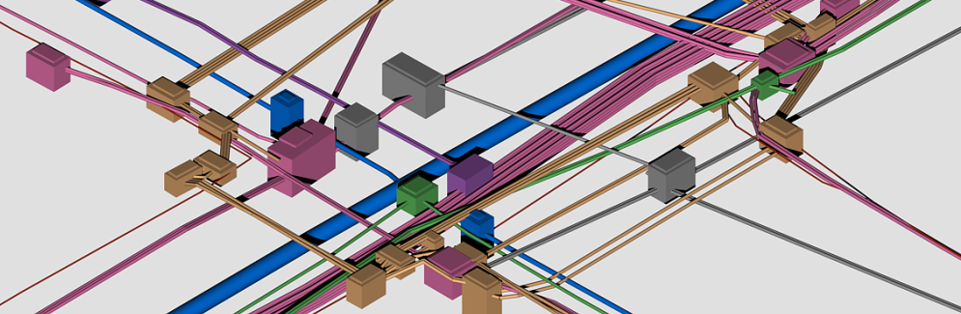
WisDOT Utility 3D Initiative
Investigate 3D data and its Usefulness, Viability, and Return on Investment for utilization in Civil 3D.
Run clash detection
Document Southeast Freeway team practices, processes and workflows from previous projects.
Notes:
Document Southeast Freeway team (SEF) practices, processes and workflows from previous projects. This includes, but is not limited to: data collection, data processing, plan preparation work flows, software tools used for various workflows, delivery requirements, etc.

Slide 15
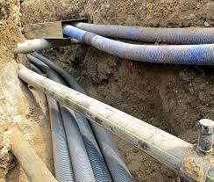
WisDOT Utility 3D Initiative
Evaluation of 3D utility survey data collection and transfer from permits issued by WisDOT
Transfer data from utility company personnel and subcontractors for use in C3D and 3D models used by the contractors.
Determination of the appropriate construction projects to utilize 3D utility survey data collection and transfer.
NEED YOUR HELP
  If you have used 3D survey techniques on any non-DOT projects we would like to know about it

Slide 16
Utility Fee Owned Land
We Energies
1197-00-00,20,70
Title: Spooner - Minong
Limits: Trego Interchange
Highway: USH 53
County: Washburn
West Wisconsin Telcom Cooperative
7090-00-04,24,74
Title: Menomonie - Eau Claire
Limits: CTH EE/Town Hall Road Intersection
Highway: USH 12
County: Eau Claire
Eau Claire Energy Cooperative
7080-01-02,22,72
Title: Eau Claire - Fall Creek
Limits: Elco Rd To Oak Knoll Rd
Highway: USH 12
County: Eau Claire

Slide 17
Utility Fee Owned Land
WisDOT Regional Real Estate and Utility Coordination staff need to work closely together with the affected Utility Company.
WisDOT Office of General Counsel has been providing guidance.
Each acquisition has been unique and needs to be analyzed.
The acquisition amount from Real Estate and the Utility Relocation costs are analyzed and whatever amount is most advantageous to the Utility Company will be the suggested compensation.

Slide 18


2019 Meeting Dates:
Thursday April 4th, 2019
Thursday August 8th, 2019
Thursday, November 7th, 2019
Location: State Patrol Building, 851 S. ROLLING MEADOWS DRIVE, Fond du Lac, WI
Time: 9:30 a.m.

Slide 19
ANNUAL
UTILITY CONFERENCES
2019
  Northwest Region
  Northcentral Region
  Southeast Region
2020
  Statewide Utility Conference
2021
  Northeast Region
  Southwest Region

Slide 20
Norman Pawelczyk
Bureau of Technical Services
Acquisition & Services Unit Chief
(Desk) 608-266-2362
(Cell) 608-516-6355

