Slide 1
Buy America Development Team
Michael Baumann, WisDOT
February 20, 2019
North Central Region Annual Utility Conference
Notes:
Good morning.
I am Mike Baumann, one of the Statewide Utility Engineers in the Bureau of Technical Services, Utility and Access Unit.
Today, I will be talking about the Buy America Development Team.

Slide 2
Overview of Presentation
Buy America Development Team
Why was it created?
Who is participating?
What has been accomplished?
What are the next steps?
Questions and Contacts
Notes:
I will be talking about:
Why the Buy America Development Team was created?
Who is participating on the team?
What the team has accomplished so far?
And where the team is heading?
And finally, an opportunity for you to ask questions about Buy America.

Slide 3
Buy America Development Team
FHWA and WisDOT met in mid-December 2017
WisDOT now has opportunity to clarify Buy America requirements
These requirements will be based upon:
Federal Code and Guidance
Court Cases
Guidance from other states
Defining predominantly steel or iron
Notes:
Now, let’s go over “Why” the Buy America Development Team was created.
Seeing as WisDOT has been discussing Buy America issues with FHWA, FHWA has been discussing ways to resolve these issues.
In mid December of 2017, FHWA set-up a meeting with WisDOT in which they proposed a means to resolve some of the issues by following in the footsteps of what some other states have done.
By following what other states have done, WisDOT believes there is an opportunity for making the Buy America requirements easier to follow and easier to be in compliance with.
WisDOT believes this is possible and we will remain in compliance with Federal Code and the United States District Court case decision.

Slide 4
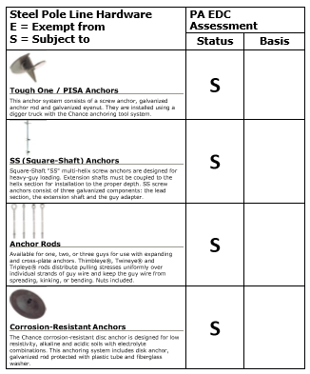
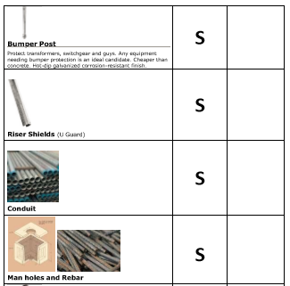
Buy America Development Team
The following are examples from PennDOT:
Notes:
One option that was considered in order to help clarify what items must be complaint with Buy America is to follow what the Pennsylvania DOT has done.
This slide shows an example of the guidance that they have developed in-regards to Buy America.
The Buy America Development Team discussed this and decided that this is something that has too much detail and would require a lot of effort in order to keep this up to date.
Please note, the full PennDOT guidance document is available on the internet.
I just want to make it clear that this document is only useful in Wisconsin for agreements that have been signed on or before January 15, 2016.

Slide 5
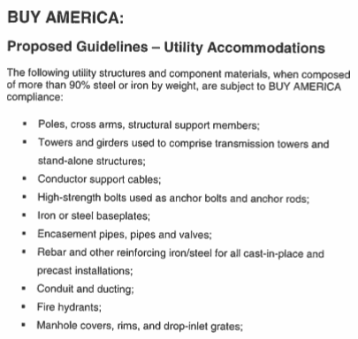
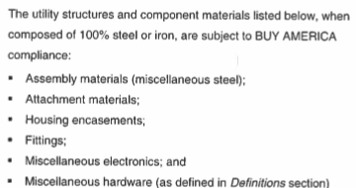
Buy America Development Team
The following is an example from TxDOT:
Notes:
Another option that the Buy America Development Team considered is what the Texas DOT has done.
This slide shows a portion of the guidance that they have developed in-regards to Buy America.
This guidance was developed after the United States District Court case decision.
The Buy America Development Team decided that this level of detail is closer to what is needed in Wisconsin.
Please note, WisDOT was not comfortable with following this exactly as written as it is eerily similar to what the United States District Court decision struck down.

Slide 6
Buy America Development Team
The team includes representatives from WisDOT and utility companies
Team members include:
Mike Baumann, Andy Devos, Norm Pawelczyk WisDOT
Brian Hammes Border States
Don Server, Rebecca Fletcher Alliant Energy
Ryan Huebner ATC
Greg Wagner, Lou Armstrong AT&T
Joel Sullivan, Rick Podolak AT&T Wisconsin
Adam Schleicher City of Sun Prairie
Lori Butry, Matt McGill, Ross Barrette WPS
Dan Sande, Nicole Smullen, Steve Quick We Energies
Notes:
So now lets look at “Who” is participating on the Buy America Development Team.
The team is made up of individuals that represent WisDOT, Utility Company Suppliers, Electric Transmission, Electric Distribution, Natural Gas, Telecommunications, and Municipal Utilities.
In addition, the team consists of a broad range of classifications from managers to engineers/designers to buyers.

Slide 7
Buy America Development Team
WisDOT and utility company representatives started meeting in May 2018
To date, there has been one Face to Face Meeting and five Skype meetings
Team prioritized biggest issues with Buy America compliance
Through this discussion, team decided to focus on:
Ductile iron items for overhead utility facilities
If necessary, clearer definition of predominantly
Notes:
Next lets look at “What” the Buy America Development Team has been accomplished so far.
To date, the team has held one Face to Face Meeting and five Skype meetings.
The team looked into what were the biggest obstacles that prevented utility companies from complying with Buy America.
After much discussion, the team decided that ductile iron items used with overhead utility facilities was causing the biggest problem.
In addition, it was discussed that maybe a clearer definition for “predominantly” may be useful for certain items.

Slide 8
Buy America Development Team
So far, the team has completed the following:
Research relevant Federal code and guidance documents
Organize information in chronological order
Establish three topics which include:
Manufactured Products
Steel
Ductile Iron
Created very rough “draft” of guidance for each of the three topics
So far this guidance includes an Executive Summary, Definitions, and Legal Basis for each of the three topics
Notes:
From here, the Buy America Development Team completed research on the applicable Federal code and guidance documents.
In order to get a clear understanding of these documents, it was necessary to organize this information in chronological order.
The organization of this information made it apparent that any guidance would need to be developed by considering three topics. These topics include:
Manufactured Products
Steel
And Ductile Iron
From here, a very rough “draft” of guidance was created for each of these three topics.
This guidance included an Executive Summary, Definitions, and the Legal Basis for the Executive Summary.

Slide 9
Buy America Development Team
Next steps include the following:
Obtain concurrence on rough “draft” guidance from utilities
Review and organize list of 300 plus items that are not available as Buy America compliant items
Determine if guidance for the following resolves the Buy America compliance issues:
Manufactured Products
Steel
Ductile Iron
Create definition for predominantly if necessary
Revise the “draft” guidance if necessary and possible
Obtain concurrence from FHWA
Finalize guidance
Notes:
Now that we have looked at what has been accomplished, let’s look at where the Buy America Development Team is headed.
The rough “draft” of the Buy America guidance has been shared with the team.
Currently, we are waiting for concurrence from the utility companies on the direction that the guidance will take the team.
Next, we need to review the list of 300 plus items that are available but are not in compliance with Buy America.
Hopefully, we can categorize and then organize this list by the mechanism that will resolve the compliance issue.
This will be accomplished by using the rough “draft” guidance for:
Manufactured Products
Steel
And Ductile Iron
From here and if necessary, we will work on creating a definition for predominantly.
Next, we will revise any guidance documents as necessary prior to obtaining concurrence from FHWA.
Finally, the guidance documents will be finalized for use by WisDOT and all utility companies.

Slide 10
Buy America “Questions and Contacts”
Any questions?
Contact information:
Mike Baumann
715-421-7393
michael.baumann@dot.wi.gov
Notes:
Finally, let’s move onto our last topic for today which is an opportunity for you to ask questions about the Buy America Development Team.

