Slide 1
Surplus Land Appraisal Methods, Lease Updates, Lease Rate Determinations and Surplus Land Updates

Slide 2
BACKGROUND FOR CHANGES
TO
SURPLUS PROPERTY VALUATION
Historically the terms Separate Entity and Separate Entity Value were used in the valuation of surplus property. The use, or misuse, of these terms and others like them created confusion and miscommunication in the surplus property appraisal process. Many of these terms are no longer part of the WisDOT dictionary for Surplus Property.
You will find Separate Entity in the Appraisal Section of the REPM – Chapter 2, but not in Chapter 6.5. The new terms to describe surplus property are tied to their respective marketing categories or are appropriately used to identify appraisal methods and concepts.

Slide 3
MARKETING CATEGORIES
GENERAL MARKETABLE
LIMITED MARKETABLE
NON-MARKETABLE

Slide 4
MARKETING CATEGORIES
General marketable surplus - Stand-alone parcels containing characteristics of independent utility (separate entity), allowing for productive use without the need for assemblage to another parcel of land.
Any parcel, vacant or improved, that has a perceived or real value within the marketplace can be considered general marketable.
Definition of value used: Market Value

Slide 5
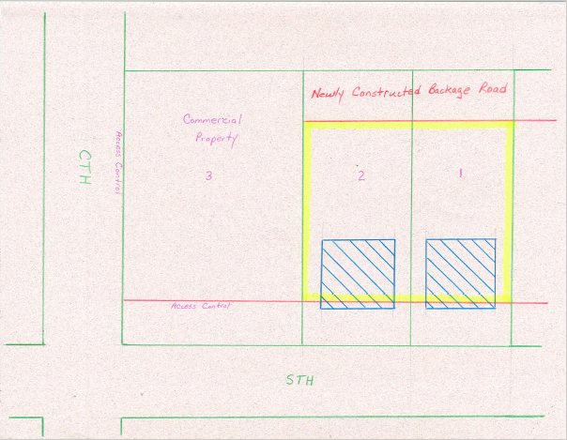

Slide 6
MARKETING CATEGORIES
Limited marketable surplus - Parcels of land lacking those characteristics, necessary for independent development. These parcels may have a potential for assemblage with two or more abutting properties.
Definition of value used: Contributory Value

Slide 7
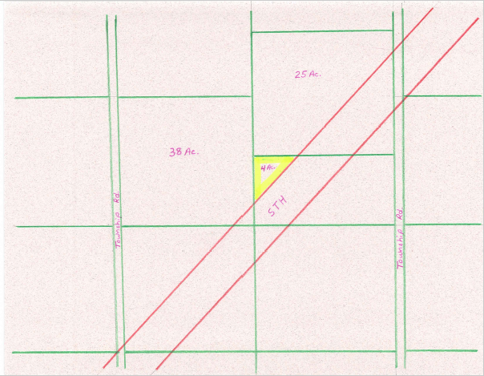

Slide 8
MARKETING CATEGORIES
Non-marketable surplus - Parcels of land lacking those characteristics, necessary for independent development. These parcels have the potential for assemblage with only one abutting property.
Definition of value used: Contributory Value

Slide 9
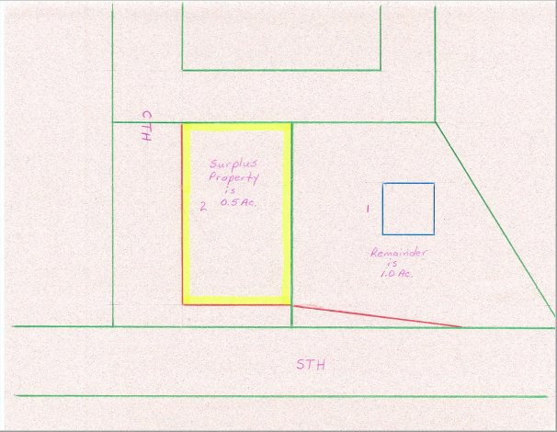
Property acquired to connect county road to the trunk highway.

Slide 10
DEFINITIONS OF VALUE
Market Value
Contributory Value

Slide 11
DEFINITIONS OF VALUE
Market value - The cash price that a willing buyer and a willing seller would agree upon, given reasonable exposure of the property to the marketplace, full information as to the potential uses of the property, and no undue compulsion to act. This concept is only true when the value being achieved is for a separate entity.

Slide 12
DEFINITIONS OF VALUE
Contributory Value -
1) A type of value that reflects the amount a property or component of a property contributes to the value of the property as a whole.
In the valuation of limited or non-marketable surplus property, the component of a property would be represented by the surplus property being valued.

Slide 13
DEFINITIONS OF VALUE
Contributory Value -
2) The change in the value of a property as a whole resulting from the addition of a property component.
This is reflective of the before and after method of valuing surplus property utilizing a hypothetical condition whereby the surplus property is combined with an adjacent parcel.

Slide 14
DEFINITIONS OF VALUE
Contributory Value
as defined above, does not recognize the effects of market limitations, or the cost/effort associated with assembling the individual components of a property, such as legal costs and entrepreneurial profits.
For this reason, contributory value is an appropriate definition of value for appraising limited and non-marketable surplus property, with a highest and best use as assemblage with an adjacent parcel.

Slide 15
APPRAISAL METHODS

Slide 16
APPRAISAL METHODS ACROSS THE FENCE METHOD
An appraisal method that involves establishing a unit value for one parcel of land by determining the high
This method is typically used for railroad or utility corridors; however, it can also be used where both parcels are similar in type.
then applying it to the first parcel, or the parcel being appraised.
This method is typically used for railroad or utility corridors; however, it can also be used where both parcels are similar in type.

Slide 17
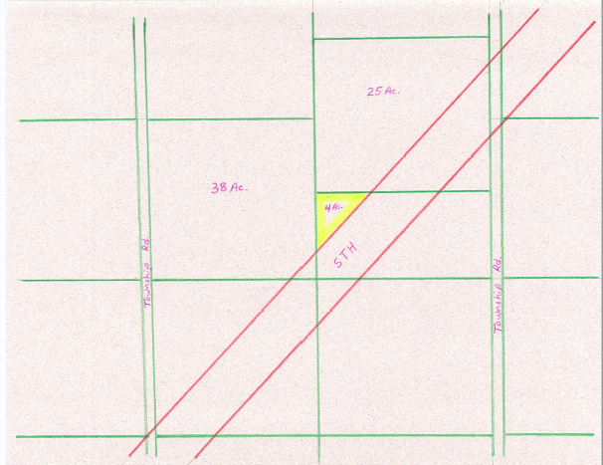

Slide 18
APPRAISAL METHODS BEFORE AND AFTER METHOD
This method analyzes the contributory value of a limited or non-marketable surplus property under the hypothetical condition of assemblage with one or more adjacent properties.
This method has similarities with the before and after approach used in partial acquisitions; however, in the case of surplus property, the property adjacent to the surplus property is first valued independently, and then it is valued as assembled with the surplus property. The difference between the two values is the contributory value of the surplus property. The added value resulting from this assemblage can be greater than (plottage value), equal to or less than the value identified across the fence.

Slide 19
Property acquired to connect county road to the trunk highway.

Slide 20
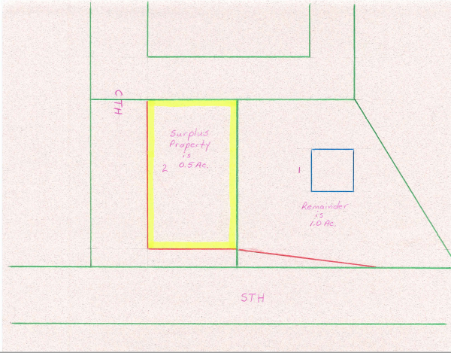
IF AN ACROSS THE FENCE METHOD WERE USED
The adjacent site is 1.0 ac. in size. Market data indicates that 1.0 Ac. sites are selling for $50,000 or $50,000 per ac.
At 0.5 Ac. the surplus property would be worth $25,000
If the surplus property were assembled with the adjacent site they would, by extension, be worth $75,000. (Market data indicates a value of $60,000.

Slide 21
USING THE OLD METHOD OF ASSEMBLING THE SURPLUS PROPERTY WITH THE ADJACENT SITE AND THEN DIVIDING THE ASSEMBLED SITE BY THE TOTAL ACREAGE TO OBTAIN A UNIT VALUE FOR THE SURPLUS PROPERTY
When the surplus property is assembled with the adjacent site market data indicates that it would be worth $60,000
With the assembled site containing 1.5 ac. the indicated unit value is $40,000 per ac.
The adjacent site would be worth $40,000 (market data indicates a value of $50,000.
The surplus property would, by extension, be worth $20,000.

Slide 22
BEFORE AND AFTER METHOD
A hypothetical assemblage of the surplus property with the adjacent site results in a 1.5 ac. site worth $60,000 based upon market data.
The value of the adjacent 1.0 ac site is worth $50,000 based upon market data.
If you subtract the value of the adjacent 1.0 ac. site from the value of the hypothetical 1.5 ac. assembled site the resultant value for the surplus property is ($60,000 - $50,000 =) $10,000.

Slide 24
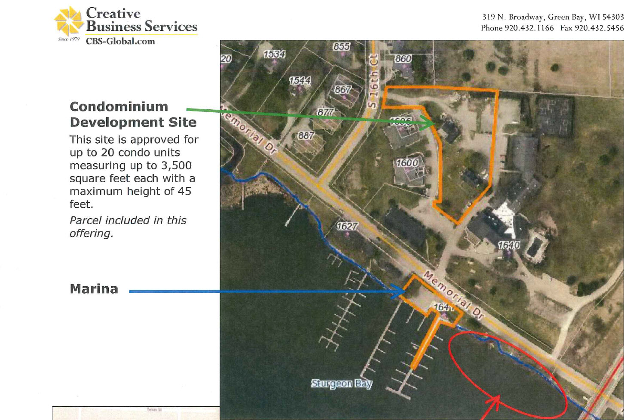

Slide 25
Land Lease on the water
Lease of the land to install floating boat slips which could be removed if the lease would end.
Should the lease be on land only?
Should the lease include the water area where slips will be installed?
Should the lease take into account the rental income of the boat slips?
Boat slips are a seasonal rental, should the lease rate only be increased during the period of the seasonal rental?

Slide 26
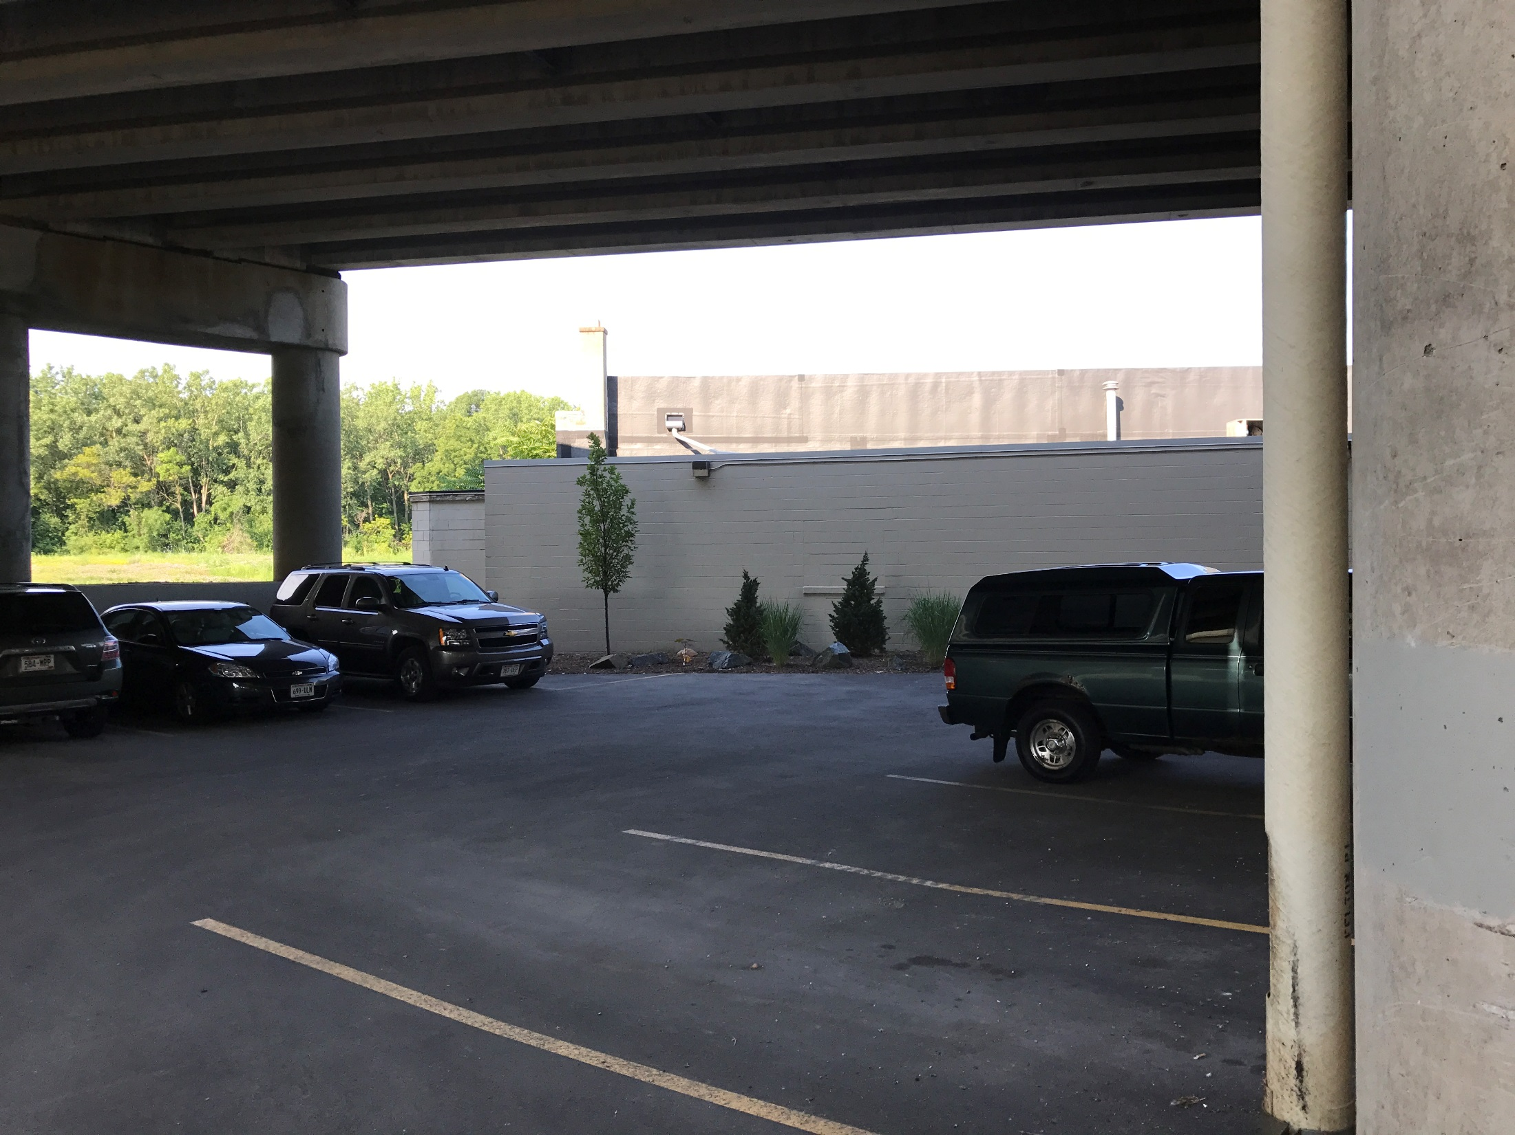

Slide 27
Lease of land for Parking in air space area under a overpass
Permanent surface parking lot installed for the lease area.
Should the lease be based on land only?
Should the lease be based on rate for each individual parking stall?
If lease ends, WisDOT receives the paved parking area. Should the rents during the lease be decreased to the leasee until the cost of the improvement is paid back to the leasee?
Lease terms should include limits to passenger type vehicles. Lease should be monitored to verify oversized vehicles, panel trucks semi trucks buses are not parked in these areas.
No structure's should be in these areas without Federal approval.

Slide 28
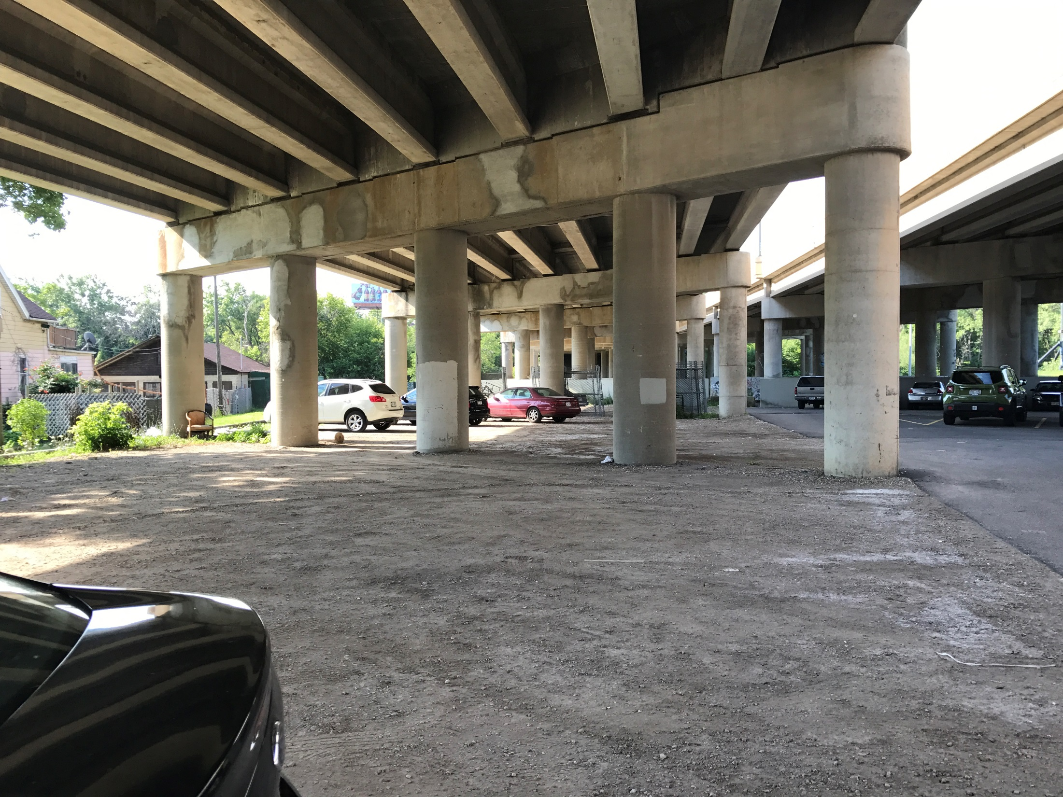

Slide 29
Partial Improvement
Unimproved parking area, should the lease be at the same rate as an improved paved parking lot?
Parking areas should have the same restrictions paved or unpaved.

Slide 30
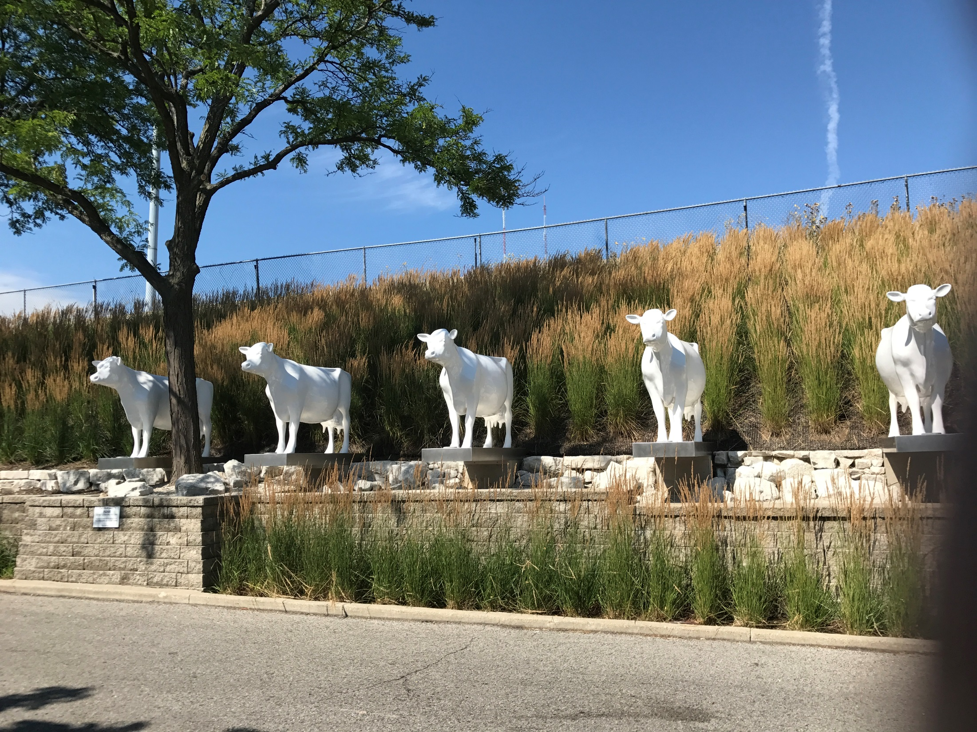

Slide 31
Alternate Right of way use
Lease of right of way in setback area.
Lease area should be secure for safety reasons.
Should lease rate be based on land rates in the area?
Should the rate be same rates as parking lease’s in the area?
Items should not obstruct highway views.

Slide 32
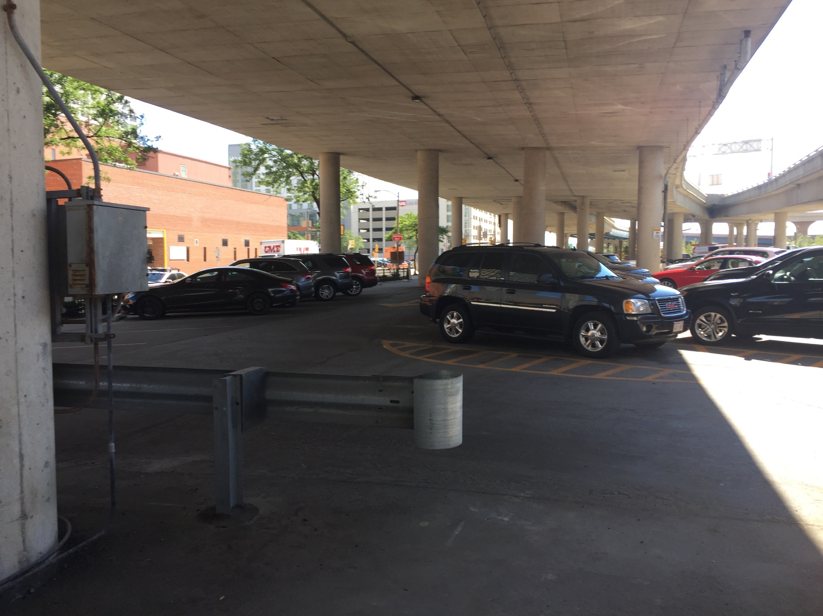

Slide 33
Protecting Bridges
Improvements and supports should be protected from possible damage.
Lease projects should be review by Highway Maintenance to protect the bridge structure.

Slide 34
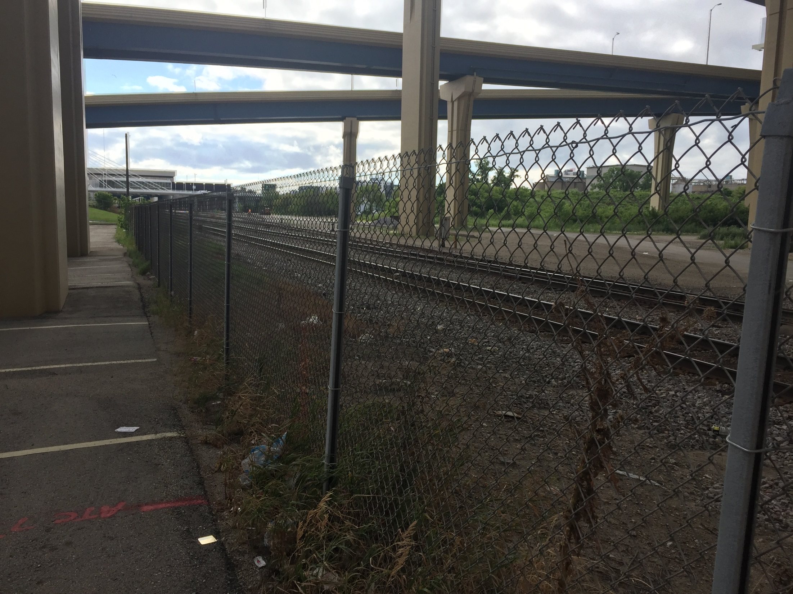

Slide 35
security
Spaces below bridges should be kept secure.
Fencing should be in place in spaces below bridges and overpasses.
Areas should be review on a regular basis for issues.
Areas with damage or alterations should be reported to Highway maintenance for repair.

Slide 36
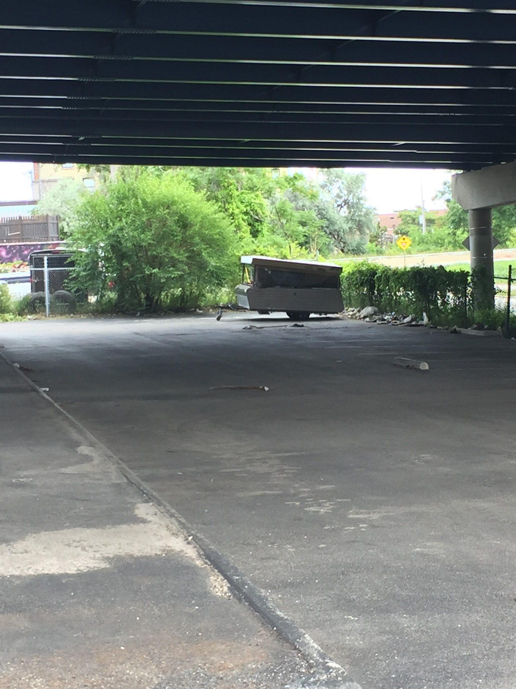

Slide 37
Questionable safety
Unauthorized vehicles
Report questionable items in air space areas.
Contact Leasee, Highway Maintenance, and Police Powers.

Slide 38
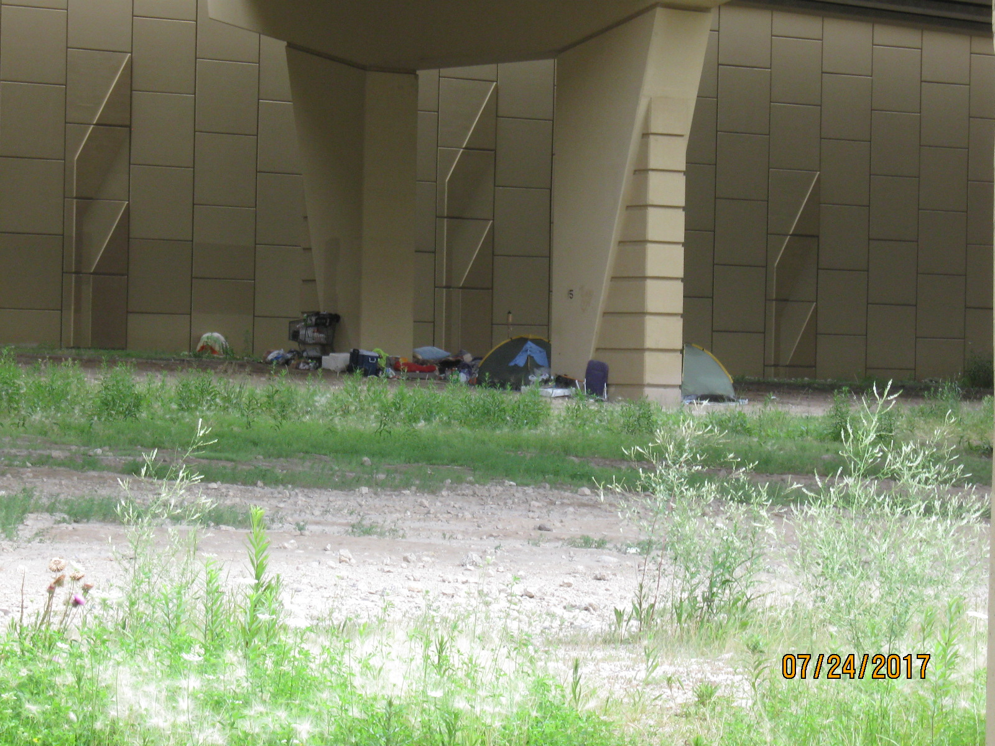

Slide 39
Trespassing
Homeless Living Under Bridges
Safety, Health and Litter Concerns
Do not approach the person(s)
Contact Highway Maintenance
Contact Local Police authorities regarding the trespassing.

Slide 40
“new” assessed value
New information is in the Real Estate Manual for the Assessed Value approach.
Limited and non-marketable parcel under $15,000 can use the abutters land value to determine the value of the surplus land parcel.
The approach will save on cost of appraisals and speed up the sale process on these parcels.

Slide 41
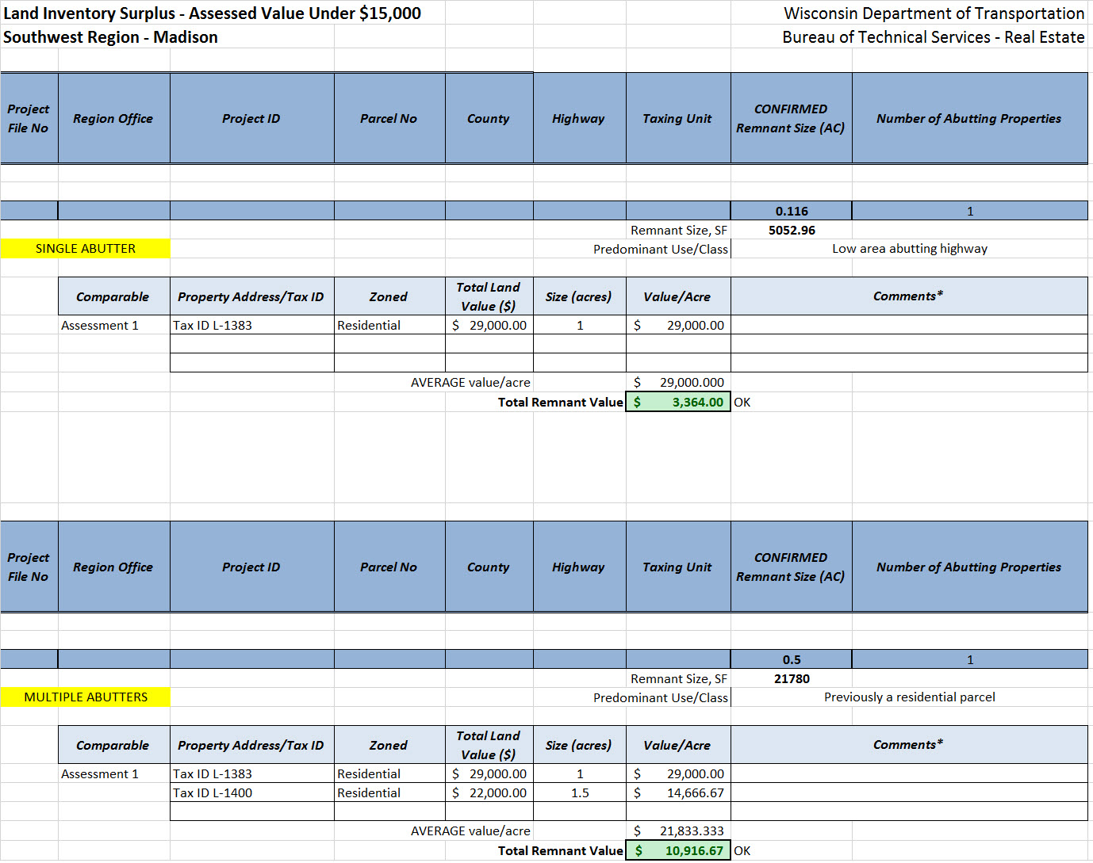

Slide 42
Reminder, whenever possible properties with a value under $15,000, complete the accessed value. This will also save money on competing appraisals.
The process will also speed up the preparation of getting a parcel ready for a sale.
Reminder, this can only be used on non-marketable and limited marketable parcels.
It can not be used on agricultural non-farmstead, marshland or agricultural forest.

Slide 43
Federal approval
All parcel sales on an interstate highway, require approval from FHWA
Prior to summiting sales packets, work with the central office on getting required information over to Federal Highways for sign off approval.

Slide 44
Reminder
Prior to any building sale, We need to notify DBM of the sale.
Verify they approve of the sale and if they have a need for the building prior to a sale.
All buildings in your inventory need to be added to the DBM inventory.
All buildings within your inventory and buildings acquired that are not going to be razed immediately, need to go through Risk Management to verify if they should be insured.

Slide 45
Moving forward
All sales packet files coming to the Central Office, please send electronically.
The change will save money in paper, copier costs and currier fee’s
We will also be working in the direction of electronic signatures from the Secretary and the Governor.

Slide 46
Fiscal 2017 sales results
Regional Surplus Land Sales/Lease/Rental - FY17
 | Southwest | Southeast | Northeast | North Central | Northwest
RE -Sale of Land (5940000) | 967,137 | 547,859 | 577,967 | 44,126 | 190,972 |  | $2,328,061
RE - Sale of Building and Personal Property (59410000) | - | 100,000 | 454,952 | - | - |  | $ 554,952
RE - Lease/Rental Income (5370000) | 275,249 | 462,296 | 48,751 | 5,675 | 7,206 |  | $ 799,177
Total | 1,242,386 | 1,110,155 | 1,081,670 | 49,801 | 198,178 |  | 3,682,190
Gross Revenue | $ 3,682,190
(Less threshold) | $ 2,750,000
Surplus | $932,190
Parcels sold | 34 | 38 | 49 | 19 | 20 |  | 160
Parcels on Marketing Plan | 44 | 33 | 24 | 28 | 45 |  | 174
Large Pending Sales
 |  |  |  | Closing
Layton Ave |  |  | $1,800,000 | 28-Aug
 |  | TOTAL | $1,800,000

Slide 47
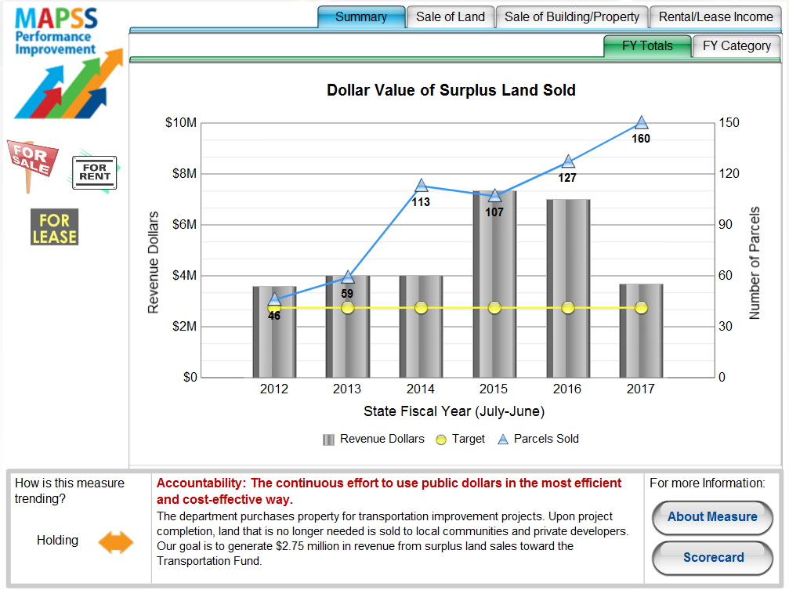

Slide 48
Fiscal 2018
Sales Budget: $6 Million

