Slide 1
Negotiating Complex Acquisition
Drew S. Jelinski - WisDOT
Niccole Smith – WisDOT
Curt Van Erem - WisDOT
September 27, 2017
Marshfield, WI
Notes:
Before
Be well prepared with content. Know facts and figures and your audience.
Everyone should be able to read the slides but if NOT, read it to them. Otherwise don’t include it.
Do a final check on microphone and other equipment well before the start time.
Practice the presentation aloud several times. Feel comfortable.
Drink fluids and do something to relax you.
During presentation
Smile and be confident.
Introduce yourself and the organization.
Speak with energy, clearly, and in a reasonable volume so everyone can hear you.
Do not read each line on the slide show – use your own wording and add in examples or additional information which will aid in comprehension.
Talk “friendly” and with the attitude that you are here to provide information and assistance. Have a “win/win” attitude.
If you make an error, politely clarify or correct it. Move on quickly and don’t dwell on it.
If you can’t answer a question, politely indicate you don’t have the information available. Indicate that you will follow-up individually with the requestor.
After presentation
Be available for follow up.
Be prepared for additional comments, questions or clarifications.
Maintain composure.
If you make a promise, be sure to follow up quickly or reassign if appropriate.

Slide 2
Intro into Complex Acquisitions
Title Issues – Drew Jelinski, Office of General Council
Life Estates
Trust
Foreclosures
Tax Liens and Judgements
Tribal Acquisitions – Niccole Smith, North Central Region
Government to government relationships
Definitions of Land Types
Regulations and Codes
Tribal Best Practice

Slide 3
Intro into Complex Acquisitions
Case Studies – Curt Van Erem, North East Region
Winneconne Bridge Project
Review Title Work
Review Zoning
Review Contamination
STH 441 Mega Project
Federal and State Tax Liens
I-41 Mega Major Project in Green Bay, WI
Tribal Property with a 50 year lease to Home Depot

Slide 4
Completing the Acquisition of Parcels When Presented with Complex Ownership and Intervening Interests
Drew S. Jelinski - WisDOT
September 27, 2017
Marshfield, WI
Notes:
Before
Be well prepared with content. Know facts and figures and your audience.
Everyone should be able to read the slides but if NOT, read it to them. Otherwise don’t include it.
Do a final check on microphone and other equipment well before the start time.
Practice the presentation aloud several times. Feel comfortable.
Drink fluids and do something to relax you.
During presentation
Smile and be confident.
Introduce yourself and the organization.
Speak with energy, clearly, and in a reasonable volume so everyone can hear you.
Do not read each line on the slide show – use your own wording and add in examples or additional information which will aid in comprehension.
Talk “friendly” and with the attitude that you are here to provide information and assistance. Have a “win/win” attitude.
If you make an error, politely clarify or correct it. Move on quickly and don’t dwell on it.
If you can’t answer a question, politely indicate you don’t have the information available. Indicate that you will follow-up individually with the requestor.
After presentation
Be available for follow up.
Be prepared for additional comments, questions or clarifications.
Maintain composure.
If you make a promise, be sure to follow up quickly or reassign if appropriate.

Slide 5
Overview
How to tackle the following issues:
Life Estates
Trusts
Foreclosures
Notes:
Overview should be specific such as listing the goals of the presentation and items to be covered. For example: “Explain Hwy 51 project alternatives.”
Use a verb followed by a brief phase or sentence.
Overview should include time for Q&A or indicate if you intend to take questions during the presentation or prefer that they wait until the end of the presentation.

Slide 6
Life Estates
Life Estates establish two different categories of property owners: the Life Tenant Owner and the Remainder Owner.
Life Tenant Owner: maintains the absolute and exclusive right to use the property during his or her lifetime. This can be a sole owner or joint Life Tenants.
Remaindermen: the person(s) who will be 100% owner(s) of the property after the life estate interest ends (normally when the life tenant dies)
Notes:
Remaindermen have what is referred to as a contingent interest, i.e. an event must happen for their interest to be realized.

Slide 7
Life Estates
Remainder Owner(s):
have no right to use the property or collect income generated by the property
not responsible for taxes, insurance or maintenance, as long as the Life Tenant is still alive
Life Tenant Owner:
Life Tenant(s) maintain responsibility for property taxes, insurance and maintenance
Life Tenant(s) CANNOT transfer clear title of the property without signatures of Remainder Owners

Slide 8
Example

Slide 9
Takeaway
Review the deed to determine who has an interest in the property
Obtain signatures from all parties, life tenant and any remainder owners
You can treat life tenant, who is likely the occupant, as the owner for purposes of communication
May need to work with remainder owners depending on age and capacity of life tenants
Notes:
Will need to send copies of appraisals and other jurisdictionally required documents to remainderman as cc’s.

Slide 10
Trusts
What is a Trust?
A trust agreement is a document that spells out the rules that you want followed for property held in trust for your beneficiaries. Common objectives for trusts are to reduce the estate tax liability, to protect property in the estate, and to avoid probate.

Slide 11
Common Types of Trusts
Living Trust
Created while owner is alive to control property
Owner is usually trustee
Property is treated the same for tax purposes as if owned in owner’s name
The trustee then takes control of property after owner’s death and administers the trust in the same manner as a trust created by will
Trust Created by Will
Created upon death
Holds property for another person's benefit (beneficiary)
A trustee is designated to oversee the trust. The trustee can be an individual or an institution like a bank or trust company
The trustee is responsible for protecting the assets, paying out income earned, and terminating the trust as will requires

Slide 12
Getting Signatures
Request the trust document if the trustee is not known
Unless WisDOT knows or has reason to know a trustee lacks authority to convey property, WisDOT may rely on a trustee’s assertions as to his/her authority to convey real estate that is property of the trust. Wis. Stats. § 701.19(11)
Use a trustee’s deed-trustee cannot warranty the property’s title
Consult REPM 3.5.9 for guidance

Slide 13
What is Foreclosure?

Slide 14
Foreclosure
Foreclosure: the process by which the lender has the collateral (the mortgaged real estate) sold and has the proceeds of the sale applied to the debt owed under the note.

Slide 15
Who are the major players?
Mortgagor: the property owner, who gives a mortgage on real estate to the lender as collateral for the loan.
Debtor: the person who promises to pay money to the bank by signing the note.
The debtor and the mortgagor can be different people.
Secure business debt of corporation with mortgage on personal residence, for example.
Grandpa might mortgage his house to provide security for loan by bank to his grandson.
Mortgagee: the lender, who provides a loan in exchange for a mortgage and lien on the real estate.

Slide 16
What is not Foreclosure?
Bankruptcy - NOT the same as a foreclosure. Bankruptcy is a federal process by which debtors are forgiven their debts or have an opportunity to pay all or part of their debts over time.
Receivership - NOT the same as a foreclosure. Receivers can be appointed by a court to consolidate a debtor’s assets and sell them. Proceeding usually brought by commercial lenders against debtor businesses that have failed or are failing. Keeps debtor from disposing of collateral.

Slide 17
Understand the Process
Process is detailed in Wisconsin Statute Chapter 846
Mortgagee files action for foreclosure in circuit court seeking judgment of foreclosure
Mortgagors are required to answer; often fail to answer, to appear, or to otherwise deny or defend the foreclosure, and the lender then obtains a judgment by default
Mortgagor may answer and defend against foreclosure

Slide 18
Understanding the Process (cont’d)
The complaint will likely contain all parties that claim liens on the property subordinate to the mortgage foreclosed at the time the complaint is filed.
You can use this to figure out who are the owner(s) and parties of interest
Judgment of foreclosure - does NOT transfer any property interests
Judgment of foreclosure grants sheriff or a referee appointed by the court the right to sell property (proceeds of sale go to the mortgagee)
Judgment of foreclosure and sale shall not be entered until 20 days AFTER a lis pendens has been filed.
Notes:
Judgment of foreclosure does not mean sale. We can continue to pursue acquisition via eminent domain process.

Slide 19
Understanding the Process (cont’d)
In all foreclosure cases filed in Wisconsin, the mortgagor (debtor) has the benefit of a redemption period (usually 2-12 months)
The redemption period provides the mortgagor time to become current on the loan and stop foreclosure
A public auction of the mortgaged premises held in the county in which the property is located
Usually scheduled six weeks before the redemption period expires by the creditor's attorney
Notes:
Important to know this because knowing this process timeline will help you set your acquisition timeline.

Slide 20
Understanding the Process (cont’d)
Once the property is sold the sheriff prepares and executes a deed to the purchaser
Legal description for each parcel of land sold to the purchaser and the sale price
Deed is filed with and retained by clerk of courts until sale is confirmed.
WHEN THE SHERIFF’S SALE IS CONFIRMED:
Court will schedule a hearing to confirm the sale.
The deed, when delivered following confirmation, vests in the purchaser all the right, title and interest of the mortgagor in and to the premises sold [s. 846.17, Stats.]
The deed bars all claim and right of equity of redemption against the parties to such action, and also against all persons claiming under them subsequent to the filing of the foreclosure Lis Pendens.

Slide 21
Negotiating
Foreclosure is not bankruptcy, and there is not a “stay” issued that freezes the property
Foreclosure judgment recognizes default and right of lender to recover security
Owner of property retains title to property throughout process (title doesn’t change hands until the proceeding concludes at confirmation of the sale)
Key is that you still negotiate with owner

Slide 22
Negotiating
Determine mortgagee
Just as in securing a partial release of mortgage for non-foreclosure acquisition, it is imperative to determine the actual mortgagee to name on the JO
Title search will likely reveal the foreclosure actions
Pleadings–the documents initiating the action including the complaint–will usually name the proper mortgagee as the plaintiff attempting to foreclose on the property
You need to make sure that the person who holds the NOTE (the promise to pay) is named as an interested party in any jurisdictional offer or award of damages.
When in doubt, NAME THEM.

Slide 23
Impact on ROW Purchases
Managers and agents should determine the point in the process to which the foreclosure has progressed.
Where the parties are at in the foreclosure process will determine how to proceed
A lis pendens may need to be filed ahead of JO to secure WisDOT’s interest in the property
Mortgagee will likely be more willing to grant partial release at beginning of process rather than at end
Understanding the process outlined above will help you manage your acquisition timelines and needs

Slide 24
Interested Parties for JO and Award
When in doubt, NAME THEM
Include the following:
The mortgagee of record in the office of the Register of Deeds.
Any person to whom the note and/or mortgage has been sold or transferred.
You need to make sure that the person who holds the NOTE (the promise to pay) as well as the mortgage is named as an interested party in any jurisdictional offer or award of damages. (discuss recent case)
Usually, the person who holds the note and mortgage will be the plaintiff in the action.

Slide 25
Interested Parties (cont.)
Where the instruments by which the mortgage and note were transferred are not of record with the Register of Deeds, name the parties of record AND all the transferees.
The court can sort out who holds what interests or liens in allocation proceedings.

Slide 26
Remember…
Always contact WisDOT Office of General Counsel as soon as you learn that a parcel is subject to a foreclosure action
Contact your project attorney if immediate legal assistance is required
Legal assistance will be required in every case to ensure that the legal description for the property subject to foreclosure is amended to acknowledge WisDOT’s purchase

Slide 27
Acquiring Right of Way on Tribal Lands
Niccole Smith
WisDOT Senior Real Estate Specialist
WisDOT 2017 Statewide Real Estate Conference
Marshfield, WI
September 27, 2017
Notes:
I am Niccole Smith
I have been a Senior Real Estate Specialist with NC Region since 2013.
I have a background in selling R/E from 2004 – 2010
I have been managing the real estate on a highway project on the Menominee Reservation since early 2015
And
I am embarking on a second segment on the Menominee Reservation this fall.

Slide 28
Overview
Wisconsin Tribes
Government to Government Relationship
Bureau of Indian Affairs (BIA)
Codes, Statutes, Regulations
Case Study / Example
Best Practices
Notes:
These are the topics I want to cover today.
There is a lengthy history on how each tribe came to be in what is now the boundaries of Wisconsin. Unfortunately we don’t have enough time in this session to discuss that. This topic could in fact be its own breakout session if not more than that. There is a lot of information worth sharing on WisDOT’s relationship with Native American Tribes.
I urge to you to research the history and take advantage of trainings that involve these cultures. For example, WisDOT hosts a cultural competency training approximately every other year that I would recommend to everyone. The history is eye opening and allows for a better understanding of typically misunderstood foundations of our current laws and policies regarding Native Americans.

Slide 29
11 Federally Recognized Tribes in Wisconsin
Bands of Lake Superior Chippewa
Bad River
Lac Courte Oreille
Lac du Flambeau
Red Cliff
St. Croix
Sokaogon
(Mole Lake)
Forest County Potawatomi
Ho-Chunk Nation
Menominee Indian Tribe of Wisconsin
Oneida Nation
of Wisconsin
Stockbridge-Munsee Band of Mohican Indians

Slide 30
Notes:
The seals of the 11 federally recognized tribes in Wisconsin.
Tribes are sovereign nations (which we will discuss shortly).
These seals are on the Tribes’ flags just like our state or national flag.

Slide 31
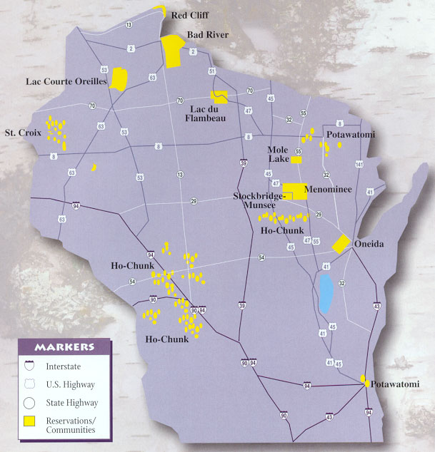
Notes:
This map shows locations of reservations and communities in Wisconsin.
A federal Indian reservation is an area of land reserved for a tribe or tribes under treaty or other agreement with the United States,
as permanent tribal homelands, and where the federal government holds title to the land in trust on behalf of the tribe.
Not every federally recognized tribe has a reservation
Ho Chunk does not have a reservation, but they do have various land tracks in Wisconsin that are held in trust status with the federal government. (More on this later)

Slide 32
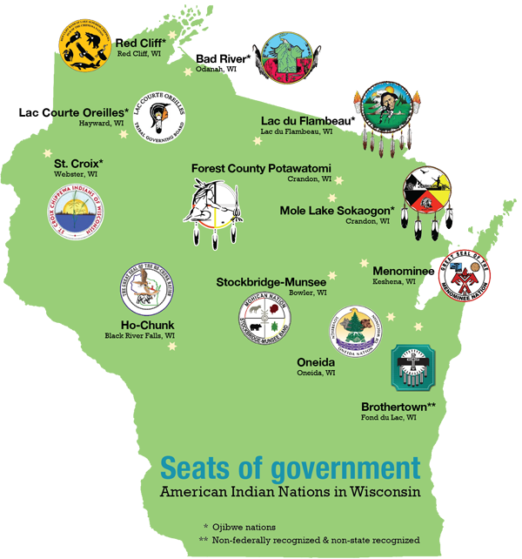
Notes:
I included this map as it also includes the Brothertown Indian Nation.
Brothertown is not a federally recognized tribe, however they have been petitioning for recognition since 1980.

Slide 33
Tribal sovereignty refers to the fact that each tribe has the inherent right to govern itself.
Tribal Sovereignty is (but not limited to):
forming governments
regulating property
maintaining law and order
regulating domestic relations
regulating trade and commerce
"Indian sovereignty is the principle that those powers which are lawfully vested in an Indian tribe, are not delegated powers granted by express acts of Congress, but rather inherent powers of a limited sovereignty which can never be extinguished.“
- Supreme Court Justice Felix Cohen, 1942
Notes:
Tribal sovereignty ensures that any decisions about the tribes with regard to their property and citizens are made with their participation and consent.

Slide 34
Government Relationships
Federal
The US Constitution gave the legislative branch plenary power over Indian Affairs.
States are also considered sovereigns.
States have no authority over Tribal Government unless expressly authorized by Congress.
State
Wisconsin Gov. Jim Doyle issued Executive Order 39 to recognize the sovereignty of the 11 federally recognized tribes in Wisconsin and directs state government to enter into government-to-government relationships with the Tribal Nations.
Executive Order 39 was reaffirmed by Wisconsin Gov. Scott Walker.
Notes:
Federally recognized tribes are not subordinate to states.
In United States constitutional law, plenary power is a power that has been granted to a body, or person, in absolute terms, with no review of, or limitations upon, the exercise of that power.
EO 39 directs state agencies to work cooperatively with tribes on policies, programs, or issues that have the potential to impact tribal communicates.

Slide 35
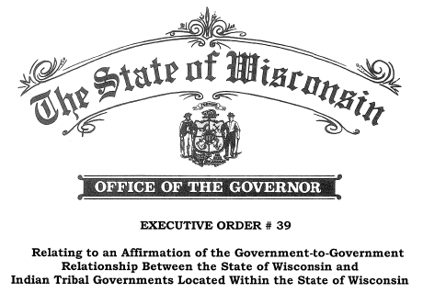
Government Partnerships
2005 Partnership Agreement:
Wisconsin’s Eleven Federally Recognized Tribes
Wisconsin Department of Transportation
Wisconsin Division – Federal Highway Administration
Inter-Tribal Task Force
WisDOT Tribal Liaisons
(amended in 2010)
Notes:
The Partnership agreement is to continue to create and define the processes by which WisDOT and FHWA will collaborate with the 11 federally recognized tribes of Wisconsin. It is designed to acknowledge and support the government to government relationship and support tribal sovereignty among state and federal agencies. The goal of the relationship is aimed at moving beyond the mindset of consulting with tribes as a legal requirement, to working with tribes as equal partners focused on people economics and natural and human environments to improve the quality of life for all people .
Intertribal task force focuses on transportation areas related to economic development, safety, shared resources, and infrastructure and mobility. Consists of WisDOT state and regional tribal liaisons and other agency employees, FHWA, and representatives appointed by each respective tribal government.
Region’s tribal liaisons – point of contact to link the department and the tribal nations on any number of transportation issues. Liaisons may not have all the answers for questions from either entity but is there to facilitate getting the correct subject matter experts involved.

Slide 36
Department of the Interior Bureau of Indian Affairs
Federal agency charged with carrying out the
United States’ trust responsibility to Native Americans:
maintaining the government to government relationship with federally recognized tribes
promoting and supporting tribal self-determination
The federal Indian trust responsibility is also a legally enforceable fiduciary obligation on the part of the United States to protect Tribal treaty rights, lands, assets, and resources, as well as a duty to carry out the mandates of federal law with respect to American Indian and Alaska Native tribes and villages.
Notes:
Established in 1824, now operates under the US Dept of the Interior.

Slide 37
Bureau of Indian Affairs
Office of Trust Services
Division of Natural Resources
Division of Probate
Division of Water and Power
Division of Forestry and Wildland Fire Management
Division of Real Estate Services
Division of Land Titles and Records
Notes:
Division of Real Estate Services.
The division provides assistance, advice, policy, oversight, monitoring, and coordination
for the protection, management, planning, conservation, development, and utilization of
trust and restricted Federal Indian-owned lands that include
acquisition, disposal, tenure, rights-of-way, permits, leasing, and sales.
Division of Land Titles and Records
The division oversees title portion of the trust asset and accounting system,
of title documents, document certification, title research and examination, and the determination of legal title for Federal Indian trust or restricted lands.
the official record of title documents and instruments affecting Indian land that require approval by the Secretary or other Federal officials.
All title documents affecting Indian land are to be recorded in the Indian Land Record of Title.

Slide 38
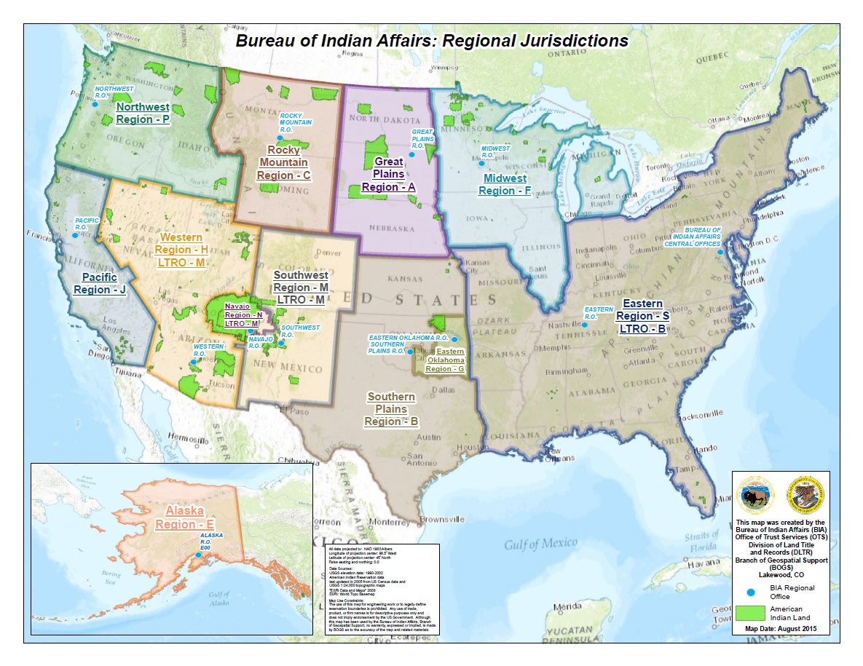
Notes:
Much like the WisDOT regions, BIA has regional offices throughout the US.
Wisconsin falls in the Midwest Region that houses several agencies. 10 of the 11 Wisconsin tribes utilize services at the Great Lakes Agency in Ashland WI. Menominee Indian Tribe of Wisconsin works with the Midwest Regional Office in Bloomington MN.
There is also a Minnesota agency in Bemidiji, a Michigan Agency in Sault Ste Marie, and a Red Lake Agency/field office in Minnesota.

Slide 39
Now What?

Slide 40
Questions to answer prior to acquisition:
Who are the team players?
Has the Tribe approved the project?
Who are we acquiring from?
What are we acquiring?
Notes:
You can’t just put an offer packet together and send it out.
WisDOT – trial liaison, real estate, project manager, supervisors
Tribe – project team – project manager, community development, real estate, Tribal Chair, Tribal legislature EACH TRIBE IS DIFFERENT, OPERATE DIFFERENTLY
BIA – Realty – Surveyor Bureau of Land Management, fiscal staff, office of Appraisal Services
Tribal Resolution approving Plat, legal descriptions, timelines, process
Who are the land owners? Is it the tribe? Tribal members, non tribal members, trust land, allotted lands?
What are we acquiring? Tribes generally will only grant easements, HE, PLE, TLE.

Slide 41
The “Who” and “What” Land Types – Part 1
Fee Lands
Individual Fee – tribal member or non-tribal member, holds legal title and carries entire bundle of rights, may be taxed in county
Tribal Fee – tribe holds full legal title and carries entire bundle of rights
Restricted Fee Land – individual or tribe holds legal title but there are specific federal government imposed restrictions on use and/or disposition
BIA has no jurisdiction over Fee Lands
Notes:
It is important to determine what land types are being affected by acquisition.
The land type will determine which federal and state regulations apply and the roles and responsibilities of the parties involved.

Slide 42
The “Who” and “What” Land Types – Part 2
Trust Lands
Trust Land – legal title is held by the trustee, in this case the federal government for use by a Tribe.
Tribal Trust
Individual Trust
Allotted lands – remnants of reservations broken up during the General Allotment Act of 1887. Trust lands held in trust for individual tribal members (and/or their heirs).
Off Reservation trust lands
States do not have the power of condemnation on trust lands
Notes:
Trustee – BIA has title and ultimate control but the Tribe/tribal member holds “beneficial use” to live on, use, profit from.
Tribe/Tribal member cannot sell or encumber trust lands without the consent of the federal government
As allotments were taken out of trust, they became subject to state and local taxation which resulted in land passing out of Indian hands.
Allotments could have 100 owners! Imagine trying to get 100 signatures to acquire a small 10’ strip TLE
Ho-chunk – off reservation trust land
Condemnation would take an act of congress

Slide 43
BIA
The “How”
WisDOT
25 CFR 169 – regulation that implements process for Rights of Way over Indian Land
Federal Laws
Tribal Laws
Yellow Book Appraisals –USPAP
49 CFR 24 – regulation that implements the Uniform Act (Uniform Relocation Assistance and Real Property Acquisition Policies Act of 1970)
Wis. Stat Chapter 32
Wis. Stat 84.09
Notes:
Early clarification during the acquisition process on which of the different controlling authorities will drive the acquisition process.
Tribes and BIA are knowledgeable about the provisions in 25 CFR whereas the state is more familiar with 49 CFR 24.
Needs to be a reconciliation of the two sets of rules early in the process so particular provisions that may not apply do not become obstacles in completing the acquisition process.
A study completed by FHWA states BIA’s regulations related to trust lands are the prevailing authority for the acquisition of right of way over native American lands.
State laws don’t apply to tribal nations.

Slide 44
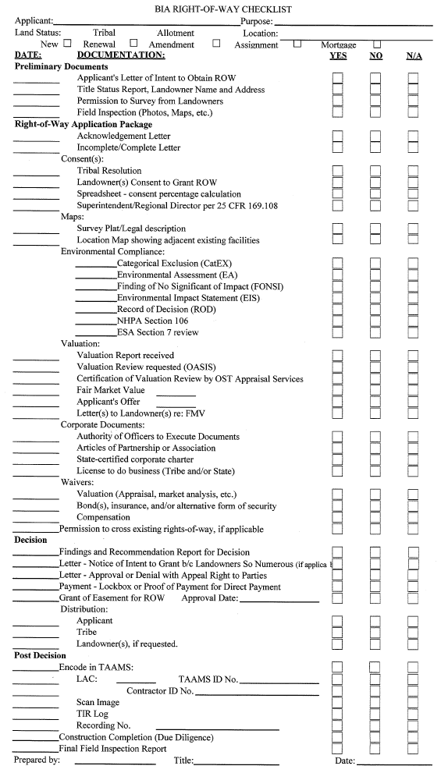
Acquiring Trust Lands
Attached is the BIA checklist for items to be completed as part of the application process for a Grant of Right of Way.
Process as per 25 CFR 169
There are 48 items on this checklist.
Not everything on this checklist is an item to be completed by the Acquisition Specialist.
Notes:
Checklist is shown as a visual to the amount of work outside WisDOT’s typical acquisition process there is

Slide 45
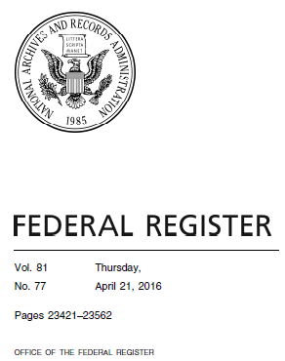
Case Study
Menominee Roundabout
Project
Operating under previous 25 CFR 169. This regulation was rewritten and amended effective April 21, 2016

Slide 46
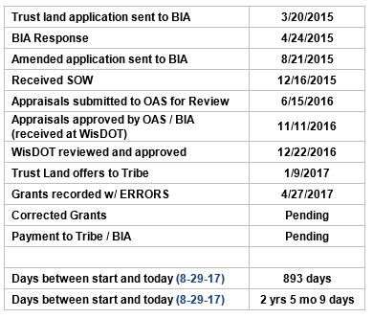
Current Project
Timeline
Notes:
17 parcels
6 trust

Slide 47
Chronology
Tribal Resolution
Application to BIA
Legal Descriptions
BIA Legal Description Review
Plat Changes
Amended Application to BIA
Statement of Work - OAS
Regulation Change
Notes:
Timeline puts PDB out of date
Appraisal intended user BIA not WisDOT
LTRO – we don’t have access
Trust Doc 1986
Separate SOW, now amended Grant

Slide 48
Chronology
Appraisals submitted to BIA / OAS
Tribal Resolution
Receive approved appraisals
Present offers to Tribe for trust land acquisitions
BIA draft Grant of Easement
BIA Director sign Grant of Easement
Grant of Easement gets recorded at LTRO
Notes:
Timeline puts PDB out of date
Appraisal intended user BIA not WisDOT
LTRO – we don’t have access
Trust Doc 1986
Separate SOW, now amended Grant
Old regs – no BIA timeline
RAB issues
Title issues – plat changes
Family probate
Blitz meeting
BIA only communicate with Tribe, not WisDOT
Trust land
Permits vs leases

Slide 49
Case Study what we learned
Be patient
Stay current
Follow up
Ask questions / verify information
Be respectful
Teamwork

Slide 50
Best Practices
Be Respectful
Consult and Coordinate
Tribes are the EXPERTS
It will take longer than you expect
Communication
Meet at Tribe’s location/convenience
Tribal Leadership
Honesty = Trust
Notes:
Respectful – Oneida and stockbridge were originally from the current New York Area. Ho-Chunk moved several times from east to Wisconsin to Nebraska to south Dakota, came back to Wisconsin etc. Burials, they haven’t always lived where they live now. There could be burial sites all over the state – only the tribes will know where.
may not be the preferred method by tribes. Expect to do a lot of follow up. Face to face. Meet at their location/convenience.
Tribal Leadership changes frequently

Slide 51
Best Practices
Start early
Minimum of 2 years to acquire project
Traditional Right of Way Plat
Metes and Bounds Legal Descriptions
Monthly meetings
Be patient yet persistent
Be innovative
Be respectful
Notes:
Respectful – Oneida and stockbridge were originally from the current New York Area. Ho-Chunk moved several times from east to Wisconsin to Nebraska to south Dakota, came back to Wisconsin etc. Burials, they haven’t always lived where they live now. There could be burial sites all over the state – only the tribes will know where.

Slide 52
Case Studies Curt Van Erem, North East Region
Overview
Winneconne Bridge Project
Review title work
Review Zoning
Review Contamination
STH 441 Mega Project
Federal and State Tax Liens
I-41 Mega Major Project in Green Bay, WI
Tribal Property with a 50 year lease to Home Depot

Slide 53
Case Study – Winneconne Bridge
Winneconne Bridge Project
Importance of Reviewing the Title Work!
Importance of Reviewing the Zoning!
Importance of Reviewing Parcel for Contamination!
Why was this a big deal?

Slide 54
Review Title Work and Zoning

Slide 55
Case Study – Winneconne Bridge
It was a big deal and became complex because
Illegal use of most of the site.
They could not continue their operation on the remainder property without proper rezoning.
This straight forward strip acquisition became complex and a relocation.
Possible soil contamination.

Slide 57
Case Study - STH 441 Mega Project
Purchasing access rights and a small strip of land from a residential lot.
Four family members inherited the property from their parent.
Offer included an alternate offer for the remainder parcel.
Seems very simple, right!

Slide 59
Property Status:
Owned by four siblings.
One family member had federal and state tax liens and both placed liens on this parcel.
None of the other family members knew of the liens until WisDOT informed them after reviewing the title work.
The outstanding liens surpassed the value of the land.
How did we resolve it?

Slide 60
Solution:
Reference REPM 3.7.3
Real Estate contacted the federal and state government contacts to learn what was possible.
The dollars were prorated to the amount the family member was to receive (1/4 of the closing price).
Was able to close the sale with only an additional six months to complete the process.
Lessons Learned:
Always Review the Title Work.
Reach out to the parties of the tax lien as soon as possible. Encourage them to hire a tax attorney.
Start Early.

Slide 61
Case Study I-41 Brown County Mega Project
Property Status:
Owned by the Oneida Nation
50 Year Lease to Home Depot
Acquisition of Strip of Land and TLE

Slide 63
Challenges:
Each Tribal Group is governed under different rules. Oneida Nation is self governed.
Oneida will only sell easements and not fee land.
BIA required an equal amount of dollars be place in a trust if the property is not returned to the agreed condition. This money will be used to correct the property.
Tenant is Home Depot which is a large corporation that added complexity to the transaction.

Slide 64
Solution:
Setup regular monthly meetings with Oneida staff members. In our case, their land office.
Presented to the tribal boards the impacts and compensation to obtain approval.
Presented to Home Depot the impacts and compensation to obtain approval.
Oneida submitted their package to the BIA for approval.
DOT had to create a new Limited Highway Easement to obtain tribal approval.
Note: The process took two years.

