Slide 1
When and How to Appraise the Elimination of Access Openings
Greg Thompson, WisDOT Statewide Review Appraiser
gregory.thompson@dot.wi.gov
Mike Roach, WisDOT Statewide Access Engineer
michael.roach@dot.wi.gov

Slide 2
Primary Focus Of Today’s Session

Slide 3
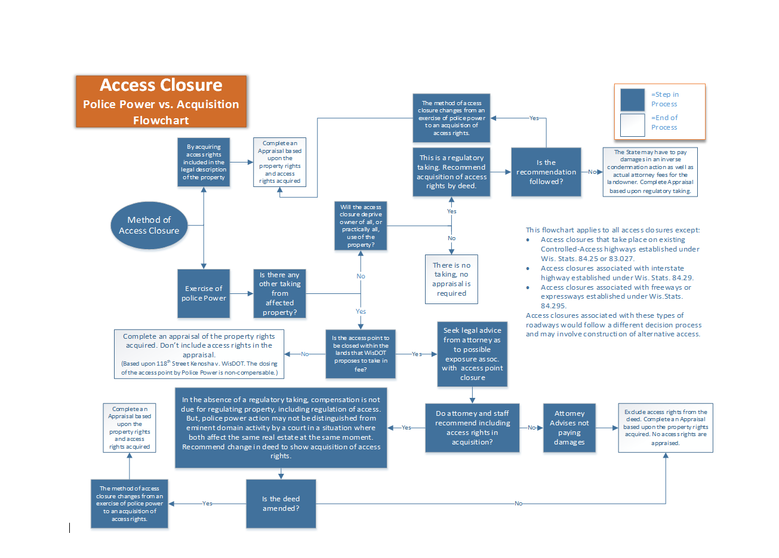

Slide 4
Basic Principles of Access Management

Slide 15
Purchased Control Wisconsin Statutes 84.09 and 32.09 Eminent Domain
Wisconsin Statute 84.09 Acquisition of lands and interests therein.
Wisconsin Statute Chapter 32 EMINENT DOMAIN
32.09 Rules governing determination of just compensation. In all matters involving the determination of just compensation in eminent domain proceedings, the following rules shall be followed:
32.09(6)(b) Deprivation or restriction of existing right of access to highway from abutting land, provided that nothing herein shall operate to restrict the power of the state or any of its subdivisions or any municipality to deprive or restrict such access without compensation under any duly authorized exercise of the police power.

Slide 17
An Exercise of Police Power
Police Power. The inherent power of government to regulate property in order to protect public health, safety and general welfare. (The Dictionary of Real Estate Appraisal 6th Edition published by the Appraisal Institute)
Police Power. The inherent power of a government to exercise reasonable control over persons and property within its jurisdiction in the interest of the general security, health, safety, morals, and welfare except where legally prohibited. (Merriam-Webster)

Slide 21
When and How to Appraise the Elimination of Access Openings

Slide 24
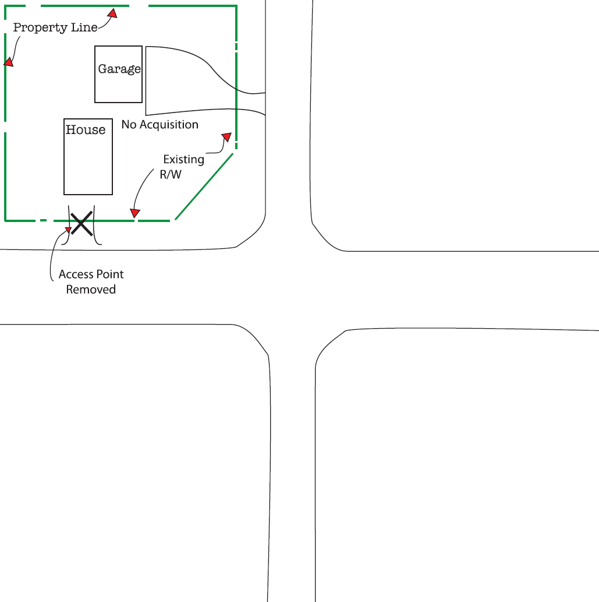

Slide 28
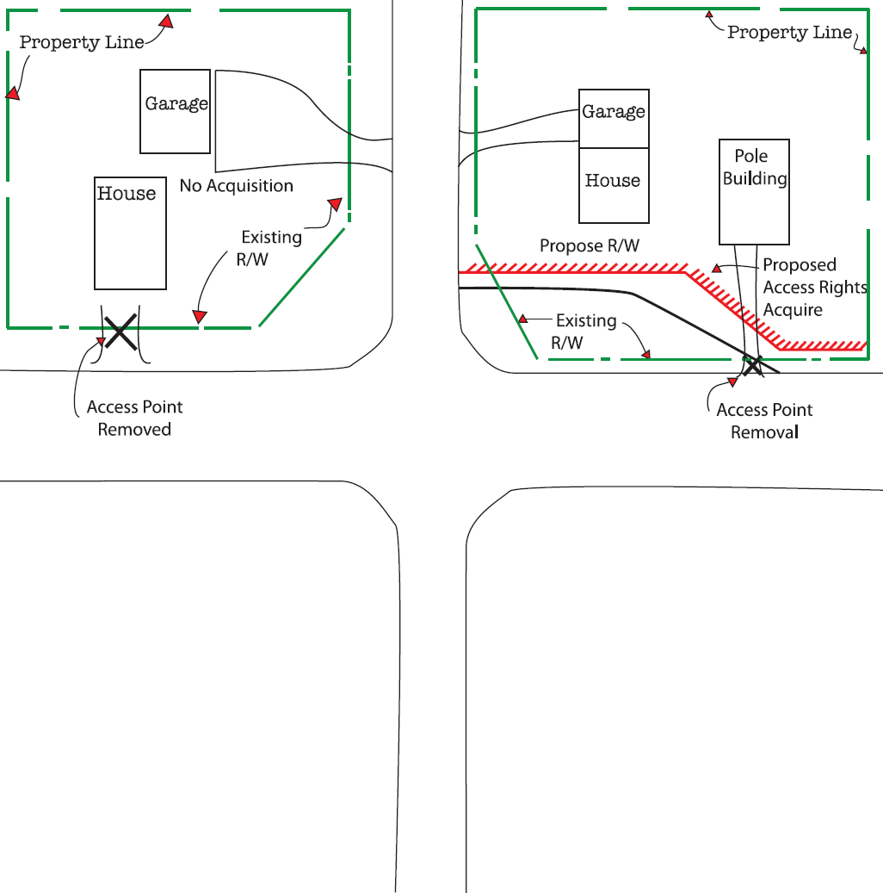

Slide 30
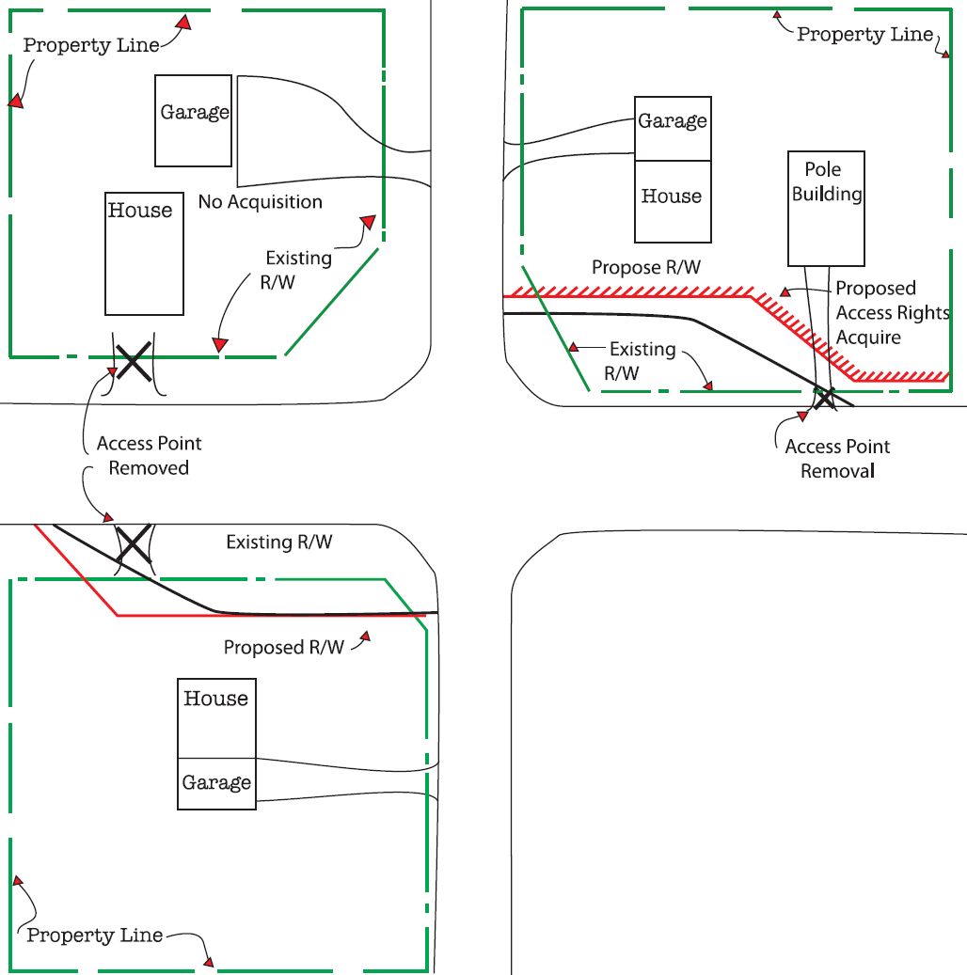

Slide 34
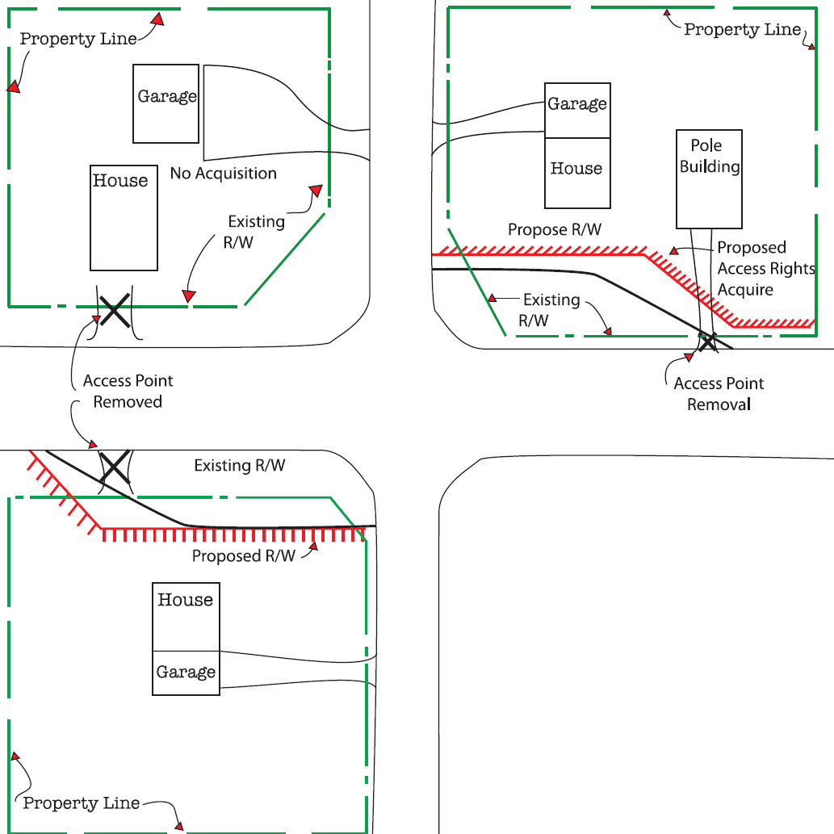

Slide 36
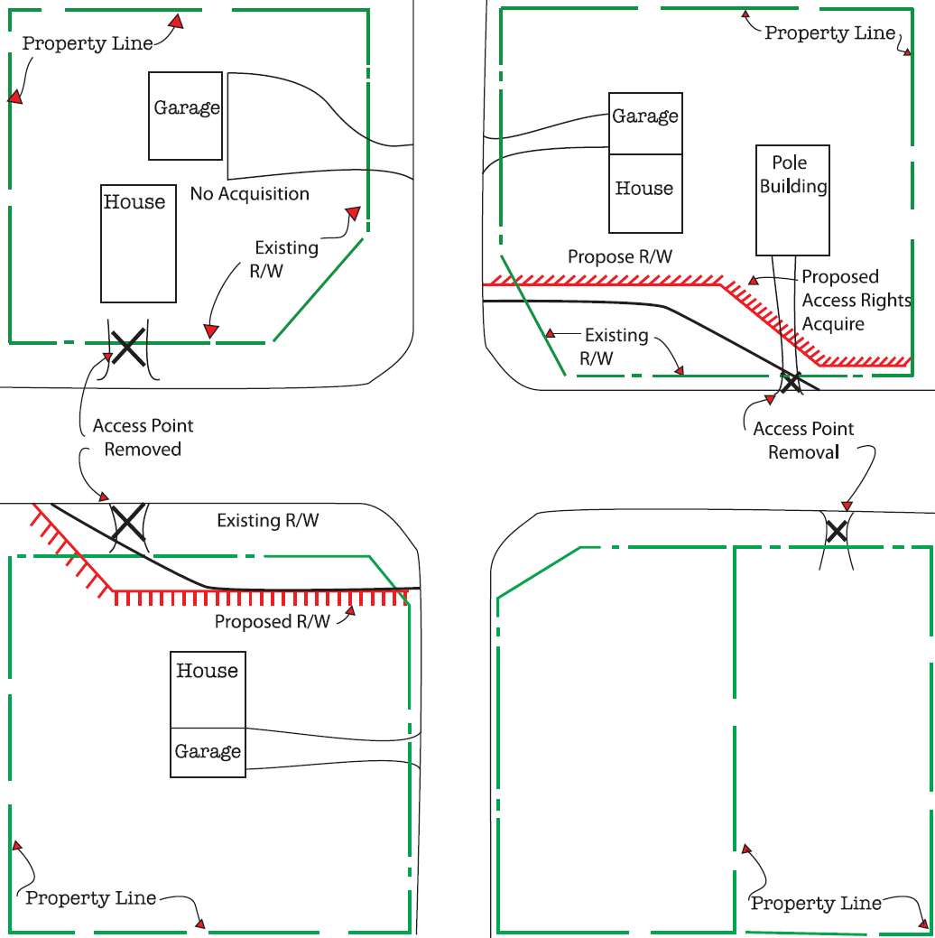

Slide 38
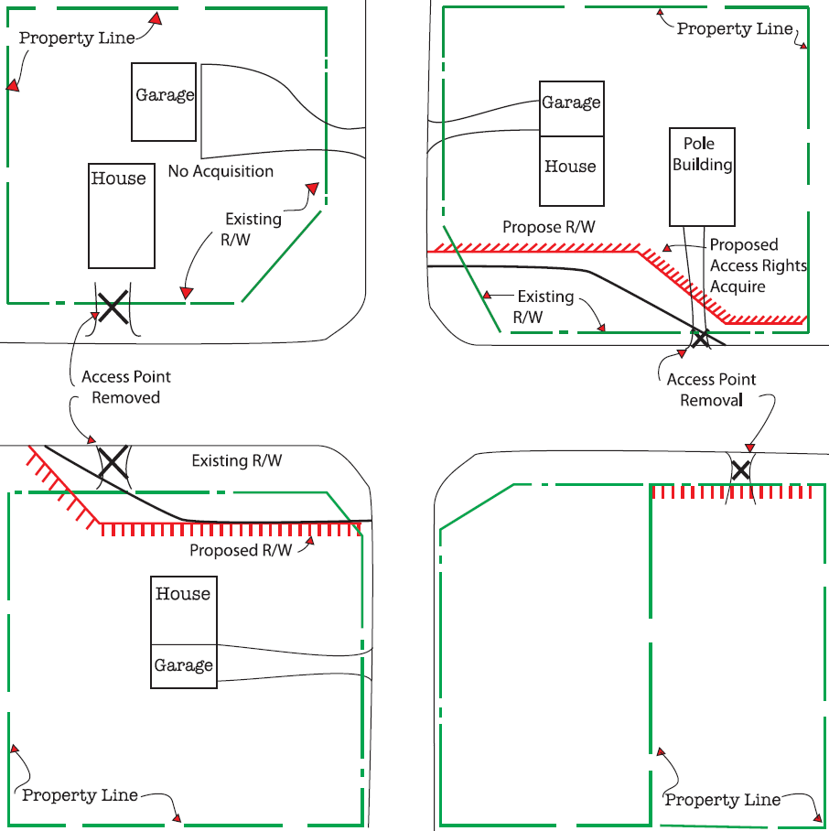

Slide 39
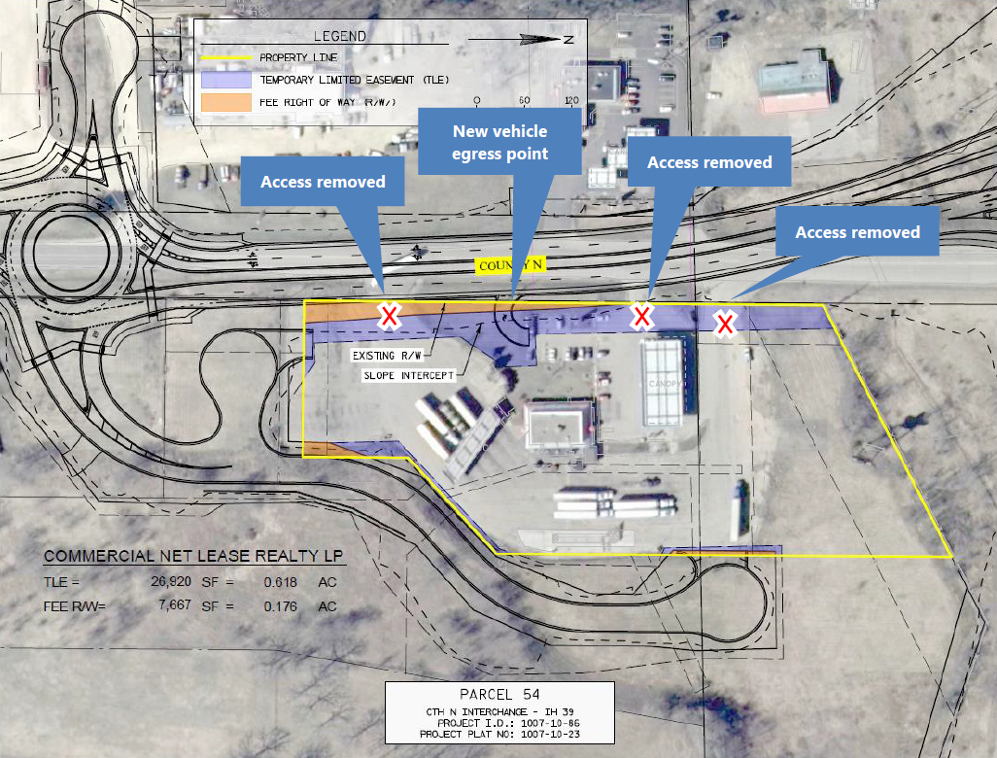
VALUATION OF ACCESS RIGHTS

Slide 41
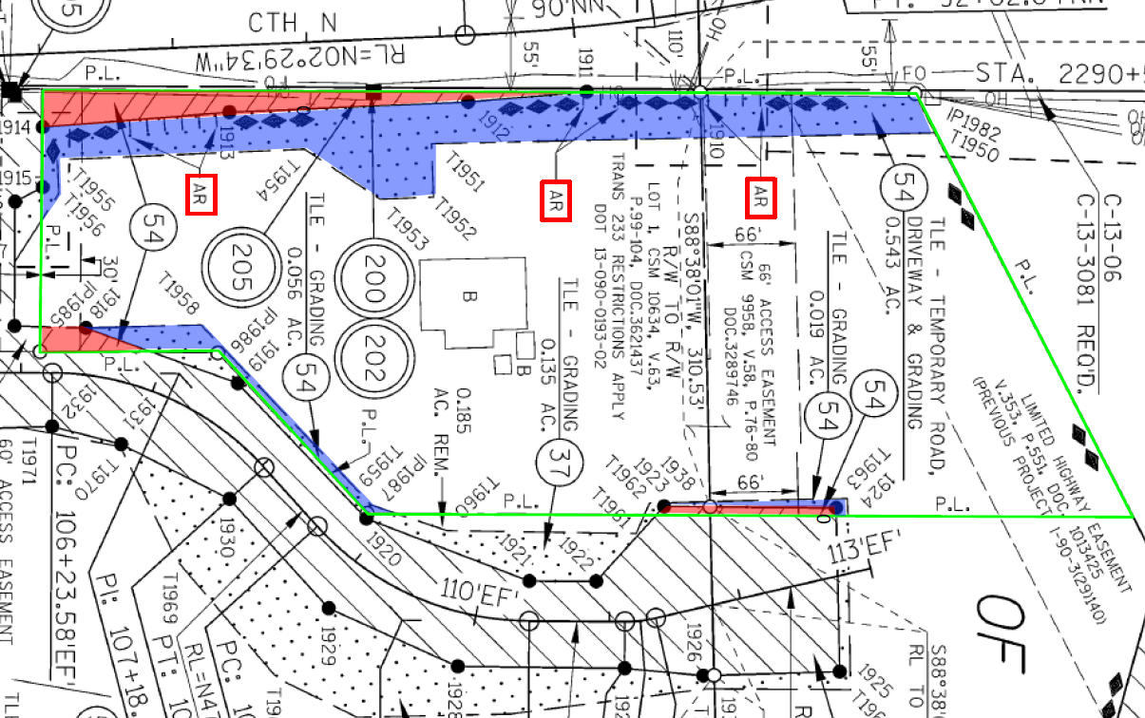

Slide 43
